Slide 1
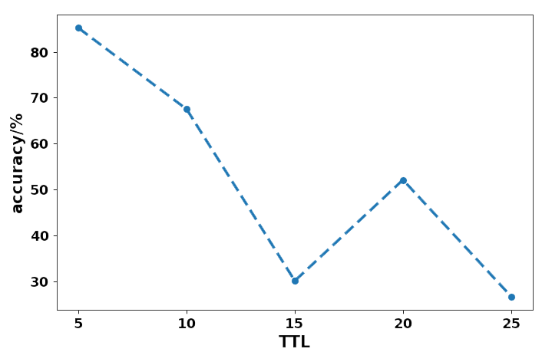
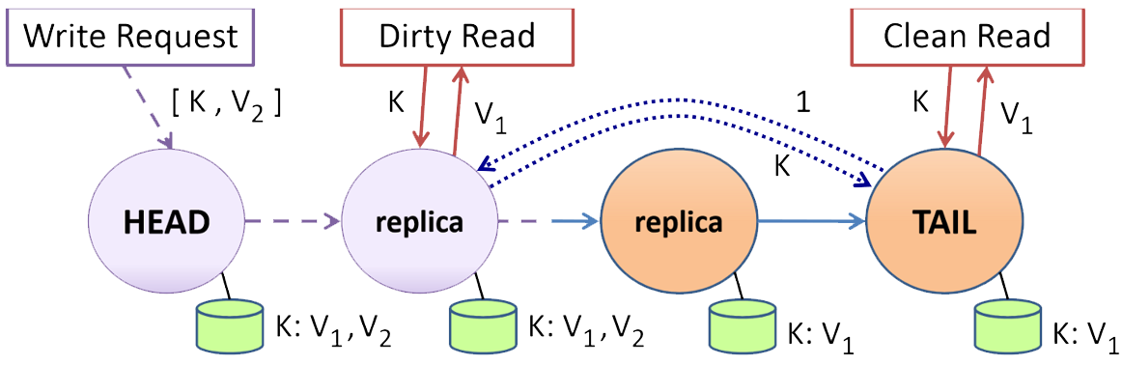

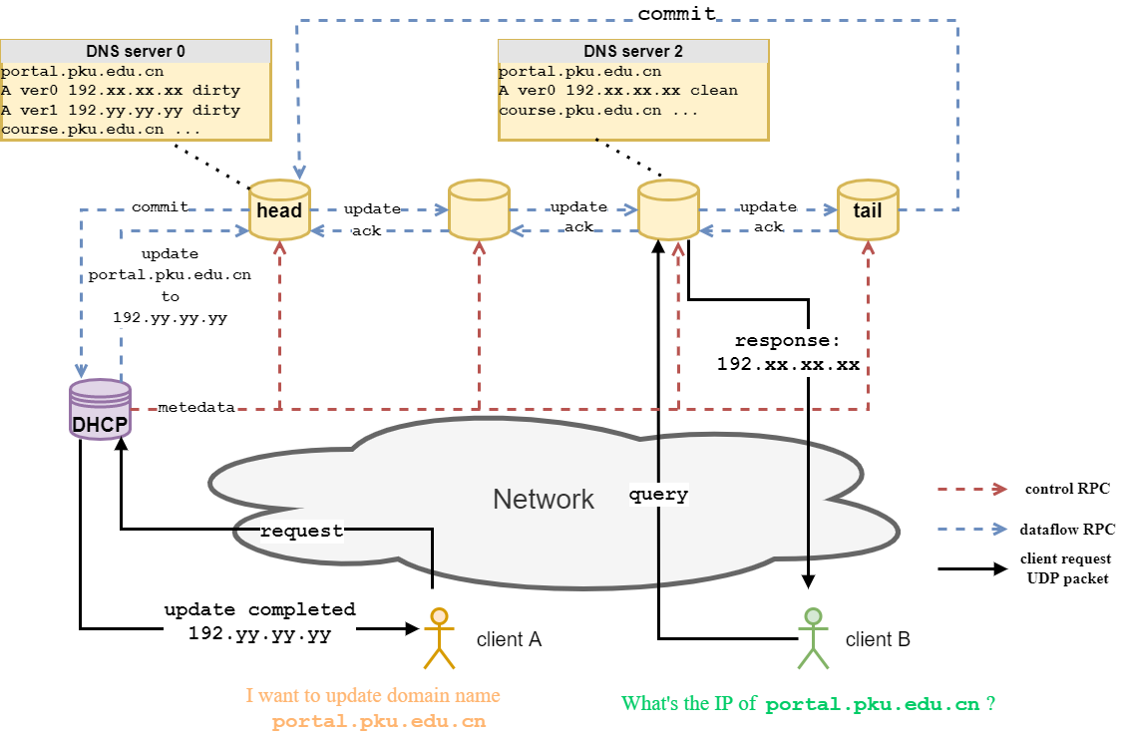
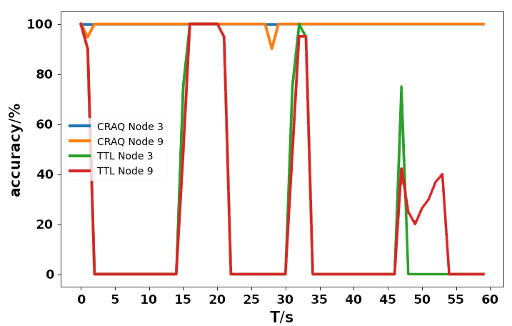
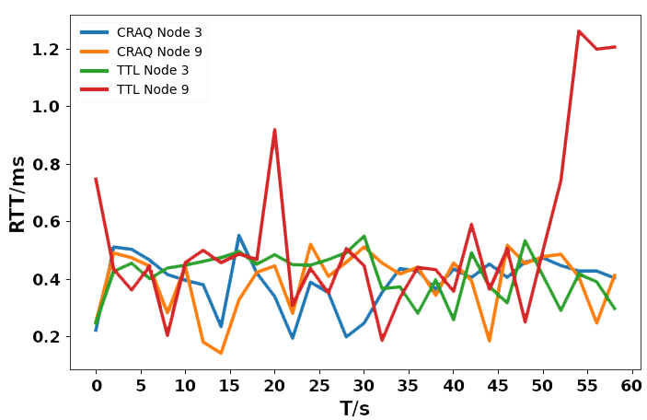
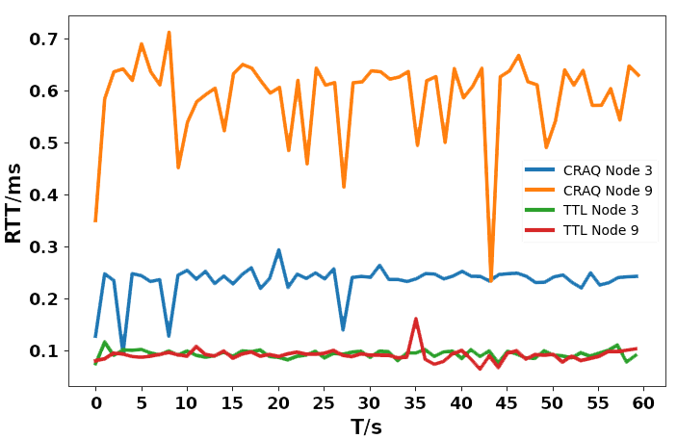

DoCR:
DNS query with strong consistency
Yuhan Zhou Wenrui Liu Chenren Xu*
Implementation, more details: https://github.com/HumphreyChou/DNS-on-CRAQ
MOTIVATION
DNS server lacks strong consistency
Observation 1
Observation 2
Observation 3
DNS with TTL mechanism reaches weak consistency
DNS server behaves like
a K-V database
CRAQ for strong consistency
Head for write request
Each node for read request
Clean/dirty state for consistency
domain name : ip
query
response
MAIN IDEA
DNS on CRAQ
How do they work?
DNS query
User can send DNS query to any node for the corresponding IP address of the domain name
IP change
Domain name owner sends an IP change request to DHCP
DHCP implements IP change action, sends write request to the DNS-on-CRAQ head and returns new IP address to the owner
PERFORMANCE
Accuracy and RTT
Accuracy:
DNS query RTT:
Write RTT:
DoCR introduces high accuracy
DoCR has no query overhead
DoCR has IP change overhead
CRAQ paper: https://pdos.csail.mit.edu/6.824/papers/craq.pdf
CRAQ on Go:https://github.com/despreston/go-craq

