Slide 1
Figures for stochastic MVT paper
11 September 2023

Slide 2



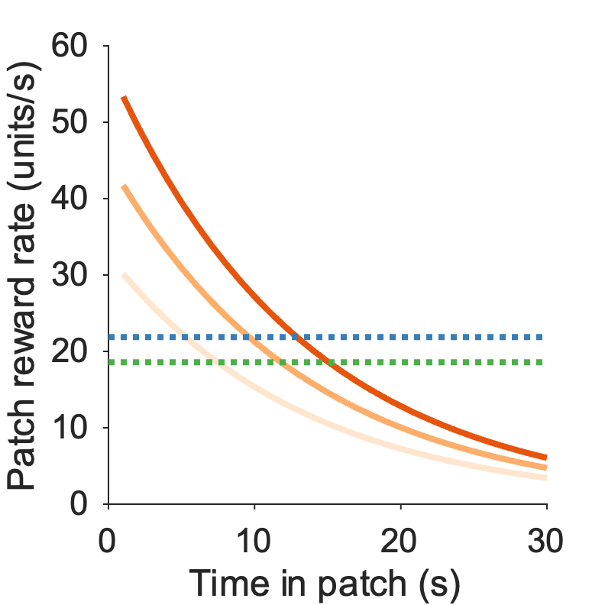
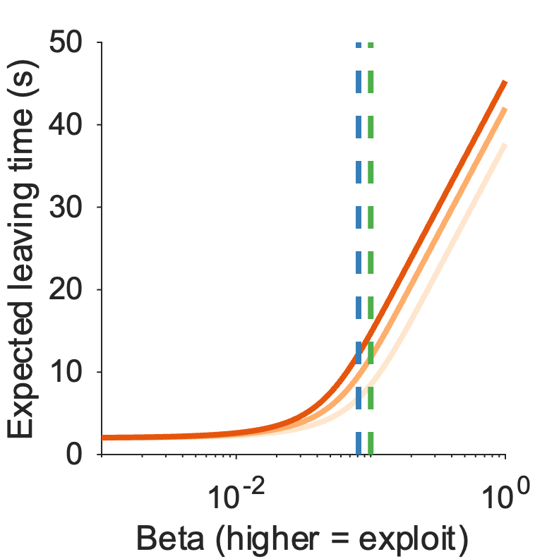
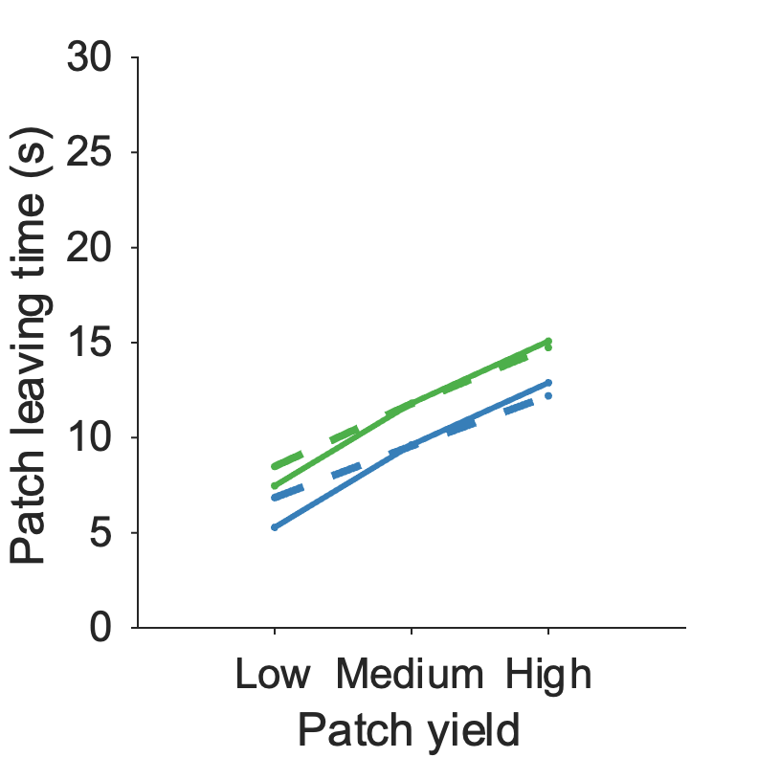

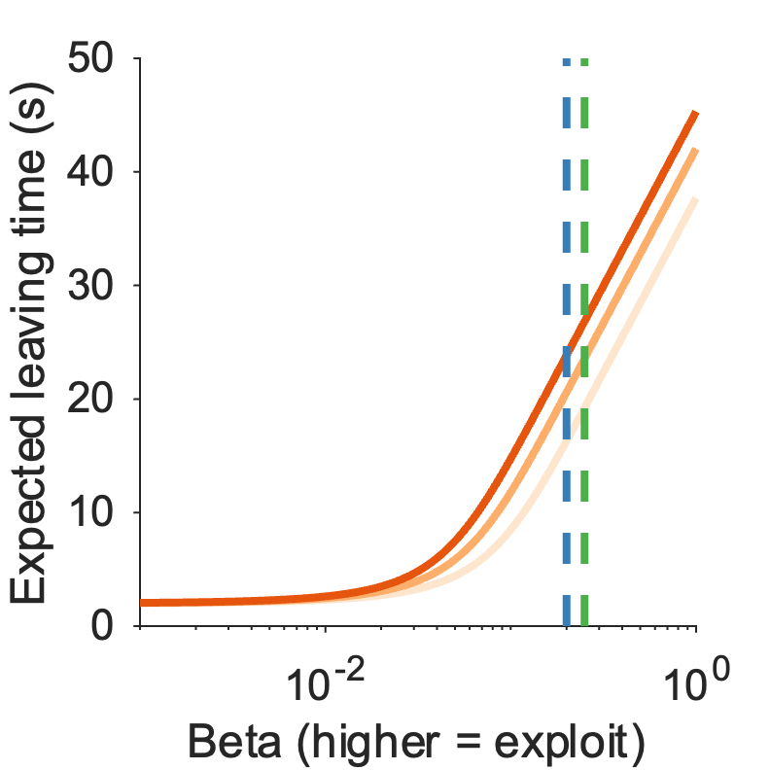
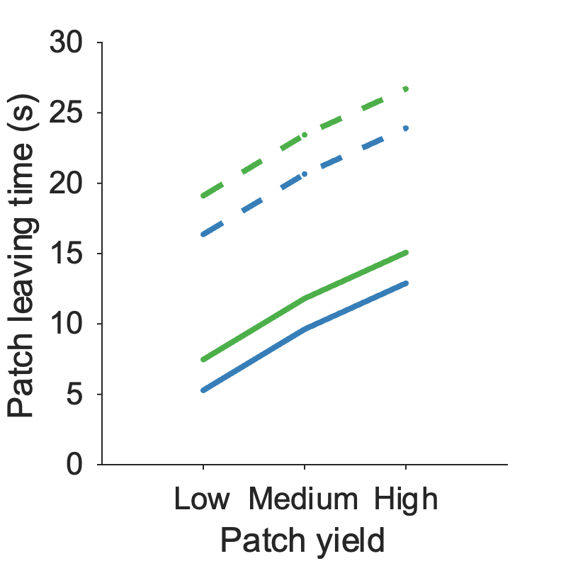
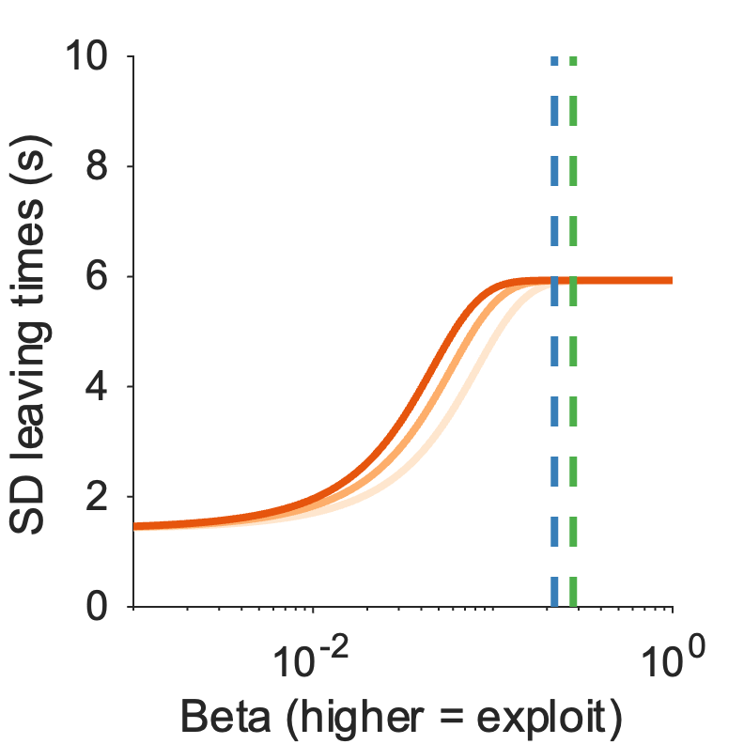

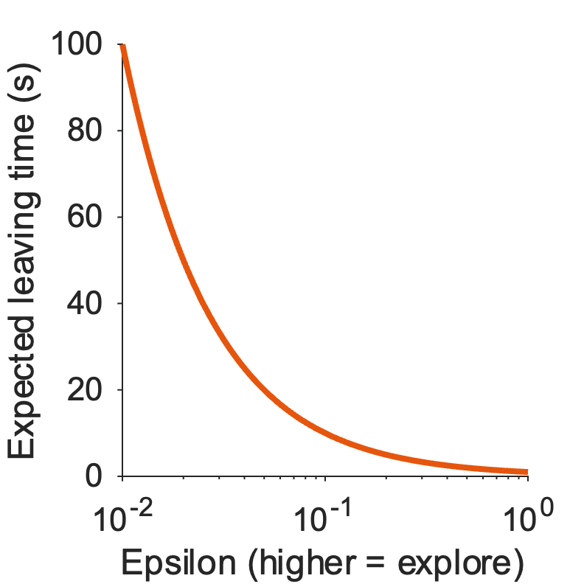
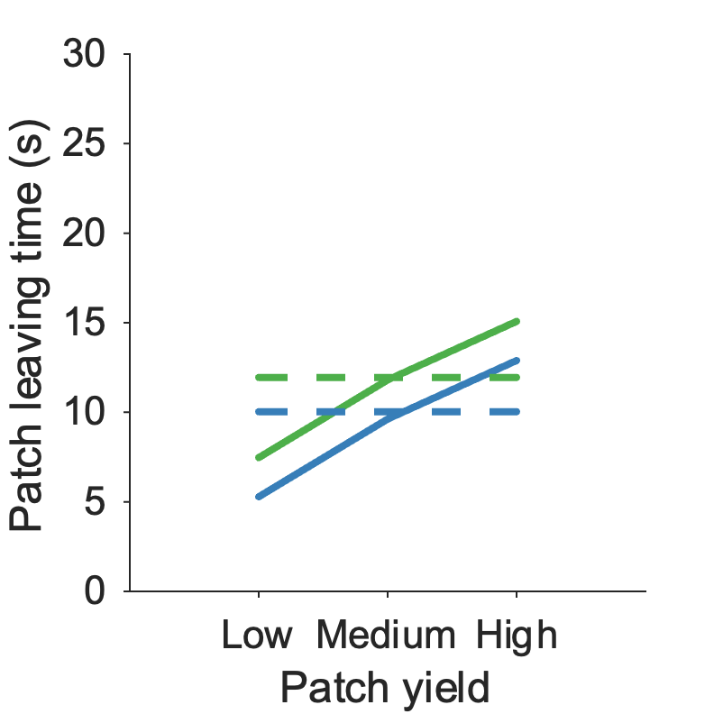

Figure 1: Model predictions
a
b
$$\text{p}\left(\text{leave} | \text{n}\right) \text{=}\frac{\text{1}}{ \text{1 + }\text{exp}\text{(}\text{βr}\left(\text{n}\right)\text{)}}$$
stay
Patch
r(1)
stay
r(2)
stay
r(3)
stay
r(n)
…
leave
leave
leave
leave
leave
3
2
1
c
Travel
d
e
f
g
h
i
j
Schematic of patch foraging decision
Schematic of model and state space
c) Introduce deterministic MVT rule: patch reward rate vs average RR in environment
d) Introduce softmax model – what does it predict? Expected leaving times for softmax model for range of beta
e) Softmax model can reproduce MVT (patch and environment effect)
f) and g) Softmax model could also reproduce overharvesting (increase in leaving times due to increase in inverse temperature (= more exploit))
h) Assuming betas that would reproduce overharvesting, the softmax model predicts a plateau in the expected SD of leaving times
i) and j) A model that isn’t reward-aware (i.e. e-greedy) cannot the patch effect of MVT

Slide 3

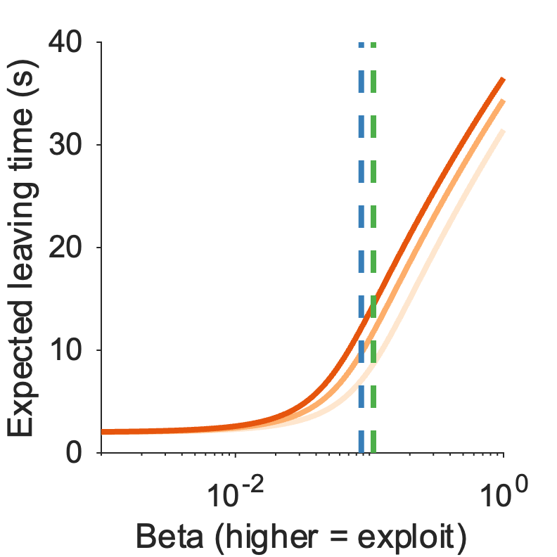
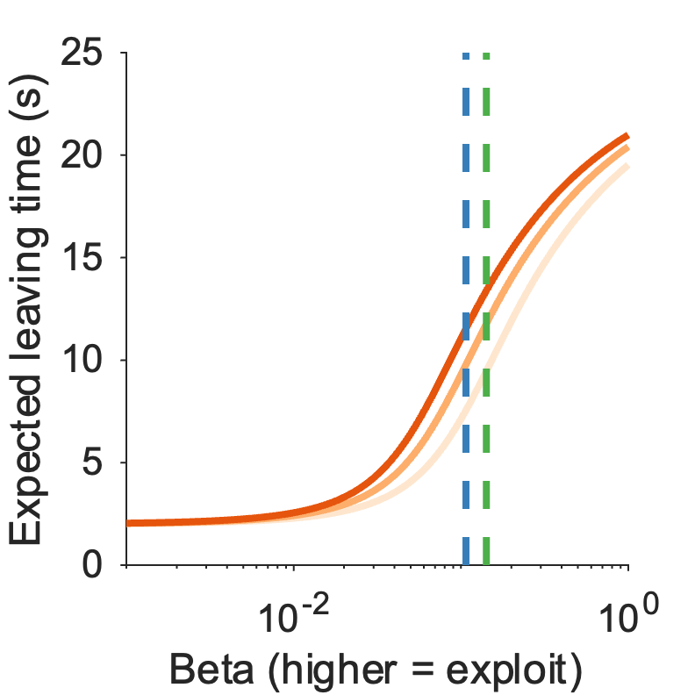
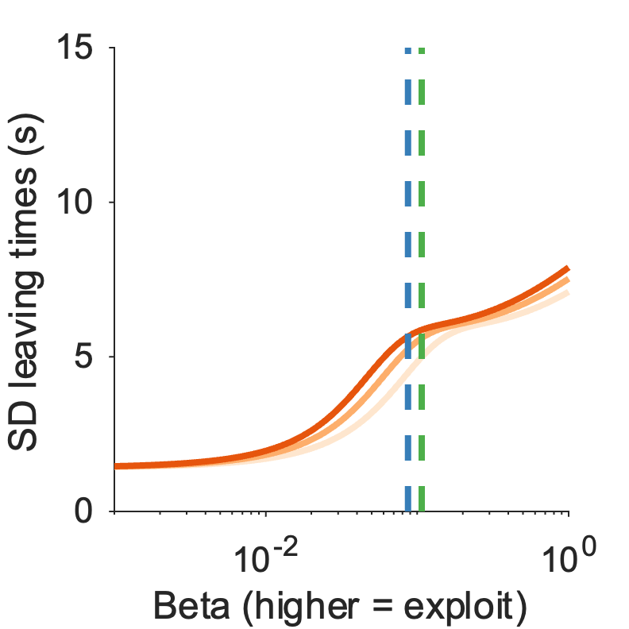
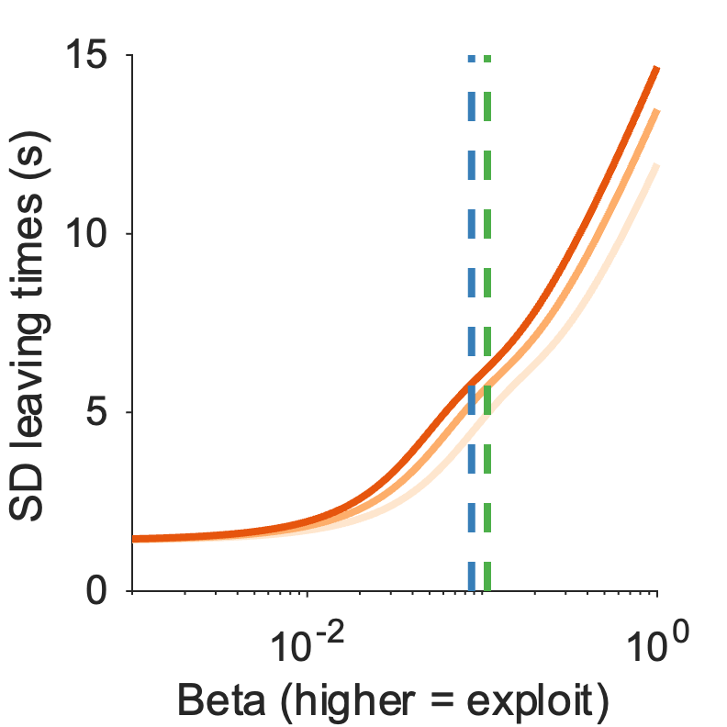
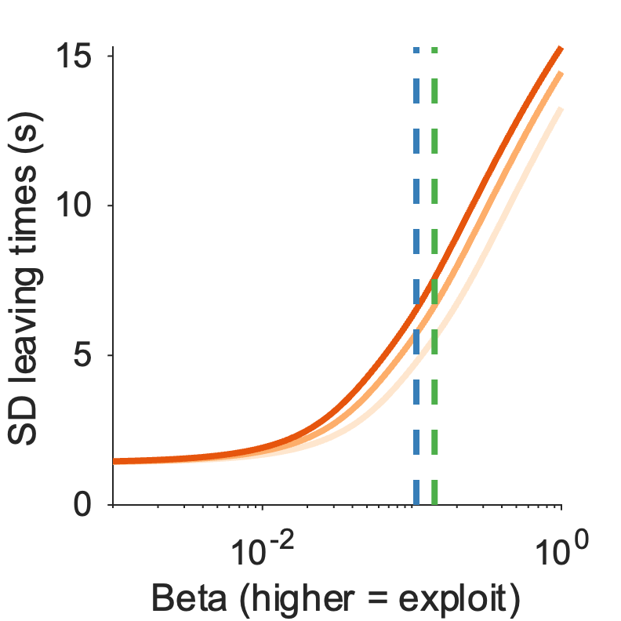
Supplementary Figure 1: Model predictions
𝜺 = 0.001
𝜺 = 0.01
𝜺 = 0.04
a-c Expected leaving times for lapse model for lapse parameter value of a) 0.001 b) 0.01 c) 0.04.
d-f SD leaving times for lapse model for lapse parameter value of a) 0.001 b) 0.01 c) 0.04.
To do: reward rate predictions for each dataset

Slide 4
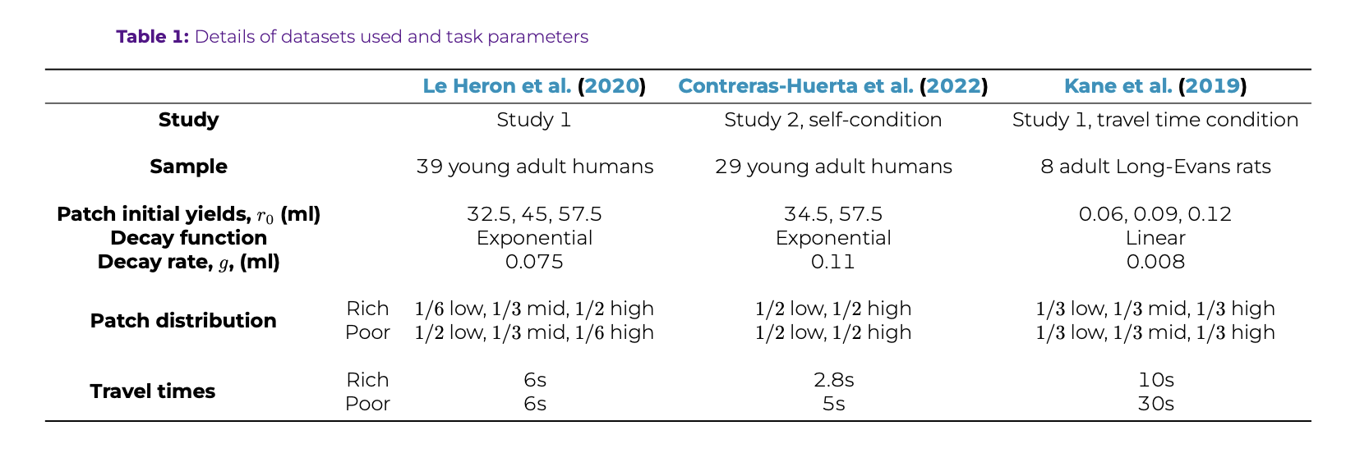
T1 – details of replication datasets

Slide 5

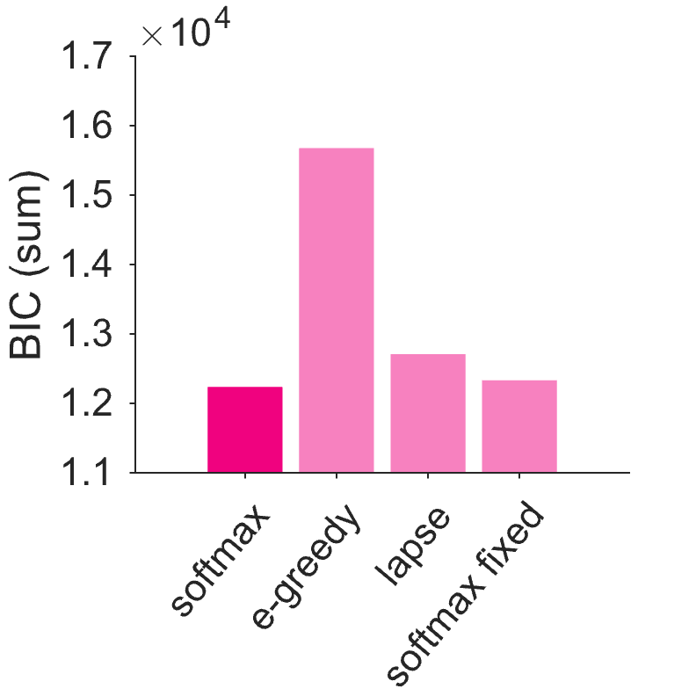
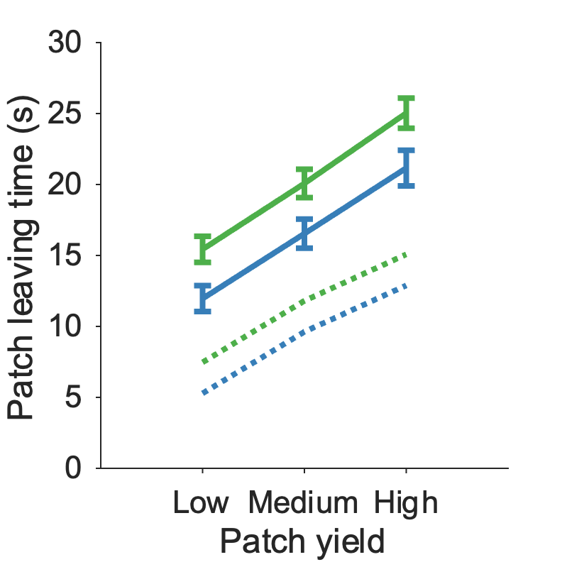
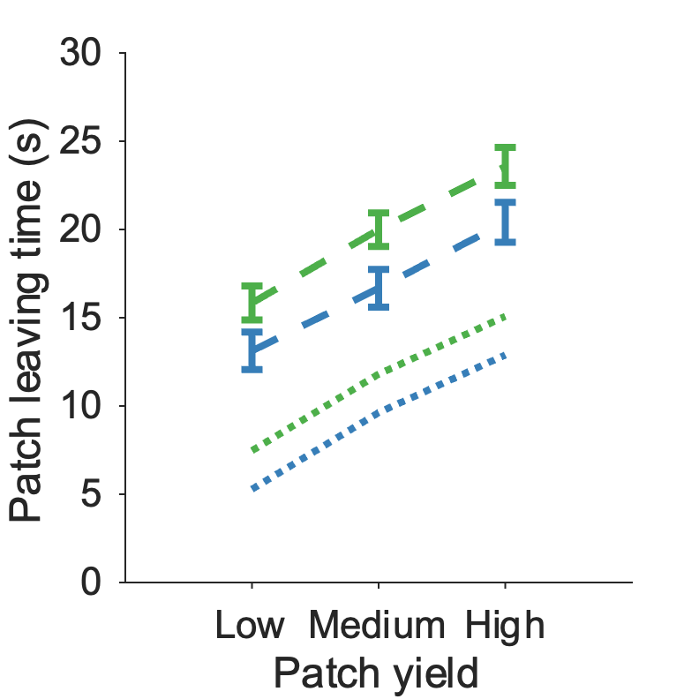
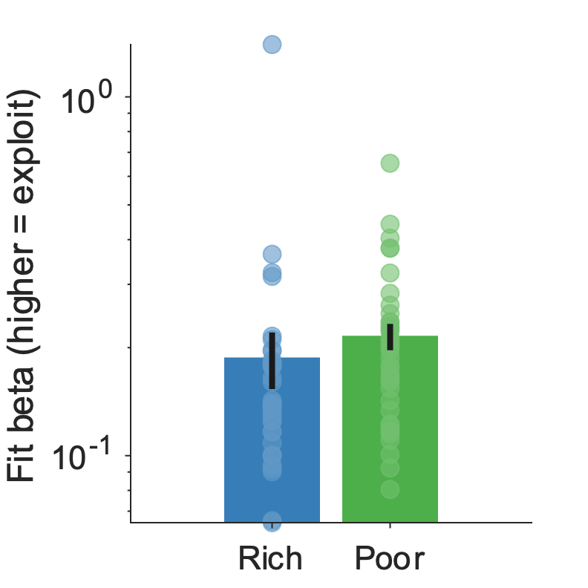
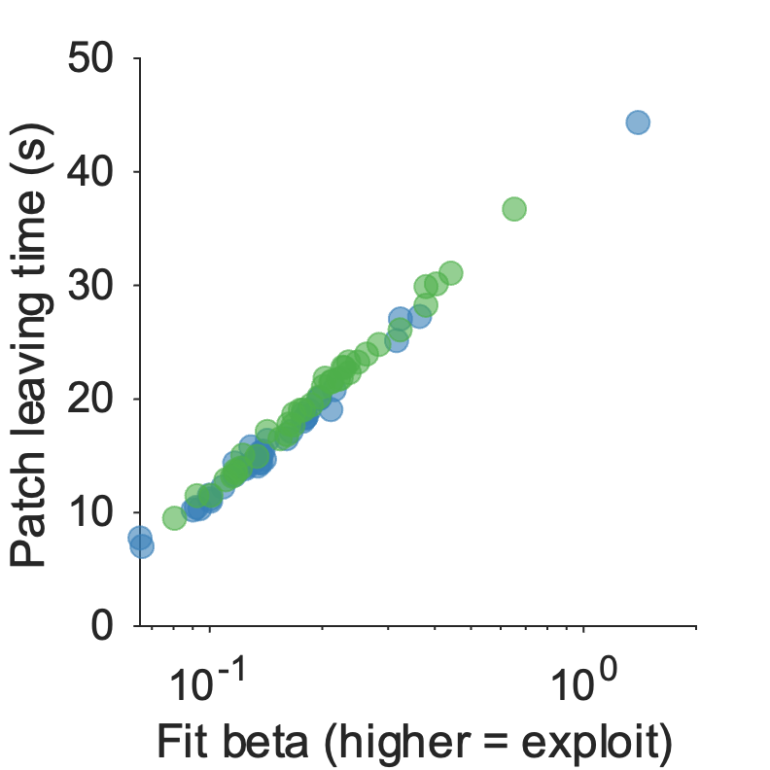
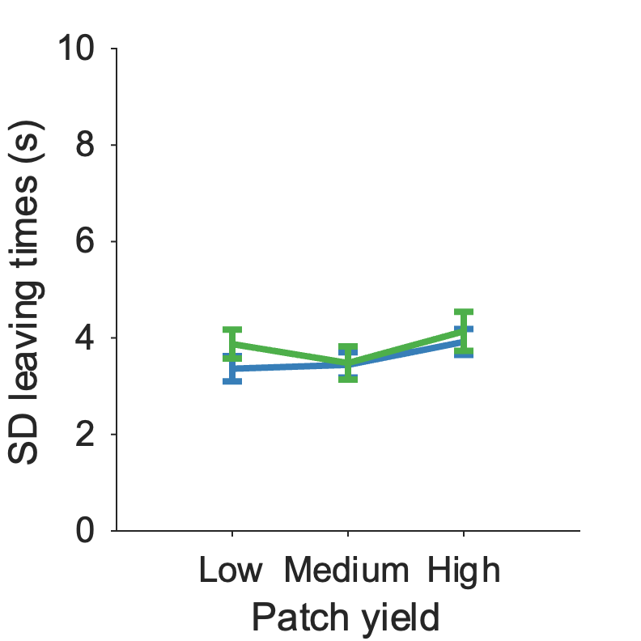
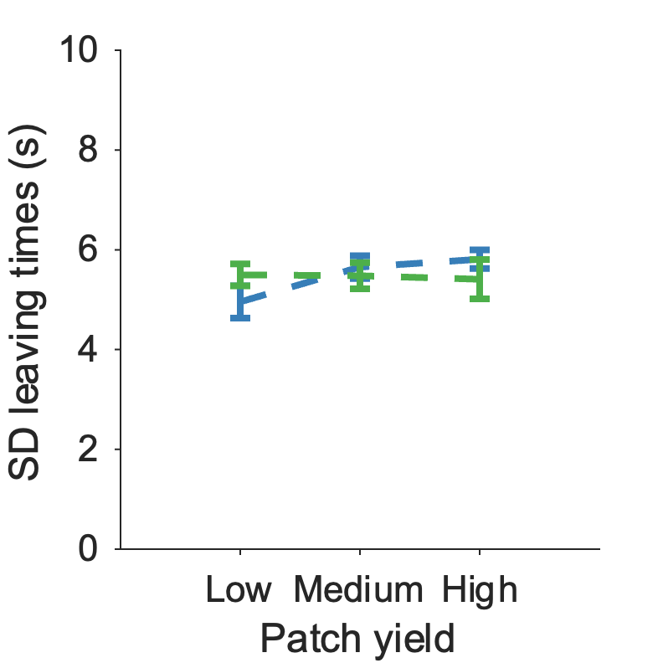
Figure 2: Le Heron fitting
a
b
c
d
e
f
g
h
***
i
j
ns
ns
a) Patch reward rate function for this task, with optimal AvgRR overlaid
b) Specific model predictions for this task – expected LT – with participant expected betas overlaid
c) Specific model predictions for this task – expected SD – with participant expected betas overlaid
d) BIC comparison of all models (softmax model is better than different choice policies and learning rules)
e) Participant leave times compared to MVT vs (f) simulated leave times from best model (compared to MVT)
g) Fit beta is significantly lower in rich compared to poor environment [t(38) = -5.0, p < .001]
h) Correlation of participant beta fits with participant mean leaving times across environments [r(76) = 0.99, p < .001]
i) SD of participants was not significantly different across patch, environment or interaction [Patch yield: F(2,228) = 1.77, p = 0.17; Environment: F(1,228) = 1.03, p = 0.31; Interaction: F(2,228) = 0.29, p = 0.75], as model predicts
(j) Consistent with participants, SD of simulated leaving times was not significantly different across patch, environment or interaction [Patch yield: F(2,228) = 1.13, p = 0.32; Environment: F(1,228) = 0, p = 0.96; Interaction: F(2,228) = 1.55, p = 0.21]

Slide 6
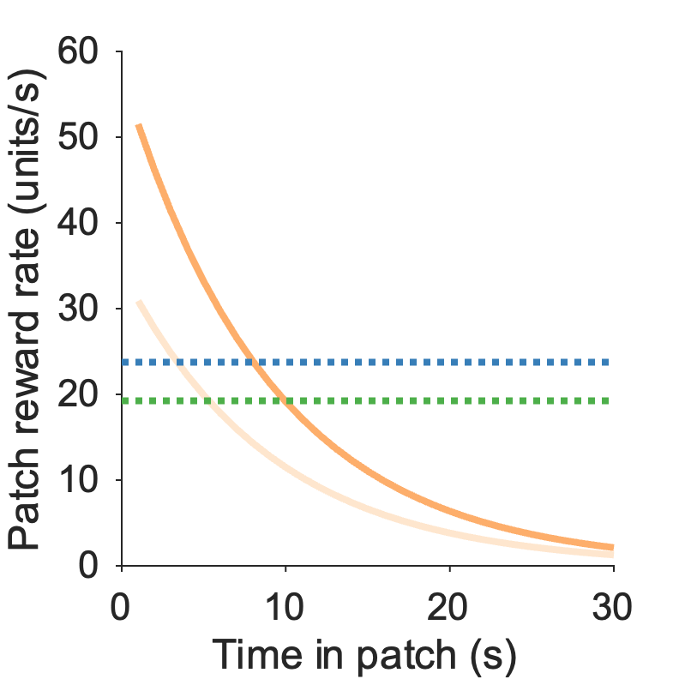
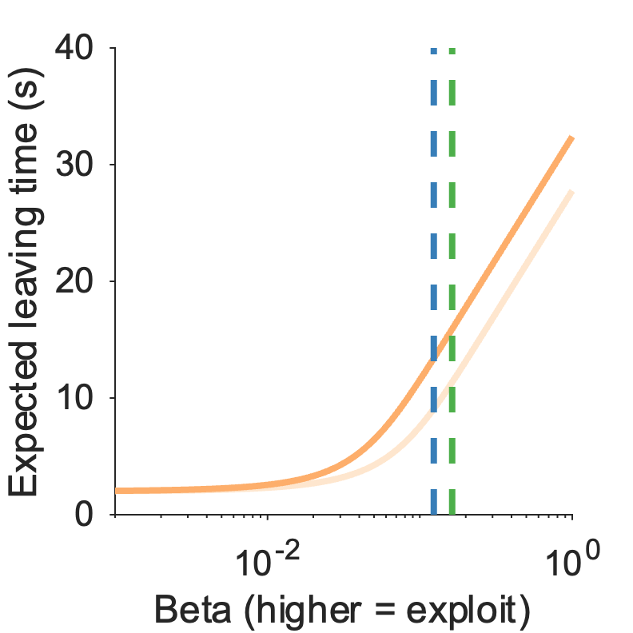
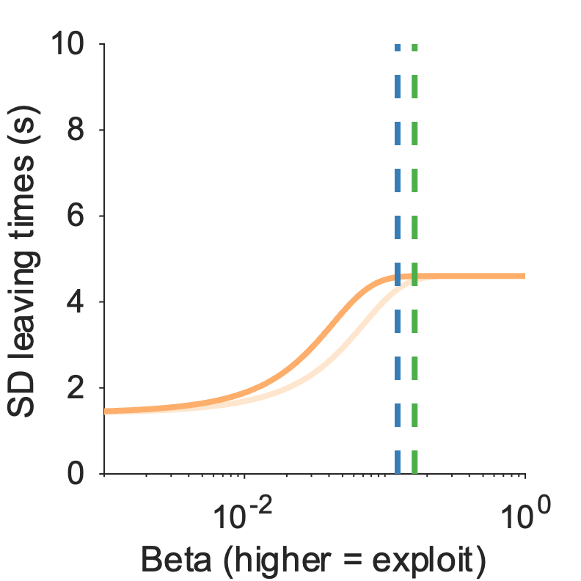
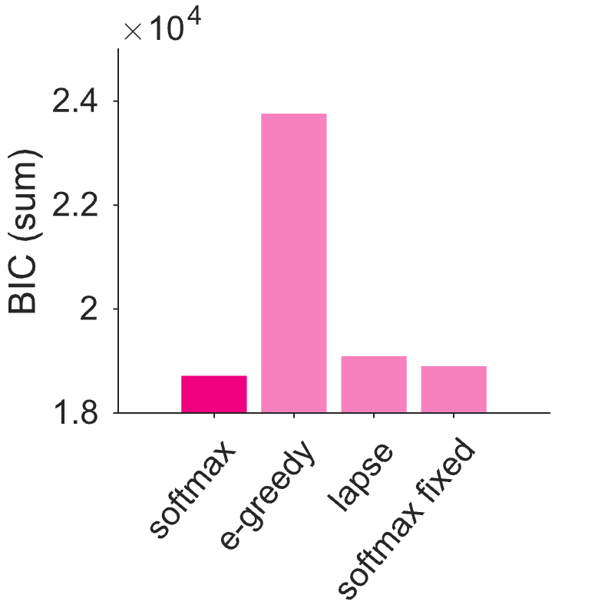
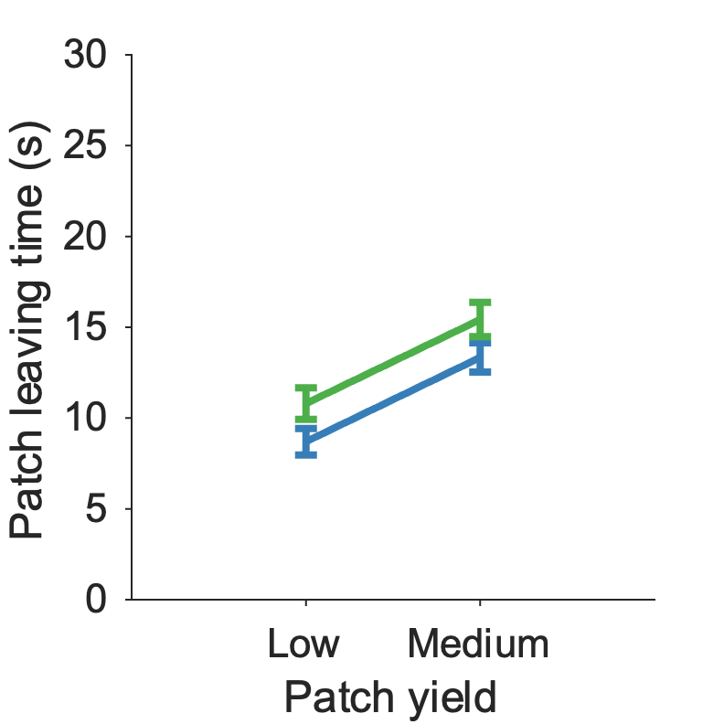
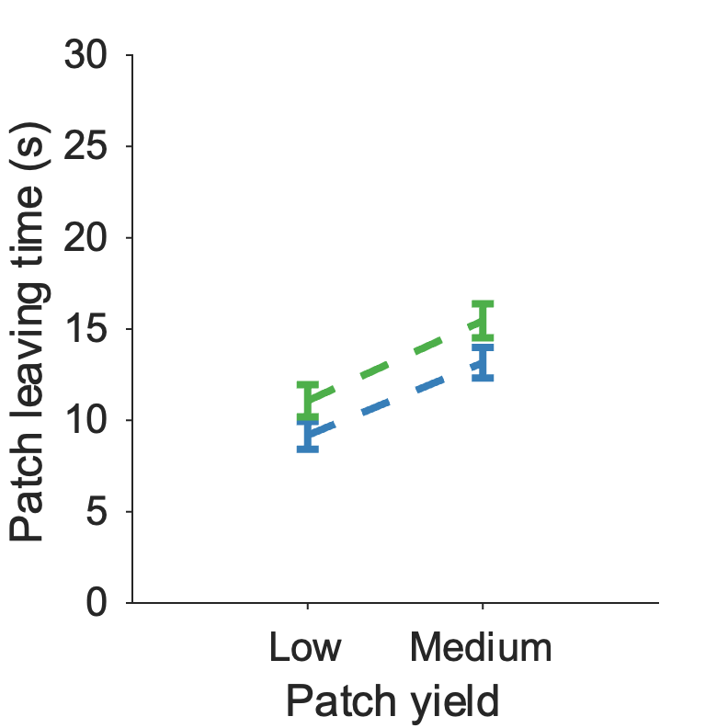
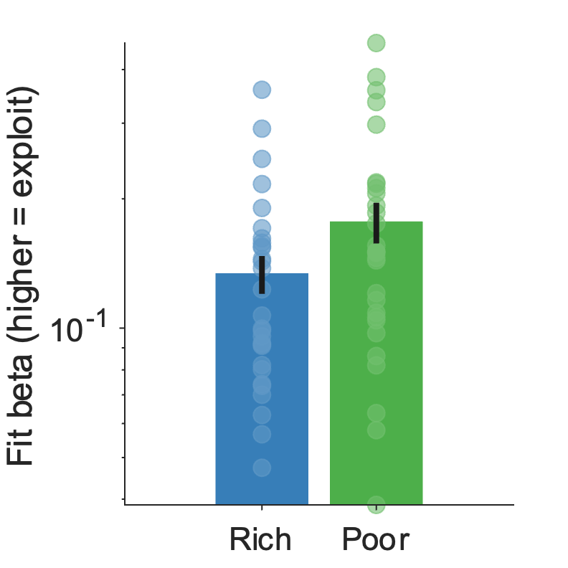
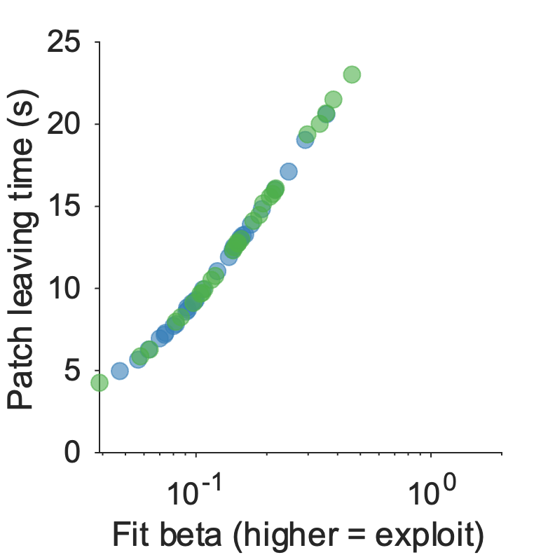
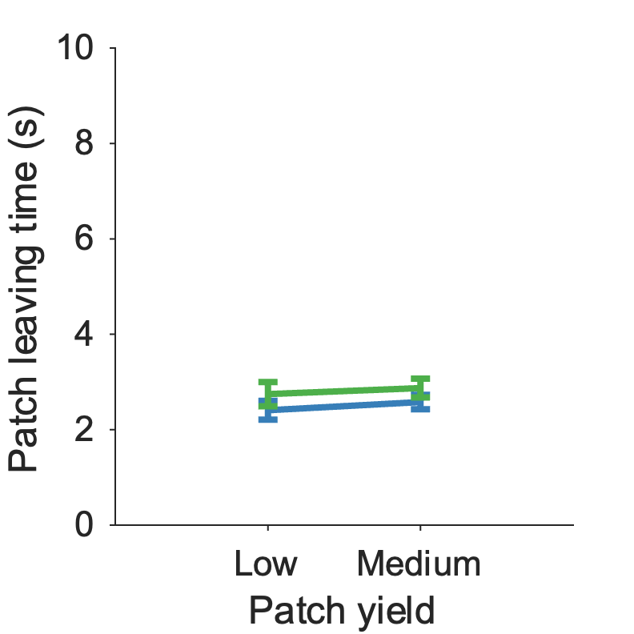
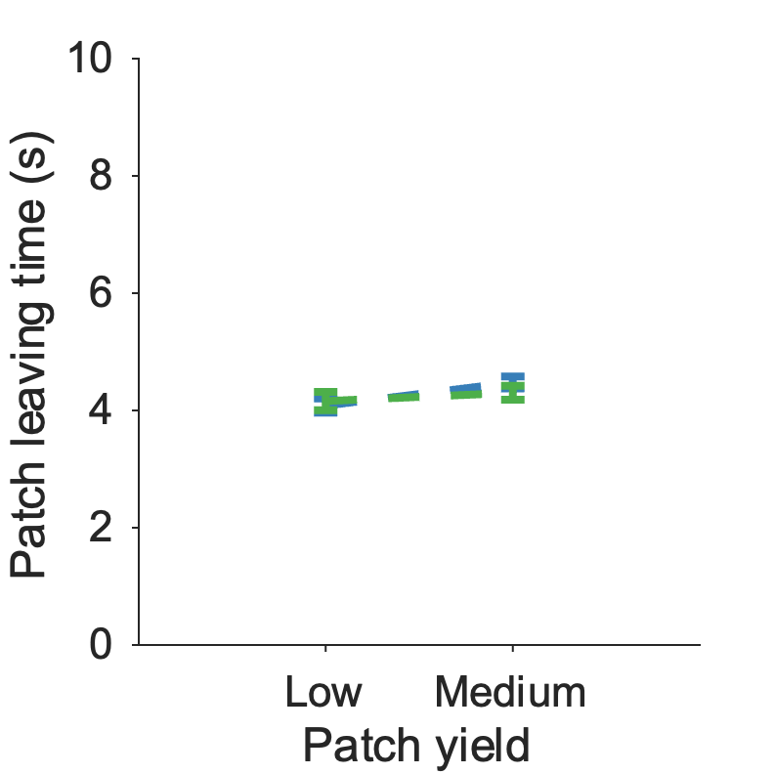
Figure 3: Contreras-Huerta fitting
a
b
c
d
e
f
g
**
h
i
j
ns
ns
a) Patch reward rate function for this task, with optimal AvgRR overlaid
b) Specific model predictions for this task – expected LT – with participant expected betas overlaid
c) Specific model predictions for this task – expected SD – with participant expected betas overlaid
d) BIC comparison of all models (softmax+avgRR learning model is best)
e) Participant leave times vs (f) simulated leave times from best model
g) Fit beta significantly lower in rich compared to poor environment [t(28) = -3.12, p = 0.004]
h) Correlation of participant beta fits with participant mean leaving times [r(56) = 0.64, p < .001]
i) SD of participants was not significantly different across patch, environment or interaction [Patch yield: F(1,112) = 0.53, p = 0.47; Environment: F(1,112) = 2.39, p = 0.13; Interaction: F(1,112) = 0.01, p = 0.91], as model predicts
(j) Consistent with participants, SD of simulated leaving times was not significantly different across patch, environment or interaction [Patch yield: F(1,112) = 0.83, p = 0.37; Environment: F(1,112) = 1.41, p = 0.24; Interaction: F(1,112) = 1.64, p = 0.20]

Slide 7
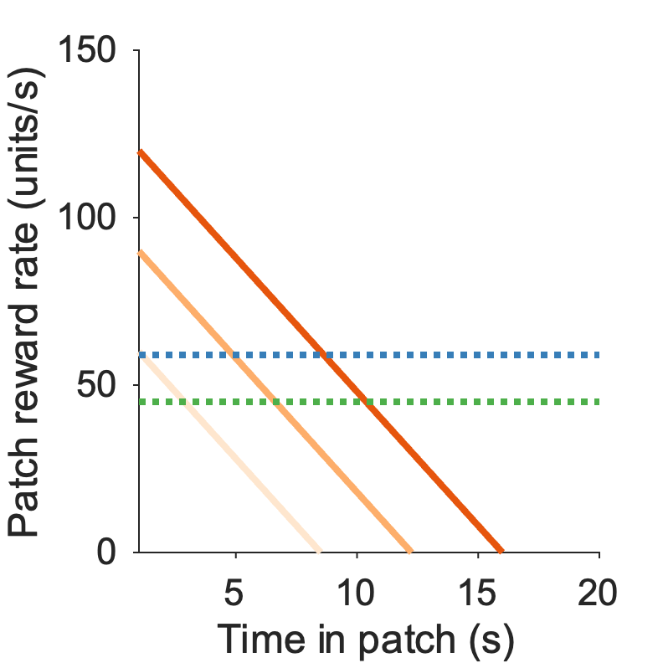
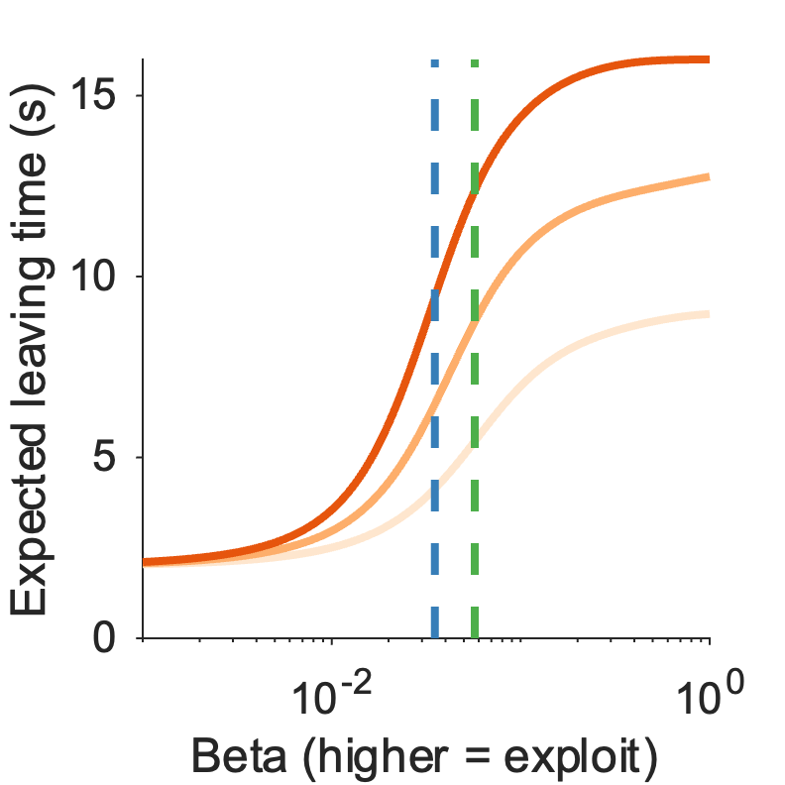
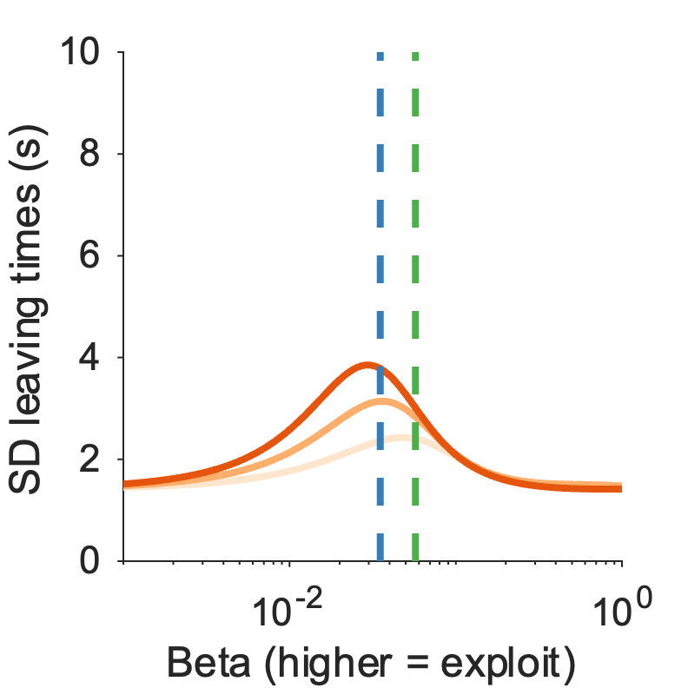
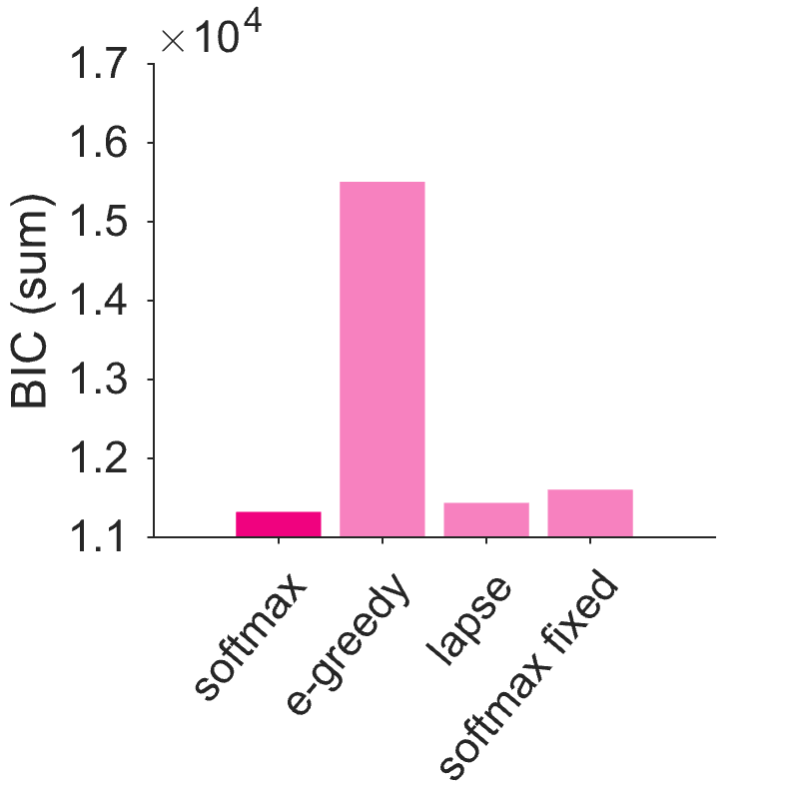
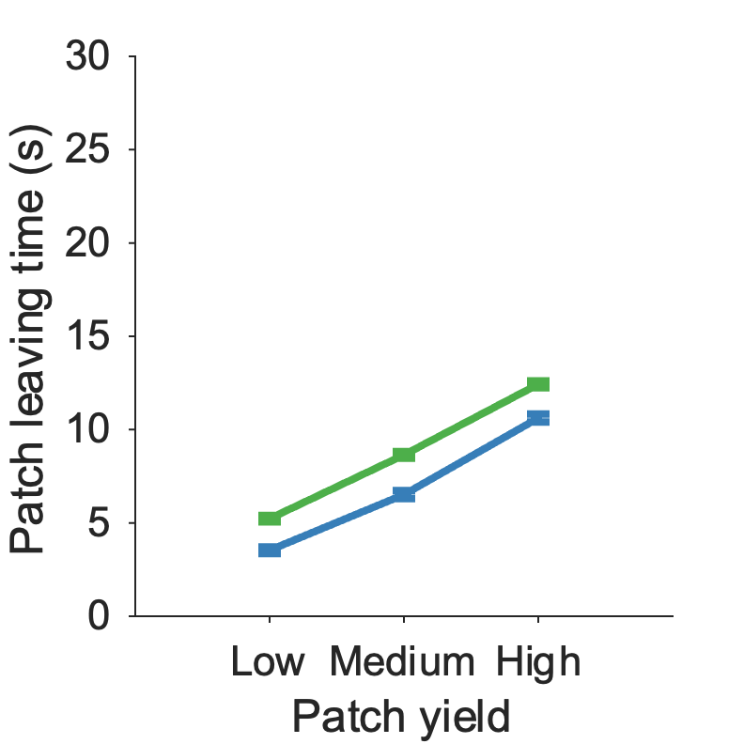
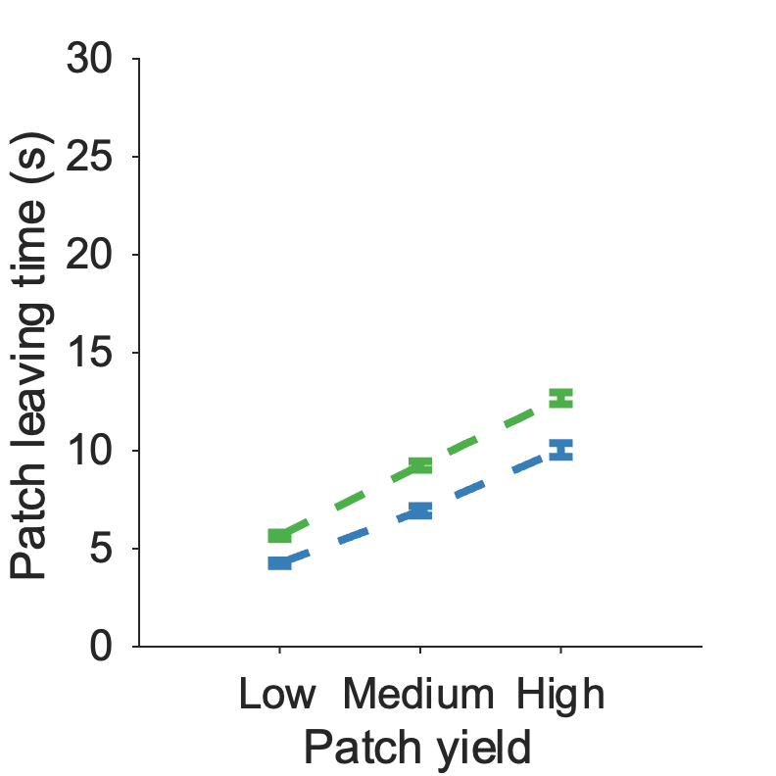
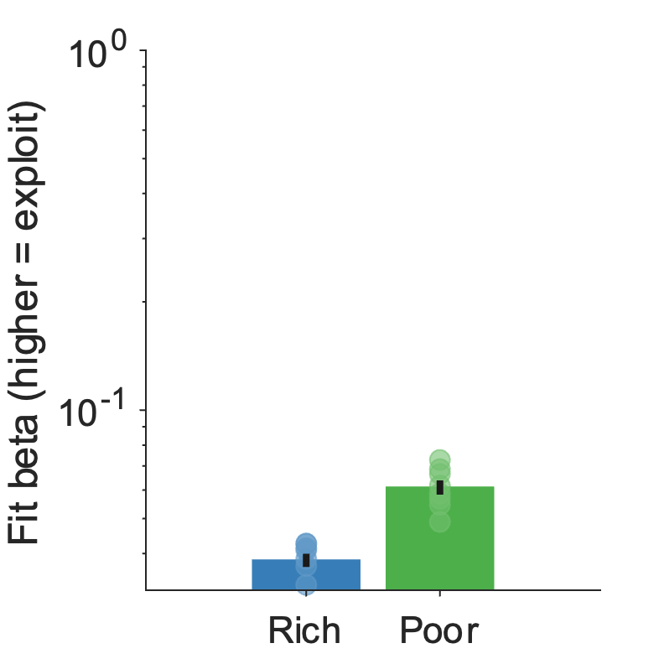
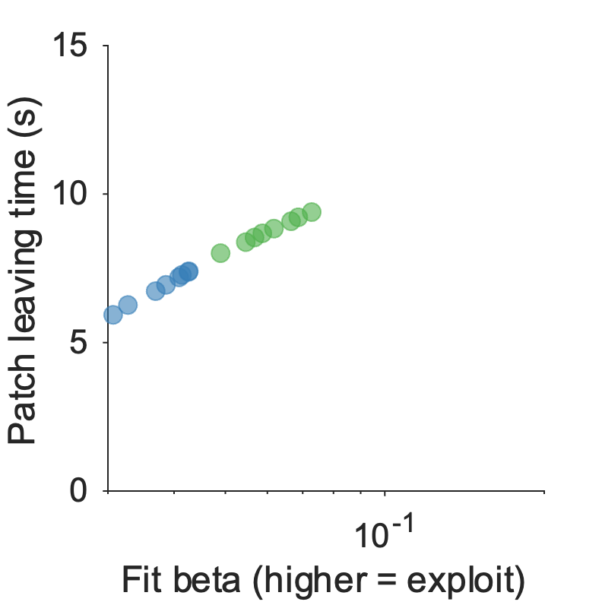
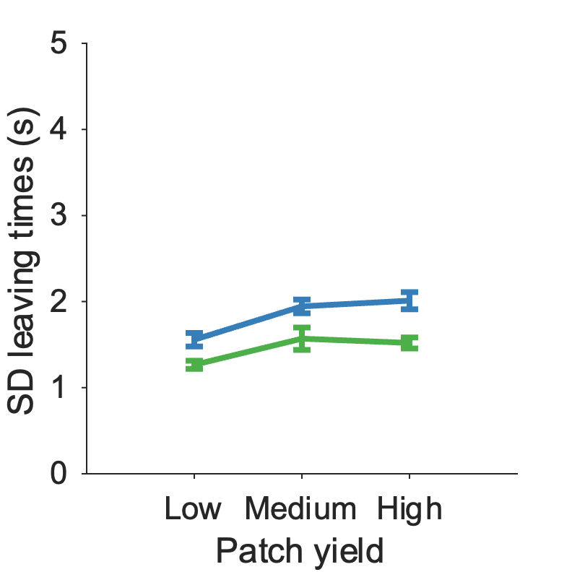
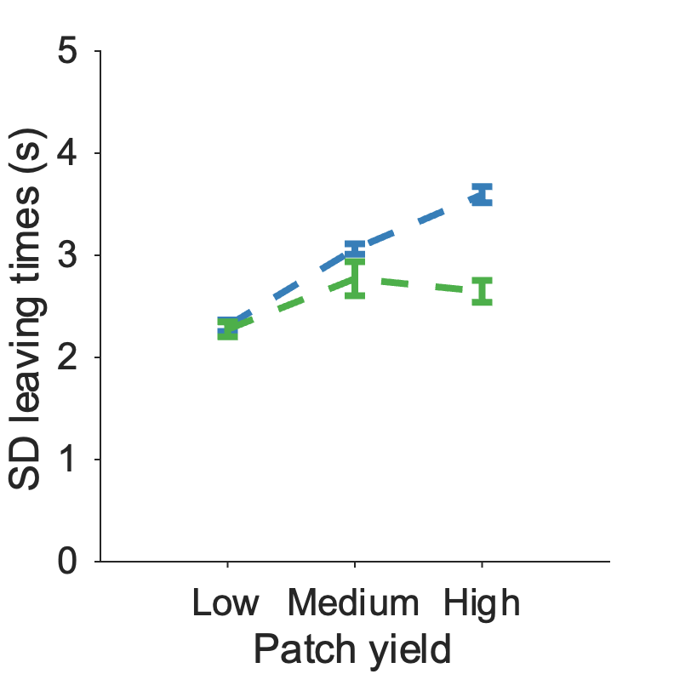
Figure 4: Kane fitting
a
b
c
d
e
f
g
h
***
i
j
***
***
a) Patch reward rate function for this task, with optimal AvgRR overlaid
b) Specific model predictions for this task – expected LT – with participant expected betas overlaid
c) Specific model predictions for this task – expected SD – with participant expected betas overlaid
d) BIC comparison of all models (softmax+avgRR learning model is best)
e) Participant leave times vs (f) simulated leave times from best model
g) Fit beta significantly lower in rich compared to poor environment [t(7) = -7.88, p < .001]
h) Correlation of participant beta fits with participant mean leaving times [r(14) = 0.94, p < .001].
i) SD of participants was significantly different for patch [Patch yield: F(2,42) = 10.76, p < .001] and environment [Environment: F(1,42) = 29.41, p < .001] but not for patch x environment interaction [Interaction: F(2,42) = 0.66, p = 0.52] (j) Consistent with participants, SD of simulated leaving times was significantly different across patch [Patch yield: F(2,42) = 14.4, p < .001], and environment [Environment: F(1,42) = 31.76, p < .001] , but predicted significant patch x environment interaction [Interaction: F(2,42) = 7.96, p = .001], which was not observed in participant data

Slide 8
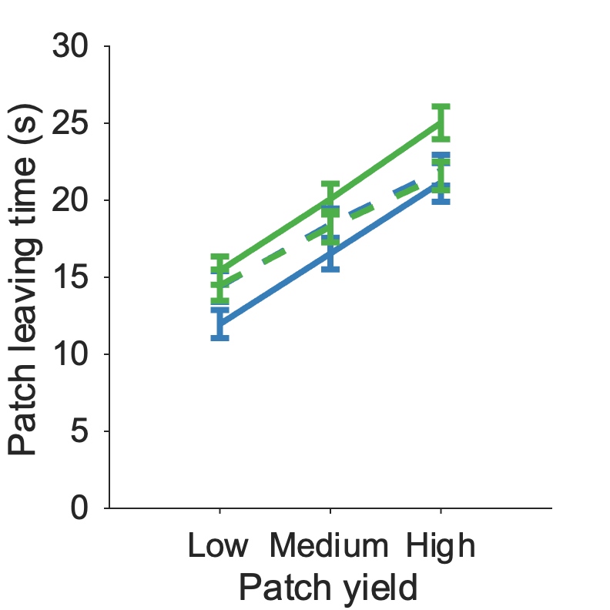
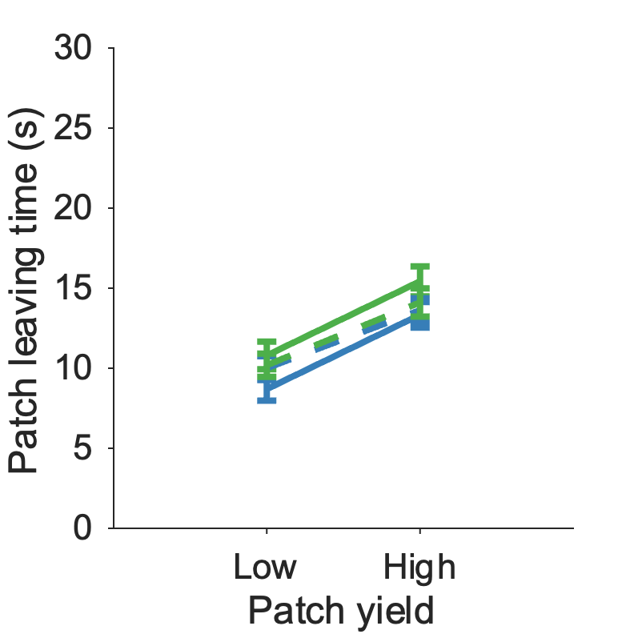
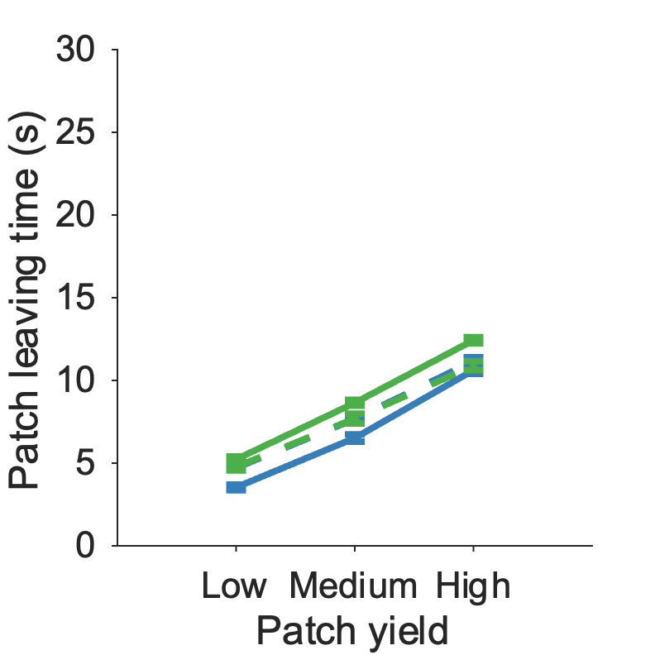
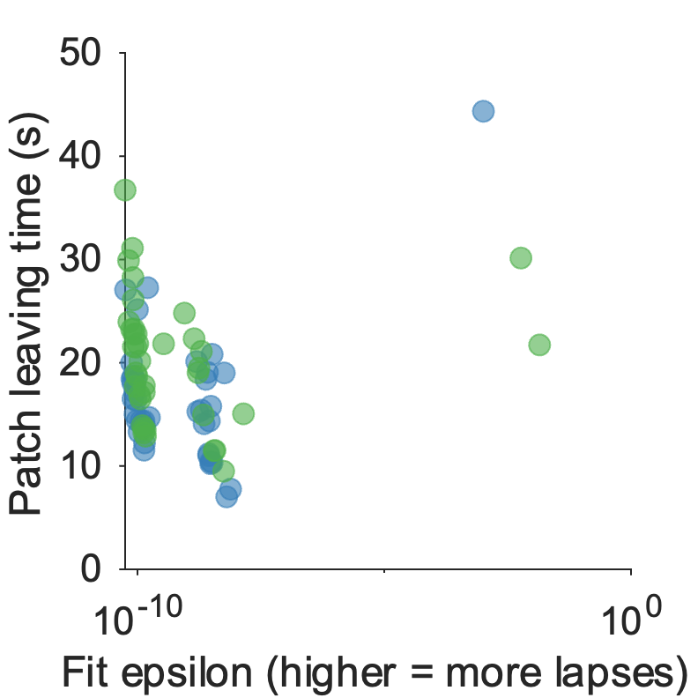
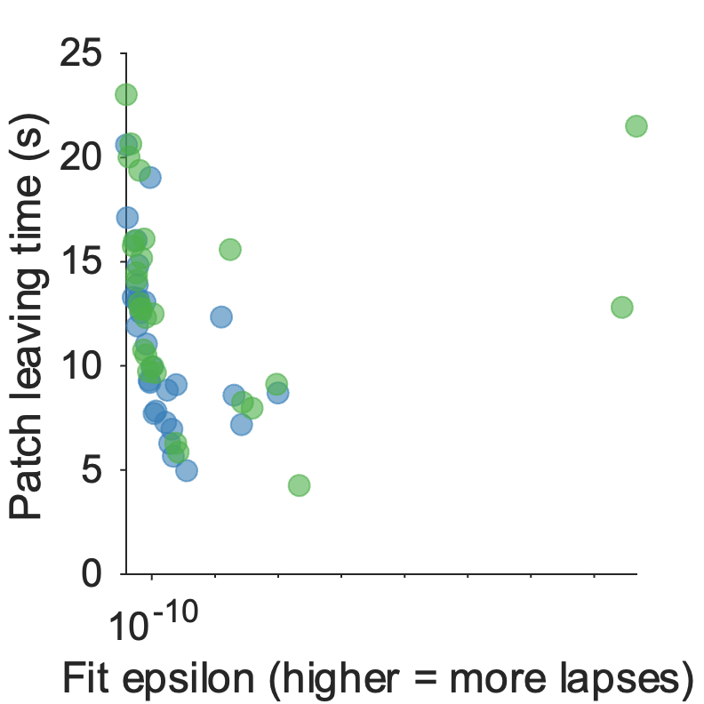
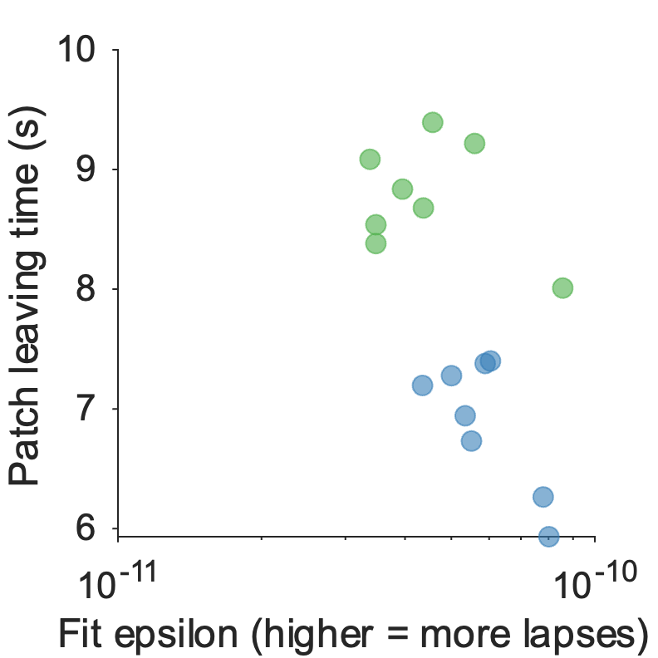
Supplementary Figure 2-4
Parameter recovery for winning models (each dataset)
Reporting Pearson’s rho
 | Beta | Lambda
M1 LeHeron rich | 0.996
M1 LeHeron poor | 0.995
M5 CH rich | 0.926
M5 CH poor | 0.707
M5 Kane rich | 0.872
M5 Kane poor | 0.941
M9 LeHeron |  | 0.961
M9 CH |  | 0.972
M9 Kane |  | 0.991
Model recovery matrix – to do
Softmax fixed model leaving times – no environment effect
Le Heron
Contreras-Huerta
Kane
Lapse model – tiny epsilon fits don’t influence the model leaving times

Slide 9
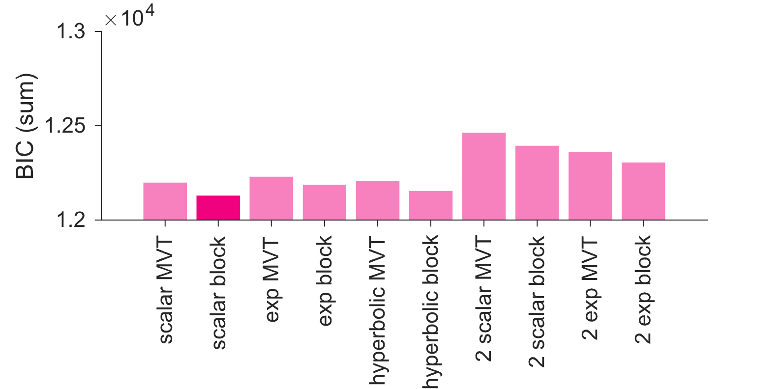
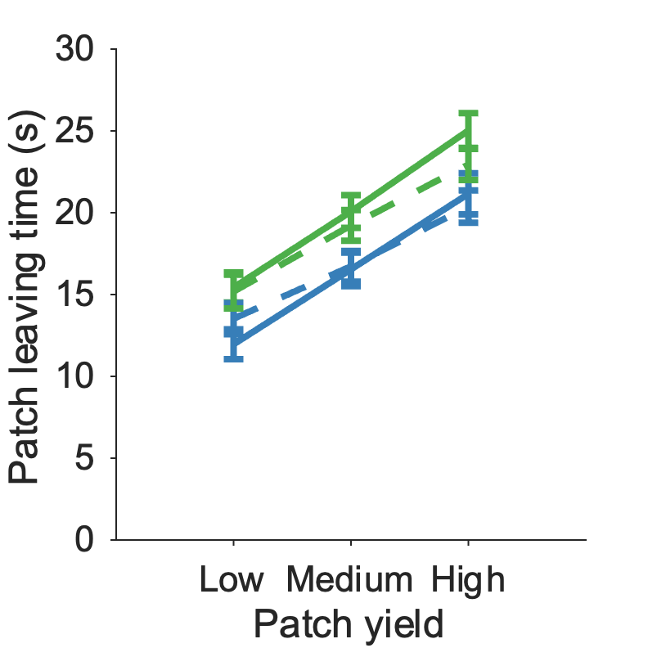
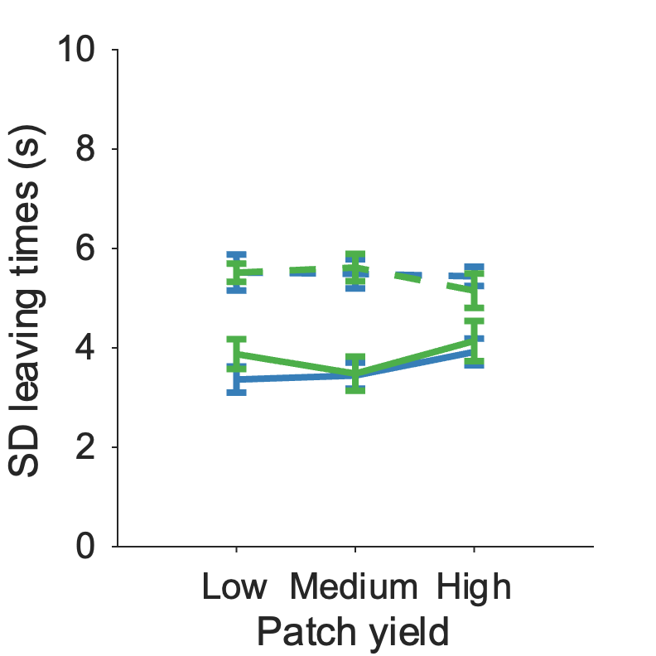

Figure 5: Mechanism – avgRR functions
a
b
c
d
BIC comparison of how beta arises from averageRR – simplest scalar model with one parameter wins, when using their real experienced average reward rate in each block.
Participant leave times vs simulated leave times
Participant SDs vs simulated SDs
d) Correlation of participant lambda fits with participant mean leaving times [r(37) = 0.99, p < .001].

Slide 10






Supplementary Figure 5: Mechanism – avgRR functions for other datasets
a
b
c
e
d
f
BIC comparison of all avgRR functions for Contreras-Huerta dataset – same simple model wins.
BIC comparison of all avgRR functions for Kane dataset – same simple model wins.
For winning function, both simulated leaving times (c-d) and standard deviations(e-f) looks like participant data for Contreras-Huerta and Kane datasets

Slide 11












Supplementary Figure 5: Mechanism – learning functions (RW)
a
b
c
d
e
f
g
h
i
j
k
l
a-c) Rescorla Wagner learning models comparison for Le Heron, Contreras-Huerta and Kane dataset
D-f) Rescorla Wagner models simulated leaving times for Le Heron, CH and Kane datasets shows still overharvesting, environment effect and patch effect, but patch effect is shallower than expected
G-i) models can capture SD patterns (Kane partially, as seen before)
J-l) correlation of learning rate fits with patch leaving times – no significant correlations, although CH is marginally significant (p = .06. ) driven by a few people with low leaving times and faster learning rates

