Slide 1
Figures for stochastic MVT paper
21 August 2023

Slide 2
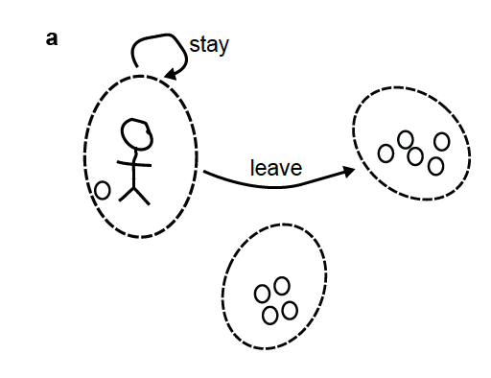
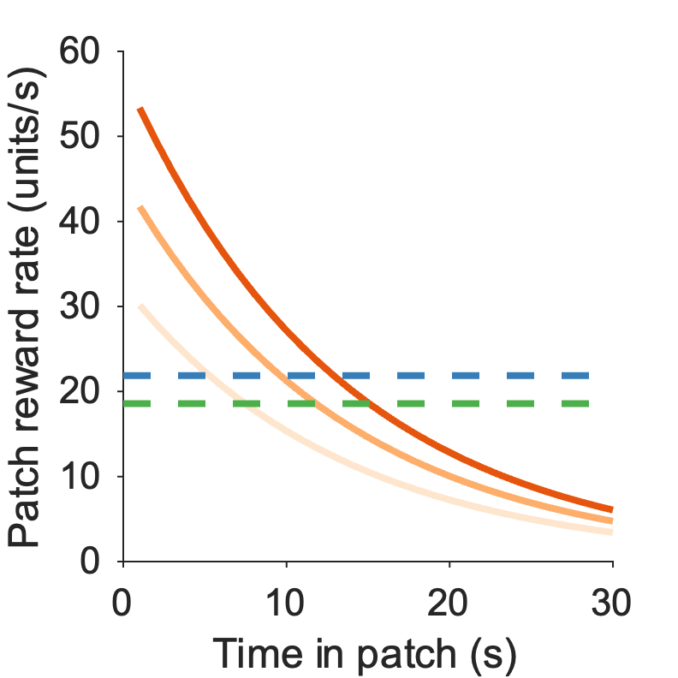
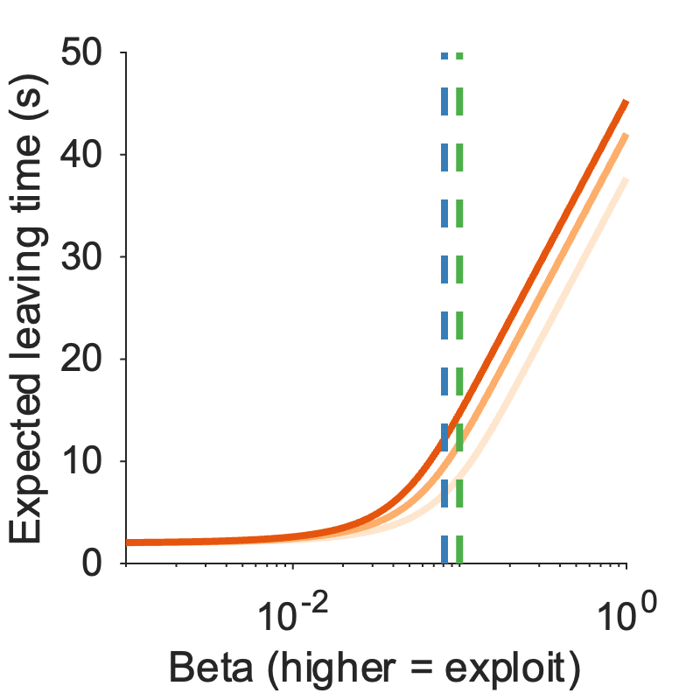
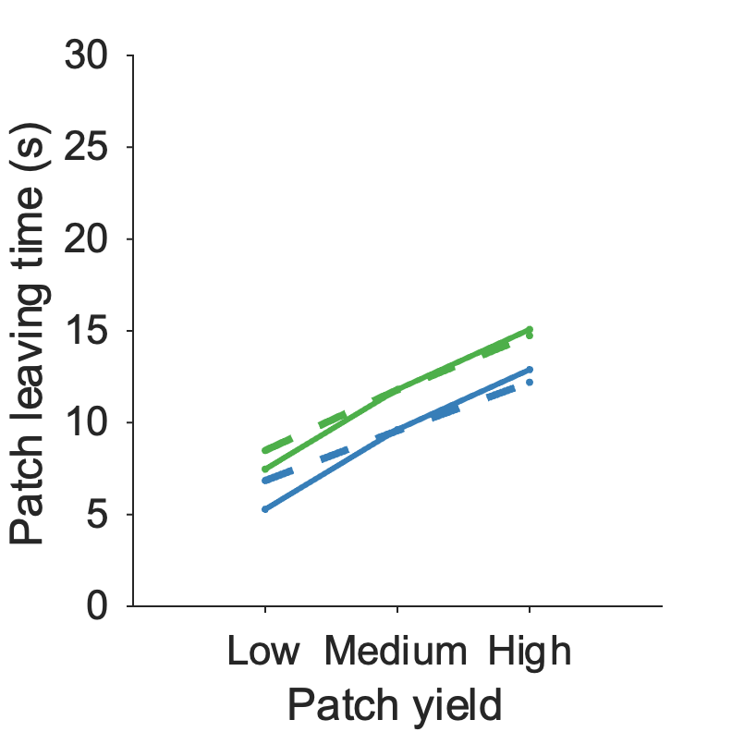
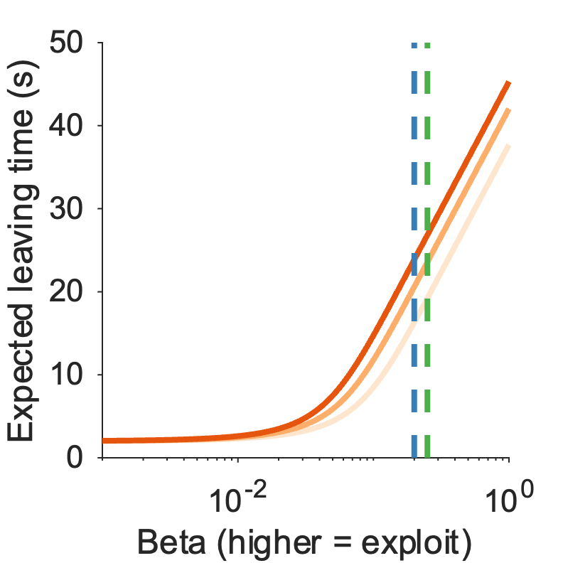
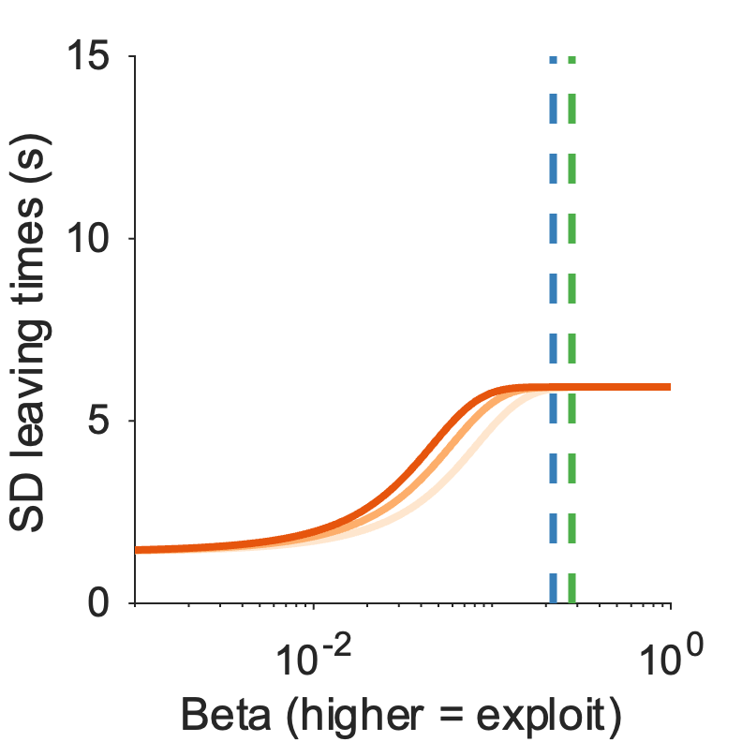
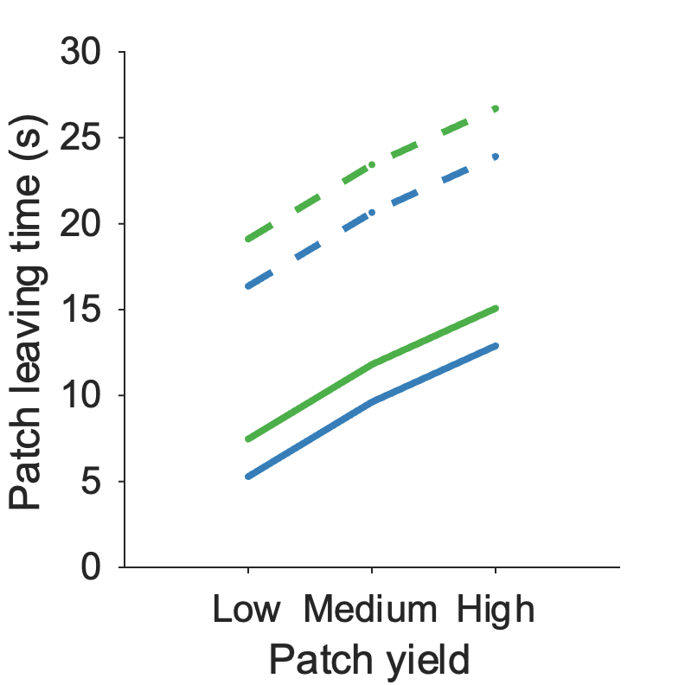
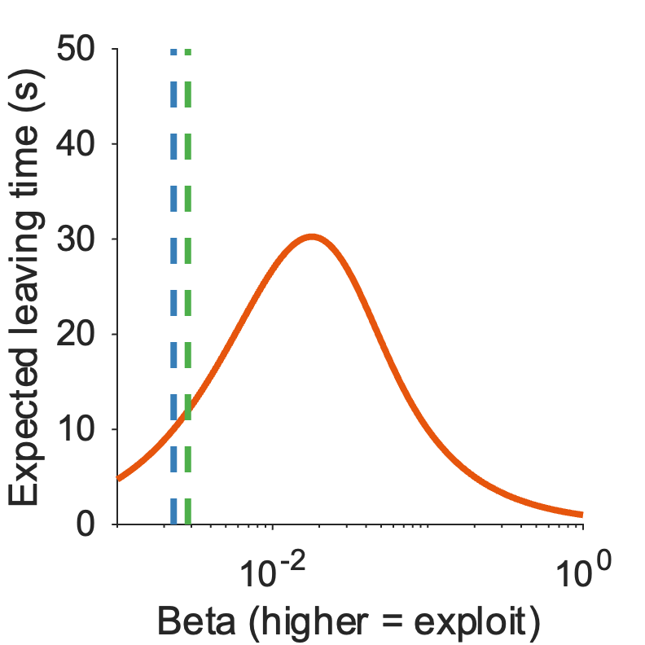
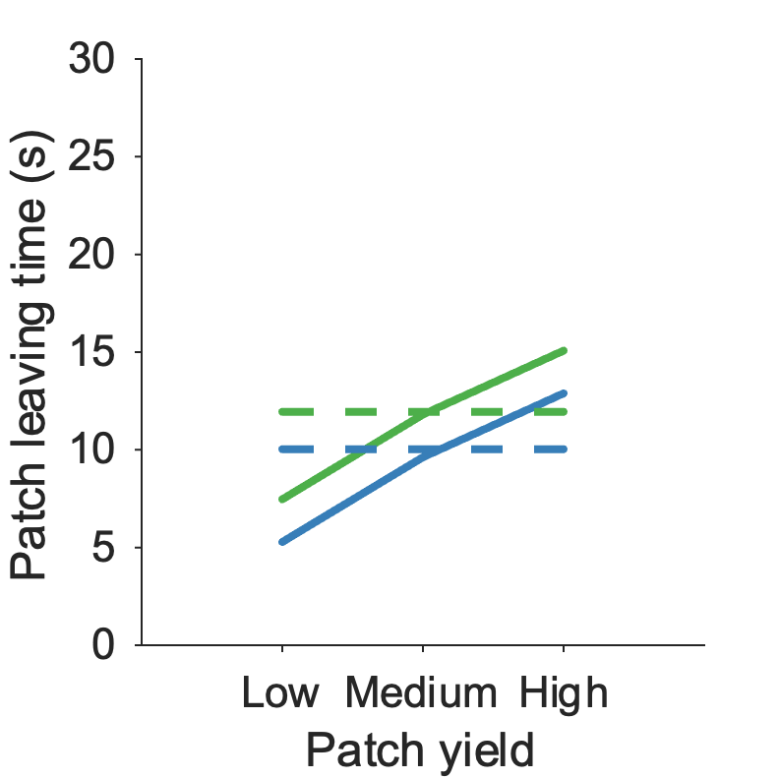
a
b
Figure 1:
Model predictions
c
d
e
f
g
h
i
a) Schematic of patch foraging decision
b) Introduce deterministic MVT rule: patch reward rate vs average RR in environment
c) Introduce softmax model – what does it predict? Expected leaving times for softmax model for range of beta
d) Softmax model can reproduce MVT (patch and environment effect)
e) and f) Softmax model could also reproduce overharvesting (increase in leaving times due to increase in inverse temperature (= more exploit))
g) Assuming betas that would reproduce overharvesting, the softmax model predicts a plateau in the expected SD of leaving times
h) and i) A model that isn’t reward-aware (i.e. e-greedy) cannot replicate MVT/overharvesting behaviour

Slide 3

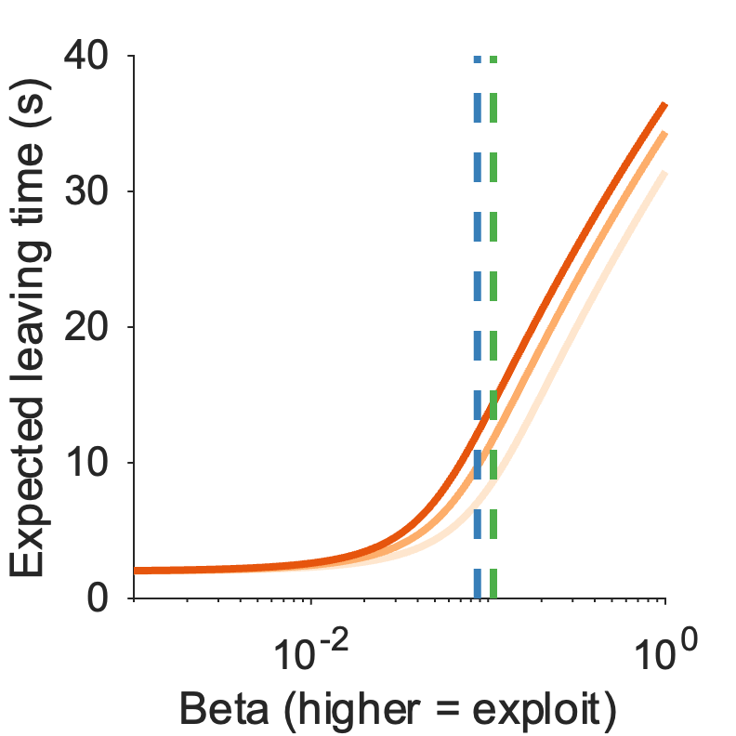
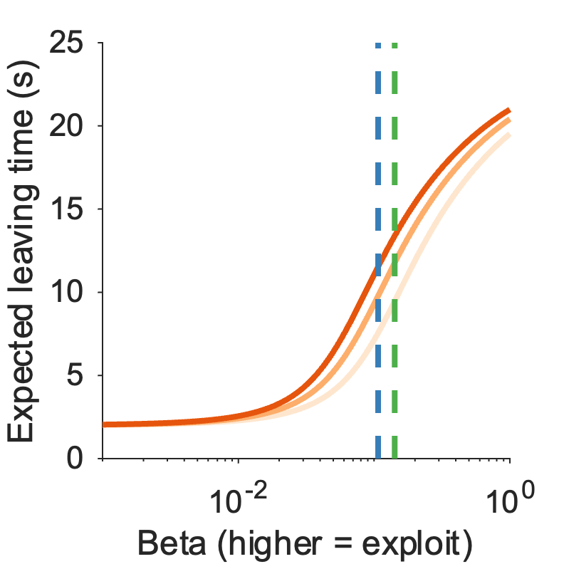
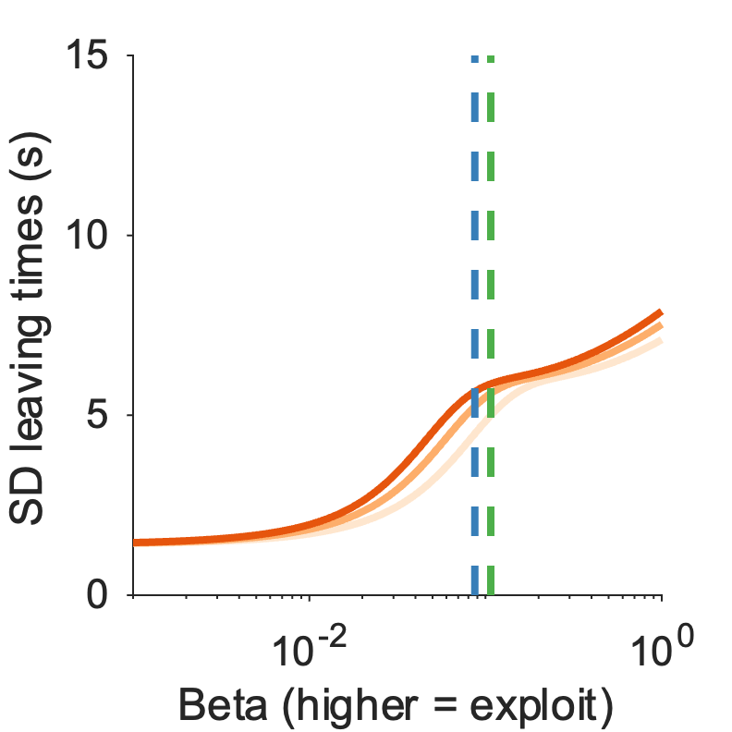
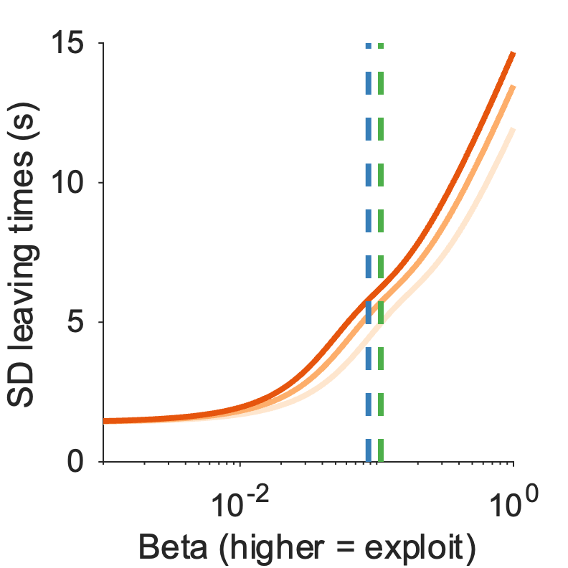
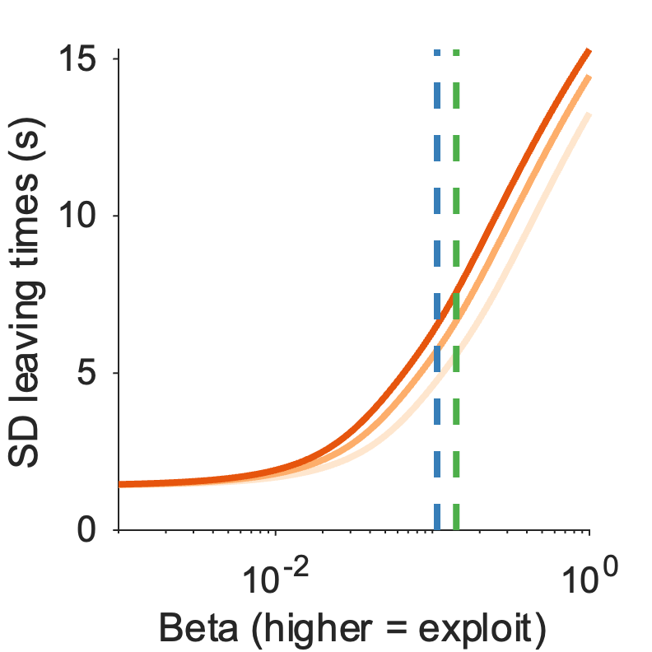
Supplementary Figure 1: Model predictions
𝜺 = 0.001
𝜺 = 0.01
𝜺 = 0.04
a-c Expected leaving times for lapse model for lapse parameter value of a) 0.001 b) 0.01 c) 0.04.
d-f SD leaving times for lapse model for lapse parameter value of a) 0.001 b) 0.01 c) 0.04.

Slide 4
T1 – details of replication datasets
Paper | Study | Sample | Patch Types | Initial yield (r0 ml) | Decay function | Decay rate | Environments | Travel Time | Patch distribution
Le Heron et al. (2020) | Study 1 | 39 young adult humans | N = 3 (low, medium, high) | [32.5, 45, 57.5] | Exponential | 0.075 | N = 2 (rich poor) | 6s | 16%, 33%, 50%
Contreras-Huerta et al. (2022) | Study 2 - self condition | 29 young adult humans | N = 2 (low, high) | [34.5, 57.5] | Exponential | 0.11 | N = 2 (short long) | [2.8s, 5s] | 50%, 50%
Kane et al. (2019) | Study 1 - travel time | 8 Adult Long-Evans rats | N = 3 (low, medium, high) | [0.06, 0.09, 0.12] | Linear | 0.008 | N = 2 (short long) | [10s, 30s] | 33% 33% 33%

Slide 5

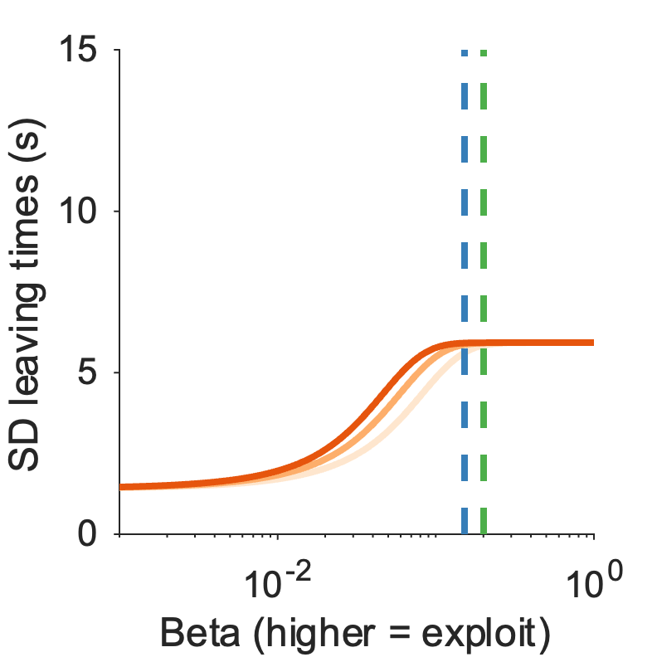
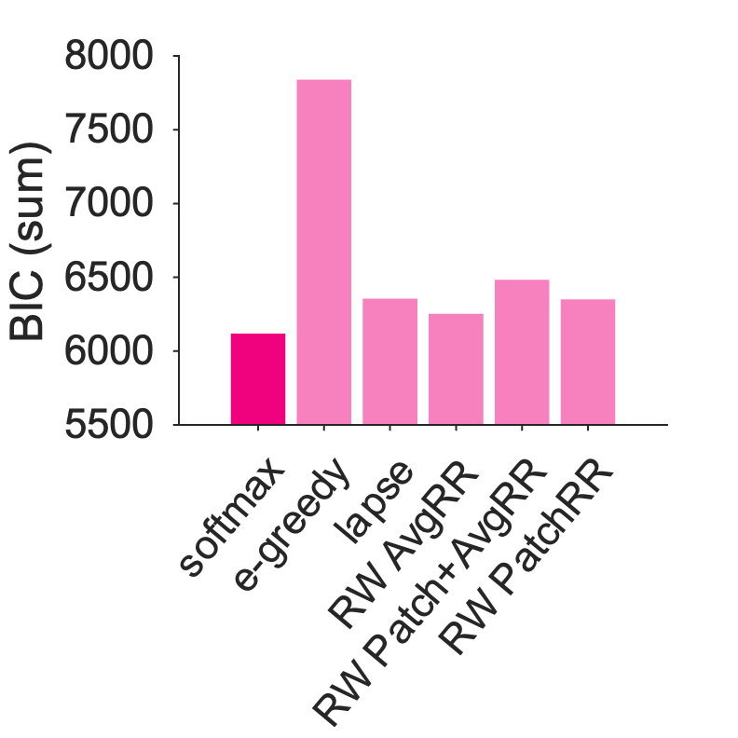
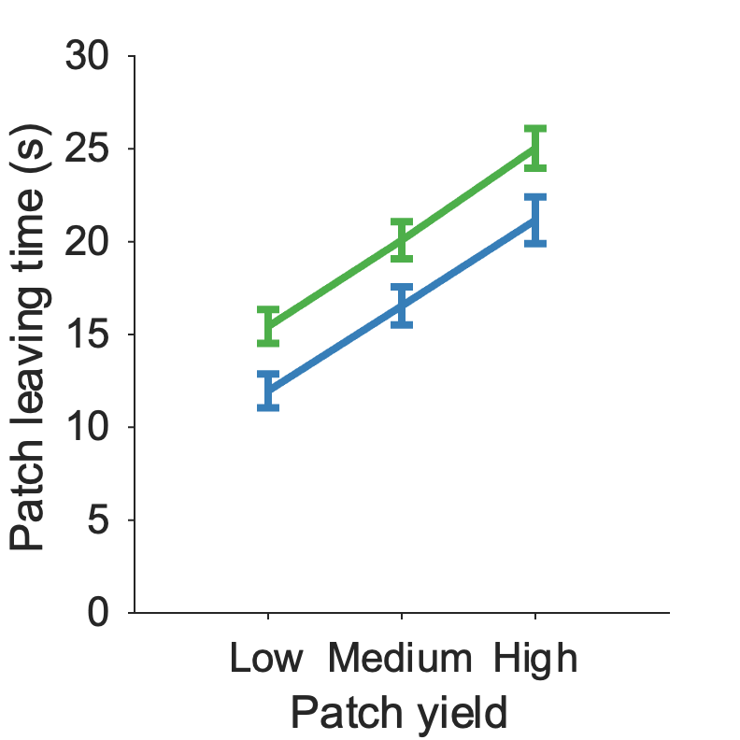
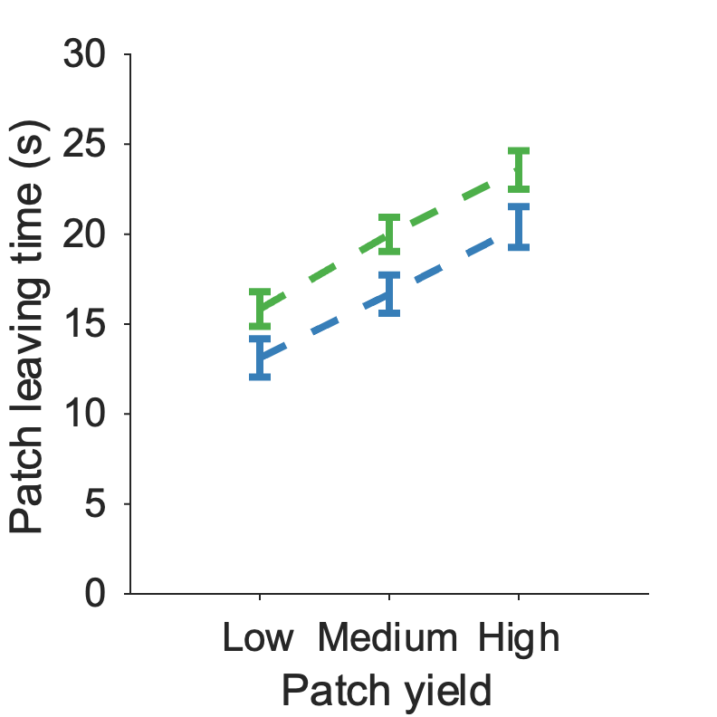
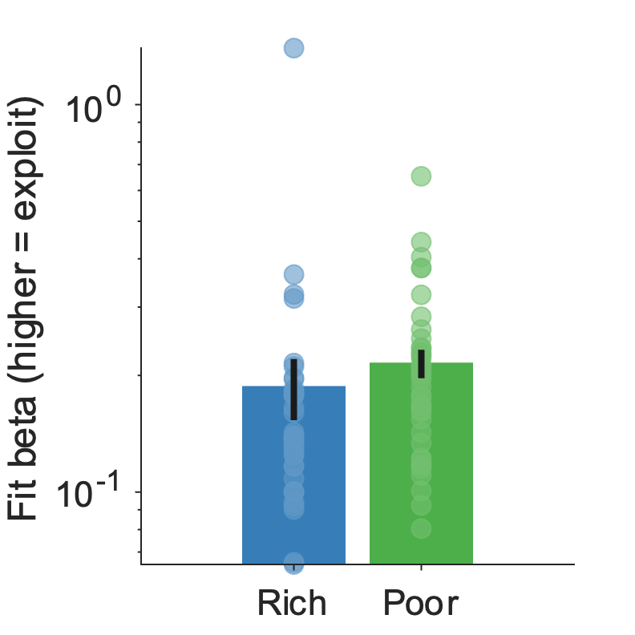
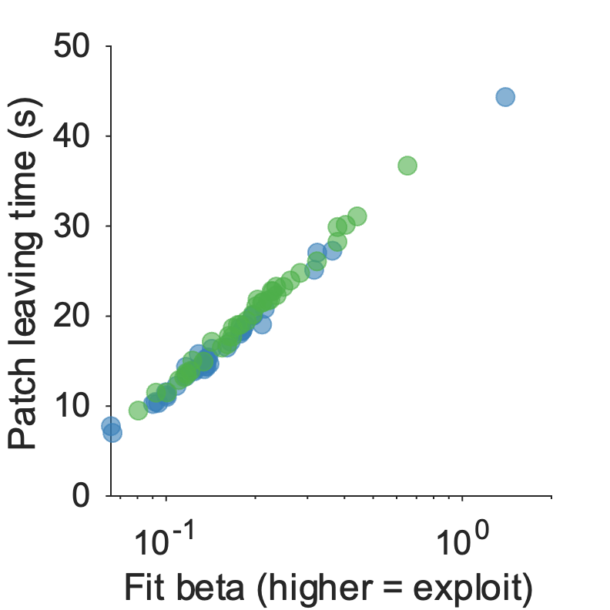
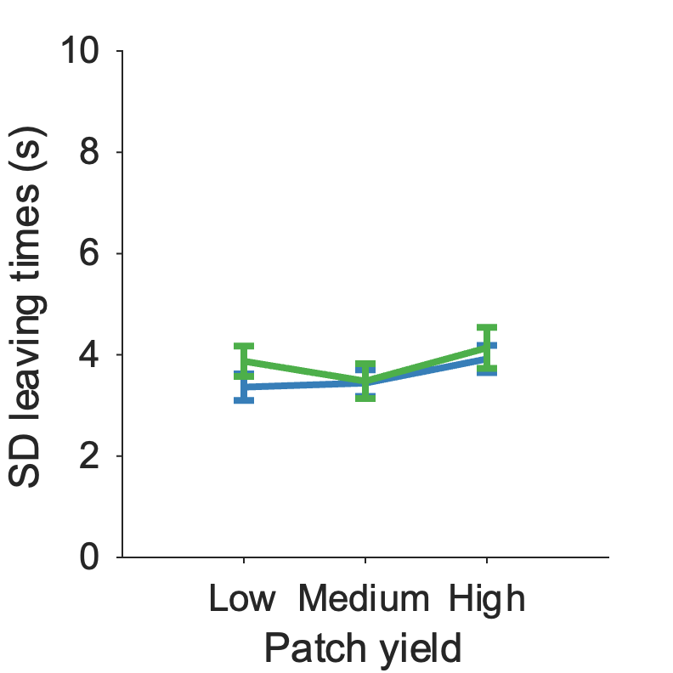
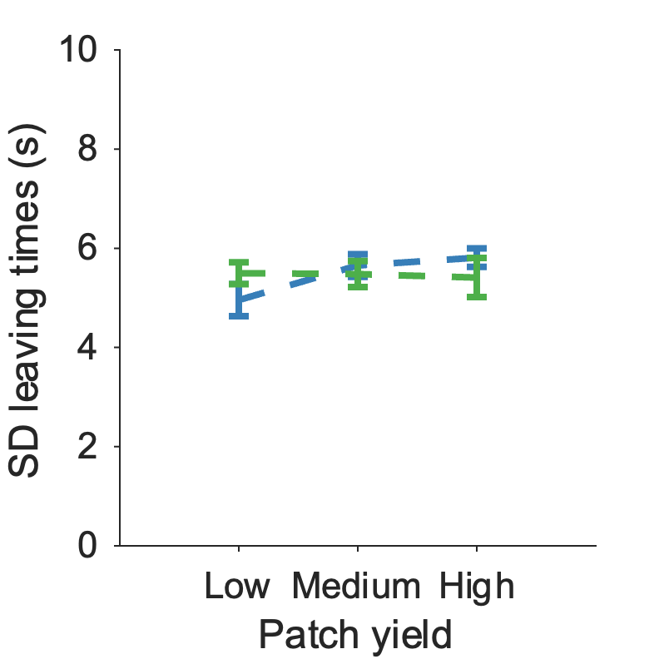
Figure 2: Le Heron fitting
a
b
c
d
e
f
g
h
***
i
j
ns
ns
a) Patch reward rate function for this task, with optimal AvgRR overlaid
b) Specific model predictions for this task – expected LT – with participant expected betas overlaid
c) Specific model predictions for this task – expected SD – with participant expected betas overlaid
d) BIC comparison of all models (softmax model is better than different choice policies and learning rules)
e) Participant leave times vs (f) simulated leave times from best model
g) Fit beta is significantly lower in rich compared to poor environment [t(38) = -5.0, p < .001]
h) Correlation of participant beta fits with participant mean leaving times across environments [r(76) = 0.99, p < .001]
i) SD of participants was not significantly different across patch, environment or interaction [Patch yield: F(2,228) = 1.77, p = 0.17; Environment: F(1,228) = 1.03, p = 0.31; Interaction: F(2,228) = 0.29, p = 0.75], as model predicts
(j) Consistent with participants, SD of simulated leaving times was not significantly different across patch, environment or interaction [Patch yield: F(2,228) = 1.13, p = 0.32; Environment: F(1,228) = 0, p = 0.96; Interaction: F(2,228) = 1.55, p = 0.21]

Slide 6
Supplementary Figure 2: Le Heron fitting
Parameter recovery for winning models (each dataset)
Reporting Pearson’s rho
 | Beta | Alpha rho | Lambda
M1 LeHeron rich | 0.996
M1 LeHeron poor | 0.995
M5 CH rich | 0.926 | 0.927
M5 CH poor | 0.707 | 0.97
M5 Kane rich | 0.872 | 0.964
M5 Kane poor | 0.941 | 0.929
M9 LeHeron |  |  | 0.961
M9 CH |  |  | 0.972
M9 Kane |  |  | 0.991
Model recovery matrix – to do

Slide 7
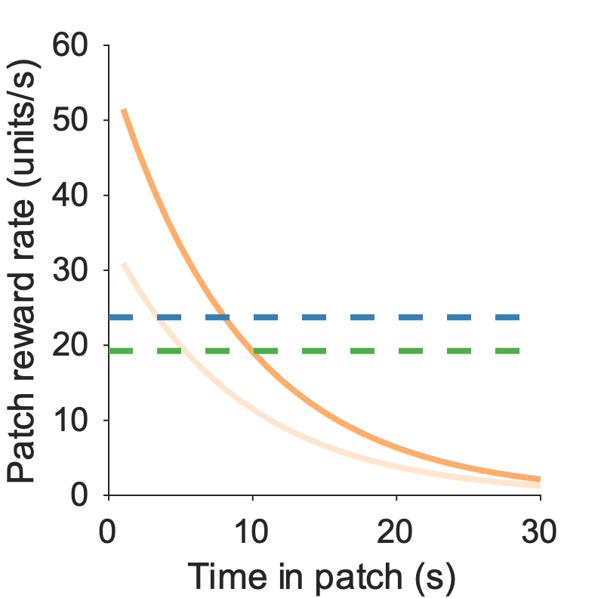
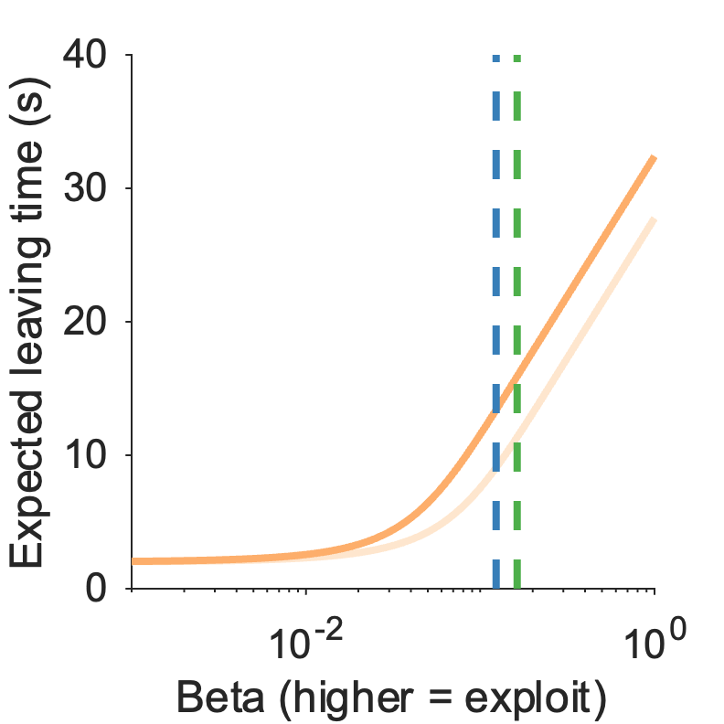
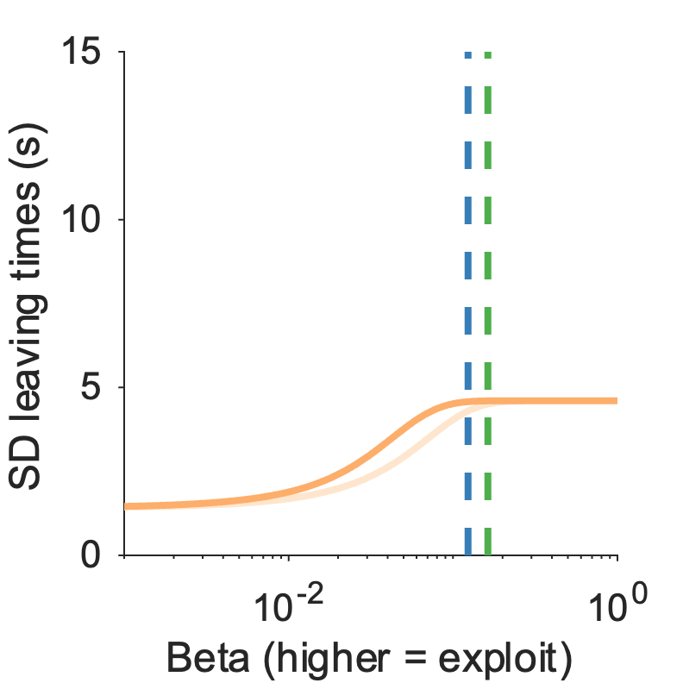
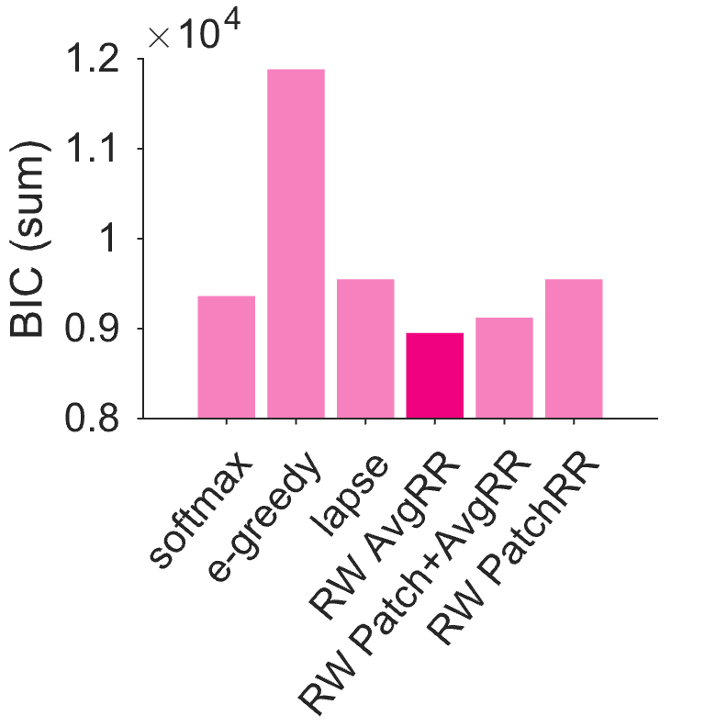
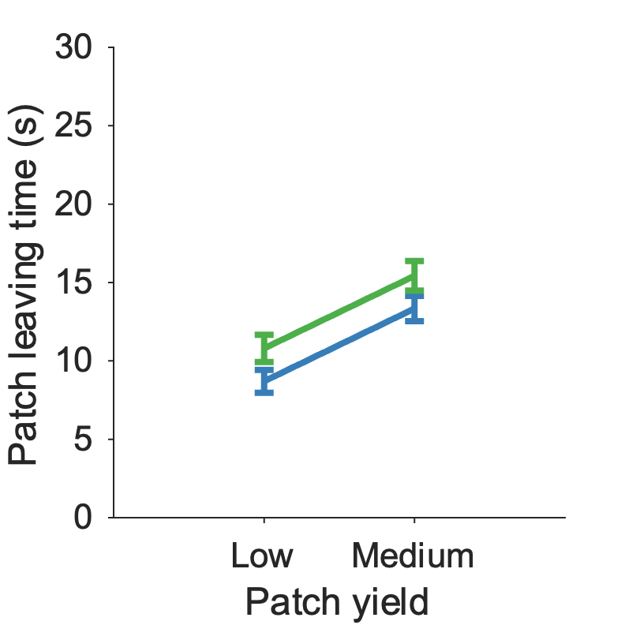
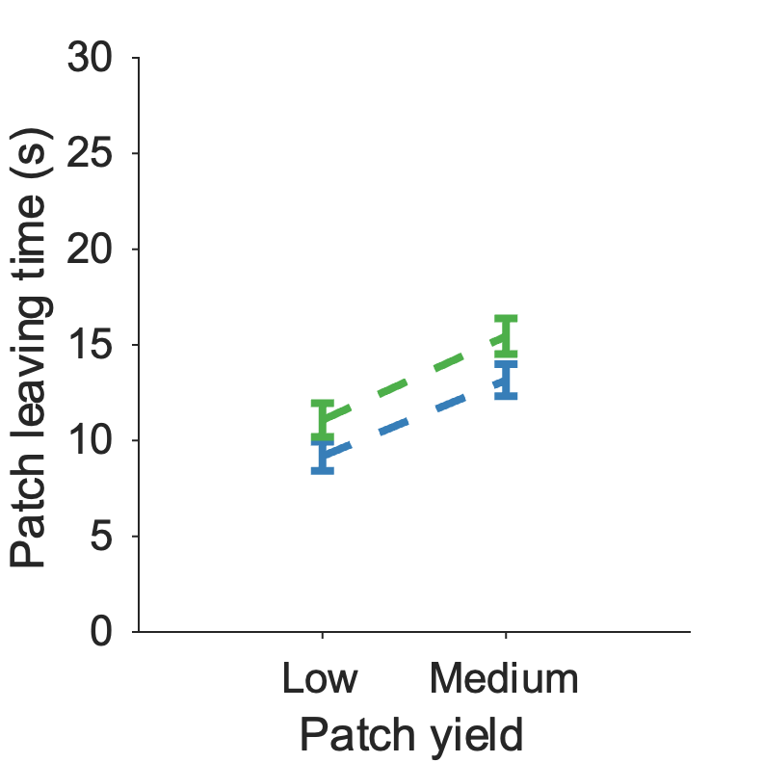
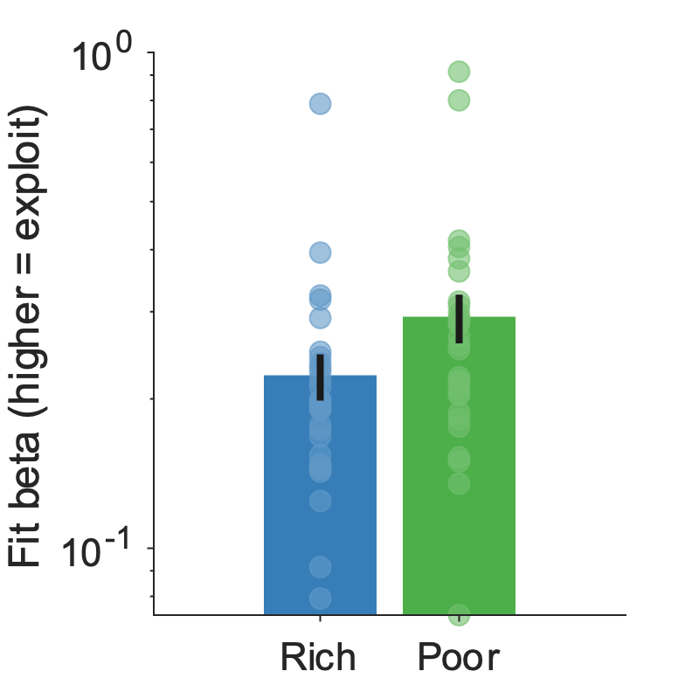
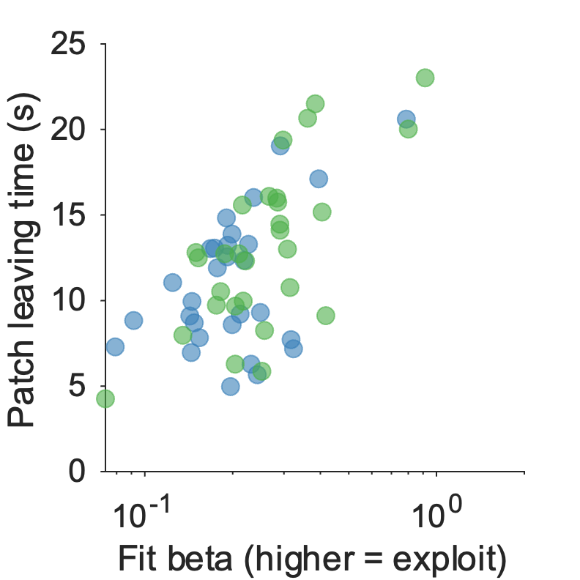
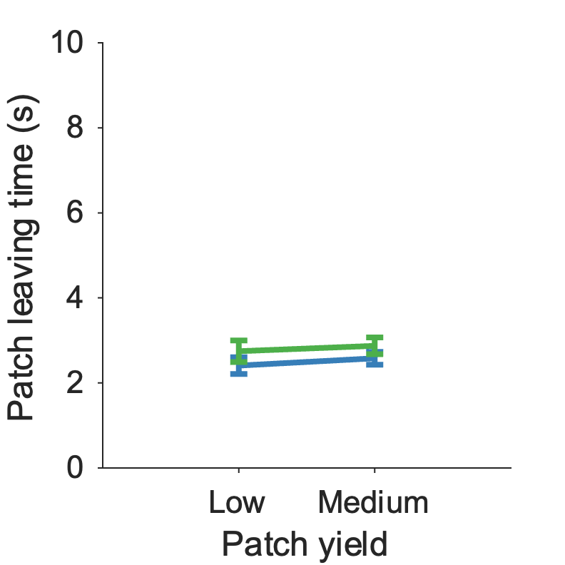
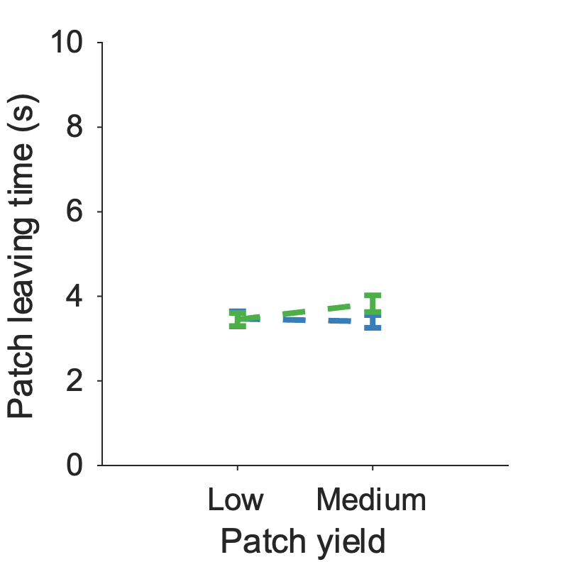
Figure 3: Contreras-Huerta fitting
a
b
c
d
e
f
g
h
**
i
j
ns
ns
a) Patch reward rate function for this task, with optimal AvgRR overlaid
b) Specific model predictions for this task – expected LT – with participant expected betas overlaid
c) Specific model predictions for this task – expected SD – with participant expected betas overlaid
d) BIC comparison of all models (softmax+avgRR learning model is best)
e) Participant leave times vs (f) simulated leave times from best model
g) Fit beta significantly lower in rich compared to poor environment [t(28) = -3.12, p = 0.004]
h) Correlation of participant beta fits with participant mean leaving times [r(56) = 0.64, p < .001]
i) SD of participants was not significantly different across patch, environment or interaction [Patch yield: F(1,112) = 0.53, p = 0.47; Environment: F(1,112) = 2.39, p = 0.13; Interaction: F(1,112) = 0.01, p = 0.91], as model predicts
(j) Consistent with participants, SD of simulated leaving times was not significantly different across patch, environment or interaction [Patch yield: F(1,112) = 0.83, p = 0.37; Environment: F(1,112) = 1.41, p = 0.24; Interaction: F(1,112) = 1.64, p = 0.20]

Slide 8
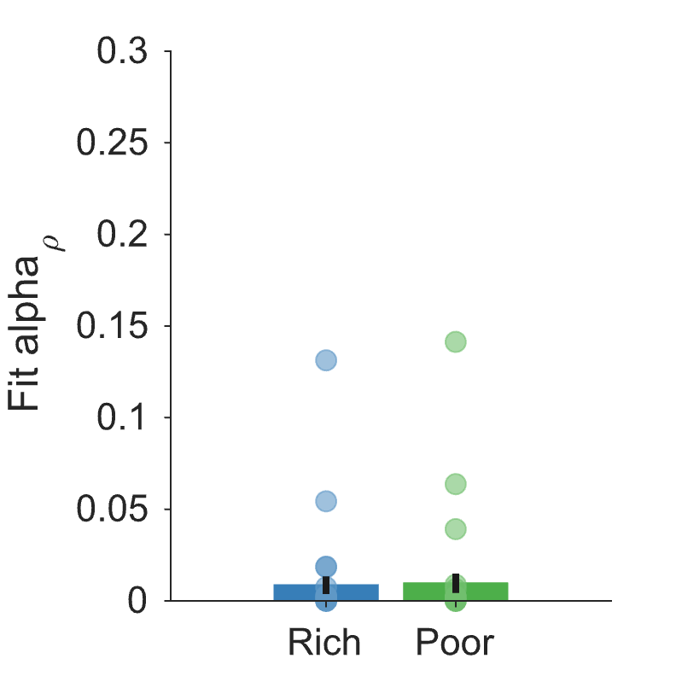
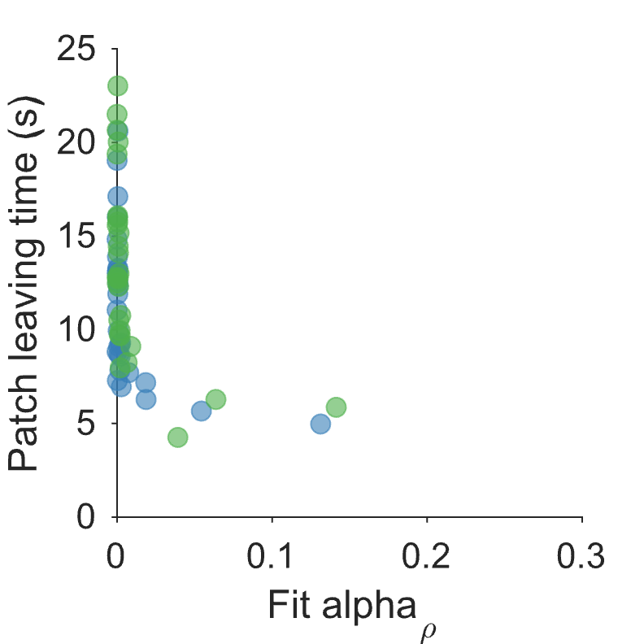
Supplementary Figure 3: Contreras-Huerta fitting
a
b
a) Learning rate fits for average reward rate is not significantly different between environments (Z = -0.4, p = 0.69).
b) Participant leaving times decrease as their fit learning rate increases [r(56) = -.73, p < .001, Spearman’s rho]. [[But this was driven by a few participants who had very short leaving times. Beta alone was unable to capture their early leaving behaviour, so they have a non-zero alpha value, which leads to a smaller PatchRR – avgRR difference entering the softmax equation, which leads to earlier leaving. ]]

Slide 9
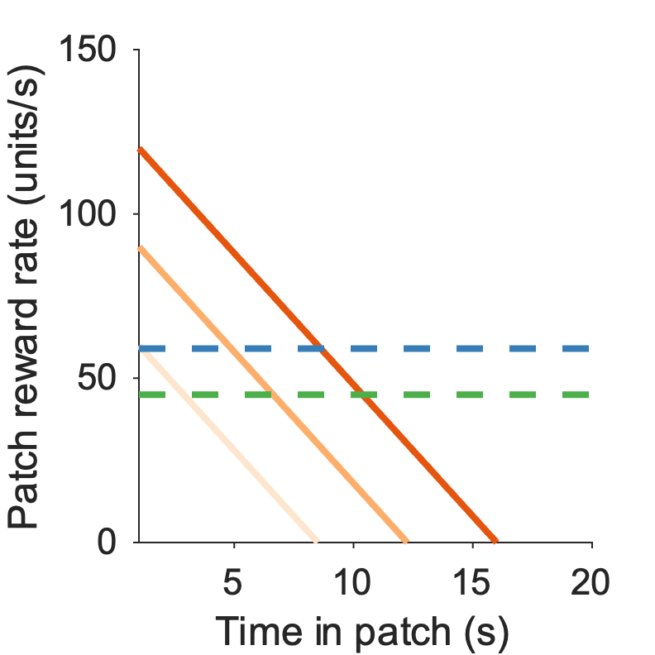
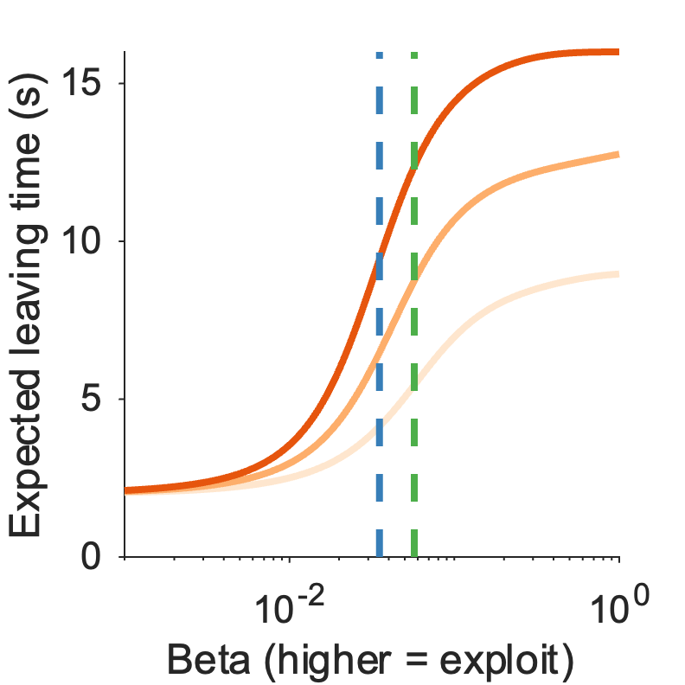
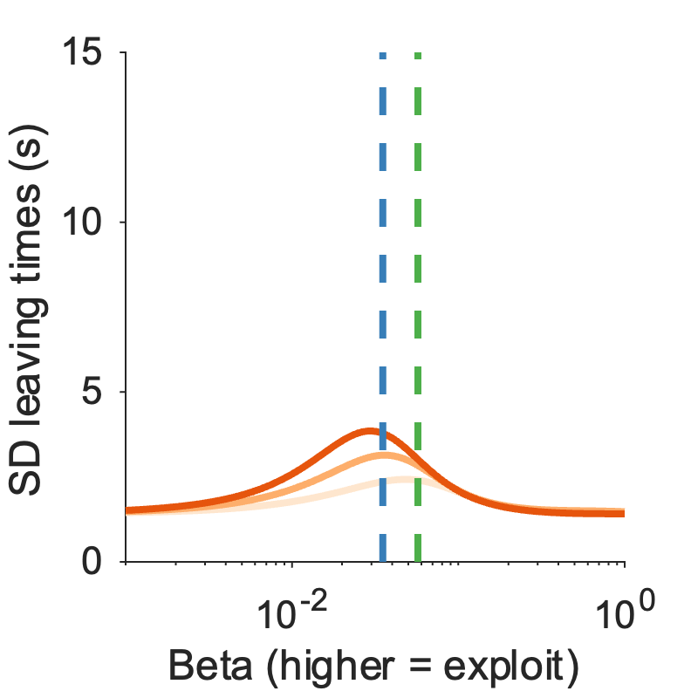
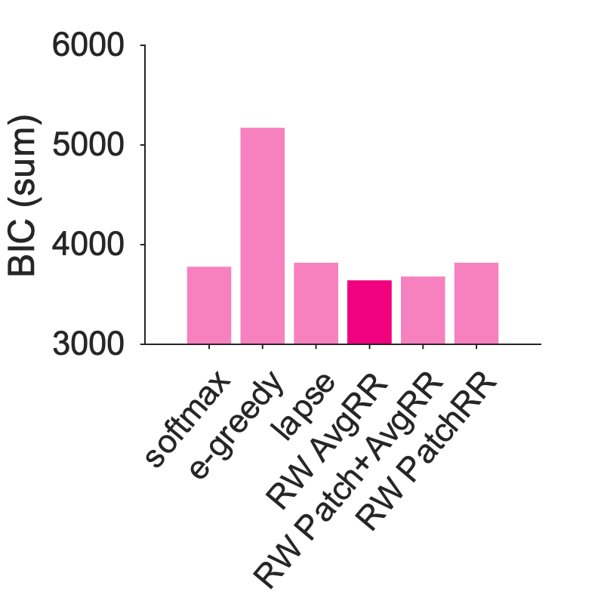
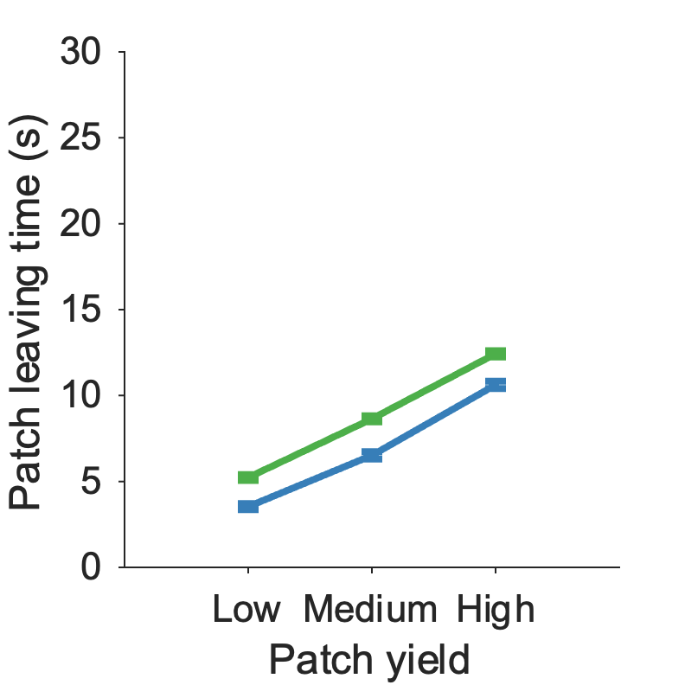
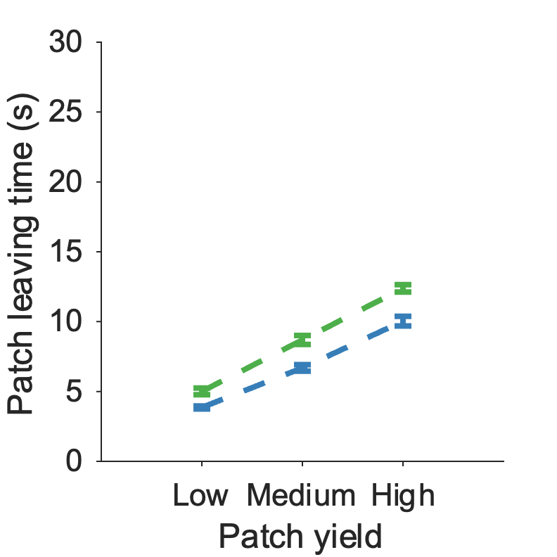
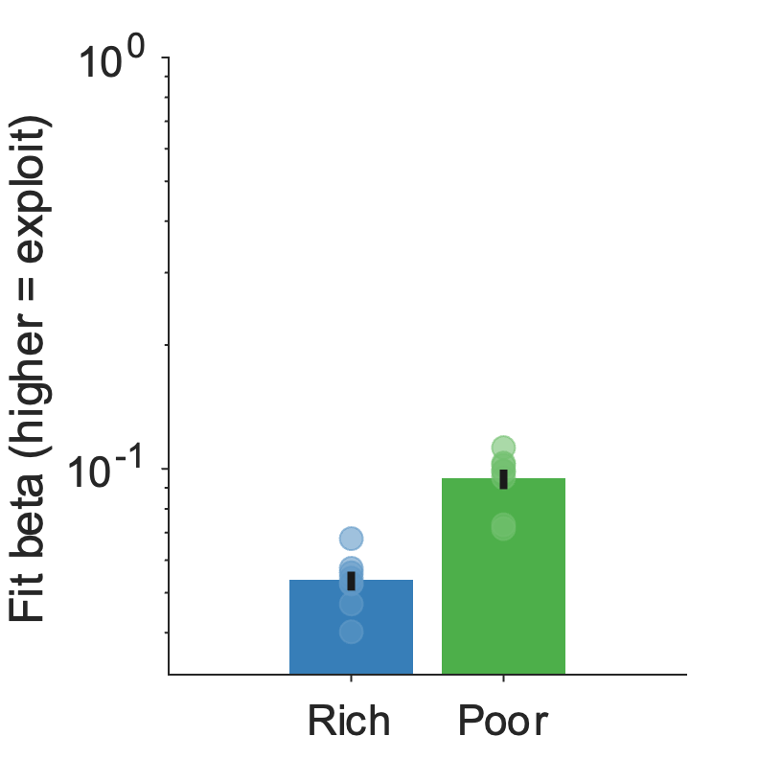
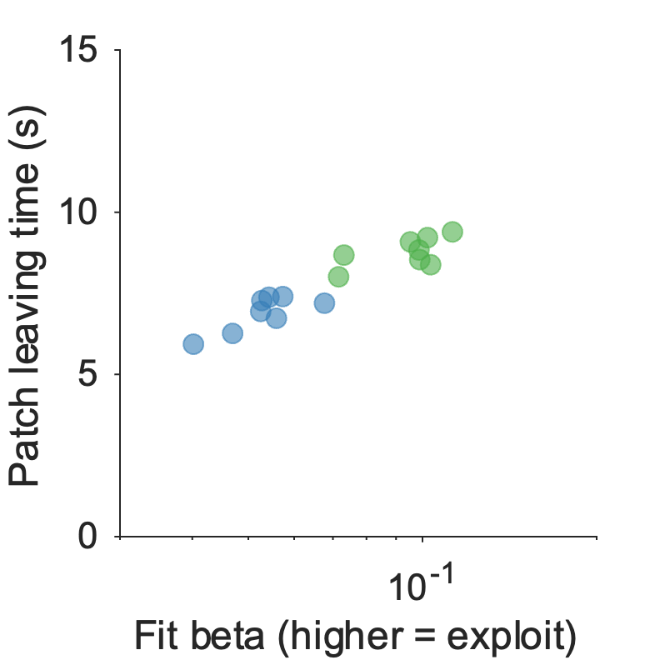
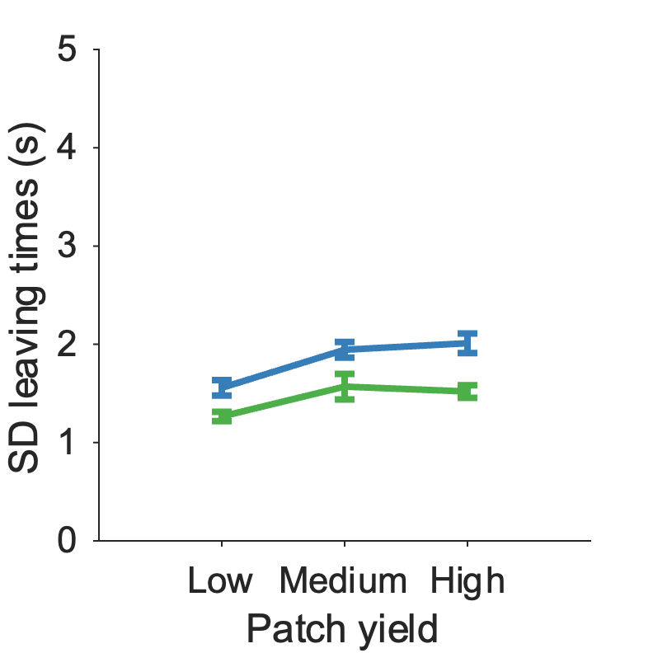
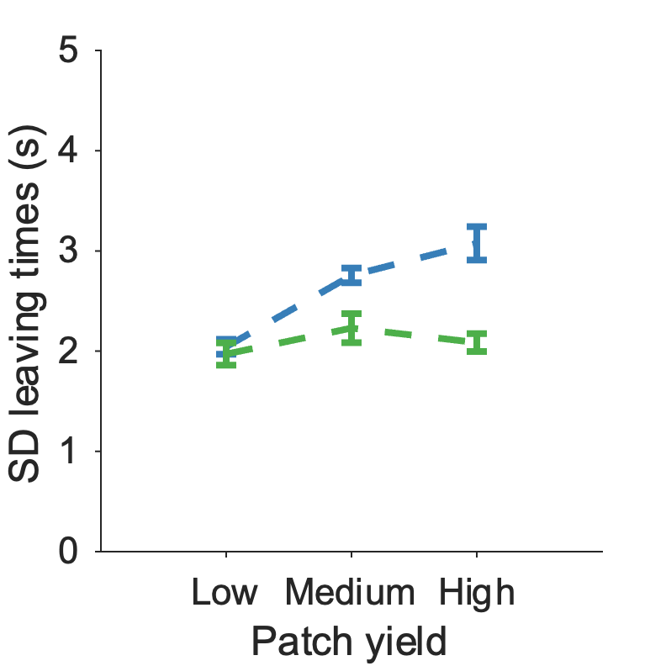
Figure 4: Kane fitting
a
b
c
d
e
f
g
h
***
i
j
***
***
a) Patch reward rate function for this task, with optimal AvgRR overlaid
b) Specific model predictions for this task – expected LT – with participant expected betas overlaid
c) Specific model predictions for this task – expected SD – with participant expected betas overlaid
d) BIC comparison of all models (softmax+avgRR learning model is best)
e) Participant leave times vs (f) simulated leave times from best model
g) Fit beta significantly lower in rich compared to poor environment [t(7) = -7.88, p < .001]
h) Correlation of participant beta fits with participant mean leaving times [r(14) = 0.94, p < .001].
i) SD of participants was significantly different for patch [Patch yield: F(2,42) = 10.76, p < .001] and environment [Environment: F(1,42) = 29.41, p < .001] but not for patch x environment interaction [Interaction: F(2,42) = 0.66, p = 0.52] (j) Consistent with participants, SD of simulated leaving times was significantly different across patch [Patch yield: F(2,42) = 14.4, p < .001], and environment [Environment: F(1,42) = 31.76, p < .001] , but predicted significant patch x environment interaction [Interaction: F(2,42) = 7.96, p = .001], which was not observed in participant data

Slide 10
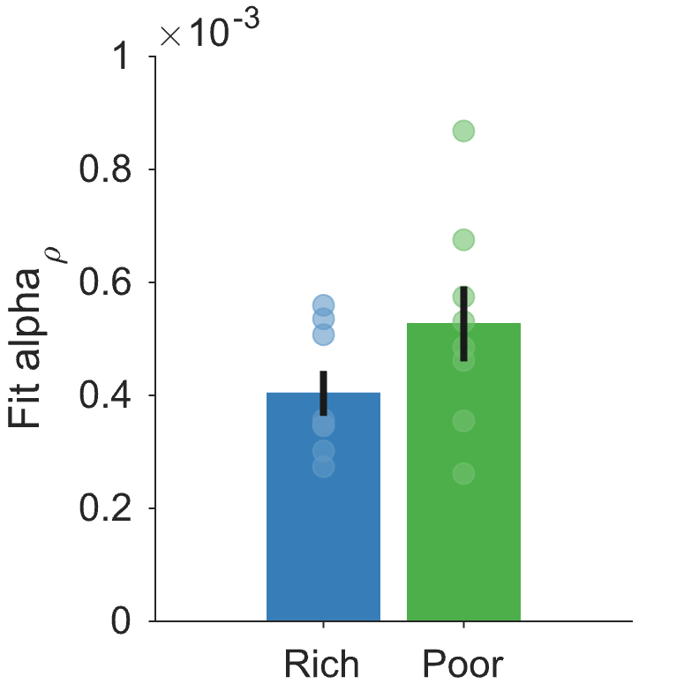
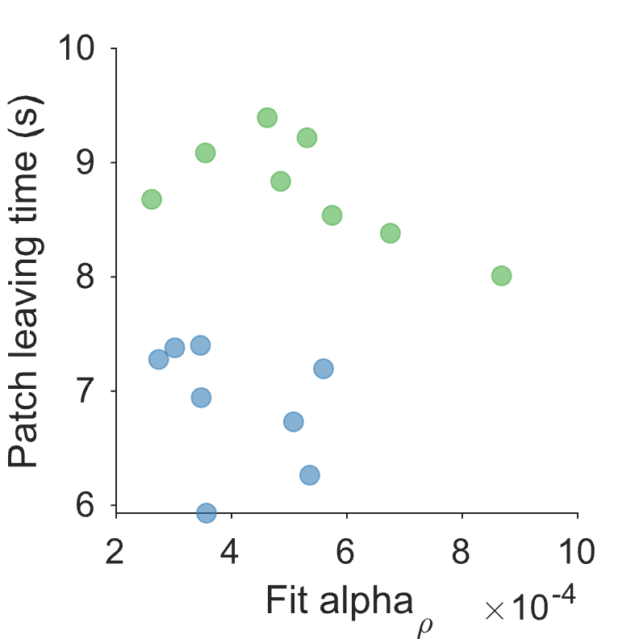
Supplementary Figure 4: Kane fitting
a
b
a) Fit alpha rho is not significantly different between environments [t(11.4) = -1.59, p = 0.14]. [Welch t-test due to unequal variance].
b) Participant leaving times are not significantly correlated with their fit alpha rho [r(14) = .03, p = 0.93] [Spearman’s rho]

Slide 11
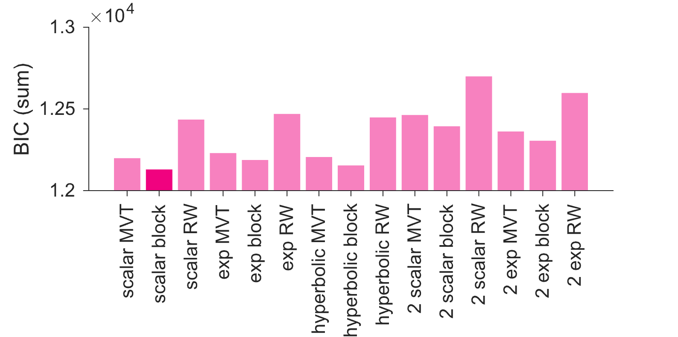
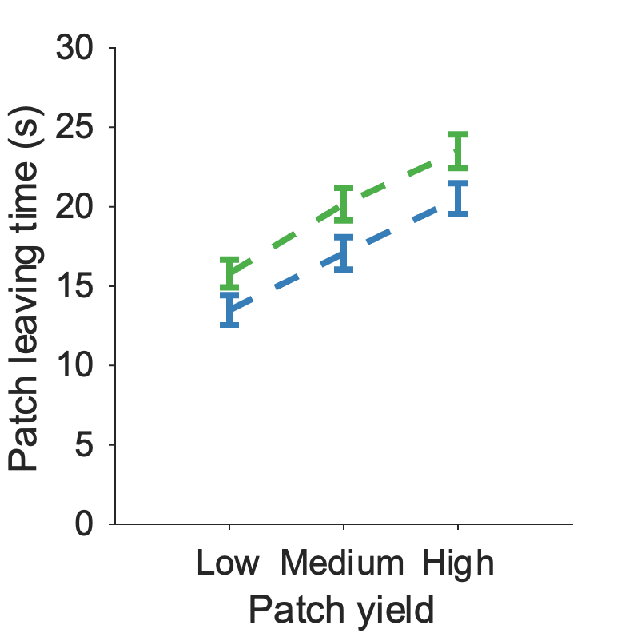
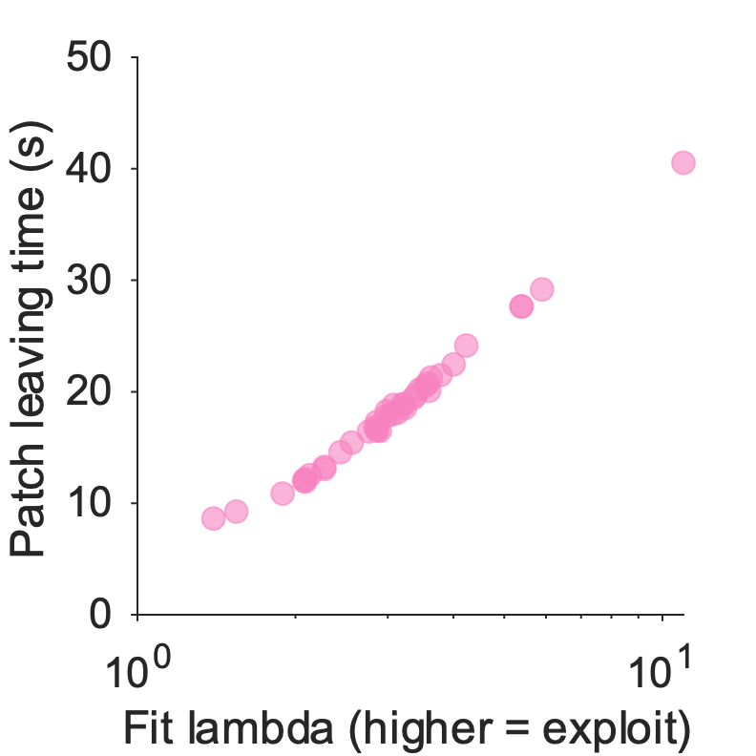
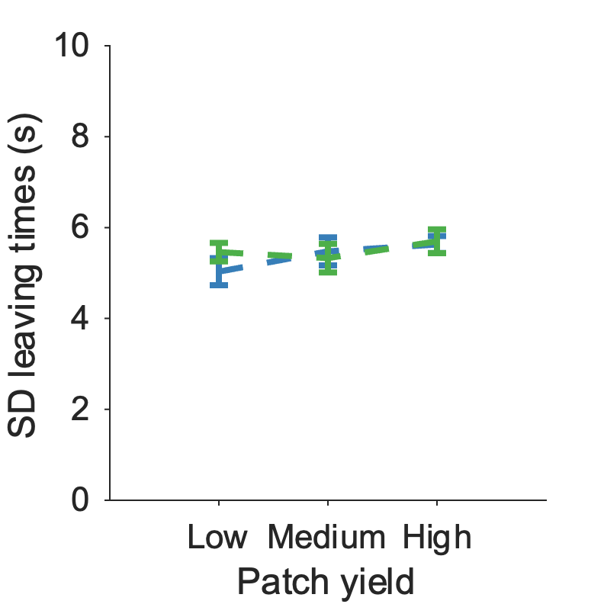
Figure 5: Mechanism – avgRR functions
a
b
c
d
e
f
ns
ns
BIC comparison of how beta arises from averageRR – simplest scalar model with one parameter wins, when using their real experienced average reward rate in each block.
Participant leave times vs (c) model simulated leaving times
d) Correlation of participant lambda fits with participant mean leaving times [r(37) = 0.99, p < .001].
e) SD of participants was not significantly different across patch, environment or interaction (statistics reported in Fig 2)
f) Consistent with participants, SD of simulated leaving times was not significantly different across patch, environment or interaction [Patch yield: F(2,228) = 1.24, p = 0.29; Environment: F(1,228) = 0.29, p = 0.59; Interaction: F(2,228) = 0.60, p = 0.55].

Slide 12






Supplementary Figure 5: Mechanism – avgRR functions
a
b
c
d
e
f
BIC comparison of all avgRR functions for Contreras-Huerta dataset – same simple model wins.
BIC comparison of all avgRR functions for Kane dataset – same simple model wins.
For winning function, both simulated leaving times and (d) standard deviations looks like participant data for Contreras-Huerta dataset
e) For winning function, simulated leaving times look like participant data for Kane dataset but f) standard deviation doesn’t replicate (as we saw with the softmax model in Fig 4 anyway)

