Slide 1
G.O.A.T DRIVER DEBUT
PROJECT BY :- NDUATI GITHU
MODULE :- GEN DATA ANALYSIS

Slide 2
problem statment
How is the greatest Formula 1 driver based on the dataset.

Slide 3
📂 Tables and Columns
1. seasons
year (INTEGER)
url (TEXT)
2. circuits
circuitid (INTEGER)
circuitref (TEXT)
name (TEXT)
location (TEXT)
country (TEXT)
lat (REAL)
lng (REAL)
alt (INTEGER)
url (TEXT)
3. constructors
constructorid (INTEGER)
constructorref (TEXT)
name (TEXT)
nationality (TEXT)
url (TEXT)
4. drivers
driverid (INTEGER)
driverref (TEXT)
number (TEXT)
code (TEXT)
forename (TEXT)
surname (TEXT)
dob (TEXT)
nationality (TEXT)
url (TEXT)
5. status
statusid (INTEGER)
status (TEXT)
6. races
raceid (INTEGER)
year (INTEGER)
round (INTEGER)
circuitid (INTEGER)
name (TEXT)
date (TEXT)
time (TEXT)
url (TEXT)
fp1_date / fp1_time (TEXT)
fp2_date / fp2_time (TEXT)
fp3_date / fp3_time (TEXT)
quali_date / quali_time (TEXT)
sprint_date / sprint_time (TEXT)
7. results
resultid (INTEGER)
raceid (INTEGER)
driverid (INTEGER)
constructorid (INTEGER)
number (TEXT)
grid (INTEGER)
position (TEXT)
positiontext (TEXT)
positionorder (INTEGER)
points (REAL)
laps (INTEGER)
time (TEXT)
milliseconds (TEXT)
fastestlap (TEXT)
rankorder (TEXT)
fastestlaptime (TEXT)
fastestlapspeed (TEXT)
statusid (INTEGER)
8. sprint_results
(similar to results, but for sprint races)
resultid, raceid, driverid, constructorid, number, grid, position, points, laps, time, fastestlap, etc.
9. qualifying
qualifyid (INTEGER)
raceid (INTEGER)
driverid (INTEGER)
constructorid (INTEGER)
number (INTEGER)
position (INTEGER)
q1 / q2 / q3 (TEXT)
10. pit_stops
raceid (INTEGER)
driverid (INTEGER)
stop (INTEGER)
lap (INTEGER)
time (TEXT)
duration (TEXT)
milliseconds (INTEGER)
11. lap_times
raceid (INTEGER)
driverid (INTEGER)
lap (INTEGER)
position (INTEGER)
time (TEXT)
milliseconds (INTEGER)
12. driver_standings
driverstandingsid (INTEGER)
raceid (INTEGER)
driverid (INTEGER)
points (REAL)
position (TEXT)
positiontext (TEXT)
wins (INTEGER)
13. constructor_results
constructorresultsid (INTEGER)
raceid (INTEGER)
constructorid (INTEGER)
points (REAL)
status (TEXT)
14. constructor_standings
constructorstandingsid (INTEGER)
raceid (INTEGER)
constructorid (INTEGER)
points (REAL)
position (INTEGER)
positiontext (TEXT)
wins (INTEGER)

Slide 4
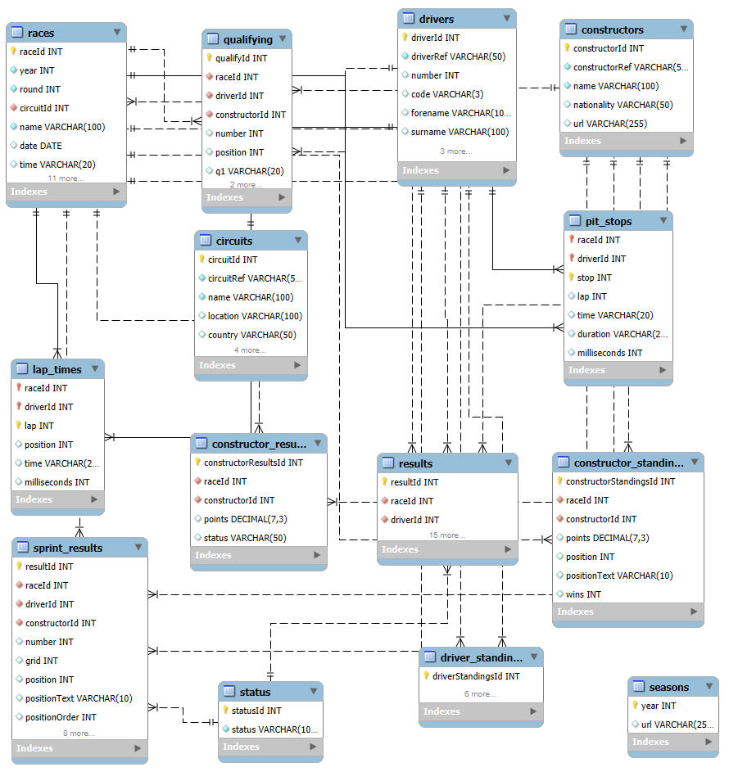
ERD DIAGRAM

Slide 5
DATA PIPELINE AND CLEANING PROCESS
After creating the database and populating it with the required data
I parsed the database to power query so as I could do abit of data cleaning .
After cleaning the database , I saved it to F1_data.csv which will be easier to query and loaded it to tableau.

Slide 6
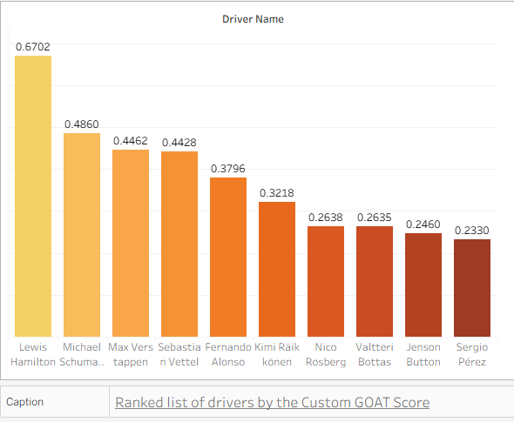
Lewis Hamilton is the G.O.A.T Driver

Slide 7
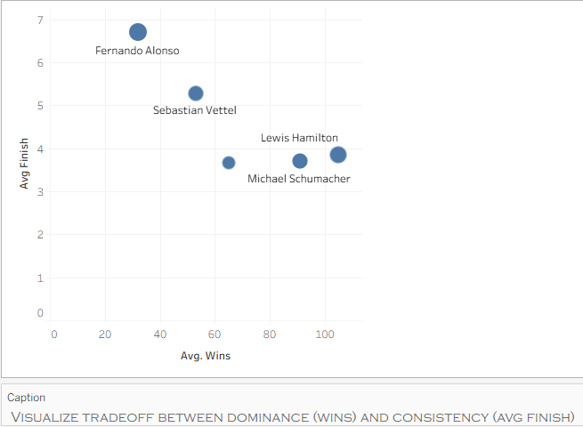
-Hamilton has won a joint-record seven Formula One World Drivers' Championship titles tied with Michael Schumacher and holds the records for most wins (105), pole positions (104), and podium finishes (202)

Slide 8
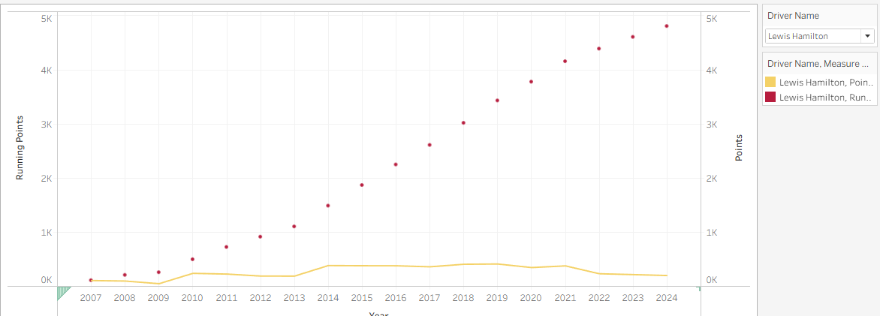
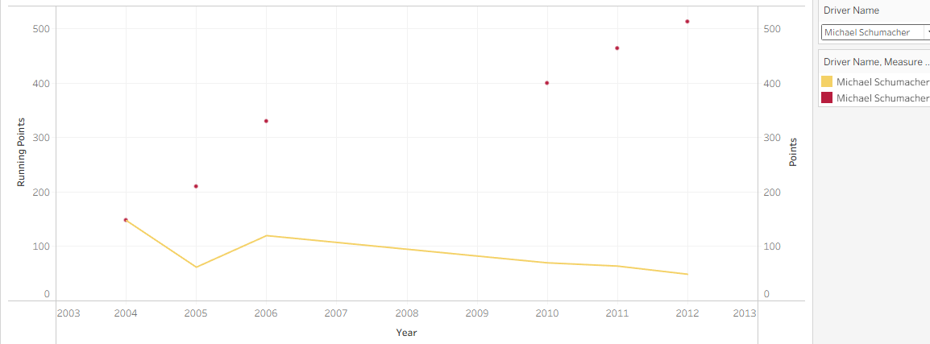
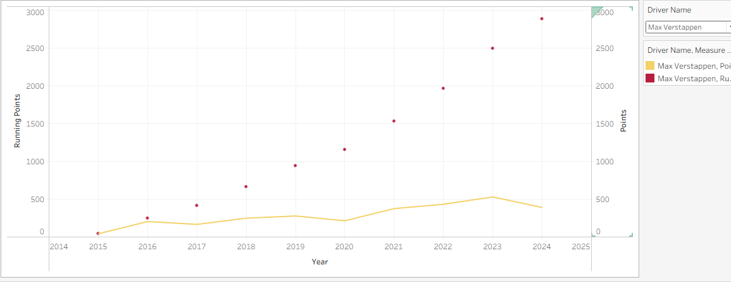
DRIVER PROGRESSION OVER THE YEARS FOR THE TOP 3 DRIVERS BASED ON POINTS

Slide 9
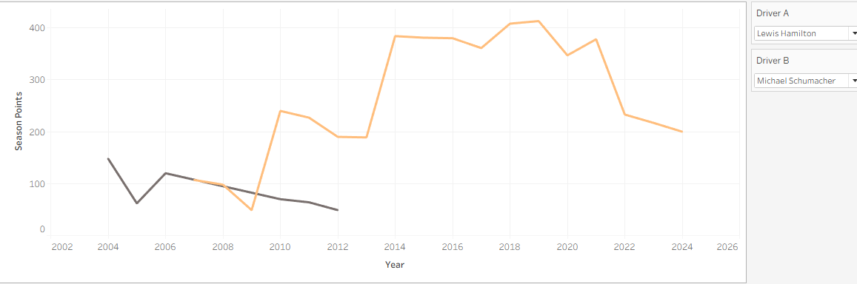
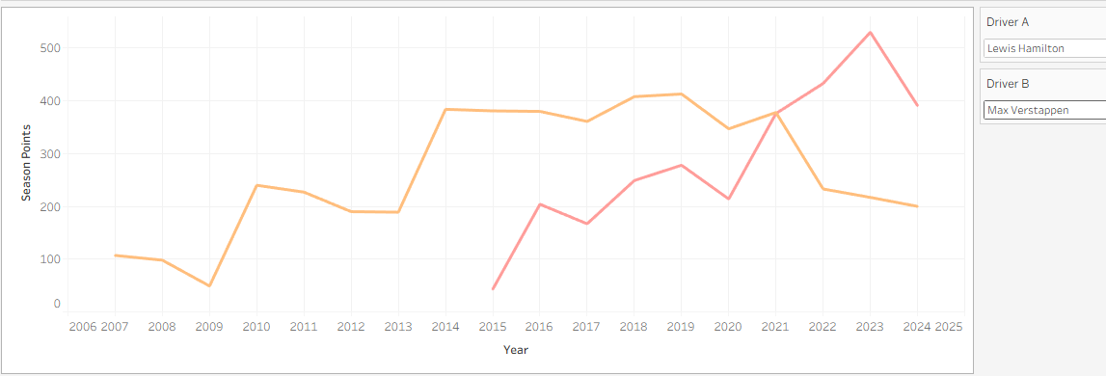
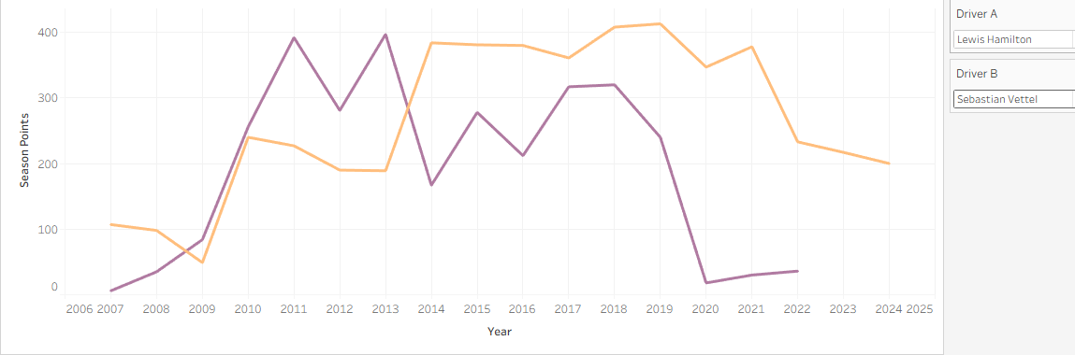
SEASON POINTS COMPERSION BETWEEN HAMILTON VS TOP 3 DRIVER

Slide 10
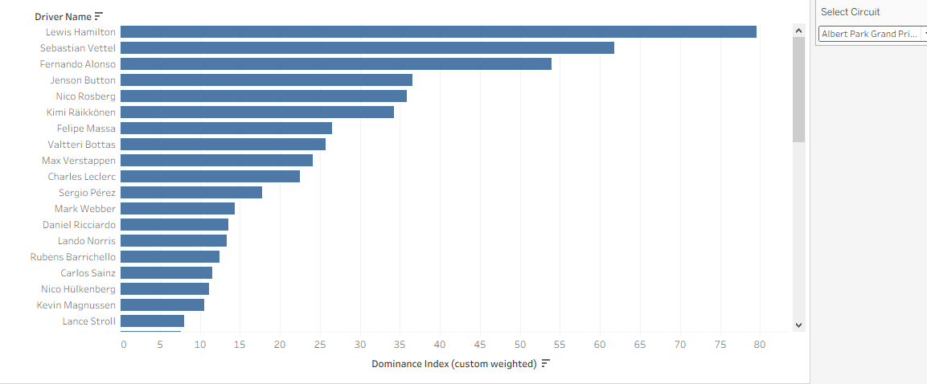
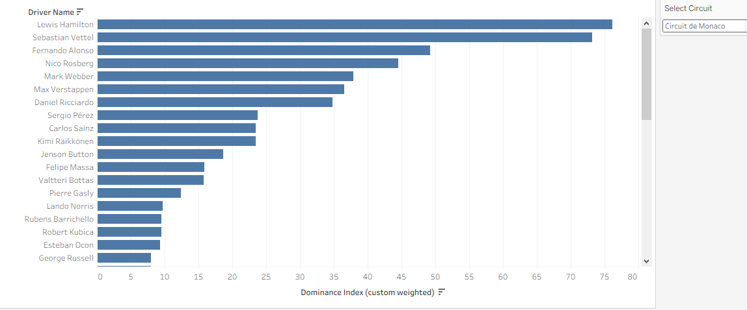
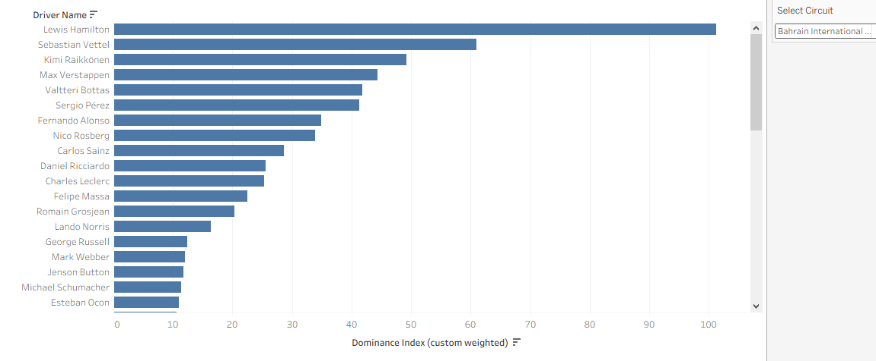
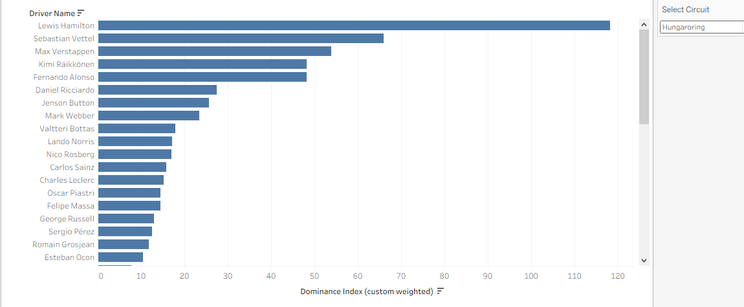
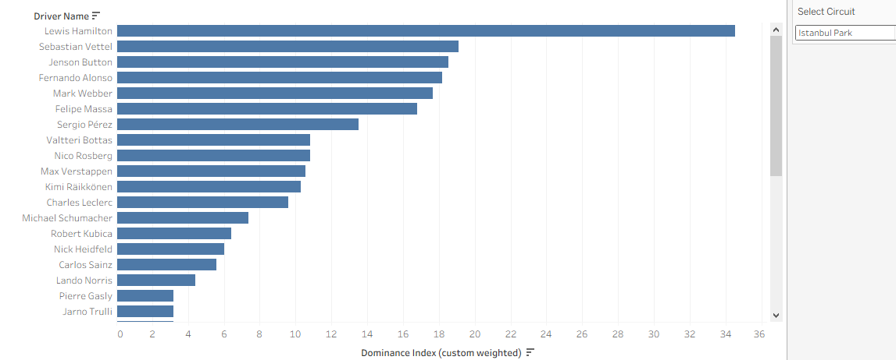
A COMPARISSON OF DRIVER DOMINANCE BASED OF CIRCUITS

