Slide 1

TEMPORAL & VOLATILITY ANALYSIS OF THE CRYPTOCURRENCY MARKET
PROJECT PRESENTATION BY : NDUATI GITHU

Slide 2
Methods / Tools used — Tech stack
Language & Libraries used include :- python, numpy, seaborn, matplotlibs, scripy and APIs (CoinCommon, Coingecko)
Pipeline steps :-
1. Load and clean data
- Parse timestamps to pandas datetime
- Sort by coin and timestamp
- Coerce numeric columns (price, volume, market_cap, circulating_supply) to numeric types
- Drop rows with critical missing values (price, timestamp, coin)
2. Feature engineering
- Hour of day, day of week
- Hourly returns: return_t = price_t / price_t-1 - 1
- Log returns where relevant
3. Intraday patterns / Hourly Trends (Question 1)
- Compute average daily volume to identify top 5 & bottom 5 coins
- Compute best trades for top 5 * bottom 5 coins
- Create comprehensive visualizations & plots
4. Stable coins vs. Volatile price movements (Question 2)
- Compute daily price range & volatility for identification of stable & volatile coins
- Compute volatility comparison
- Compute price movement patterns
- Compute daily volatility patterns
- Compute volatility distribution
5. Price Spikes Analysis (Question 3)
- Compute volume analysis
- Compute spike detection
- Compute hourly spikes
- Compute spike magnitutdes
- Compute spike direction
- Compute time categories

Slide 3
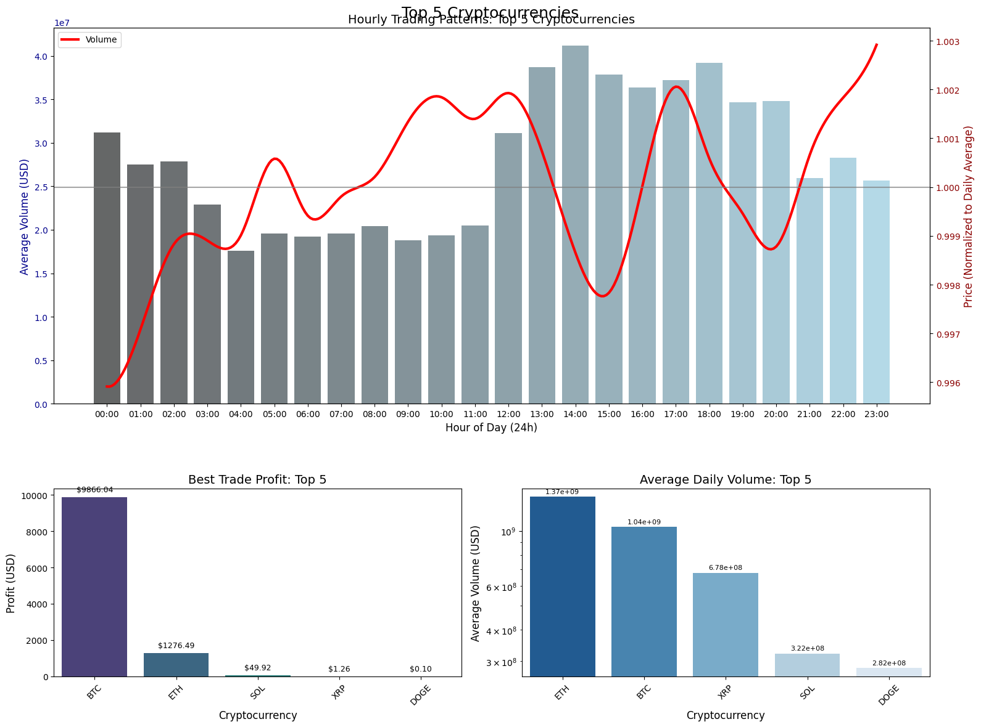
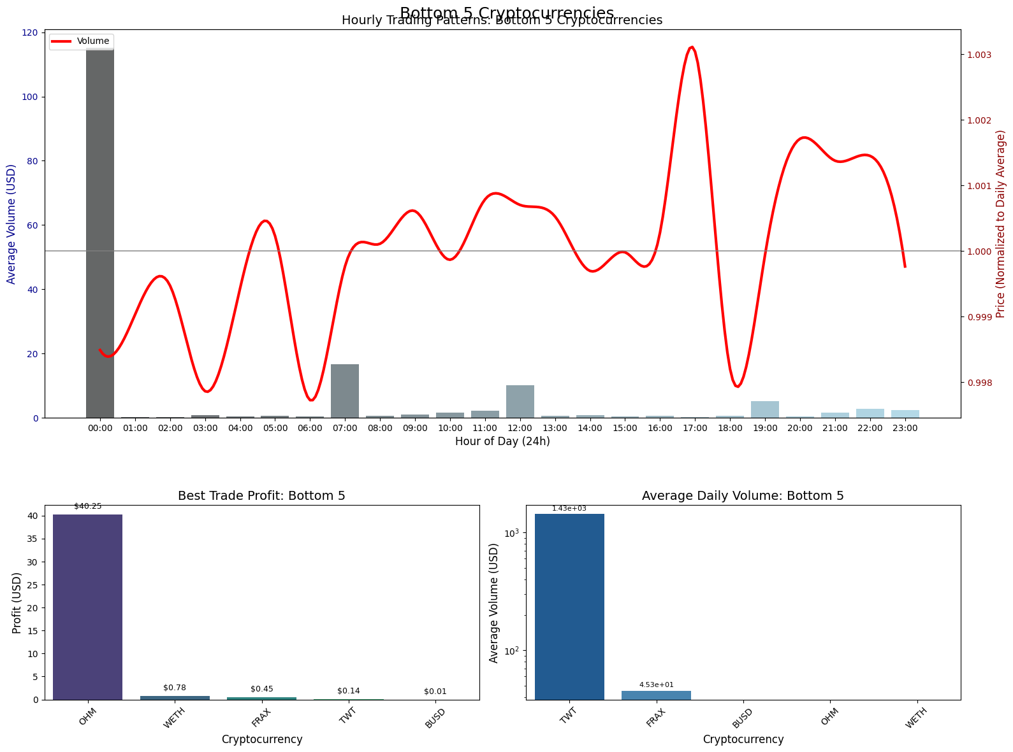
Volume peaks during 12 PM to 2 PM, suggesting higher liquidity and activity during those hours. The price spikes in the early morning (3-5 AM) might indicate news-driven movements. The correlation between volume and price isn't straightforward; sometimes high volume coincides with price increases, other times not. This could mean that price movements are influenced by factors beyond just trading volume.
The price exhibits significant volatility, peaking around 5 PM (17:00) and 8 PM (20:00), suggesting active trading or news-driven movements during these times. The midnight (00:00) volume spike lacks corresponding price movement, indicating potential algorithmic or batch trading without immediate price impact.
Institutional traders may prioritize BTC/ETH for scalable profit opportunities.
Retail traders might target SOL/XRP for speculative bets, though with lower reward potential.
Traders must weigh OHM’s high-profit potential against its illiquidity versus TWT’s stable volume but modest returns

Slide 4
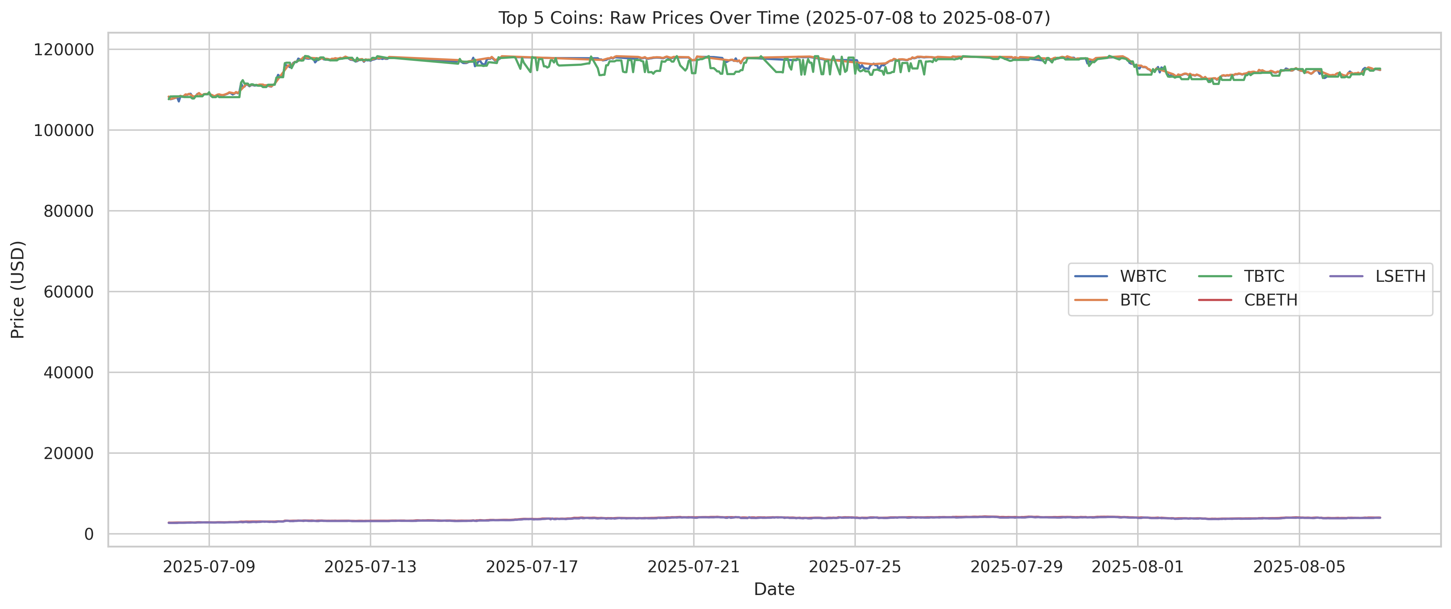
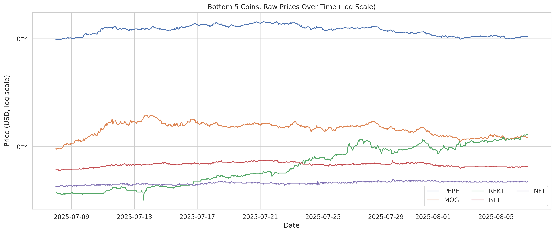
BTC, XRP, DOGE, SOL, and ETH moved similarly, peaking around mid-July (~$120k for BTC variants).
XRP and DOGE led gains (30%+ weekly) in early July, while BTC and ETH had steadier growth.
All top coins dropped after July 14, with SOL and ETH falling hardest (-20%+ by late July).
DOGE outperformed slightly, ending with a small gain.
FRAX and OHM showed explosive growth (over 25% weekly gains) in early July, peaking on July
TWT and BUSD were relatively stable but declined sharply (-10% to -20%) by late July.
WETH had moderate gains early on but stabilized later.
PEPE started highest but declined steadily.
REKT and MOG rose initially but became highly volatile.
NFT remained the lowest-priced coin with erratic fluctuations.

Slide 5
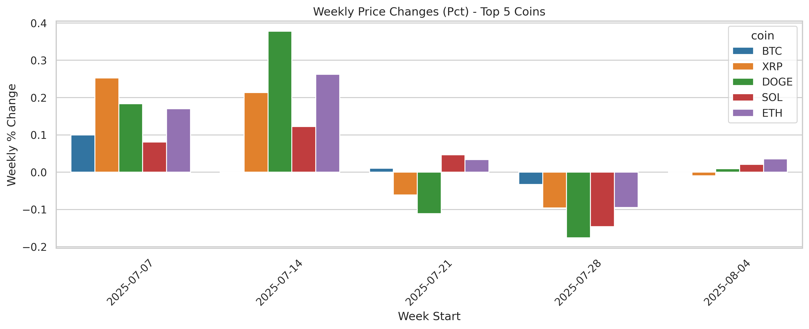
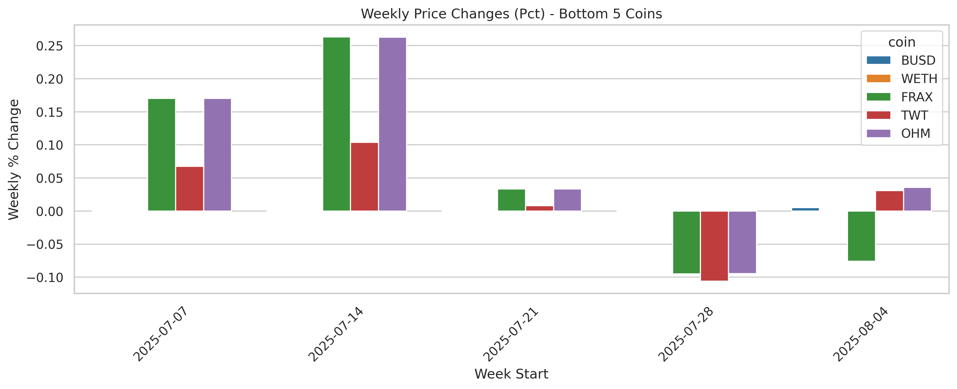
XRP and DOGE drove initial momentum but corrected heavily.
BTC and ETH showed resilience compared to smaller coins but still faced declines.
FRAX and OHM dominated growth in early weeks but crashed later.
TWT and BUSD turned negative after July 21, reflecting broader market weakness.
Early-week speculation fueled low-cap coins (e.g., FRAX, OHM), while high-caps led mainstream adoption.
Low-cap coins (e.g., FRAX, OHM) offered high rewards but extreme risk.
High-cap coins (e.g., BTC, ETH) provided steadier returns but still faced systemic risks.
Low-cap coins (e.g., FRAX, OHM) act as speculative vehicles, offering massive gains but requiring careful timing and risk management.
High-cap coins (e.g., BTC, ETH) serve as core holdings, providing exposure to the broader market but still vulnerable to macroeconomic shocks.
If I were an investor I would balance speculative bets i.e low capitalization coins with core positions i.e high capitalization coins.
Top 5 weekly gains:
coin week_start pct_change
96 B 2025-07-14 inf
801 USDF 2025-07-14 inf
586 PUMP 2025-07-14 inf
176 CFX 2025-07-14 1.176241
560 PENGU 2025-07-07 1.023601
Top 5 weekly losses:
coin week_start pct_change
743 TKX 2025-07-28 -0.483109
741 TKX 2025-07-14 -0.460087
587 PUMP 2025-07-21 -0.380179
298 FARTCOIN 2025-07-28 -0.321580
228 DEEP 2025-07-28 -0.303308

Slide 6
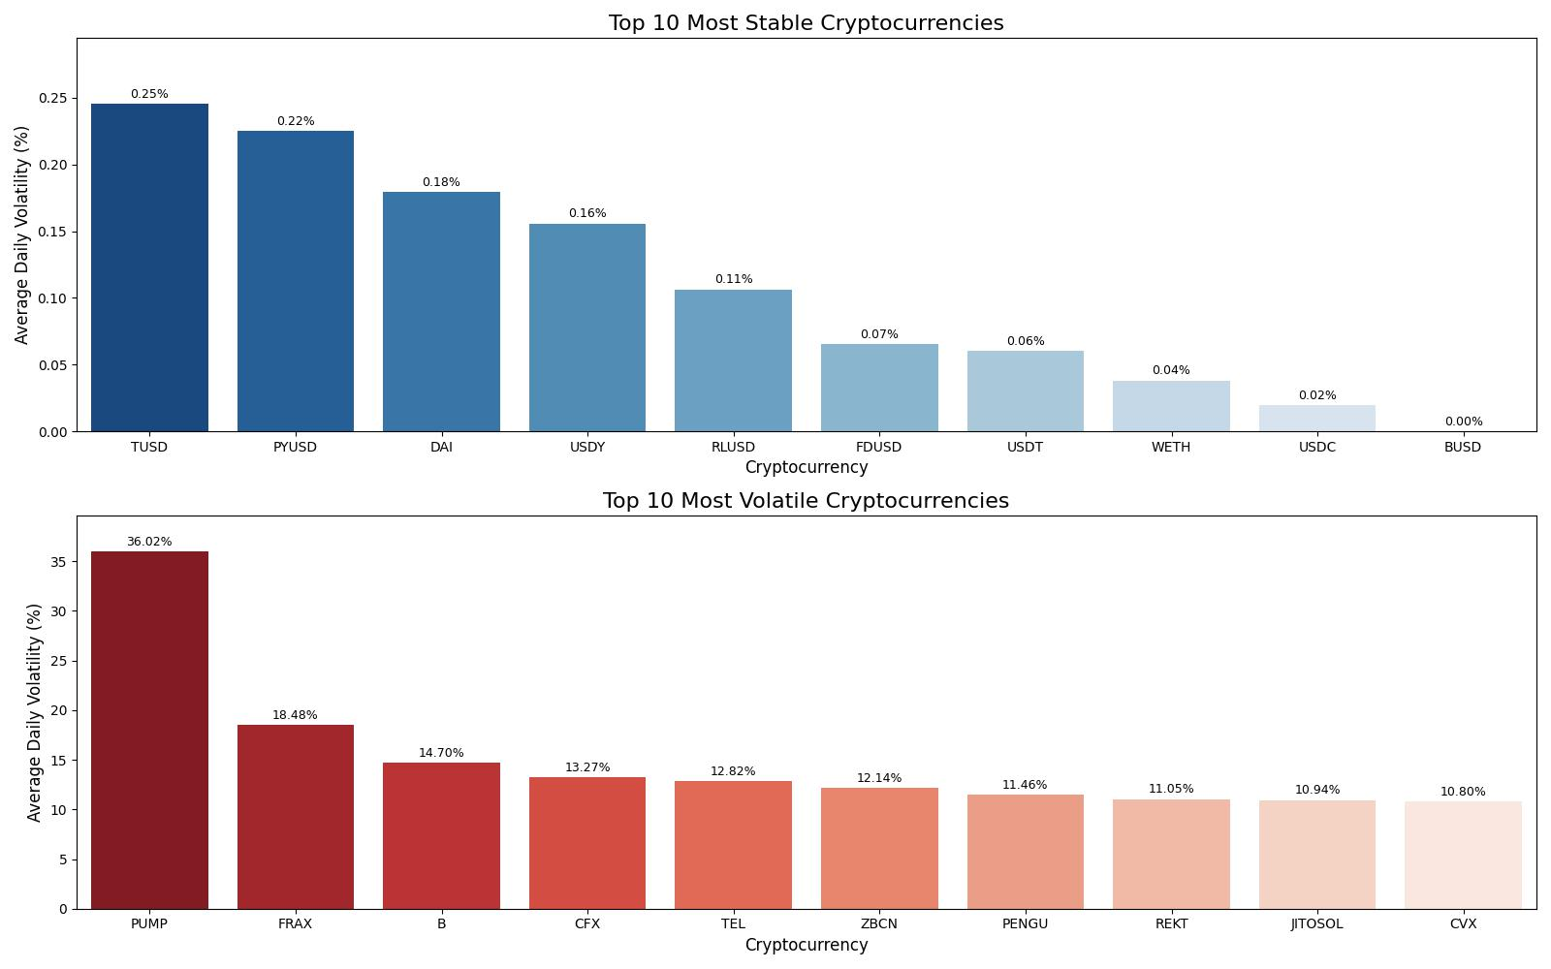
Through a little bit of research we can see that coins with deeper order books and larger, more stable market capitalization tend to have a lower realized volatility, coins with thin order books and low volume usually amplify price impacts thus increasing realized volatility.

Slide 7
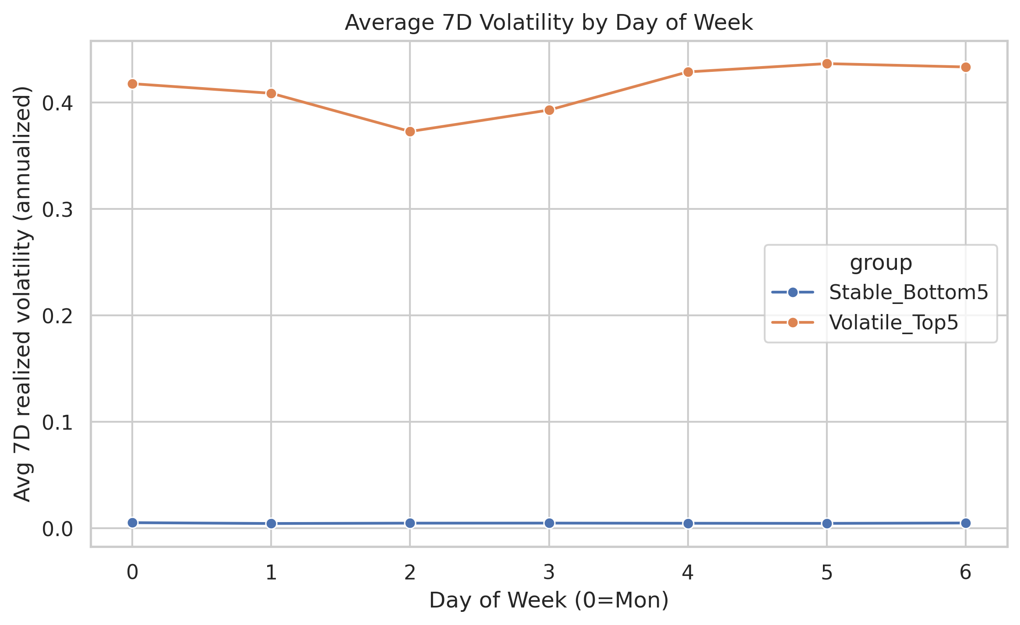
We can see that there is a seasonality where the volatility cohort remains above the stable cohort throughout the week.
Through a little bit of research we can see that there is a higher realized vol around Monday / Tuesday due to what we call (post-weekend catch-up) and around major event days; weekends can be bimodal (quiet or very spiky depending on catalysts i.e Liquidity and market depth, event-driven or speculative narratives (protocol upgrades, listings, regulatory headlines) .
Avoid Top 5 coins on weekends for risk-averse traders; Bottom 5 are consistently safe

Slide 8
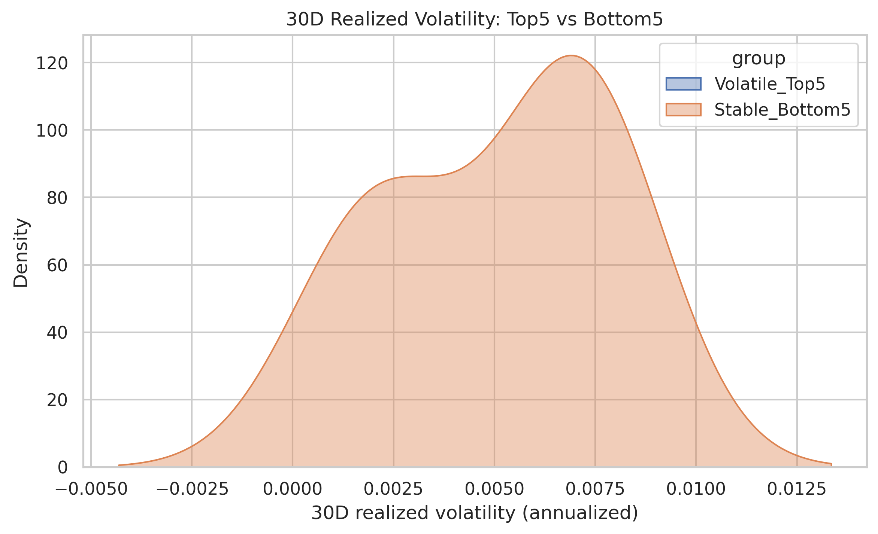
According to the plot, we can infer that there is a clear rightward shift for volatily_top5 vs stable_bottom5 which indicates a persesitently higher realized volatility in the volatile cohort.
Bottom 5 Coins: Near-flat density near zero, confirming their stability and low risk
Its my opinion that traders seeking stability favor Bottom 5, while speculators target Top 5 for high-risk bets.

Slide 9
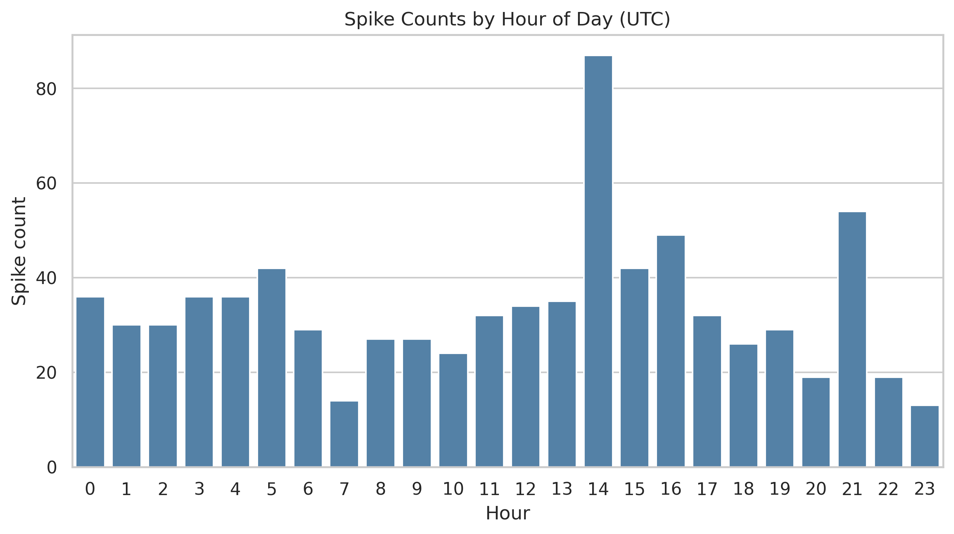
Computed time-of-day and day-of-week spike patterns
hour spikes median_mag_pct
0 0 36 4.429036
1 1 30 4.710677
2 2 30 5.490768
3 3 36 4.590060
4 4 36 4.590770
5 5 42 -4.049879
6 6 29 4.908377
7 7 14 5.097343
8 8 27 4.734848
9 9 27 5.906736
10 10 24 -4.755684
11 11 32 5.082736
12 12 34 4.349309
13 13 35 4.774898
14 14 87 4.402095
15 15 42 4.142459
16 16 49 4.406780
17 17 32 4.261473
18 18 26 5.681332
19 19 29 4.559707
20 20 19 -4.066233
21 21 54 4.957822
22 22 19 -4.521414
23 23 13 4.925210
We can see clear clusturing around certain UTC hours and US session thus indicating financial news overlap and market session open overlaps i.e Europe - Us handover.
We can also infer / takeway that high-volume regimes are associated with larger spike magnitudes and substancial share of total spikes.

Slide 10
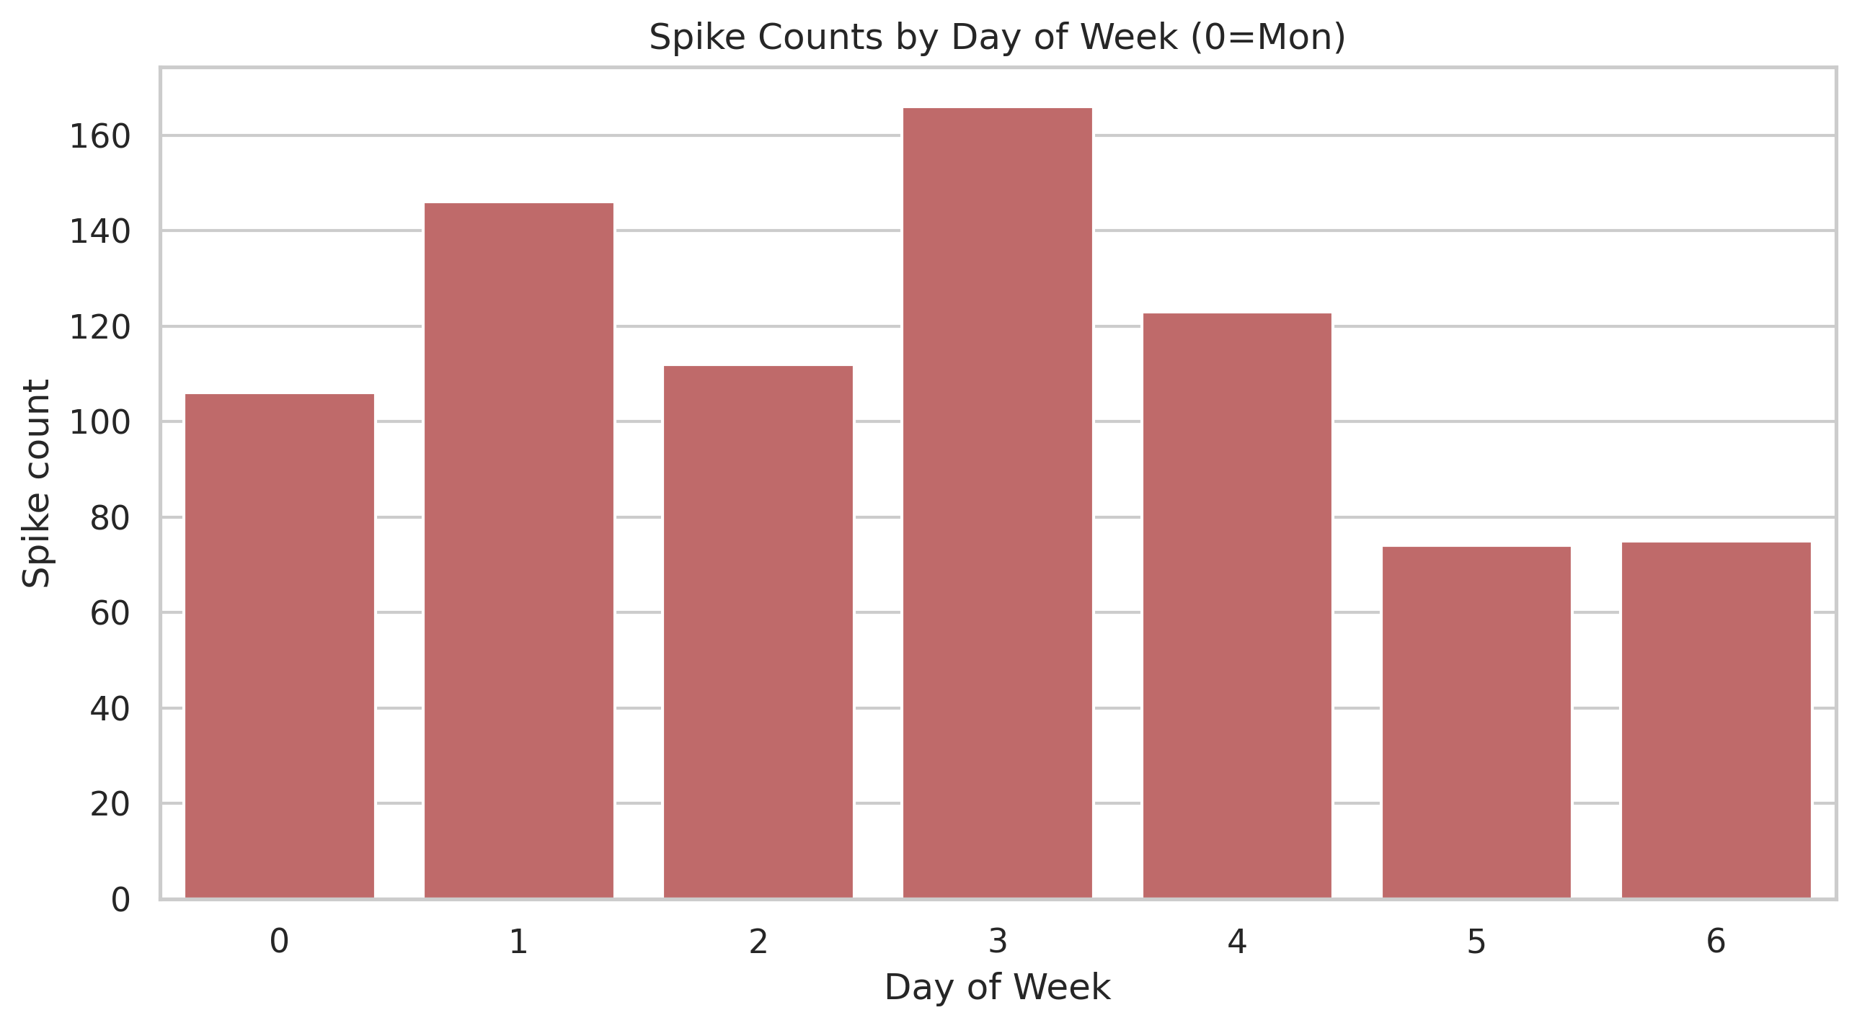
dow spikes median_mag_pct
0 0 106 4.784964
1 1 146 4.290368
2 2 112 4.536792
3 3 166 4.656305
4 4 123 4.339299
5 5 74 4.733249
6 6 75 5.291480
weekdays mid-week show more spikes than weekends, consistent with scheduled events and institutional activity.
Target Top
5 coins on weekends for high-volatility trades but exercise caution. Avoid trading Bottom 5 during spikes, as their stability makes such events rare.

Slide 11
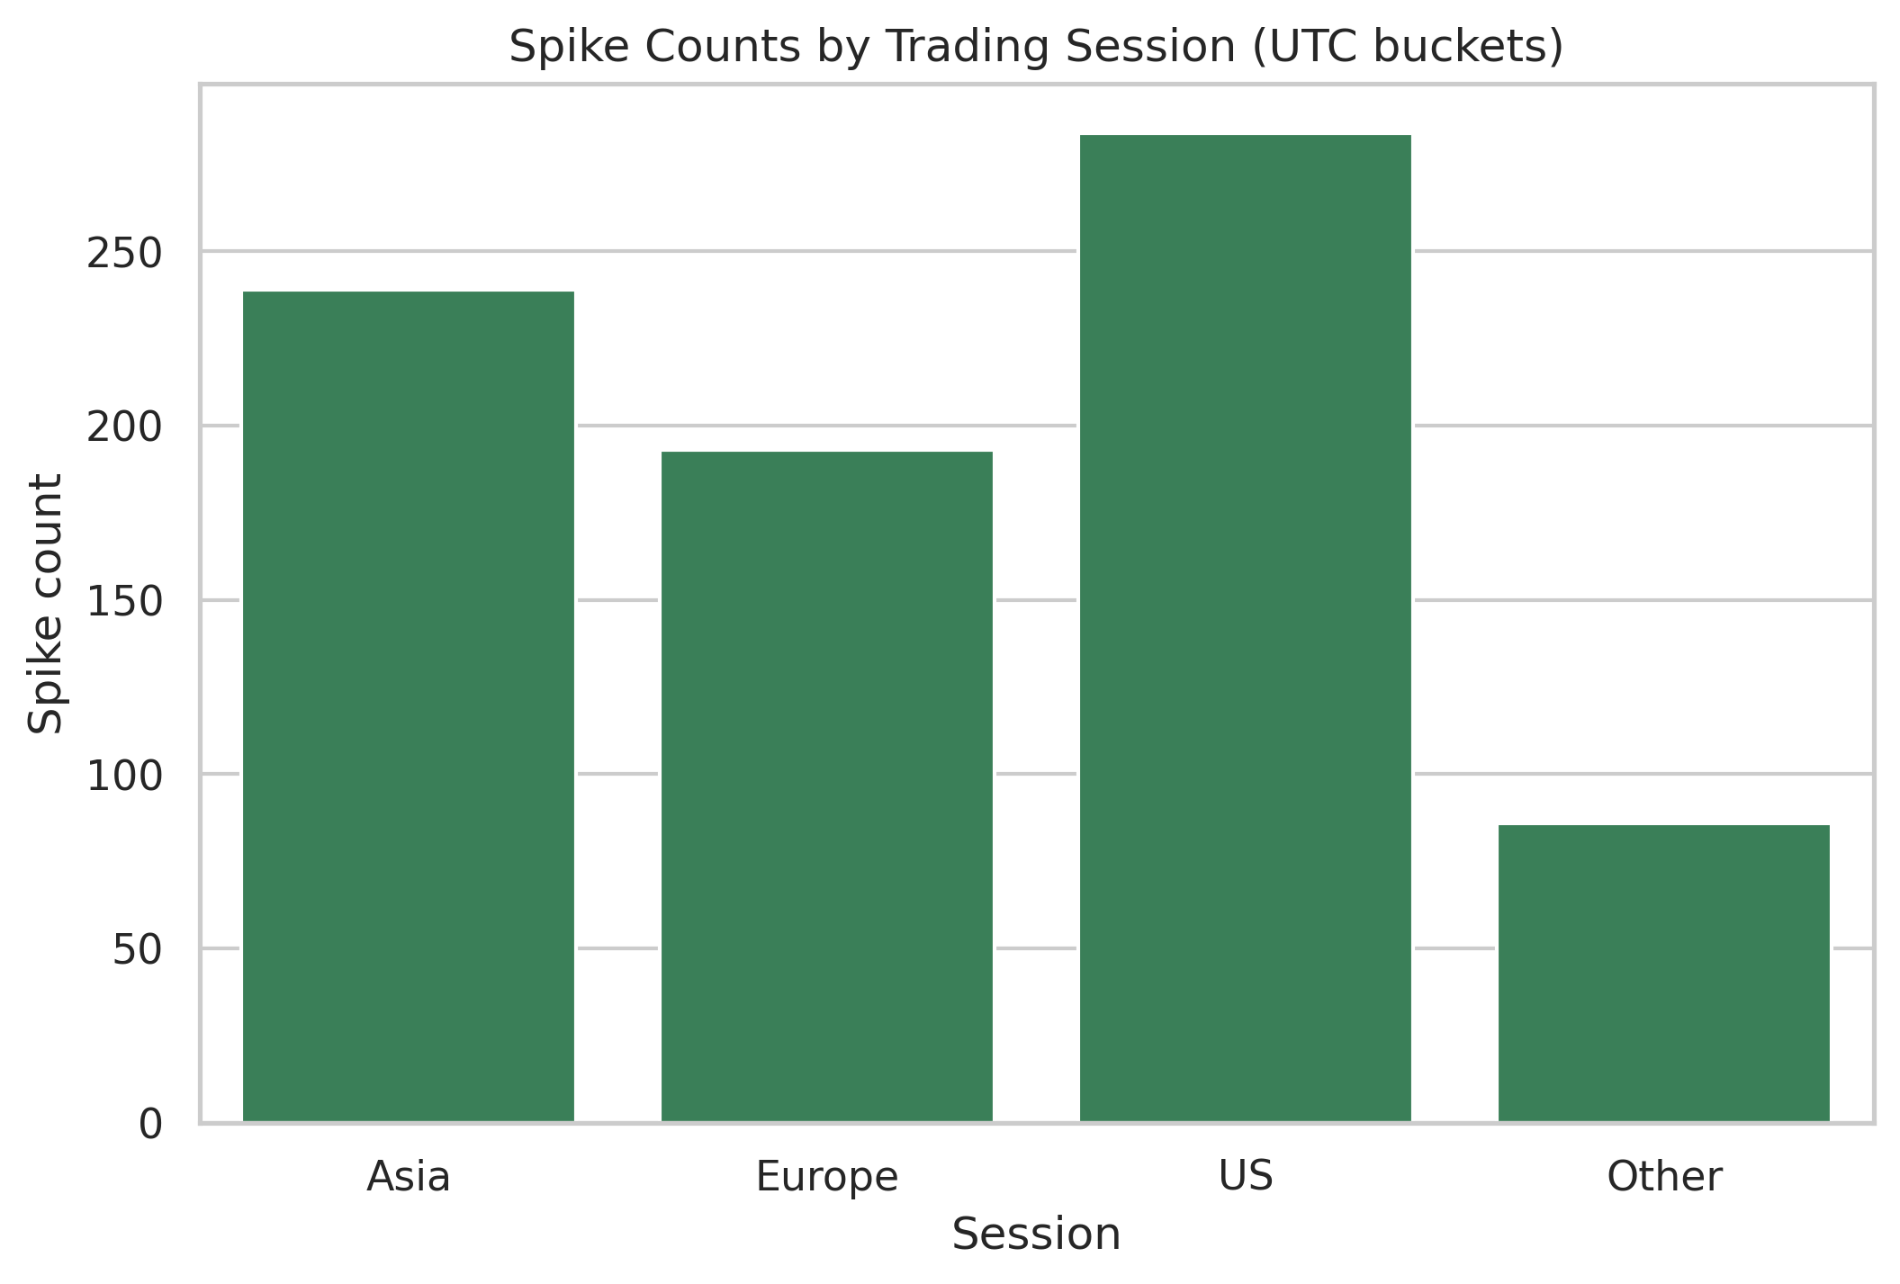
session spikes median_mag_pct
0 Asia 239 4.515599
1 Europe 193 4.695813
2 US 284 4.381634
3 Other 86 4.814836
Spikes concentrate during the US and Asia sessions, with Europe next and minimal activity Off-session.
The peak in Asia and US sessions likely results from overlapping trading hours, amplifying liquidity and price movements. For example, late Asian hours (e.g., Tokyo) coincide with early US hours (e.g., New York), creating a continuous flow of orders.
If I were a betting man I would advice traders seeking volatility to prioritize the Asia and US sessions for short-term gains, though caution is advised due to heightened uncertainty.

Slide 12
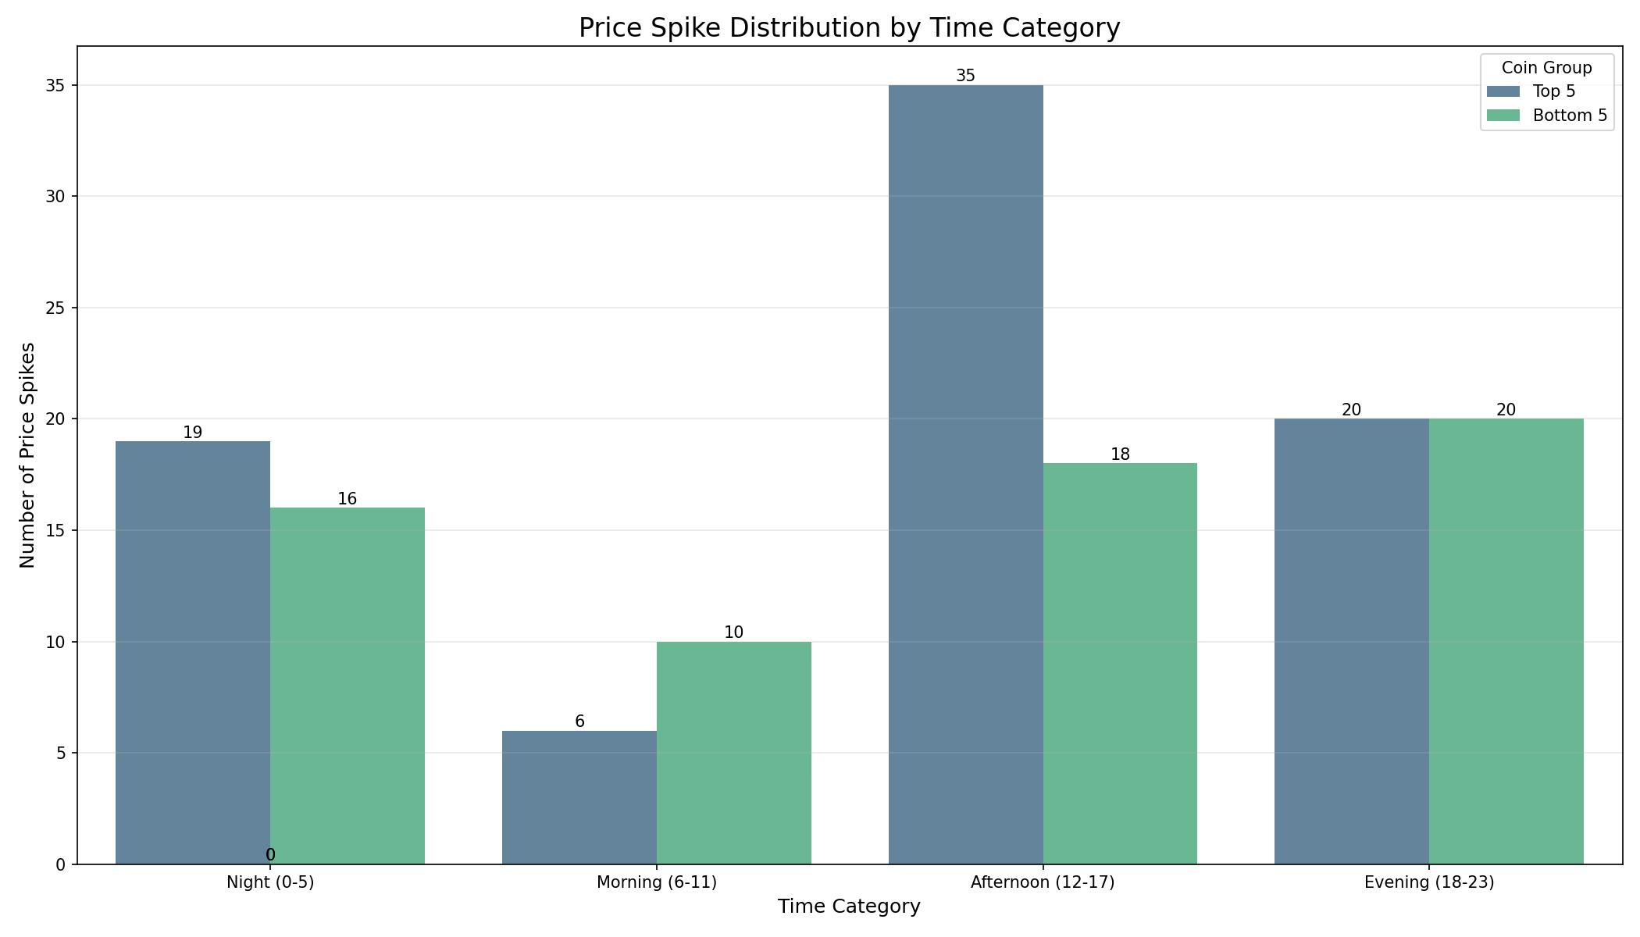
• For the Top 5 coins price spikes
occurs throughout the day but
the its at its lowest in the
morning between 0600 -
1100hrs and it's at its highest in
the afternoon between 1200 -
1700hrs
• For the Bottom 5 coins price
spikes distribution is somewhat
on a even distribution with the
exception of in the morning 0600
- 1100hrs where we experience a
low count.

