Slide 1
Project Defence
Kaggle competition: ICR - Identifying Age-Related Conditions
Done by: Anna Nazarova

Slide 2
Overview of the problem

Slide 3
Context
From heart disease and dementia to hearing loss and arthritis, aging is a risk factor for numerous diseases and complications. The growing field of bioinformatics includes research into interventions that can help slow and reverse biological aging and prevent major age-related ailments.
In this competition, participants will work with measurements of health characteristic data to solve critical problems in bioinformatics. Based on minimal training, a model will be created to predict if a person has any of three medical conditions.

Slide 4
Goal
The goal of this competition is to predict if a person has any of three medical conditions.
Class 1 - person has one or more of any of the three medical conditions
Class 0 - none of the three medical conditions

Slide 5

Evaluation
Submissions are evaluated using a balanced logarithmic loss. The overall effect is such that each class is roughly equally important for the final score.

Slide 6
Data analysis

Slide 7
Columns
Id - Unique identifier for each observation.
AB-GL - 56 anonymized health characteristics. All are numeric except for EJ, which is categorical.
Class - A binary target: 1 indicates the subject has been diagnosed with one of the three conditions, 0 indicates they have not.

Slide 8
Columns
Note: Organizations provide extra tables, which includes:
More details about target column: A (no disease), B, C, D (class 1)
Three experimental characteristics
The date the data for this subject was collected

Slide 9
Columns
Since the organisers anonymised the names of the columns, it is not clear what meaning they carry. The only thing that can be determined from the context of the contest is that they are related to the human parameters (age, weight, height and etc.).

Slide 10
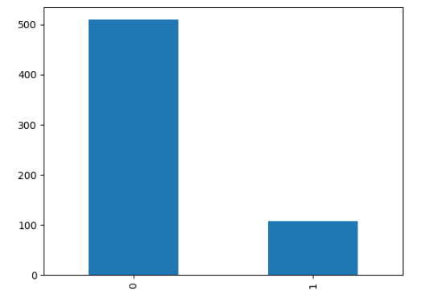
Target column
There is a noticeable imbalance of objects in classes.

Slide 11
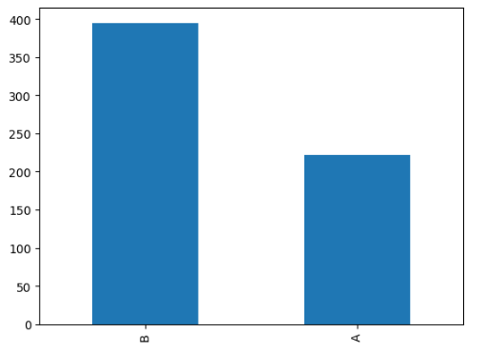
Categorical column - EJ
There is also an imbalance, but less pronounced.

Slide 12
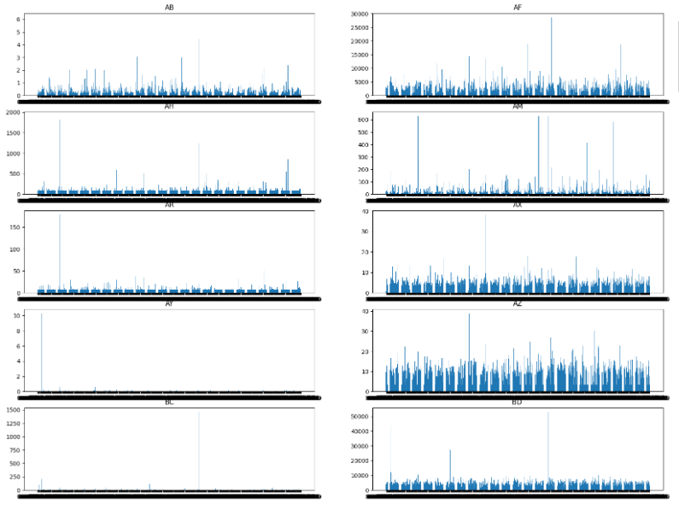
Numeric data
There are too many numeric columns and they all have different properties. It is not yet possible to identify any patterns at this step.

Slide 13
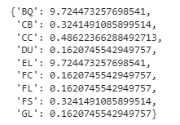
Empty columns
There are 9 columns with nan values.
All columns, except for BQ and EL, have less than 1% of nan cells, so we can drop them. But BQ and EL have almost 10% of nan values. For simplicity it was decide to fill them with mean values.

Slide 14
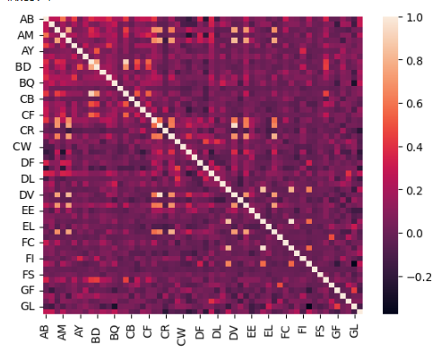
Correlation
Most of the columns have little correlation with each other.
Also, due to the large number of columns for prediction, there is a possibility of use of finding the most important features.

Slide 15
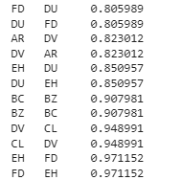
Correlation
6 objects with high correlation
DH - 2
FD - 2
DV - 2
EH - 2
AR - 1
BC - 1
BZ - 1
CL - 1

Slide 16
Experiments

Slide 17
Models
LogisticRegression with elastic net penalty
SVM
AdaBoostClassifier
XGBClassifier
CatBoostClassifier

Slide 18
Only train data. What to do?
Only the training data was open to the competitors and the test data was closed. To check the result of work it was decided to use StratifiedKFold(n_splits=5, shuffle=True, random_state=42)

Slide 19
LogisticRegression
LogisticRegression(penalty = 'elasticnet', solver = 'saga', l1_ratio = 0.5)
LogLoss: 0.6238
LogLoss: 0.5453
LogLoss: 0.4352
LogLoss: 0.5002
LogLoss: 0.4254
Mean score: 0.5060

Slide 20
SVM
SVC(probability=True)
LogLoss: 0.4213
LogLoss: 0.4162
LogLoss: 0.4241
LogLoss: 0.5143
LogLoss: 0.4070
Mean score: 0.4366

Slide 21
AdaBoostClassifier
AdaBoostClassifier(random_state=42)
LogLoss: 0.5884
LogLoss: 0.6177
LogLoss: 0.6311
LogLoss: 0.6123
LogLoss: 0.6094
Mean score: 0.6118

Slide 22
XGBClassifier
XGBClassifier(n_jobs=-1, early_stopping_rounds=300,)
Log-loss: 0.1639
Log-loss: 0.1998
Log-loss: 0.1332
Log-loss: 0.2249
Log-loss: 0.2303
Mean score: 0.1904

Slide 23
CatBoostClassifier
CatBoostClassifier(custom_loss=[metrics.Logloss()],random_seed=42,logging_level='Silent')
Log-loss:0.1627
Log-loss:0.1994
Log-loss:0.1576
Log-loss: 0.2175
Log-loss: 0.1659
Mean score: 0.1806

Slide 24
The best models
The best result was shown by CatBoostClassifier, which was be used to find better parameters to improve score.

Slide 25
GridSearchCV
'depth': [4,6,8],
'learning_rate' : [0.005, 0.01,0.03],
'iterations' : [100, 500, 1000]

Slide 26
Result
Log-loss: 0.1656
Log-loss: 0.2037
Log-loss: 0.1514
Log-loss:0.2162
Log-loss: 0.1766
Mean score: 0.1827

Slide 27
Experiments 2.0
Imbalance data

Slide 28
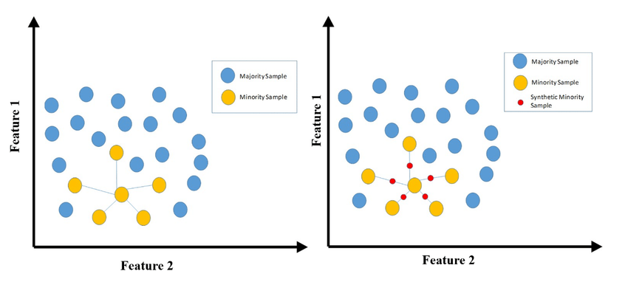
SMOTE (Synthetic Minority Oversampling Technique)
This algorithm is based on the idea of generating some number of artificial examples that would be similar to the existing ones in the minority class, while not duplication of them.

Slide 29
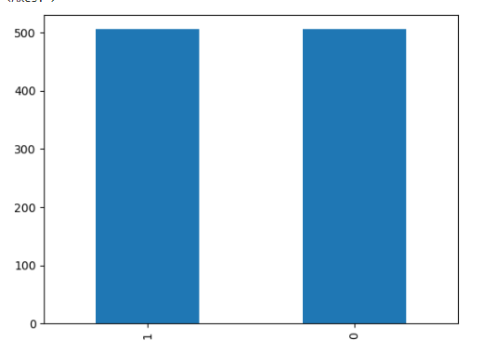
SMOTE
Before examples: 612
After SMOTE examples: 1010

Slide 30
Models
LogisticRegression with elastic net penalty
SVM
AdaBoostClassifier
XGBClassifier
CatBoostClassifier

Slide 31
LogisticRegression
LogisticRegression(penalty = 'elasticnet', solver = 'saga', l1_ratio = 0.5)
LogLoss: 0.6141
LogLoss: 0.5796
LogLoss: 0.6063
LogLoss: 0.6569
LogLoss: 0.5907
Mean score: 0.6095

Slide 32
SVM
SVC(probability=True)
LogLoss: 0.5839
LogLoss: 0.5551
LogLoss: 0.5814
LogLoss: 0.6065
LogLoss: 0.5834
Mean score: 0.5820

Slide 33
AdaBoostClassifier
AdaBoostClassifier(random_state=42)
LogLoss: 0.6143
LogLoss: 0.6241
LogLoss: 0.6179
LogLoss: 0.6230
LogLoss: 0.6099
Mean score: 0.6178

Slide 34
XGBClassifier
XGBClassifier(n_jobs=-1, early_stopping_rounds=300,)
Log-loss: 0.0835
Log-loss: 0.1647
Log-loss: 0.2608
Log-loss: 0.0480
Log-loss: 0.0759
Mean score: 0.1266

Slide 35
CatBoostClassifier
CatBoostClassifier(custom_loss=[metrics.Logloss()],random_seed=42,logging_level='Silent')
Log-loss: 0.0655
Log-loss: 0.0988
Log-loss: 0.1882
Log-loss: 0.0363
Log-loss: 0.0544
Mean score: 0.0887

Slide 36
Comparison
Model | Before SMOTE | After SMOTE
LogisticRegression with elastic net penalty | 0.5060 | 0.6095
SVM | 0.4366 | 0.5820
AdaBoostClassifier | 0.6118 | 0.6178
XGBClassifier | 0.1904 | 0.1266
CatBoostClassifier | 0.1806 | 0.0887

Slide 37
Experiments 3.0
Ensemble + SMOTE

Slide 38
Ensemble
XGBClassifier+CatBoostClassifier
LogLoss: 0.0572
LogLoss: 0.1180
LogLoss: 0.1857
LogLoss: 0.0566
LogLoss: 0.1002
Mean score: 0.1035

Slide 39
Submission

Slide 40

Submission result
Without SMOTE

Slide 41
Submission result
With SMOTE

Slide 42
Submission result
Ensemble+SMOTE

Slide 43
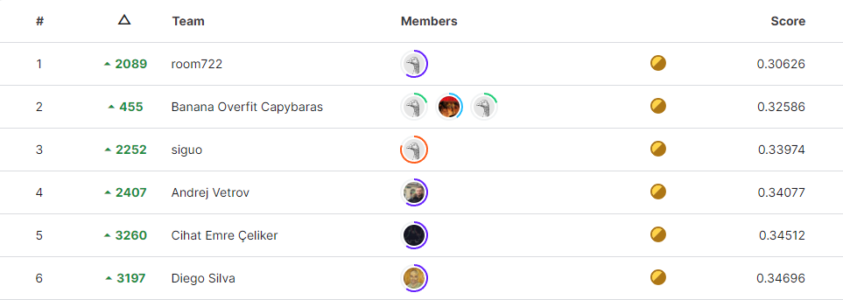
Leaderboard results (Private)

Slide 44
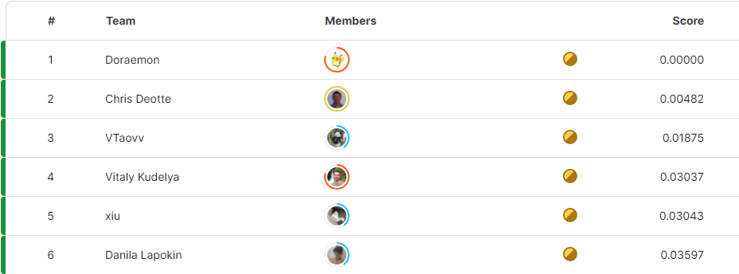
Leaderboard results (Public)

Slide 45
Conclusion
Use another ensemble models
Split by time
Use another sampling methods

Slide 46
Thank you for your attention!

