Slide 1

Bellman-Ford Algorithm

Slide 2
Today Covered
Bellman-Ford Algorithm
  Analysis
  Proof
Shortest path in Directed Acyclic Graphs
  Assumptions
  Algorithm
  Analysis
  Proof of correctness

Slide 3
Analysis: The Bellman-Ford Algorithm
  BELLMAN-FORD (G, w, s)
  1 INITIALIZE-SINGLE-SOURCE (G, s)
  2 for i ← 1 to |V [G]| - 1
  3 do for each edge (u, v)  E[G]
  4 do RELAX (u, v, w)
  5 for each edge (u, v)  E[G]
  6 do if d[v] > d[u] + w(u, v)
  7 then return FALSE
  8 return TRUE
 (V)
}
 (V.E)
}
O(E)
Total Running Time = O(V.E)
Contd..

Slide 4
Proof
Case 1
Suppose graph G contains no negative-weight cycles that are reachable from the source s.
We first prove the claim that at termination, d[v] = δ(s, v) for all vertices v  V .
  If v is reachable from s, Lemma above proves it.
  If v is not reachable from s, then claim follows from no-path property.
The predecessor subgraph property, along with the claim, implies that G_{π} is a shortest-paths tree.
(Once d[v] = δ(s, v) for all v  V, the predecessor sub-graph is a shortest paths tree rooted at s)

Slide 5
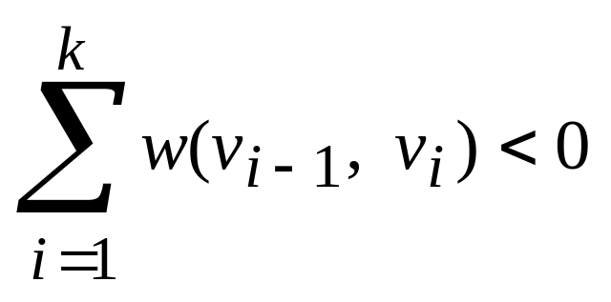
Contd..
Now we use the claim to show that BELLMAN-FORD returns TRUE.
  At termination, for all edges (u, v)
  d[v] = δ(s, v) ≤ δ(s, u) + w(u, v) = d[u] + w(u, v),
  It therefore returns TRUE
Case 2,
Suppose that graph G contains a negative-weight cycle that is reachable from the source s
Let this cycle be c = v₀, v₁,..., v_{k}, where v₀ = v_{k},
Then, (A)

Slide 6
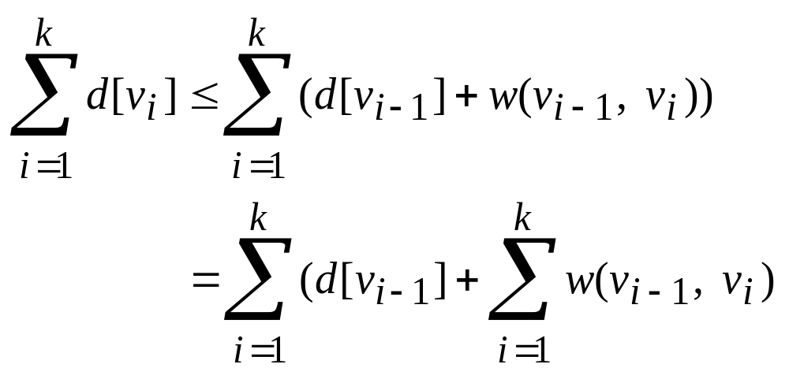
Contd..
Assume for the purpose of contradiction that the Bellman-Ford algorithm returns TRUE.
Thus, d[v_{i}] ≤ d[v_{i-1}] + w(v_{i-1}, v_{i}) for i = 1, 2,..., k.
Summing the inequalities around cycle c gives us
Dr. Nazir A. Zafar Advanced Algorithms Analysis and Design

Slide 7
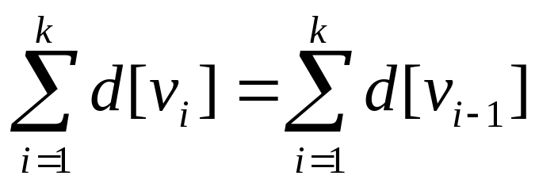
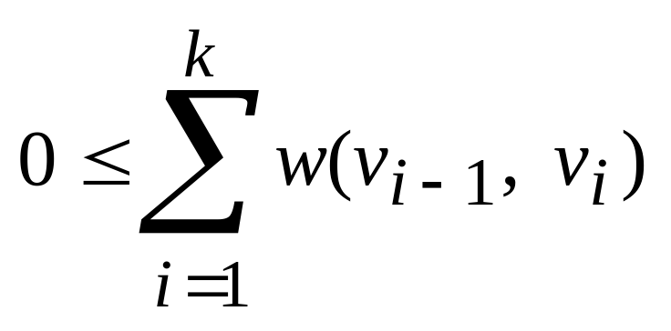
Contd..
Since v₀ = v_{k}, each vertex in c appears exactly once in each of the summations and, and so
Of course d[v_{i}] is finite for i = 1, 2,..., k. Thus,
Which contradicts inequality (A). And hence it proves the theorem

Slide 8
Shortest Paths in Directed Acyclic Graphs

Slide 9
Shortest Paths in Directed Acyclic Graphs
By relaxing edges of Directed Acyclic Graph (dag) G = (V, E) according to topological sort of vertices single source shortest path can be computed in
 (V + E) time
Shortest paths are always well defined in a dag
  Since even if there are negative-weight edges no negative weight cycle exists.
It starts topologically sorting dag, to impose linear ordering of vertices.
  If there is path from u to v then u precedes v.
Each vertex and each edge that leaves the vertex is processed that is why this approach is well defined

Slide 10
Algorithm : Topological Sort
TOPOLOGICAL-SORT (G)
Call DFS(G) to compute f [v] of each vertex v  V.
Set an empty linked list L = Ø.
When a vertex v is colored black, assign it f (v).
Insert v onto the front of the linked list, L = {v}.L.
return the linked list.
The rank of each node is its position in the linked list started from the head of the list.
Example
Total Running Time =  (V + E)

Slide 11
Algorithm : Shortest Path (dag)
  DAG-SHORTEST-PATHS (G, w, s)
  1 topologically sort the vertices of G
  INITIALIZE-SINGLE-SOURCE (G, s)
  3 for each vertex u, taken in topologically sorted order
  4 do for each vertex v  Adj[u]
  do RELAX (u, v, w)
 (V+E)
 (V)
Θ(V)
Θ(E)
Each iteration of for loop takes  (1)
Total Running Time =  (V+E)

Slide 12
SSSP in Directed Acyclic Graphs
6
x
1
r
s
t
y
z
5
2
7
-1
-2
∞
0
∞
∞
∞
∞
3
4
For each vertex v  V(G)
  d[v] ← ∞
  π[v] ← NIL
Considering s as root node
  d[s]  0
The vertices are taken in
topologically sorted order
2

Slide 13
SSSP in Directed Acyclic Graphs
6
x
1
r
s
t
y
z
5
2
7
-1
-2
∞
0
∞
∞
∞
∞
3
4
Considering vertex r
Adj[r] = s, t
  d[s] > d[r] + w(r, s)
  But (0 < ∞ + 5)
  d[t] > d[r] + w(r, t)
  But (∞ < ∞ + 3)
2

Slide 14
SSSP in Directed Acyclic Graphs
Considering vertex s
Adj[s] = t, x
  d[t] > d[s] + w(s, t)
  (∞ > 0 + 2)
  d[t] ← d[s] + w(s, t)
  0 + 2 = 2
  π[t] ← s
  d[x] > d[s] + w(s, x)
  (∞ > 0 + 6)
  d[x] ← d[s] + w(s, x)
  0 + 6 = 6
  π[x] ← s
6
x
1
r
s
t
y
z
5
2
7
-1
-2
∞
0
2
6
∞
∞
3
4
2

Slide 15
SSSP in Directed Acyclic Graphs
Considering vertex t
Adj[t] = x, y, z
  d[x] > d[t] + w(t, x)
  But (6 < 9)
  d[y] > d[t] + w(t, y)
  (∞ > 2 + 4)
  d[y] ← d[t] + w(t, y)
  2 + 4 = 6
  π[y] ← t
  d[z] > d[t] + w(t, z)
  (∞ > 2 + 2)
  d[z] ← d[t] + w(t, z)
  2 + 2 = 4
  π[z] ← t
6
x
1
r
s
t
y
z
5
2
7
-1
-2
∞
0
2
6
6
4
3
4
2

Slide 16
SSSP in Directed Acyclic Graphs
Considering vertex x
Adj[x] = y, z
  d[y] > d[x] + w(x, y)
  (6 > 6 + (-1))
  d[y] ← d[x] + w(x, y)
  6 + (-1) = 5
  π[y] ← x
  d[z] > d[x] + w(x, z)
  But (4 < 6 + 1)
6
x
1
r
s
t
y
z
5
2
7
-1
-2
∞
0
2
6
5
4
3
4
2

Slide 17
SSSP in Directed Acyclic Graphs
Considering vertex y
Adj[y] = z
  d[z] > d[y] + w(y, z)
  (4 > 5 + (-2))
  d[z] ← d[y] + w(y, z)
  5 + (-2) = 3
  π[z] ← y
6
x
1
r
s
t
y
z
5
2
7
-1
-2
∞
0
2
6
5
3
3
4
2
6
x
1
r
s
t
y
z
5
2
7
-1
-2
∞
0
2
6
5
3
Considering vertex z
Adj[z] = 
3
4
2

Slide 18
Theorem: Proof of Correctness
If a weighted, directed graph G = (V, E) has source vertex s and no cycles, then at the termination of the DAG-SHORTEST-PATHS procedure, d[v] = δ(s, v) for all vertices v  V, and the predecessor subgraph G_{π} is a shortest-paths tree.
Proof
We first show that d[v] = δ(s, v) for all vertices v  V at termination.
Case 1
If v is not reachable from s, then d[v] = δ(s, v) = ∞ by the no-path property.

Slide 19
Theorem (Cont.)
Case 2
Now, suppose that v is reachable from s, so that there is a shortest path p = v₀, v₁,..., v_{k}, where v₀ = s and v_{k} = v.
Because we process the vertices in topologically sorted order, the edges on p are relaxed in the order (v₀, v₁), (v₁, v₂),..., (v_{k-1}, v_{k}).
The path-relaxation property implies that d[v_{i}] = δ(s, v_{i}) at termination for i = 0, 1,..., k.
Hence it proves the theorem

