Slide 1
Car Dealership Data Analysis
By Humza Khalid

Slide 2
Introduction
The Core Challenge: Maximizing Inventory Value
Question
How can we use our current inventory data to strategically price vehicles, prioritize high-value purchases, and maximize profit margins?
Purpose
To provide dealership management with actionable, data-backed insights on which vehicle attributes (drive type, condition, mileage) are the strongest drivers of price and value.
Who Benefits?
Dealerships: Better inventory purchasing and pricing decisions.
Sales Team: Targeted marketing and accurate valuation.
Finance/Accounting: Improved forecasting and profit realization.

Slide 3
Methodology & Data Sources
Data Source
auto-Inventory-.csv (CSV File)
Key Features
Price, Mileage, Model Year, Drive Type, Condition (New/Used/Certified)
Tools Used
Python: The core language for analysis.
Unit of Analysis
auto_inventory_cleaned.csv (cleaned CSV File)
Each individual vehicle (a single row in the dataset).
Condition Report
Jupyter Notebooks: Environment for executing and documenting code.
pandas: Data manipulation and cleaning.
matplotlib & seaborn: Visualization and statistical graphing.

Slide 4
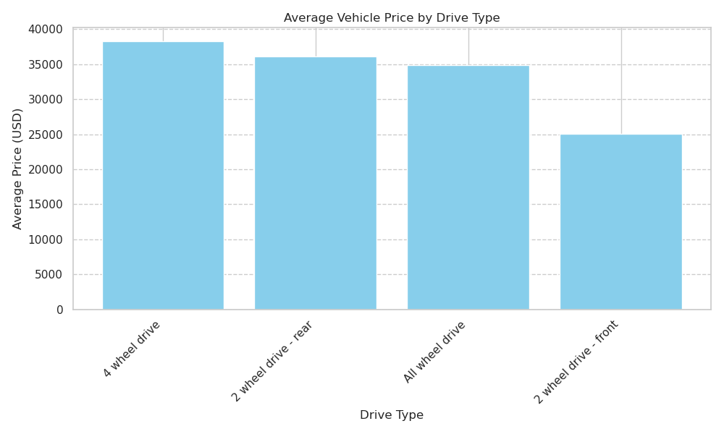
1)Does drive type (front-wheel, all-wheel, rear-wheel) influence average vehicle price?
Analysis:
This Chart indicates that vehicles with 4-wheel drive have the highest average price, while those with front-wheel drive have the lowest average price. Overall showing the drive system is a key factor in determining a vehicle's market value, mainly due to differences in producing cost, mechanical complexity, and the type of vehicle model it is.
Recommendation:
Focus on advertising cars with 4 wheel or 2-wheel rear drive train to increase Profit Potential

Slide 5
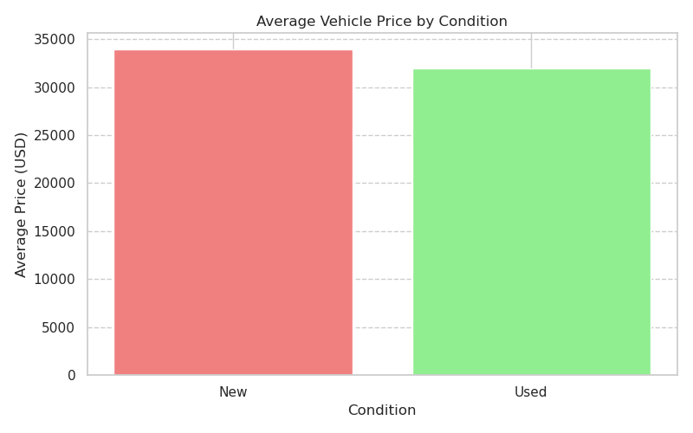
2) Are there notable pricing differences between “Used” and “Certified/New” vehicles?
Analysis:
This chart indicates that there is a noticeable difference in average price, with new vehicles being slightly more expensive than used vehicles.
Recommendation:
Concentration on acquiring new vehicles rather than used vehicles to maximize growth potential.

Slide 6
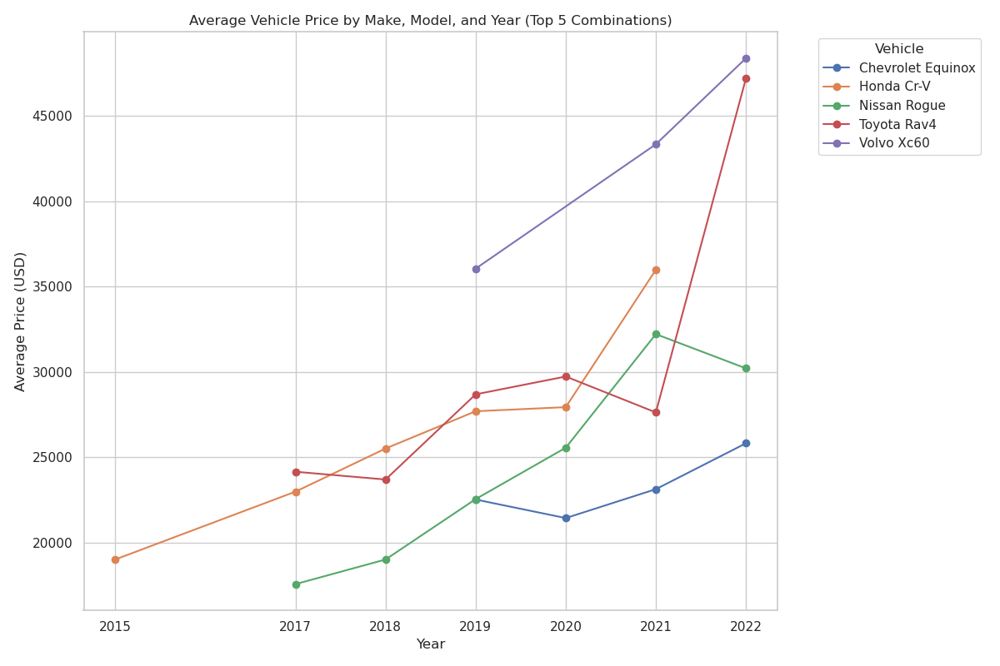
3) What is the relationship between a vehicle's model year and its price?
Analysis:
This Chart indicates that most cars that are newer in model, prices tends to be higher but as the cars start to get older the price starts to depreciate. Some models of cars such as the Nissan Rogue tend to not be in as much of demand therefore the price of the newer model is lower than the older model.
Recommendation:
Center the buying niches with vehicles that have a great performances as well as price, and that indicate for a demand to accumulate the most earnings.

Slide 7
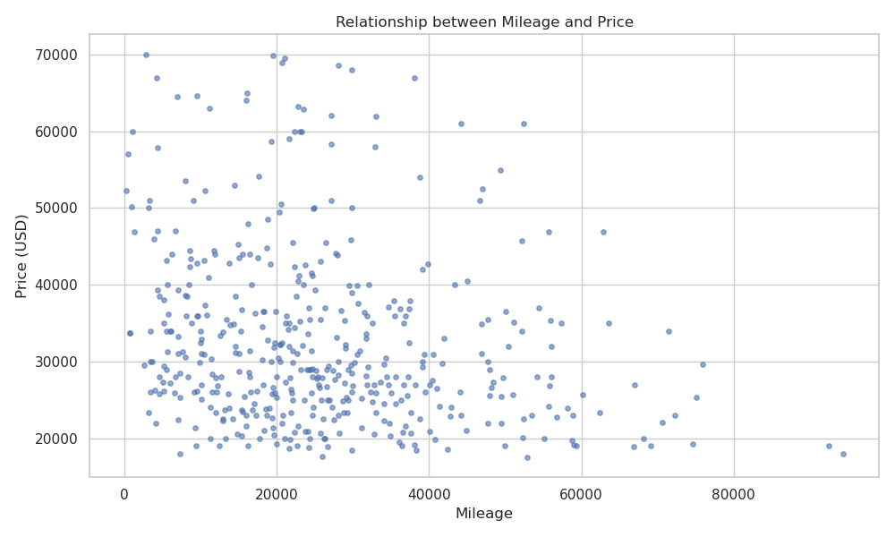
4)What is the relationship between mileage and price — do higher-mileage cars consistently sell for less?
Analysis:
This chart mostly shows that majority of the cars are in the lower mileage range and lower price range due to the fact that the vehicle has a bad condition report making the overall value depreciate significantly.
Recommendation:
Focus on refurbishing efforts from low-mileage vehicles with poor reports to retrieve max bottom line.

Slide 8
Future Work: Deepening the Analysis
New Question 1
Evaluate Condition Impact: How much does each type of damage (e.g., mechanical vs. cosmetic) depreciate a vehicle?
Next Step 1
Categorize and analyze the specific issues mentioned in "bad condition reports" to guide the most profitable repair investments.
New Question 2
Profitability by Segment: Which manufacturers and body styles (SUVs vs. Trucks) are the most/least profitable vehicles for our dealership?
Next Step 2
Analyze average profit margins by manufacturer and body style.

Slide 9
Conclusion
Overall prioritizing the acquisition of 4-wheel and rear-wheel drive vehicles, while strategically focusing on newer model years and New/Certified conditions, will maximize the dealership's average vehicle revenue.

