Slide 1
NLP project Topic presentation
team: softNLP
팀원: 유승욱(조장), 김민주, 정훈석

Slide 2

News search (fake news and Media comparison)

Slide 3

Overflowing information

Slide 4
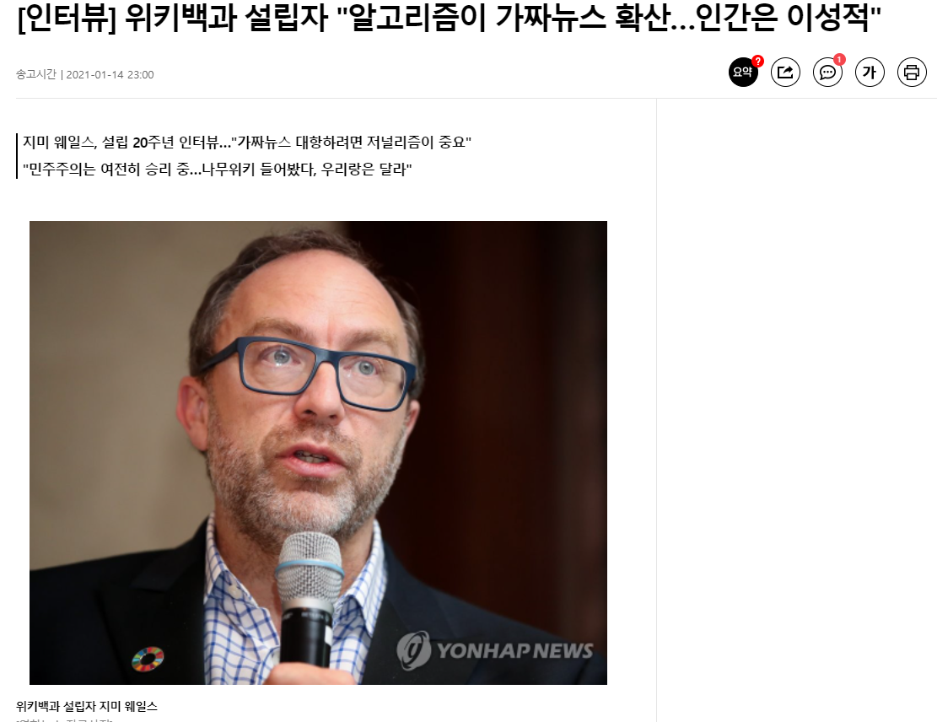


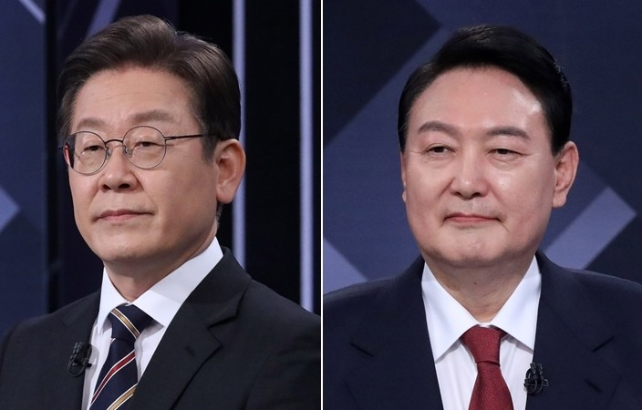
Fake news

Slide 5
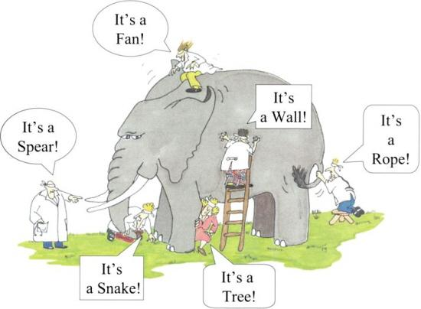
Check fact

Slide 6


Our Project
Latent
analysis
Similarity
Vector
Model
Similar
News
Rate validity

Slide 7



How it works
Output
Check
details
Program
Rate validity
input

Slide 8

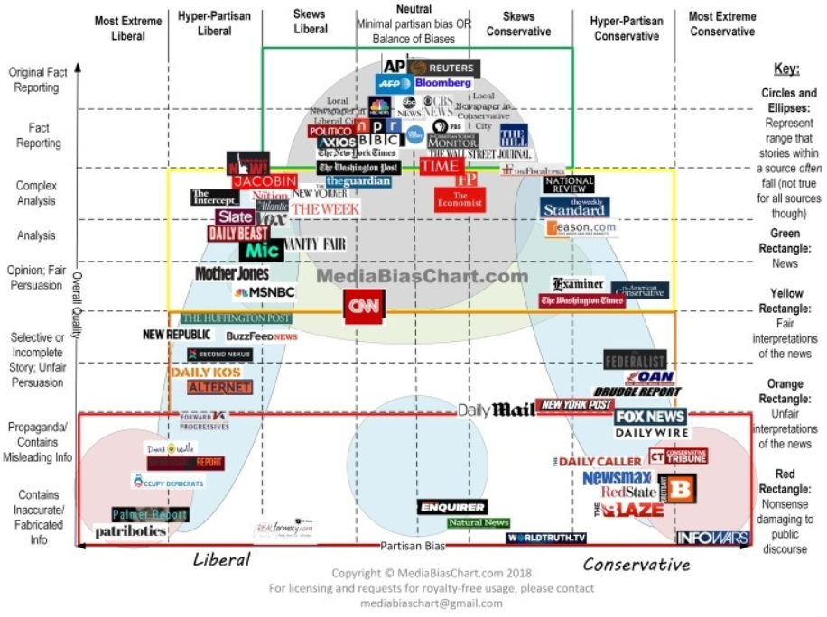
Expected Results
Find Accurate information
Multiple perspectives

Slide 9
schedule
Evaluation
Fake news dataset(English)
Role
김민주 유승욱(조장) 정훈석
10Week | 11Week | 12Week | 13Week | 14Week
Data to indexing | Searching Engine | User Interface1 | User Interface2 | Presentation

Slide 10
Thank you for listening

