Slide 1
An extension to 11ba: legacy IEEE 802.11 transmitter solution for 802.11ba receivers
Date: 2019-01-15
Authors:
Authors | Affiliations | Address | Phone | email
Martí Cervià | Universitat Politècnica de Catalunya (UPC)¹
Anna Calveras | Universitat Politècnica de Catalunya (UPC)¹
Eduard Garcia-Villegas | Universitat Politècnica de Catalunya (UPC)¹ |  |  | eduardg@entel.upc.edu
Elena López-Aguilera | Universitat Politècnica de Catalunya (UPC)¹
Ilker Demirkol | Universitat Politècnica de Catalunya (UPC)¹
Josep Paradells-Aspas | Fundació i2CAT and Universitat Politècnica de Catalunya (UPC)¹
(1) supported by ERDF and the Spanish Government through project TEC2016-79988-P, AEI/FEDER, UE

Slide 2
Abstract
TGba works on a WuR implementation for IEEE 802.11 WLAN networks. However, legacy devices are unable to generate the OOK modulated signal defined in IEEE 802.11ba.
This contribution aims to present a technique to generate a pseudo-OOK modulation to show that legacy IEEE 802.11 OFDM PHY, could be made compatible with IEEE 802.11ba WUR-LDR (Low Data Rate) receivers (to some extent).

Slide 3
Motivation
IEEE 802.11ba will enable interesting new usage models for IEEE 802.11 devices [1], spreading its presence in the IoT ecosystem.
However…
IEEE 802.11ba will define a new type of signal, which will require a modified PHY
Therefore…
Existing 802.11 devices will not be able to participate in those new scenarios. Why leaving them behind?
How many billion devices?

Slide 4
Motivation
Just allowing pre-11ba devices to send WuR packets, new 11ba receivers (e.g. Wi-Fi IoT devices) suddenly have a wider market
Other legacy solutions exist for 802.11-based WUR (e.g. [2]), but they are not compatible with forthcoming 11ba receivers
In the past, people showed interest in a future extension of IEEE 802.11ba
See [3]

Slide 5
OOK Modulation: Backwards Compatibility
As defined by IEEE 802.11ba, WuR transmitter uses OOK to modulate a reduced subset of the OFDM subcarriers (a.k.a. MC-OOK [4])
Not possible in pre-11ba devices
Backwards compatible solutions should be based on software updates
Implementation needs to take into account the whole IEEE 802.11 OFDM PHY signal processing chain.

Slide 6
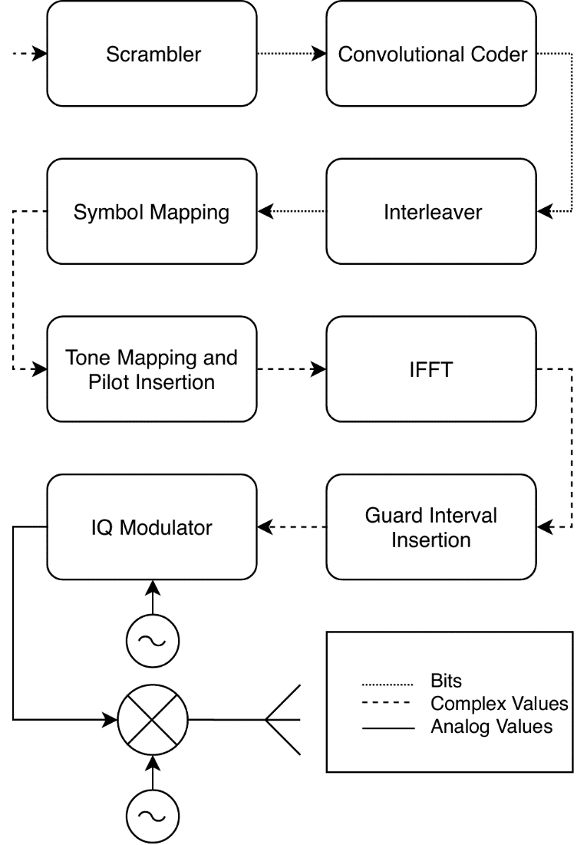
OOK Signal Generation on Legacy IEEE 802.11 OFDM PHY
Input bit sequence
IEEE 802.11 OFDM PHY does not enable the generation of OOK’s OFF symbols.
Elements of IEEE 802.11 OFDM PHY add power to symbols:
Subcarrier modulations
Pilot tones

Slide 7
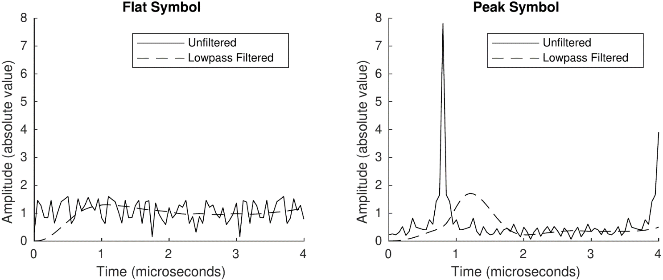
A pseudo-OOK modulation example
Flat Symbol as OOK-ON Symbol.
Peak Symbol as OOK-OFF Symbol.
Both symbols can be generated using the input bitstream to the OFDM PHY

Slide 8
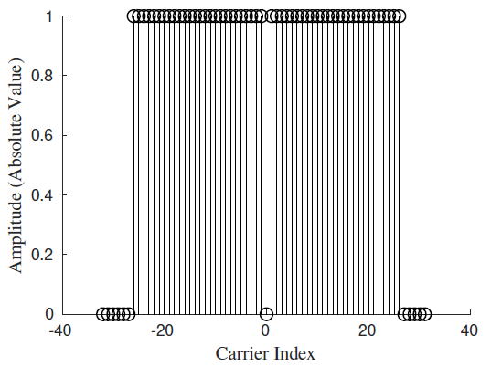
Generation of the Peak Symbol (1)
Problem statement:
Obtain an input sequence to OFDM PHY that is encoded with uniform subcarrier symbol values after scrambling, channel coding and interleaving.
Solution:
Use a pre-scrambled uniform binary input block with length N, where N is the payload length of the OFDM symbol.

Slide 9
Generation of the Peak Symbol (2)
One magic trick:
Pre-scrambling applied to input bit sequence so that we have all ‘0’ or all ‘1’ at the output of the scrambler.
Data remains uniform after convolutional coding and interleaving.
Encoded as a uniform block of subcarrier values.
Caveats:
Requires knowledge of the scrambler seed.
Resulting symbols affected by pilot tone phase.

Slide 10
Generation of the Flat Symbol
Bitstream input optimized for maximum output flatness (i.e. minimize PAPR).
Depends on the modulation used for transmission.
Same MCS chosen to generate Peak symbol
Tailed with 7 ‘0’ bits to avoid transitory effects.
Reset state of convolutional code not to interfere with Peak symbol generation
Example bitstream for flat symbol with BPSK:
S[n] = {1, 1, 0, 0, 1, 1, 1, 0, 1, 0, 1, 1, 0, 1, 0, 1, 0, 0, 0, 0, 0, 0, 0, 0}

Slide 11
WuS Modulation Procedure
Example of application for IEEE 802.11g OFDM PHY with BPSK
Align bitstream to ODFM symbol boundary.
Bitstream must be encoded in a single OFDM symbol
Append WuS data to bitstream:
If “0”: S[n] = {0, 0, 0, 0, 0, 0, 0, 0, 0, 0, 0, 0, 0, 0, 0, 0, 0, 0, 0, 0, 0, 0, 0, 0}
If “1”: S[n] = {1, 1, 0, 0, 1, 1, 1, 0, 1, 0, 1, 1, 0, 1, 0, 1, 0, 0, 0, 0, 0, 0, 0, 0}
Pre-Scramble the resulting bitstream.
Send the bitstream to IEEE 802 OFDM PHY

Slide 12
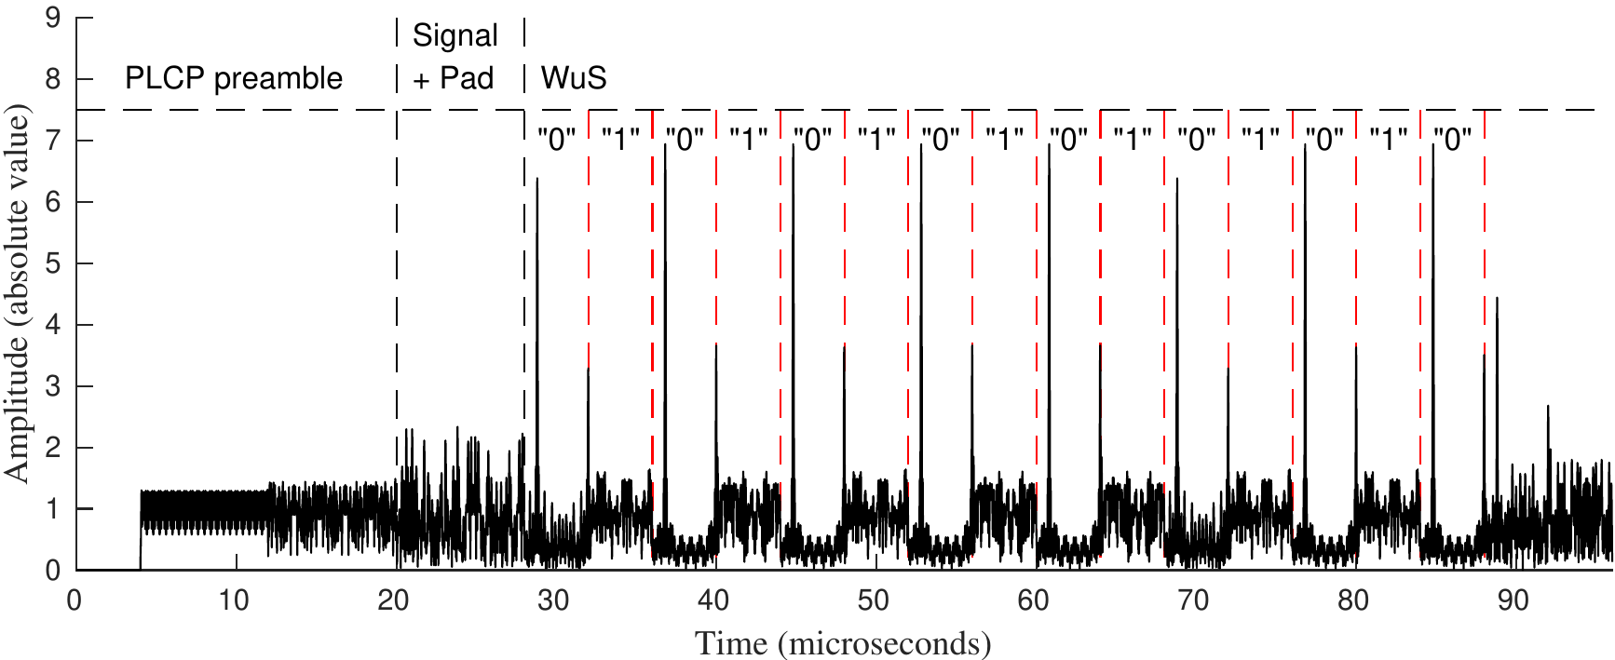
WuS Modulation
Proof of Concept:
IEEE 802.11g BPSK using MATLAB WLAN Toolkit.

Slide 13
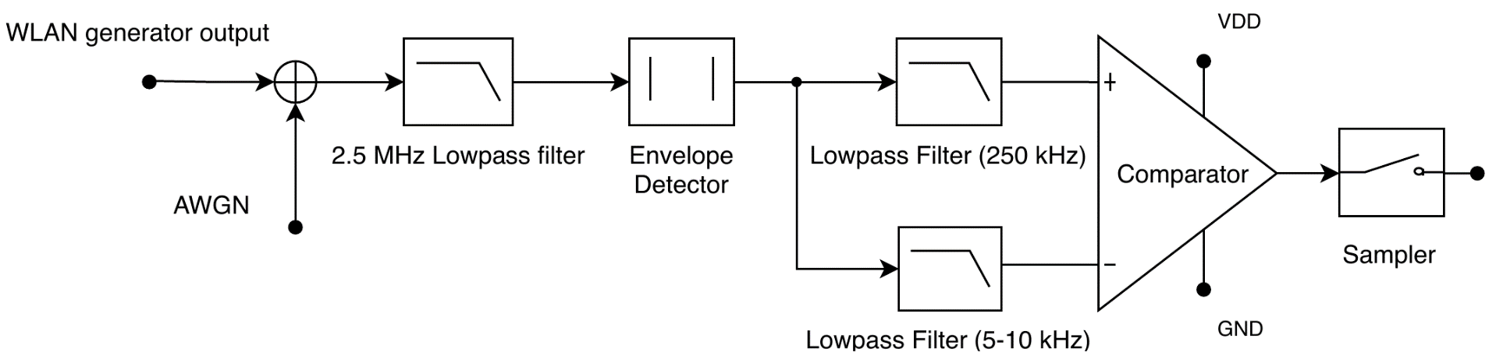
Performance Test
Comparison of plain OOK with pseudo-OOK (peak-flat) on a minimal OOK receiver.
Matlab implementation for baseband simulation:

Slide 14
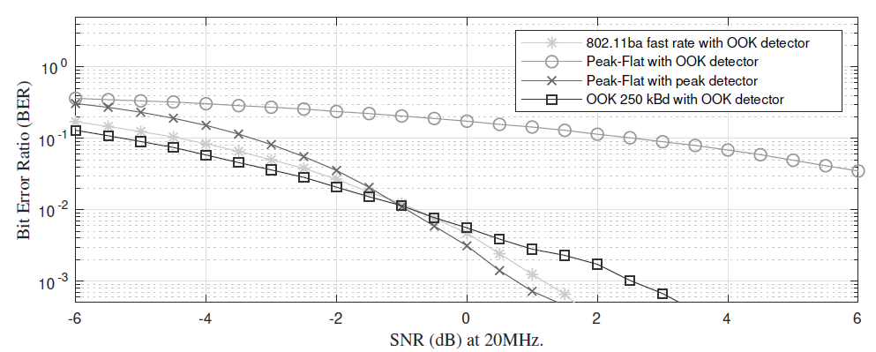
Simulation Results
AWGN channel
150,000 bits sent to compute BER

Slide 15
Conclusions
Signal generated by legacy IEEE 802.11 OFDM hardware can be decoded by IEEE 802.11ba-like MC-OOK receiver just using software level access (e.g: raw-sockets API)
Proved with LDR version of IEEE 802.11ba
Knowledge of the IEEE 802.11 OFDM PHY scrambler state is required.
Performance is sub-optimal compared to IEEE 802.11ba fully compliant signals.
Shorter range with typical/simple OOK receiver
Similar performance when using specific receiver for the pseudo OOK (peak-flat) modulation

Slide 16
References
11-17/0029r10, WUR Usage Model Document, Sep. 2017
Oller, J.; Garcia, E.; Lopez, E.; Demirkol, I.; Casademont, J.; Paradells, J.; Gamm, U.; Reindl, L. IEEE 802.11-enabled wake-up radio system: Design and performance evaluation. Electron. Lett. 2014, 50, 1484–1486.
11-18/0540r1, IEEE 802.11ba: more than a wake-up radio, Mar. 2018
IEEE P802.11ba/D1.1, Nov. 2018

Slide 17
Straw Poll 1
What do you think about enabling WUP transmission from non-11ba devices?
I don’t support the idea
It makes sense as a future amendment/extension to IEEE 802.11ba
No opinion/Don’t care
Results: A() / B() / C()
Eduard Garcia-Villegas (UPC)

