Slide 1
Ancestry-Informative SNP Selection
A Statistical Approach Beyond FST
CN · JPT · SEA — East Asian Population Classification
614,759 SNPs
504 Individuals
3 Populations
1000 Genomes Project | East Asian Super-Population

Slide 2
Why Does Ancestry Matter?
🔬 Forensics
💊 Medicine
🌏 Population Genetics
🧬 Research
Ancestry inference from biological trace evidence
Drug metabolism and disease risk vary by population
Tracing human migration and evolutionary history
Understanding genetic diversity and structure
Goal: Find the smallest set of SNP positions that reliably identifies a person's ancestral population
AISNP Selection Pipeline
2 / 14

Slide 3
The Data
1000 Genomes Project — East Asian Super-Population
CN
JPT
SEA
CHB + CHS (Han Chinese)
JPT (Japanese)
KHV + CDX (Kinh + Dai)
n = 208
n = 104
n = 192
All groups belong to the same EAS super-population — genetically close → deliberately hard problem
AISNP Selection Pipeline
3 / 14

Slide 4
The Scale Challenge
Whole-genome sequencing
~78,000,000 raw SNPs
▼
Quality filtering (QC)
614,759 candidates
▼
Smart selection ???
~1,000 informative SNPs
▼
ML panel reduction
50 – 150 final SNPs
⚠ ML cannot handle 600k features directly — a principled pre-selection step is essential
AISNP Selection Pipeline
4 / 14

Slide 5
Our Pipeline — 4 Stages
STAGE 1
STAGE 2
STAGE 3
STAGE 4
Pre-filtering (Quality Control)
SNP Scoring FST vs Statistical
ML Training 7 classifiers, CV
ML Reduction Panel size sweep
→
→
→
78M → 614,759 SNPs
→ ~1,000 candidates
accuracy benchmark
50–150 SNP final panel
STAGE 2 splits into two competing approaches:
FST-based
Statistical ← NEW
AISNP Selection Pipeline
5 / 14

Slide 6
Stage 1 — Pre-filtering (Quality Control)
Standard genomics QC — unchanged from classical practice
SNP-only
Remove insertions, deletions, structural variants
Biallelic
Keep variants with exactly 2 alleles
Min. frequency
MAF ≥ 0.1% (at least 1 allele across all 504 samples)
Call rate
≥ 95% of samples must be genotyped at each site
HWE test
Remove sites likely caused by genotyping error (p < 10⁻⁶)
LD pruning
Remove correlated variants R² < 0.10, 1000 kb window
78,000,000 → 614,759 independent SNPs
AISNP Selection Pipeline
6 / 14

Slide 7
Stage 2A — FST (Baseline Approach)
Classical population genetics — the reference method
FST = (Total variance − Within-population variance) / Total variance
Why FST works
• Normalizes by total heterozygosity
FST = 0
Allele frequencies identical across all populations
FST = 1
Allele frequencies completely diverged (fixed)
• Upweights rare alleles with large freq. gaps
Pairwise
CN↔JPT, CN↔SEA, JPT↔SEA → aggregated
• Interpretable as a proportion [0, 1]
Output
Top 1,000 SNPs by FST → passed to ML
• Well-validated in population genetics
AISNP Selection Pipeline
7 / 14

Slide 8
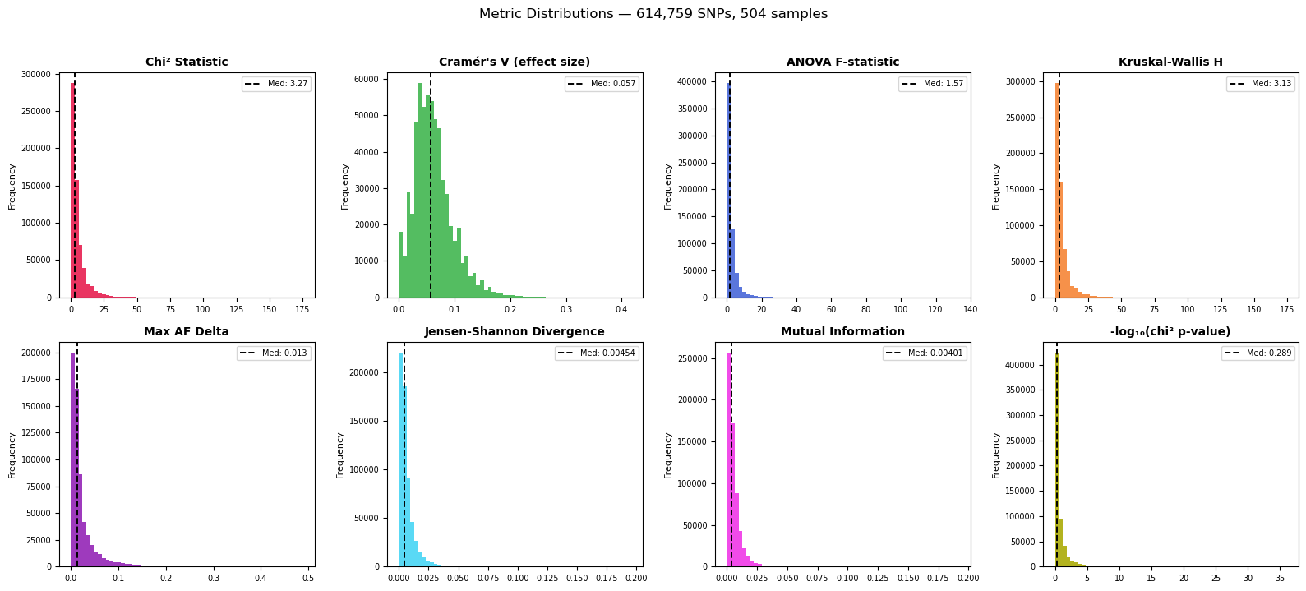
Stage 2B — Statistical Filtering (New Approach)
7 metrics evaluated across all 614,759 SNPs simultaneously
χ²
Chi-squared
Genotype–population independence test
Cramér's V
Effect size
Normalised χ², bounded [0, 1]
ANOVA F
Parametric
Mean dosage difference across groups
KW H
Non-parametric
Rank-based analog of ANOVA
δAF
Frequency gap
Max pairwise allele frequency difference
JSD
Distributional
Jensen-Shannon Divergence of genotype distributions
MI
Info. theory
Mutual information between genotype and population
★ Selected: χ² · δAF · JSD
Vectorized NumPy — < 15 sec for 600k SNPs
AISNP Selection Pipeline
8 / 14

Slide 9
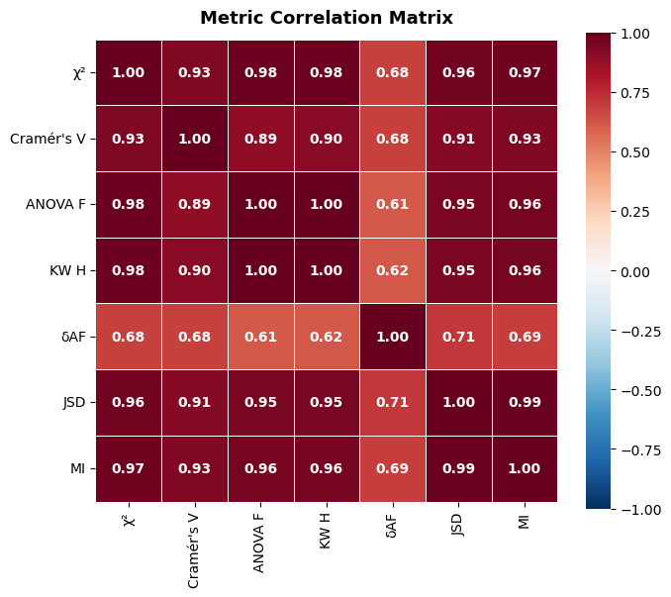
Finding Independent Signals
Most metrics are highly correlated — they measure the same underlying phenomenon
Pearson R across 614,759 SNPs:
ANOVA F ↔ KW H
1.00
Identical — drop one
JSD ↔ MI
0.99
Identical — drop one
χ² ↔ ANOVA F
0.98
χ² subsumes ANOVA
χ² ↔ JSD
0.96
High overlap
χ² ↔ δAF
0.68
Most independent ✓
δAF ↔ JSD
0.71
Independent from freq. gap ✓
Three independent signals:
χ²
categorical
δAF
freq. gap
JSD
distrib.
AISNP Selection Pipeline
9 / 14

Slide 10
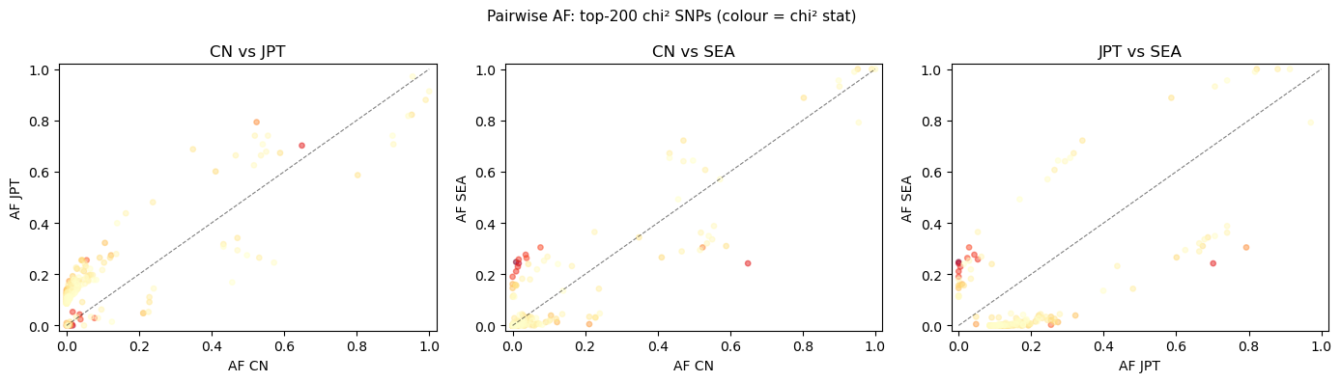
Note: δAF ≠ FST
Similar idea — very different mathematics and SNP selection
δAF (Max AF Delta)
FST (Fixation Index)
Formula
max |AF_i − AF_j|
Var(AF) / (p̄ × (1−p̄))
Normalization
None — absolute
By heterozygosity
Rare alleles
Same weight as common
Upweighted
Top-500 overlap with χ²
14%
~30–40%
Top-200 chi² SNPs: points far from the diagonal = high differentiation between populations
AISNP Selection Pipeline
10 / 14

Slide 11
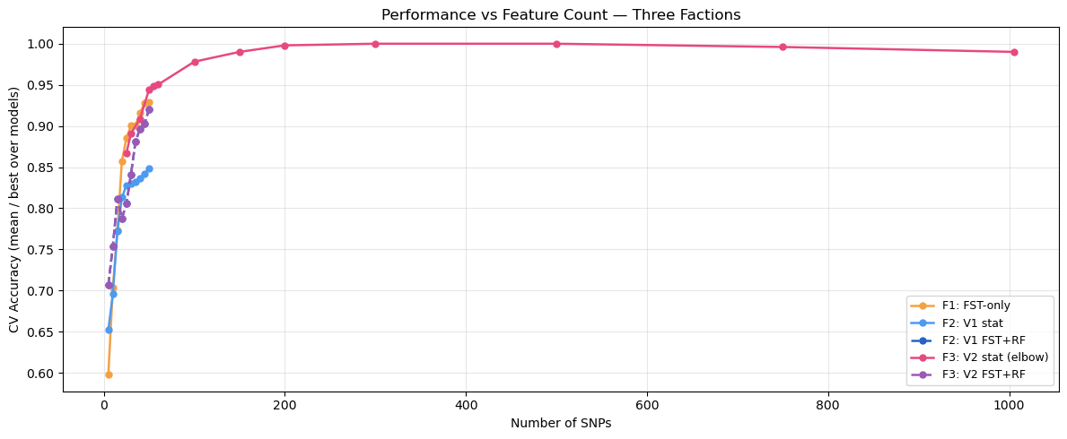
Stage 4 — ML-Based Panel Reduction
Starting from ~1,005 SNPs ranked by RF + LR feature importance
Panel Size
Best Accuracy
Classifier
Drop from full
50 SNPs
0.944
SVM (RBF)
−4.6%
100 SNPs
0.978
SVM (RBF)
−1.2% ← elbow
150 SNPs
0.990
SVM (RBF)
~0% (saturated)
AISNP Selection Pipeline
11 / 14

Slide 12
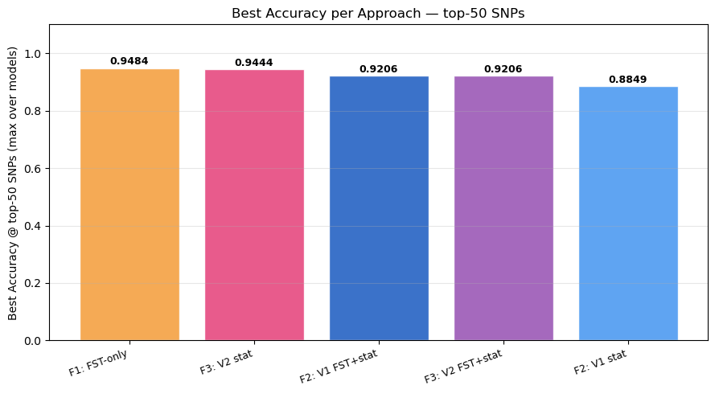
Results — Fair Comparison at Top-50 SNPs
All approaches evaluated at exactly 50 SNPs
Statistical V2 matches FST at top-50 | At 150+ SNPs statistical surpasses FST
• V1 → V2 improvement: +6 pp (new metric set was critical) • FST + Statistical combination does NOT improve over either alone at top-50
AISNP Selection Pipeline
12 / 14

Slide 13
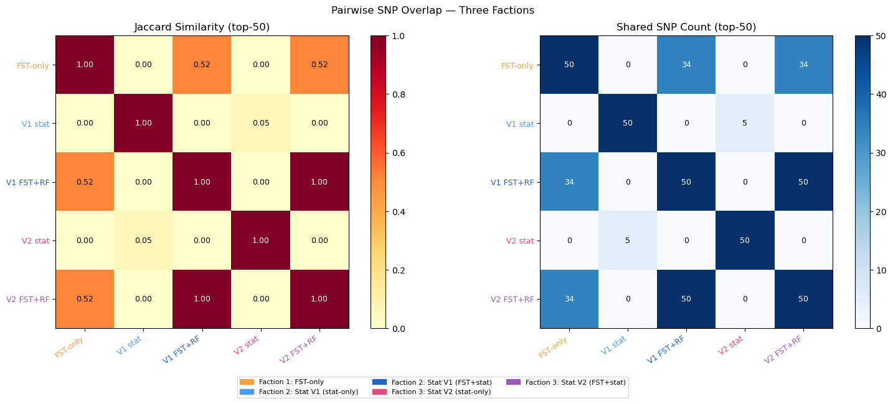
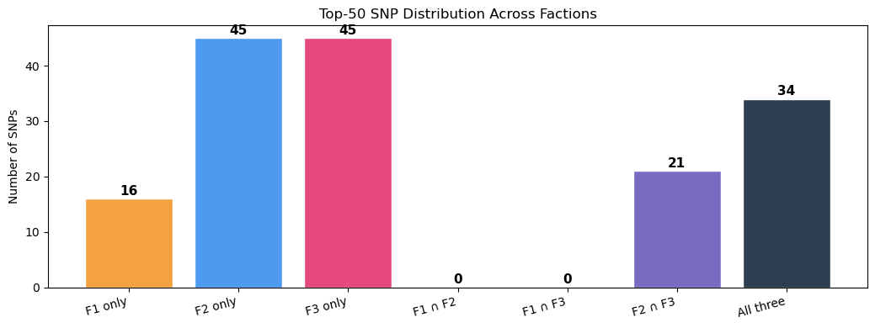
The 34-SNP Core
SNPs confirmed by every approach — the highest-confidence markers
34
SNPs appear in the top-50 of FST-only ∩ V1 FST+RF ∩ V2 FST+RF — independently confirmed by three methodologically distinct pipelines
AISNP Selection Pipeline
13 / 14

Slide 14
Key Takeaways & Future Work
1
Statistics rivals FST
χ², δAF, JSD union matches FST accuracy at 50 SNPs and surpasses it at larger panels
2
Most metrics redundant
7 tests collapse to 3 independent signals — less computation, no loss of information
3
50 SNPs is practical
94% accuracy — a realistic panel for genotyping arrays or targeted sequencing
4
Complementary, not substitutes
FST and statistical methods share only 34 SNPs — they probe different genomic signals
Future Work
• Benchmark vs published AISNP panels
• Validate 34-SNP core on external populations
• Extend to global populations beyond EAS
AISNP Selection Pipeline
14 / 14

