Slide 1
Digital Radiography: An Overview
From film to pixels to PACS
Diagnostic Imaging · Homework 1, Topic 1
Group: A · B · C · D (replace with names)
Primary source: Seeram E. (2019), Digital Radiography, 2nd ed., Springer, Ch. 1
Notes:
A opens. Welcome, introduce the four members and who speaks when: A (hook, definition, film, fluoroscopy), B (exposure factors, film limits, DR system, PACS), C (CR, flat panels, latitude, Activity 1), D (Activity 2, EI/DI, QA, close). Total about 17 minutes with two activities.

Slide 2
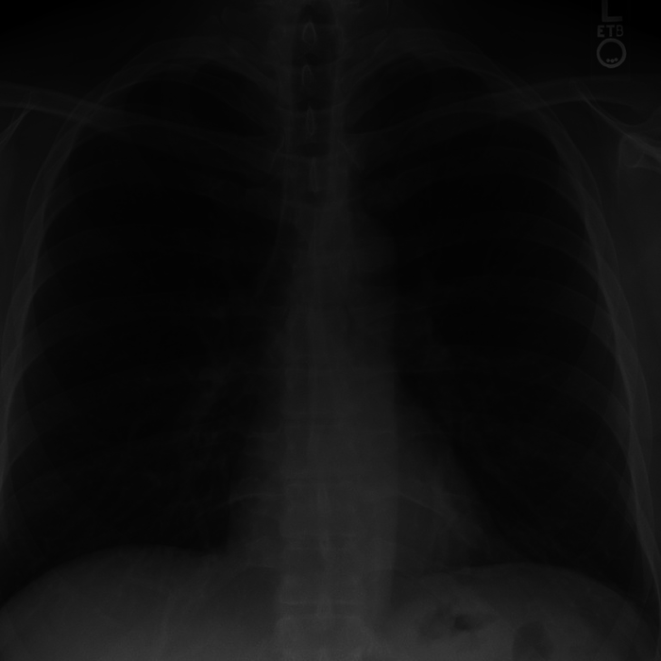
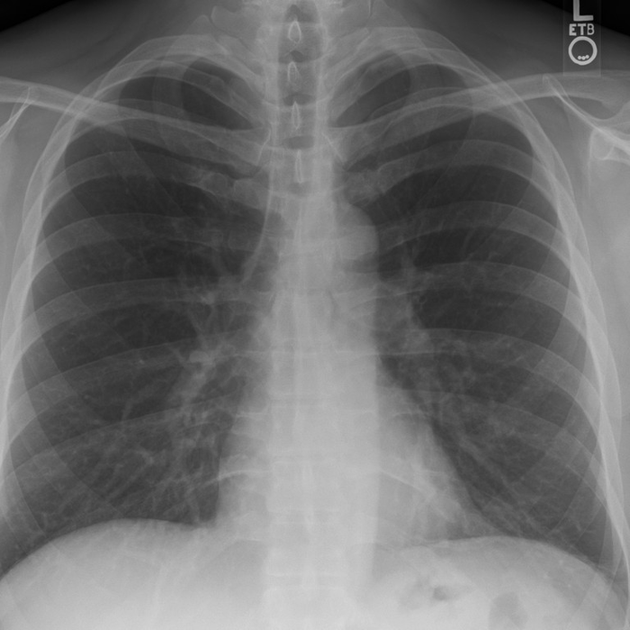
Same mistake, two outcomes
Same chest.
Same 4× mAs.
Film
Detectors
Dose
PACS
Film
Digital (DR)
almost black: repeat needed
looks normal
Which patient received too much radiation?
Images: simulated by the group from a CC0 chest PA radiograph (Wikimedia Commons, Stillwaterising); film via an H&D-curve model, cf. Seeram (2019) Figs 1.3-1.4. Noise/exposure exaggerated.
1
Notes:
A. Show the same chest taken with 4x the correct mAs. On film it comes out almost black and must be repeated, so the patient gets more radiation. On digital it looks normal. Ask: which patient received too much radiation? Answer: both did, but only one image shows it. Keep this question open, we come back to it. Agenda: film, detectors, dose, PACS. HANDOVER: "First, how did film work and why did we leave it?"

Slide 3
What is digital radiography?
Digital detectors turn X-ray exposure into numbers, and give usable images over a wider range of exposures than film.
analog signal
X-ray tube
Patient
Digital detector
ADC
analog → digital
digital data
Displayed image
DAC
digital → analog
27 22 24
25 28 21
digital image = numbers
Computer
processing
Radiologists never see the numbers, only the displayed image.
Redrawn from Seeram (2019) Fig 1.1 and Fig 1.5; definition after AAPM Report 116, quoted in Seeram §1.2.
2
Notes:
A. In our words: digital radiography uses electronic or phosphor detectors to produce a digital projection image, and it works over a wider range of exposures than film. Walk the chain: tube, patient, detector. The detector produces an analog signal; the ADC converts it to numbers; the computer processes it; the DAC turns the numbers back into a signal for the monitor. Key point: the radiologist never sees the numbers, only the displayed image. HANDOVER: "Before we see how digital works, how did film work?" (still A).

Slide 4
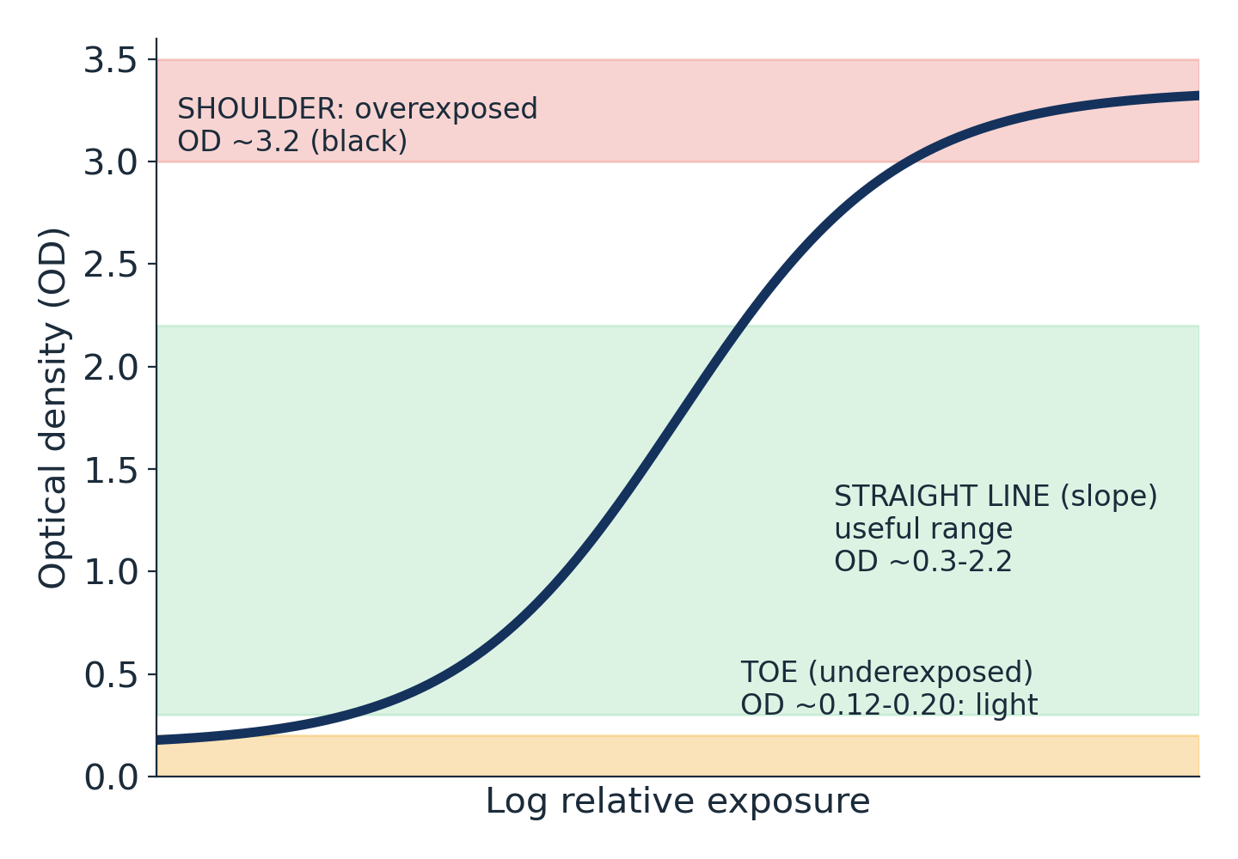

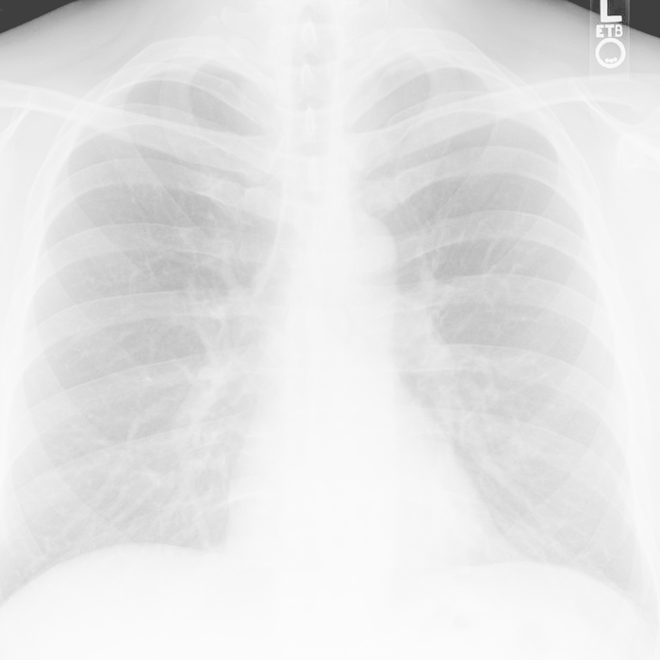
How film works, and its S-curve
X-ray exposure
Shoulder
overexposed
Latent image
Straight line
Chemical processing
useful
Toe
Viewbox
underexposed
OD = log₁₀ (I₀ / Iₜ) · Film = detector + display + archive in one
Redrawn from Seeram (2019) Figs 1.2 and 1.4 (OD values from §1.3.2). Thumbnails: simulated by the group from a CC0 chest radiograph.
3
Notes:
A. Film chain: X-rays make a latent image, chemical processing makes it visible, the radiologist reads it on a viewbox. Optical density OD = log of incident over transmitted light. The characteristic or H&D curve plots OD against log exposure. Toe: underexposed, light, OD about 0.12 to 0.20. Straight-line portion: useful, OD about 0.3 to 2.2. Shoulder: overexposed, dark, OD about 3.2. Film is detector, display and archive in one. HANDOVER: "B will show what technologists can control, and why film had to go."

Slide 5
Exposure factors: what the technologist controls
 | kVp (tube voltage) | mAs (tube current × time)
Controls | Beam quality: penetrating power | Beam quantity: number of photons
Main image effect | Contrast: lower kVp = higher contrast | Noise: low mAs = grainy (quantum mottle)
Patient dose | ≈ kVp² at fixed mAs | Proportional: 2× mAs = 2× dose
AEC stops the exposure at a preset detector level (film: optical density · digital: signal-to-noise)
Seeram (2019) §1.3.3-1.3.6. Dose-vs-kVp relation is an approximation at fixed mAs.
4
Notes:
B. kVp sets beam quality or penetration and is the main control of contrast: lower kVp, higher contrast. mAs is mA times seconds, it sets the number of photons and is the main control of noise: low mAs gives quantum mottle. Dose is directly proportional to mAs; at fixed mAs it rises roughly with kVp squared (approximation). Higher kVp with lower mAs can cut dose but also lowers contrast. AEC ends the exposure when a preset detector level is reached: optical density for film, signal-to-noise for digital. HANDOVER from A: "B now explains..." HANDOVER to next slide: "What went wrong with film?"

Slide 6
Why film had to go
1
2
3
Wrong exposure = repeat
The display is fixed
The archive is physical
Too light or too dark film is unusable. A repeat means extra dose.
Brightness and contrast are set at exposure. A change needs a new exposure.
Envelopes, large rooms, manual retrieval. One copy in one place.
Film’s one strength: spatial resolution ≈ 5–15 lp/mm
Seeram (2019) §1.3.7.
5
Notes:
B. Three limitations. One: if exposure is wrong the film is too light or too dark; it must be repeated, so extra dose; film also cannot show tissue contrast differences below about 10 percent. Two: the display is fixed once processed; to change contrast you would need a new exposure. Three: the archive is physical, envelopes in a big room, retrieved by hand, one copy in one place. Film does have excellent spatial resolution, about 5 to 15 line pairs per mm. HANDOVER: "So what replaced the cassette and the darkroom? Let us look inside a digital system."

Slide 7
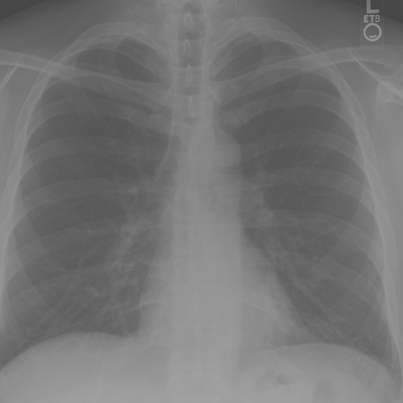
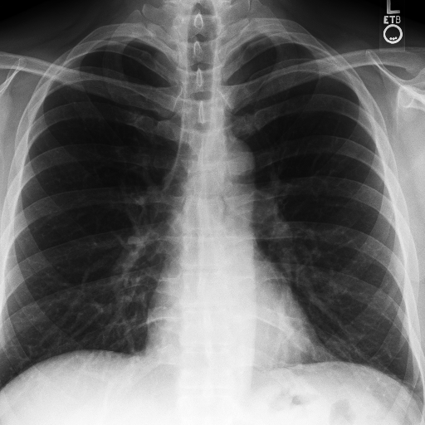
Inside a digital radiography system
1
2
3
4
5
6
Acquisition
ADC + computer
Display + post-processing
Storage
Communications
Management
digital detector
binary processing
DAC, monitor, grayscale mapping
RAID, tape, optical disk
LAN inside, WAN outside
PACS, RIS, HIS
Computers store everything as bits
EUCLID in binary:
01000101 01010101 01000011
01001100 01001001 01000100
Grayscale mapping: low → high contrast
Redrawn from Seeram (2019) Fig 1.5 and §1.4; grayscale mapping after Fig 1.6 (same CC0 chest radiograph, processed by the group).
6
Notes:
B. Six building blocks. One, data acquisition: the detector. Two, ADC and computer processing; computers store bits, for example the word EUCLID in 8-bit ASCII. Three, display and post-processing: DAC, then tools such as grayscale mapping that turn a low-contrast image into a high-contrast one. Four, storage: RAID, tape, optical disk. Five, communications: LAN inside the hospital, WAN outside. Six, image and information management: PACS, RIS, HIS. HANDOVER: "C will open the detector and show what turns X-rays into a signal."

Slide 8
Computed radiography (CR): the reusable plate
1
2
3
4
Expose the plate
(latent image)
Laser scan
(light emitted)
Light guide + PMT
(electrical signal)
Digital processing
Phosphor
BaFBr:Eu²⁺ on an imaging plate (IP)
Introduced
Fuji, 1983
Spatial resolution
≈ 3–5 lp/mm
Dynamic range
≈ 10,000 : 1 (far wider than film)
7
6
5
Plate ready
for reuse
Erase with
bright light
Display
back to step 1
Latent image = trapped electrons; the laser frees them as light
Redrawn from Seeram (2019) Fig 1.8 and §1.6.1. Laser/emission details: Storage Phosphors for Medical Imaging, Materials 2011 (PMC5448636).
7
Notes:
C. CR uses a photostimulable phosphor, barium fluorohalide, on an imaging plate in a cassette, so existing X-ray rooms can be used. Fuji introduced it clinically in 1983. Cycle: one, expose the plate, electrons are trapped as a latent image. Two, a laser scans the plate, trapped electrons are released and light is emitted. Three, a light guide and photomultiplier tube turn the light into an electrical signal. Four, the computer processes it. Five, display. Six, erase the plate with bright light. Seven, reuse. Spatial resolution about 3 to 5 lp/mm, but a far wider dynamic range than film. HANDOVER: "Now the detector that needs no cassette at all."

Slide 9
Flat-panel detectors: indirect vs direct
Indirect: X-ray → light → signal
Direct: X-ray → signal
X-ray photons ↓
X-ray photons ↓
Scintillator (CsI)
Photoconductor (a-Se)
light
light
no light step
a-Si photodiode + TFT array
TFT array
Electrical signal → digital image
Electrical signal → digital image
Both: immediate readout · high DQE · resolution comparable to CR · (variant: scintillator + optics + CCD)
Redrawn from Seeram (2019) Figs 1.9 and 1.10, §1.6.2. Terms (a-Si photodiode + TFT): see sources.md.
8
Notes:
C. Two families of flat-panel detector. Indirect: a scintillator, usually caesium iodide, turns X-rays into light; an amorphous-silicon photodiode and TFT array turn the light into charge and signal. X-ray to light to electrical signal. Direct: a photoconductor, amorphous selenium, turns X-rays straight into charge, which the TFT array reads out. X-ray to electrical signal, no light step. A third variant uses scintillator, optics and a CCD array. All flat panels read out immediately, have high DQE and resolution comparable to CR. HANDOVER: "These detectors are linear. Why that matters for exposure..."

Slide 10
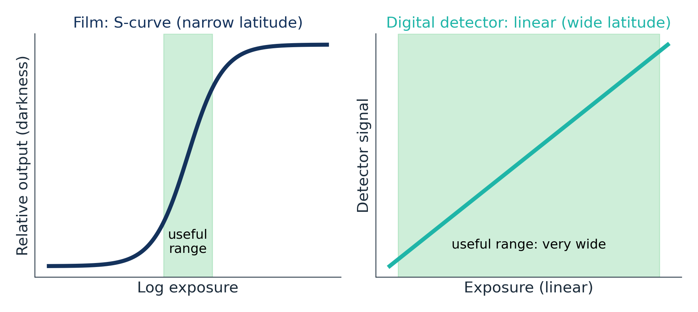
Straight line vs S-curve: exposure latitude
Too little exposure
→ grain (noise) shows
Too much exposure
→ looks fine, dose is hidden
Digital dynamic range ≈ 10,000 : 1; film’s useful latitude is far narrower.
So how good are your eyes at judging exposure?
Redrawn from Seeram (2019) Figs 1.4 and 1.11, §1.6.2. Dynamic range: Seeram §1.6.1 (see Knowledge Guide for caveat).
9
Notes:
C. Film has an S-shaped curve and a narrow useful range. A digital detector responds linearly over a very wide range, so the computer can rescale the brightness and give an acceptable image even if exposure was too low or too high. The catch: under-exposure shows up as noise, grain. Over-exposure does not show at all until the detector saturates, so nobody notices the extra dose. That is why we test your eyes now. HANDOVER: "Activity 1: the Radiologist Eye Test."

Slide 11
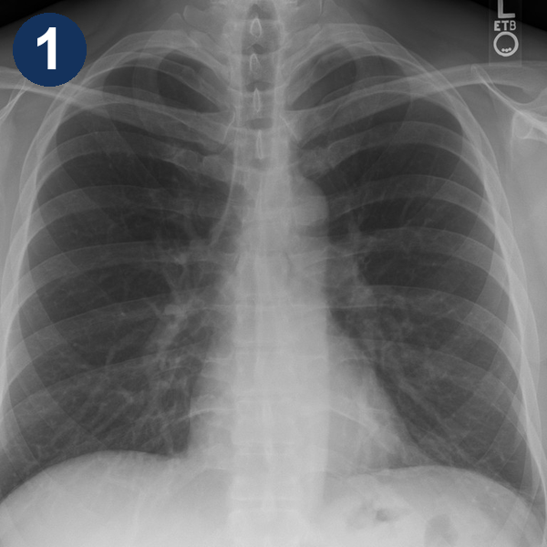
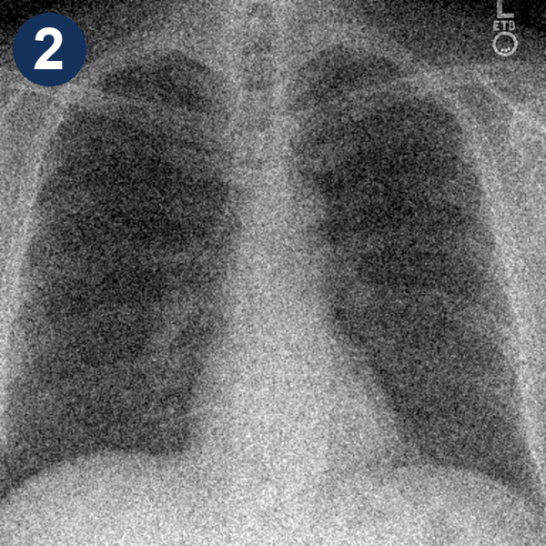


Activity 1: the Radiologist Eye Test
ACTIVITY 1 · 1 min
Four chest X-rays: same patient, different dose.
Hold up 1–4 fingers: which got the LOWEST dose?
Now: which got the HIGHEST?
Open DR_Lab.html → tab 2 “Warm-up”
Images: simulated by the group from a CC0 chest radiograph (Wikimedia Commons); noise exaggerated for projection. Run from DR_Lab.html, tab 2.
10
Notes:
C hosts, D reveals. Open DR_Lab.html tab 2. Say: four chest X-rays, same patient, different doses. Hold up fingers: which panel got the LOWEST dose? (10 s; most hold up 2, the grainiest.) D clicks Reveal lowest. Now: which got the HIGHEST dose? (10 s; class splits between 1 and 3.) D clicks Reveal all: panels are 1x, 1/4x, 3x, 1/2x. Punchline: grain tells you when you gave too little; nothing tells you when you gave too much. Remember that for the next game. HANDOVER to D: "D runs X-ray Blackjack."

Slide 12
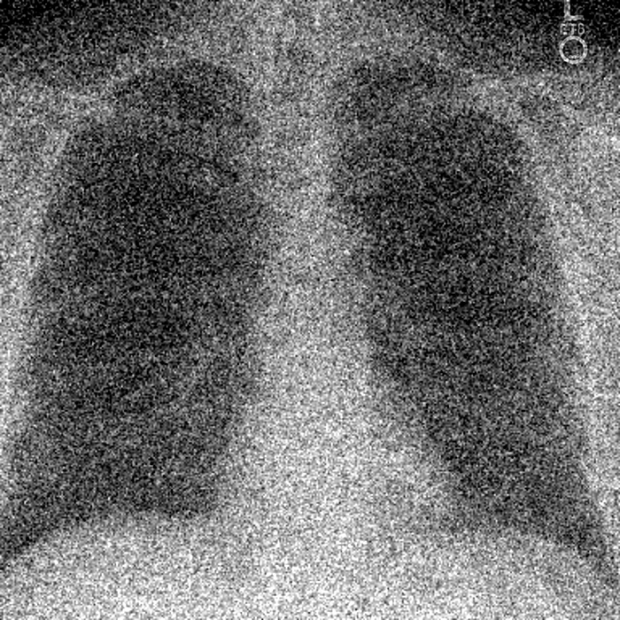
Activity 2: X-ray Blackjack
ACTIVITY 2 · 3 min
30 s per turn · 3:00 total
1
Both teams start from the same grainy image.
2
Each turn: play a × card. It multiplies your last scan, so cards chain.
3
Order: first team once, then the other twice in a row, then alternate (L R R L R L R L). No copying: not the card your opponent just played.
Start: both teams
Ideal
×⅙
×¼
×⅓
×½
×1.5
×2
×3
×4
×6
4
4 scans each, or STAND (timeout = STAND). Last image counts.
Cards chain on your last scan
Score = Quality × 2 − Dose
start
1
play ×6
= 6 × start
then ×1.5
= 9 × start
Images: simulated by the group from a CC0 chest radiograph (Wikimedia Commons); simplified model: noise ∝ 1/√photons, dose ∝ mAs (Seeram §1.3.5-1.3.6). DR_Lab.html, tab 3.
11
Notes:
D hosts; A clicks cards, B referees, C collects Team Left votes. Split the room into Team Left and Team Right, each with a captain. Both teams start from the same grainy image; the ideal image is always on screen. Each round, a team plays a multiplier card on its own last scan, so cards chain (x6 then x1.5 = x9 of the start). The new image appears for both teams, so they compare; once anyone has played, the START image appears as a reference column. The first team's card is blocked for the second team that round. The Random button decides who plays first; that team plays once, then the other team plays twice in a row (its trade for going second), then they alternate: L R R L R L R L, four scans each. Clocks: 30 seconds per turn (timeout means that team stands) and 3 minutes for the whole game (when it ends both teams stand). Up to 4 rounds or STAND; a team that stands is out, but the other team keeps playing all its remaining rounds, so standing early gives no advantage. The last image is the submission. Score = Quality x 2 minus Dose; quality is hidden until the reveal, dose is the bar. About 25 s per round. Then press Reveal and hand to slide 12.

Slide 13
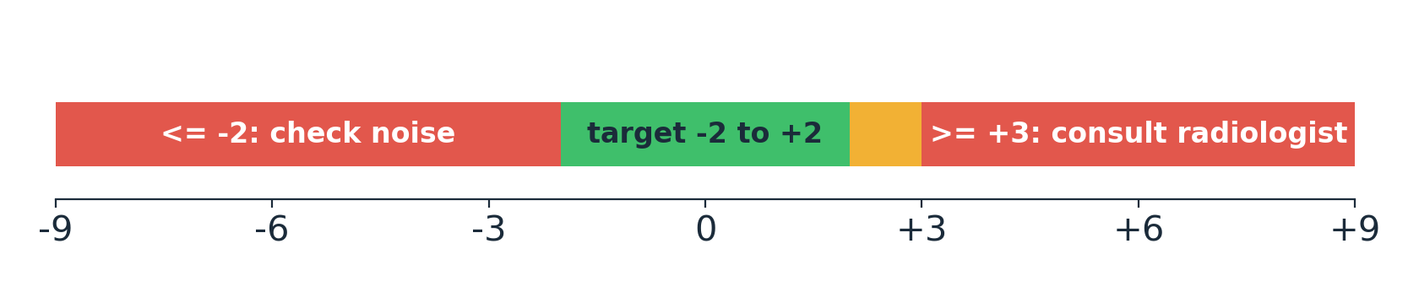
The number your eyes can’t see: EI, DI and dose creep
DI = 10 · log₁₀ (EI / EIₜ)
EI: standardized detector-exposure number (not patient dose). EIₜ: target for the exam. +3 ≈ 2× exposure · −3 ≈ ½×
1× · DI 0.0
3× · DI +4.8
Both look right. Only the DI shows who gave 3× the exposure.
Dose creep: exposures drift upward because over-exposed digital images look fine.
ALARA: read the number, not just the image
AAPM Report No. 116 (2009) and IEC 62494-1 (2008); DI action bands as summarised in Seibert, IUPESM slides (see sources.md). Images: simulated by the group.
12
Notes:
D debriefs the game. Show the two final images: they look the same, yet one team gave about three times the exposure. The Exposure Index is a standardized number tied to the detector exposure; each exam has a target EI. The Deviation Index is ten times log10 of EI over target EI. DI zero is on target; plus 3 is about double the exposure; minus 3 is about half. Guidance summarised from AAPM TG-116: target DI about minus 2 to plus 2; between plus 2 and plus 3 investigate the cause; at plus 3 or more consult the radiologist and counsel the technologist; at minus 2 or below check for noise and consider a repeat. Remember EI reflects the signal at the detector, it is not a measure of patient dose. Dose creep is the gradual drift to higher exposures because overexposed digital images look fine. That is the ALARA problem of digital. Answer to the opening question: both patients got extra dose, only film showed it. HANDOVER to A: "A will show where else digital imaging is used."

Slide 14
Beyond the chest X-ray: fluoroscopy and mammography
Digital fluoroscopy and DSA
Digital mammography
Pre-contrast image
−
Post-contrast image
=
Vessels only
CR
Direct FPD
Indirect FPD
CCD
detectors used
Real-time moving images (GI tract, vessels)
Image intensifier + TV/CCD → ADC
Subtraction: temporal (in time) or energy (two kVp)
Digital post-processing to enhance interpretation
CAD = “second reader” for microcalcifications and masses
Leads to digital tomosynthesis
Digital tools: process, subtract and flag, after the exposure
Seeram (2019) §1.6.3-1.6.4, Figs 1.12-1.13. Diagram redrawn by the group.
13
Notes:
A. Digital fluoroscopy gives real-time moving images, for the GI tract and blood vessels. It uses an image intensifier with a TV or CCD camera; the output is digitized by the ADC, and flat panels are replacing the intensifier. Digital subtraction angiography subtracts the pre-contrast image from the post-contrast image, leaving only the vessels. Temporal subtraction works in time; energy subtraction uses two kVp. Digital mammography uses CR, flat-panel or CCD detectors, allows post-processing, and computer-aided detection acts as a second reader for microcalcifications and masses. HANDOVER to B: "All these images go to PACS."

Slide 15
PACS: the department’s backbone
CT
HIS / RIS
(text data)
DICOM
MRI
images + metadata
HL7
CR
Inter-
faces
Diagnostic workstation
PACS server
database + archive
text / patient information
DR
IHE
US
Review workstation
makes them work together
Nuclear med.
Lossless
(reversible)
Lossy
(irreversible)
Web access
Film digitizer
Compression
Next era: enterprise imaging · cloud · Big Data (volume, variety, velocity, veracity) · machine / deep learning · AI
Redrawn from Seeram (2019) Fig 1.14, §1.4.4-1.7, §1.9. IHE: RSNA + HIMSS, 1998. Next-era terms: Seeram §1.9.2.
14
Notes:
B. PACS is a computer system for electronic storage and distribution of medical images, integrated with the acquisition and display devices and linked to RIS and HIS. Modalities such as CT, MRI, CR, DR, ultrasound, nuclear medicine and film digitizers send images through interfaces to the PACS server with its database and archive; diagnostic and review workstations and web access display them. DICOM is for images; HL7 is for text and patient information; IHE makes the standards work together. Compression: lossless is reversible, lossy is not. One line on the next era: enterprise imaging, cloud, Big Data with its four Vs, machine learning, deep learning, AI. HANDOVER to D: "D closes with quality assurance and the take-home."

Slide 16
Quality assurance and take-home
1
2
3
Film = detector + display + archive in one, with narrow latitude.
DR splits them: detector (CR / indirect / direct) → computer → display → PACS.
Wide latitude hides overexposure: read the EI / DI, not just the image.
QA / QC aims
Minimum dose (ALARA)
Optimum image quality for diagnosis
Lower the cost of radiology operations
The technologist of the future is also an informaticist
Seeram (2019) §1.8 and §1.9.3; EI/DI: AAPM Report 116 (2009).
15
Notes:
D closes. QA and QC have three goals: patients get minimum dose, ALARA; the image quality is optimal for diagnosis; and radiology operations cost less. Digital systems have their own QC tests, for example dark noise and exposure index calibration. The technologist of the future is also an informaticist or PACS administrator. Three messages. One: film combined detector, display and archive in one object, with narrow latitude. Two: digital splits them: detector, computer, display, PACS. Three: wide latitude hides overexposure, so read the EI and DI, not just the image. Thank the class and invite questions. Remind everyone to credit the AI declaration on the last slide.

Slide 17
References and AI declaration
Seeram E. Digital Radiography: Physical Principles and Quality Control. 2nd ed. Springer; 2019. Ch. 1. doi:10.1007/978-981-13-3244-9_1 (primary source)
Seibert JA. Dose metrics: exposure index (summary of AAPM TG-116 / IEC 62494-1). IUPESM teaching slides, 2015.
Leblans P, et al. Storage phosphors for medical imaging. Materials 2011;4:1034-86 (PMC5448636).
AAPM Report No. 116. An exposure indicator for digital radiography. 2009.
IEC 62494-1:2008. Exposure index of digital X-ray imaging systems.
Chest radiograph: "Chest Xray PA 3-8-2010.png", Stillwaterising, Wikimedia Commons, CC0 1.0. All exposure/film simulations were generated by the group from it.
AI declaration: Claude (Anthropic) assisted with planning, game design, scripting and slide drafting. The group checked all content against Seeram (2019) and the references above, and re-derived the game scores by simulation.
Notes:
D. References and AI declaration. Adjust the wording to the course regulation text if it differs.

