Slide 1
Assignment 1
Phạm Trần Gia Hưng - 2331200153
Exploring AWS
Global Infrastructure
AWS
Course: Cloud Computing | Lecturer: Rohit Kumar Kasera
Amazon Web Services

Slide 2
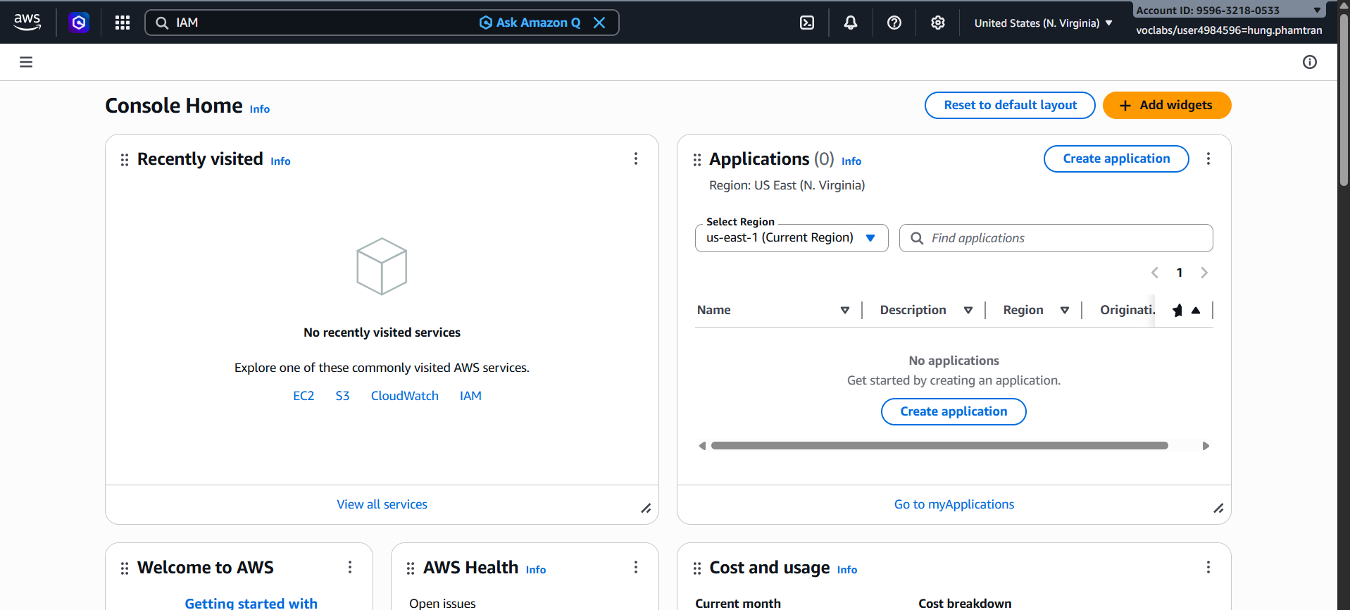
Task 1 – AWS Account Setup & Console Exploration
Successfully logged into the AWS Management Console and explored core services including EC2, S3, and IAM.
Assignment 1 – AWS Global Infrastructure | EIU

Slide 3
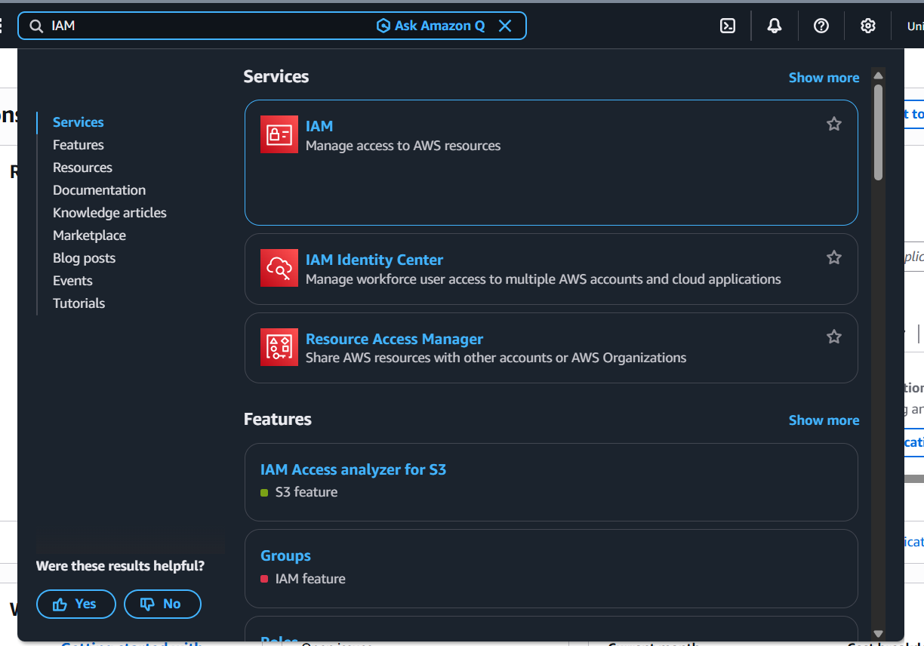
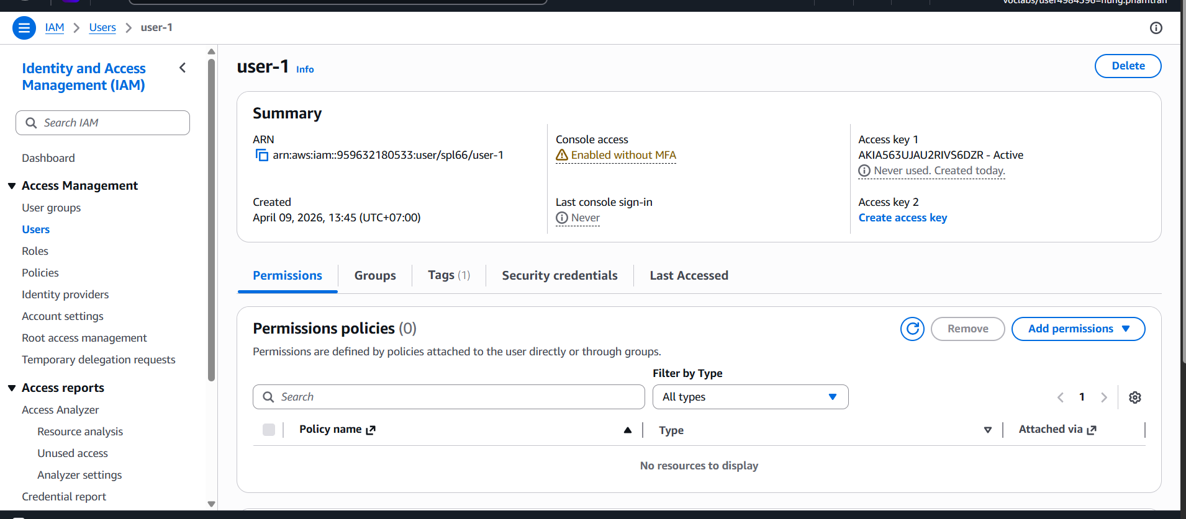
Task 2 – IAM Users & Groups
Three pre-created users (user-1, user-2, user-3) and three groups (EC2-Admin, EC2-Support, S3-Support) were inspected.
IAM Users list
user-1 permissions (none)
Assignment 1 – AWS Global Infrastructure | EIU

Slide 4
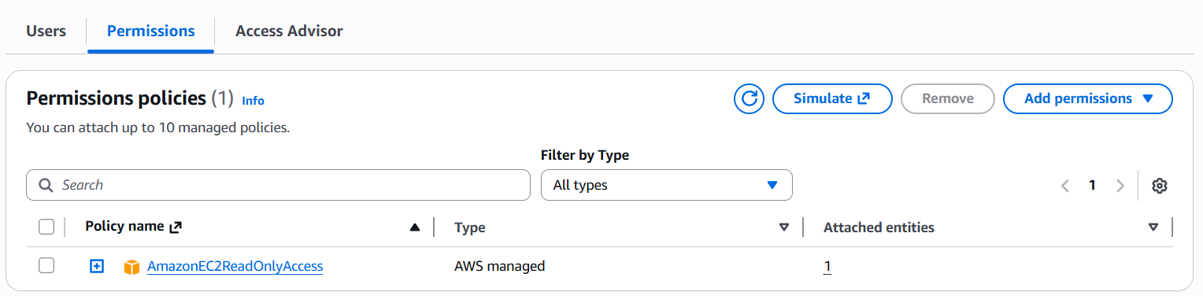
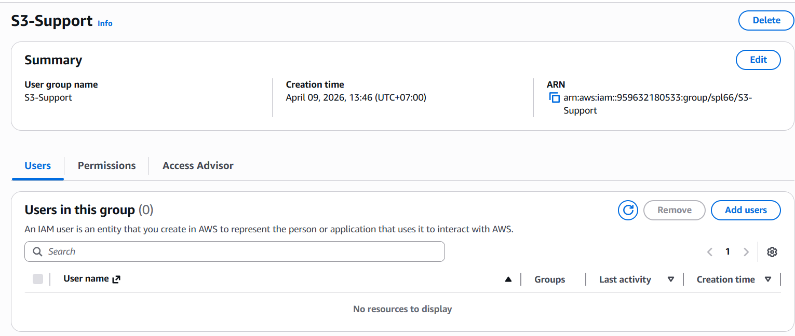
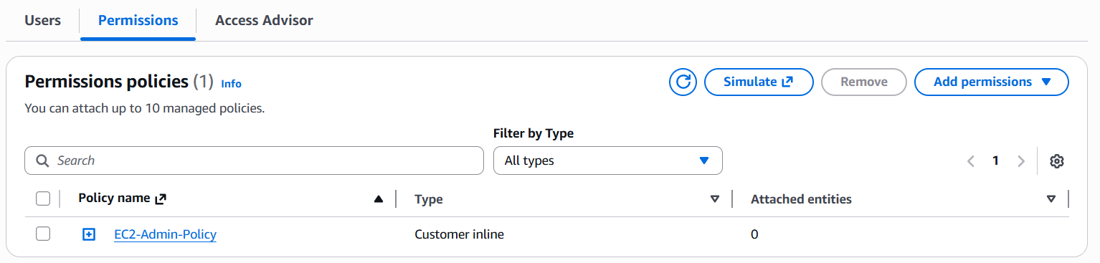
Task 2 – Inspecting IAM Policies
TASK 2
EC2-Support
S3-Support
EC2-Admin
AmazonEC2ReadOnlyAccess (Managed)
AmazonS3ReadOnlyAccess (Managed)
Inline Policy
List & Describe EC2, ELB, CloudWatch, Auto Scaling
Get & List resources in Amazon S3
Describe, Start & Stop EC2 instances
IAM Policy Structure: Effect (Allow/Deny) → Action (API calls) → Resource (scope)
Assignment 1 – AWS Global Infrastructure | EIU

Slide 5
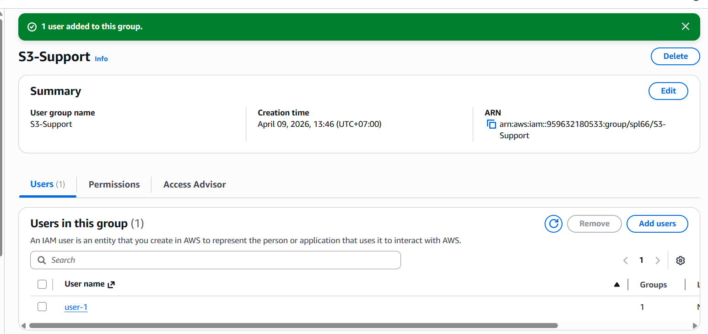
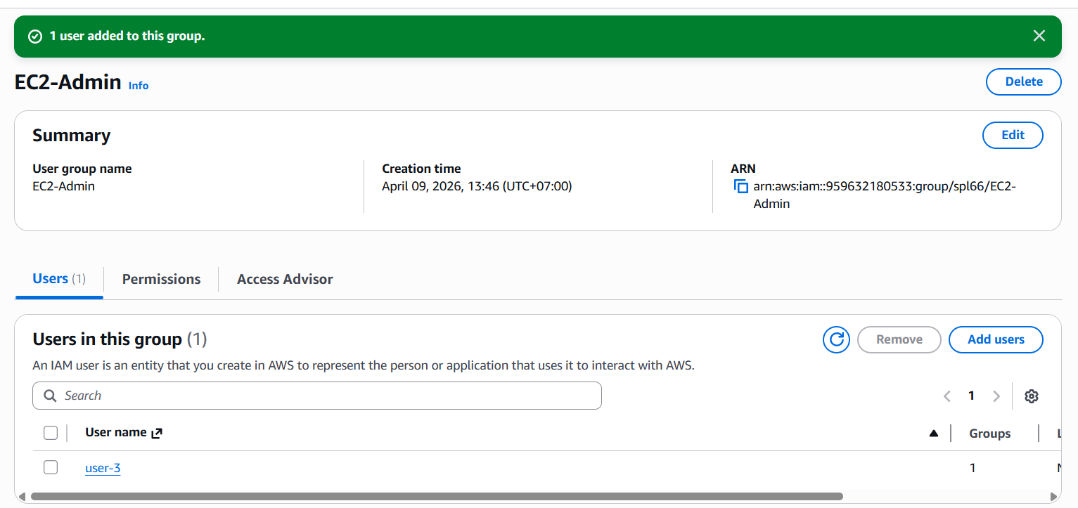
Task 3 – Add Users to Groups
User | Assigned Group | Policy Inherited
user-1 | S3-Support | AmazonS3ReadOnlyAccess
user-2 | EC2-Support | AmazonEC2ReadOnlyAccess
user-3 | EC2-Admin | EC2 Inline Policy (Start/Stop)
All groups now show 1 user each ✓
Assignment 1 – AWS Global Infrastructure | EIU

Slide 6
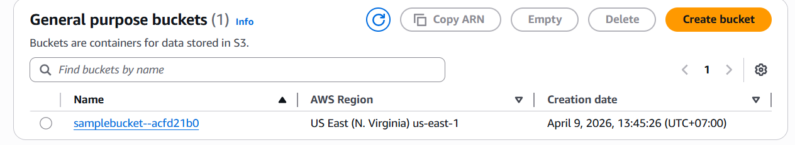
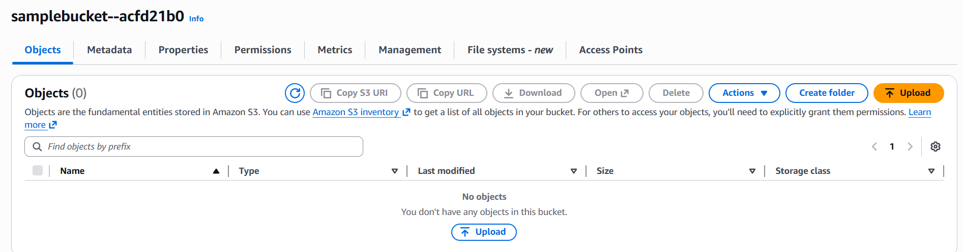
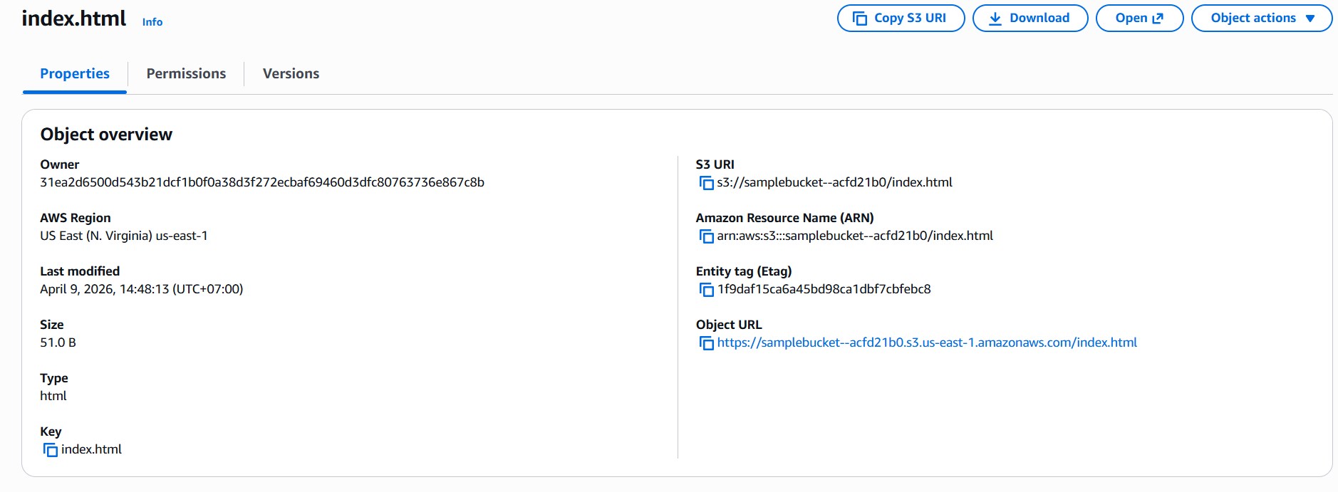
Task 4 – Static Website Deployment with Amazon S3
TASK 4
1
Created S3 bucket with unique naming
2
Disabled 'Block all public access'
3
Uploaded index.html
4
Enabled static website hosting
5
Set bucket policy for public read access
6
Tested website endpoint in browser ✓
Assignment 1 – AWS Global Infrastructure | EIU

Slide 7
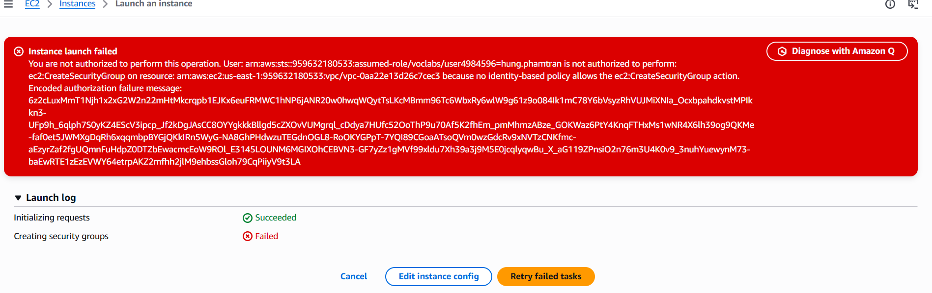
Task 5 – Launching EC2 Instance
TASK 5
AMI
Amazon Linux 2 (Free Tier)
Instance Type
t2.micro / t3.micro
Key Pair
RSA key pair for SSH
Security Group
Allow SSH (port 22)
Launch Method
GUI / AWS CLI / Terraform
Verify
uname -a command output
Assignment 1 – AWS Global Infrastructure | EIU

Slide 8
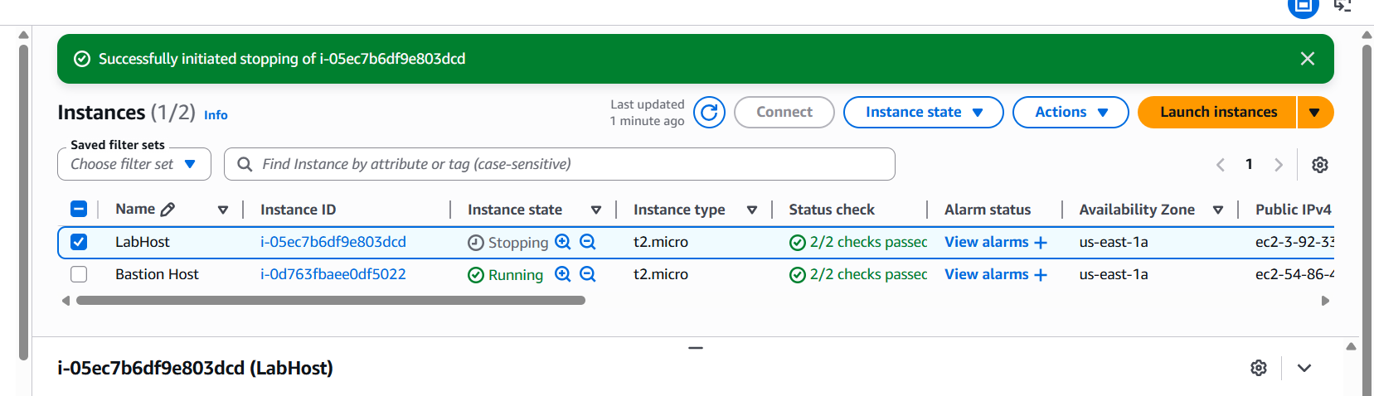
Task 6 – Terminating the EC2 Instance
It's crucial to terminate instances no longer in use to avoid unnecessary costs.
AWS Console (GUI)
AWS CLI
Terraform
Navigate to EC2 service
Select your instance
Click Instance State → Terminate instance
Confirm termination
aws ec2 terminate-instances
--instance-ids <your-id>
Navigate to your main.tf directory
Run: terraform destroy
Type yes to confirm
All provisioned resources removed
EC2 instance successfully terminated ✓
Assignment 1 – AWS Global Infrastructure | EIU

Slide 9
Task 7 – Reflection Questions
Q1: What felt different about deploying in the cloud vs. using your personal computer?
Deploying on AWS removes all physical constraints. Unlike a local machine limited by hardware, power, and cooling, AWS provides on-demand infrastructure. The pay-as-you-go pricing model means we only pay for what we use, and scaling is instant. AWS IAM also introduces granular access control — defining exactly what each user or service is allowed to do — making cloud environments significantly more secure than a shared local machine.
Q2: How does cloud computing change the way organizations build and deliver software?
Cloud computing transformed software delivery from slow, capital-heavy data centers to agile, on-demand infrastructure. Teams provision global resources instantly, CI/CD pipelines push updates daily, and services like S3, EC2, RDS, and IAM let developers focus on business logic rather than server management. Automatic scaling handles unexpected demand, and built-in redundancy ensures reliability without manual intervention — enabling organizations to operate faster, at lower cost, and globally.
Assignment 1 – AWS Global Infrastructure | EIU

