Slide 1
Assignment 2
Phạm Trần Gia Hưng – 2331200153
Launching, Load Balancing
& Scaling on AWS EC2
AWS
Amazon Web Services
Course: Cloud Computing | Lecturer: Rohit Kumar Kasera

Slide 2
Assignment Overview
Task 1
Task 2
Launch an EC2 Instance
via AWS Console
Monitor & Manage
the EC2 Instance
Task 3
Task 4
Load Balancer &
Auto Scaling Group
Reflection
Questions
Assignment 2 – EC2 Launching, Load Balancing & Scaling | EIU

Slide 3
Task 1 – Launching an EC2 Instance
Module 6 Lab-3 · AWS Academy
Configured the following settings before launching:
1 Name & Tag
2 AMI
Named the instance 'Web Server' — stored as a resource tag
Amazon Linux 2 (Free Tier) — provides the OS image
3 Instance Type
4 Key Pair
t2.micro — general purpose, Free Tier eligible
RSA key pair — used for encrypted SSH authentication
5 Network
6 Firewall
Lab VPC with two public subnets across two AZs
Created 'Web Server Security Group' — removed default SSH rule
Assignment 2 – EC2 Launching, Load Balancing & Scaling | EIU
Assignment 2 – EC2 Launching, Load Balancing & Scaling | EIU

Slide 4
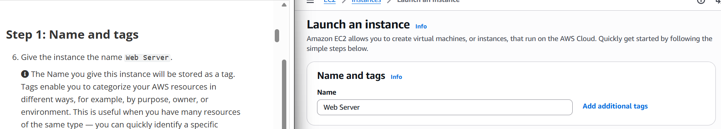
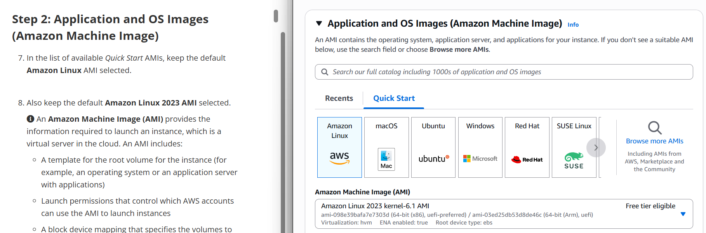
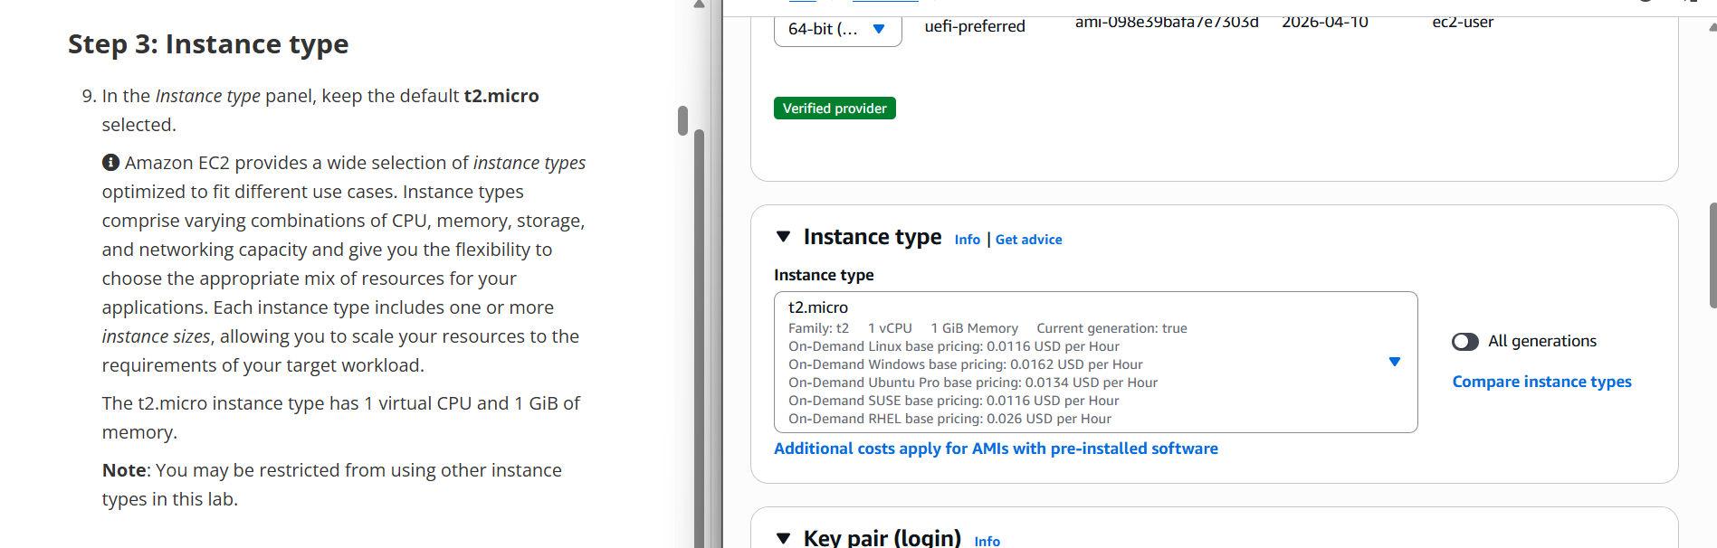
Task 1 – Instance Configuration Screenshots
Name & Tag · AMI · Instance Type
Amazon Machine Image (AMI)
Instance Type – t2.micro
Assignment 2 – EC2 Launching, Load Balancing & Scaling | EIU
Assignment 2 – EC2 Launching, Load Balancing & Scaling | EIU

Slide 5
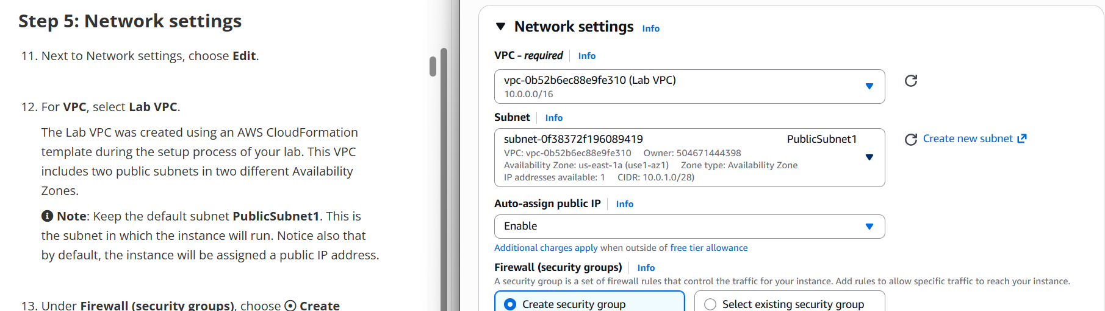
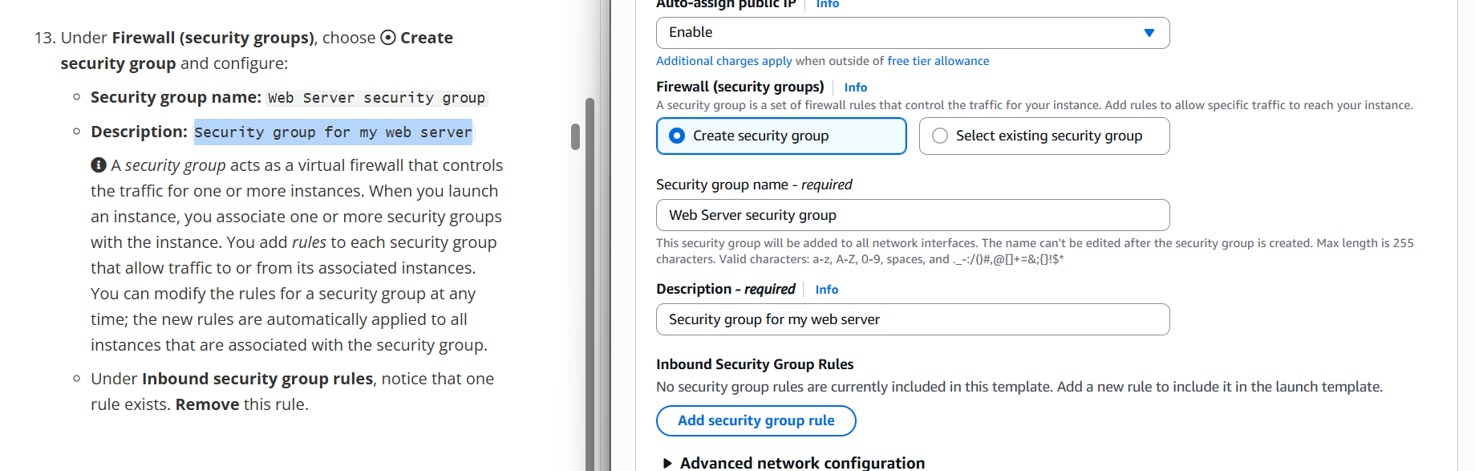
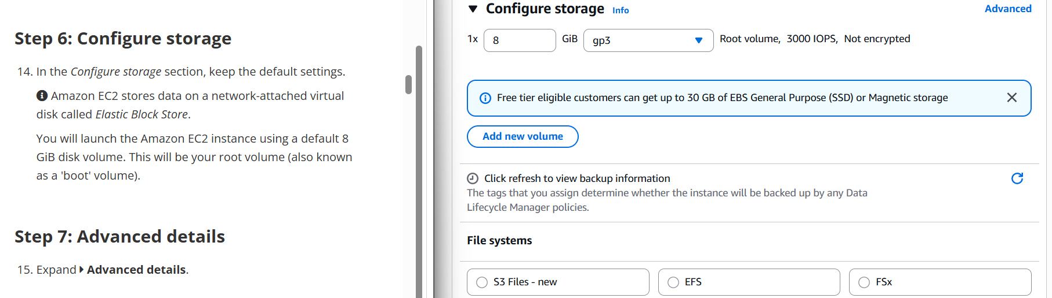
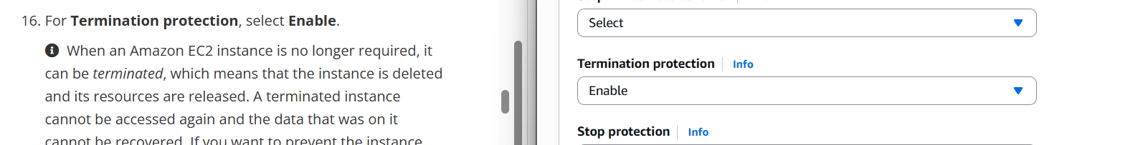
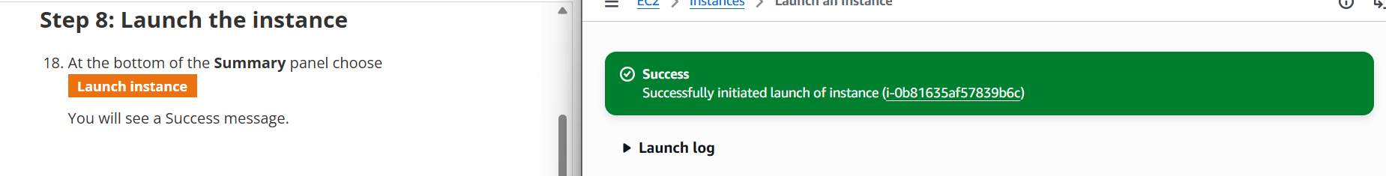
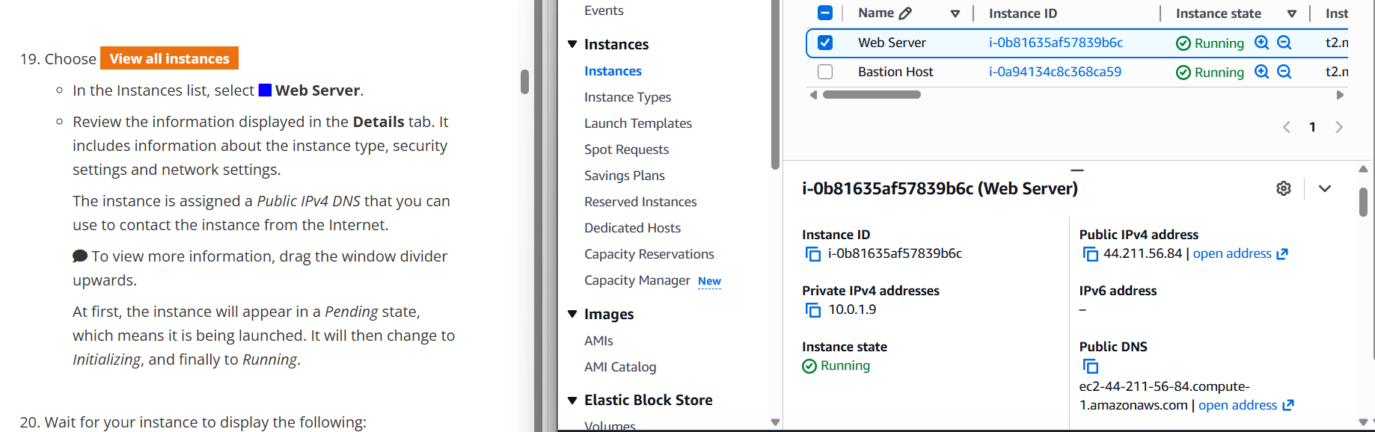
Task 1 – Network, Firewall, Storage & Advanced Settings
Network Setting – Lab VPC
Firewall – Security Group
Storage – 8 GiB Root Volume
Advanced – Termination Protection Enabled
Instance Successfully Launched
Assignment 2 – EC2 Launching, Load Balancing & Scaling | EIU
Assignment 2 – EC2 Launching, Load Balancing & Scaling | EIU

Slide 6
Task 2 – Monitor & Manage EC2 Instance
Module 6 Lab-3 · AWS Academy
Status Checks
CloudWatch Monitoring
Verified system & instance health — both passed (2/2 checks)
CPU Utilization, Network In/Out, Disk Read/Write observed in real time
System Log
Instance Screenshot
Retrieved OS boot log via Monitor & Troubleshoot menu
Captured graphical console screenshot to verify OS state
Security Group Update
Resize Instance
Added inbound HTTP (port 80) rule to allow web access
Stopped → changed to t2.small → resized EBS to 10 GiB → restarted
EC2 Limits
Stop Protection
Explored Service Quotas for running on-demand instances
Tested stop protection: blocked until explicitly disabled
Assignment 2 – EC2 Launching, Load Balancing & Scaling | EIU
Assignment 2 – EC2 Launching, Load Balancing & Scaling | EIU

Slide 7
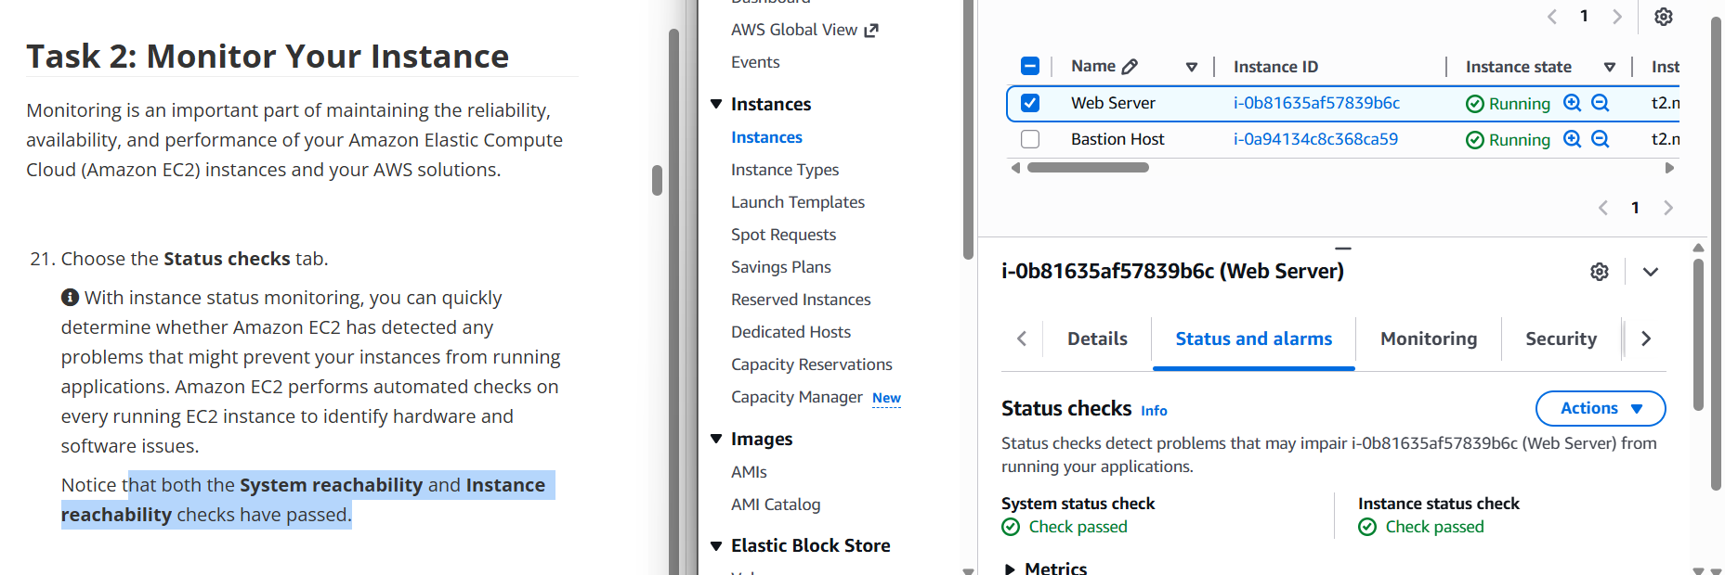
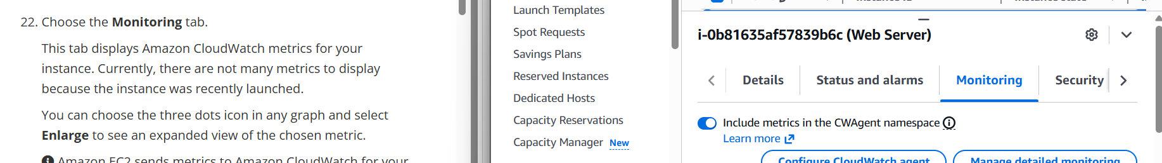
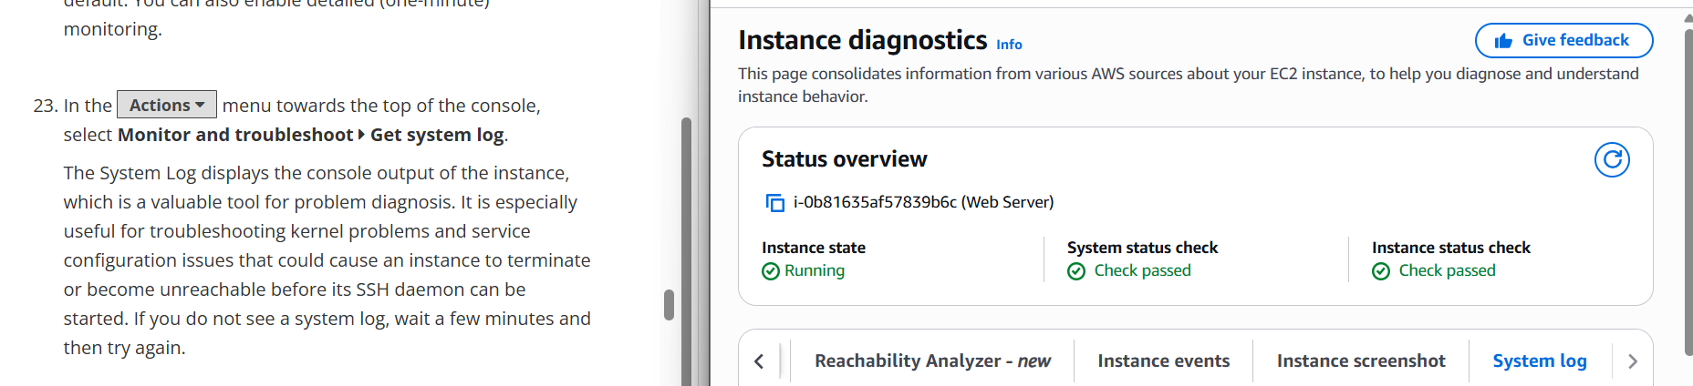
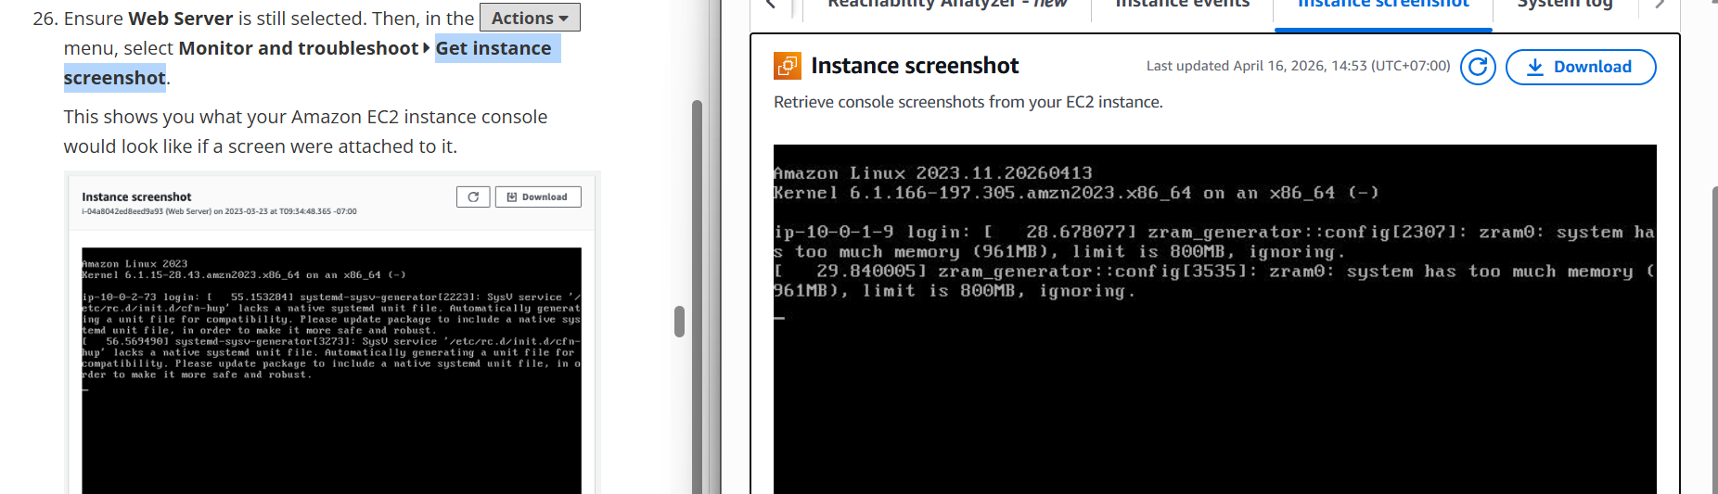
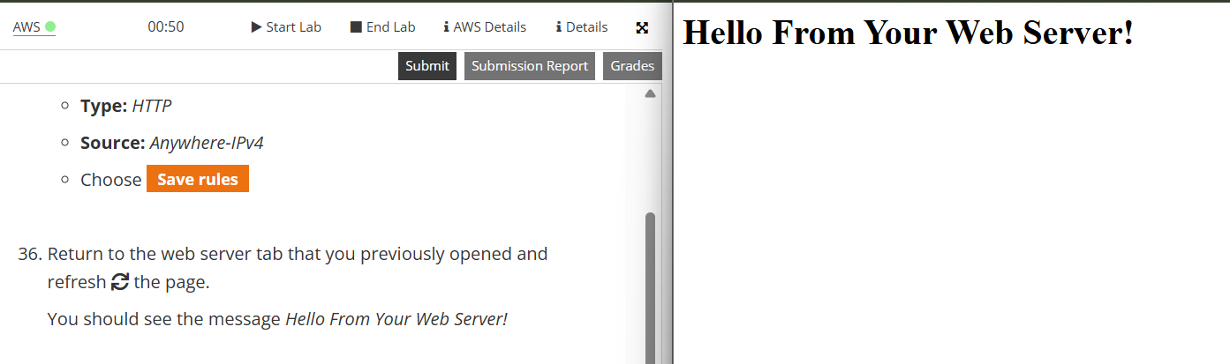
Task 2 – Status Checks & CloudWatch Monitoring
Status Check – 2/2 checks passed
CloudWatch Monitoring Tab
System Log (OS Boot Log)
Instance Screenshot (Console)
IPv4 Address – HTTP Access via Browser
Assignment 2 – EC2 Launching, Load Balancing & Scaling | EIU
Assignment 2 – EC2 Launching, Load Balancing & Scaling | EIU

Slide 8
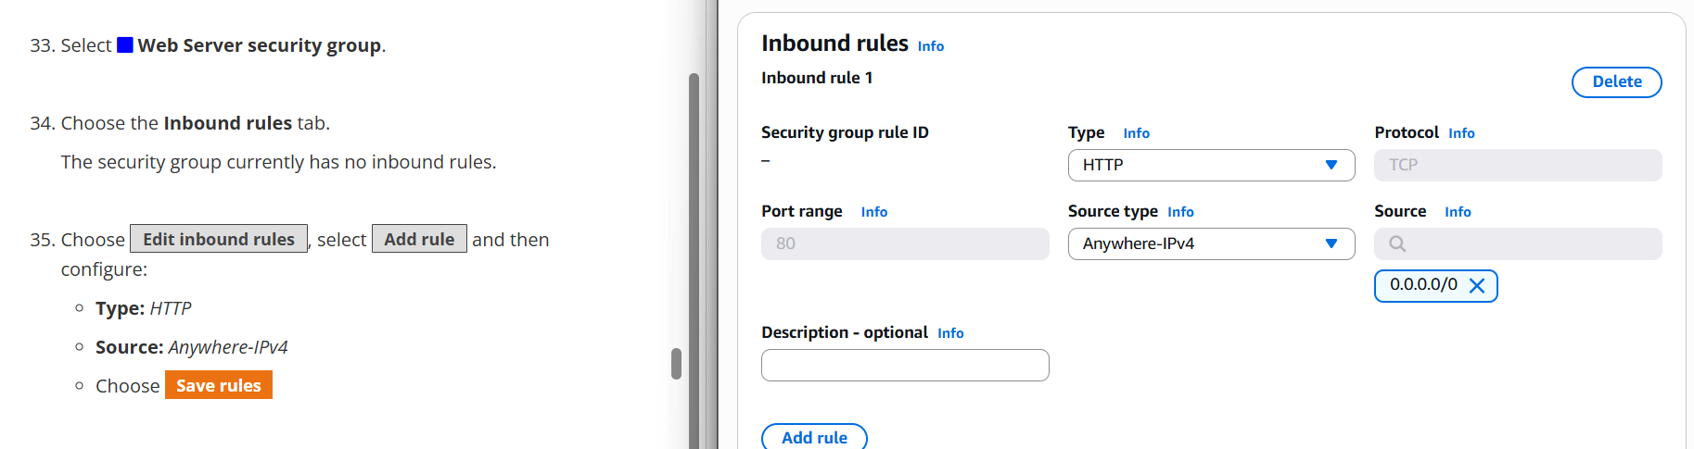
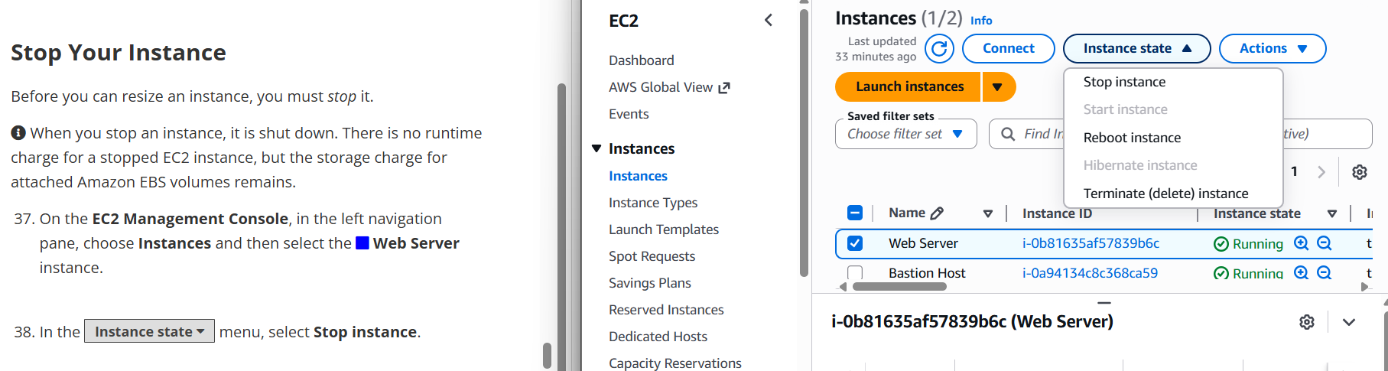
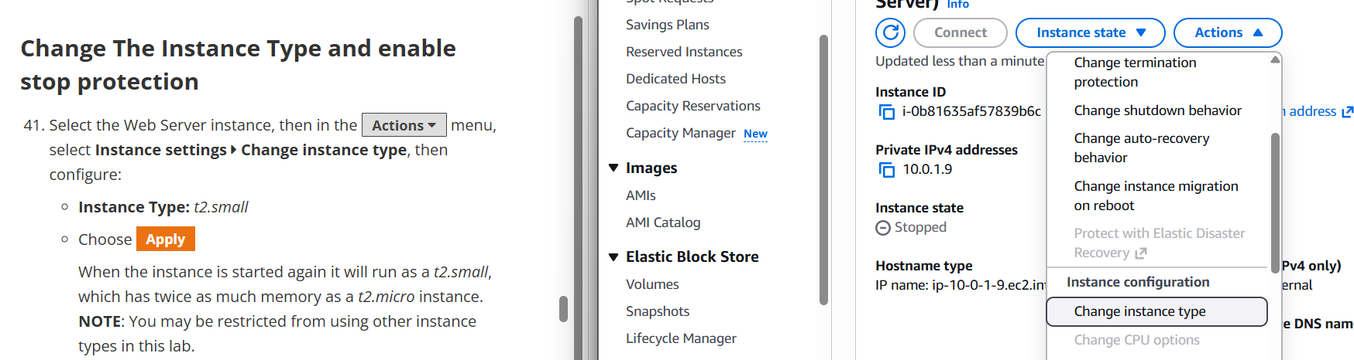
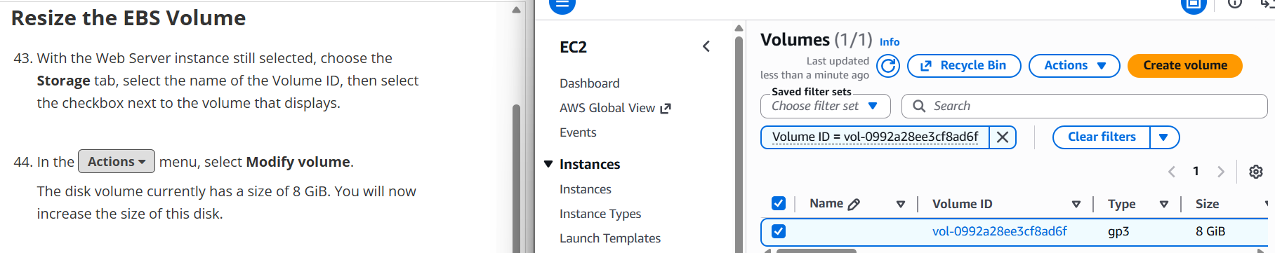
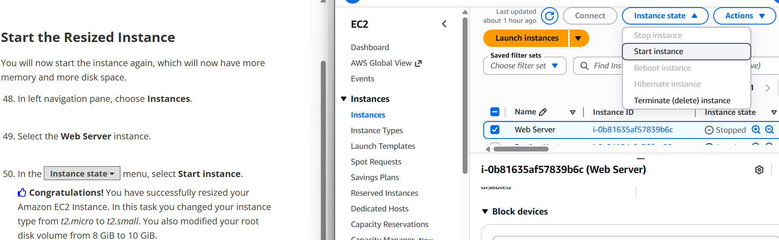
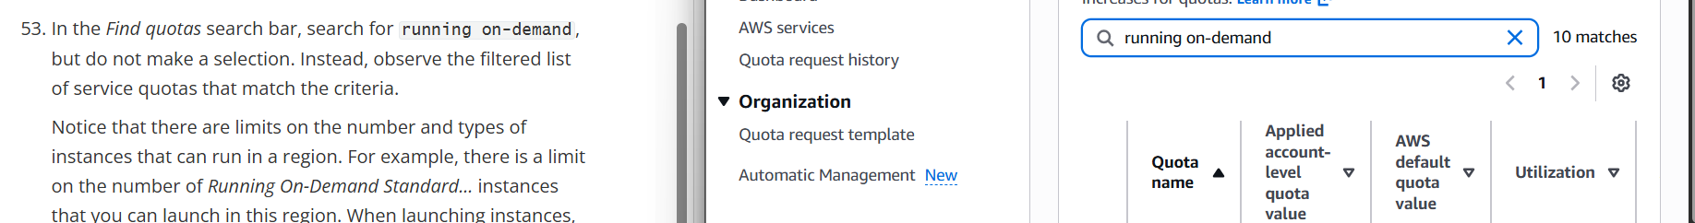
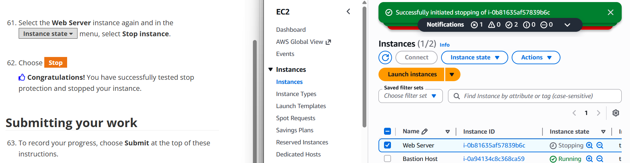
Task 2 – Security Group Update & Instance Resize
Add HTTP Inbound Rule (Port 80)
Stop Instance before Resize
Change Instance Type to t2.small
Resize EBS Volume (10 GiB)
Start Resized Instance & Explore EC2 Limits / Stop Protection
Assignment 2 – EC2 Launching, Load Balancing & Scaling | EIU
Assignment 2 – EC2 Launching, Load Balancing & Scaling | EIU

Slide 9
Task 3 – Load Balancer & Auto Scaling Group
Module 10 Lab-6 · AWS Academy
Create AMI
Target Group
1
2
Snapshot of Web Server 1 as blueprint for new instances
LabGroup – registers EC2 instances for health-checked routing
App Load Balancer
Launch Template
3
4
ALB distributes HTTP traffic across healthy instances
LabConfig – defines AMI, instance type, key pair, SG for ASG
Auto Scaling Group
Verify & Test
5
6
Min: 2 / Desired: 2 / Max: 6 — Target CPU: 60%
Confirmed LB DNS works; stress-tested to trigger scale-out
Assignment 2 – EC2 Launching, Load Balancing & Scaling | EIU
Assignment 2 – EC2 Launching, Load Balancing & Scaling | EIU

Slide 10
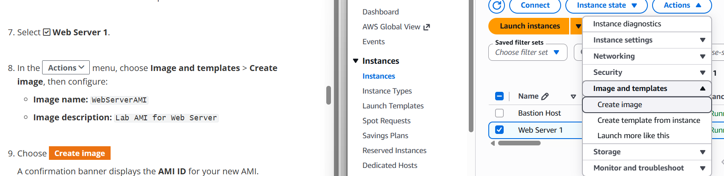
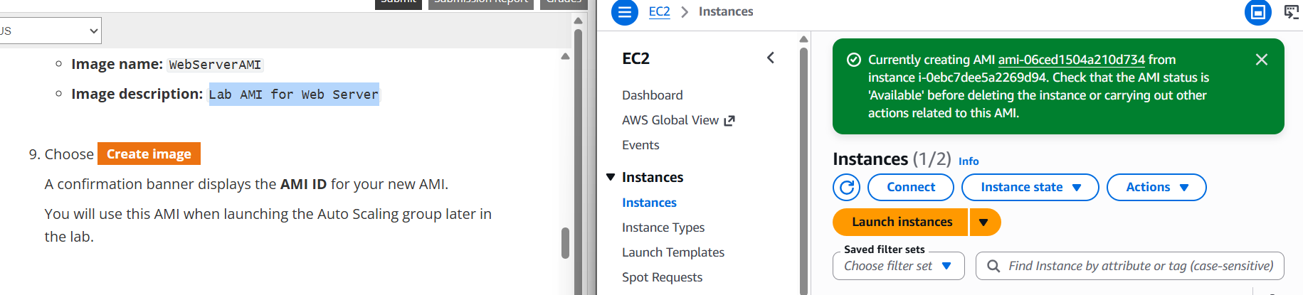
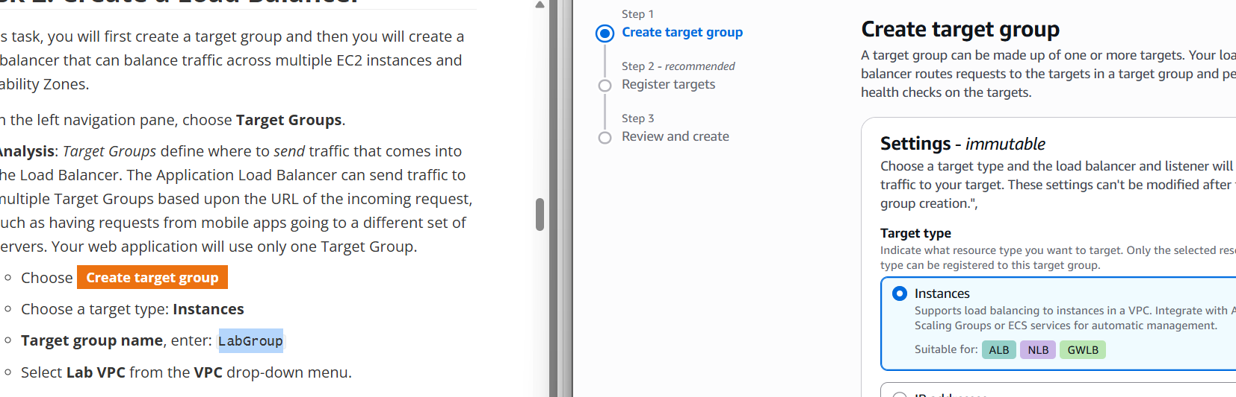
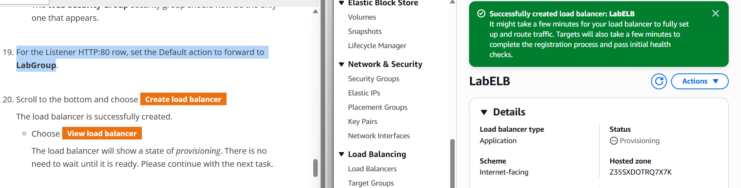
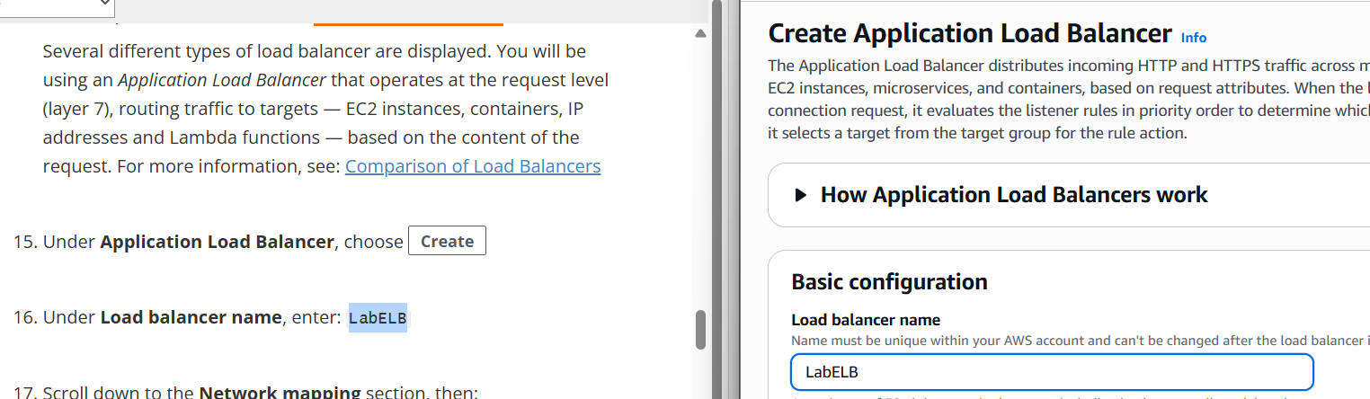
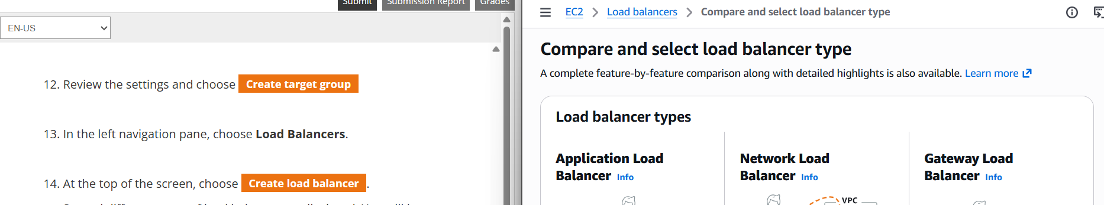
Task 3 – Creating AMI & Load Balancer
Select Web Server 1 → Create Image
AMI Created Successfully
Create Target Group (LabGroup)
Application Load Balancer Created
ALB Configuration – Listener HTTP:80 → forward to LabGroup
Assignment 2 – EC2 Launching, Load Balancing & Scaling | EIU
Assignment 2 – EC2 Launching, Load Balancing & Scaling | EIU

Slide 11
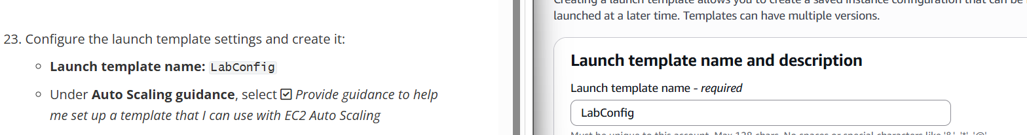
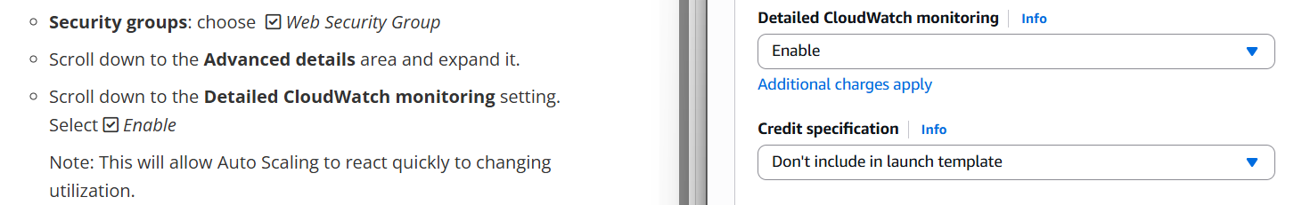
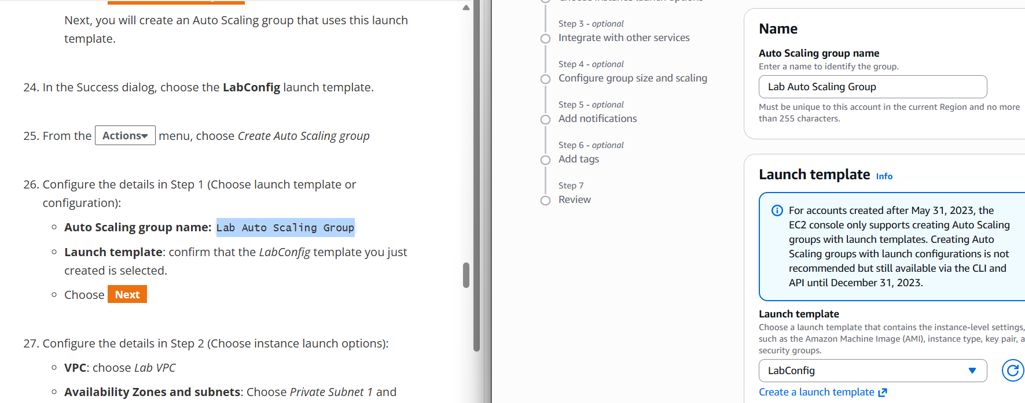
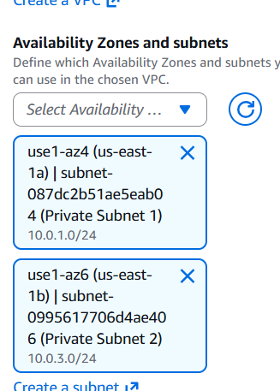
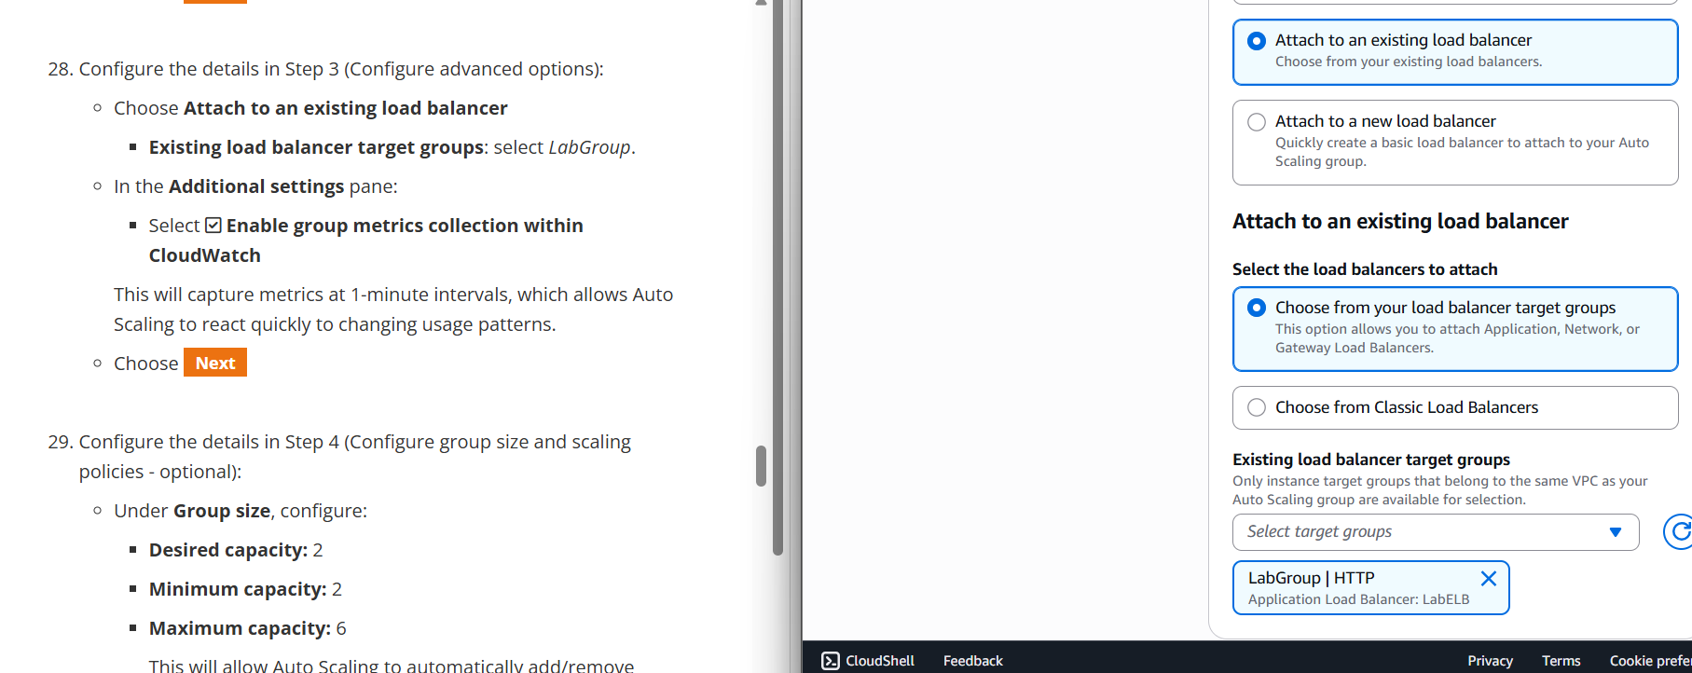
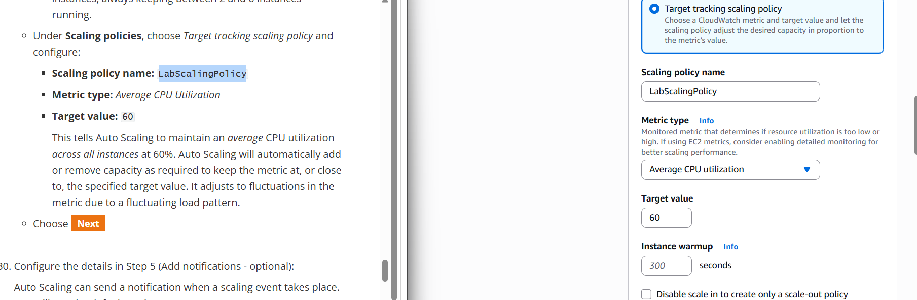
Task 3 – Launch Template & Auto Scaling Group
Launch Template – LabConfig (AMI, Instance Type, Key Pair, SG)
Auto Scaling Group – Step 1 & Step 2 (VPC / Subnets)
ASG Step 3 – Attach to Load Balancer + CloudWatch | Step 4 – Scaling Policy (CPU 60%)
Assignment 2 – EC2 Launching, Load Balancing & Scaling | EIU
Assignment 2 – EC2 Launching, Load Balancing & Scaling | EIU

Slide 12
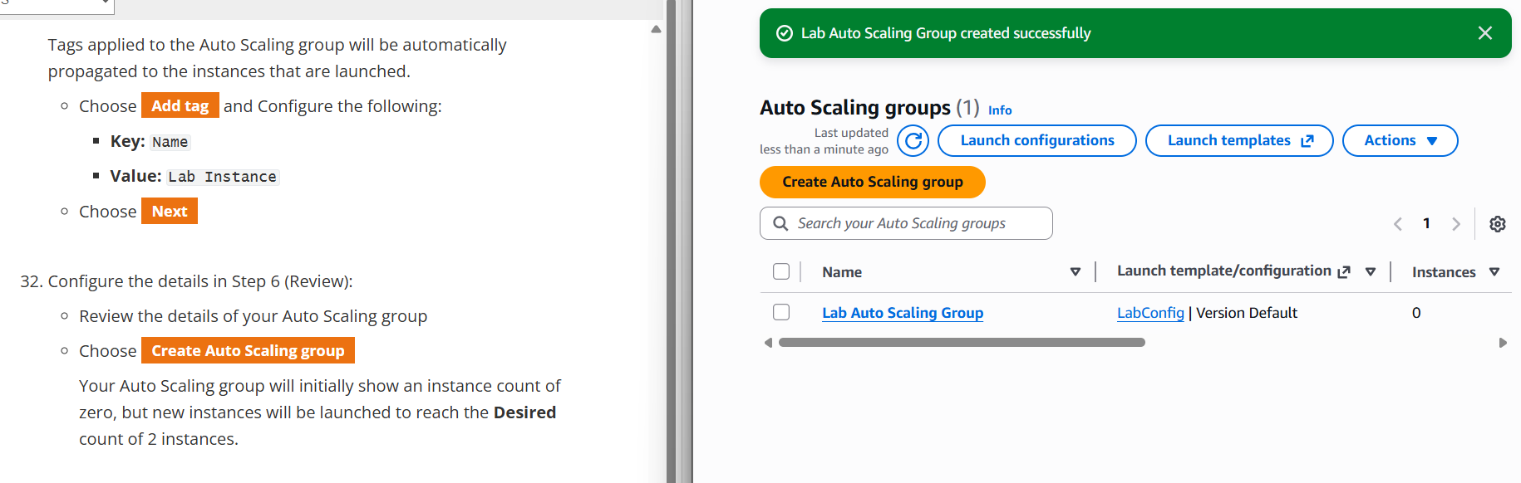
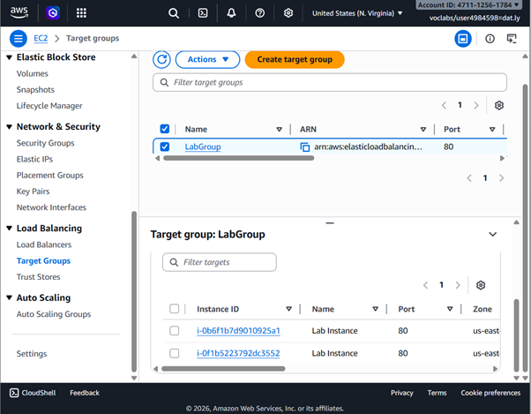
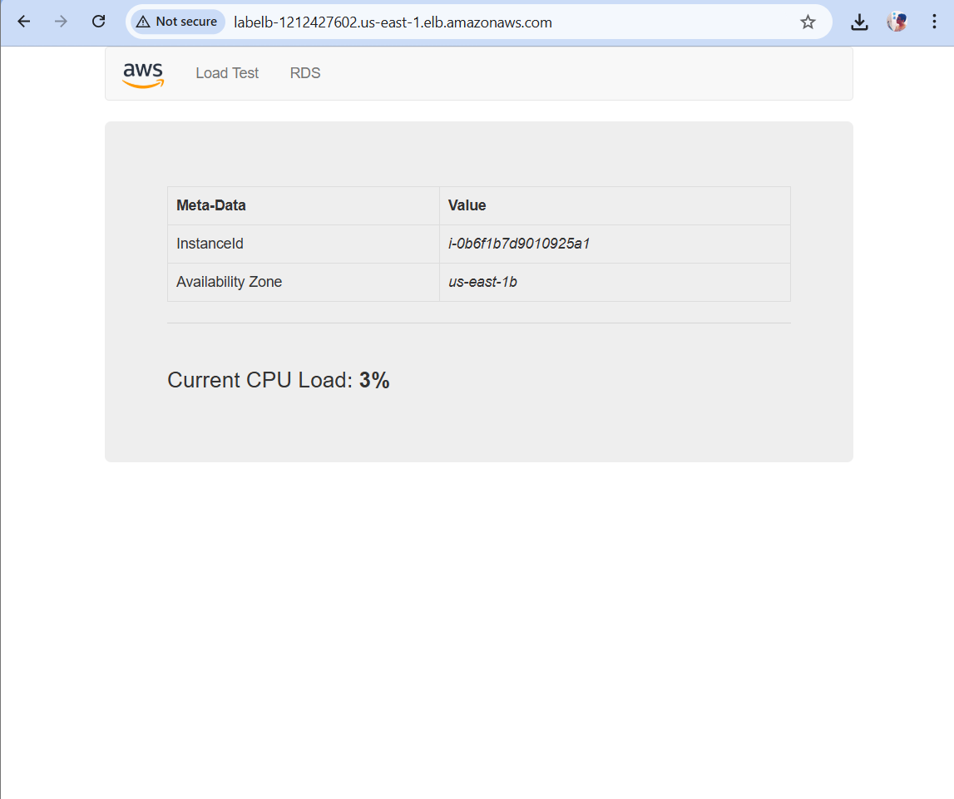
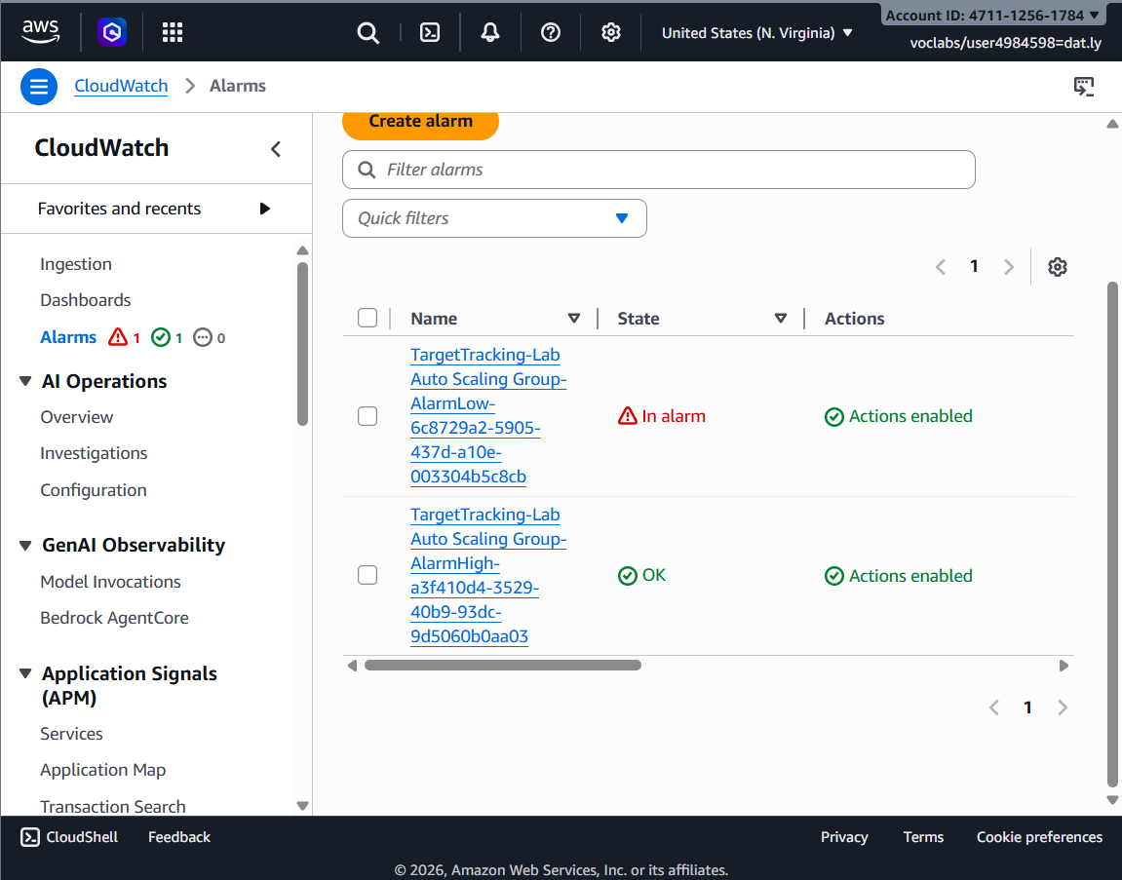
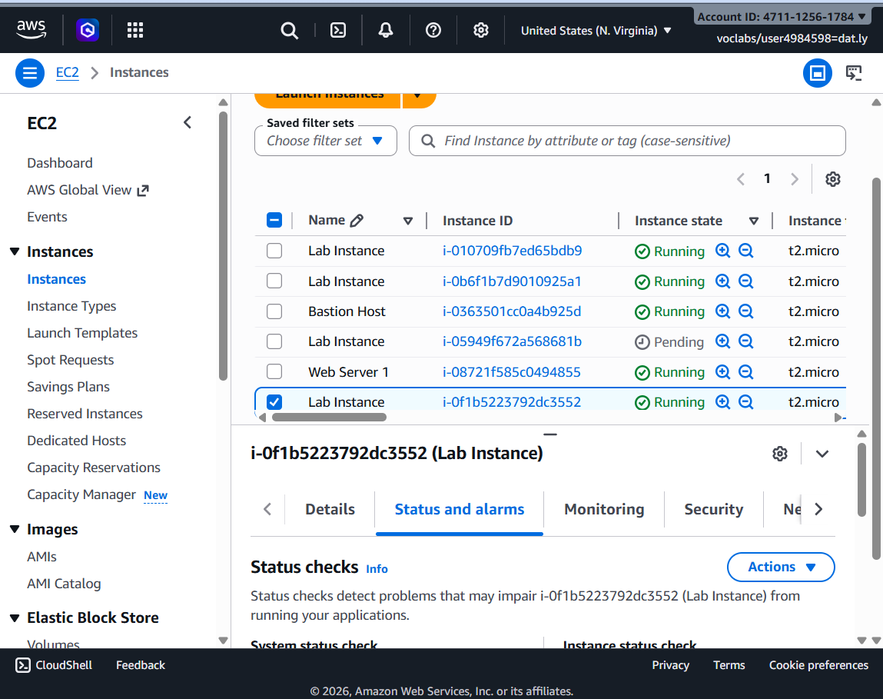
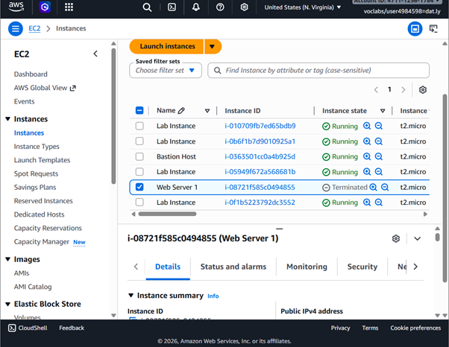
Task 3 – Verify Load Balancing & Test Auto Scaling
ASG Created – 2 Instances Running
Target Group – Instances Healthy
Web App Accessible via Load Balancer DNS
AlarmHigh Triggered – Scale-Out Occurred
Web Server 1 Terminated – ASG maintained healthy instance count
Assignment 2 – EC2 Launching, Load Balancing & Scaling | EIU
Assignment 2 – EC2 Launching, Load Balancing & Scaling | EIU

Slide 13
Task 4 – Reflection Questions (1 & 2)
Q1: Why was termination protection enabled while launching the EC2 instance?
Termination protection was enabled to prevent accidental deletion by a user mistake, an automated process, or an unintended API call. Since this EC2 instance was the foundation for the entire lab (hosting the web application, used to create the AMI, and serving as the base for Auto Scaling), accidental termination would mean losing all configuration. With protection enabled, any termination attempt is blocked unless explicitly disabled first.
Q2: Which metrics did you monitor to check the EC2 instance performance?
• CPU Utilization – percentage of compute units in use; indicates load vs idle state.
• Network In / Network Out – volume of incoming and outgoing traffic; detects traffic spikes.
• Disk Read / Write (I/O) – read/write operations on instance storage; identifies I/O bottlenecks.
• Status Check Metrics – system & instance health checks confirming reachability and OS health.
Assignment 2 – EC2 Launching, Load Balancing & Scaling | EIU
Assignment 2 – EC2 Launching, Load Balancing & Scaling | EIU

Slide 14
Task 4 – Reflection Questions (3 & 4)
Q3: Why did you modify the security group to allow HTTP access?
By default, a new security group blocks all inbound traffic. HTTP (port 80) had to be explicitly allowed so users and the Load Balancer could reach the web server in a browser. Without this inbound rule, all web requests would be silently dropped even if Apache/Nginx was running perfectly inside the instance. Security groups act as virtual firewalls; every required port must be opened intentionally.
Q4: What is the purpose of using a Load Balancer in this lab?
• Traffic Distribution – evenly spreads HTTP requests across all healthy EC2 instances, preventing overload.
• High Availability – routes traffic only to healthy instances (via health checks); failed instances are bypassed.
• Single Entry Point – provides one stable DNS endpoint even as ASG adds/removes instances dynamically.
• Decoupling – users never interact with instances directly, making the architecture more fault-tolerant.
Assignment 2 – EC2 Launching, Load Balancing & Scaling | EIU
Assignment 2 – EC2 Launching, Load Balancing & Scaling | EIU

Slide 15
Task 4 – Reflection Questions (5 & 6)
Q5: What happens in the Auto Scaling group when application traffic increases?
When CPU Utilization exceeds the target threshold (60%), the ASG triggers a scale-out action: it launches new EC2 instances using the Launch Template (referencing the pre-built AMI), automatically registers them with the Load Balancer, and redistributes traffic across all healthy instances. When traffic drops below the threshold, a scale-in removes excess instances down to the minimum count, optimizing cost. The group always maintains instance count within defined Min / Max boundaries.
Q6: Why did you create an AMI before creating the launch template?
The AMI was created first because it is the blueprint that the Launch Template references. An AMI is a point-in-time snapshot of the EC2 instance capturing the OS, installed software in a ready-to-run state. When Auto Scaling needs to launch a new instance during scale-out, it uses the Launch Template -> AMI to guarantee every new instance is identical to the original: pre-configured, pre-installed, and immediately ready to serve traffic. Without the AMI, repeatable automated scaling would be impossible.
Assignment 2 – EC2 Launching, Load Balancing & Scaling | EIU
Assignment 2 – EC2 Launching, Load Balancing & Scaling | EIU

