Slide 1
Assignment 3
AWS
Phạm Trần Gia Hưng – 2331200153
Amazon Web Services
Working with Amazon
Storage Services
Course: Cloud Computing | Lecturer: Rohit Kumar Kasera

Slide 2
Assignment Overview
Task 1
Task 2
EBS & EFS Storage Lab
S3 Static Website
Create, attach, format, mount EBS volumes
Create snapshots & restore data
Module 7: Storage Lab – AWS Academy
Create S3 bucket, upload index.html
Configure static website hosting
Set bucket policy for public access
Task 3
Task 4
Reflection Questions
Lessons Learned
EBS persistence vs instance store
Snapshots, storage management
S3 hosting concepts & IAM Roles
Challenges encountered
Key takeaways from hands-on lab
AWS storage service differences
Assignment 3 – Working with Amazon Storage Services | EIU

Slide 3
Task 1 – Working with EBS & Shared Storage (EFS)
Module 7: Storage Lab · AWS Academy
1
Create EBS Volume
2
Attach to EC2 Instance
3
Format & Mount
gp2 · 1 GiB · same AZ as EC2 instance
Tagged as 'My Volume'
Attach to Lab instance via /dev/sdb
Volume state becomes In-use
mkfs ext3 → mkdir /mnt/data-store
Mount + auto-mount entry in /etc/fstab
4
Create File & Snapshot
5
Delete & Restore
Write file.txt → Create snapshot
Tagged 'My Snapshot' in S3
Delete file.txt → Restore from snapshot
Create 'Restored Volume' → reattach & verify
Assignment 3 – Working with Amazon Storage Services | EIU

Slide 4
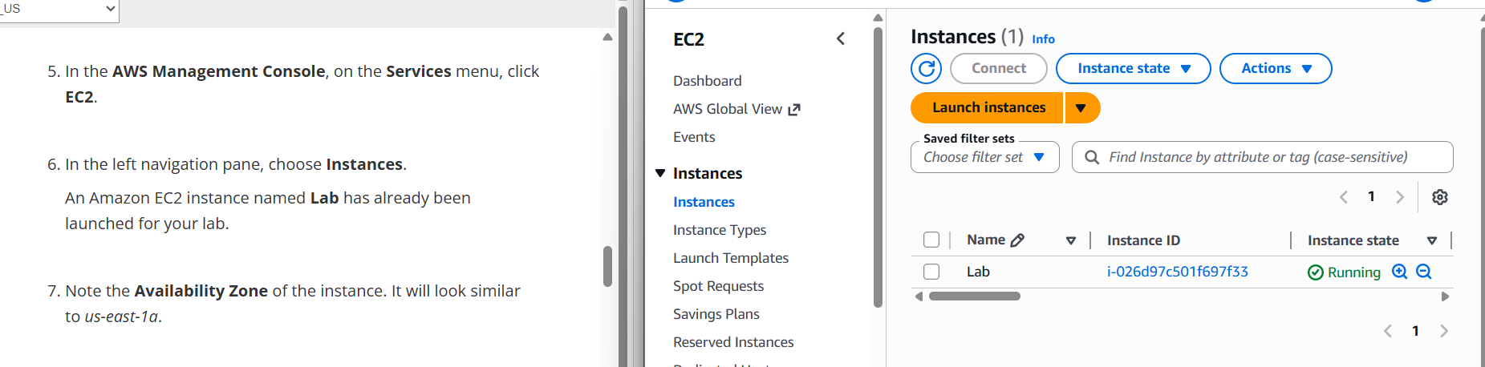
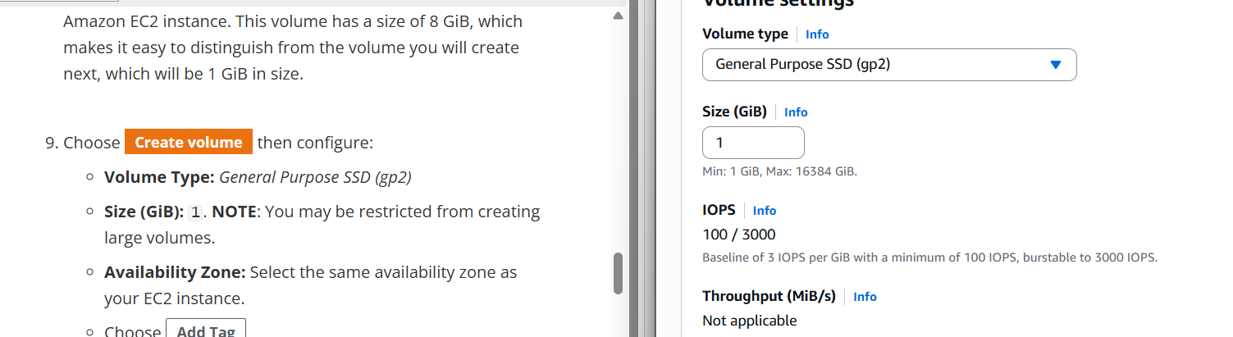
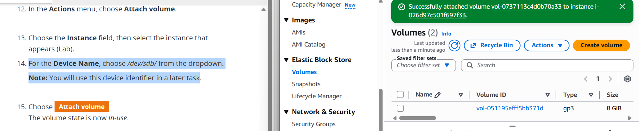
Task 1 – Create & Attach EBS Volume
Module 7: Storage Lab · AWS Academy
Lab EC2 Instance – Running
Create Volume – gp2, 1 GiB
Volume Successfully Attached to EC2 Instance
Assignment 3 – Working with Amazon Storage Services | EIU

Slide 5
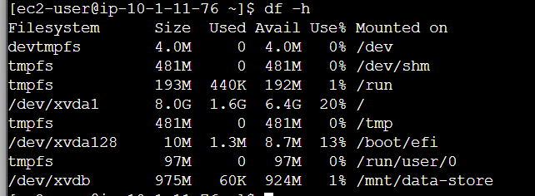
Task 1 – Format, Mount & Write Data
Module 7: Storage Lab · AWS Academy
Commands Used
$ df -h
$ sudo mkfs -t ext3 /dev/sdb
$ sudo mkdir /mnt/data-store
$ sudo mount /dev/sdb /mnt/data-store
df -h output – /dev/xvdb mounted at /mnt/data-store
# echo ... >> /etc/fstab
$ df -h # verify mount
$ sudo sh -c "echo some text..."
> /mnt/data-store/file.txt
$ cat /mnt/data-store/file.txt
Write file.txt → verify → delete
Assignment 3 – Working with Amazon Storage Services | EIU

Slide 6
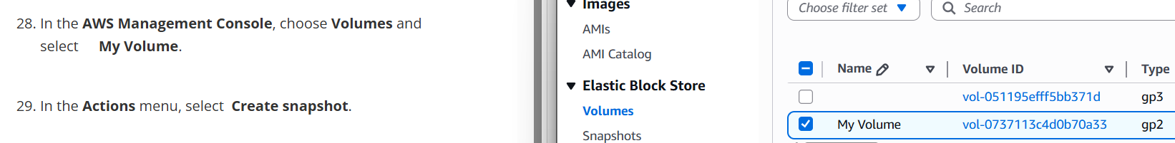
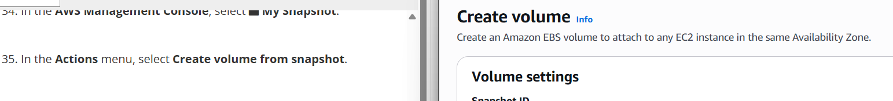
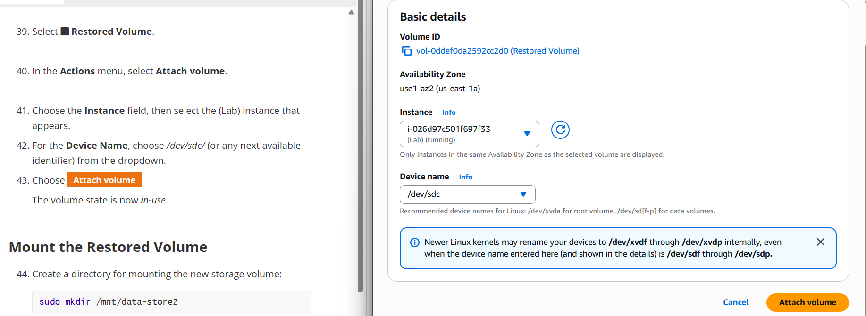
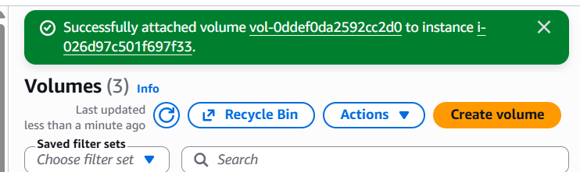
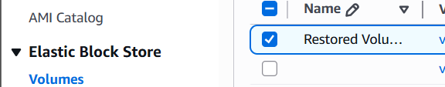
Task 1 – Snapshot Creation & Volume Restore
Module 7: Storage Lab · AWS Academy
My Volume selected → Create Snapshot
Create Volume from Snapshot
3 Volumes – Restored Volume Attached
Attach Restored Volume → /dev/sdc
Restored Volume – in-use
Assignment 3 – Working with Amazon Storage Services | EIU

Slide 7
Task 2 – Create S3 Bucket & Publish Static Webpage
Sandbox Environment · AWS Academy
1
Create S3 Bucket
2
Upload index.html
3
Enable Static Hosting
Unique name (giahung1510)
Region: us-east-1
Disable Block all public access
Click Upload → Add files
Upload provided index.html
Confirm upload complete
Properties → Static website hosting
Enable → Host a static website
Index document: index.html
4
Set Bucket Policy
5
Test the Website
Permissions → Bucket Policy
Add s3:GetObject Allow policy
Principal: * (public)
Copy Endpoint URL from Properties
Paste in browser → verify page loads
Delete bucket after completion
Assignment 3 – Working with Amazon Storage Services | EIU

Slide 8
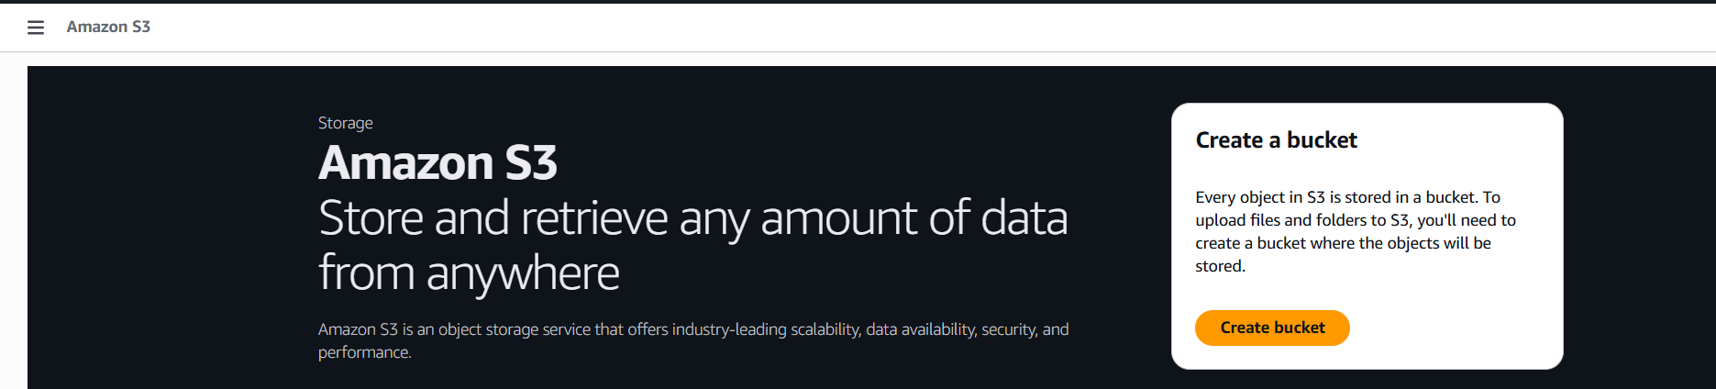
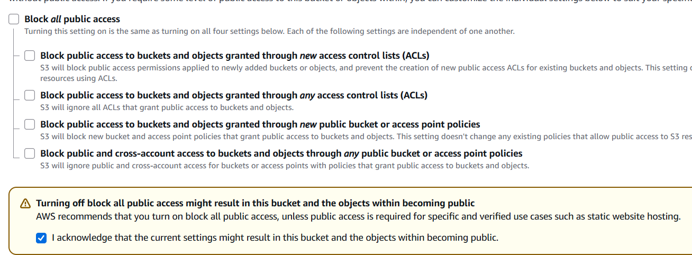
Task 2 – S3 Bucket Setup & Public Access
Sandbox Environment · AWS Academy
Navigate to Amazon S3 Console
Uncheck 'Block all public access' and acknowledge the warning
Assignment 3 – Working with Amazon Storage Services | EIU

Slide 9
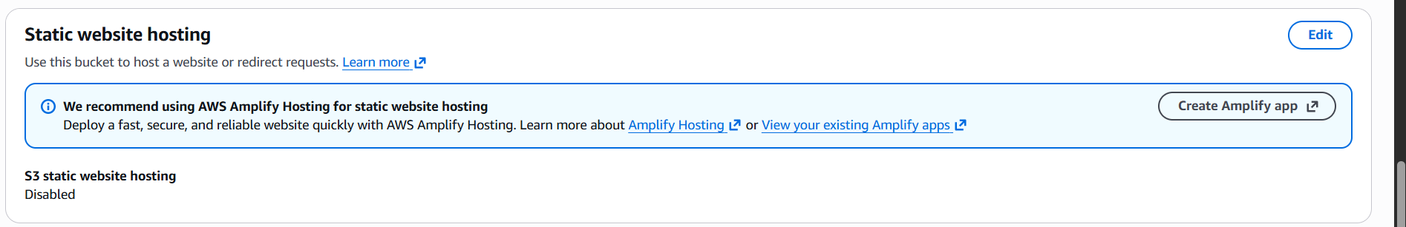
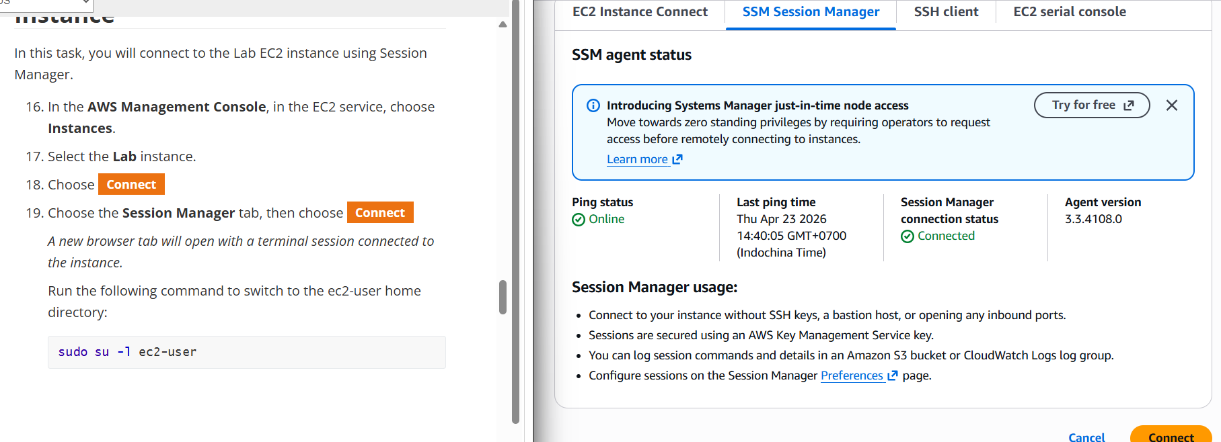
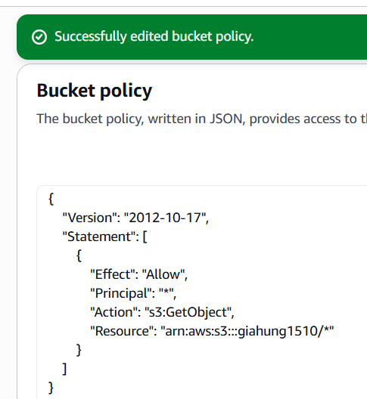
Task 2 – Static Hosting & Bucket Policy
Sandbox Environment · AWS Academy
Static Website Hosting → Enable
EC2 – Session Manager Connected
Bucket Policy (JSON)
{
"Version": "2012-10-17",
"Statement": [
{
"Effect": "Allow",
"Principal": "*",
"Action": "s3:GetObject",
"Resource":
"arn:aws:s3:::giahung1510/*"
}
]
}
Bucket Policy – s3:GetObject Allow (*)
Assignment 3 – Working with Amazon Storage Services | EIU

Slide 10
Task 3 – Reflection Questions (1–3)
Q1: How does EBS provide persistent storage vs. EC2 default storage?
EC2 instance store is ephemeral — data is lost on stop/terminate. EBS is a separate, persistent volume that survives instance lifecycle events and can be reattached to another instance.
Q2: What is the importance of snapshots in EBS?
Snapshots are point-in-time backups stored in S3. They allow restoring a volume after accidental deletion or corruption, and can be used to create new volumes or copy data across regions.
Q3: What did you learn about managing storage (attach, detach, reuse)?
EBS volumes can be attached, formatted, and mounted like a regular disk. They can be detached and reattached to different instances without data loss — making them reusable and instance-independent.
Assignment 3 – Working with Amazon Storage Services | EIU

Slide 11
Task 3 – Reflection Questions (4–7)
Q4: Why must 'Block all public access' be disabled for S3 static website?
S3 blocks all public access by default. A static website needs files accessible over the internet. Disabling this setting allows the bucket policy to grant public read access.
Q5: What is the role of the index.html file?
index.html is the default entry point (homepage) of the static website. When a visitor accesses the website URL without specifying a file, S3 automatically serves index.html.
Q6: Why is a bucket policy required even after uploading files?
Uploading files only stores them — it does not make them public. A bucket policy explicitly grants s3:GetObject permission. Without it, all public requests are denied.
Q7: Why is an AWS IAM Role needed for secure S3 access?
IAM Roles allow EC2 instances to access S3 without hardcoded credentials. The instance assumes a role with least-privilege permissions, using temporary credentials — eliminating credential leak risks.
Assignment 3 – Working with Amazon Storage Services | EIU

Slide 12
Lessons Learned & Challenges
💡 EBS vs Instance Store
📸 Snapshot-Based Recovery
🪣 S3 Permissions Model
Learned the critical difference between persistent EBS volumes and ephemeral instance store — EBS data survives instance stop/restart.
Snapshots are not just backups — they enable full volume restoration, cross-AZ copies, and repeatable provisioning workflows.
Understood that uploading files and making them public are separate steps — a bucket policy is always required for public access.
🔐 IAM Roles over Credentials
⚠️ Challenges
Using IAM Roles on EC2 is more secure than embedding access keys. Temporary credentials and least-privilege reduce attack surface.
Ensuring the correct Availability Zone when creating EBS volumes matched the EC2 instance. Remembering to delete the S3 bucket after the lab to avoid costs.
Assignment 3 – Working with Amazon Storage Services | EIU

Slide 13
Thank You
Assignment 3 – Working with Amazon Storage Services
Phạm Trần Gia Hưng
Student ID: 2331200153
Course: Cloud Computing | EIU
AWS

