Slide 1

CPEG-AI周报
报告人：Edward Zhang
2026年04月29日

Slide 2
CPEG-IIC 2026數位化 & 智能化-正在開發專案(AI – 表1)
Done: 1
On Going: 12
Open: 2
No | 枝術方向 | Type | 项目 | 場景功能明 | OT | AT | Status | Due Date
1 | 智能化 | HumanoidRobot | 具身智能人形机器人輔助員工作業 | 在工厂或实验室环境中部署人形机器人, 用于执行基础操作任务 | TE | AI | On Going | 2026/12
2 |  | AI-Agent | 多模态 AI Agent提升工作效率 | 開發AI Agent軟件，提供接口与现有系统集成，实现工作流程的自动化与标准化 | All User | AI | On Going | 2026/10
3 |  |  | AI新技术解决方案提升AI認知 | 因为很多用户想导入AI，但苦于没有技术和经验。我们AI凭借专业性，帮用户梳理痛点，提供解决方案技术服务。 | Al User | AI | On Going | 2026/12
4 |  | LLM | Lighthouse 服务器降本专案，階段1：在本地服务器上安装 5 个 Case 网站 | 云服务器成本过高，通过切换为本地服务器部署，每年可节省高达30,000USD的云服务器租赁费用。 | DT | AI | On Going | 2026/07
5 |  |  | Lighthouse 服务器降本专案，階段2：将 OMV 集成到同一台服务器上的 5 个网站 Use Case 中。 | 将Lighthouse项目的所有功能、网站及模块统一集成至同一台服务器，便于维护与管理，并有效优化硬件资源利用。 | DT | AI | On Going | 2026/10
6 |  | Computer Vision | AI quality inspection product packing | 开发用于监控员工包装操作的系统，确保作业流程规范且产品数量准确，从而优化运营成本并降低不良率。 | AE | AI | Closed | 2026/03
7 |  |  | IP CAM AI Project [Fuction A: Smart Inspection for safety phase 2] | 本系统用于监控与检查工厂内的安全要素，包括：灭火器的状态与摆放位置、通道是否被遮挡或堵塞，以及员工是否按规定佩戴劳动防护用品。 | Security | AI | On Going | TBD
3/N

Slide 3
CPEG-IIC 2026數位化 & 智能化-正在開發專案(AI – 表2)
Done:1
On Going: 12
Open: 2
No | 枝術方向 | Type | 项目 | 場景功能明 | OT | AT | Status | Due Date
8 | 智能化 | Computer Vision | IP CAM AI Project [Fuction B: Intelligent monitoring IPCAM for safety] | 本系统用于监控与检查工厂内的安全要素，包括：灭火器的状态与摆放位置、通道是否被遮挡或堵塞，以及员工是否按规定佩戴劳动防护用品。 | Security | AI | Ongoing | TBD
9 |  |  | IP CAM AI Project [Fuction C: Auto BBS phase 3] | 该系统旨在通过对关键区域的同步监控，实现工厂多点位安全检查的自动化。 | Security | AI | Ongoing | TBD
10 |  |  | Check PCB Xray | 系统可对多种产品型号的元器件进行自动检测，确保类型与数量的准确性。 | ME | AI | Ongoing | 2026/06
11 |  |  | Project A - AI quality inspection product in Test station | 系统自动监控并检测放置托盘、放置称重及保持称重状态等操作，确保各步骤符合既定流程及时间标准。 | ME | AI | Open | TBD
12 |  |  | Project B - AI quality inspection product in Packing station | 系统自动监控产品的包装流程，确保每个产品单元均按规范完成包装且组成完整。 | ME | AI | Open | TBD
13 |  | Machine Learning | DOE-Reflow Oven | 开发并部署AI预测模型，基于PCB的物理及材料特性，推荐最优的回流焊炉温度曲线设置。 | ME | AI | Ongoing | 2026/12
14 |  | LLM | AI Smart Translation | 为Software部门提供API接口，实现越南语、英语及中文之间的文本自动翻译功能。 | QA | AI | Ongoing | 2026/11
15 |  | All Field | Maintain all AI software | 负责已开发软件的维护与运行，确保系统持续稳定、准确地满足实际应用需求。 | All User | AI | Ongoing | 2026/12
3/N

Slide 4
Meeting topic reply
Team | Content | Answer
AI Team | 用戶問題描述: Case 9 SMT智能编程软件1.依據程式撰寫步驟給出每一步的可行性分析2.完成版程式以CRB格式呈現，程式信息正確率100%，包含BOM料號、位置、X、Y、Z、極性、拼版信息、MARK點、區域座標、PD庫、PD影像并可導入NPM DGS進行二次工時優化，NPM機台識別程式信息， | 詳情: Because it will cost too much time labors cost, in the other hand there are too many users want the similar solutions. Please submit AI labors quotation to the Esign system to start the project. We will review review and research it after Esign approve

Slide 5
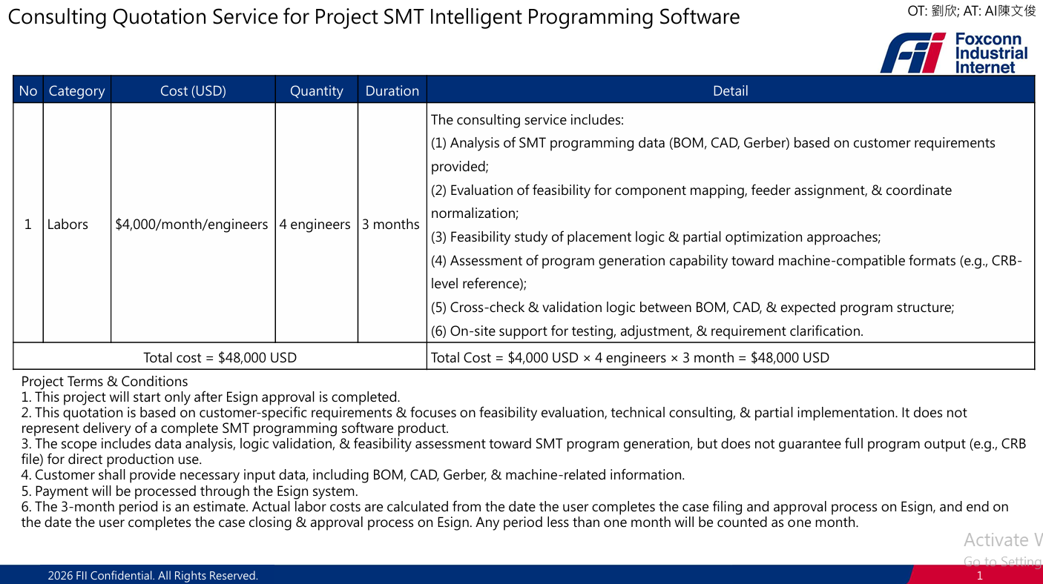

Slide 7
Meeting topic reply
Team | Content | Answer
AI Team / CBD security team | 1.BBS巡檢開發停止原因:4/1晚上B09-2FIT机房警报问题,AI排查结果: CPEGIICAI的2台Server未见异常且已关闭360 IP CAM AI系统，并对server做断电处理。但为保险起见，360IP CAM将暂停服务。 2.列出廠商需要提供的安全驗證文件 3.郵件推動廠商儘快給出安全認證 4.確認認證無問題，專案啟動 | 关于供应商来Fii富联厂区检修，报告须包含如下內容，且除了越南文版外，至少须附有中文版或英文版： 1.故障分析報告，包含GPU烧毁原因分析和实验验证报告。如果烧毁责任在厂商，则厂商须分析具体原因，且免费更换同型号新GPU；如果烧毁责任在Fii，则厂商须提供再现实验报告，并取得Fii的IT处级主管和工务处级主管的签字认可。 2.检修报告。对有异常的4台AI服务器的检修项目清单、排除再次烧毁风险的证据和检修结论。 3.质量保证书。如果4台AI服务器检修后合格，则供应商须书面承诺若发生类似烧毁异常甚至火灾，将承担全部责任。 以上请让供应商在检修后及时提交。然后用户阿实请IT、工务等相关主管签核认可報告后，再重新启用检修合格的AI服务器。

Slide 8
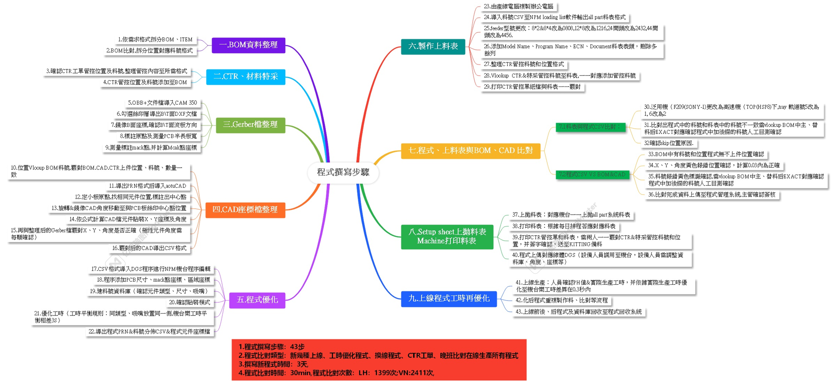
The sections requiring feasibility assessment include I, III, IV, V.
1

Slide 9
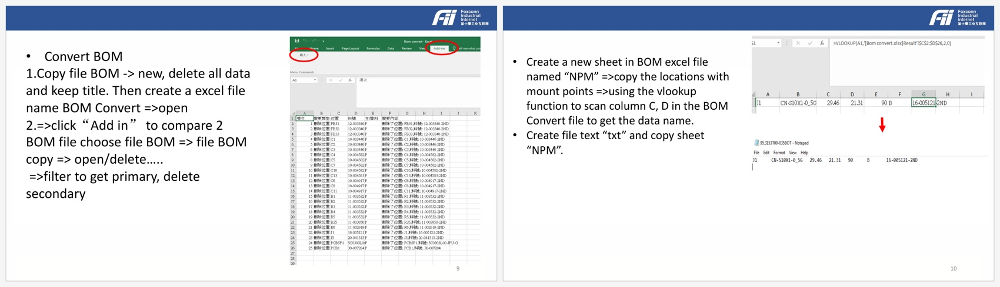
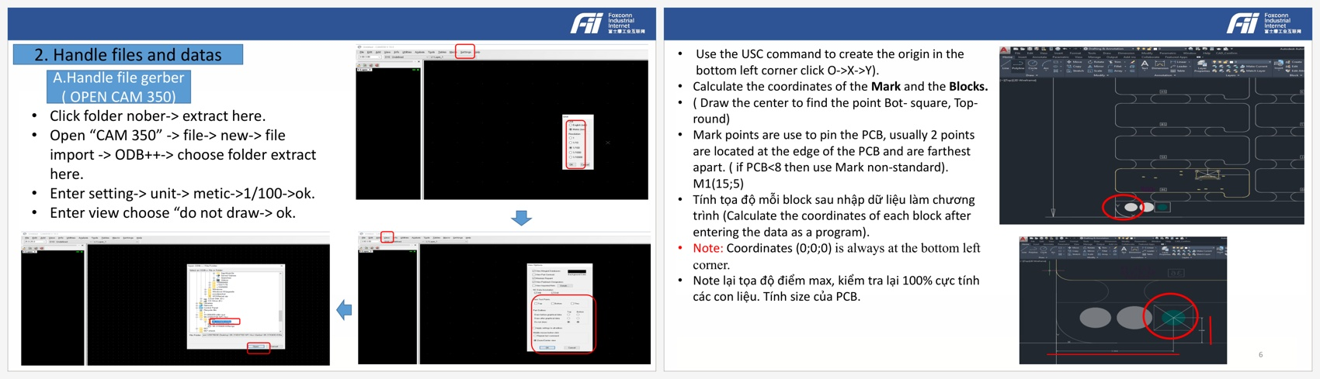
1. SMT Programming Requirement Assessment: Technical Feasibility Evaluation
Steps
Illustration Images
Manual operation by ME-SMT Engineers
Should be Automated by system
Technical
Feasibility
Prerequisites
I. BOM
Data
Organization
Split BOM / ITEM by required format;
Create BOM Convert;
Filter primary vs secondary rows;
Use VLOOKUP to map mount-point names & export TXT;
Develop BOM parser,
Format normalizer,
Mount-point mapping,
Pre-check engine for later program generation.
Feasible
Clean BOM / ITEM field names.
Access to Fox PDM export.
Main / substitute-part rules agreed.
NPI p9 + p10
III. Gerber File
Organization /
Processing
Import ODB++ into CAM350.
Export B-side DXF.
Mirror BOT direction.
Mark reference points & calculate Mark / Block / Mack coordinates.
Develop CAM/Gerber parser,
Side-orientation logic,
Reference-point extraction,
Coordinate pre-processing.
Feasible
ODB++ / DXF files available.
Fixed board-side naming rules.
Reference-point selection rule st&ardized.
NPI p3 + p6
2
Notes:
[Sources] - Tổng hợp các bước trong sơ đồ tư duy.txt: steps 1 & 3 definition & subtasks. - npi.pdf pages 3, 6, 9, 10: operating evidence & simulation images used on this slide. - 監測需求評估報_gluecase告 1.0.pdf pages 1-6: layout/style reference for the feasibility table.

Slide 10
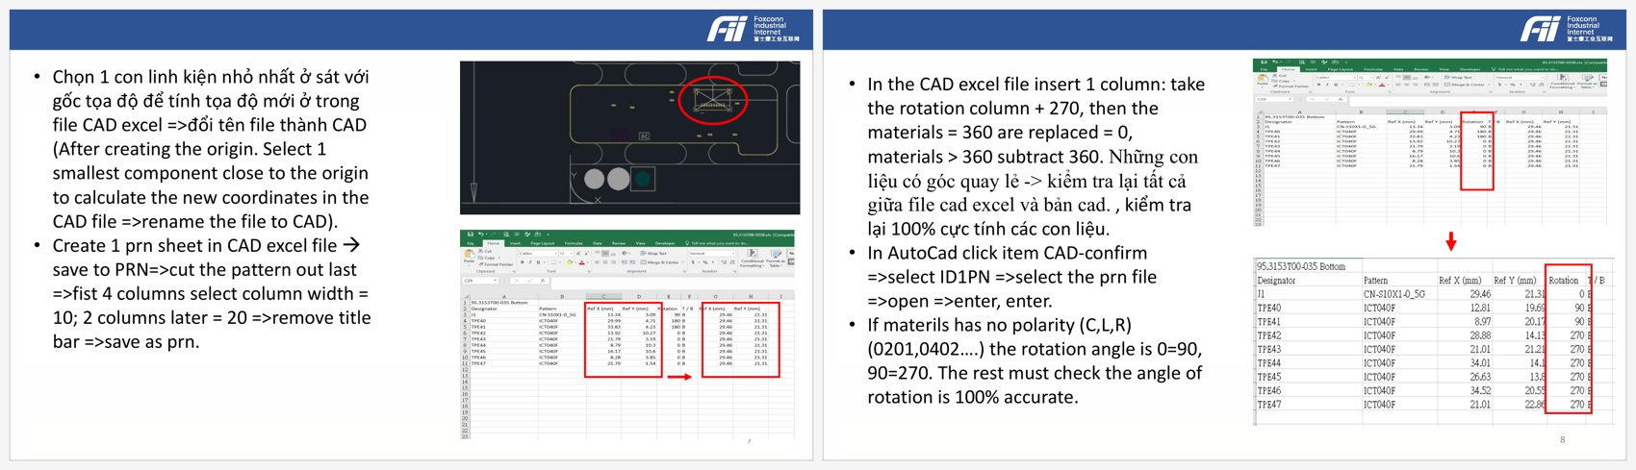
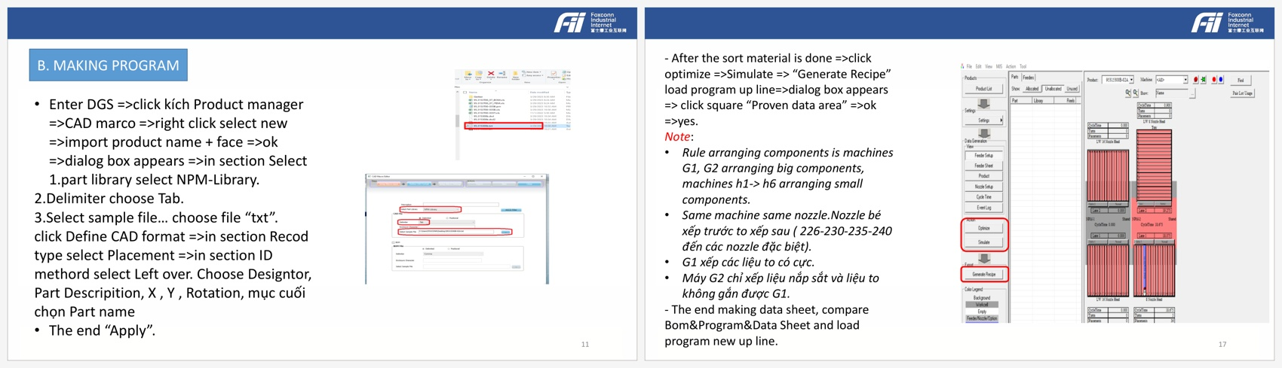
1. SMT Programming Requirement Assessment: Technical Feasibility Evaluation
Steps
Illustration Images
Manual operation by ME-SMT Engineers
Should be Automated by system
Technical
Feasibility
Prerequisites
IV. CAD Coordinate
File Organization /
Processing
Select origin reference part.
Create PRN.
Rotate + mirror CAD angles.
Apply +270 rotation rule.
Check X / Y / angle & 100% polarity for sensitive parts.
Develop CAD/CTR/BOM reconciliation,
origin setup, coordinate transformation,
angle conversion,
polarity check, & CSV export.
Feasible
CAD / BOM / CTR naming consistent.
Approved angle / polarity rules.
Polarized-part exceptions maintained.
NPI p7 + p8
V. Program
Optimization
Import TXT into DGS Product Manager.
Set revision & NPM library.
Select mount mode / optimizer options.
Optimize, simulate, & generate recipe.
Develop DGS/NPM import module,
part-library binding,
mount-mode rule engine,
recipe export workflow.
Feasible
DGS / NPM environment accessible.
Historical NPM-Library available.
Optimizer template & machine rules confirmed.
NPI p11 + p17
3
Notes:
[Sources] - Tổng hợp các bước trong sơ đồ tư duy.txt: steps 4 & 5 definition & subtasks. - npi.pdf pages 7, 8, 11, 12, 16, 17: operating evidence & simulation images used on this slide. - 監測需求評估報_gluecase告 1.0.pdf pages 1-6: layout/style reference for the feasibility table.

Slide 11
Phase 1: Install usecase 1,2,3,5 on DT's Server_10.72.75.14 (2x GPU-PRO6000)
OT： DT 黃趙五; AT: AI 潘洛興
I. Overview
Project | Use case | IP/Port | Functionality | Status | Responsible | Describe Current Status
LightHouse | 1 | 10.72.75.16:443 | Login | Done | 文宝, Panda, AnyScript
 |  |  | LLM | Done
 |  |  | Web UI Interaction | Done
 | 3 | 10.72.75.16:8081 | Login | Done
 |  |  | LLM | Done
 |  |  | Web UI Interaction | Done
 | 2 | 10.72.75.14:8081 | Login | Done | 徐逸兴, Panda, AnyScript, 陳冠瑋(Kuan-Wei Chen) Peter | Onmiverse data has been moved to the new server (72.75.14)
 |  |  | Onmiverse | On-going
 |  |  | Web UI Interaction | Done
 | 4 | 10.72.75.18:443 | Login | Done | 徐逸兴, Panda, 陳冠瑋(Kuan-Wei Chen) Peter | 1. Real-time data is only available on the main UI, sub-UI do not display this data. 2. The LLM currently is not working.(This feature link with Case 5) 3. Onmiverse data was transferred to the new server (72.75.14) and then to 72.75.41. The Onmiverse function is not yet operational.
 |  |  | Real-time data | Done
 |  |  | LLM | On-going
 |  |  | Onmiverse | On-going
 |  |  | Web UI Interaction | Done
 | 5 | 10.72.75.31:8081 | Login | Done | 安之君, Panda, AnyScript | The requested application for LLM has been approved, we will continue to fix it.
 |  |  | Real-time data | Done
 |  |  | LLM | On-going
 |  |  | Web UI Interaction | Done
2

Slide 12
Phase 1: Install usecase 1,2,3,5 on DT's Server_10.72.75.14 (2x GPU-PRO6000)
OT： DT 黃趙五; AT: AI 潘洛興
Case | Function | Progress (Green: Done/Closed; Yellow: Ongoing; Other color: Open) | Due date
2 | Onmiverse | 1. Create access application to transfer data – Done-阮功俊英, 潘落興-26/04/08 2. Setting server and create new VM (75.42) to store data of case 2 OMV – Done-Panda-26/04/07 3. Transfer data from old server (93.48) to new server (75.14) and then to VM42 (75.42)–Done-TARG 陳冠瑋(Kuan-Wei Chen) Peter-26/04/13 | 26/04/15
 |  | 4. Get chiller MQTT data source address–On going- 陳冠瑋(Kuan-Wei Chen) Peter, 阮功俊英 (1) OMV Use case 2 receives data from more than 4 different IP addresses; we are compiling them into a list before submitting it. The application has been submitted and is awaiting approval.– Due Date: D days (D is the actual number of days it takes for the application to be approved.) | D+5
 |  | 5. Re-configure and deploy OMV web- TARG 陳冠瑋(Kuan-Wei Chen) Peter, 阮功俊英 | D+8
 |  | 6. Run OMV Kit app service & web service (change port to 8080)- TARG 陳冠瑋(Kuan-Wei Chen) Peter, 阮功俊英 | D+8
 |  | 7. Update i-frame on main website- AnyScript | D+11
 |  | 8. Test website function- TARG 陳冠瑋(Kuan-Wei Chen) Peter, 阮功俊英 | D+16
4 | Onmiverse | 1. Create access application to transfer data – Done-阮功俊英, 潘落興-26/04/08 2. Setting server & create new VM (75.41) to store data of case 4 OMV– Done-Panda-26/04/07 3. Transfer data from old server (93.48) to new server (75.14) and then to VM42 (75.42)–Done-TARG陳冠瑋(Kuan-Wei Chen) Peter-26/04/13 | 26/04/15
 |  | 4. Test website function – On going-鄧潘英, TARG Peter, TARG Panda (1) (1) Omniverse service retrieves data from server 72.75.41 via ports 8080 and 49100. Currently, only port 8080 is accessible → Waiting for the access application to open port 49100- Due Date: D days | D+5
 | LLM | Submit internet application for IOC access with updated port- On-going- 阮功俊英, 潘落興 → The application has been submitted and is awaiting approval. | D
 |  | 2. Deploy ioc service- Ongoing- TARG袁小利 | D+7
 |  | 3. Test LLM function - 鄧潘英 | D+12
5 | LLM | Submit internet application for IOC access with updated port- On-going- 阮功俊英, 潘落興 → The application has been submitted and is awaiting approval. | D
 |  | 2. Deploy ioc service - Ongoing- TARG袁小利 | D+7
 |  | 3. Test LLM function -阮功俊英 | D+12

Slide 13
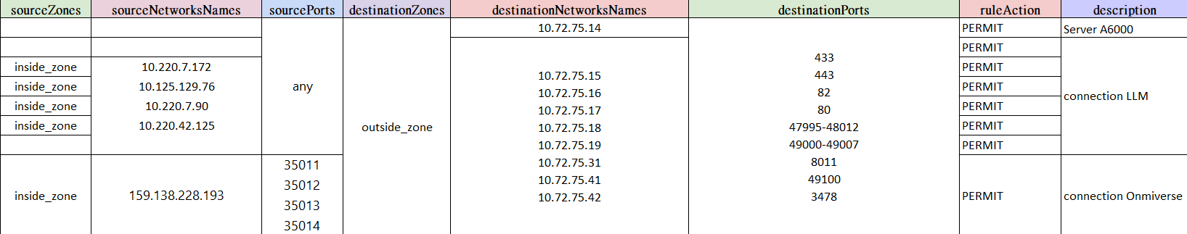
Phase 1: Install usecase 1,2,3,5 on DT's Server_10.72.75.14 (2x GPU-PRO6000)
OT： DT 黃趙五; AT: AI 潘洛興
Fig 1. Acess Application Form

