Slide 1
FINAL PROJECT REPORT
SOFTWARE ENGINEERING
Instructor guide: Mr. Pham Thai Ki Trung

Slide 2
Thành viên Nhóm 10
Nguyen Phan Quoc Hung
519H0171
Duong Quang The
519H0350

Slide 3
01
04
INTRODUCTION
ARCHITECTURE
02
05
DESIGN
PROJECT MANAGERMENT PLAN
03
REQUIREMENT SPECIFICATIONS
06
DEMO

Slide 4
INTRODUCTION
1

Slide 5
INTRODUCTION
Purpose and scope: This section is intended to assist learners in understanding diagram design, use case specification, customer needs assessment capabilities, software infrastructure, databases, application and system development. The scope of research and implementation for the topic of software engineering focuses on creating software that improves operational efficiency and people's quality of life.
2

Slide 6

Product overview: From the specifications and requirements of the topic, we can describe the class diagram, the usage diagram and understand how to create the system interface and user interface. Clarifying each function of the system, optimizing functions to limit errors to meet user requirements.
3

Slide 7
INTRODUCTION
4
Structure of the document: Includes introduction, project management plan, requirements specification, architecture, design, test plan to ensure the software works properly and finally the Demo is the result of the product including the basic database, source code and test

Slide 8
PROJECT MANAGEMENT PLAN
5
Project organization:
My team will divide the work for 2 people including: analyzing project requirements, drawing diagrams, designing databases, creating main functional code interfaces, testing errors and finally running product demos.

Slide 9
Lifecycle model used: Waterfall model because of the use of waterfall model as follows: Simple, easy to understand and use. For smaller projects, the waterfall model works well and yields consistent results. The stages of waterfall model are rigid and precise, one phase is done once, it is easy to maintain
PROJECT MANAGEMENT PLAN
6

Slide 10
Hardware and software resource requirements: About hardware: Intel Core i5-6500 CPU @ 3.20GHz Ram 8GB Win 10 About software: SQL server management studio, Visual studio.
PROJECT MANAGEMENT PLAN
7

Slide 11
Gantt Diagram
PROJECT MANAGEMENT PLAN
8

Slide 12
Impact of the project on individuals and organizations: For organizations, it will be easier to manage employees, have a reward and punishment policy, and spend less time. As for individuals, the work will be easier, less stressful, more professional, and less time wasted on cumbersome manipulations to work more efficiently.
PROJECT MANAGEMENT PLAN
9

Slide 13
10
REQUIREMENT SPECIFICATIONS
Stakeholders for the system: Develop, Accountant, Branch.

Slide 14
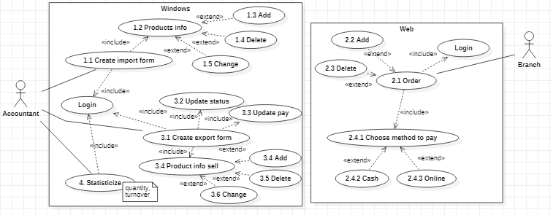
11
REQUIREMENT SPECIFICATIONS
Usecase diagrams:

Slide 15
12
ARCHITECTURE
Architectural style used: Layered architecture because:
We just need to understand the layers below the one we're working on.
Each class can be replaced with an equivalent implementation without affecting other classes.
- A class can be used by several different top level classes.

Slide 16
ARCHITECTURE
13
Rationale for architectural styles and models: The application server provides access to the data to the client. It serves as an interface between the client and one or more database servers. The database server does all the rest of the query processing

Slide 17
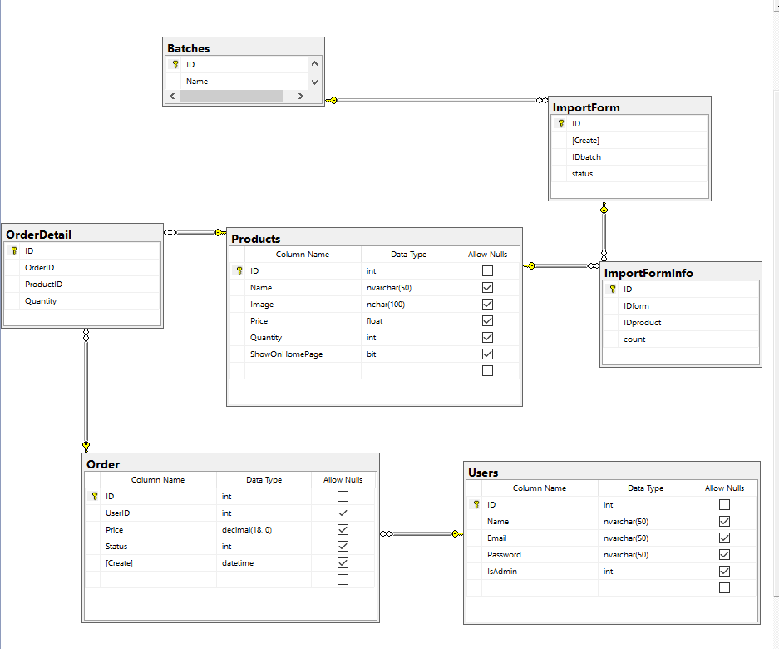
DESIGN
14
Database design

Slide 18
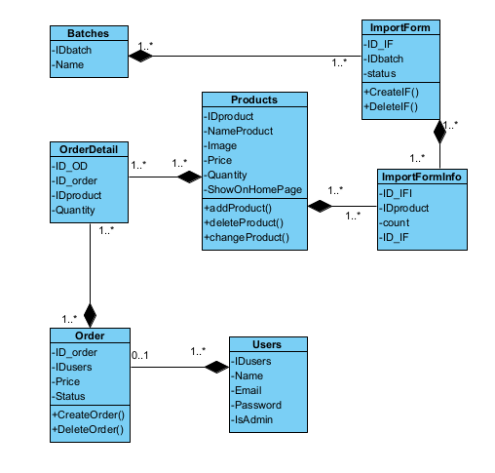
15
DESIGN
Class diagrams

Slide 19
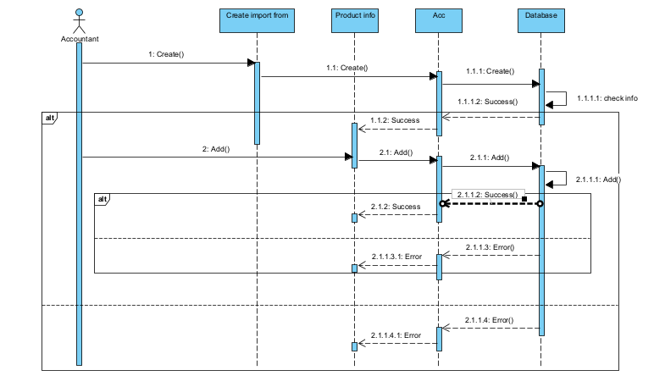
16
DESIGN
Sequence diagrams

Slide 20
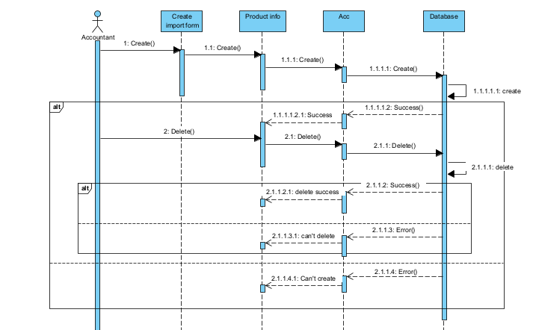
17
DESIGN
Sequence diagrams

Slide 21
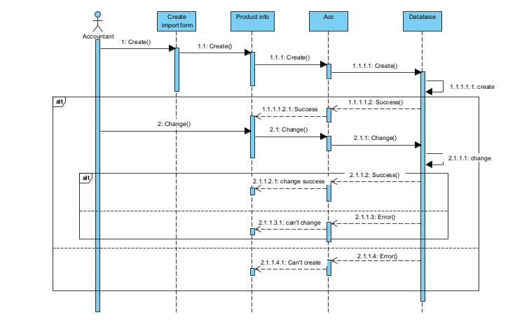
18
DESIGN
Sequence diagrams

Slide 22
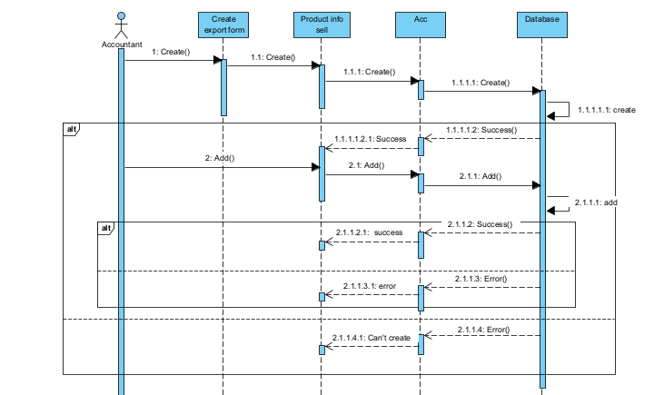
19
DESIGN
Sequence diagrams

Slide 23
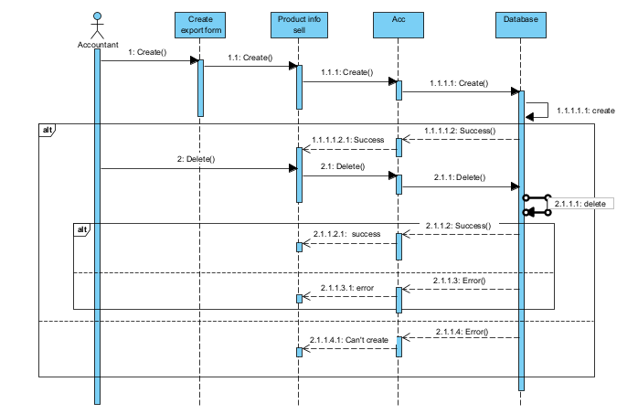
20
DESIGN
Sequence diagrams

Slide 24
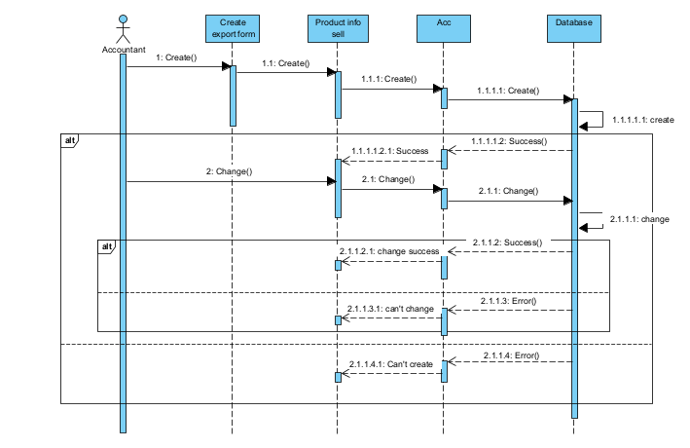
21
DESIGN
Sequence diagrams

Slide 25
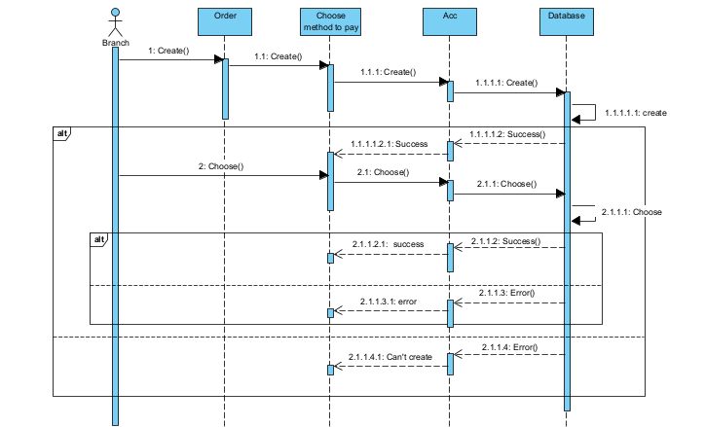
22
DESIGN
Sequence diagrams

Slide 26
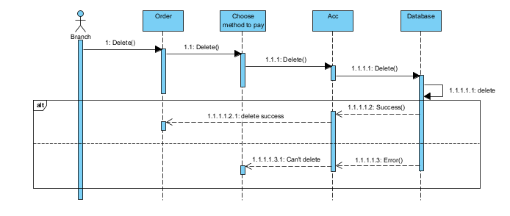
23
DESIGN
Sequence diagrams

Slide 27
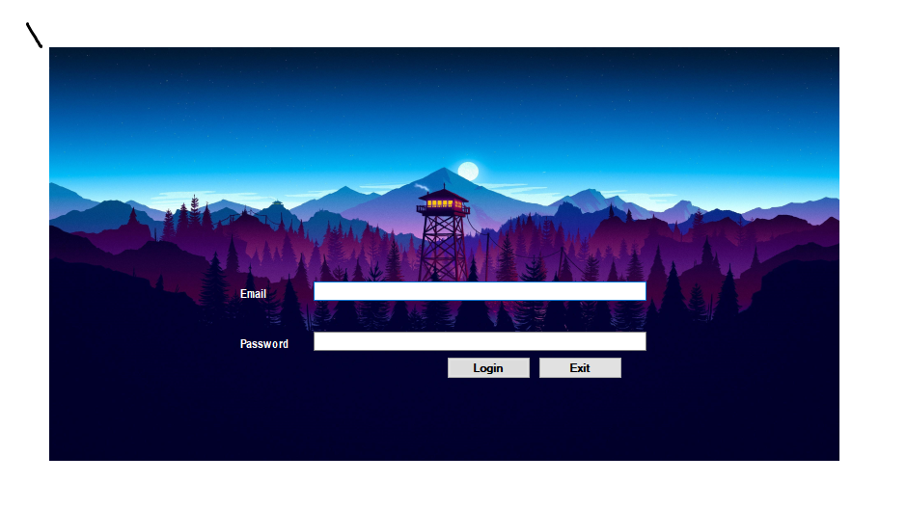
Winform
24
Login

Slide 28
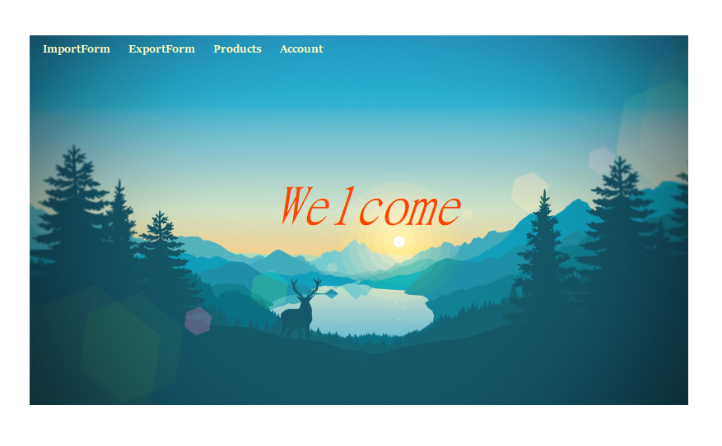
Winform
25
Home

Slide 29
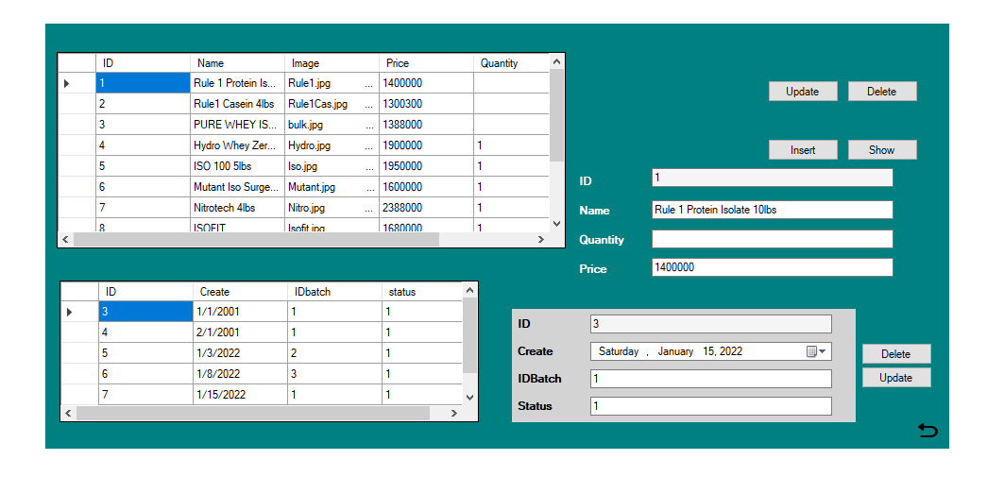
Winform
26
Enter coupon

Slide 30
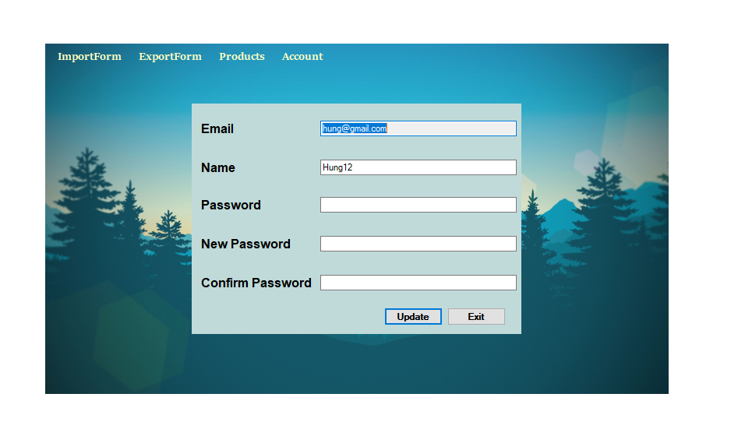
Winform
27
User account

Slide 31
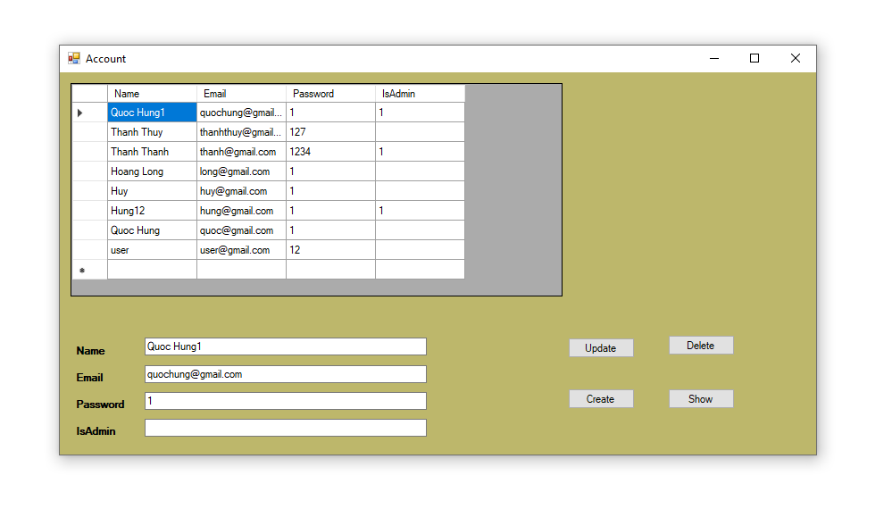
Winform
28
Admin account

Slide 32
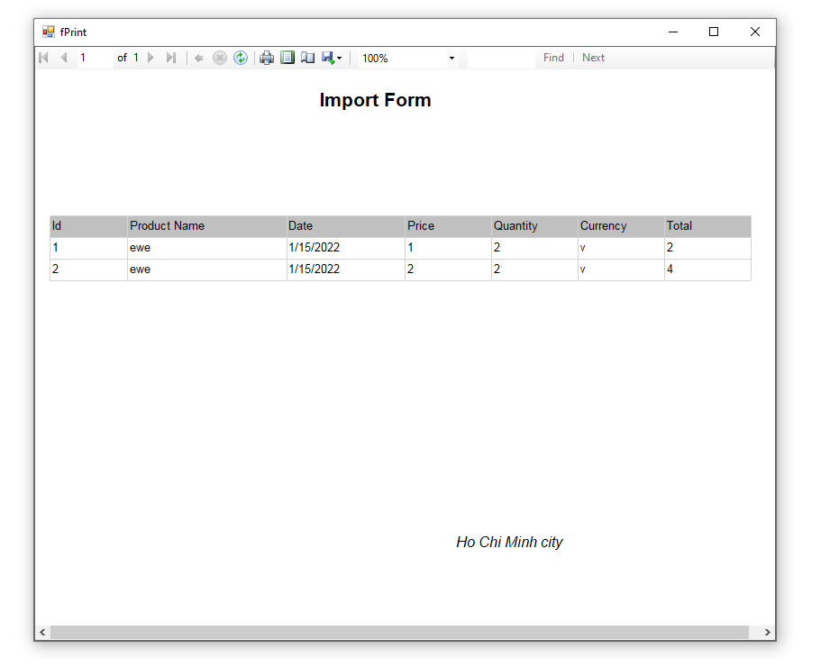
Winform
In phiếu nhập

Slide 33
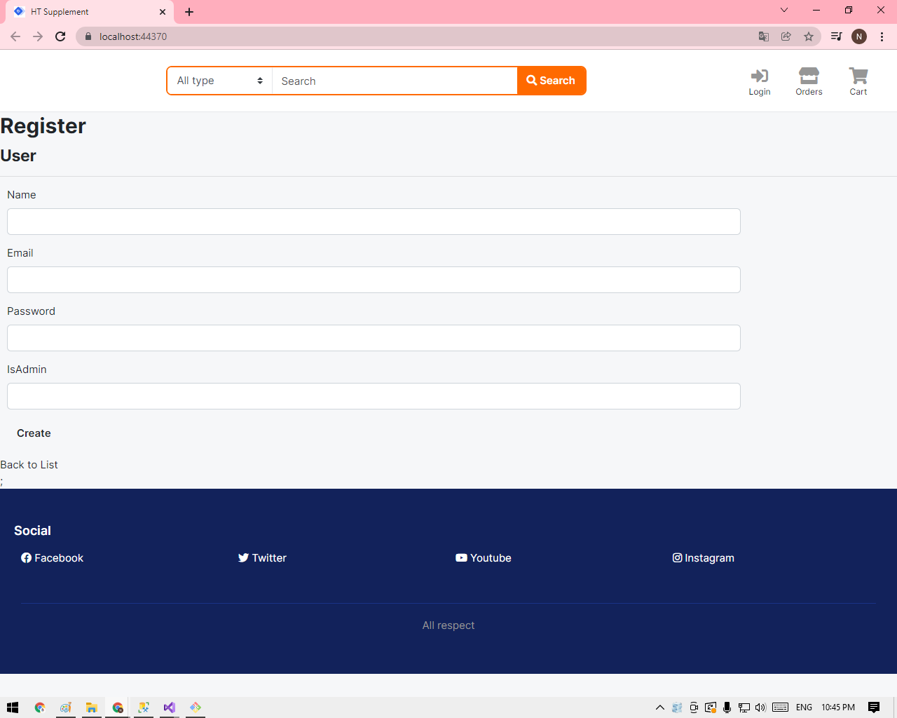
Webform
29
Register

Slide 34
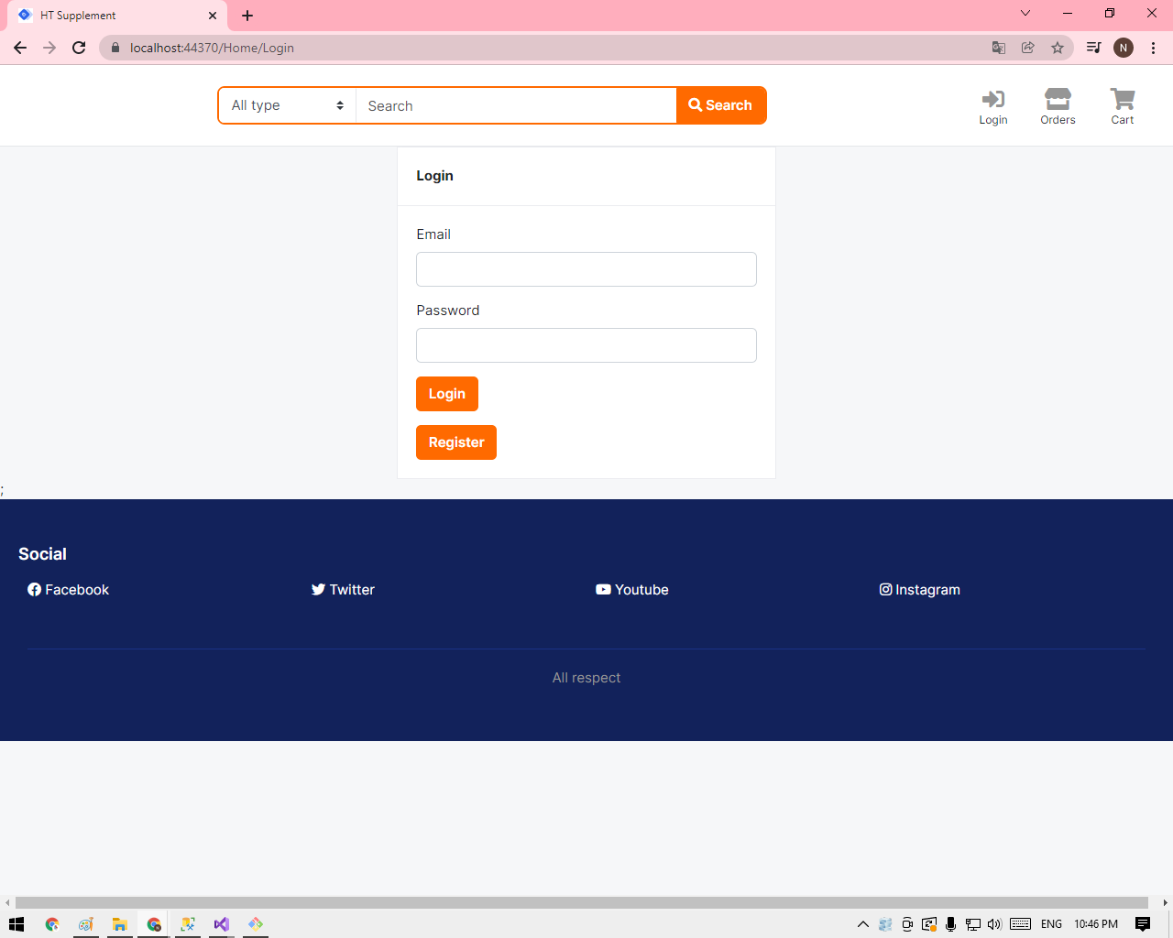
Webform
30
Login

Slide 35
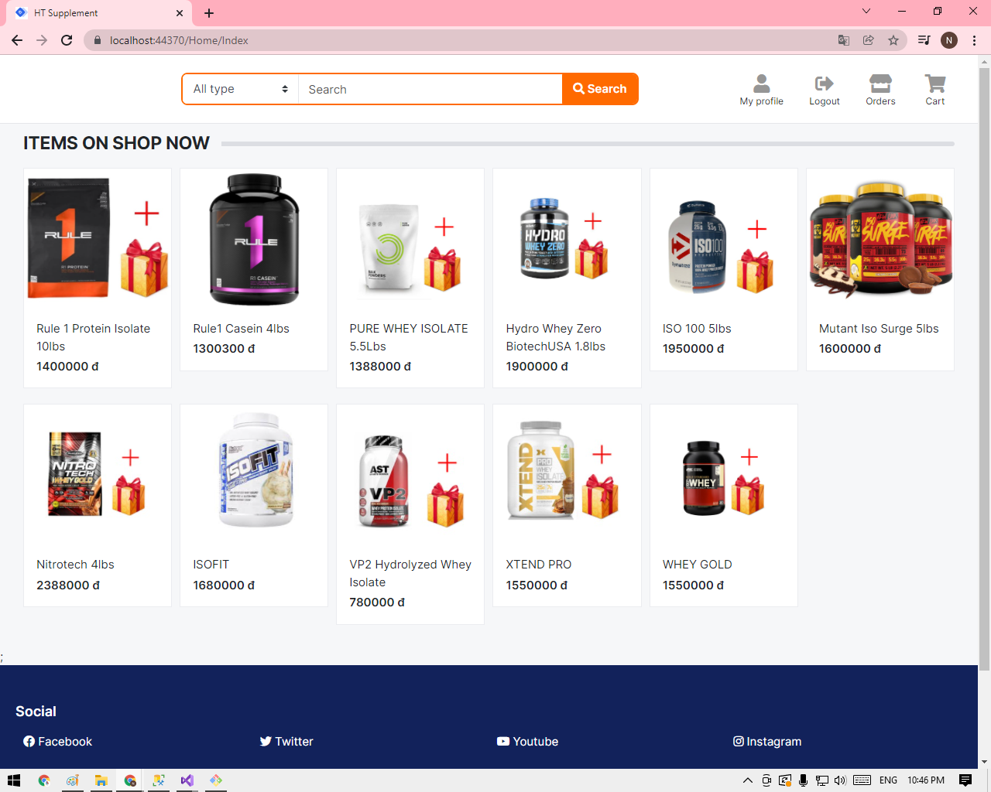
Webform
31
Product info

Slide 36
THANK FOR WATCHING!

