Slide 1
A STUDY OF TRUBEAM STX SIMULATION USING GATE/GEANT4 TOOLKIT
PROJECT’S REPORTS
Author: Bui Tien Hung
Adress: Vietnam Atomic Energy Institute
Phone: 0352348985
Email: buitienhung19081997@gmail.com
Instructors: Dr. Tran Ngoc Toan

Slide 2
Contents
I. Introduction
II. Materials and methods
III. Results and Discussion
IV. Conclusion

Slide 3
I. Introduction

Slide 4
Problems

Slide 5
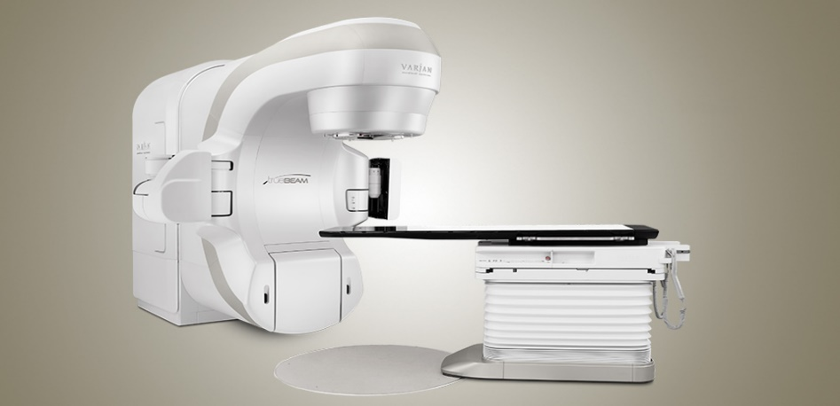

TrueBeam STx
This is the most advantage system that have:
    Integrated the conical collimator with size of 4 – 17,5 mm that can be used for radiosurgery.
    The MLC had 120 leaves.
    That have 4 energies for photon (6, 8, 10, 15 MV) and 7 energies for electron (6, 12, 15, 18, 20, 22 MeV).
    Dose rate can be reached 1400 MU/min for 6MV FFF and 2400 MU/min for 10 MV FFF.
    There are many techniques can be used for TrueBeam STx, for examples IMRT, VMAT, …
TrueBeam STx system made by Varian
Multi leaves collimator
(MLC)

Slide 6
II. Materials and Methods

Slide 7
Objects and Methods

Slide 8
Monte Carlo simulation

Slide 9
Gate/Geant4 toolkit

Slide 10
TrueBeam’s structure for simulation

Slide 11
Phase space files (psf)
“A phsp is defined as a collection of representative pseudo-particles emerging from a radiation therapy treatment source along with their properties that include energy, particle type, position, direction, progeny and statistical weight. Every pseudo-particle in the phsp should be scored in such a way that it is recorded only once during the course of passage through the scoring surface (i.e., no further recording of the same particle or descendents). A phsp can take the form of a computer file containing the detailed description of the phsp particles, i.e., phsp variables as generated via a Monte-Carlo simulation of the treatment source, or the form of a computer code (event generator) which simulates the treatment source using either a full Monte-Carlo simulation or beam model of the radiation therapy source.” (source: https://www-nds.iaea.org/phsp/phsp.htmlx)

Slide 12
Psf format
There are many common psf formats used for Gate/Geant4:
  IAEA format
  Hdf5 format (only for Geant4)
  Root format
  Gaga format (only for Gate)

Slide 13
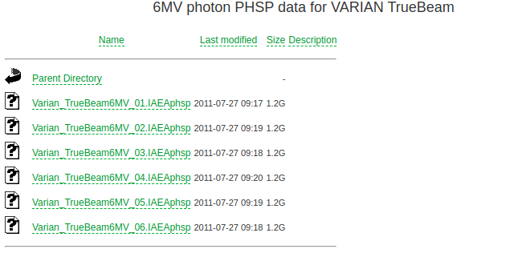
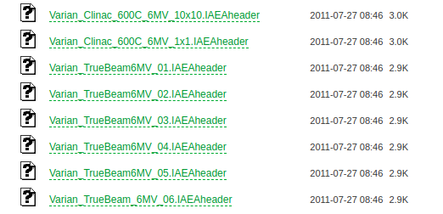
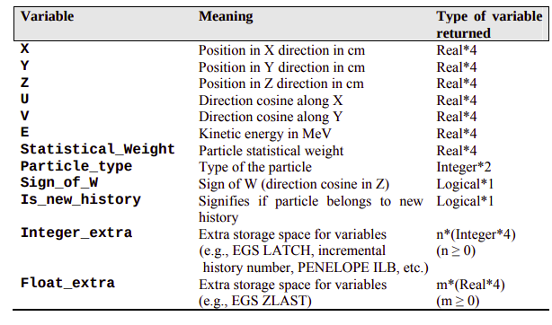
IAEA format
The IAEA psf stored information[1]
Each psf had 2 files: *.IAEAheader and *.IAEAphsp.
There are 3 types of IAEA psf:
  Cobalt source
  Photon beam
  Electron beam

Slide 14
Hdf5 format (only suport for Geant4)
G4PhspH5 is a new opensource tool for writting and reading phase-space file based on HDF5 file format originally developed by Jaafar EL Bakkali, it can be easy incoporated into existing Geant4 application, since only two C++ classes needed to be added into an existing code in order to perform phase-space writting task and only one for phase-space reading task.
It requires that HDF5 C++ Library is installed, which it can be obtained from HDF5 Group website, it strongly recommended that the user install this library into the " /opt" UNIX folder.
This format was published by Jaafar EL Bakkali on Github:https://github.com/EL-Bakkali-Jaafar/G4PhpH5 (for single calculation)
It also applied in G4Linac_MT by him at: https://github.com/EL-Bakkali-Jaafar/G4Linac_MT

Slide 15
Root format
Root format can be supported by both Geant4 and Gate.
The Gate’s user will interact with psf through Phase space actor. It allows user read and write particle to attached plane for simulation.
Users can use python programming or Root syntaxt to read and analysis phase space easily.

Slide 16
Gaga (only suport for Gate)
“Varian propose on its website the sources of TrueBeam STx in IAEAphsp format. But, unfortunately, these files are not in open acces and are only for VARIAN customers. GAMMORA can create macro for these native files. For the users who do not have access to these IAEAphsp files, we propose in GAMMORA the phase spaces for photon sources for all energies as a pre trained Generative Adversarial Neural (GAN) network. These GAN were trained using the gaga tool (GAn fo Gate).”
Currently, only Gate support Gaga format. It available at: https://github.com/dsarrut/gaga-phsp
We can download and train modle from root psf format to Gaga to reduce size. The instruction is at here: https://github.com/OpenGATE/GateContrib/tree/master/dosimetry/gaga-phsp
Gaga psf for TrueBeam can be found in the GAMMORA project.

Slide 17
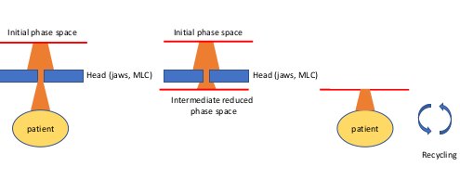
Input construction for Gate
Instead of simulating all components of the TrueBeam, we should divide it into 2 segments.
a) For the first segment: we read initial psf to transport through jaws and mlc. We will use a plane to record particles and save as root psf format.
b) For the last segment: we read particles from the root psf and transport particles to the phantom/ patient. In this step, we can sample particles many times to reduce errors.
The ideals for simulation:
Diagram for simulation step by step

Slide 18
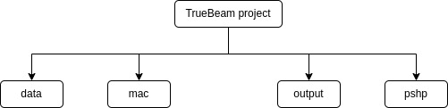
Directory structure
We have divided the main input file into various sub-files that are contained in specific sub-folders.
“data folder” contains data for simulation, for example the materials data base, experiment data, …
“mac folder” contains some macro files to describle geometry information, the ways to read and write psf, how to extract useful quatities, …
“out folder” contains the resuls.
“phsp folder” contains phase space files

Slide 19
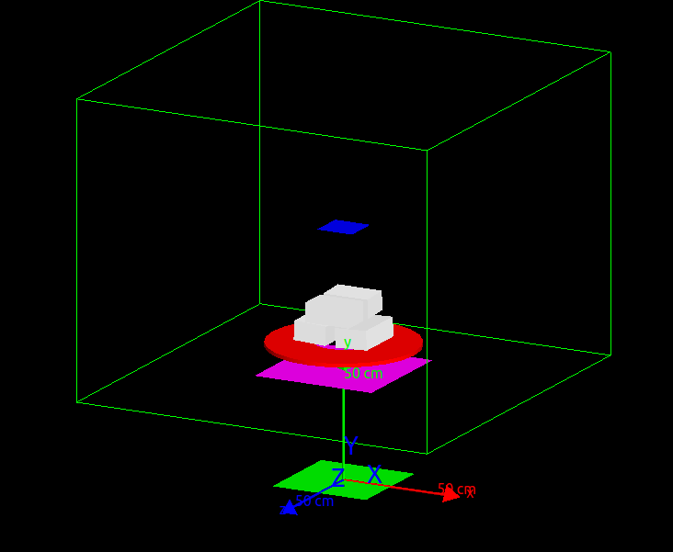
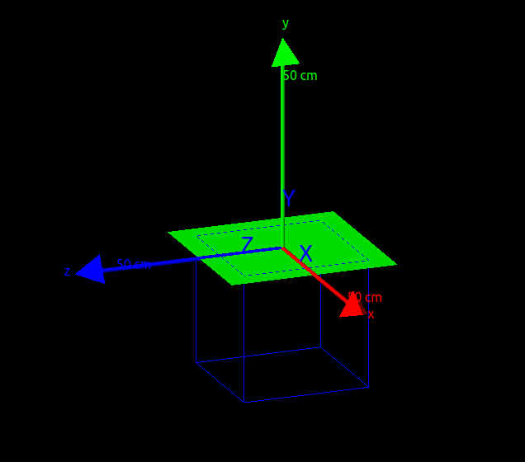
General geometry
segment 1
segment 2
out psf
initial psf
jaws
out psf
phantom

Slide 20
MLC modeling
segment 1
segment 2
out psf
initial psf
jaws
out psf
phantom

Slide 21
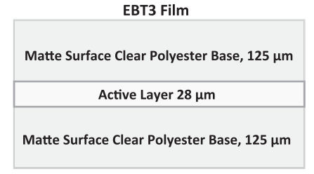
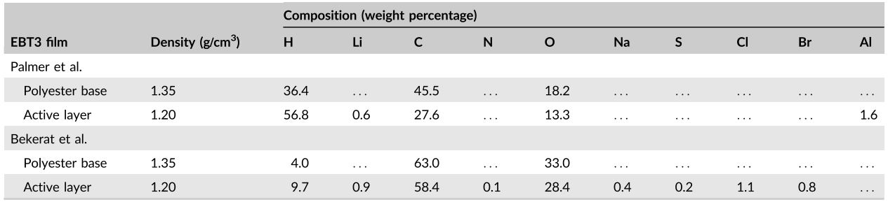
EBT3 film modeling
segment 1
jaws
EBT3 film structure[2]
out psf
phantom

Slide 22
Physics list
We used “emstandard_opt3” library for this medical application.
The cutoff threshold for regions and particles:
 | electron | positron | photon
world | 1 mm | 1 mm | 1 mm
phantom | 0.1 mm | 0.1 mm | 0.1 mm

Slide 23
Dose actor

Slide 24
Visualization

Slide 25
How to run simulation
To run simulation, the user need to open terminal in the TrueBeam project folder.
Just type "Gate mac/S1Main.mac" to run segment 1 transport or "Gate mac/S2Main.mac" to run segment 2 transport.

Slide 26
Parallel calculation

Slide 27
III. Results and Discussion

Slide 28
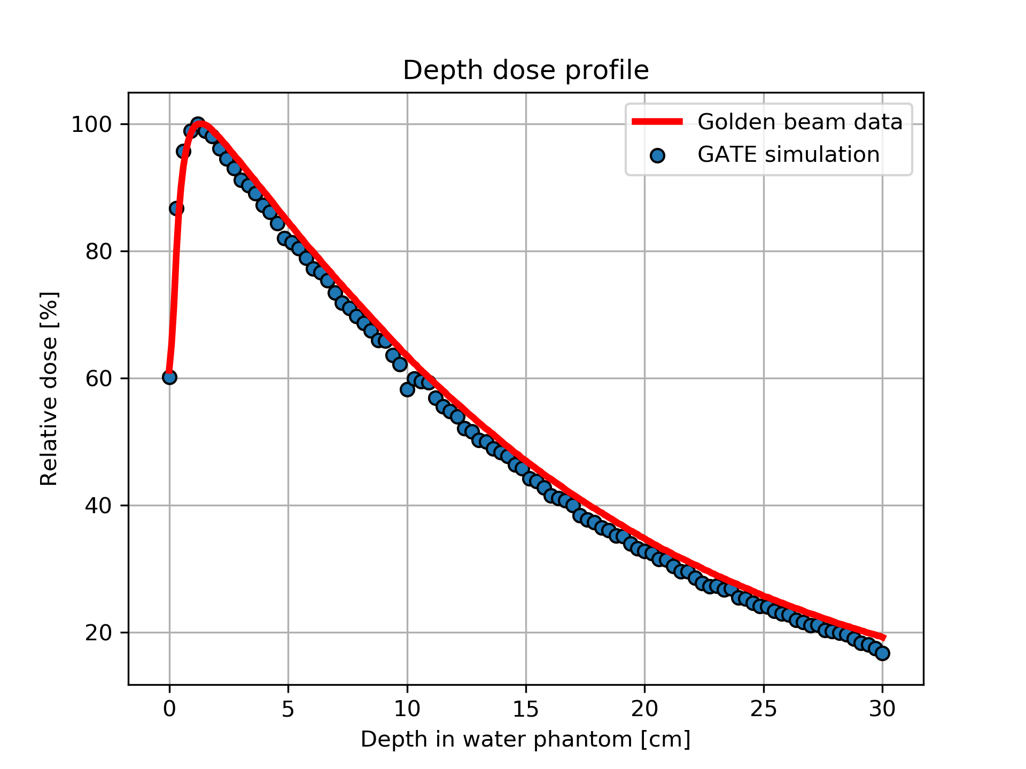
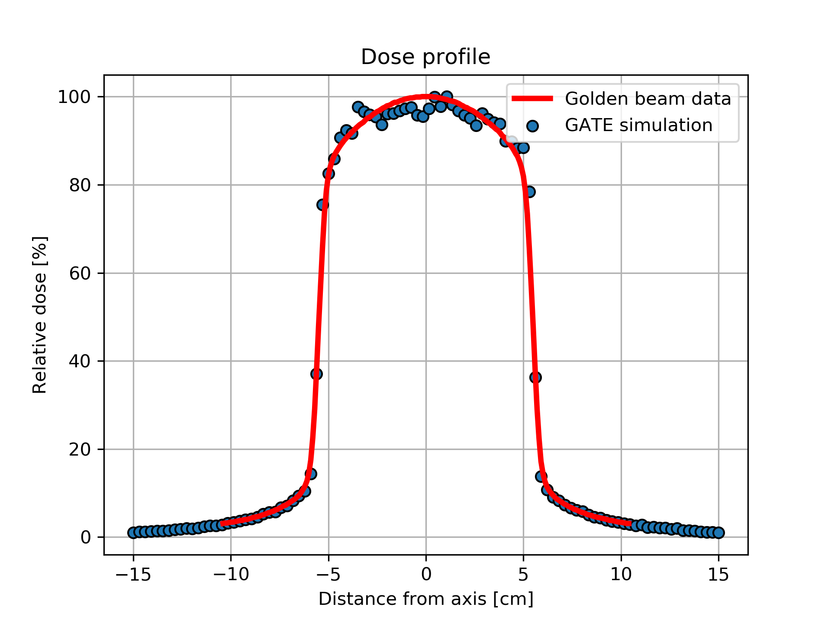
QA problems for 10x10 cm

Slide 29
References
[1].Capote, R., R. Jeraj, C. M. Ma, D. WO Rogers, F. Sánchez-Doblado, J. Sempau, J. Seuntjens, and J. V. Siebers. "Phase-space database for external beam radiotherapy. Summary report of a consultants' meeting." (2006).
[2].Robinson, Spencer M., et al. "Monte Carlo simulations of EBT3 film dose deposition for percentage depth dose (PDD) curve evaluation." Journal of Applied Clinical Medical Physics 21.12 (2020): 314-324.
[3].Morales, Johnny E., et al. "Monte Carlo calculated output correction factors for Gafchromic EBT3 film for relative dosimetry in small stereotactic radiosurgery fields." Physical and Engineering Sciences in Medicine 43.2 (2020): 609-616.

