Slide 1

OneFS SyncIQ Benefits and Applications
Enhancing data replication and disaster recovery solutions
Notes:
AI-generated content may be incorrect. ---

Slide 2
OneFS SyncIQ Overview and Benefits
Notes:
--- This slide references information from the following file: https://infohub.delltechnologies.com/en-au/l/dell-powerscale-onefs-technical-overview/file-system-structure/ Introduction to SyncIQ, Key Benefits of SyncIQ

Slide 3
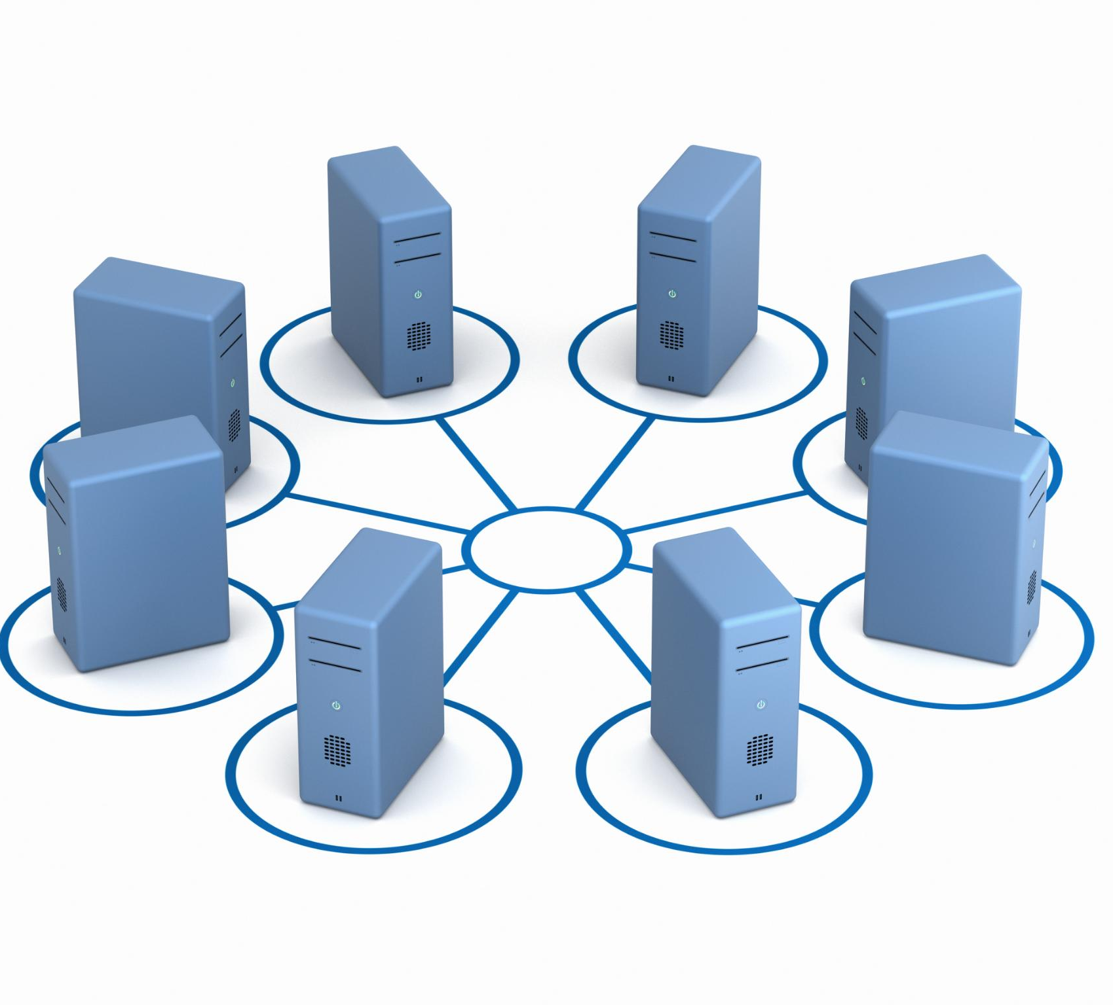
Introduction to SyncIQ
Core Replication Technology
SyncIQ is built into OneFS for flexible, automated, and scalable data replication across distributed clusters.
Efficient Data Synchronization
It asynchronously replicates only changed data increments, optimizing bandwidth and maintaining consistency.
Scalable Parallel Architecture
Replication tasks are parallelized across nodes, enabling scalable throughput at multi-petabyte scale.
Policy-Driven Control
Administrators manage replication with fine-grained policies triggered by schedules or modifications.
Notes:
--- This slide references information from the following file: https://infohub.delltechnologies.com/en-au/l/dell-powerscale-onefs-technical-overview/file-system-structure/ SyncIQ is a core data replication technology built into the Dell PowerScale OneFS operating system, designed to provide highly flexible, automated, and scalable replication across distributed storage clusters. At its foundation, SyncIQ enables organizations to efficiently protect, move, and synchronize their unstructured data across LAN or WAN environments, offering multiple deployment topologies that support diverse resilience and performance needs. This capability is especially valuable for enterprises managing expanding volumes of unstructured data, including analytics workloads, media pipelines, or general-purpose file services that demand consistent availability and protection. SyncIQ operates asynchronously, allowing production environments to continue performing without interruption while replication occurs in the background. The process leverages sophisticated scanning and change-detection mechanisms to identify modified data and transfer only incremental updates, which optimizes bandwidth consumption while maintaining dataset consistency between clusters. Through its parallelized architecture, SyncIQ distributes replication tasks across cluster nodes so that throughput scales in line with overall system capacity—making it particularly effective at multi-petabyte scale. Administrators benefit from a policy-driven framework, enabling fine-grained control over replication behavior at the file, directory, or full filesystem level. These policies can be executed based on schedules, triggered by dataset modifications, or run manually for operational or maintenance purposes. Broad connectivity support means SyncIQ is equally suited for short-distance datacenter failover architectures or long-distance disaster recovery sites. Collectively, these capabilities make SyncIQ a foundational component in enterprise strategies for resilience, data mobility, and infrastructure optimization, delivering seamless integration with other OneFS services, such as SnapshotIQ for snapshot-driven data lifecycle management.

Slide 4

Key Benefits of SyncIQ
High-Performance Replication
SyncIQ uses asynchronous replication to sync large datasets efficiently without affecting production workloads.
Scalability and Parallelism
It scales seamlessly with no fixed size limits by spreading workload across cluster resources for consistent replication.
Flexible Recovery Objectives
SyncIQ offers flexible Recovery Point and Time Objectives, allowing calibration of protection based on risk tolerance and investment.
Network Adaptability and Control
The engine optimizes performance for LAN and WAN environments and supports granular policy-based replication control.
Notes:
--- This slide references information from the following file: https://infohub.delltechnologies.com/en-au/l/dell-powerscale-onefs-technical-overview/file-system-structure/ SyncIQ delivers a robust suite of benefits that make it a powerful and essential replication engine for large-scale unstructured data environments. One of the most notable advantages is its high-performance asynchronous replication, which ensures that large datasets can be synchronized efficiently without impacting production workloads. SyncIQ’s design enables organizations to maintain flexible Recovery Point Objectives (RPO) and Recovery Time Objectives (RTO), allowing them to calibrate protection levels against infrastructure investments and operational risk tolerance. Its scalability is virtually unmatched, with no fixed limitations on replicated filesystem size, empowering organizations to maintain replication consistency even as their datasets expand into multiple-petabyte ranges. The engine achieves this by employing a highly parallel replication architecture that spreads workload across cluster resources—ensuring throughput scales in proportion to capacity increases, and enabling stable RPO performance even for growing datasets. SyncIQ also excels in network adaptability, offering tunable performance characteristics optimized for both LAN and WAN environments. This flexibility allows organizations to replicate across geographically distant clusters for regional disaster recovery or within the same facility for high-availability designs. The policy-based structure adds further control, enabling replication to be tailored at granular levels such as individual directories or entire filesystems, and triggered based on schedules or changes detected at the source. These features collectively provide exceptional operational control, scalability, efficiency, and adaptability, making SyncIQ a strategic tool for modern data protection, mobility, and multi-site storage architectures.

Slide 5
Applications and Comparative Advantages
Notes:
--- This slide references information from the following file: https://lenovopress.lenovo.com/lp1700-lenovo-everyscale-design-architecture-for-weka-storage,https://techcommunity.microsoft.com/blog/azurehighperformancecomputingblog/breaking-the-speed-limit-with-weka-file-system-on-top-of-azure-hot-blob/4171777 Real-World Use Cases of SyncIQ, SyncIQ vs Traditional Backup Approaches

Slide 6

Real-World Use Cases of SyncIQ
Disaster Recovery Synchronization
SyncIQ continuously syncs data between primary and secondary clusters to minimize downtime and data loss during site failures.
Snapshot Archiving Integration
SyncIQ replicates snapshots to remote clusters, ensuring long-term retention and compliance without overcrowding primary storage.
Multi-Site Data Distribution
Enables geographically dispersed teams to access synchronized datasets efficiently without slow manual transfers.
Handling Large Unstructured Data
Ideal for industries managing massive data volumes like AI, genomic sequencing, and scientific simulations.
Notes:
--- This slide references information from the following file: https://lenovopress.lenovo.com/lp1700-lenovo-everyscale-design-architecture-for-weka-storage,https://techcommunity.microsoft.com/blog/azurehighperformancecomputingblog/breaking-the-speed-limit-with-weka-file-system-on-top-of-azure-hot-blob/4171777 SyncIQ is widely employed across industries to address mission-critical data protection, mobility, and operational continuity challenges. A primary use case is disaster recovery (DR), where SyncIQ continuously synchronizes data between primary and secondary PowerScale clusters, ensuring organizations have a ready-to-activate replica environment in the event of a site-level failure. This cluster-to-cluster redundancy significantly strengthens business continuity plans by minimizing downtime and data loss. Another important application is snapshot archiving, especially when integrated with SnapshotIQ. In this workflow, SyncIQ replicates snapshots to remote clusters for long-term retention, dataset consistency, and compliance-driven retention strategies. This approach prevents primary storage from becoming overcrowded with historical snapshots while preserving rapid access and recovery options. SyncIQ also supports multi-site data distribution, enabling geographically dispersed teams—such as research groups, analytics departments, or media production units—to access synchronized datasets without relying on slow or manually managed transfers. Its ability to handle extremely large unstructured datasets makes it ideal for industries dealing with massive data volumes, such as AI and machine learning pipelines, genomic sequencing, VFX rendering, or scientific simulations. Across all these scenarios, SyncIQ's policy-driven management framework ensures that replication can be tailored to specific operational requirements, whether the priority is rapid failover, data lifecycle management, or distributed collaboration across global environments.

Slide 7

SyncIQ vs Traditional Backup Approaches
Faster Recovery Operations
SyncIQ uses synchronized cluster replicas enabling rapid recovery and minimal operational disruption.
Automated Data Synchronization
SyncIQ automates synchronization entirely, reducing human error and administrative workload.
Efficient Resource Usage
Parallel replication architecture avoids performance degradation during data transfers in production systems.
Incremental and Asynchronous Sync
SyncIQ performs incremental, asynchronous syncs, reducing bandwidth use and speeding synchronization cycles.
Notes:
--- This slide references information from the following file: https://lenovopress.lenovo.com/lp1700-lenovo-everyscale-design-architecture-for-weka-storage,https://techcommunity.microsoft.com/blog/azurehighperformancecomputingblog/breaking-the-speed-limit-with-weka-file-system-on-top-of-azure-hot-blob/4171777 SyncIQ offers several compelling advantages over traditional backup systems, particularly tape-based workflows that can be slow, operationally complex, and resource intensive. Because SyncIQ maintains synchronized cluster replicas, recovery operations are significantly faster than when relying on sequential tape restoration, enabling organizations to resume operations with minimal disruption. Unlike traditional backups that depend on manual processes or long-running jobs, SyncIQ automates data synchronization entirely, reducing the likelihood of human error and freeing IT teams from repetitive administrative tasks. Its parallel replication architecture also ensures that data transfers occur without degrading the performance of production systems, which is a common challenge in legacy backup environments where backup windows can interfere with operational workloads. Additionally, the asynchronous, incremental nature of SyncIQ allows organizations to maintain up-to-date replicas without requiring full system scans or complete dataset retransfers. This efficiency directly translates to lower bandwidth usage, faster synchronization cycles, and more predictable protection schedules. Together, these advantages position SyncIQ as a modern, resilient, and highly efficient alternative to older backup solutions, especially for organizations operating at scale or requiring rapid recovery, high availability, and minimal operational overhead.

