Slide 1

WELCOME TO OUR TEAM

Slide 2
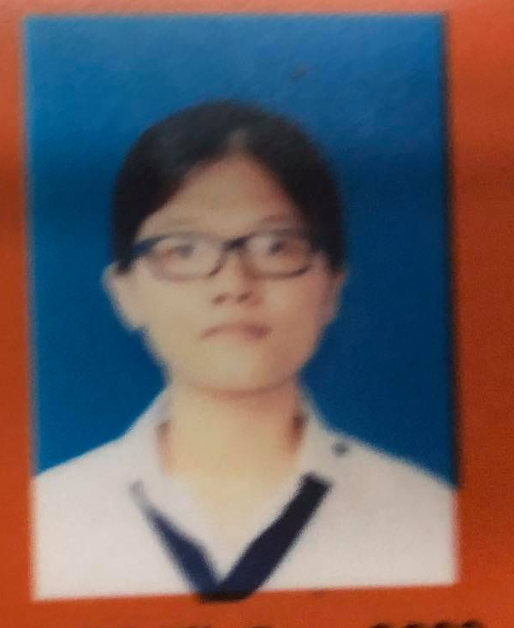


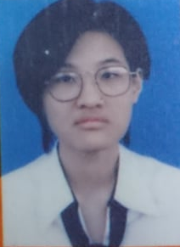
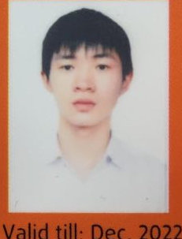
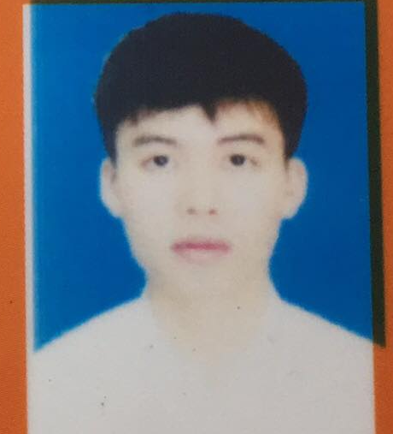
MEMBER INTRODUCTION
Name: Cao Ngọc Nhật Vy
DOB: 04/12/2000
Contact: vycnnse140072@fpt.edu.vn
Name: Vũ Thu Giang
DOB: 26/10/2000
Contact: giangvtse140954@fpt.edu.vn
Name: Nguyễn Hoàng Minh Tú
DOB: 23/02/2000
Contact: tunhmse140357@fpt.edu.vn
Name: Nguyễn Thị Hồng Ngọc
DOB: 06/12/2000
Contact: ngocnthse140547@fpt.edu.vn
Name: Nguyễn Văn Hùng
DOB: 08/11/2000
Contact: hungnvse140996@fpt.edu.vn
Name: Phan Trung Dũng
DOB: 19/02/2000
Contact: dungptse141015@fpt.edu.vn

Slide 3

AUTOMATION TESTING TOOL

Slide 4
01
INTRODUCTION
02
CONFIGURATION
03
SETTING UP PROJECT
04
DEMO CODE
05
REPORTING

Slide 5
INTRODUCTION

Slide 6
WHAT IS CUCUMBER?
Cucumber is a tool that supports Behavior-Driven Development (BDD) used by the testers to develop test cases for the testing of behavior of the software.
Cucumber uses Gherkin language to write the test scripts.
Cucumber tool initially supports "Ruby" programming language.
But now, Cucumber supports many programming languages including Java, JavaScript, Python, PHP, Net, Perl, etc.

Slide 7
WHAT IS BDD?
BDD is a software development process that allows the tester/business analyst to create test cases in simple text language (English).
The simple language used in the scenarios helps even non-technical team members to understand what is going on in the software project. This helps and improves communication among technical and non-technical teams, managers, and stakeholders.

Slide 8
WHAT IS BDD?
Features:
Test scenarios are written separately in a different file, named as Feature file.
Tests are written by focusing user stories and system behavior in a layman language.
Code is subject to be written differently in step definitions file i.e. Java, Python.

Slide 9
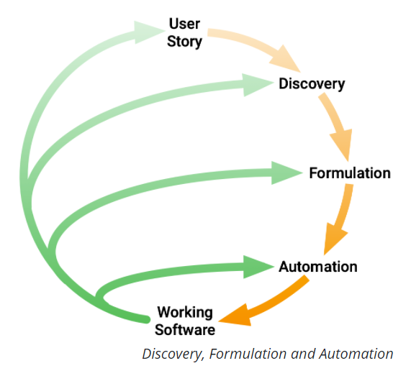
WHAT IS BDD?
DISCOVERY: What it could do
FORMULATION: What it should do
AUTOMATION: What it actually does

Slide 10
HOW DOES CUCUMBER WORKS?
Firstly, Cucumber tool reads the step written in a Gherkin or plain English text inside the feature file.
Now, it searches for the exact match of each step in the step definition file, then executes the test case and provides the result as pass or fail.
The code of developed software must correspond with the BDD defined test scripts. If it does not, then code refactoring will be required. The code gets freeze only after successful execution of defined test scripts.

Slide 11
ADVANTAGES
The test case writing is very easy and understandable.
It provides an end-to-end testing framework, unlike other tools.
It supports almost all popular different languages like Java, JavaScript, Ruby, PHP, etc.
It works as a bridge between business and technical language, and this bridge is sustainable.
The testing environment set up and execution both are very quick and easy.

Slide 12
CONFIGURATION

Slide 13
SETTING UP PROJECT

Slide 14
DEPENDENCY
Selenium-java
Cobertura
Cucumber-jvm-deps
Cucumber-reporting
Gherkin
Junit
Mockito-all-1.10.19
Cucumber-core
Cucumber-java
Cucumber-junit

Slide 15
WRITE A SCENARIO
When we do BDD with Cucumber we use concrete examples to specify what we want the software to do.
Scenarios are written before production code. They start their life as an executable specification.
As the production code emerges, scenarios take on a role as living documentation and automated tests.

Slide 16
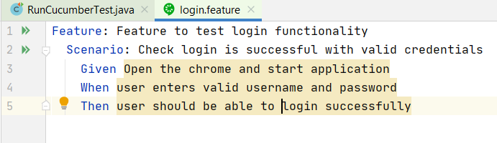
FEATURE FILE
Feature: is a beginning keyword of each feature file of Cucumber testing, which describes the function to be tested.
Scenario: is one of the core structures of the Gherkin language. It consists of a list of steps.
Given: refers to the pre-condition of the test.
When: refers to the actions of a user that is to be executed.
Then: refers to the outcome of the previous step or upcoming action.

Slide 17
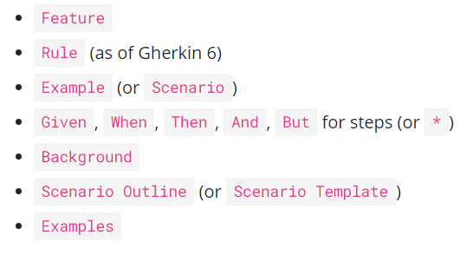
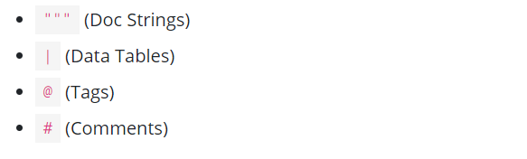
GHERKIN REFERENCE
Gherkin uses a set of special keywords to give structure and meaning to executable specifications.
Primary keywords: Secondary keywords:

Slide 18
DEMO CODE

Slide 19
REPORTING

Slide 20
REPORTING
Cucumber uses reporter plugins to produce reports that contain information about what scenarios have passed or failed.

Slide 21
HOOK
The hook is the block of code which can be defined with each scenario in step definition file by using the annotation @Before and @After.
Cucumber hook facilitates us to handle the code workflow better and also helps us to reduce code redundancy.

Slide 22
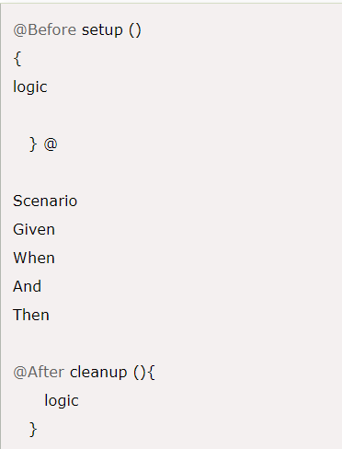
HOOK
The hook is the block of code which can be defined with each scenario in step definition file.
Cucumber hook facilitates us to handle the code workflow better and also helps us to reduce code redundancy.
@Before
Is used with the function/method after which we need to start web driver.
@After
Is used with the function/method after which we need to close the web driver.

Slide 23
REFERENCES
https://cucumber.io/
https://www.javatpoint.com/cucumber-testing
https://viblo.asia/p/automated-testing-with-cucumber-phan-1-khai-quat-so-luoc-ve-cucumber-Do7546AWZM6
https://viblo.asia/p/automated-testing-with-cucumber-phan-2-khai-quat-so-luoc-ve-cucumber-Do7546AWZM6
https://viblo.asia/p/automated-testing-with-cucumber-phan-3-khai-quat-so-luoc-ve-cucumber-Do7546AWZM6
https://viblo.asia/p/automated-testing-with-cucumber-phan-4-khai-quat-so-luoc-ve-cucumber-Do7546AWZM6
https://medium.com/@mlvandijk/getting-started-with-cucumber-in-java-a-10-minute-tutorial-586652d2c82

Slide 24
THANK FOR LISTENING

