Slide 1
Linked Lists, Stacks and Queues

Slide 2
Linked List
List is a collection of items.
There are two ways of maintain the list in the computer memory:
Arrays: Insertion & Deletion of an element from an array requires more processing.
Linked list: collection of nodes where each node has two parts, first part contains the information, and the second part contains the address of the next node.

Slide 3
Linked List: A Dynamic Data Structure
A data structure that can shrink( thu nhỏ) or grow (phát triển) during program execution.
The size of a dynamic data structure is not necessarily known at compilation time, in most programming languages.
Efficient insertion and deletion of elements.
The data in a dynamic data structure can be stored in non-contiguous (arbitrary) locations.
Linked list is an example of a dynamic data structure.
3

Slide 4
Advantages of linked list
Unused locations in array is often a wastage of space
Linked lists offer an efficient use of memory
Create nodes when they are required
Delete nodes when they are not required anymore
We don‘t have to know in advance how long the list should be
4

Slide 5
Applications of linked list
Linked lists are used to represent and manipulate polynomial. Polynomials are expression containing terms with non zero coefficient and exponents. For example:
P(x) = a₀ X^{n} + a₁ X^{n-1} + …… + a_{n-1} X + a_{n}
Represent very large numbers and operations of the large number such as addition, multiplication and division.
Linked lists are to implement stack, queue, trees and graphs.
Implement the symbol table in compiler construction.
5

Slide 6
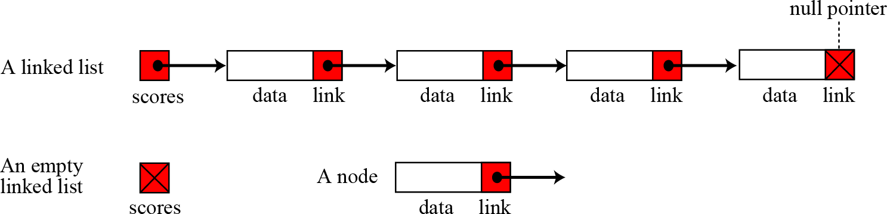
Introduction to Linked List
A linked list is a collection of data in which each element contains the location of the next element—that is, each element contains two parts: data and link
6

Slide 7
Linked list
The general form of a linked list is
Struct node
{
Type member1;
Type member2;
Struct node *link;
};

Slide 8
Linked List
The nodes of a linked list are not stored contiguously in memory.
In array we can perform all the operations using array name.
In case of linked list, we perform all the operations with the help of a pointer that points to the first node of the linked list.
This pointer is generally named start and it is the only source through which we can access our linked list.
The list will be considered empty if the pointer start contains NULL value.

Slide 9
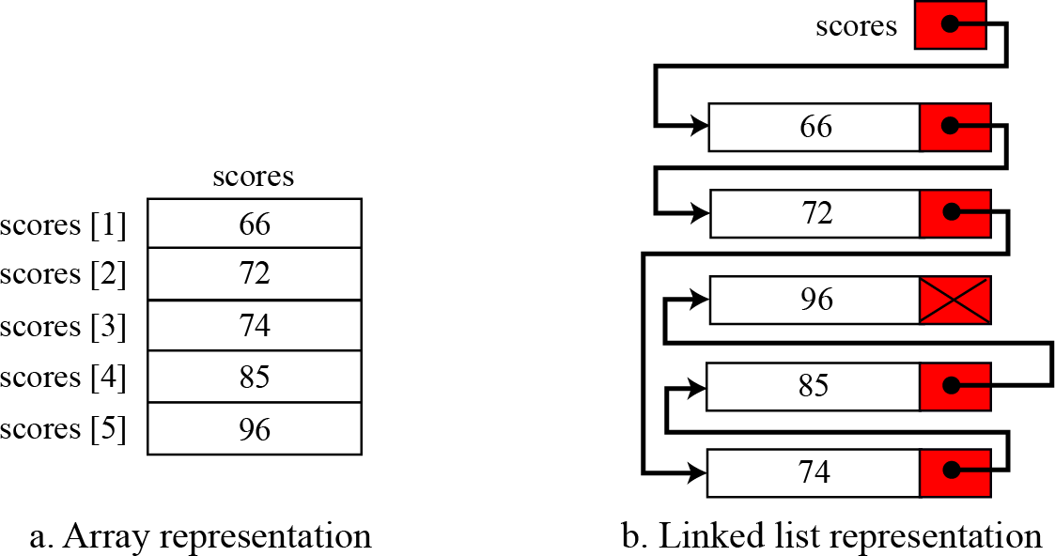
Arrays versus Linked Lists
Both an array and a linked list are representations of a list of items in memory. The only difference is the way in which the items are linked together. The Figure below compares the two representations for a list of five integers.
9

Slide 10
Linked list
Consider a linked list that contains an integer value in the information part. The structure for the nodes of this list will be defined as-
Struct node
{
int info;
Struct node *link;
};

Slide 11

















Linked list that has 4 nodes
start
350
33 | 900
44 | 150
55 | 700
66 | NULL
350
900
150
700

Slide 12
Types of linked lists
There are four types of Linked lists:
Single linked list
Begins with a pointer to the first node
Terminates with a null pointer
Only traversed in one direction
Circular single linked list
Pointer in the last node points back to the first node
Doubly linked list
Each node has a forward pointer and a backward pointer
Allows traversals both forwards and backwards
Circular double linked list
Forward pointer of the last node points to the first node and
backward pointer of the first node points to the last node
12

Slide 13
Singly Linked Lists
A singly linked list is a concrete data structure consisting of a sequence of nodes
Each node stores
next
Element/information
link to the next node
elem
node
∅
A
B
C
D
13

Slide 14
Singly Linked Lists
A linked list allocates space for each element separately in its own block of memory called a "node".
Each node contains two fields; a "data" field to store whatever element, and a "next" field which is a pointer used to link to the next node.
Each node is allocated space in the heap memory using malloc(), so the node memory continues to exist until it is explicitly de-allocated using free().
The front of the list is a pointer to the “start” node.
14

Slide 15
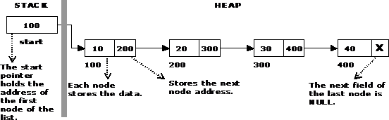

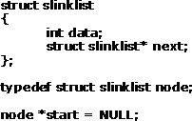

Single Linked List
15

Slide 16
Operations on Linked Lists
The basic operations of a single linked list are
Creation of a linked list
Insertion of an element
Deletion of an element
Traversal of a linked list
Searching an element
Reversal of a linked list
16

Slide 17
Traversing a Linked List
Traversal means visiting each node, starting from the first node till we reach the last node.
A structure pointer p will point to the node that is currently being visited.
Initially we have to visit the first node, so p is assigned the value of start.
p= start;
We can access the info part of the first node by writing
P-> info

Slide 18
Traversing a Linked List
To shift the pointer p forward so that it points to the next node.
p=p->link;
Now p has the address of the next node.
Similarly, we can visit each node of the linked list through this assignment until p has NULL, which is link part value of last element.

Slide 19
Traversing a Linked List
So, linked list traversed as
While(p!=NULL)
{
printf(“%d”, p->info);
p=p->link;
}

Slide 20


































Linked list that has 4 nodes
start
350
33 | 900
44 | 150
55 | 700
66 | NULL
350
900
150
700

Slide 21
Display the contents of the linked list
Void display(struct node *start)
{
struct node *p;
if(start == NULL)
{ printf(“List is Empty\n”);
return;
}
P=start;
Printf(“List is: \n”);
While(p != NULL)
{
printf(“%d”, p-> info);
p=p->link;
}
Printf(“\n\n”);

Slide 22


Count the number of elements in the list
void count(struct node *start)
{
struct node *p;
int cnt=0;
p=start;
while(p!=NULL)
{
p=p->link;
cnt++;
}
printf(“Number of Elements are %d\n”,cnt);
}

Slide 23

Searching in a linked List
Void search(struct node *start, int item )
{
struct node *p=start;
int pos=1;
While(p!=NULL)
{
if(p-> info == item)
{
printf(“item %d found at position %d\n”,item,pos);
return;
}
p= p->link;
Pos++;
}
printf(“item %d not found in the list\n”,item);
}

Slide 24



























Insertion in a linked list
There can be four cases while inserting a node in a linked list
1. Insertion at the beginning
2. Insertion in an empty list
3. Insertion at the end
4. Insertion in between the nodes.

Slide 25
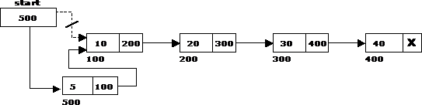






Insertion at the beginning

Slide 26






Insertion at the beginning
Struct node *addatbeg(struct node *start, int data)
{
struct node *tmp;
tmp=(struct node *) malloc(sizeof(struct node));
tmp -> info=data;
tmp-> link=start;
start=tmp;
return start;
}

Slide 27





Insertion in an empty list
start
NULL
start
NULL
Node T
tmp->link =start;
Start=tmp;

Slide 28
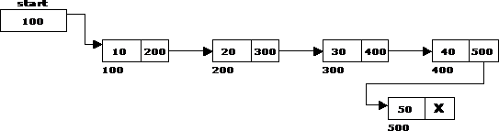

















Insertion at the end of the list
We have to insert a new node T at the end of the list

Slide 29



Insertion at the end of the list
Struct node *addatend(struct node *start, int data)
{
struct node *p,*tmp;
tmp=(struct node *) malloc(sizeof(struct node));
tmp -> info=data;
p=start;
While(p->link!=NULL)
p=p-> link;
p=p-> link=tmp;
tmp-> link=NULL;
return start;
}

Slide 30
Insertion after a node
Struct node *addafter(struct node *start, int data,int item)
{
struct node *p,*tmp;
p= start;
while(p->link!=NULL)
{
if(p->info == item)
{
tmp=(struct node *) malloc(sizeof(struct node));
tmp -> info=data;
tmp->link = tmp;
return start;
}
p->link;
}
Return start;
}

Slide 31




Insertion before a node
Struct node *addbefore(struct node *start, int data,int item)
{
struct node *p,*tmp;
if(start==NULL)
{
printf(“List is empty\n”);
return start;
}
If( item == start -> info)
{
tmp=(struct node *) malloc(sizeof(struct node));
tmp -> info=data;
tmp->link = start;
start=tmp;
return start;
}
p= start;
while(p->link!=NULL)
{
if(p->info == item)
{
tmp=(struct node *) malloc(sizeof(struct node));
tmp -> info=data;
tmp->link = tmp;
return start;
}
p= p->link;
}
Return start;
}

Slide 32
Insertion at a given position
Struct node *addatpos(struct node *start, int data,int pos)
{
struct node *p,*tmp;
int i;
p= start;
for(i=1;i<pos-1 && p!=NULL; i++)
p=p->link;
If(p==NULL)
Printf(“There are less than %d elements\n”,pos);
else
{
tmp=(struct node *) malloc(sizeof(struct node));
tmp -> info=data;
if(pos==1)
{
tmp->link = tmp;
start =tmp;
}
Else
{
tmp->link = p->link;
p->link=tmp;
}
}
Return start;
}

Slide 33






Creation of a linked list
Struct node *create(struct node *start)
{
int i, n, data;
printf(“Enter the number of nodes”);
scanf(“%d”,&n);
start=NULL;
if(n==0)
return start;
Printf(“Enter the element to be insearted:”);
scanf(“%d”,&data);
Start= addatbeg(start,data);
For(i=2;i<=n;i++)
{
printf(“Enter the element to be inserted”);
scanf(“%d”,&data);
Start=addatend(start,data);
}
Return start;
}

Slide 34

Deleting a node at the beginning
The following steps are followed, to delete a node at the beginning of the list:

Slide 35
Deleting a node at the end
The following steps are followed to delete a node at the end of the list:
If list is empty then display "Empty List"message.
If the list is not empty, follow the steps given below:
temp = prev = start; while(temp -> next != NULL)
{
prev = temp;
temp = temp -> next;
}
prev -> next = NULL;
free(temp);

Slide 36


Deleting a node at the end

Slide 37
Deleting a node at Intermediate position
The following steps are followed, to delete a node from an intermediate position in the list:
# Given a reference to the head of a list and a position, delete the node at a given position def deleteNode(self, position):
# If linked list is empty if self.head == None:
return
# Store head node temp = self.head

Slide 38

Deleting a node at Intermediate position
P=start;
While(p->link->info == data)
{
tmp=p->link;
P->link=tmp->link;
Free(tmp);
Return start;
}
P=p-> link;
}

Slide 39
Deleting a node at Intermediate position
# Find previous node of the node to be deleted for i in range(position -1 ):
temp = temp.next
if temp is None:
break
# If position is more than number of nodes
if temp is None:
return
if temp.next is None: return

Slide 40
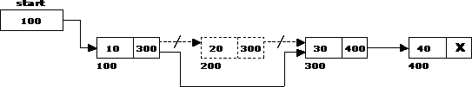




Deleting a node at Intermediate position
110

Slide 41
Double Linked List
A double linked list is a two-way list in which all nodes will have two links. This helps in accessing both successor node and predecessor node from the given node position. It provides bi-directional traversing. Each node contains three fields:
Left link.
Data.
Right link.
The left link points to the predecessor node and the right link points to the successor node. The data field stores the required data.

Slide 42
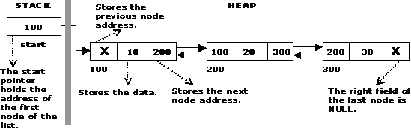






A Double Linked List

Slide 43
Basic operations in a double linked list
Creation
Insertion
Deletion
Traversing
The beginning of the double linked list is stored in a "start" pointer which points to the first node. The first node‘s left link and last node‘s right link is set to NULL.

Slide 44
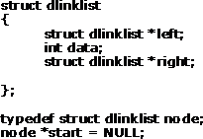

Structure of a Double Linked List

Slide 45
Advantages and Disadvantages of Double Linked List
The major disadvantage of doubly linked lists (over singly linked lists) is that they require more space (every node has two pointer fields instead of one). Also, the code to manipulate doubly linked lists needs to maintain the prev fields as well as the next fields; the more fields that have to be maintained, the more chance there is for errors.
The major advantage of doubly linked lists is that they make some operations (like the removal of a given node, or a right-to-left traversal of the list) more efficient.

Slide 46
Circular Single Linked List
It is just a single linked list in which the link field of the last node points back to the address of the first node.
A circular linked list has no beginning and no end. It is necessary to establish a special pointer called start pointer always pointing to the first node of the list.
Circular linked lists are frequently used instead of ordinary linked list because many operations are much easier to implement. In circular linked list no null pointers are used, hence all pointers contain valid address.

Slide 47
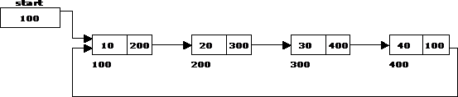

Circular Single Linked List and its basic operations
The basic operations in a circular single linked list are:
Creation
Insertion
Deletion
Traversing

Slide 48

Advantages of Circular Lists
The major advantage of circular lists (over non-circular lists) is that they eliminate some extra-case code for some operations (like deleting last node).
Also, some applications lead naturally to circular list representations.
For example, a computer network might best be modeled using a circular list.

Slide 49

Applications of Linked Lists: Representing Polynomials
A polynomial is of the form:
Where, c_{i} is the coefficient of the i^{th} term and n is the degree of the polynomial
Some examples are:
5x² + 3x + 1
5x⁴ – 8x³ + 2x² + 4x¹ + 9x⁰
The computer implementation requires implementing polynomials as a list of pairs of coefficient and exponent. Each of these pairs will constitute a structure, so a polynomial will be represented as a list of structures. A linked list structure that represents polynomials 5x⁴ – 8x³ + 2x² + 4x¹ + 9x⁰ illustrated.

Slide 50
Addition of Polynomials
To add two polynomials, if we find terms with the same exponent in the two polynomials, then we add the coefficients; otherwise, we copy the term of larger exponent into the sum and go on. When we reach at the end of one of the polynomial, then remaining part of the other is copied into the sum.
To add two polynomials follow the following steps:
Read two polynomials.
Add them.
Display the resultant polynomial.

Slide 51
Stacks
A stack is a list of elements in which an element may be inserted or deleted only at one end, called the top of the stack.
The elements are removed from a stack in the reverse order of that in which they were inserted into the stack.
Stack is also known as a LIFO (Last in Fast out) list or Push down list.
fully descending stack (arm cortex M4)
Fully Ascending stack

Slide 52
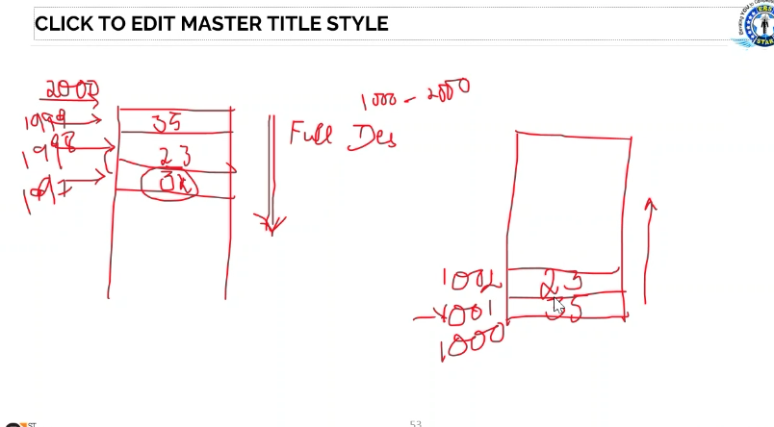

Slide 53
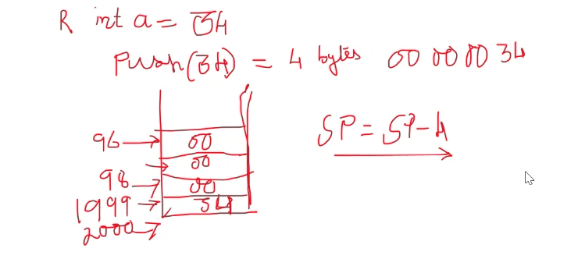

Slide 54
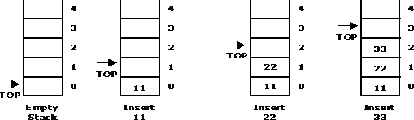
Basic Stack Operations
PUSH: It is the term used to insert an element into a stack.
PUSH operations on stack

Slide 55
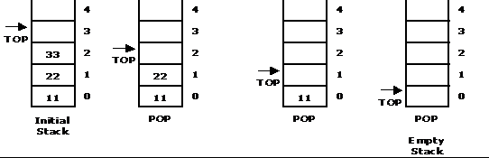
Basic Stack Operations
POP: It is the term used to delete an element from a stack.
POP operation from a stack

Slide 56
Standard Error Messages in Stack
Two standard error messages of stack are
Stack Overflow: If we attempt to add new element beyond the maximum size, we will encounter a stack overflow condition.
Stack Underflow: If we attempt to remove elements beyond the base of the stack, we will encounter a stack underflow condition.

Slide 57
Stack Operations
PUSH (STACK, TOP, MAXSTR, ITEM): This procedure pushes an ITEM onto a stack
If TOP = MAXSIZE, then Print: OVERFLOW, and Return.
Set TOP := TOP + 1 [Increases TOP by 1]
Set STACK [TOP] := ITEM. [Insert ITEM in TOP position]
Return
POP (STACK, TOP, ITEM): This procedure deletes the top element of STACK and assign it to the variable ITEM
If TOP = 0, then Print: UNDERFLOW, and Return.
Set ITEM := STACK[TOP]
Set TOP := TOP - 1 [Decreases TOP by 1]
Return

Slide 58
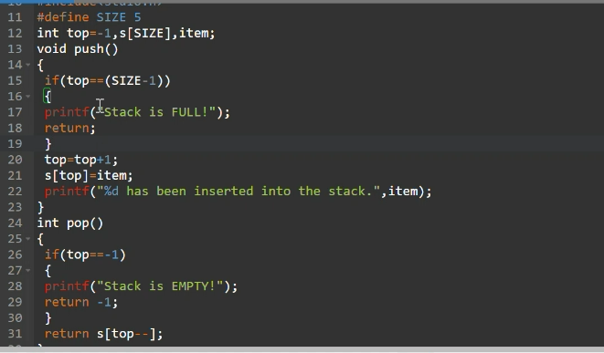
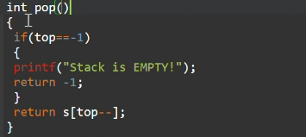
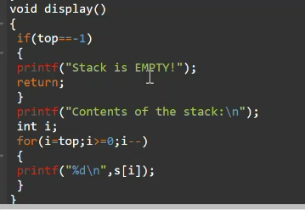

Slide 59
Applications of Stack
Converting algebraic expressions from one form to another. E.g. Infix to Postfix, Infix to Prefix, Prefix to Infix, Prefix to Postfix, Postfix to Infix and Postfix to prefix.
Evaluation of Postfix expression.
Parenthesis Balancing in Compilers.
Depth First Search Traversal of Graph.
Recursive Applications.

Slide 60
Algebraic Expressions
Infix: It is the form of an arithmetic expression in which we fix (place) the arithmetic operator in between the two operands. E.g.: (A + B) * (C - D)
Prefix: It is the form of an arithmetic notation in which we fix (place) the arithmetic operator before (pre) its two operands. The prefix notation is called as polish notation. E.g.: * + A B – C D
Postfix: It is the form of an arithmetic expression in which we fix (place) the arithmetic operator after (post) its two operands. The postfix notation is called as suffix notation and is also referred to reverse polish notation. E.g: A B + C D - *

Slide 61
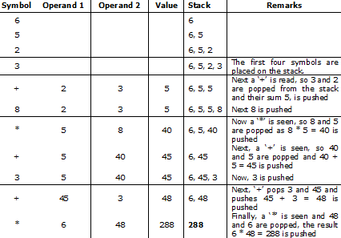
Evaluation of Postfix Expression
Postfix expression: 6 5 2 3 + 8 * + 3 + *

Slide 62
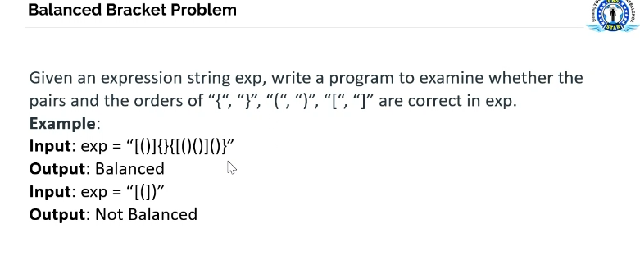

Slide 63
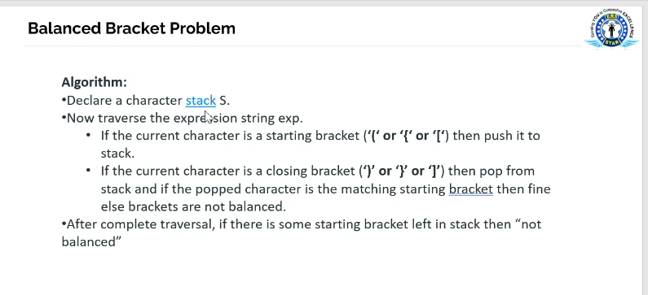

Slide 64
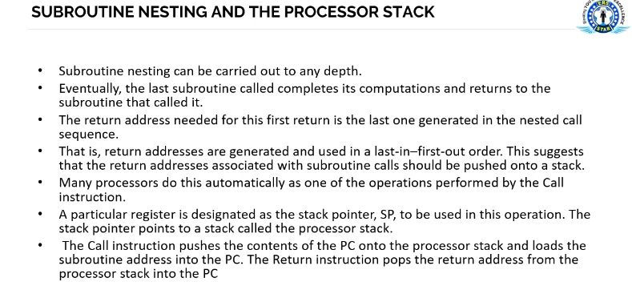

Slide 65
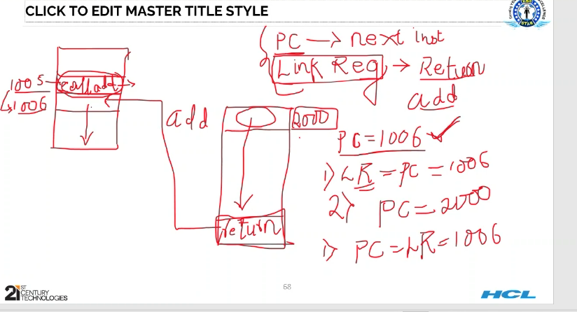
Cách

Slide 66
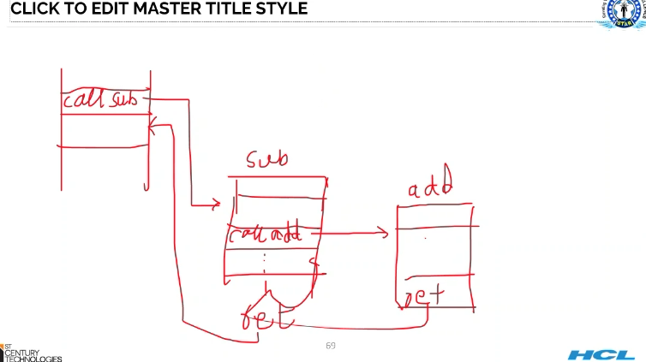

Slide 67
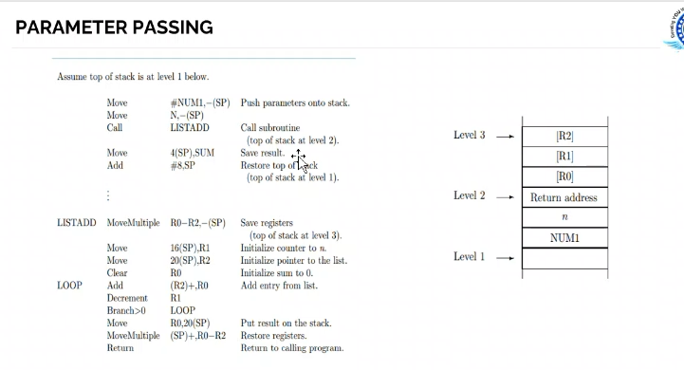

Slide 68
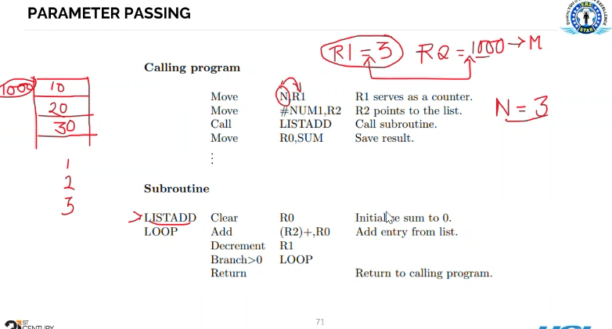

Slide 69
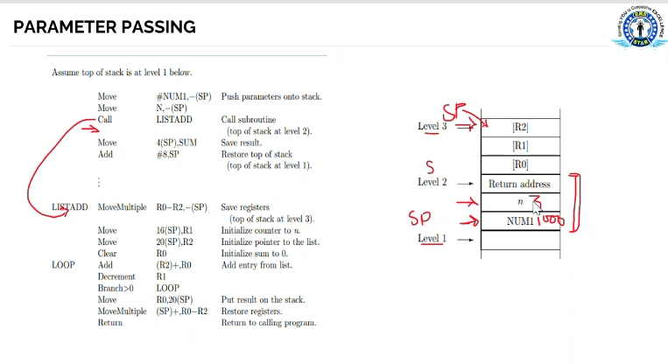

Slide 70
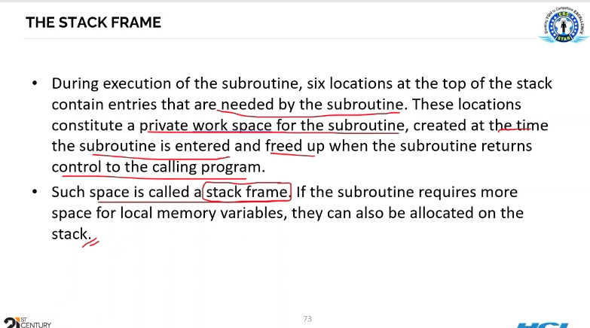

Slide 71
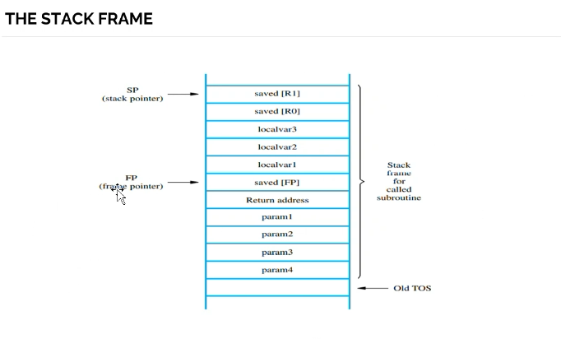

Slide 72
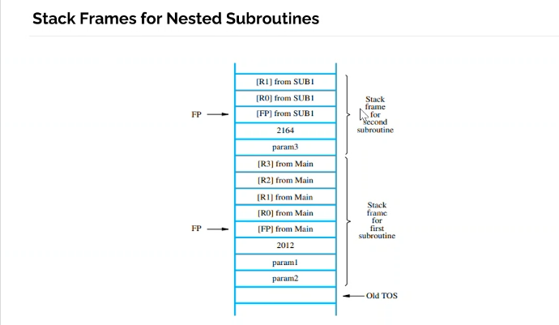

Slide 73
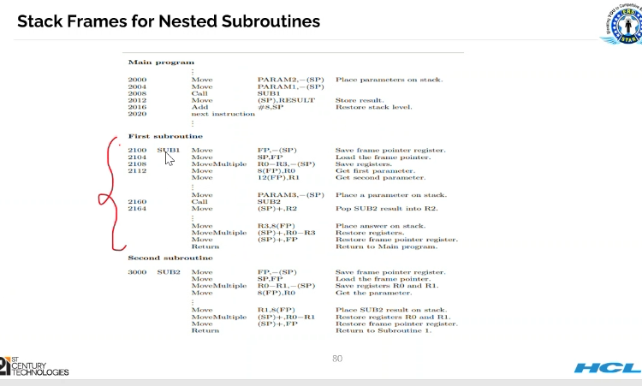

Slide 74
Queue
A queue is a data structure where items are inserted at one end called the rear and deleted at the other end called the front.
Another name for a queue is a “FIFO” or ―First-in-first-out list.
Operations of a Queue:
enqueue:which inserts an element at the end of the queue.
dequeue:which deletes an element at the front of the queue.

Slide 75



Representation of Queue
Initially the queue is empty.
Now, insert 11 to the queue. Then queue status will be:
Next, insert 22 to the queue. Then the queue status is:

Slide 76


Representation of Queue
Now, delete an element 11.
Next insert another element, say 66 to the queue. We cannot insert 66 to the
queue as it signals queue is full. The queue status is as follows:

Slide 77
Queue Operations using Array
V arious operations of Queue are:
insertQ(): inserts an element at the end of queue Q.
deleteQ(): deletes the first element of Q.
displayQ(): displays the elements in the queue.
There are two problems associated with linear queue. They are:
Time consuming: linear time to be spent in shifting the elements to the beginning of the queue.
Signaling queue full: even if the queue is having vacant position.

Slide 78
Applications of Queue
It is used to schedule the jobs to be processed by the CPU.
When multiple users send print jobs to a printer, each printing job is kept in the printing queue. Then the printer prints those jobs according to first in first out (FIFO) basis.
Breadth first search uses a queue data structure to find an element from a graph.

Slide 79
Write a function to count the number of occurrences of an element in a single linked list.
Write a function to reverse the linked list
Write a function to move the largest element to the end of a single linked list
Write a function to remove the last node of the list and insert at the beginning without changing the info part of any node,

Slide 80
