Slide 1
C programming
Variable in C

Slide 2

Lesson Objectives
Introductory question
Basic Data Types
Store Class
Key words for variable
Pointer variable
Struct data type
Casting

Slide 3
Introductory question
Section 1

Slide 4
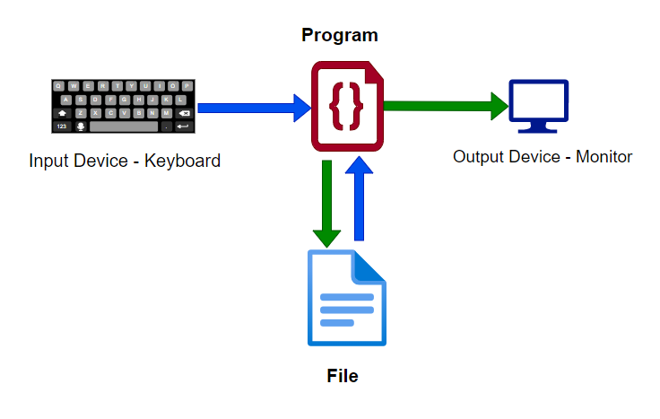
Introductory question
What is variable?
Why do need variable in programming?

Slide 5
Basic Data Types
Section 2

Slide 6
Basic Data Types. Agenda
Basic data types in C
Derived Data Types

Slide 7
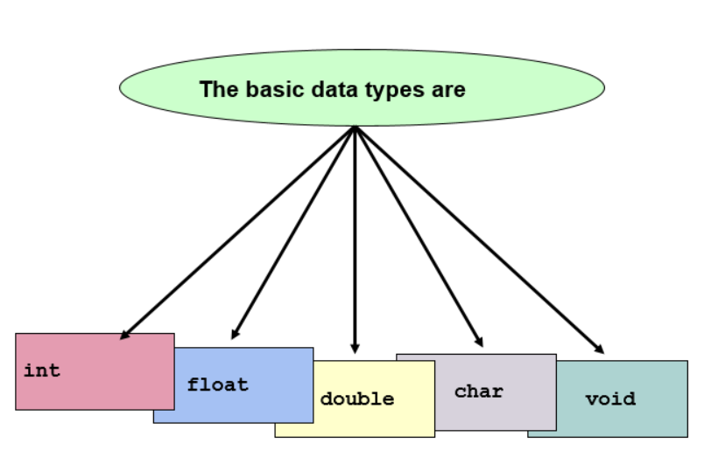
Basic Data Types in C

Slide 8
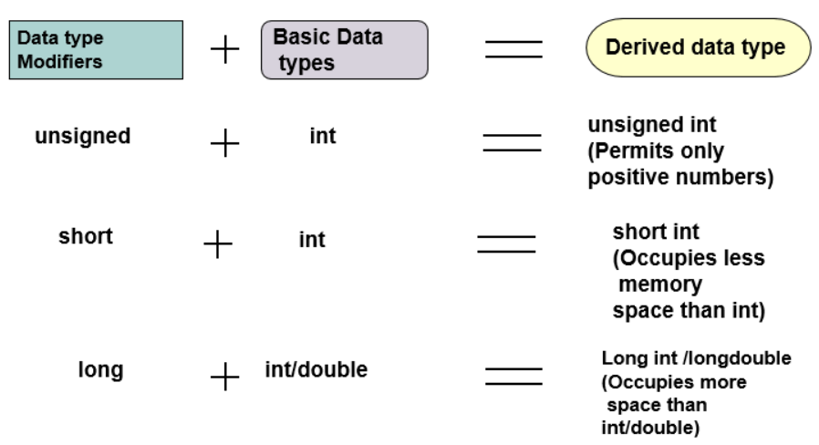
Derived Data Types

Slide 9
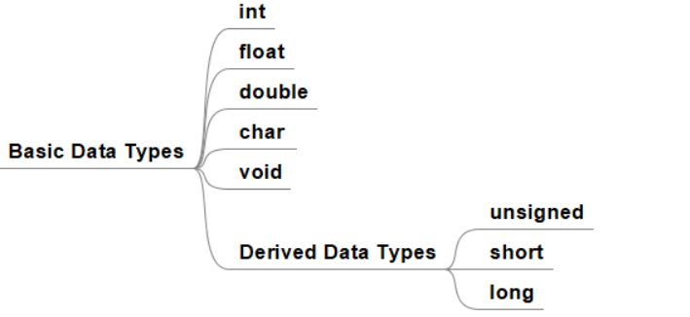
Basic Data Types. Summary

Slide 10
Store Class
Section 3

Slide 11
Store Class. Agenda
Time life of a variable
Scope of a variable
Variable in memory
Global and Local discriminative

Slide 12
Time life of a variable
When was a variable allocated in memory?
When was a variable destroyed?
The lifetime of a variable is the time period in which the variable has valid memory.

Slide 13
Scope of a variable
Where was a variable declared in the program?
The scope of a declaration is the part of the program for which the declaration is in effect.

Slide 14
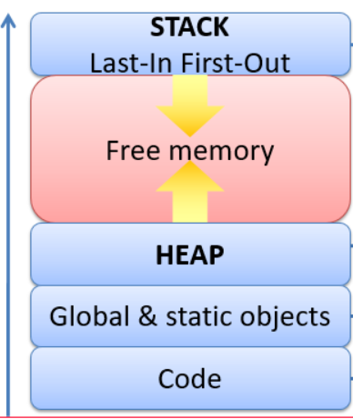
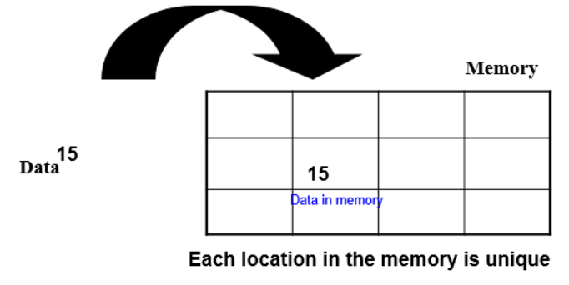
Variable in memory

Slide 15
Global and Local variable discriminative
- Global variables are declared outside any function, and they can be accessed (used) on any function in the program. Local variables are declared inside a function, and can be used only inside that function. It is possible to have local variables with the same name in different functions.
Time life ?
Scope ?
Memory ?

Slide 16
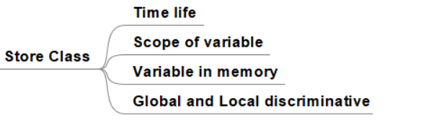
Store class. Summary

Slide 17
Key word for variable
Section 4

Slide 18
Key word for variable. Agenda
static
extern
register
volatile

Slide 19
Key word: static
In some programming languages such as C (and its close descendants like C++, Objective-C, and Java), static is a reserved word controlling both lifetime (as a static variable) and visibility (depending on linkage). The effect of the keyword varies depending on the details of the specific programming language. (wiki)
Static global variable ?
Static function ?
Static local variables ?

Slide 20
Key word: extern
Extern is a keyword in C programming language which is used to declare a global variable that is a variable without any memory assigned to it. It is used to declare variables and functions in header files. Extern can be used access variables across C files.
Extern variable ?
Extern function ?

Slide 21
Key word: register
Register variables tell the compiler to store the variable in CPU register instead of memory. Frequently used variables are kept in registers and they have faster accessibility. We can never get the addresses of these variables. “register” keyword is used to declare the register variables.
(wikis)

Slide 22
Key word: volatile
- The volatile keyword is intended to prevent the compiler from applying any optimizations on objects that can change in ways that cannot be determined by the compiler.

Slide 23
User case
What is the key words: static,…?
When will use static, extern, register, volatile key words?

Slide 24
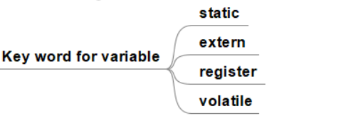
Key word for variable. Summary

Slide 25
Pointer variable
Section 5

Slide 26
Pointer variable. Agenda
What is pointer?
User case?

Slide 27
What is pointer?
A pointer is a variable whose value is the address of another variable, i.e., direct address of the memory location. Like any variable or constant, you must declare a pointer before using it to store any variable address.

Slide 28
User case?
We have 2 lesson about user case for pointer.

Slide 29
Pointer variable. Summary
Understanding about pointer variable.

Slide 30
Structure data type
Section 6

Slide 31
Structure data type. Agenda
Structure variable
Union
Enum

Slide 32
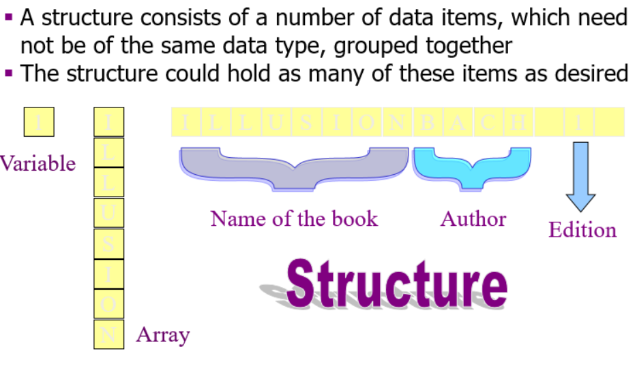
What is structure data type?

Slide 33
Define a structure data type.
A structure definition forms a template for creating structure variables
The variables in the structure are called structure elements or structure members
Example:
struct cat
{ char bk_name [25];
char author [20];
int edn;
float price;
};

Slide 34
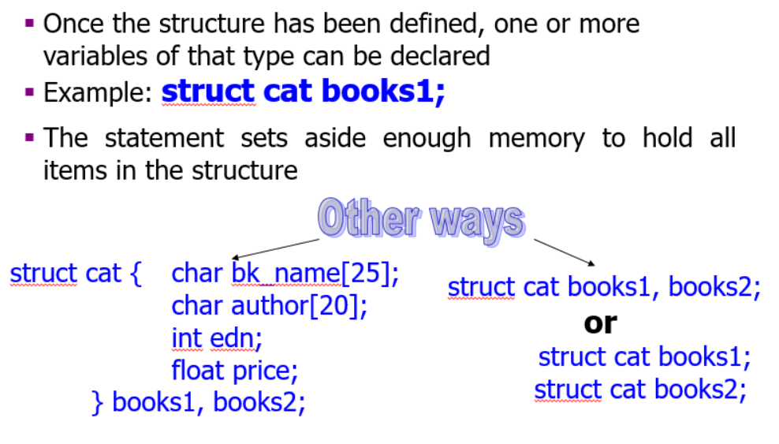
Declare structure data type variables.

Slide 35
Structure data type variables.
Size of structure data type ?
Data structure alignment ?
User case ?
What is typedef?

Slide 36
Union variable
What is Union?
Define Union.
Declare Union variables.
Size of Union?
User case?

Slide 37
Union variable: What is Union?
A union is a special data type available in C that allows to store different data types in the same memory location. You can define a union with many members, but only one member can contain a value at any given time. Unions provide an efficient way of using the same memory location for multiple-purpose.

Slide 38
Union variable: Define Union?
union [union tag] {
member definition;
member definition;
...
member definition;
} [one or more union variables];

Slide 39
Union variable?
Declare Union variables:
union <union tag> <union variable>;
Size of Union?
The memory occupied by a union will be large enough to hold the largest member of the union.
Accessing Union Members.
To access any member of a union, we use the member access operator (.).
User case?

Slide 40
Enum variable
What is enum?
Define enum.
Declare enum variables.
Size of enum?
User case?

Slide 41
Enum variable: What is enum?
Enumeration is a user defined datatype in C language. It is used to assign names to the integral constants which makes a program easy to read and maintain. The keyword “enum” is used to declare an enumeration.
(wiki)

Slide 42
Enum variable
Define enum:
The syntax of enum in C language:
enum enum_name{const1, const2, ....... };
Declare enum variables:
enum enum_name enum_variable;
Size of enum?
In C all enums are most of the time integers of type int.
User case?

Slide 43
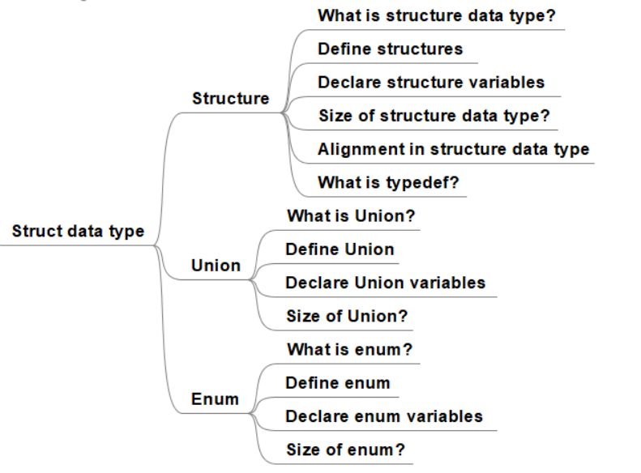
Structure data type. Summary

Slide 44
Lesson Summary
Basic Data Types
Store Class
Key words for variable
Pointer variable
Struct data type
Casting

Slide 45

Thank you

