Slide 1
React - Redux

Slide 2
Contents:
1. Redux Overview and Concepts
2. Redux in React Hooks
3. Using Redux
4. Local Storage and Session Storage

Slide 3
What is Redux ?
Redux is a pattern and library for managing and updating application state, using events called "actions".
It serves as a centralized store for state that needs to be used across your entire application, with rules ensuring that the state can only be updated in a predictable fashion.

Slide 4
Why Should I Use Redux?
The patterns and tools provided by Redux make it easier to understand when, where, why, and how the state in your application is being updated, and how your application logic will behave when those changes occur.

Slide 5
When Should I Use Redux?
You have large amounts of application state that are needed in many places in the app
The app state is updated frequently over time
The logic to update that state may be complex
The app has a medium or large-sized codebase, and might be worked on by many people

Slide 6
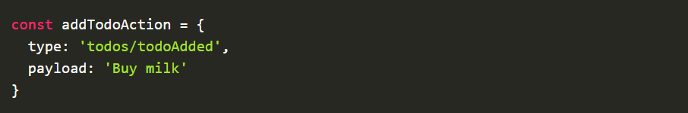
Actions
You can think of an action as an event that describes something that happened in the application.

Slide 7
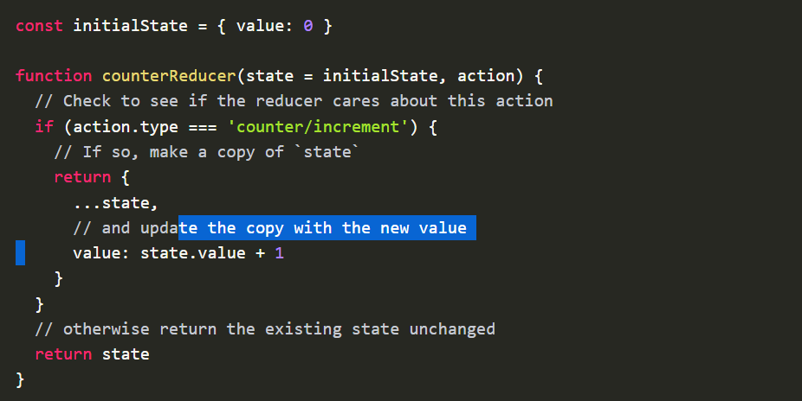
Reducers
A reducer is a function that receives the current state and an action object, decides how to update the state if necessary, and returns the new state: (state, action) => newState.
You can think of a reducer as an event listener which handles events based on the received action (event) type.

Slide 8
Specific Rules
They should only calculate the new state value based on the state and action arguments
They are not allowed to modify the existing state. Instead, they must make immutable updates, by copying the existing state and making changes to the copied values.
They must not do any asynchronous logic, calculate random values, or cause other "side effects"

Slide 9
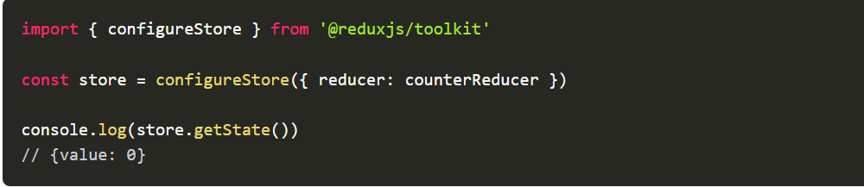
Store
The current Redux application state lives in an object called the store

Slide 10
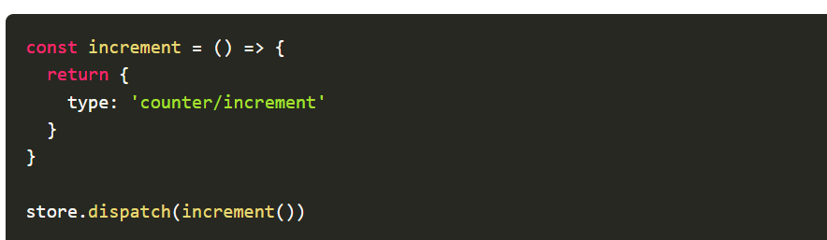
Dispatch
The only way to update the state is to call store.dispatch() and pass in an action object.
You can think of dispatching actions as "triggering an event" in the application.

