Slide 1
Unit Testing
R05942039 許宏瑋

Slide 2
Tested Unit
Splay Tree class in an open Binary Search Tree repository
( https://github.com/ignl/BinarySearchTrees )
Small, white-box testing
The test unit of this repository is some basic and simple test
Goal: Robusty
Testing Library: JUnit

Slide 3
Tested Unit
AbstractBinarySearchTree ( 304 line )
AbstractSelfBalancedBinarySearchTree ( 78 lines )
SplayTree ( 108 lines )

Slide 4
Test Requirements
1. Correctness
2. Complexity: Running Time < 4s for inserting, searching, and
deleting 10^6 data.
3. Operations on Empty Tree
Notes:
Node insert(int), Node search(int), Node delete(int)
int getMinimum(), int getMaximum(), int getSuccessor(int)
int getSize(), void printTreeInOrder(), void printTreePreOrder()
void printTreePostOrder()

Slide 5
Test Data
20 distinct files of 10 ^ 6 integers
randomly generated
unique numbers.

Slide 6
Test
Operations on Empty Trees
assure emptyness
robusty ( delete, query )
Intensive operation on structure
value
returned node
Time Complexity ( timeout )

Slide 7
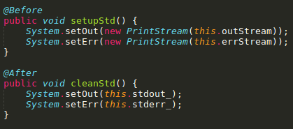
Processing Standard Output

Slide 8
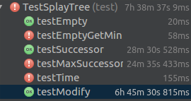

Result
Exception thrown ( Successor, Minimum, Maximum )
All requriments are reached except for the time requirement.
(7 seconds without coverage analysis)
Runing Time: ~7.5 hours ( with converage analysis )
Notes:
#the fail of testTime in the left graph is due to a misspelling in filename, the right is a re-run of testTime.

Slide 9
Coverage Analysis Tools
Command Line Tools:
Emma
Cobertura
... etc
Both have incompatibility problems with jdk7+
IDE plugin:
Intellji ( used here )
Eclipse
... etc

Slide 10
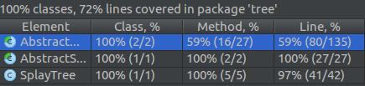
Coverage
Coverage: 72 %
Score: 2 + 0.72 * log (135 + 27 + 42) = 7.095

