Slide 1
Plotting with ggplot2: Part 2
Computing for Data Analysis

Slide 2
What is ggplot2?
An implementation of the Grammar of Graphics by Leland Wilkinson
Grammar of graphics represents and abstraction of graphics ideas/objects
Think “verb”, “noun”, “adjective” for graphics
Allows for a “theory” of graphics on which to build new graphics and graphics objects

Slide 3
Basic Components of a ggplot2 Plot
A data frame
aesthetic mappings: how data are mapped to color, size
geoms: geometric objects like points, lines, shapes.
facets: for conditional plots.
stats: statistical transformations like binning, quantiles, smoothing.
scales: what scale an aesthetic map uses (example: male = red, female = blue).
coordinate system

Slide 4
Building Plots with ggplot2
When building plots in ggplot2 (rather than using qplot) the “artist’s palette” model may be the closest analogy
Plots are built up in layers
Plot the data
Overlay a summary
Metadata and annotation

Slide 5
Example: BMI, PM_{2.5}, Asthma
Mouse Allergen and Asthma Cohort Study
Baltimore children (age 5-17)
Persistent asthma, exacerbation in past year
Does BMI (normal vs. overweight) modify the relationship between PM_{2.5} and asthma symptoms?

Slide 6
Basic Plot
qplot(logpm25, NocturnalSympt, data = maacs, facets = . ~ bmicat, geom = c("point", "smooth"), method = "lm”)

Slide 7
Building Up in Layers
> head(maacs)
logpm25 bmicat NocturnalSympt
2 1.5361795 normal weight 1
3 1.5905409 normal weight 0
4 1.5217786 normal weight 0
5 1.4323277 normal weight 0
6 1.2762320 overweight 8
8 0.7139103 overweight 0
> g <- ggplot(maacs, aes(logpm25, NocturnalSympt))
> summary(g)
data: logpm25, bmicat, NocturnalSympt [554x3]
mapping: x = logpm25, y = NocturnalSympt
faceting: facet_null()
Data Frame
Aesthetics
Initial call to ggplot
Summary of ggplot object

Slide 8
No Plot Yet!
> g <- ggplot(maacs, aes(logpm25, NocturnalSympt))
> print(g)
Error: No layers in plot
> p <- g + geom_point()
> print(p)
> g + geom_point()
Explicitly save and print ggplot object
Auto-print plot object without saving

Slide 9
First Plot with Point Layer
g <- ggplot(maacs, aes(logpm25, NocturnalSympt))
g + geom_point()

Slide 10
Adding More Layers: Smooth
g + geom_point() + geom_smooth()
g + geom_point() + geom_smooth(method = "lm”)

Slide 11
Adding More Layers: Facets
Labels from facet variable
Add facets
Faceting (factor) variable
g + geom_point() + facet_grid(. ~ bmicat) + geom_smooth(method = "lm")

Slide 12
Annotation
Labels: xlab(), ylab(), labs(), ggtitle()
Each of the “geom” functions has options to modify
For things that only make sense globally, use theme()
Example: theme(legend.position = "none")
Two standard appearance themes are included
theme_gray(): The default theme (gray background)
theme_bw(): More stark/plain

Slide 13
Modifying Aesthetics
g + geom_point(color = "steelblue”, size = 4, alpha = 1/2)
g + geom_point(aes(color = bmicat), size = 4, alpha = 1/2)
Constant values
Data variable

Slide 14
Modifying Labels
labs() function for modifying titles and x-, y-axis labels
g + geom_point(aes(color = bmicat)) + labs(title = "MAACS Cohort") + labs(x = expression("log " * PM[2.5]), y = "Nocturnal Symptoms")

Slide 15
Customizing the Smooth
Modified smoother
g + geom_point(aes(color = bmicat), size = 2, alpha = 1/2) + geom_smooth(size = 4, linetype = 3, method = "lm", se = FALSE)

Slide 16
Changing the Theme
g + geom_point(aes(color = bmicat)) + theme_bw(base_family = "Times”)

Slide 17
A Notes about Axis Limits
testdat <- data.frame(x = 1:100, y = rnorm(100))
testdat[50,2] <- 100 ## Outlier!
plot(testdat$x, testdat$y, type = "l", ylim = c(-3,3))
g <- ggplot(testdat, aes(x = x, y = y))
g + geom_line()

Slide 18
Axis Limits
Outlier missing
Outlier included
g + geom_line() + ylim(-3, 3)
g + geom_line() + coord_cartesian(ylim = c(-3, 3))

Slide 19
More Complex Example
How does the relationship between PM_{2.5} and nocturnal symptoms vary by BMI and NO₂?
Unlike our previous BMI variable, NO₂ is continuous
We need to make NO2 categorical so we can condition on it in the plotting
Use the cut() function for this

Slide 20
Making NO₂ Deciles
## Calculate the deciles of the data
> cutpoints <- quantile(maacs$logno2_new, seq(0, 1, length = 11), na.rm = TRUE)
## Cut the data at the deciles and create a new factor variable
> maacs$no2dec <- cut(maacs$logno2_new, cutpoints)
## See the levels of the newly created factor variable
> levels(maacs$no2dec)
[1] "(0.378,0.969]" "(0.969,1.1]" "(1.1,1.17]" "(1.17,1.26]"
[5] "(1.26,1.32]" "(1.32,1.38]" "(1.38,1.44]" "(1.44,1.54]"
[9] "(1.54,1.69]" "(1.69,2.55]"

Slide 21
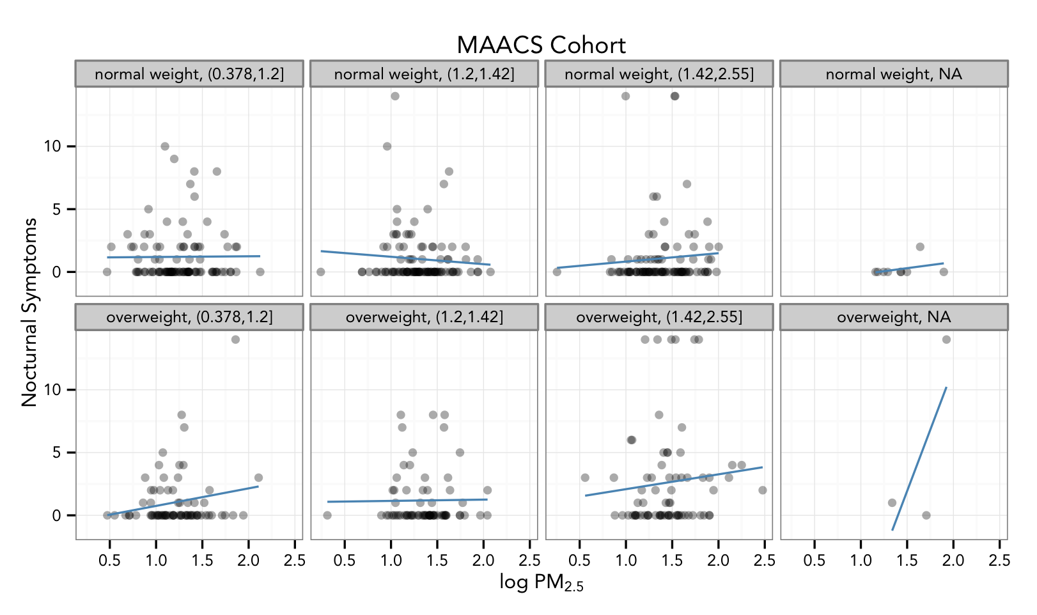
Final Plot
Non-default font
Multiple panels
Transparent points
Smoother
Labels/Title

Slide 22
Code for Final Plot
Add points
## Setup ggplot with data frame
g <- ggplot(maacs, aes(logpm25, NocturnalSympt))
## Add layers
g + geom_point(alpha = 1/3)
+ facet_wrap(bmicat ~ no2dec, nrow = 2, ncol = 4)
+ geom_smooth(method="lm", se=FALSE, col="steelblue")
+ theme_bw(base_family = "Avenir", base_size = 10)
+ labs(x = expression("log " * PM[2.5])
+ labs(y = "Nocturnal Symptoms”)
+ labs(title = "MAACS Cohort”)
Add smoother
Make panels
Change theme
Add labels

Slide 23
Summary
ggplot2 is very powerful and flexible if you learn the “grammar” and the various elements that can be tuned/modified
Many more types of plots can be made; explore and mess around with the package (references mentioned in Part 1 are useful)

