Slide 1
Understanding the behavior of Buses through Monitoring Web Interface
First name, Surname Hongyang Liu
Supervisor Yuantao Fan, Reza Khoshkangini

Slide 2
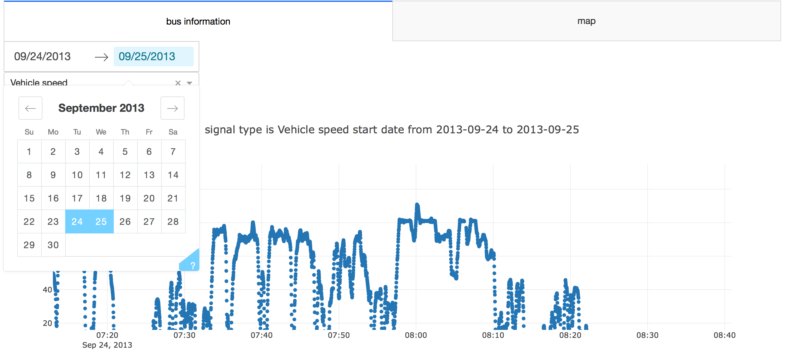
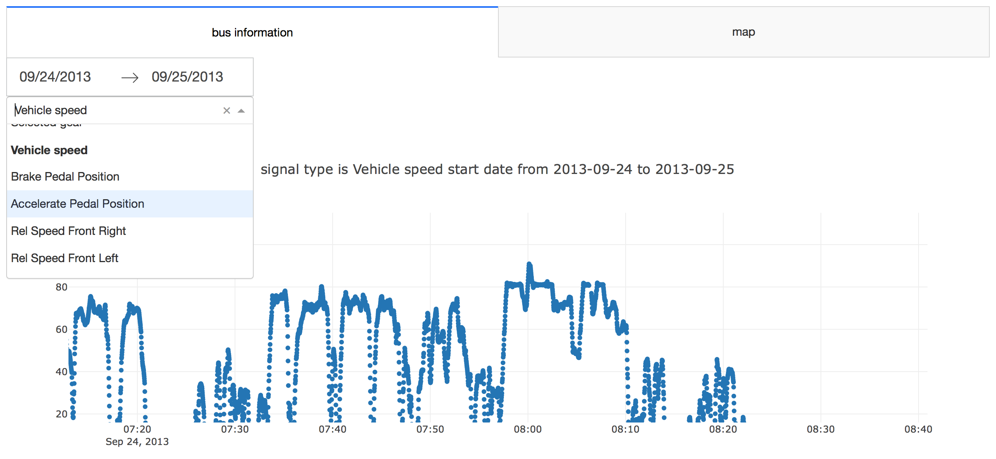
Interface Results

Slide 3
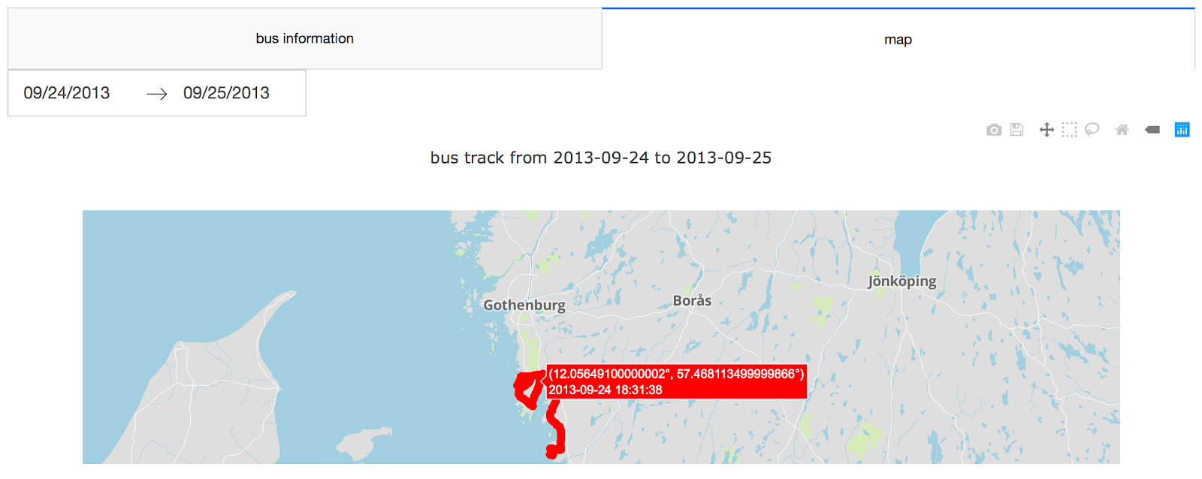
Interface Results

Slide 4
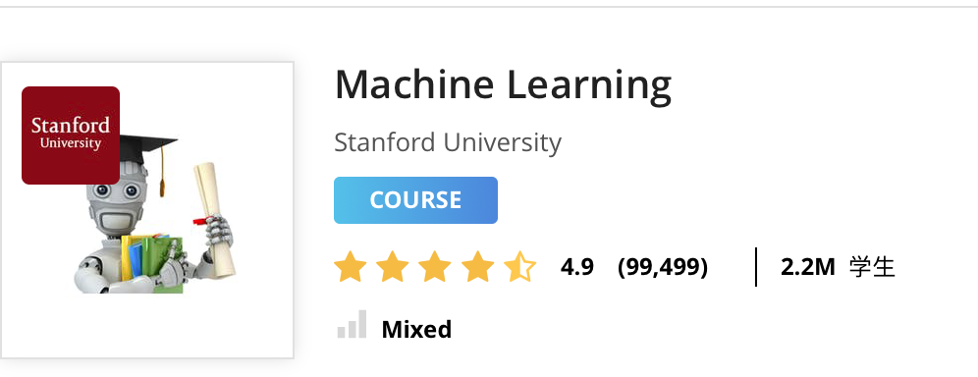
Background Knowledge

Slide 5
Further Plan
LABELING
ALGORITHM
EVALUATION

Slide 6
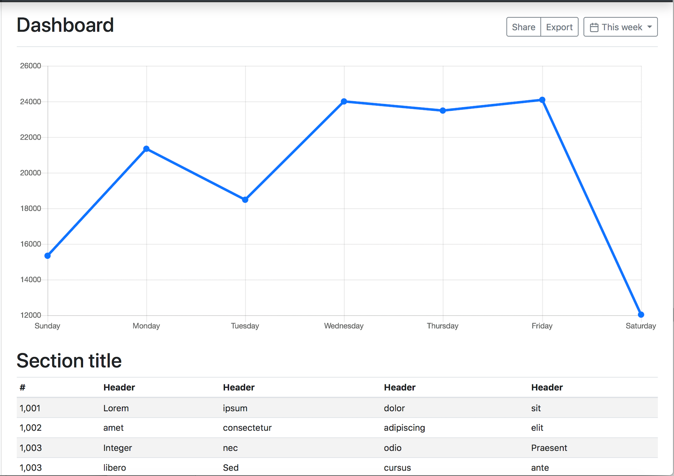
LABELING
Input:
Time series:
Time: Smallest time per hour
Features: eg: Vehicle Rate, Vehicle Speed
Processing:
Labeling the data manually
Eg. Accelerated, decelerated
High temperature, Low temperature,
Rural or urban area.
Output:
1.Generating tables
2.Export csv files

Slide 7
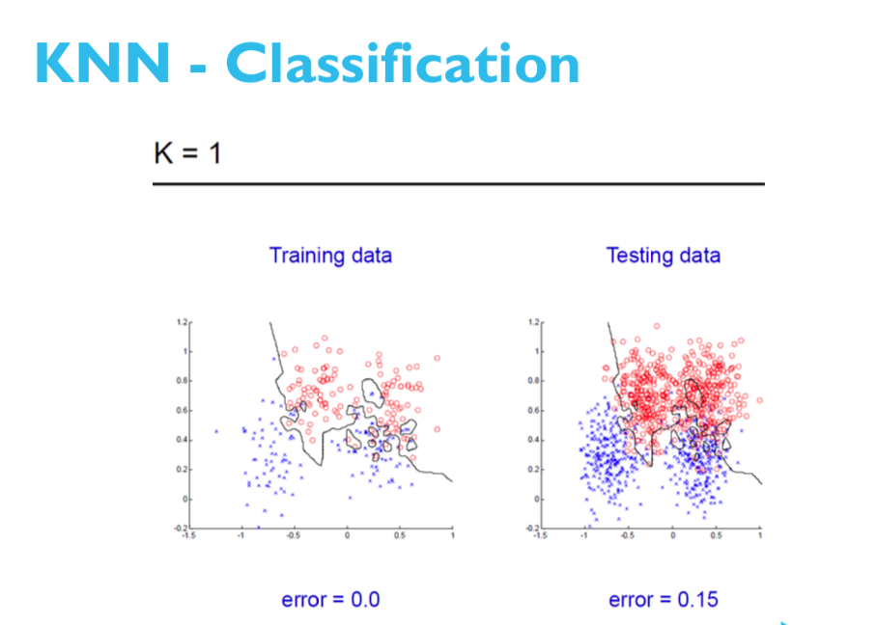
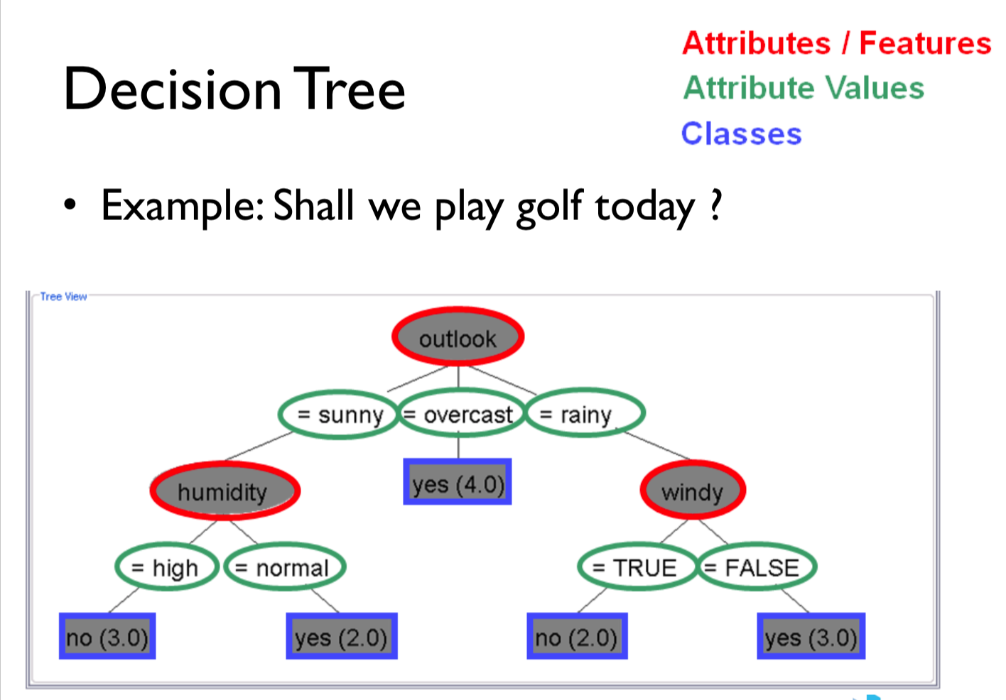
Algorithm
Eg.
KNN
Decision Tree
SVM

Slide 8
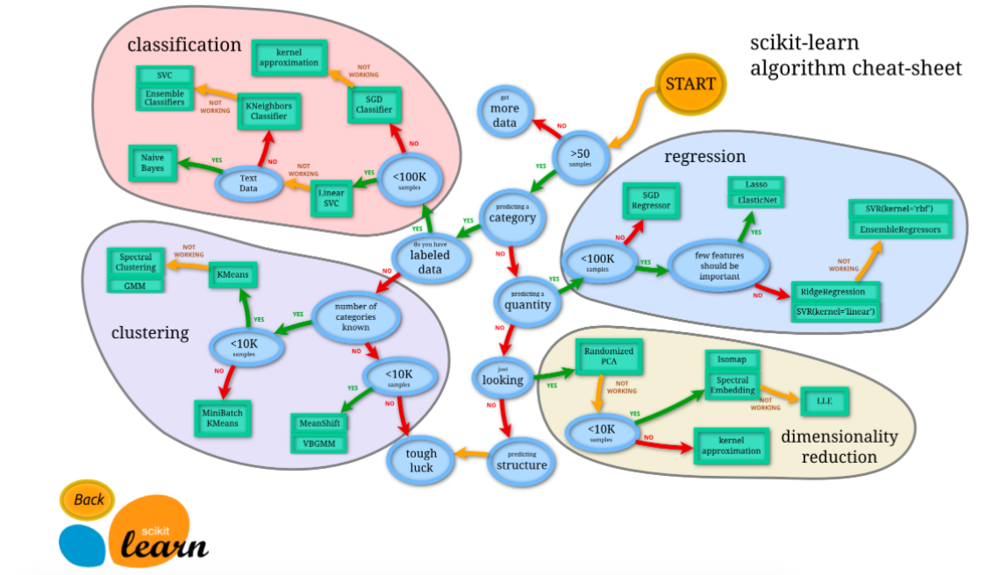
Algorithm

Slide 9
EVALUATION
Web interface
Survey
Standard/Rules
Machine learning method
Meitrics: classification accuracy
Cross-validation

