Slide 1

Some Algorithm for Three Partition Problem
谢骐骏，许景轶，朱泽豪
Group 17

Slide 2
Contents
01
Problem Restatement & Our Work
02
DFS&DP Algorithm
03
Simulated Annealing Algorithm
04
Test of Algorithm

Slide 3
0 1
Problem Restatement & Our Work

Slide 4
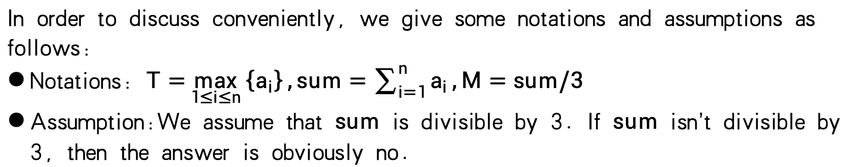
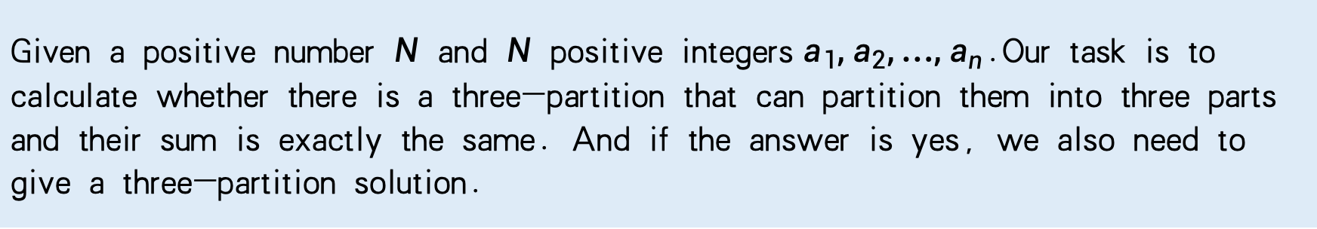
Problem Restatement
Problem Restatement：
Given a positive number $N$ and $N$ positive integers$a_{1},a_{2},…,a_{n}$.Our task is to calculate whether there is a three-partition that can partition them into three parts and their sum is exactly the same. And if the answer is yes, we also need to give a three-partition solution.
In order to discuss conveniently, we give some notations and assumptions as follows:
Notations: $T=\max_{1≤i≤n}\left\{a_{i}\right\},sum=\sum_{i=1}^{n}{a_{i}},M=sum/3$
Assumption:We assume that $sum$ is divisible by 3. If $sum$ isn’t divisible by 3, then the answer is obviously no.

Slide 5
Our Work
Our Work：
Initially, we employed a DFS algorithm with pruning and a DP algorithm to provide an exact solution to the problem. Subsequently, considering that the runtime of the first two algorithms would increase significantly for larger-scale instances, we adopted a simulated annealing(SA) algorithm to address this issue. The SA algorithm can determine with a high probability whether the problem has a solution within a relatively short time and, if a solution exists, provide a valid set of assignments.

Slide 6
0 2
DFS&DP Algorithm

Slide 7
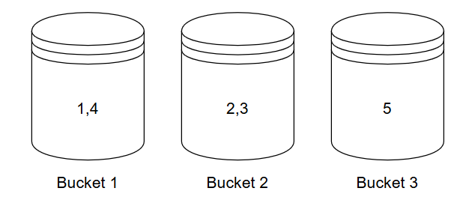
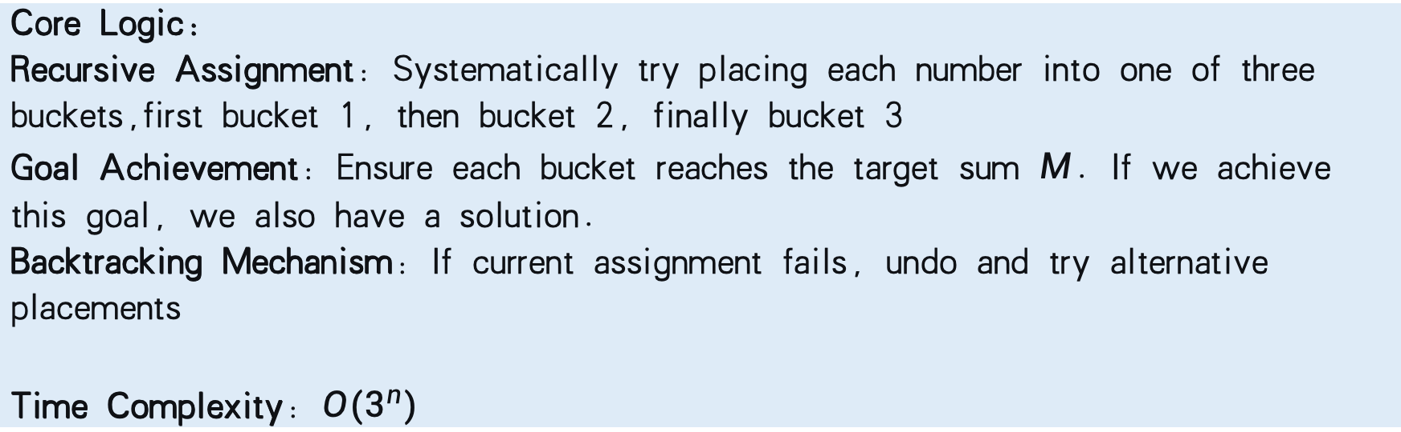
DFS Algorithm
Core Logic:
Recursive Assignment: Systematically try placing each number into one of three buckets,first bucket 1, then bucket 2, finally bucket 3
Goal Achievement: Ensure each bucket reaches the target sum $M$. If we achieve this goal, we also have a solution.
Backtracking Mechanism: If current assignment fails, undo and try alternative placements
Time Complexity: $O(3^{n})$
An example：

Slide 8
DFS Algorithm
Here are two pruning strategy we use:
Sort Descending: Prioritize processing large numbers. Large numbers have less flexibility, which can either fill up buckets faster or trigger capacity overflow, thereby leading to faster backtracking.
Symmetry Breaking Pruning(crucial): If the current bucket is empty, and our attempt to place the current number into it fails, then there's no need to try subsequent empty buckets. That’s because empty buckets are mathematically completely equivalent - failure in the first empty bucket means failure in all empty buckets.
After pruning, it runs fast in practice. We can see this in “Test of Algorithm”.

Slide 9
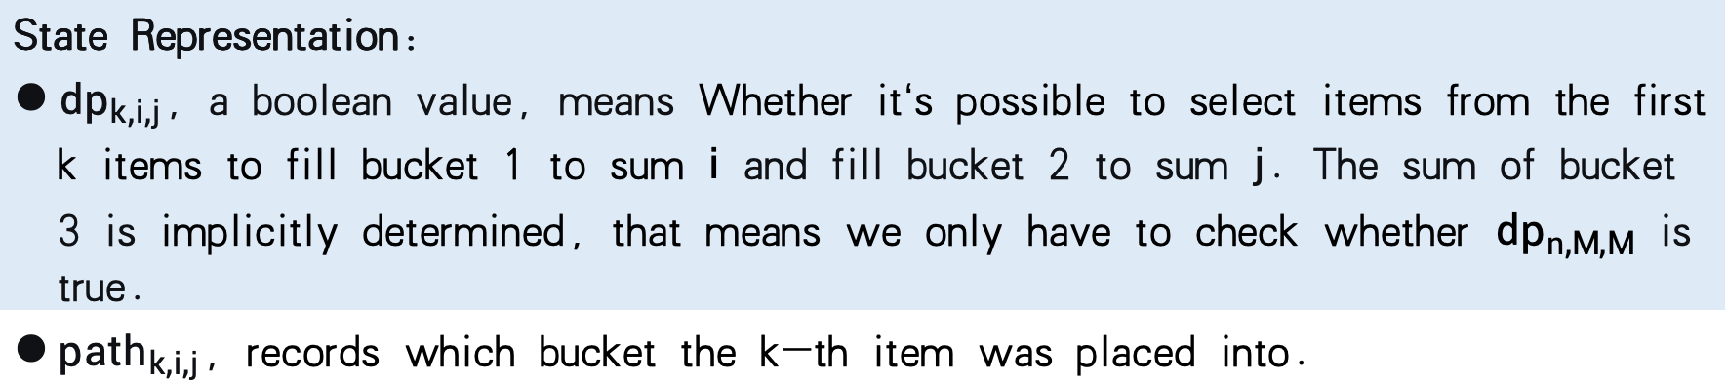
DP Algorithm
Problem Classification
Multidimensional 0/1 Knapsack Variant
Key Difference: Standard 0/1 knapsack allows incomplete filling, while this requires exactly filling three buckets of size M each.
State Representation:
${dp}_{k,i,j}$, a boolean value, means Whether it‘s possible to select items from the first k items to fill bucket 1 to sum $i$ and fill bucket 2 to sum $j$. The sum of bucket 3 is implicitly determined, that means we only have to check whether ${dp}_{n,M,M}$ is true.
${path}_{k,i,j}$, records which bucket the k-th item was placed into.
Initialization: All ${dp}_{k,i,j}$ set to false, and all ${path}_{k,i,j}$ set to 0.

Slide 10

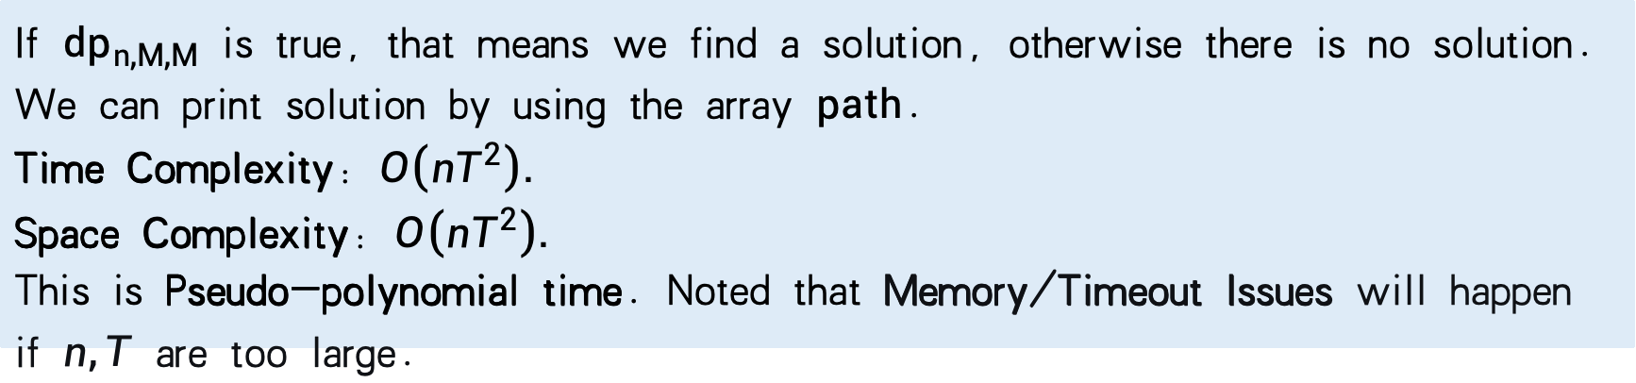
DP Algorithm
State Transition Equations(Pseudocode):
If ${dp}_{n,M,M}$ is true, that means we find a solution, otherwise there is no solution.
We can print solution by using the array $path$.
Time Complexity: $O\left(nT^{2}\right).$
Space Complexity: $O\left(nT^{2}\right).$
This is Pseudo-polynomial time. Noted that Memory/Timeout Issues will happen if $n,T$ are too large.
The fact is that three-partition problem is strongly NP-C problem. So is there an algorithm that can solve this problem in high probability within a reasonable amount of time?

Slide 11
0 3
Simulated Annealing Algorithm

Slide 12
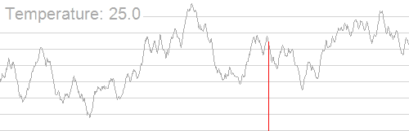
Simulated Annealing Algorithm
Introduction:
Simulated Annealing is a probabilistic optimization algorithm inspired by the metallurgical process of annealing, where materials are heated and slowly cooled to reduce defects. In computer science, it solves complex optimization problems by mimicking this thermal process. The algorithm explores the solution space by occasionally accepting worse solutions with a probability, which helps escape local optima and gradually converges toward a global optimum. This makes it particularly effective for combinatorial optimization problems where traditional methods might get stuck.
Cited from here

Slide 13
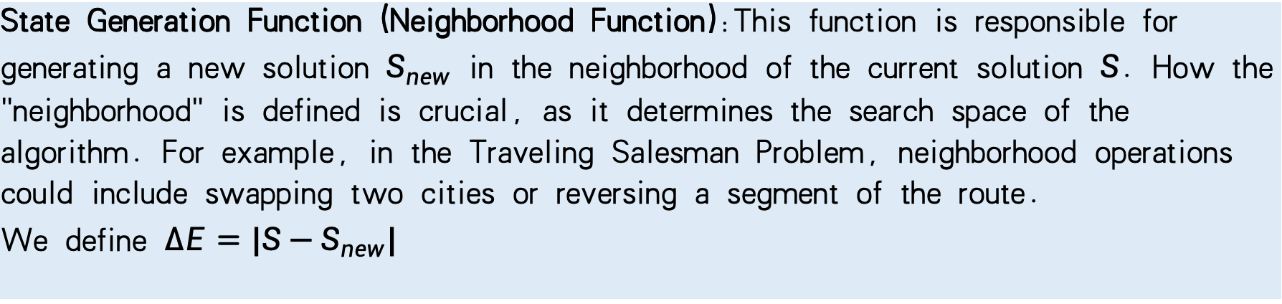
Simulated Annealing Algorithm
State Generation Function (Neighborhood Function):This function is responsible for generating a new solution $S_{new}$ in the neighborhood of the current solution $S$. How the "neighborhood" is defined is crucial, as it determines the search space of the algorithm. For example, in the Traveling Salesman Problem, neighborhood operations could include swapping two cities or reversing a segment of the route.
We define $∆E=|S−S_{new}|$

Slide 14
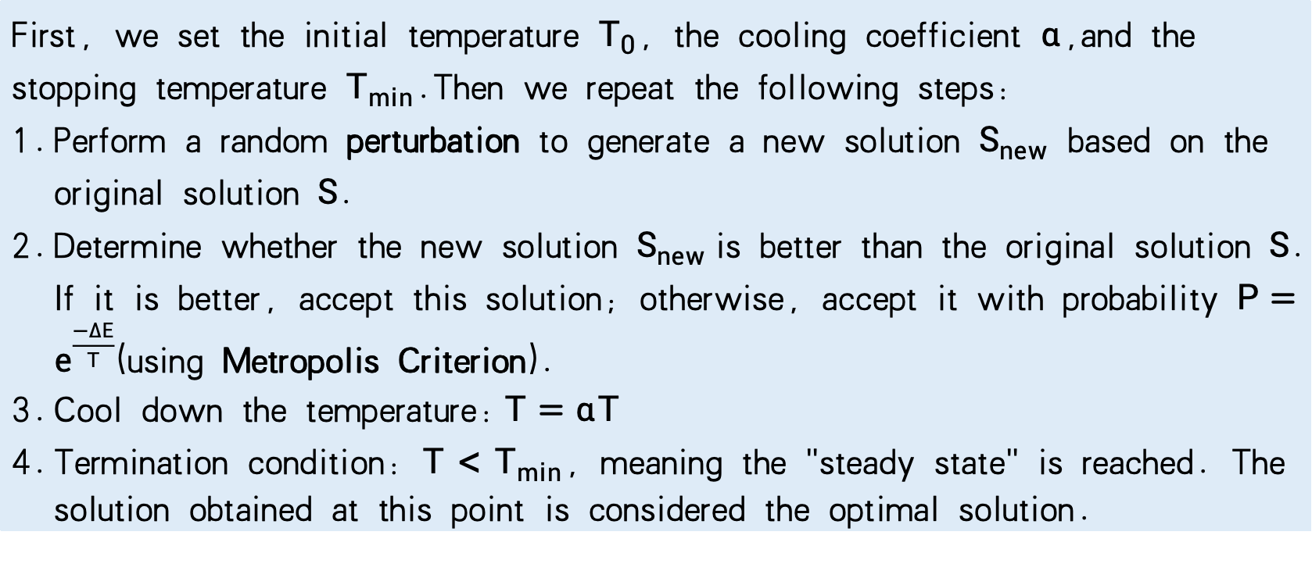
Simulated Annealing Algorithm
Logic:
First, we set the initial temperature $T_{0}$, the cooling coefficient $α$,and the stopping temperature $T_{min}$.Then we repeat the following steps:
Perform a random perturbation to generate a new solution $S_{new}$ based on the original solution $S$.
Determine whether the new solution $S_{new}$is better than the original solution $S$. If it is better, accept this solution; otherwise, accept it with probability $P=e^{\frac{−∆E}{T}}$(using Metropolis Criterion).
Cool down the temperature:$T=αT$
Termination condition: $T<T_{min}$, meaning the "steady state" is reached. The solution obtained at this point is considered the optimal solution.

Slide 15
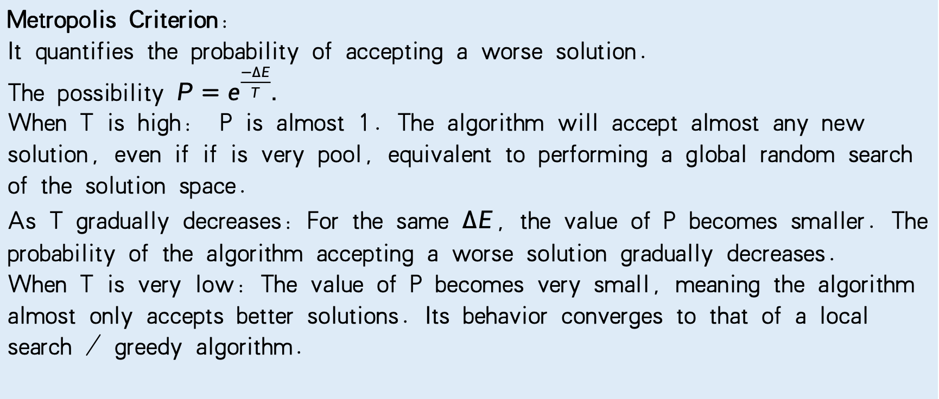
Simulated Annealing Algorithm
Metropolis Criterion:
It quantifies the probability of accepting a worse solution.
The possibility $P=e^{\frac{−∆E}{T}}.$
When T is high: P is almost 1. The algorithm will accept almost any new solution, even if if is very pool, equivalent to performing a global random search of the solution space.
As T gradually decreases: For the same $∆E$, the value of P becomes smaller. The probability of the algorithm accepting a worse solution gradually decreases.
When T is very low: The value of P becomes very small, meaning the algorithm almost only accepts better solutions. Its behavior converges to that of a local search / greedy algorithm.

Slide 16
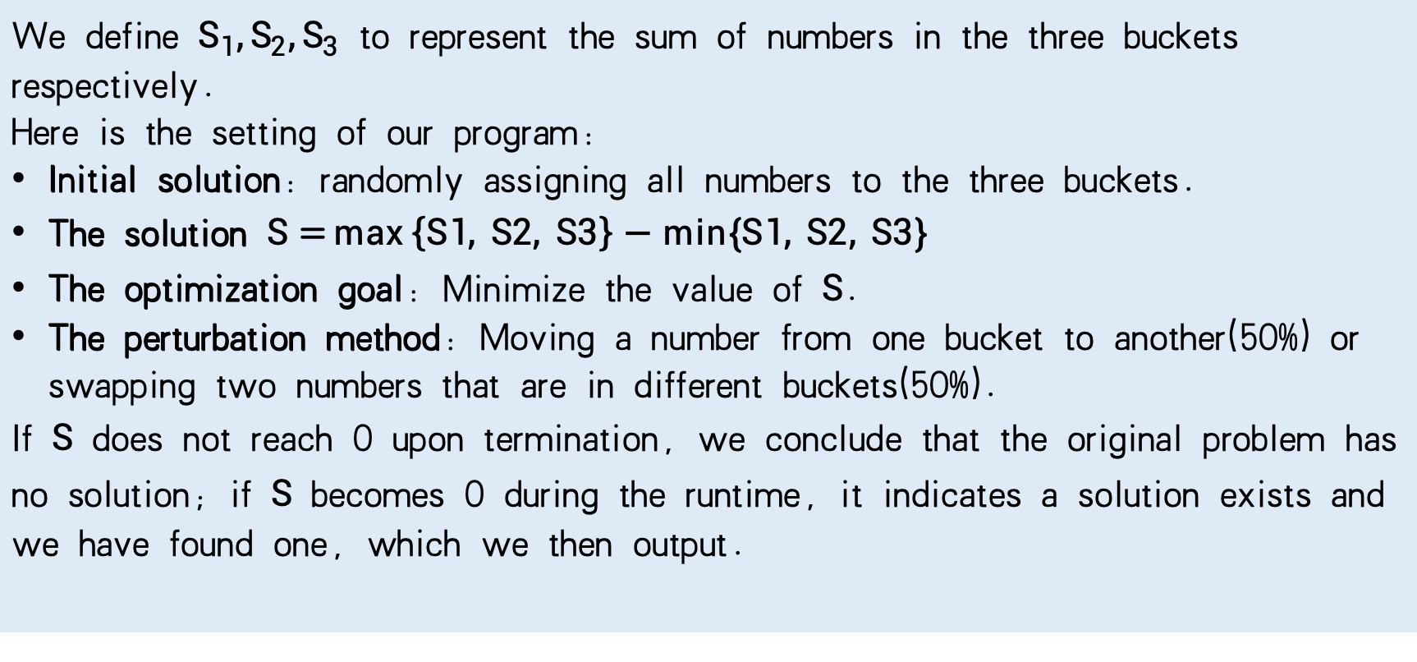
Simulated Annealing Algorithm
We define $S_{1},S_{2},S_{3}$ to represent the sum of numbers in the three buckets respectively.
Here is the setting of our program:
Initial solution: randomly assigning all numbers to the three buckets.
The solution $S=\max\left\{S1, S2, S3\right\}−min\{S1, S2, S3\}$
The optimization goal: Minimize the value of $S$.
The perturbation method: Moving a number from one bucket to another(50%) or swapping two numbers that are in different buckets(50%).
If $S$ does not reach 0 upon termination, we conclude that the original problem has no solution; if $S$ becomes 0 during the runtime, it indicates a solution exists and we have found one, which we then output.

Slide 17
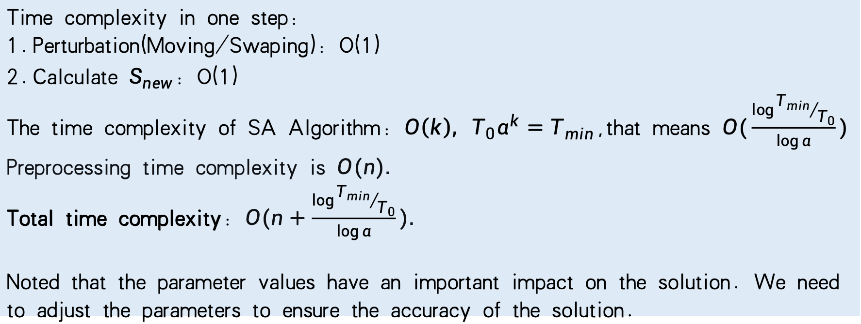
Simulated Annealing Algorithm
Time complexity in one step:
Perturbation(Moving/Swaping): O(1)
Calculate $S_{new}$: O(1)
The time complexity of SA Algorithm: $O\left(k\right), T_{0}α^{k}=T_{min}$,that means $O(\frac{\log{{T_{min}}/{T_{0}}}}{\log{α}})$
Preprocessing time complexity is $O(n).$
Total time complexity: $O(n+\frac{\log{{T_{min}}/{T_{0}}}}{\log{α}}).$
Noted that the parameter values have an important impact on the solution. We need to adjust the parameters to ensure the accuracy of the solution.

Slide 18
0 4
Test of Algorithm

Slide 19
Test of Algorithm
For the DFS component, we designed two types of test data: one category consists of inputs with small n but large sum, aimed at examining the effectiveness of the pruning strategy under extreme conditions; the other category comprises typical inputs where both n and sum are relatively small, used for benchmarking the runtime performance of DFS under conventional scales.
For the DP algorithm, we constructed three sets of test data. The first set maintains a fixed n while progressively increasing the sum, used to observe the time growth trend of the DP algorithm as the state space expands with the increasing total sum. The second set keeps the sum fixed but gradually increases n, in order to analyze the sensitivity of DP to input size. The third set simultaneously and continuously increases both n and the sum, aimed at evaluating the computable range of DP under large-scale data and performing fitting analysis on its empirical time complexity.

Slide 20
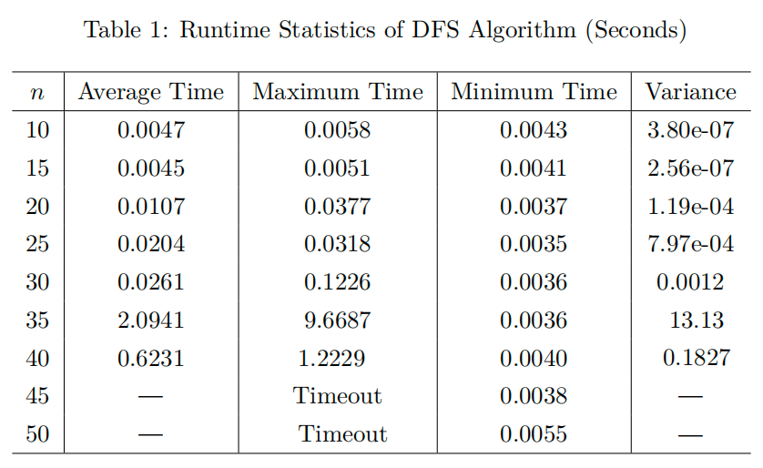
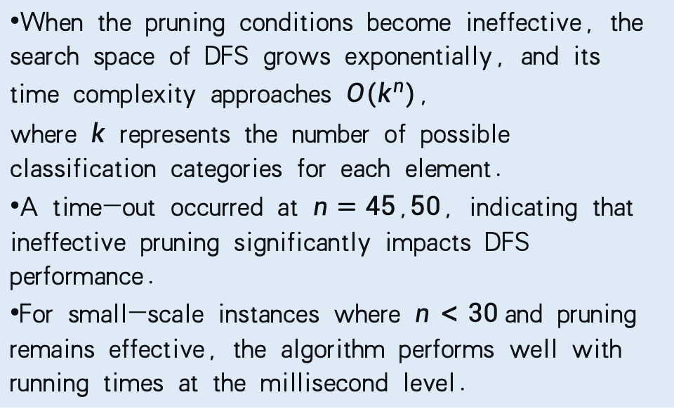
Test of DFS
Under conditions of small n and large sum values, the DFS algorithm experiences a significant increase in computation time when its pruning strategy becomes ineffective. In some cases, the calculation time even becomes excessively long.
Here is the table:
When the pruning conditions become ineffective, the search space of DFS grows exponentially, and its time complexity approaches $O(k^{n})$, where $k$ represents the number of possible classification categories for each element.
A time-out occurred at $n=45$,$50$, indicating that ineffective pruning significantly impacts DFS performance.
For small-scale instances where $n<30$and pruning remains effective, the algorithm performs well with running times at the millisecond level.

Slide 21
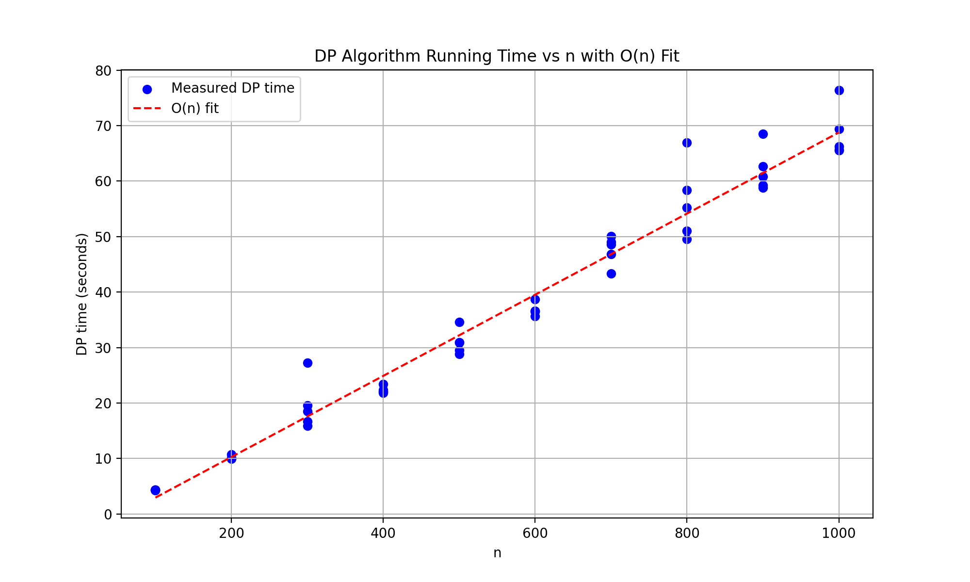
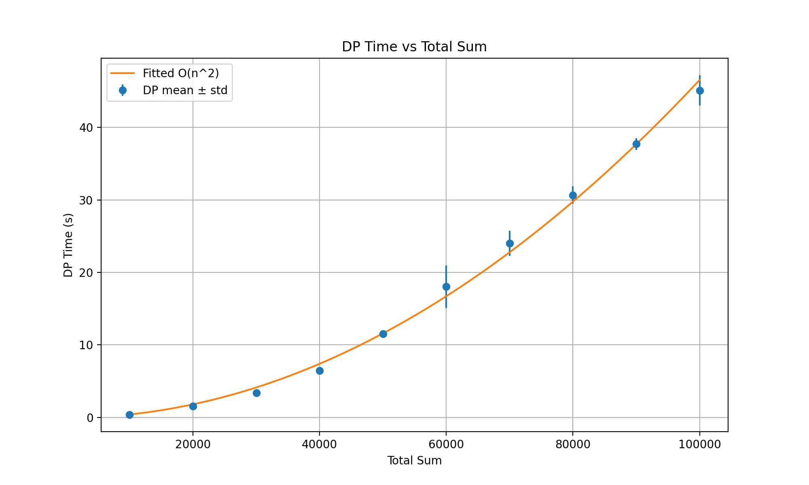
Test of DP
Figure 1: Fixed T, varying n
Figure 2: Fixed n, varying T
Based on the two graphs above, the runtime complexity closely matches the theoretical curve, thereby validating that the dynamic programming algorithm exhibits pseudo-polynomial complexity.

Slide 22
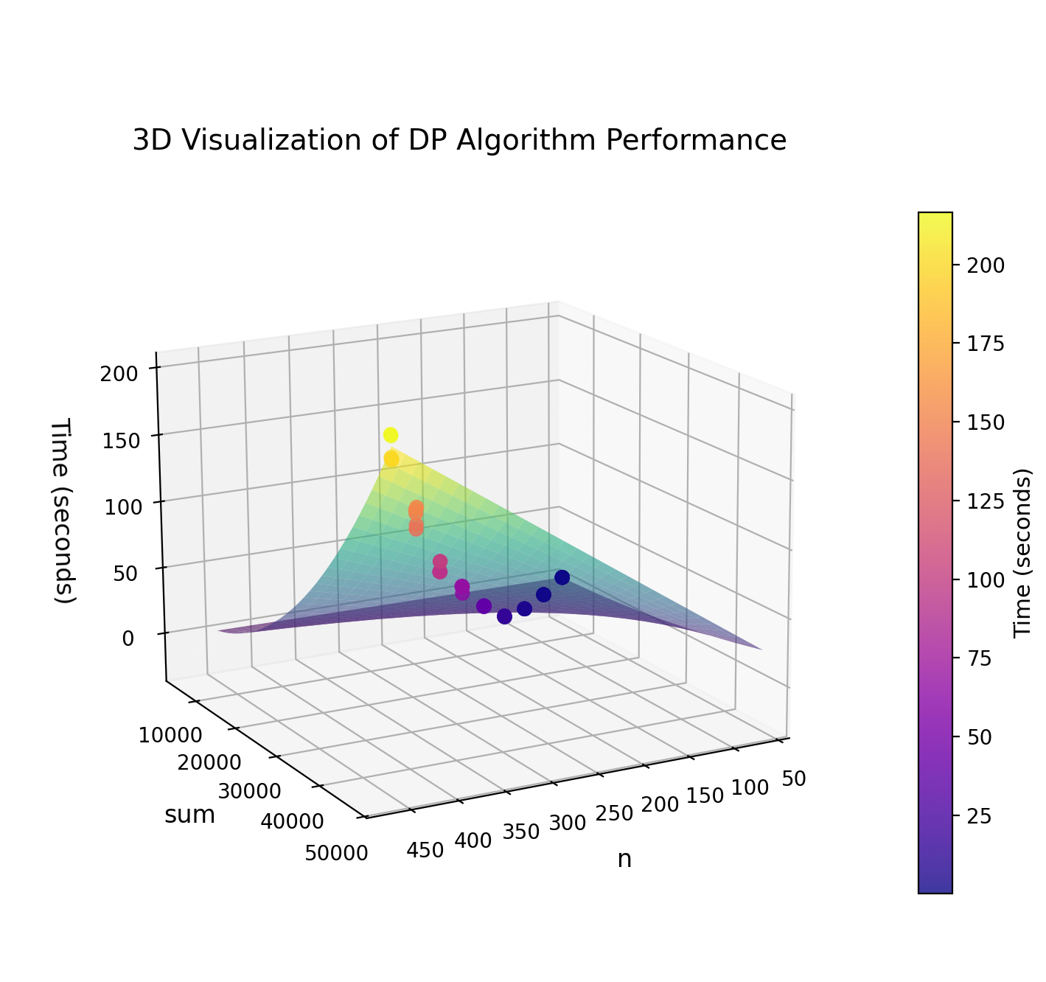
Test of DP
This is the performance visualization of the dynamic programming algorithm with simultaneous increases in n and sum. The goodness-of-fit R² = 0.9959 indicates that the model accurately describes the algorithm's time complexity.
This experiment empirically verifies the indispensable significance of the simulated annealing algorithm in handling large-scale inputs. While dynamic programming guarantees optimality for small-scale problems, its computational complexity prevents effective scaling to real-world large-scale optimization problems, thereby highlighting the necessity of heuristic algorithms in practical applications.

Slide 23
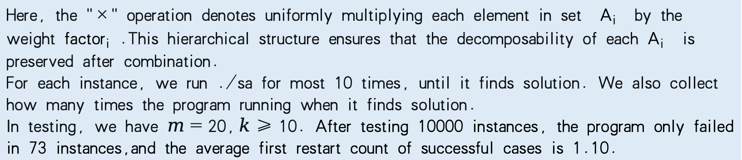
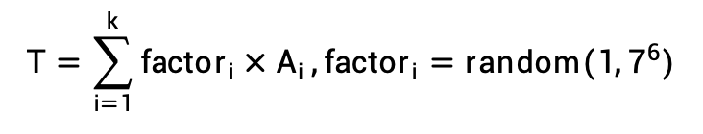
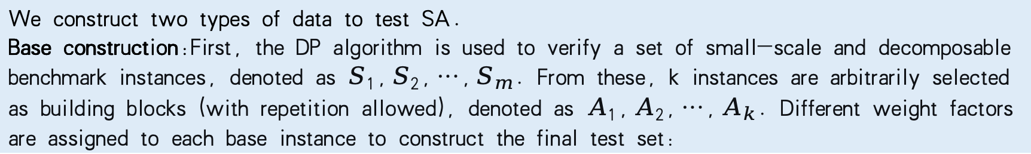
Test of SA
We construct two types of data to test SA.
Base construction:First, the DP algorithm is used to verify a set of small-scale and decomposable benchmark instances, denoted as $S_{1},S_{2},…,S_{m}$. From these, k instances are arbitrarily selected as building blocks (with repetition allowed), denoted as $A_{1},A_{2},…,A_{k}$. Different weight factors are assigned to each base instance to construct the final test set:
$$T=\sum_{i=1}^{k}{{factor}_{i}×A_{i}},{factor}_{i}=random(1,7^{6})$$
Here, the "×" operation denotes uniformly multiplying each element in set $A_{i}$ by the weight ${factor}_{i}$ .This hierarchical structure ensures that the decomposability of each${ A}_{i}$ is preserved after combination.
For each instance, we run ./sa for most 10 times, until it finds solution. We also collect how many times the program running when it finds solution.
In testing, we have $m=20,k≥10.$ After testing 10000 instances, the program only failed in 73 instances,and the average first restart count of successful cases is 1.10.

Slide 24
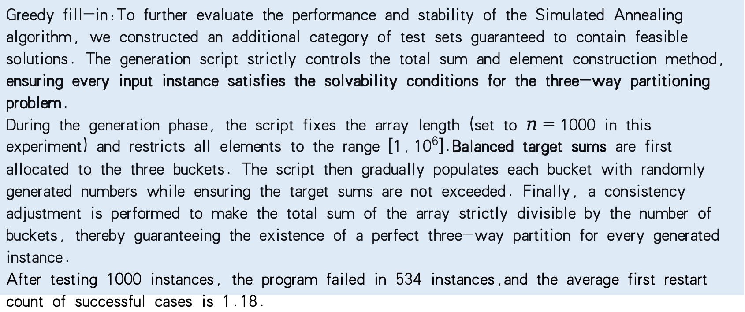
Test of SA
Greedy fill-in:To further evaluate the performance and stability of the Simulated Annealing algorithm, we constructed an additional category of test sets guaranteed to contain feasible solutions. The generation script strictly controls the total sum and element construction method, ensuring every input instance satisfies the solvability conditions for the three-way partitioning problem.
During the generation phase, the script fixes the array length (set to $n=1000$ in this experiment) and restricts all elements to the range $[1,{10}^{6}]$.Balanced target sums are first allocated to the three buckets. The script then gradually populates each bucket with randomly generated numbers while ensuring the target sums are not exceeded. Finally, a consistency adjustment is performed to make the total sum of the array strictly divisible by the number of buckets, thereby guaranteeing the existence of a perfect three-way partition for every generated instance.
After testing 1000 instances, the program failed in 534 instances,and the average first restart count of successful cases is 1.18.

Slide 25
Test of SA
It is evident that the construction method of base construction introduces significantly less randomness compared to greedy fill-in. However, the fact that ./sa performs so effectively on solutions obtained through base construction may suggest an approach to imposing additional constraints on the three-way partitioning problem, enabling this ./sa to solve it more efficiently. Furthermore, despite the substantial gap in success rates between the two methods, when the maximum number of restarts is set to 10, their average number of initial successes is remarkably close to 1. This indicates that simply increasing the number of restarts within a certain scale does not effectively enhance the performance of SA.

Slide 26
Test Comprehensive Analysis
DFS with Pruning demonstrates significant effectiveness on small-scale data. However, when pruning fails, the search space grows exponentially, leading to drastically degraded performance.
The DP Algorithm remains stable and efficient for small to medium-scale data. Yet, its performance is constrained by the product of n and sum, potentially failing to return results for extremely large inputs.
SA is suitable for large-scale or approximate solution scenarios, capable of quickly finding feasible solutions, albeit with a lower accuracy rate。
In summary, different algorithms are suited for the three-way partitioning problem across varying scales and scenarios: DFS is more appropriate for small-scale exact solutions, DP is ideal for medium-scale optimal solutions, while SA can be employed for large-scale approximate solutions.

Slide 27
Thank you!

