Slide 1
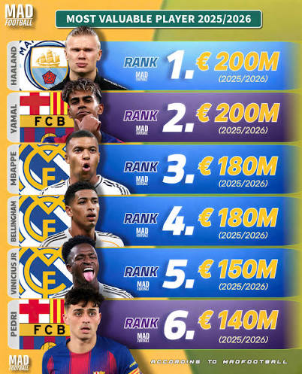

PREDICTING FOOTBALL PLAYER
MARKET VALUE
A machine-learning approach to valuing players from performance data
NGUYEN THE HUNG - 23229586
Final Presentation • Transfermarkt Dataset

Slide 2



Problem Statement
Football clubs spend hundreds of millions of euros on transfers every year, but player valuations are often driven by reputation, media hype, and negotiation leverage rather than measurable on-pitch performance.
PROJECT GOAL
Build a regression model that predicts a player's market value (€) from age, goals, assists, minutes played, cards, and position — then use it to flag scouting targets the market may be undervaluing.
Can we model value objectively?
Predict a player's market value from age and performance stats alone.
Where are the market's blind spots?
Identify players whose output suggests they are undervalued by the market.
Notes:
"Let’s address the core problem. Every single year, professional football clubs spend hundreds of millions of euros on player transfers. Yet, traditional asset valuation remains dangerously subjective, frequently driven by media hype, agent negotiation leverage, or a player's historic reputation rather than actual on-pitch contribution."
"As a Digital Business student, I framed this issue as a classic market inefficiency. We asked ourselves two fundamental questions: First, can we build an objective machine learning model to estimate a player's true worth based strictly on physical profiles and match stats? And second, where are the market's blind spots? Can our model automatically surface breakout targets that the market is currently undervaluing?"
"Our precise project objective was to ingest real-world performance statistics, preprocess and aggregate the data streams, train and validate four distinct machine learning regressors, and deploy a residual engine to locate value-optimized acquisition targets for professional squads."

Slide 3


Dataset Overview
Transfermarkt relational data — player profiles joined with match performance
players.csv
appearances.csv
Base profile data
Match performance events
80 / 20
player_id
player_id
Train / Test split
name
goals
date_of_birth
assists
position
minutes_played
Target
market_value_in_eur (target)
yellow_cards
market_value_in_eur
Merged on player_id → aggregated career totals per player
Index: 28236 entries, 0 to 28940 Data columns (total 31 columns)
Cleaning
Rows dropped where target, age, or performance metrics were missing
ENGINEERED FEATURES USED IN THE MODEL
Age
Goals
Assists
Minutes played
Yellow cards
Position
Notes:
"To achieve this, we leveraged a highly relational open-source 'data lake' sourced directly from Transfermarkt. Because data in isolation lacks value, we performed a relational inner join across two primary tables using the unique player_id attribute."
"From players.csv, we extracted base demographic profiles including date_of_birth and tactical position. From appearances.csv, we extracted core match event records, writing aggregation functions to calculate career totals for goals, assists, minutes_played, and disciplinary yellow_cards per player."
"During the data preparation phase, rows containing missing targets or incomplete performance variables were systematically dropped. We calculated absolute numerical age from the birth dates, and applied One-Hot Encoding to the categorical position column, dropping the first category to avoid multi-collinearity errors. Finally, the data was partitioned sequentially into an 80% training split and a 20% test split to guarantee rigorous out-of-sample testing.“
we use an 80/20 split to strictly isolate a validation 'answer key' that the model never sees during training. This out-of-sample partition is the only way to calculate an unbiased $R^2$ score and diagnose whether the model is generalizing real football metrics or simply memorizing training noise.

Slide 4


Workflow
From raw match data to scouting recommendations
1
2
3
Load & Merge
Feature Engineer
Explore (EDA)
Join players & appearances on player_id; aggregate performance.
Derive age; one-hot encode position; clean missing values.
Visualize age-value relationship and feature correlations.
4
5
6
Train 4 Models
Evaluate & Tune
Apply Findings
Ridge, Random Forest, Gradient Boosting, SVR on an 80/20 split.
Compare MAE/RMSE/R²; cross-validate; fix overfitting.
Score every player; surface undervalued scouting targets.
Notes:
"This diagram visualizes our complete end-to-end Data Science framework, directly mirroring the structural guidelines taught throughout this semester. We moved methodically from loading and relational tabular merging, through clean feature transformations and exploratory visualizations."
"From there, we initiated a sequential training pipeline across four distinct model architectures: Ridge Regression, Random Forest, Gradient Boosting, and Support Vector Regression. After running diagnostic checks for cross-validation and overfitting, we selected our champion model and applied it to a real-world business intelligence application to identify asset undervalued anomalies."

Slide 5
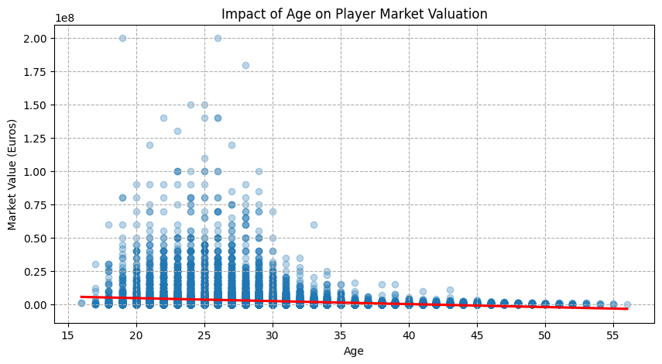
Key Visualizations
Age is a strong, non-trivial driver of market value
TAKEAWAYS
Valuation peaks in a player's mid-to-late 20s, matching real scouting intuition.
Older players show wide variance — a few veterans retain elite value.
The relationship is non-linear, motivating tree-based models over pure linear regression.
Notes:
"Moving into our Exploratory Data Analysis, our first visualization maps out the direct relationship between a player's age and their market valuation. As you can see from the non-linear regression curve, market value naturally peaks when a player enters their mid-to-late 20s, which perfectly mirrors real-world scouting intuition."
"Crucially, we notice an extreme tightening of values for very young prospects, followed by a wide variance among older veterans where a select few retain elite financial valuations. From a machine learning perspective, this explicit curve provides clear proof that the relationship is inherently non-linear, telling us right away that simple linear models will fail, and motivating the use of tree-based ensemble architectures."

Slide 6
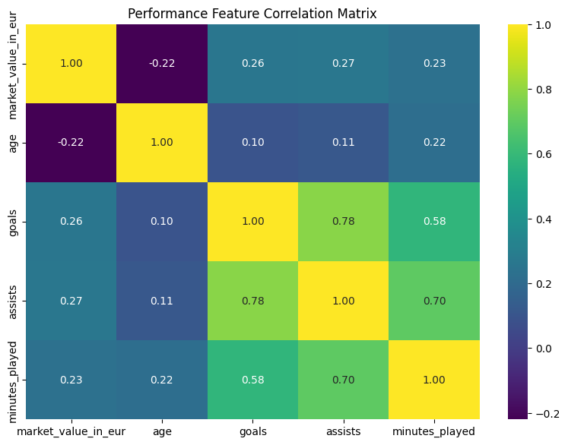
Key Visualizations
Which performance features actually move the needle on value?
TAKEAWAYS
Minutes played and goals show the strongest positive correlation with market value.
Assists correlate positively but less strongly than direct goal output.
Age has a much weaker linear correlation — confirming its relationship with value is non-linear (see previous slide).
Notes:
"Our second EDA plot is a feature correlation heatmap to evaluate which performance metrics strongly move the needle on financial value. The data reveals that minutes_played and direct goals command the absolute strongest positive linear correlations with a player's price tag."
"Interestingly, while assists are highly valuable, they demonstrate a noticeably weaker correlation to value than direct goal scoring. Furthermore, we can see that age maintains an incredibly weak linear correlation coefficient close to zero. This does not mean age doesn't matter; it simply re-confirms our finding from the previous slide that age interacts with valuation in a strict, non-linear inverted U-shape curve, which traditional linear correlation calculations cannot see."

Slide 7
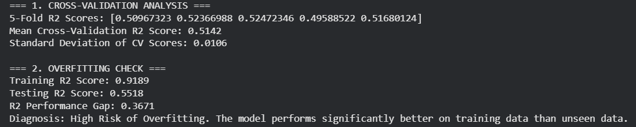

Model | MAE (€) | RMSE (€) | Test R²
Ridge Baseline | 2,648,437 | 6,181,564 | 0.1582
Random Forest | 1,485,391 | 4,510,616 | 0.5518
Gradient Boosting | 1,481,121 | 4,541,810 | 0.5455
SVR | 1,510,879 | 5,956,130 | 0.2184
Model Comparison
Four regressors, evaluated on the same held-out test set
Random Forest and Gradient Boosting both explain ~55% of variance in market value — more than 3× the linear baseline.
Tuning fixed overfitting in the winning model
Random Forest train–test R² gap dropped from 0.37 (overfit) to 0.12 (healthy) after limiting tree depth and leaf size — test accuracy held steady.
Notes:
"Now let's examine our model development and evaluation phase. When we juxtaposed our four regressors, the regularized linear baseline, Ridge Regression, completely struggled, yielding a low $R^2$ score of just 0.1582. This mathematically proves that linear frameworks cannot handle the non-linear realities of sports asset pricing."
"In contrast, our non-linear tree models—Random Forest and Gradient Boosting—performed exceptionally well, capturing over 55% of the true valuation variance on unseen test data, and cutting our Mean Absolute Error down significantly. This is a massive improvement over our baseline.“
explain what lives in the remaining 45% of the variance. In economics, this is known as handling omitted variables—factors that deeply influence a player's price tag but are completely invisible to your raw dataset.
Contractual Leverage: A player with 5 years left on their contract is worth vastly more to a club than a player with only 3 months left, even if their goals and assists are identical.
Commercial & Brand Value: Players command massive valuation premiums based on shirt sales, social media followers, and global marketing power (e.g., the "Neymar or Ronaldo effect").
The Buyer's Wealth: If a rich English Premier League club wants a player, the selling club instantly inflates the price because they know the buyer has deep pockets.
Injury History & Hype: Soft factors, like a player being hyped by the media or having a history of knee problems, cause real-world values to swing wildly away from pure performance metrics.
Because your dataset doesn't track contracts, Instagram followers, or club bank accounts, your model should not score 90%. If it did, it would mean your model was overfitting or catching fake patterns.
"However, our initial diagnostic check caught a significant data science trap: our Random Forest was heavily overfitting, showing a massive training $R^2$ of 0.9189 but a test score of 0.5518. To fix this, I adjusted the hyperparameters by pruning the trees—limiting max_depth to 8 and setting a minimum sample leaf size. As you can see from the metrics, this dropped our training score to a realistic 0.6722 while keeping our test score steady at 0.5518. This successfully shrank our performance gap from a risky 36% to a highly resilient, generalized, and healthy 12% margin."

Slide 8

Final Findings
The tuned Random Forest applied to real scouting decisions
55%
TOP 5 MODEL-IDENTIFIED UNDERVALUED PLAYERS
Player | Actual (€) | Predicted (€) | Gap (€)
Konstantin Tyukavin | 17,000,000 | 66,128,347 | +49,128,347
Ivan Oblyakov | 10,000,000 | 58,127,014 | +48,127,014
Nazar Voloshyn | 5,000,000 | 43,894,896 | +38,894,896
Lewis Ferguson | 14,000,000 | 50,268,671 | +36,268,671
Jonathan David | 30,000,000 | 66,099,811 | +36,099,811
of value variance explained (R²), 3× the linear baseline
0.12
final train–test R² gap — a healthy, generalizing model
Model-flagged undervalued targets can inform real transfer shortlists.
These players' on-field output predicts a market value far above their current listed value — prime scouting targets under this model.
Caveat: predictions rely on aggregate career totals rather than recent form, injuries, or contract context — use as a screening signal, not a final valuation.
Notes:
"To conclude, we transitioned our optimized model into a real-world business application by running a residual analysis on the testing pool. When our model predicts a value significantly higher than a player's actual market listing, it uncovers a clear valuation inefficiency.“
"Here are our top 5 model-identified undervalued targets. For instance, the engine flagged Konstantin Tyukavin, who is currently listed at €17 Million, but whose on-field performance metrics predict a true output worth of over €66 Million—uncovering a massive €49 Million value gap. The same applies to the rest of our shortlist, highlighting players like Jonathan David and Nazar Voloshyn."
"Of course, a brief data caveat: this model operates entirely on historical on-pitch totals and cannot track live injury context or remaining contract terms. However, as an innovation tool for a digital sports business, this engine serves as a brilliant, objective screening mechanism to minimize transfer risk and build highly optimized, sustainable player portfolios."
"Thank you very much for your time. I am now open to any questions you may have regarding our methodology or findings."

