Slide 1
Lesson 1_2: What is a Commit?

Slide 2
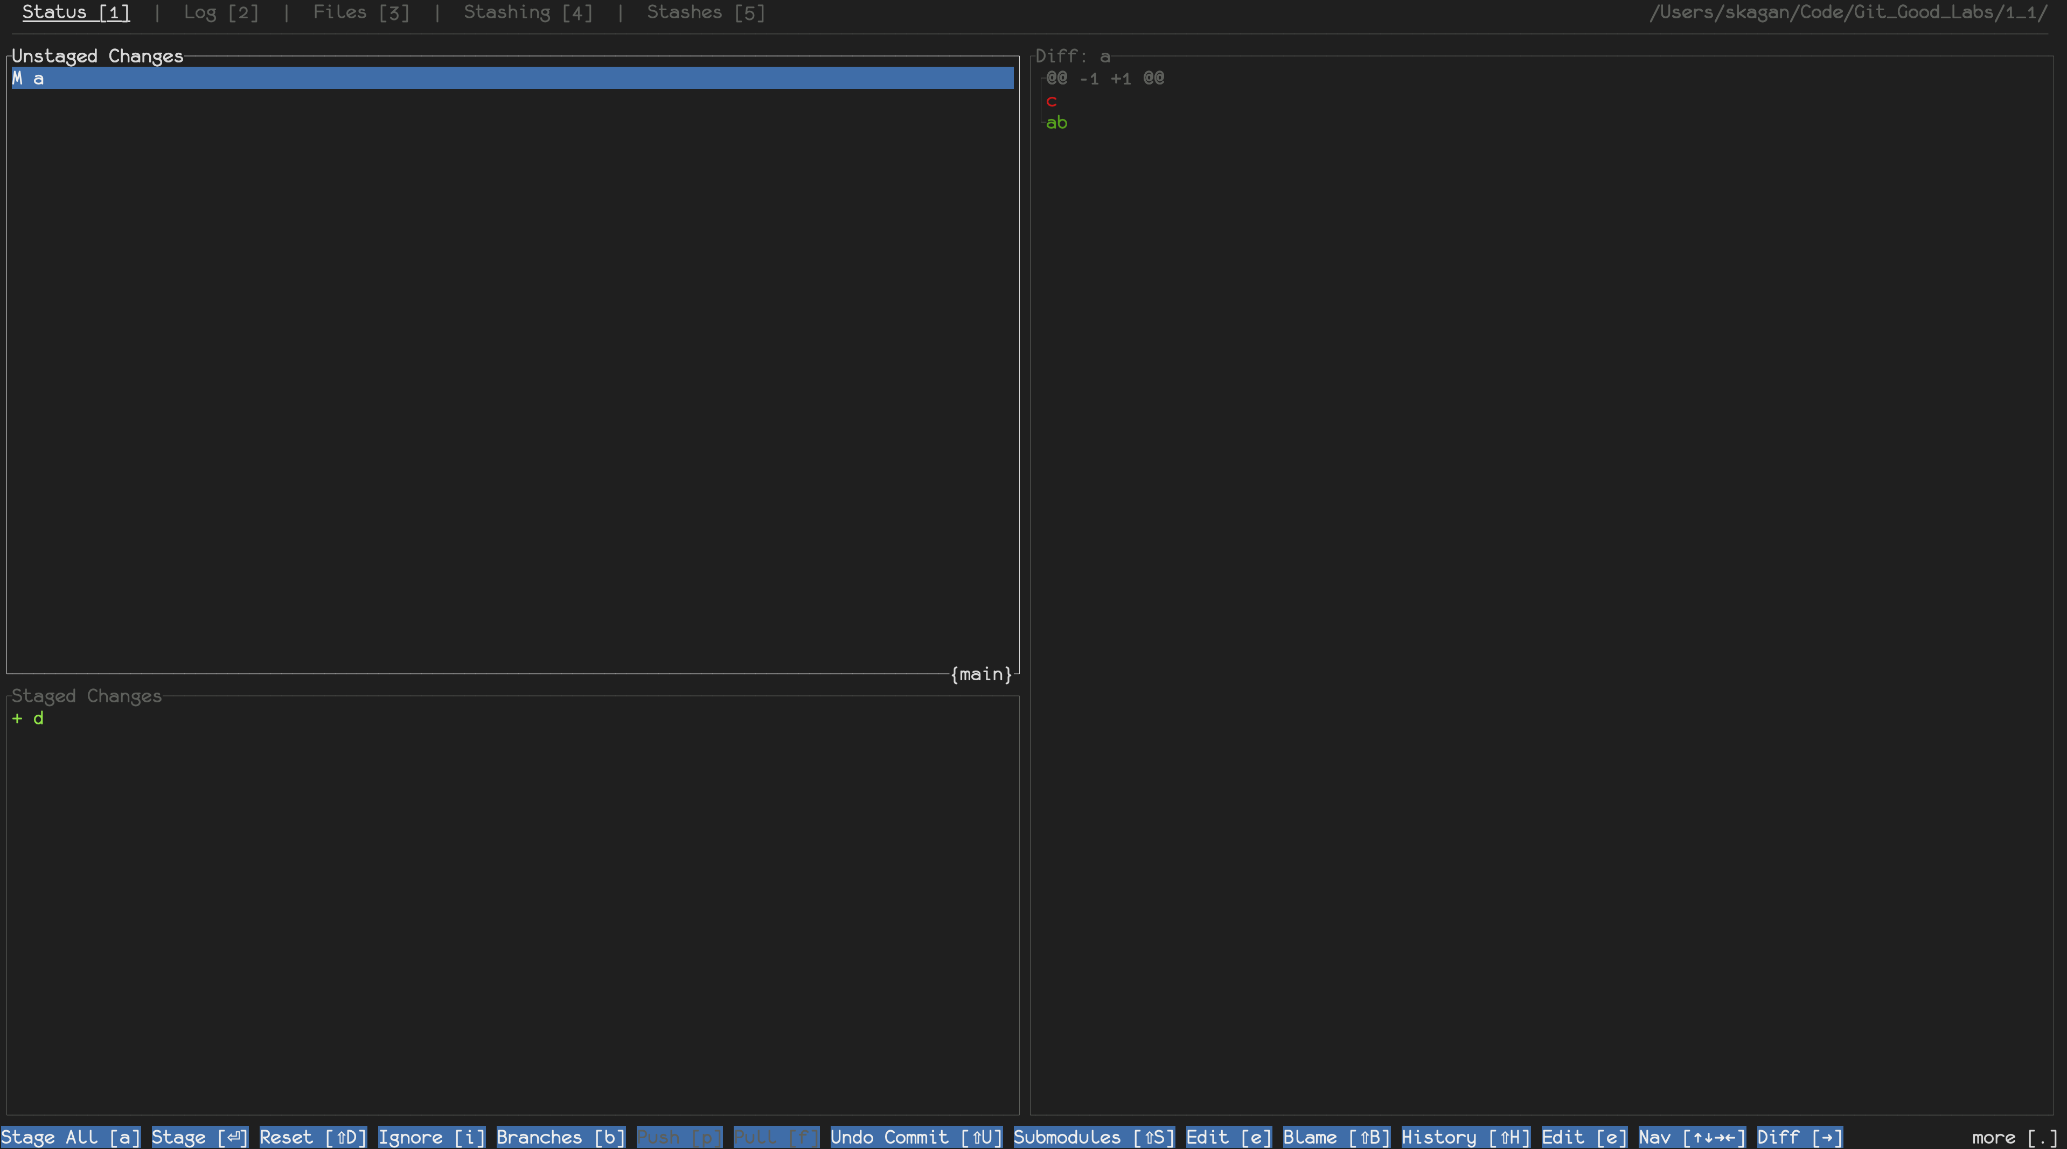
Lab 1_1: The Three States
Talking about all of these today

Slide 3
Git Objects
Only three kinds of things in a Repository
Blobs, trees, commits
Collectively called “objects”
Each object is addressed by a hash of its contents
Implies that each object is immutable
Immutability implies
Changing the Repository always generates new object(s)
Object equality is object identity

Slide 4
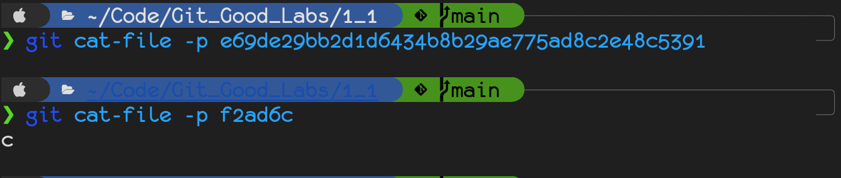
Blobs
Represent version of files in the Working Directory
Just content and size
No names, despite what git_graph shows
Allows cheap support for renaming files

Slide 5
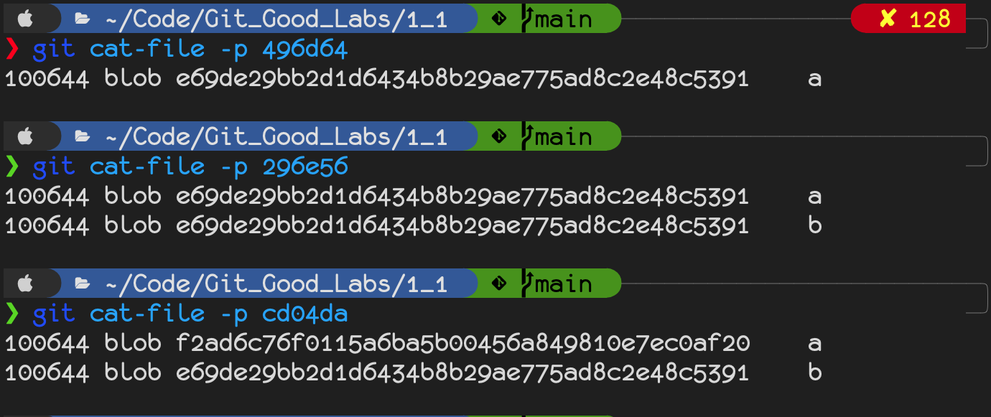
Trees
Represent versions of directories in the Working Directory
Trees of blobs
Own the names of their children
a
a
b
b
a

Slide 6
Commits
Represent points in the Working Directory’s history
Since that history is the Repository, they’re also nodes in its graph
Contents:
A tree of the Working Directory’s root
Reference(s) to parent commit(s)
Message
Author
Committer
a
b
b
a

Slide 7
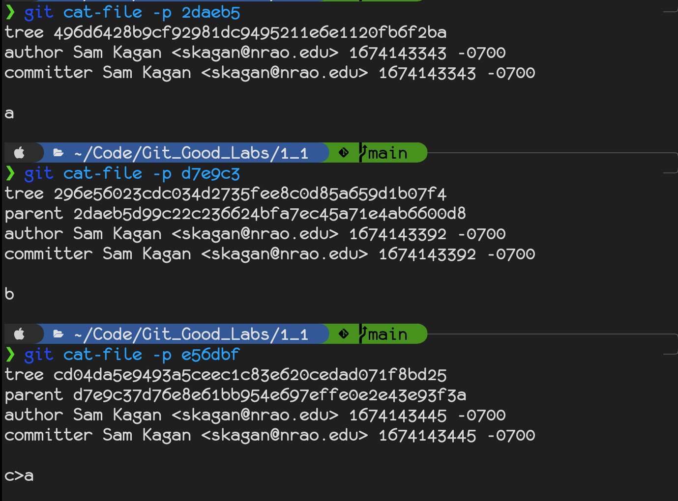
Commit, cont’d
a
b
b
a

Slide 8
Teaser for Next Time
Branches are references to commits
When checked out, move to accommodate new commits
HEAD is a reference to the checked-out branch

Slide 9
Sources
Pro Git, 10.2 Git Interals – Git Objects (https://git-scm.com/book/en/v2/Git-Internals-Git-Objects)
Pro Git, 3.1 Git Branching –Branching in a Nutshell (https://git-scm.com/book/en/v2/Git-Branching-Branches-in-a-Nutshell)
Git from the Bottom Up, Repository: Directory content tracking through How trees are made (https://jwiegley.github.io/git-from-the-bottom-up/1-Repository/1-directory-content-tracking.html)
Gitui (https://github.com/extrawurst/gitui)
Git-graph (https://github.com/HungryJoe/git-graph)

