Slide 1
Lesson 1_3: What is a Branch?
Git References

Slide 2
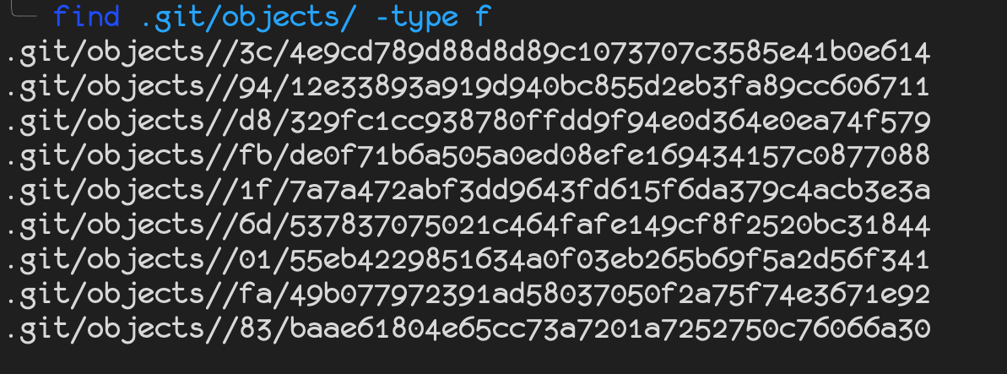
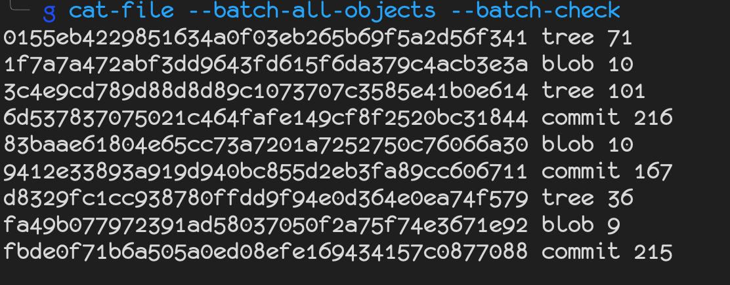
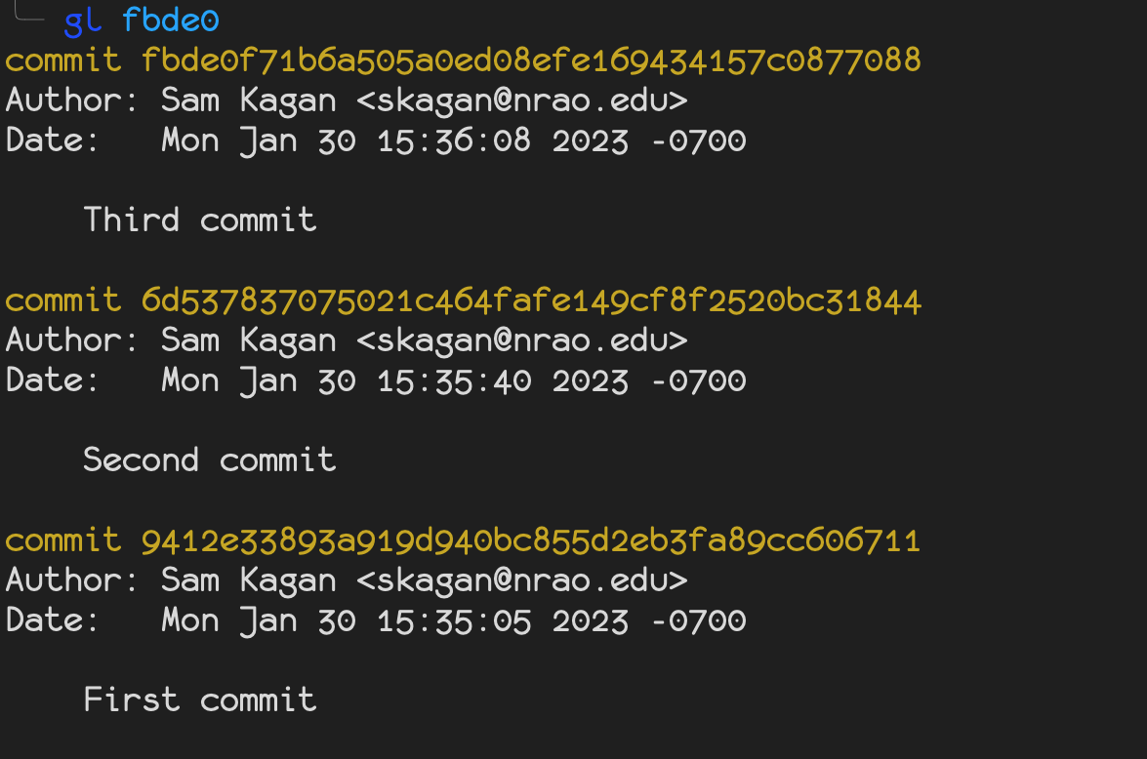
Lab 1_2: Git Objects

Slide 3
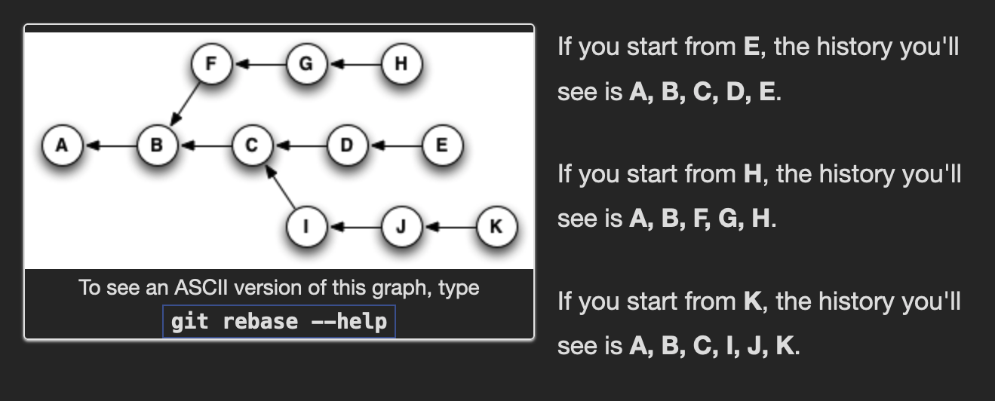
Git References: Why have them?
Commits represent histories through their parents
References indicate which histories matter for a particular Repository
Make histories findable so you can easily make use of them
Tell Git not to garbage-collect those histories

Slide 4
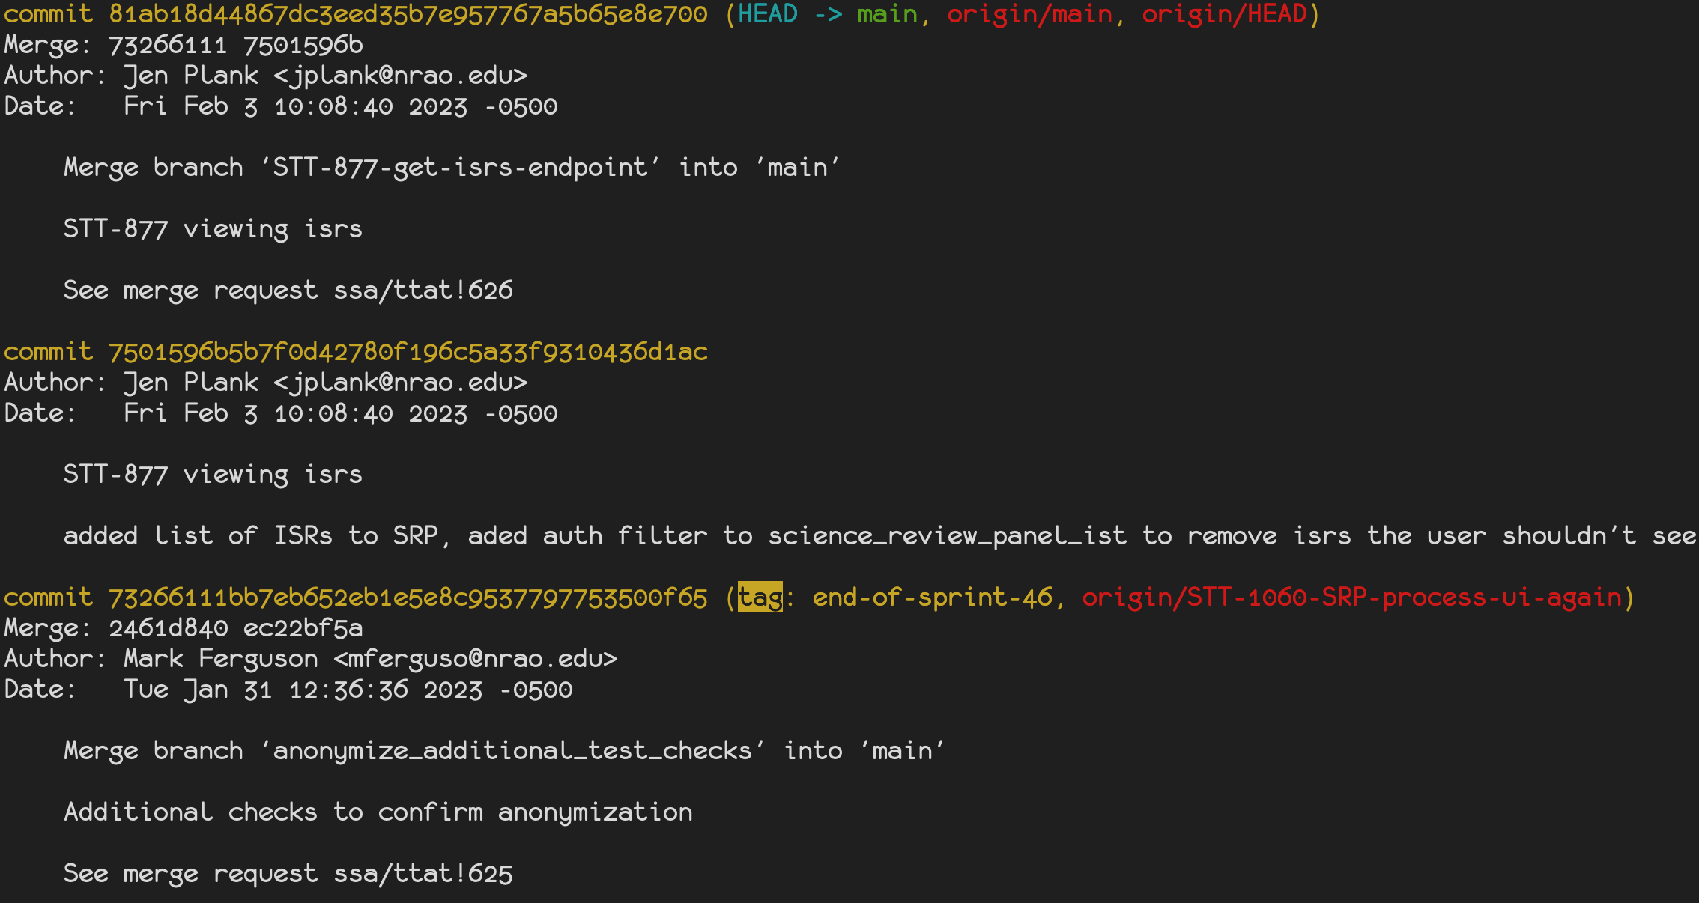
Git References: What are they?
HEAD
branch
3 kinds of references in Git, plus HEAD
Tags
Branches
HEAD (technically a symbolic reference)
Remotes
Reference objects (from the last lesson)
Nearly always reference commits specifically
Generally located in .git/refs/<reference-type>/<reference-name>
Each reference file only contains the commit hash being referenced
Makes creating and deleting references really cheap
remotes
tag

Slide 5
Git References: Tags
Two kinds: annotated and lightweight
Lightweight Tags
Location: .git/refs/tags/<tag-name>
Just object references
Annotated Tags
Location: .git/refs/tags/<tag-name> and .git/objects/<hash>
Objects as well as references
Contain metadata in addition to a name and the hash of another object
Metadata: tagger, time of tagging, message

Slide 6
Git References: Branches
Location: .git/refs/heads/<branch-name>
They can move when they're checked out.
Updated when you make a new commit and they're in HEAD

Slide 7
Git (Symbolic) References: HEAD
Location: .git/HEAD
HEAD will always refer to a branch (symbolic ref) or commit (normal ref)
A repository is said to be in "detached HEAD state" when its HEAD refers to a commit
The file looks either like:
ref: refs/heads/<branch-name>
<object-hash>
Symbolic references refer to a reference instead of directly to a commit
Refers (directly or indirectly) to the currently checked-out commit or branch
Whenever a new commit is made via `git commit`, its parent is set to the commit in HEAD
HEAD is then updated, directly or indirectly by updating its branch

Slide 8
Git References: Remotes
Location: .git/refs/remotes/<remote-name>/<branch-name>
Represent other repositories’ branches the last time they were interacted with
Read-only
Can `git switch` to them (in detached HEAD state), but can't commit on them with `git commit`

Slide 9
Lab 1_3: Git References
Follow along with 10.3 in Pro Git (ignoring the Remotes section)

Slide 10
Sources
Pro Git, 10.3 Git Internals – Git References, https://git-scm.com/book/en/v2/Git-Internals-Git-References
Think Like a Git, References Make Commits Reachable, https://think-like-a-git.net/sections/experimenting-with-git/references-make-commits-reachable.html
Think Like a Git, Reachability, https://think-like-a-git.net/sections/graph-theory/reachability.html
Git-graph (https://github.com/HungryJoe/git-graph)

