Slide 1
Lesson 1.1: What is a Repository?

Slide 2
Course Overview

Slide 3
The Many Meanings of “Repository”
History in Git plus working copy/directory/tree
For us, Repository + Staging Area + Working Directory
History in Git plus everything else Git-related for a given project
For us, Repository + Staging Area
History in Git
This is what I’ll be referring to as the “Repository”

Slide 4
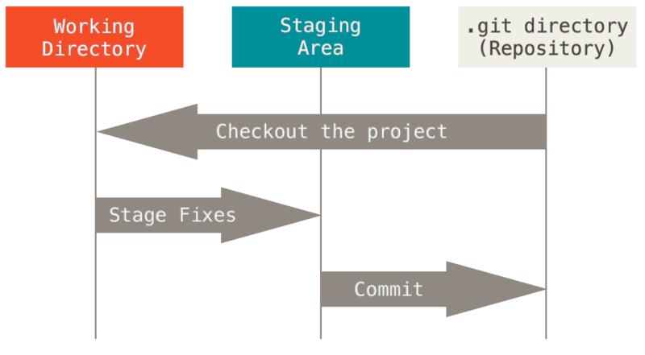
The Three States
or change HEAD (i.e. switch branches)

Slide 5
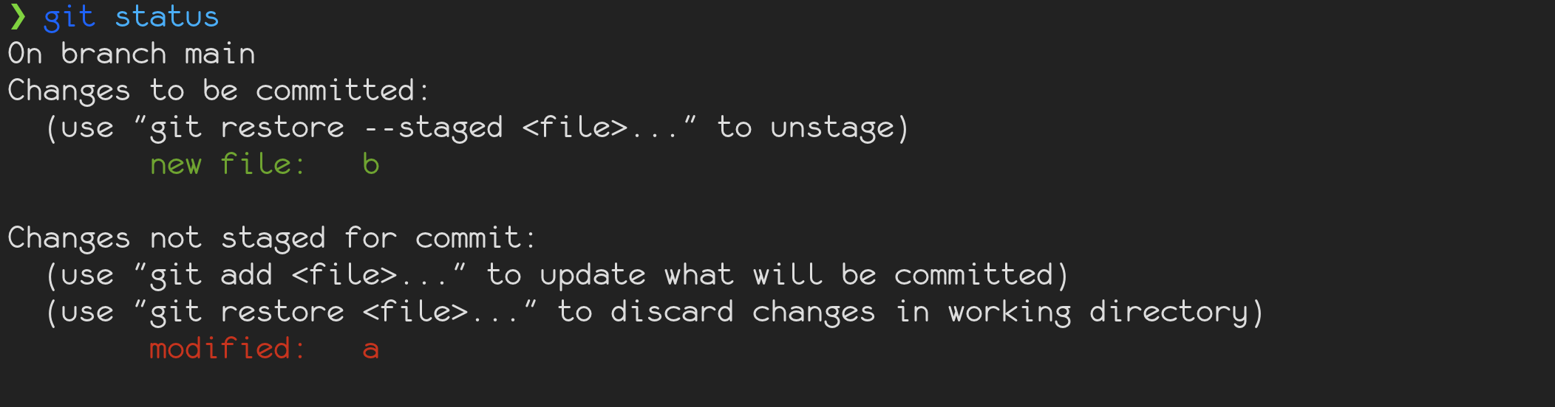
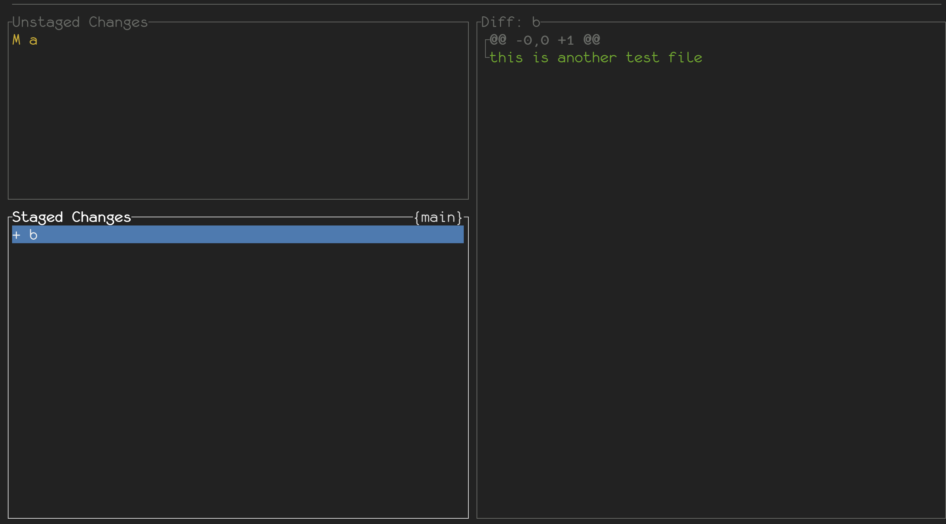
The Staging Area

Slide 6
The Repository – A Graph of Commits
Ignore these for now

Slide 7
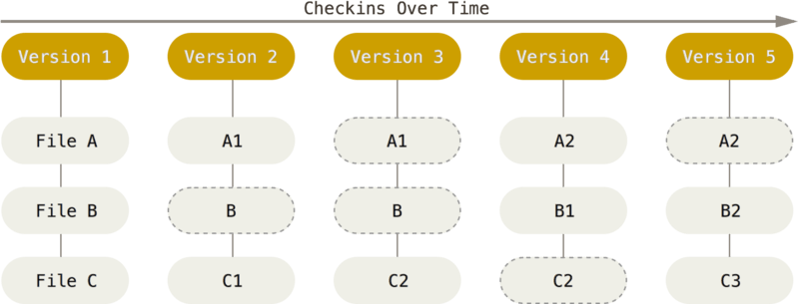
The Repository – Commits are Snapshots

Slide 8
Sources
Pro Git, 1.3 Getting Started – What is Git?, https://git-scm.com/book/en/v2/Getting-Started-What-is-Git%253F
Gitui (https://github.com/extrawurst/gitui)
Git-graph (https://github.com/HungryJoe/git-graph)

