Slide 1

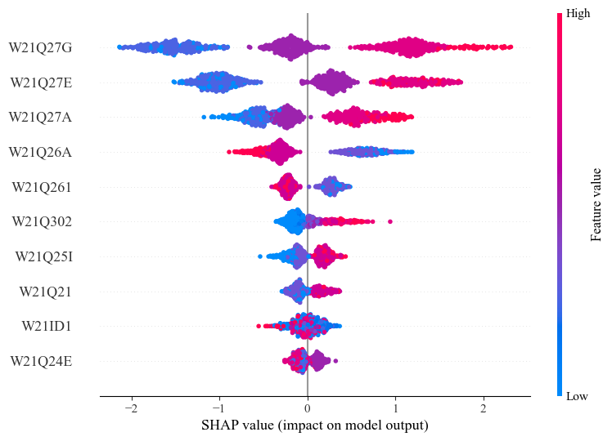
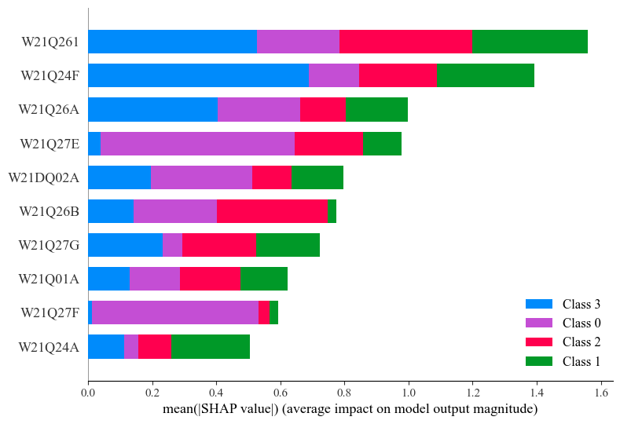



Training Step
Analysis
Multi-Classification
PI
PI
PI
XGBoost Model 1
…
PI
PI
PI
Interpretation
FI
Training Data
Multi-Label Classification
…
FI
SHAP Analysis
XGBoost Model 2
Prediction
Result
Decision
-making
Organizational
management
strategic plan
Pretrained
parameters
Knowledge
Multi-Classification
XGBoost Model 1
Prediction
Test Data
Multi-Label Classification
HRD
Practitioner & Researcher
XGBoost Model 2
Inference step

Slide 2

Training Step
Multi-Classification
XGBoost Model 1
Prediction
HRD
Practitioner & Researcher
Training Data
Multi-Label Classification
Prediction
Result
Knowledge
XGBoost Model 2
Decision
-making
Organizational
management
strategic plan
Pretrained
parameters
Multi-Classification
PI
PI
PI
Analysis
data
XGBoost Model 1
…
PI
Interpretation
PI
PI
FI
Test Data
Multi-Label Classification
…
FI
XGBoost Model 2
SHAP
Explaining step

Slide 3
Training Step
Multi-Classification
XGBoost Model 1
Prediction
HRD
Practitioner
Training Data
Multi-Label Classification
XGBoost Model 2
Pretrained
parameters
FI
PI
Multi-Classification
PI
PI
PI
PI
XGBoost Model 1
…
PI
Interpretation
PI
PI
PI
PI
PI
FI
Test Data
Multi-Label Classification
…
FI
XGBoost Model 2
SHAP
Analysis data

Slide 4
Multi-Classification
Prediction
XGBoost Model 1
Multi-Label Classification
Interpretation
XGBoost Model 2

Slide 5
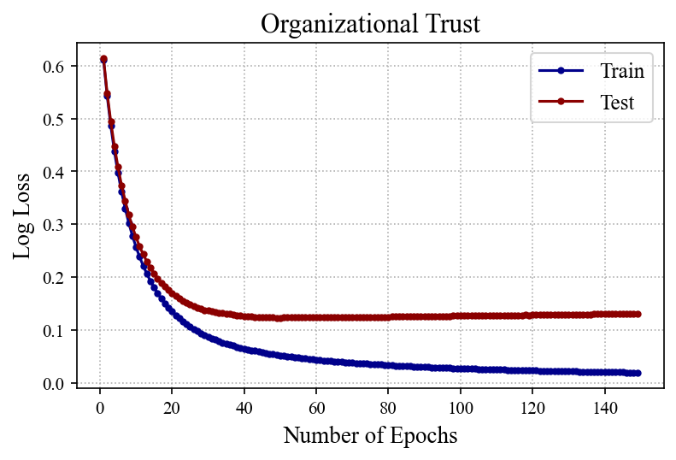
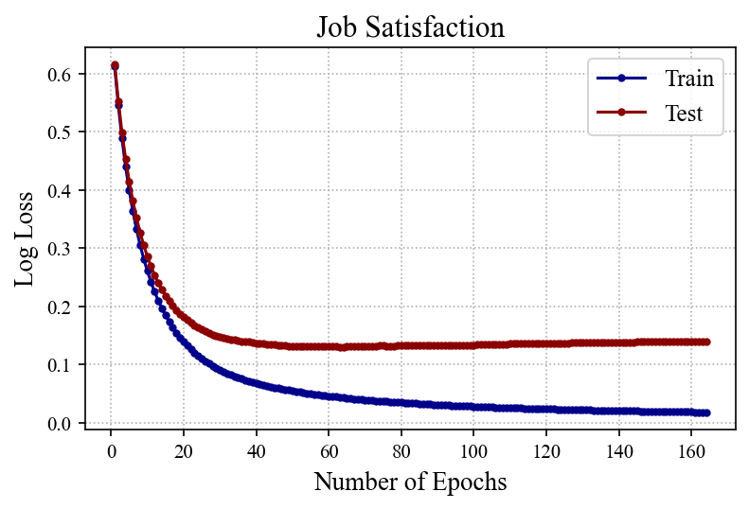
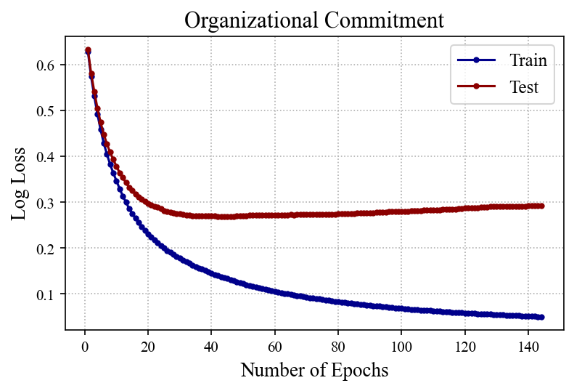
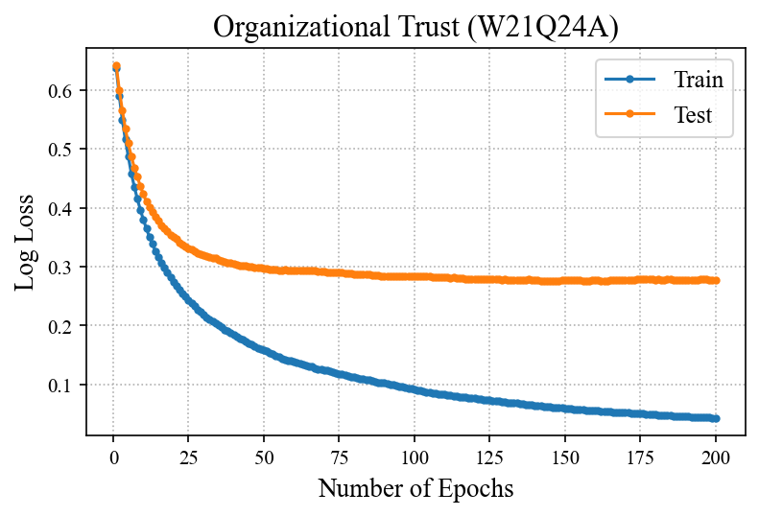
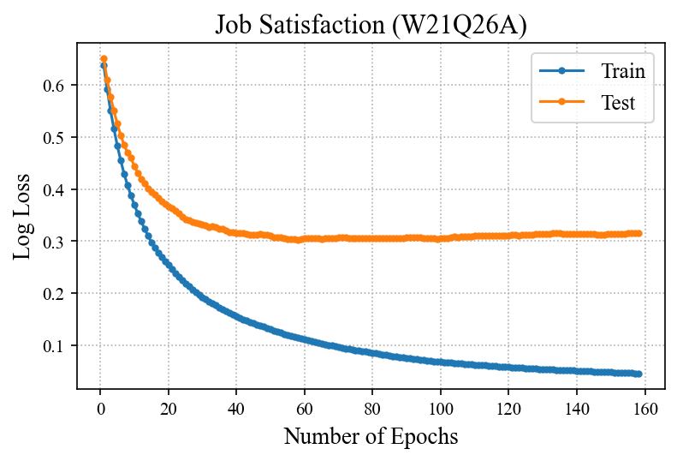
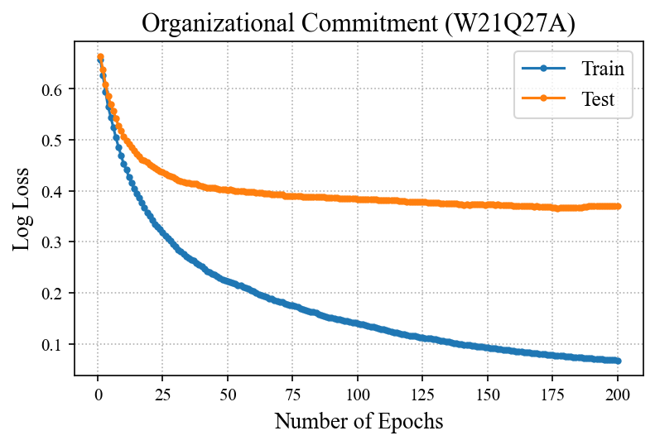
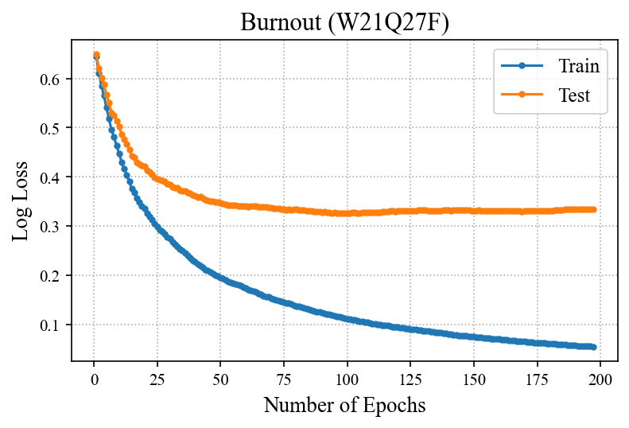
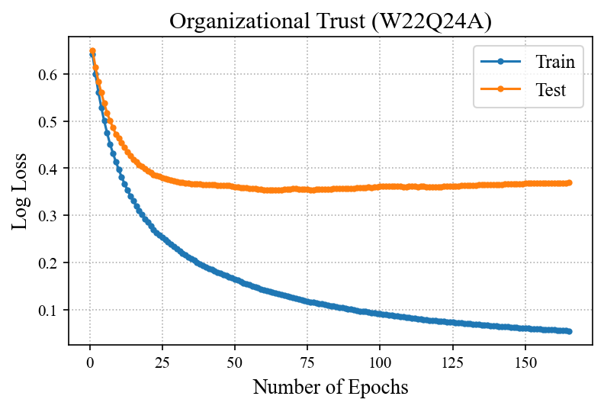
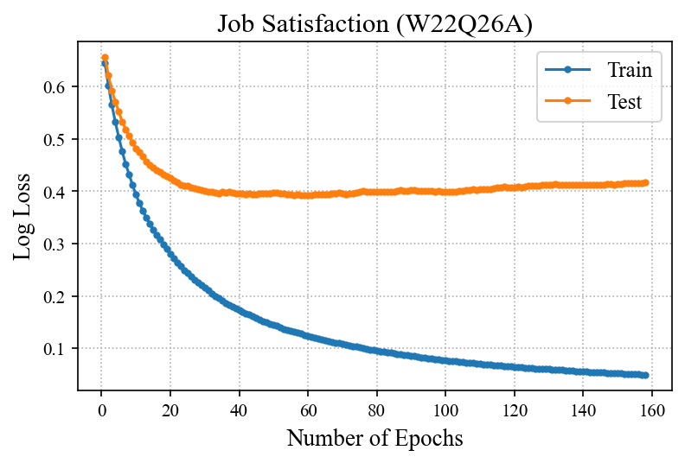
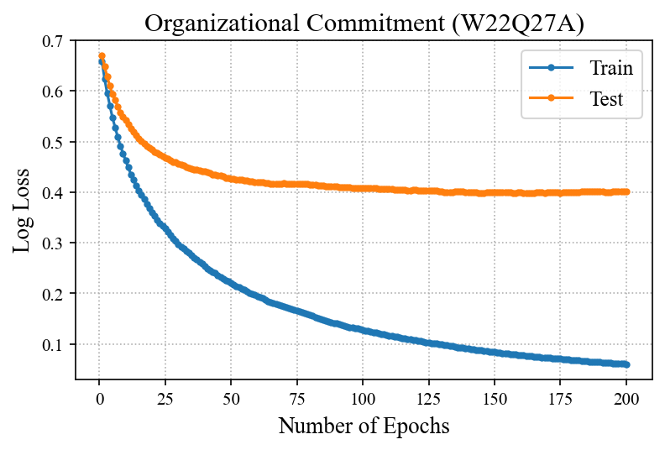
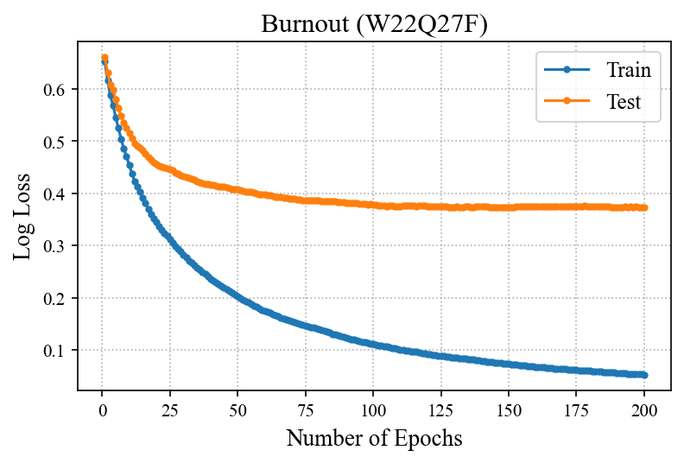

Slide 6
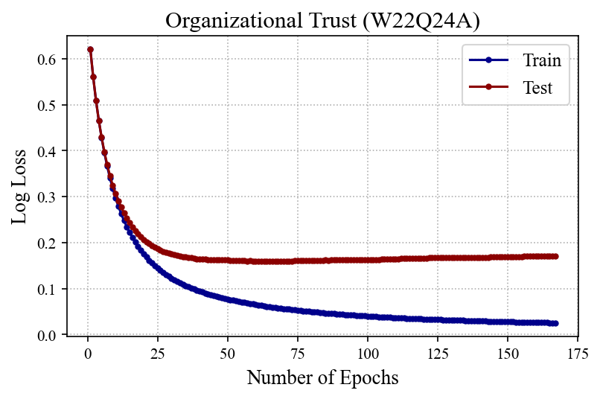
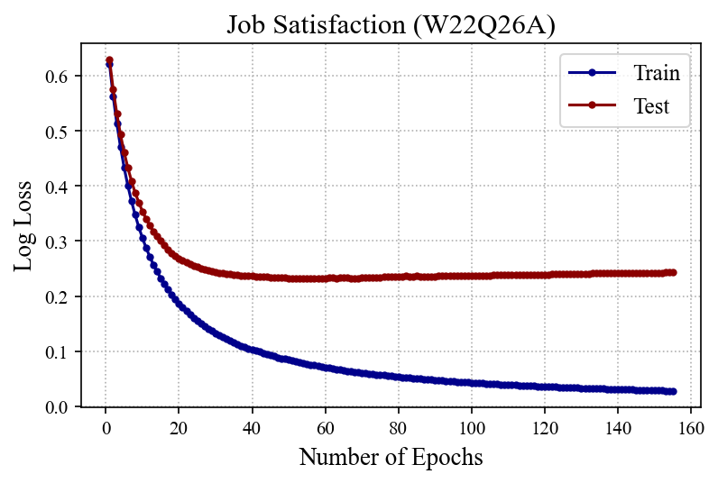
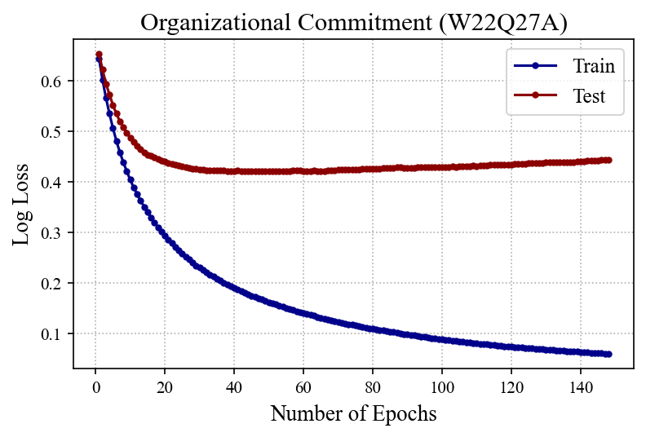

Slide 7
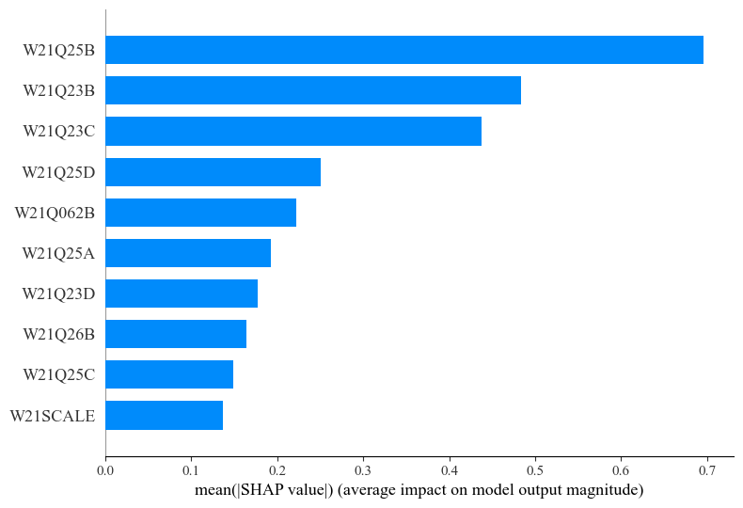
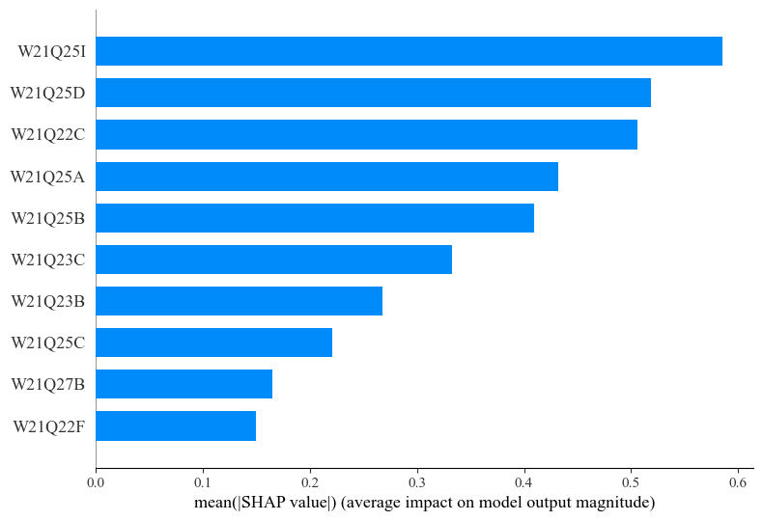
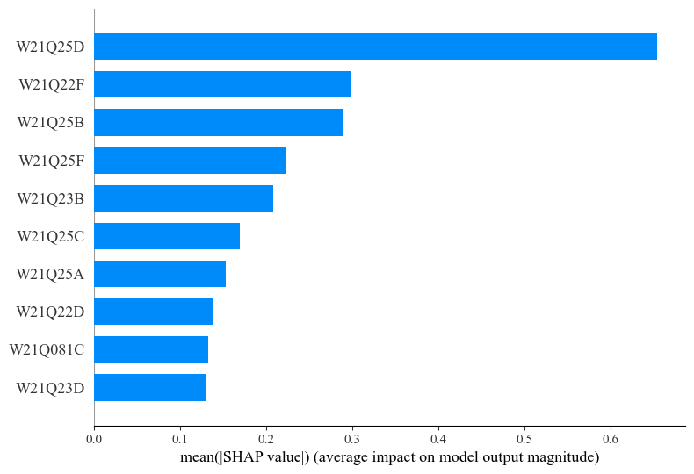
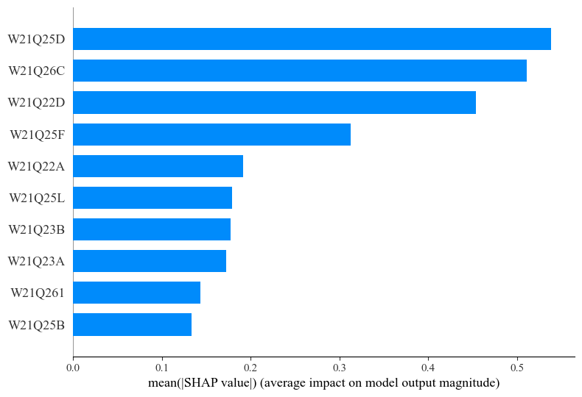
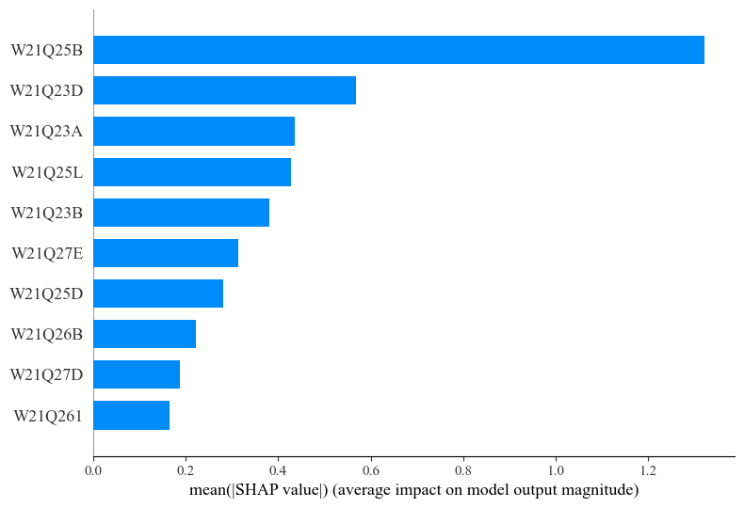
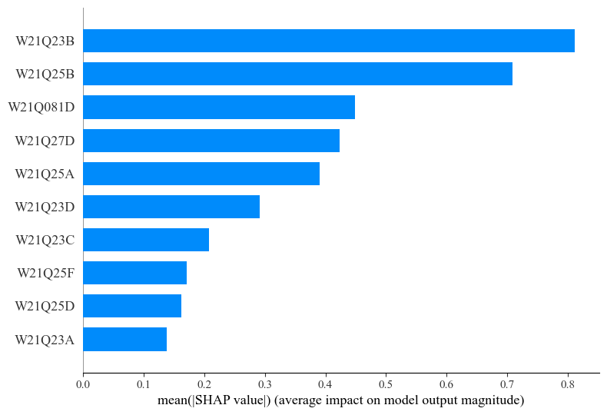
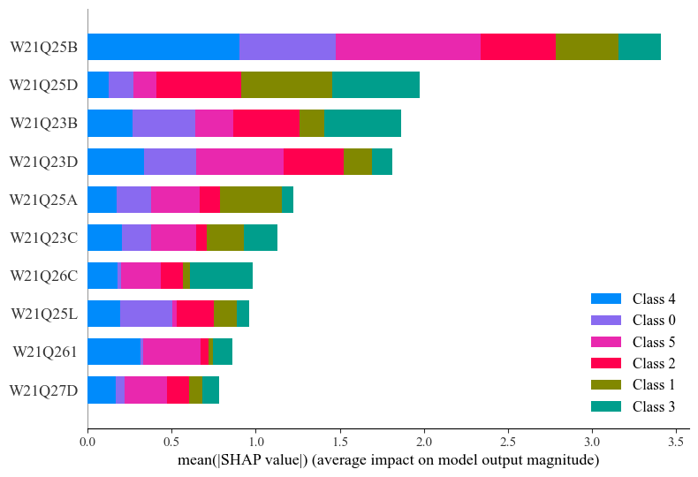
W21Q24A
W21Q24B
W21Q24C
W21Q24D
W21Q24E
W21Q24F
W21Q24F

Slide 8








$𝕄_{1}$ (W21Q24A)
$𝕄_{1}$(W21Q24B)
$𝕄_{1}$(W21Q24C)
$𝕄_{1}$(W21Q24D)
$𝕄_{1}$(W21Q24E)
$𝕄_{1}$(W21Q24F)
$𝕄_{1}$ Model
$𝕄_{2}$ Model

Slide 9








$𝕄_{1}$ (W21Q24A)
$𝕄_{1}$(W21Q24B)
$𝕄_{1}$(W21Q24C)
$𝕄_{1}$(W21Q24D)
$𝕄_{1}$(W21Q24E)
$𝕄_{1}$(W21Q24F)
$𝕄_{1}$ Model
$𝕄_{2}$ Model

Slide 10
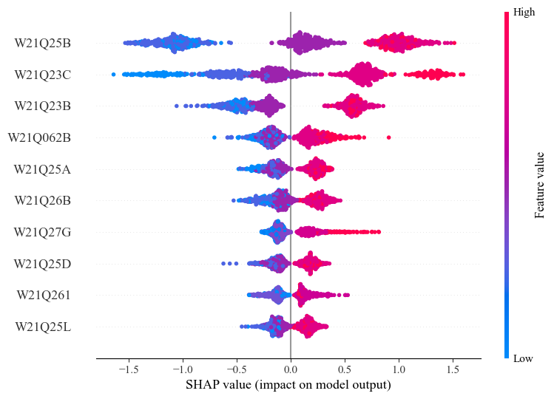
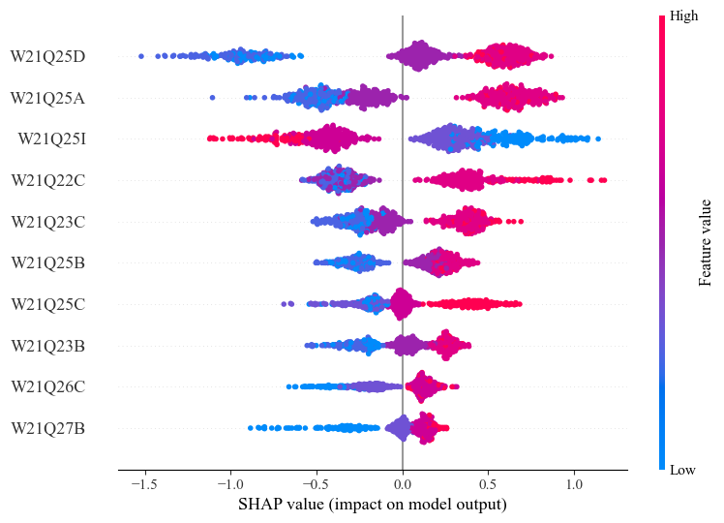
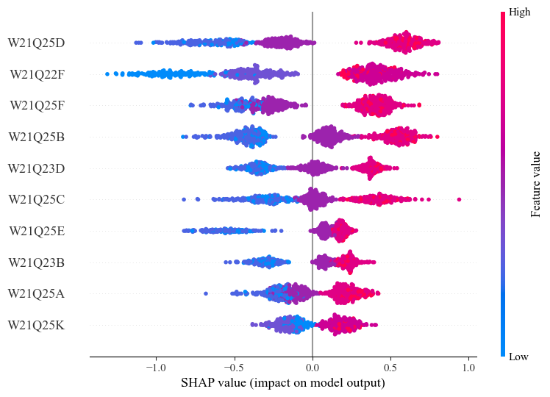
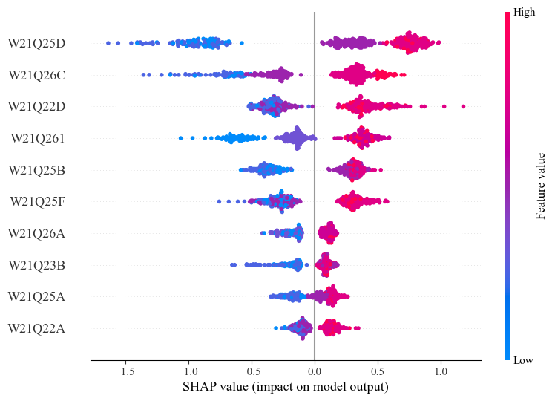
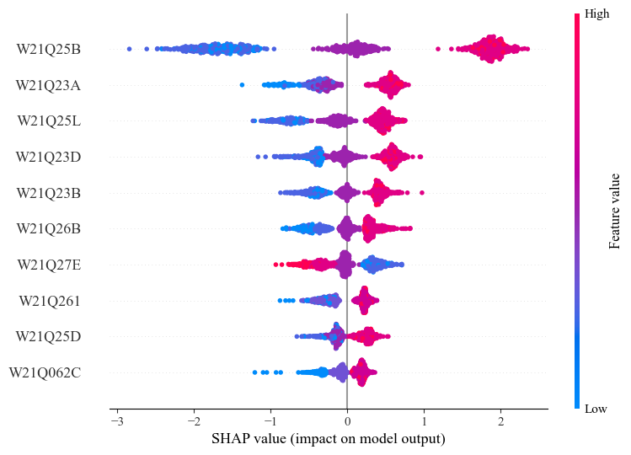
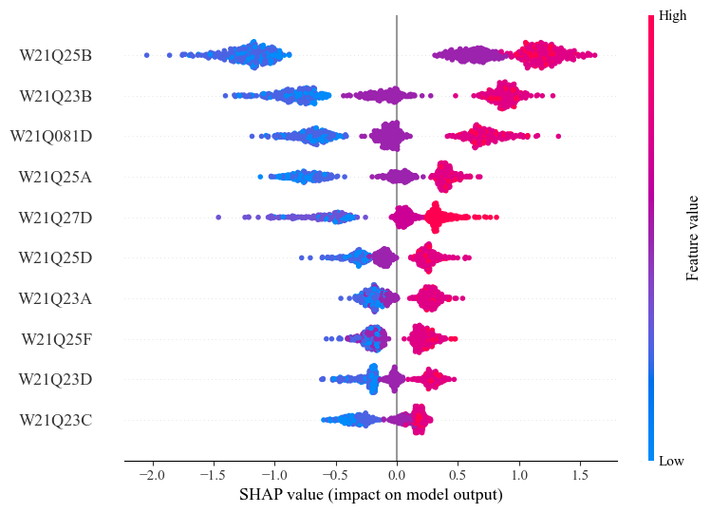






$𝕄_{1}$(W21Q24A)
$𝕄_{1}$(W21Q24B)
$𝕄_{1}$(W21Q24C)
$𝕄_{1}$(W21Q24D)
$𝕄_{1}$(W21Q24E)
$𝕄_{1}$(W21Q24F)

Slide 11
