Slide 1
Inexact Restoration method for solving Hinge loss problems
Master thesis
Hunor Tot-Bagi

Slide 2



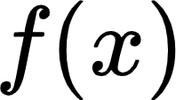


Agenda
Motivation
Machine learning
The Hinge loss function
The algorithm
Numerical results

Slide 3
Motivation
The non-smooth Hinge loss function
Second order derivatives
Big data & sample size
Inexact restoration

Slide 4

L2 - regularized binary hinge loss
Hinge loss for anomaly detection

Slide 5
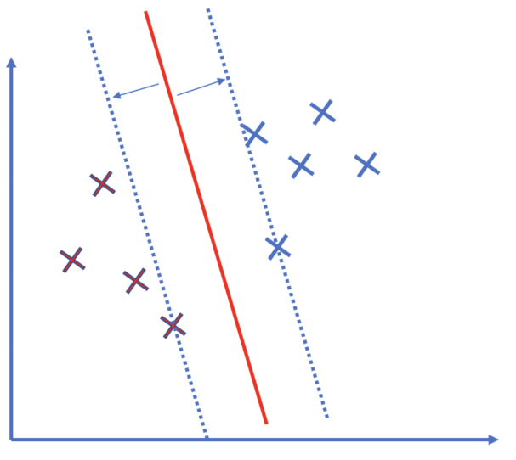
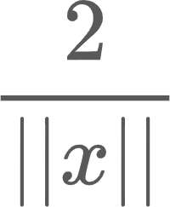
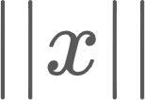
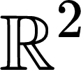
L2 - Regularized binary hinge loss
Width of the margin
If we want to maximize it, we need to minimize
Optimization problem
Hyperplanes in

Slide 6
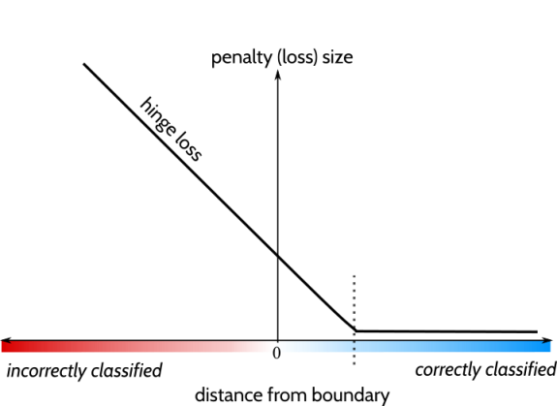
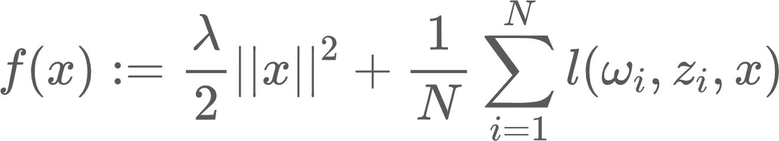
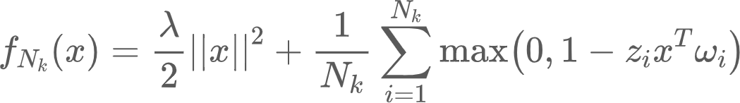
L2 - Regularized binary hinge loss
Hinge loss function

Slide 7
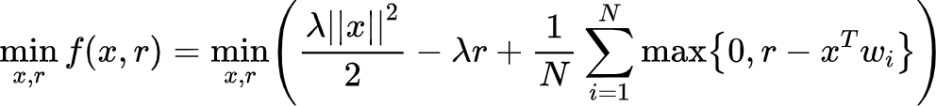
Hinge loss for anomaly detection

Slide 8


The algorithm
BFGS update
Descent direction
Inexact Restoration approach

Slide 9
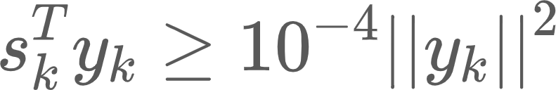
BFGS update
Broyden-Fletcher-Goldfarb-Shanno
Iterative method
Has an advantage if the function is convex
We skip the update if

Slide 10
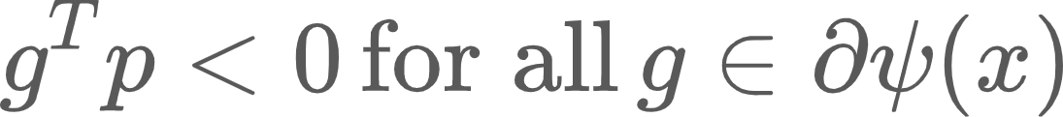
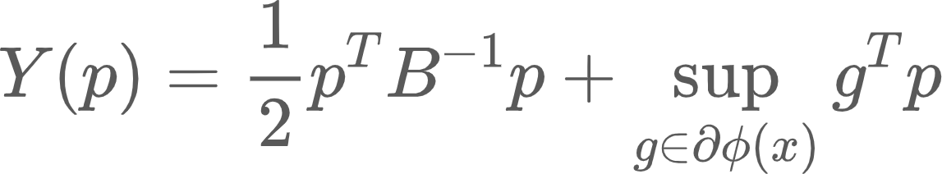

Descent direction algorithm
What is a descent direction
Minimize the pseudo-quadratic model
For nonsmooth function

Slide 11
Inexact restoration algorithm
S1 - Restoration phase
S2 - Updating parameter theta
S3 - Optimization phase
Calculating new descent direction
Searching for step size with backtracking

Slide 12
Inexact restoration algorithm
S4 - Update for solution vector
S5 - Choosing the next subgradient and update the next BFGS
S6 - Increase the counter and go to S1

Slide 13


Numerical results
Properties of the dataset used in the experiments
 | Dataset | N | n | N_{train} | N_{test} | Max_{FEV}
1 | Splice | 3175 | 60 | 2540 | 635 | 10^5
2 | Mushrooms | 8124 | 112 | 6500 | 1624 | 10^5
3 | Adult | 32561 | 123 | 26049 | 6512 | 10^6

Slide 14

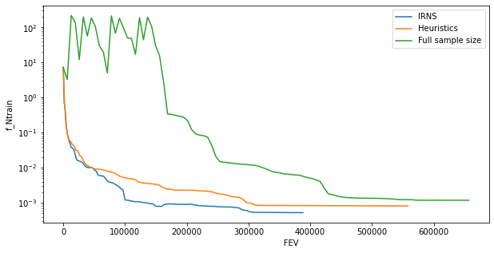
Mushroom dataset
Edible (1) or not (-1)
Training loss versus FEV

Slide 15
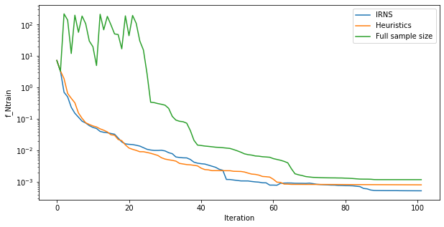
Mushroom dataset
Training loss versus iteration

Slide 16
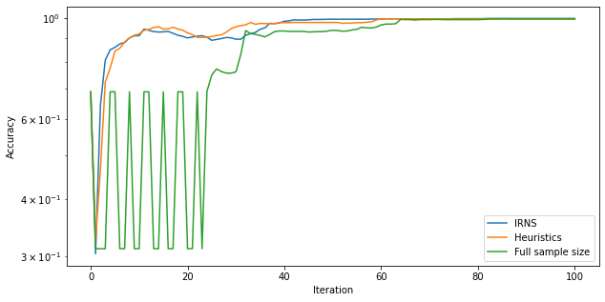
Mushroom dataset
Accuracy versus iteration

Slide 17
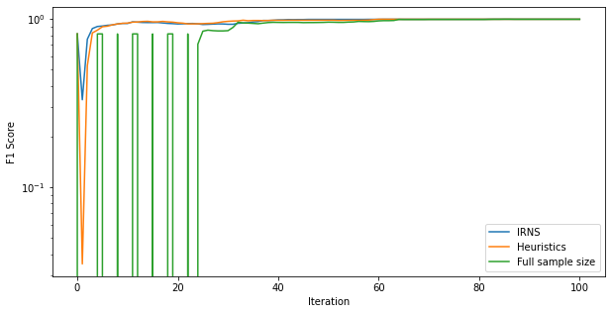
Mushroom dataset
F1 Score versus iteration

Slide 18
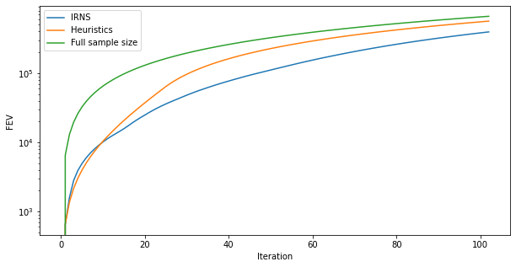
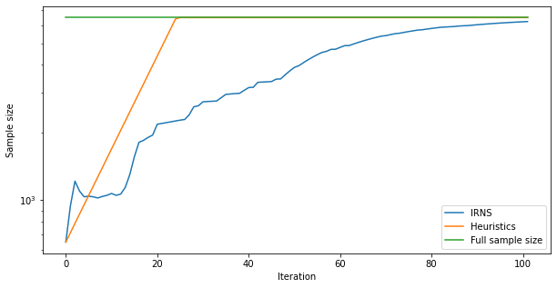
Mushroom dataset
FEV versus iteration
Sample size representation

Slide 19

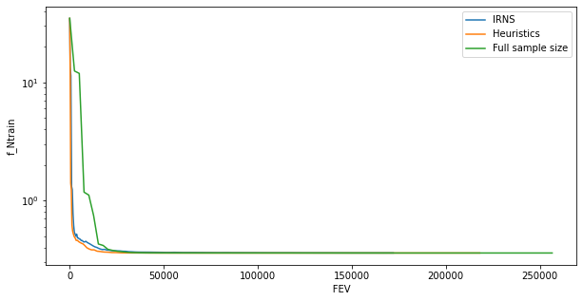
Splice dataset
Training loss versus FEV

Slide 20
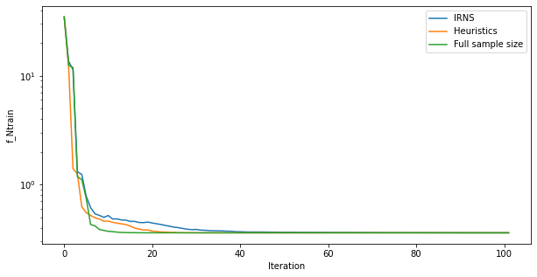
Splice dataset
Training loss versus iteration

Slide 21
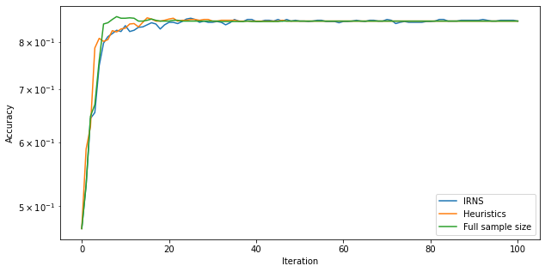
Splice dataset
Accuracy versus iteration

Slide 22
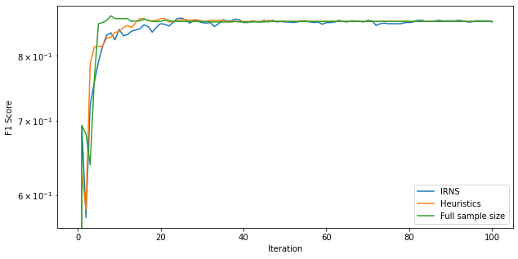
Splice dataset
F1 Score versus iteration

Slide 23
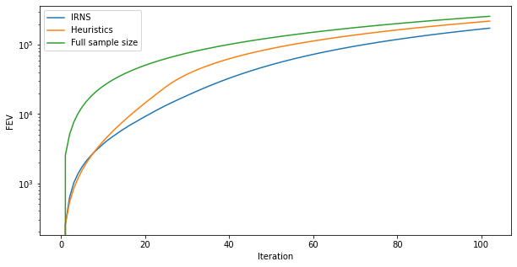
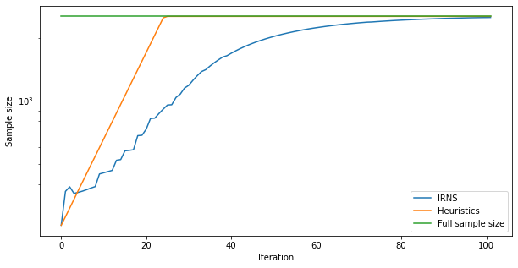
Splice dataset
FEV versus iteration
Sample size representation

Slide 24

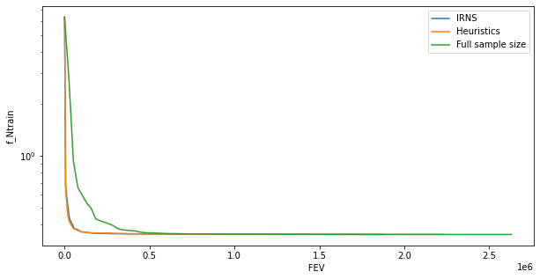
Adult dataset
Training loss versus FEV

Slide 25
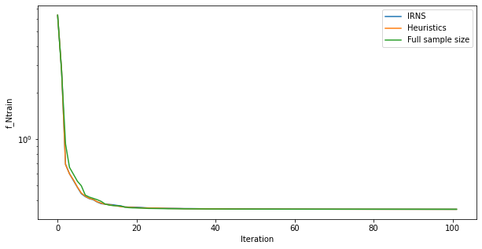
Adult dataset
Training loss versus iteration

Slide 26
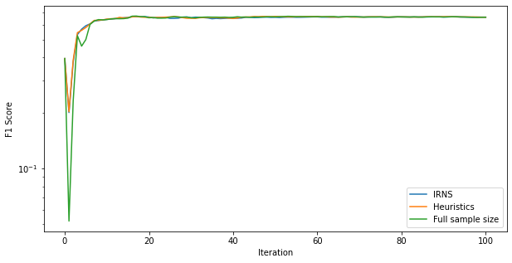
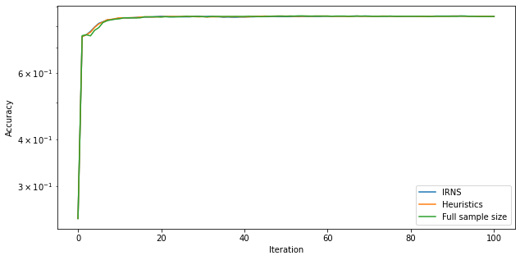
Adult dataset
F1 Score versus iteration
Accuracy versus iteration

Slide 27
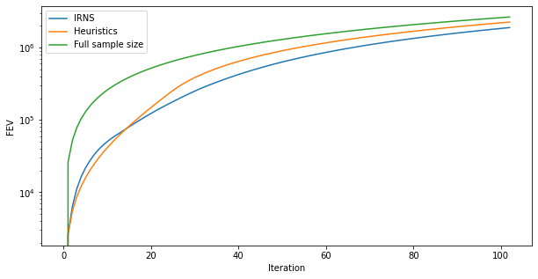
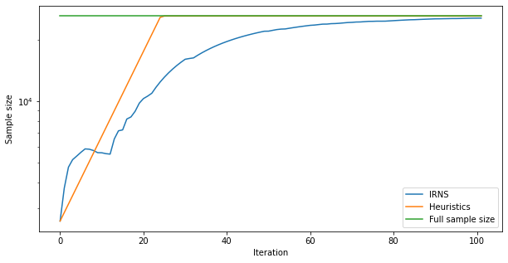
Adult dataset
FEV versus iteration
Sample size representation

Slide 28

IoT dataset
H2020 C4IIoT project - Cyber security 4.0
Data was generated using NB-IoT edge nodes
Box-shaped container inside a transport vehicle in Novi Sad
12678 samples for train and 1571 samples for test
Timestamps, 13 attributes

Slide 29
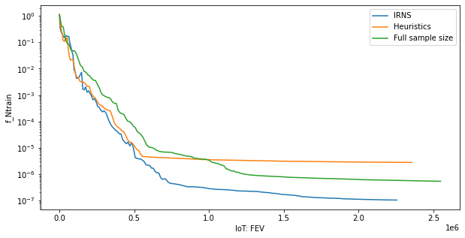
IoT dataset
Training loss versus FEV

Slide 30
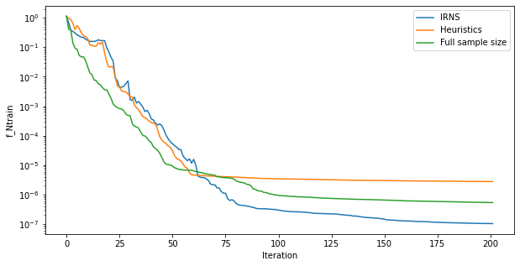
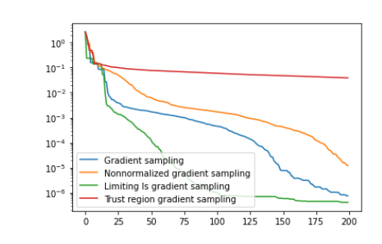
IoT dataset
Training loss versus iteration
Representing the training loss of the gradient sampling method

Slide 31
IoT dataset
Confusion matrix
Classification results
 | IRNS | Heuristics | Ful sample size
TP | 95 | 118 | 88
FP | 336 | 395 | 189
FN | 71 | 48 | 178
TN | 1069 | 1010 | 1216
 | IRNS | Heuristics | Full sample size
Accuracy | 0.741 | 0.718 | 0.83
Precision | 0.220 | 0.230 | 0.318
Recall | 0.572 | 0.711 | 0.53
F1 score | 0.318 | 0.348 | 0.397

Slide 32
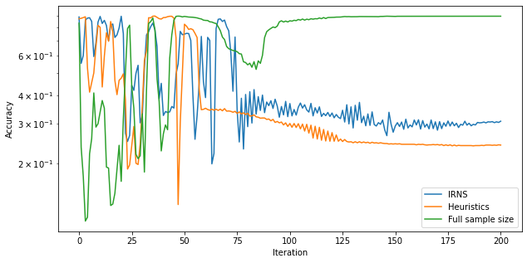
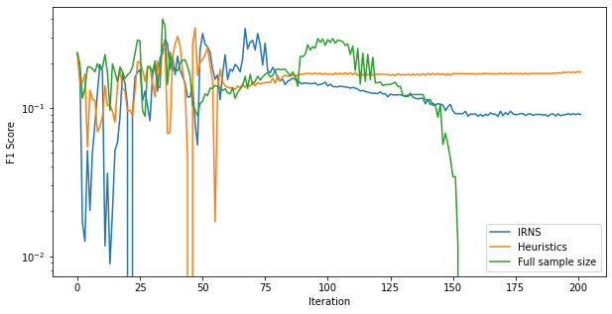
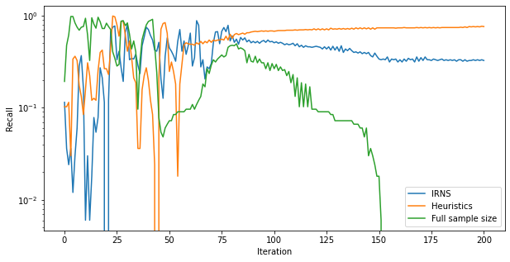
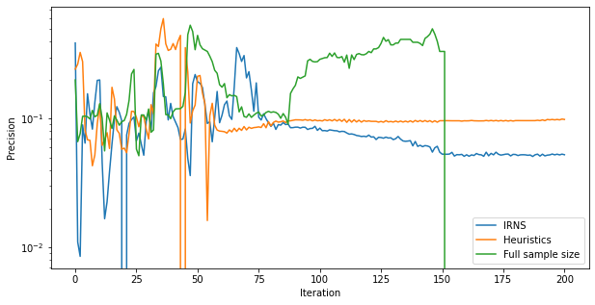
IoT dataset - Classification results

Slide 33
Conclusions
Advantages of IRNS in terms of FEV
Second order information
Better vicinity of the solution than Gradient Sampling
Classification results

