Slide 1

Welcome to

Slide 2
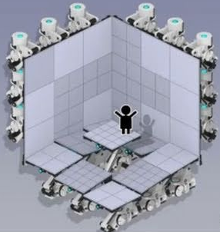
Get chosen
Olimpians
Warheroes
Astronauts
All talent is welcome
You

Slide 3
Your career at A.L.
In house preference for new departments
regular salary re-negotiations

Slide 4
Stuck?
Get help from a generous collegue

Slide 5
Join a bustling community
Have fun
Meet creative people
complete tests

Slide 6

Our new fronteer: team work
Depend on each other
4 eyes see more than 2

Slide 7
We hope to see you at

