Slide 1
Correlation Analysis
In CPU
CONFIDENTIAL Copyright 2008-2020 BeulahWorks LLC All rights Reserved Confidential dnevill@beulahworks.com All information contained here is proprietary to BeulahWorks LLC

Slide 2
BeulahWorks Data Analysis Engine
CONFIDENTIAL Copyright 2008-2020 BeulahWorks LLC All rights Reserved Confidential dnevill@beulahworks.com All information contained here is proprietary to BeulahWorks LLC
A cloud-based service designed to allow non-statisticians to analyze data. Currently it is implemented in R.
An important part of the system is correlation analysis.

Slide 3
What is correlation
CONFIDENTIAL Copyright 2008-2020 BeulahWorks LLC All rights Reserved Confidential dnevill@beulahworks.com All information contained here is proprietary to BeulahWorks LLC
A statistical technique that can show whether and how strongly two variables are related.
Examples
Height v.s. Weight.
Education level v.s. Income
Smoking v.s. Cancer
Public park use rate v.s. Ice-cream sales.
Temperature v.s. Employee Efficiency
Correlation != Causation

Slide 4
Types of data
CONFIDENTIAL Copyright 2008-2020 BeulahWorks LLC All rights Reserved Confidential dnevill@beulahworks.com All information contained here is proprietary to BeulahWorks LLC
Categorical
e.g. gender, country, language
Numerical
e.g. height, weight, grade.

Slide 5
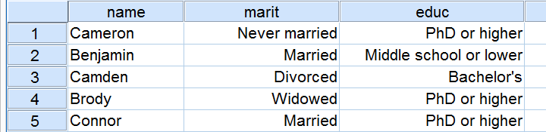
Chi-square Test
CONFIDENTIAL Copyright 2008-2020 BeulahWorks LLC All rights Reserved Confidential dnevill@beulahworks.com All information contained here is proprietary to BeulahWorks LLC
When we have 2 categorical variables like below:

Slide 6
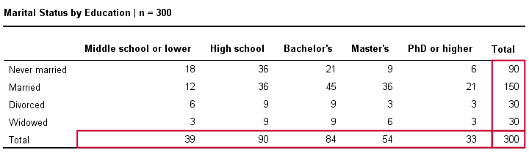
Chi-square Test
CONFIDENTIAL Copyright 2008-2020 BeulahWorks LLC All rights Reserved Confidential dnevill@beulahworks.com All information contained here is proprietary to BeulahWorks LLC
How to calculate the correlation between marital status and education level?
Contingency Table

Slide 7
Chi-square Test
CONFIDENTIAL Copyright 2008-2020 BeulahWorks LLC All rights Reserved Confidential dnevill@beulahworks.com All information contained here is proprietary to BeulahWorks LLC
Chi-square Test (χ²) is a non-parametric test that analyzes correlation between categorical variables.
Formula with example
Data size assumptions:
All cells in contingency table must have >=1 frequency.
At least 80% of cells must have >=5 frequency.
Time Complexity:
Count frequency and build contingency table: O(r) r is number of rows
Calculate the difference between expected and actual: O(mn)
Overall: O(r + mn) = O(r)

Slide 8
Hypothesis Testing
CONFIDENTIAL Copyright 2008-2020 BeulahWorks LLC All rights Reserved Confidential dnevill@beulahworks.com All information contained here is proprietary to BeulahWorks LLC
A simple hypothesis testing
Null Hypothesis H₀: Bill was being honest.
Alternative Hypothesis H_{a}: Bill was cheating.

Slide 9
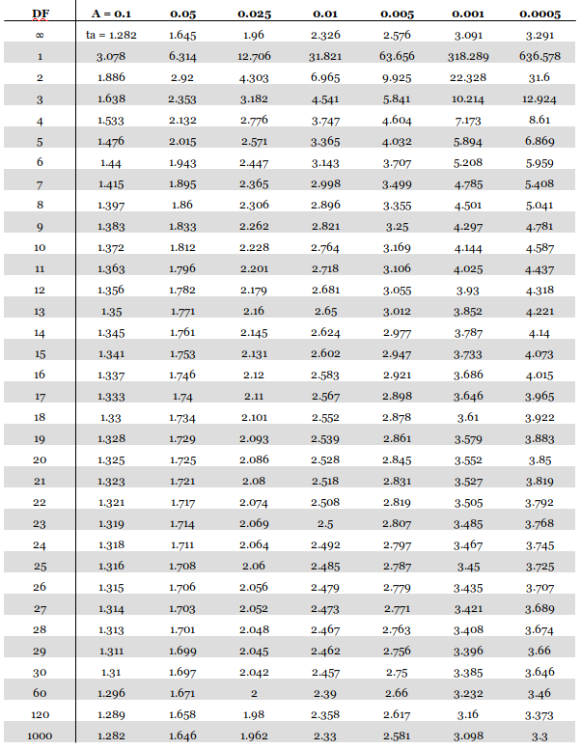
Hypothesis Testing
CONFIDENTIAL Copyright 2008-2020 BeulahWorks LLC All rights Reserved Confidential dnevill@beulahworks.com All information contained here is proprietary to BeulahWorks LLC
Call a library function (will be provided) to calculate the p-value, giving the chi-square value and degree of freedom.
If p-value is less than threshold, then ignore this pair.
Time Complexity: O(1)

Slide 10


Multiple Categorical Variables
CONFIDENTIAL Copyright 2008-2020 BeulahWorks LLC All rights Reserved Confidential dnevill@beulahworks.com All information contained here is proprietary to BeulahWorks LLC
A dataset may have more than 2 categorical variables.
e.g. gender, marital status, education level, state, country, etc.
Without requiring user to define any constraints, the engine should blindly search for any possible correlations.
E.g. gender v.s. marital status? education level v.s. State?
Combinatorics: Choose k (k=2) from n (n is number of categorical variables).
When k=2, it is O(n(n-1)/2) = O(n²)
Chi-square on all pair has time complexity of O(n²r)

Slide 11
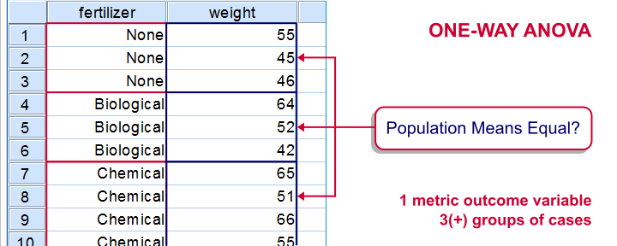
Kruskal-Wallis Test
CONFIDENTIAL Copyright 2008-2020 BeulahWorks LLC All rights Reserved Confidential dnevill@beulahworks.com All information contained here is proprietary to BeulahWorks LLC
When we have a numerical variable and a categorical variable, like below:

Slide 12
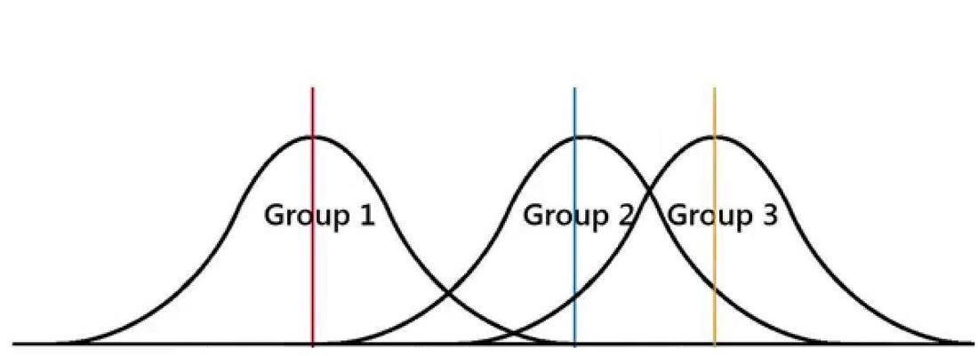
Kruskal-Wallis Test
CONFIDENTIAL Copyright 2008-2020 BeulahWorks LLC All rights Reserved Confidential dnevill@beulahworks.com All information contained here is proprietary to BeulahWorks LLC
At least 2 groups have significantly different means.

Slide 13
Kruskal-Wallis Test
CONFIDENTIAL Copyright 2008-2020 BeulahWorks LLC All rights Reserved Confidential dnevill@beulahworks.com All information contained here is proprietary to BeulahWorks LLC
ANOVA is most widely (mis)used approach.
It is a parametric approach with the following assumptions / limitations:
The experimental errors of data are normally distributed.
Equal variances between categories.
Kruskal-Wallis H Test is the nonparametric version of ANOVA.

Slide 14
Kruskal-Wallis Test
CONFIDENTIAL Copyright 2008-2020 BeulahWorks LLC All rights Reserved Confidential dnevill@beulahworks.com All information contained here is proprietary to BeulahWorks LLC
Time Complexity: r is number of rows, c is number of categorical columns, n is number of numerical columns.
Rank numbers: r*log(r)
Calculating statistic: O(r)
Total: O(r*log(r)) for one pair of columns.
Choose 1 categorical and 1 numerical column has c*n possibilities.
Grandtotal: O(c*n*r*log(r))
Hypothesis Testing
Call a library function (will be provided) to get the p-value.
If p-value is less than the threshold, then ignore this pair.

Slide 15
Mann-Whitney U Test
CONFIDENTIAL Copyright 2008-2020 BeulahWorks LLC All rights Reserved Confidential dnevill@beulahworks.com All information contained here is proprietary to BeulahWorks LLC
If the categorical variable has >2 unique values (groups), the Kruskal-Wallis Test does not tell you which pair of groups have significant differences.
Mann-Whitney U Test is used for that.
Time Complexity:
Choose 2 groups from g groups: O(g²).
For each pair, rank the numerical variables: O(r).
Calculating statistics: O(r).
Total: O(r*g²)

Slide 16
Project Requirements
CONFIDENTIAL Copyright 2008-2020 BeulahWorks LLC All rights Reserved Confidential dnevill@beulahworks.com All information contained here is proprietary to BeulahWorks LLC
Implement the correlation algorithms with fast execution speed using C++.
Code shall be written in C++ 11 or older standard.
Code shall contain an ‘entry’ function (e.g. chisquare()) that is called by main().
main() shall not contain any logic other than a) read input dataset (csv files) and b) call the ‘entry’ function.

Slide 17
Project Requirements
CONFIDENTIAL Copyright 2008-2020 BeulahWorks LLC All rights Reserved Confidential dnevill@beulahworks.com All information contained here is proprietary to BeulahWorks LLC
The ‘entry’ function should take at least the following arguments:
The input dataset.
The p-value threshold (usually 0.05, but can be configured).
The input dataset shall be a struct containing the number of rows and columns, and 2 unordered_maps holding the categorical and numerical columns. The keys are strings (name of column, must be unique) and the values are either a string or floating point vector (column data). The input struct is like below:

Slide 18
Project Requirements
CONFIDENTIAL Copyright 2008-2020 BeulahWorks LLC All rights Reserved Confidential dnevill@beulahworks.com All information contained here is proprietary to BeulahWorks LLC
struct Dataset{
int nrow; //number of rows
int ncol; //number of columns
std::unordered_map<string, vector<string>> cat_cols;//categorical cols
std::unordered_map<string, vector<float>> num_cols;//numerical cols
};

Slide 19
Project Requirements
CONFIDENTIAL Copyright 2008-2020 BeulahWorks LLC All rights Reserved Confidential dnevill@beulahworks.com All information contained here is proprietary to BeulahWorks LLC
The ‘entry’ function should return the following:
For each pair of correlated columns with p-value > threshold, return a struct that contains:
the two columns’ names.
the correlation coefficient
The result shall be a vector of the above construct.
struct Correlation{ vector<Correlation>* result = new vector<Correlation>();
string column_1_name; result->push_back(...);
string column_2_name; return result;
float coefficient;
};

Slide 20
Project Requirements
CONFIDENTIAL Copyright 2008-2020 BeulahWorks LLC All rights Reserved Confidential dnevill@beulahworks.com All information contained here is proprietary to BeulahWorks LLC
All input dataset will be clean, which means:
There are no missing values.
There are no characters in a numeric column.
The dataset has at least 2 rows and 2 columns.
The dataset for chi-square correlation has at least 2 categorical columns.
The dataset for kruskal-wallis correlation has at least 1 categorical and 1 numerical column.
All functions must have 100% test coverage, except the main() function. A code coverage tool must be used to generate a report showing 100% test coverage rate. You may select any tool you like.
R’s chisq.test() and kruskal.test() functions from the standard package will be used to provide the ‘standard answer’ for testing your code’s correctness. The difference shall be within 0.1 for test statistics and 0.001 for p values.

Slide 21
Project Requirements
CONFIDENTIAL Copyright 2008-2020 BeulahWorks LLC All rights Reserved Confidential dnevill@beulahworks.com All information contained here is proprietary to BeulahWorks LLC
Standard datasets will be used to benchmark your code.
Benchmarking platform will be provided as a google cloud VM.
Ubuntu 18.04, Intel Sky Lake CPU with 32 physical threads, enough memory. X-Window system for GUI. Remote Desktop server.
GCC 8.1.0 for compilation. gprof for benchmarking. main() function’s time will NOT be counted (that’s mostly reading csv files).
Up to 3 benchmarking opportunities will be provided to each team before the final presentation. Date/Time to be arranged via email.
Team leaders, send your email to admin@beulahworks.com for communications.
There will be a final benchmarking on the final presentation. It’s performance will be considered as final. It will affect your score.

Slide 22
Project Requirements
CONFIDENTIAL Copyright 2008-2020 BeulahWorks LLC All rights Reserved Confidential dnevill@beulahworks.com All information contained here is proprietary to BeulahWorks LLC
Multithreading shall be used to achieve maximum performance.
C++ Multithreading Tutorial
Use MinGW with pthread support on Windows.
Consider using SIMD instructions and it’s not required (AVX).
AVX Vector programming in C++.
And don’t forget about the -O3 gcc option!
Warning: there can be bugs with g++ -O3. If so, you may either debug it in assembly or use -O2.

Slide 23
Project Requirements
CONFIDENTIAL Copyright 2008-2020 BeulahWorks LLC All rights Reserved Confidential dnevill@beulahworks.com All information contained here is proprietary to BeulahWorks LLC
A GUI shall be built to demo your code.
The GUI shall allow user to select a (clean) csv file and run correlation analysis on it.
The GUI shall show at minimum the following information:
The number of rows, categorical columns and numerical columns of the input dataset.
The number of pairs of correlated columns.
The top 10 pairs ranked by their correlation coefficient.
The execution time.
The GUI can be built with any programming language for any OS, not necessarily Ubuntu. In other words, you can run the code twice: once in GUI mode to demo its functionality, and another in non-GUI mode for benchmarking purposes.
Your GUI shall call your C++ code for execution.

