Slide 1
DATA ENGINEERING PROJECT
Real-Time Used Vehicle
Market Analytics
A scalable batch & streaming data‑engineering solution to transform
noisy marketplace listings into business‑ready analytics.
242K+ Listings
Bronze→Silver→Gold
Harshit Ranjan
Kafka Streaming
Tableau Dashboards

Slide 2
Problem Statement
⚠ The Challenge
🎯 Objectives
Online vehicle marketplaces produce high‑velocity, messy listing data: missing values, duplicates, inconsistent categories, invalid prices and noisy text — unsuitable for direct analysis.
Build a scalable pipeline to clean, validate and feature‑engineer listings; enable real‑time processing; centralise analytical data; automate workflows; and deliver Tableau dashboards for business users.
KEY REQUIREMENTS
⚡
Scalability
🔄
Fault Tolerance
📊
Low Latency
Distributed Spark on HDFS handles 240K+ records across 50 states
Retries, PERMISSIVE mode, logging & Airflow alerts ensure recovery
Confluent Kafka + Spark Streaming for near real‑time analytics

Slide 3
Technology Stack
Modern distributed tools across every layer of the platform
Storage & Compute
Warehouse & Query
Streaming & Orchestration
Visualization
▸ HDFS — raw storage & Bronze layer
▸ Apache Hive — Gold layer external tables
▸ Apache Kafka + Confluent Cloud — message bus
▸ Tableau — executive & price intelligence dashboards
▸ Apache Spark / Spark SQL — batch & streaming ETL
▸ Spark SQL — in-pipeline SQL transformations
▸ Spark Structured Streaming — consumer pipeline
▸ Interactive KPIs, maps & drilldown filters
▸ Databricks — cloud-native Spark processing
▸ Python — orchestration & custom transformations
▸ Apache Airflow — DAG scheduling & SLAs
▸ Precomputed extracts for fast exploration
▸ PySpark with Window & broadcast functions
▸ Parquet — columnar storage format
▸ DLT (Delta Live Tables) on Databricks
▸ Near real‑time tiles from streaming aggregates

Slide 4
End-to-End Architecture
Unified batch + streaming design: raw CSV → Bronze → Silver → Featured → Gold → Hive → Tableau
CSV
Source
BRONZE
SILVER
FEATURED
GOLD
HIVE
DW
TABLEAU
Craigslist
Listings
▶
▶
▶
▶
▶
▶
Raw HDFS
Immutable
Cleaned
Validated
13 Engineered
Features
Aggregated
Analytics
External
Parquet
Dashboards
& KPIs
Apache Spark ETL
⚡ STREAMING TRACK (Databricks + Confluent Kafka)
Auto Loader
(Databricks)
Bronze DLT
Table
Kafka Topic
(Confluent)
Streaming
Silver DLT
Gold
Aggregation
→
→
→
→
SASL/SSL Auth

Slide 5
Batch Processing Pipeline
Bronze → Silver → Featured layer transformations via Apache Spark
SILVER LAYER TRANSFORMATIONS
FEATURE ENGINEERING (13 Features)
🔢
Schema & Type Casting
Vehicle Classification
All columns read as STRING; lat/long → double, posting_date → timestamp, price/year/odometer → numeric
• vehicle_age & age_group (0–2 yrs → Nearly New, 15+ → Classic)
🔍
Missing Value Strategy
• price_category (5 tiers: Budget < $5K → Luxury $75K+)
Category A dropped (county); Category B → "unknown"; odometer imputed via cascading window median (model → mfr → global)
• mileage_category (5 tiers: Low < 20K → Extreme 150K+)
🏷️
Manufacturer Inference
• vehicle_segment (Passenger Car / SUV / Truck / Van / Wagon)
Model-name keyword lookup (MANUFACTURER_LOOKUP dict, 70+ entries) via Spark when/contains chains fills blank manufacturer fields
Financial Metrics
🔄
Transmission Mode Fill
• price_per_mile = price ÷ odometer (null if odo = 0)
Window-ranked frequency count per mfr+model picks most common valid transmission; falls back to "automatic"
• depreciation_index = price ÷ vehicle_age (null if age ≤ 0)
🗺️
State Code Enrichment
Temporal Features
Broadcast join of 51-row lookup converts state abbreviations (TX) to full names (Texas) — optimised small table join
• posting_year, posting_month, posting_day, posting_weekday, posting_hour
📏
Price & Year Filters
• is_weekend (Sat/Sun), posting_period (Morning/Afternoon/Evening/Night)
Price > 0; Year between 1980 and current_year+1; null year rows dropped. Fuzzy duplicate groups reported (not dropped)
Boolean Flags
• is_luxury (17 luxury brands), is_alternative_fuel (EV/hybrid)
▶ Output: Parquet on HDFS, partitioned by state_name
▶ Output: Silver Featured Parquet — 40+ columns ready for Hive
• is_automatic, is_salvage, clean_title

Slide 6
Hive Data Warehouse
Gold layer: aggregated, query‑optimised tables for analyst workflows and Tableau connectivity
Why External Tables? — Hive stores only metadata. Actual data stays in HDFS. DROP TABLE removes metadata only — data is never lost.
📈
KPI Summary Table
🗺️
Manufacturer & State Summaries
📅
Monthly Trends & Condition Analysis
Precomputed KPIs for fast dashboarding.
Avg Price · Median Mileage · Listing Velocity
Updated per pipeline run. Powers Tableau headline cards.
Aggregations by make, model, state and posting period for deep market analysis.
Pre-joined with state_name for geo filters.
Time series prepared for trend detection and seasonal insights.
Is_weekend & posting_period breakdown included.
avg_price
median_mileage
by_manufacturer
by_state
monthly_trends
seasonal_patterns
total_listings
listing_velocity
by_model
by_period
condition_mix
price_by_condition
Hive tables stored as PARQUET · Partitioned for query performance · enableHiveSupport() in Spark Session · Single CSV export via coalesce(1) for Tableau

Slide 7
Databricks & Streaming Pipeline
PRODUCER PIPELINE
CONSUMER PIPELINE
01
Databricks Volume
01
Kafka Source Read
CSV files land in a Databricks Volume — cloud object storage mounted to the cluster.
Spark Structured Streaming reads from Confluent — startingOffsets: latest.
02
Auto Loader (cloudFiles)
02
Schema-on-Read
DLT reads new files incrementally using Auto Loader — no manual file tracking needed.
from_json() with explicit StructType — 25 typed fields parsed from JSON payload.
KAFKA
03
Bronze DLT Table
03
Silver DLT Table
Raw multiline CSV data ingested as a streaming table: gdrive_bronze_raw.
Cleaning: fillna, price_quality_status (ZERO/SUSPECT_LOW/HIGH/VALID), listing_quality_score (0–5).
04
Confluent Kafka Sink
04
Gold Aggregation
dlt.create_sink() pushes records as JSON to topic gdrive-csv-stream-topic via SASL/SSL.
groupBy(manufacturer, state, price_quality_status) → count, avg price, avg mileage, last_updated.
✓ Near Real-Time Market Visibility
✓ Cloud-Native Scalability
✓ Decoupled Producer / Consumer
✓ Windowed Aggregations

Slide 8
Workflow Automation — Apache Airflow
Orchestrates and schedules the full pipeline lifecycle end-to-end
Bronze
Ingest
Silver
ETL
Feature
Engineering
Hive
Load
Kafka
Production
Streaming
Jobs
→
→
→
→
→
Airflow DAG
01
Scheduling & Dependencies
02
Reliability & Observability
03
Operationalisation
• DAGs with clear task dependency graphs and SLA checks
• Email & Slack alerts on task failure or SLA breach
• Parameterised jobs via Airflow Variables and Connections
• Cron-based scheduling: daily batch runs and on-demand triggers
• Full task logs accessible from Airflow UI for debugging
• Environment promotion: dev → staging → prod configurations
• Task-level retries with exponential backoff on failure
• Dead-letter handling for bad Kafka messages
• Runbook integration and self-service re-run capability
• Cross-pipeline dependencies tracked via XCom and Sensors
• Pipeline health tracked via custom metrics and log dashboards
• Docker containerised workers for consistent environments

Slide 9
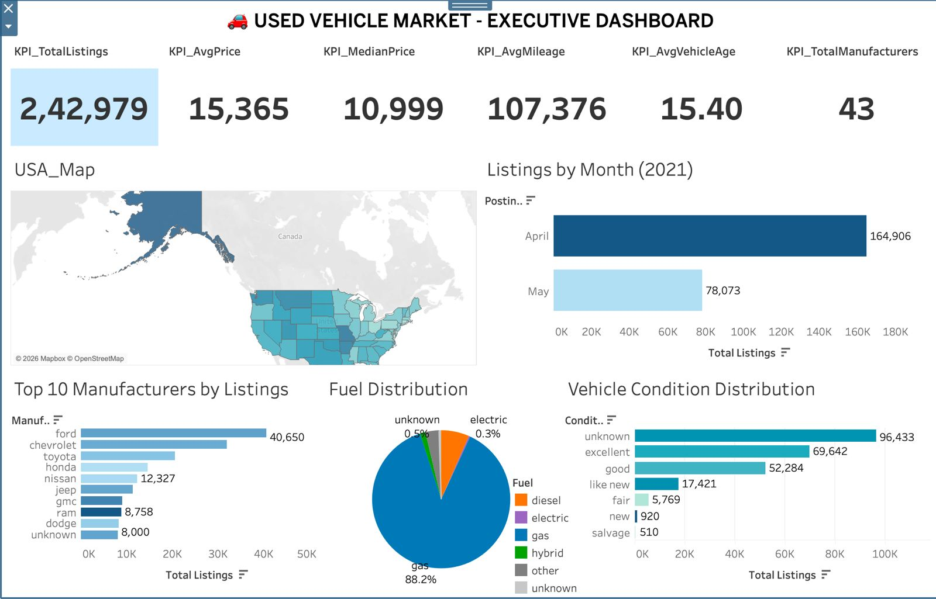
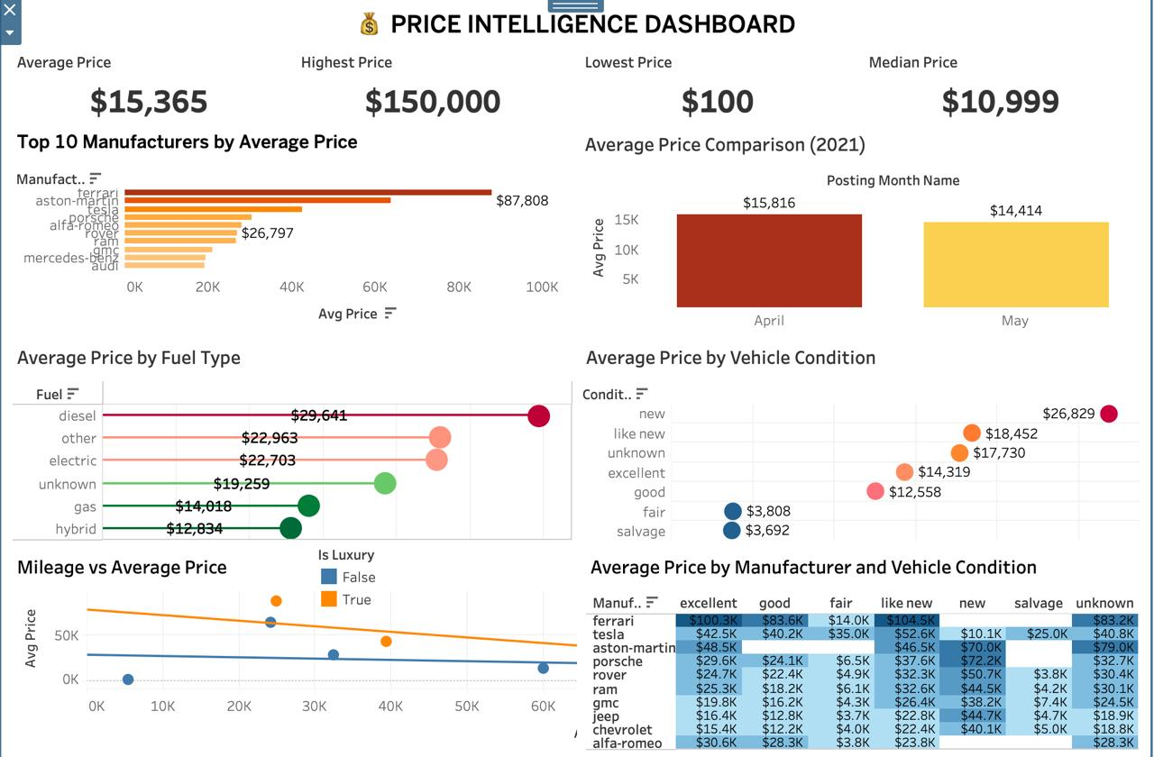
Results & Dashboards
Executive Dashboard
Price Intelligence Dashboard
2,42,979
$15,365
$10,999
107,376
15.4 yrs
43
Total Listings
Avg Market Price
Median Price
Avg Mileage
Avg Vehicle Age
Manufacturers
KEY INSIGHTS
▸ Ford leads with 40,650 listings (16.7% share)
▸ Gas fuel dominates at 88.2%; EV only 0.3%
▸ April peak: 164,906 listings vs 78,073 in May
▸ Ferrari avg $87.8K; Hybrid avg $12.8K
▸ New cars avg $26.8K vs Salvage $3.7K
▸ "Unknown" condition = 39.7% — data quality gap identified

Slide 10
Conclusion & Future Scope
✅ Achievements
🚀 Next Steps
End‑to‑end Medallion Architecture (Bronze → Silver → Featured → Gold)
01
AWS S3 + Delta Lake
Migrate HDFS storage to S3 and adopt Delta format for ACID transactions and time-travel.
Distributed Spark ETL with advanced null imputation & feature engineering
02
ML Price Prediction
Hive External Data Warehouse with Parquet partitioning
Train a regression model on engineered features to predict fair market value in real time.
Confluent Kafka + DLT streaming pipeline on Databricks
03
Apache Iceberg / Flink
Evaluate Iceberg for table format evolution and Flink for lower-latency streaming.
Airflow DAG orchestration with retry, alerts & SLA tracking
04
Docker & Kubernetes
Tableau dashboards: Executive + Price Intelligence views
Containerise Spark jobs and Airflow workers for reproducible, cloud-agnostic deployments.
242K+ listings processed across 50 US states, 43 manufacturers
05
CI/CD for Pipelines
Automated testing, linting, and promotion workflows for robust pipeline delivery.
Thank you — Questions Welcome 🙏

