Slide 1
Clean Energy in the us
By: Hunter Farrar

Slide 2
agenda
What energy sources and years are being analyzed?
Individual energy source analysis.
What was the top three months of energy consumption using these sources?
What are the top five states when it comes to percentage of overall production of energy?
What are the top five states that consumed the most energy per capita?
Compare Tennessee to the leading states in select renewable energy sources.

Slide 3
Energies and years observed
Year range being analyzed:
2013-2023
I decided to go with three of the more popular forms of clean energy:
Hydroelectric (renewable)
Solar (renewable)
Wind (renewable)
Other forms of clean energy which were not included are the following:
Nuclear (non-renewable)
Biomass (renewable)
Geothermal (renewable)

Slide 4
Hydro Energy
Hydroelectric energy is the oldest form of renewable energy.
Hydroelectric energy can be produced in homes if there is a form of running water on the property.
In 2022 Washington was the leader in Hydroelectric energy produced. With the Pacific Ocean on their west coast and the Colombia River flowing throughout the state.
Between 2013 and 2023, the year with the most energy consumption was 2017 while the year with the least was 2015.

Slide 5
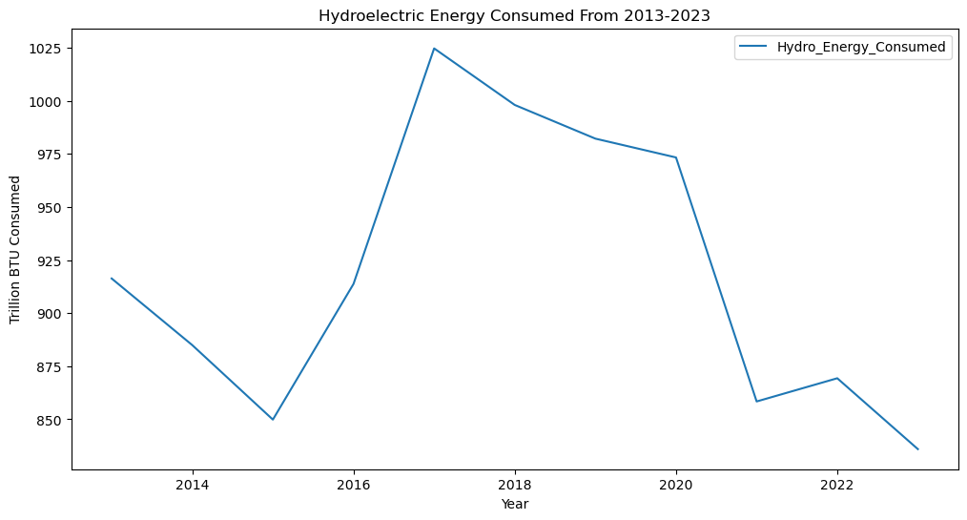
Overall U.S. Hydro Consumption

Slide 6
Top three months of Hydroelectric consumption
Date | Amount of Energy Consumed | Units* | Energy Type
5/2017 | 111.255 | Trillion BTU | Hydroelectric Consumption
5/2019 | 109.123 | Trillion BTU | Hydroelectric Consumption
6/2017 | 104.323 | Trillion BTU | Hydroelectric Consumption
*British thermal units
**Data collection range from 2013 – 2023

Slide 7
Solar Energy
Solar energy usage has grown more popular since it’s able to easily have its panels installed on houses.
From 2013 – 2023 solar energy consumption has only risen.
California was the leading state in Solar energy production in 2022.

Slide 8
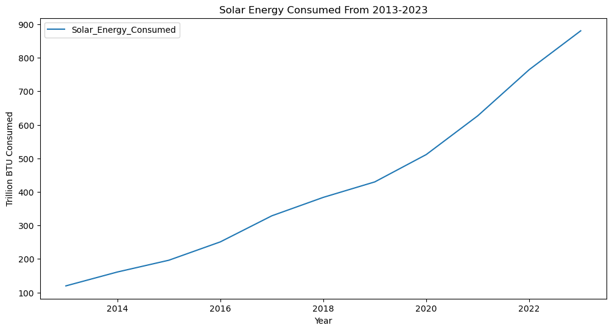
Overall u.s. solar consumption

Slide 9
Top three months of solar consumption
Date | Amount of Energy Consumed | Units* | Energy Type
7/2023 | 97.656 | Trillion BTU | Solar Consumption
8/2023 | 92.824 | Trillion BTU | Solar Consumption
6/2023 | 92.683 | Trillion BTU | Solar Consumption
*British thermal units
**Data collection range from 2013 – 2023

Slide 10
Wind Energy
Wind energy is the most accessible in places with strong winds to generate a sufficient amount of energy.
Wind energy, similar to solar, had climbed in consumption usage between 2013 and 2022, but had a drop in consumption in 2023.
During 2022 Texas led the nation in Wind energy production.

Slide 11
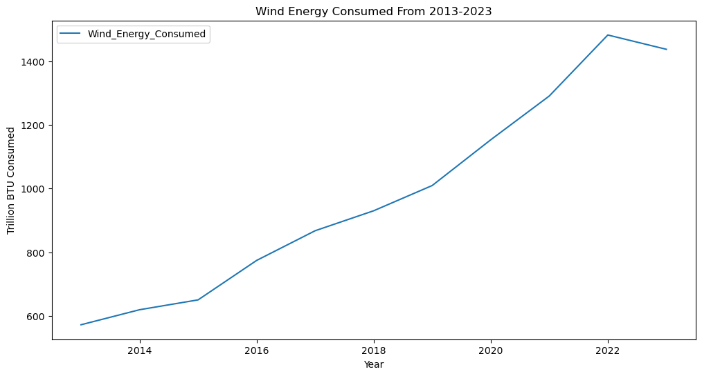
Overall U.S. Wind Consumption

Slide 12
Top three months of Wind consumption
Date | Amount of Energy Consumed | Units* | Energy Type
4/2022 | 157.522 | Trillion BTU | Wind Consumption
3/2023 | 148.708 | Trillion BTU | Wind Consumption
3/2022 | 146.82 | Trillion BTU | Wind Consumption
*British thermal units
**Data collection range from 2013 – 2023

Slide 13
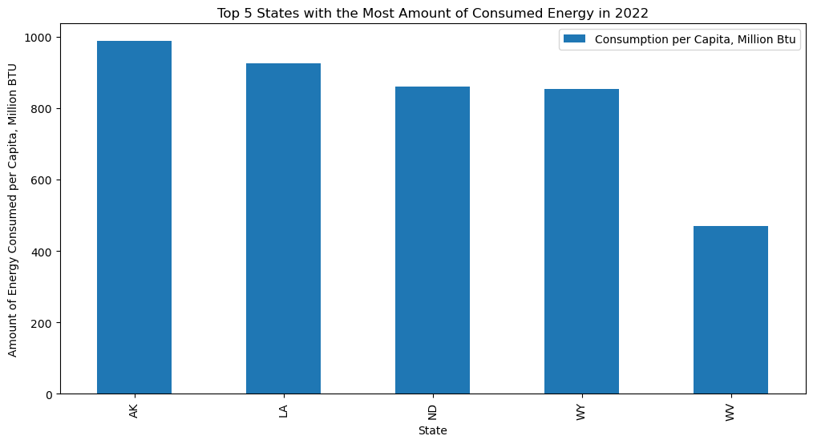
States with the most consumed energy
*Year: 2022

Slide 14
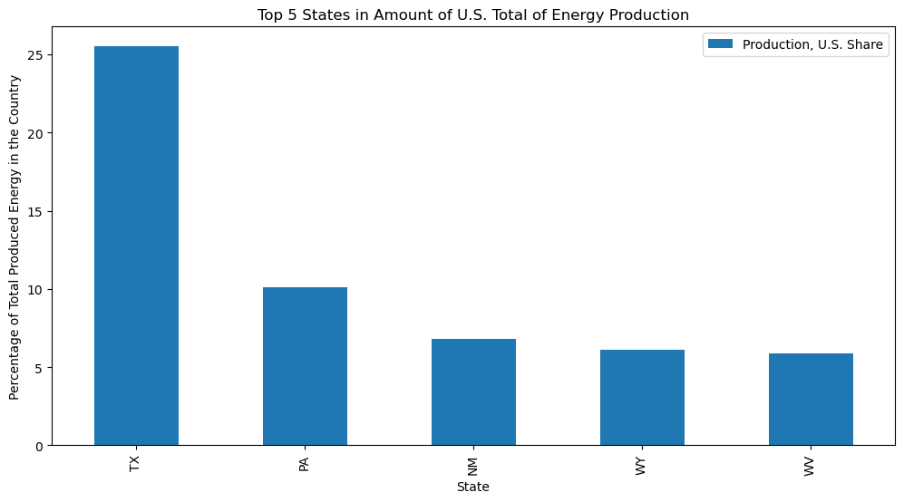
States with the highest percentage of overall energy production in the u.s.
*Year: 2022

Slide 15
Tennessee Compared to other leading states
Texas
2022: Ranked first in production of wind energy
Accounts for 25% of US wind energy production
Washington
2022: Highest production rank for hydroelectric energy
Made up 31% of total hydro energy
California
2022: Highest production rank for Solar
Produced 26% of total solar energy
Tennessee
Solar:
Hydroelectric:
Wind:

Slide 16
Tennessee compared to renewable energy leaders in 2022
State | Production, U.S. Share* | Production Rank | Consumption per Capita, Million BTU | Consumption per Capita, Rank | Expenditures per Capita, Dollars | Expenditures per Capita, Rank
TN | 0.5 | 30 | 298 | 22 | 5158 | 25
TX | 25.5 | 1 | 459 | 6 | 6748 | 6
WA | 0.5 | 28 | 202 | 42 | 4382 | 44
CA | 1.6 | 12 | 176 | 49 | 5123 | 26
*Percentage of overall production

Slide 17
Sources
eia.gov
seia.org
energy.ca.gov

Slide 18
Thank you for your time and attention, are there Any questions?

