Slide 1
A Deeper Look at Education Platform Opportunities for Stack Overflow
Danylo Sovgut
Kirthi Rao
Rebecca Guo
Hunter Guo
Kurt Fischer

Slide 2

Assess the potential for Stack Overflow to expand into online education
By leveraging insights from the 2024 Stack Overflow Developer Survey, we aim to analyze user engagement, demographic trends, and learning preferences to recommend a targeted online learning platform for new and existing Stack Overflow users.
This platform will provide practical, community-vetted coding courses while generating a new revenue stream and further monetizing Stack Overflow’s existing intellectual property and user base.

Slide 3

Executive Summary: Data Pipeline for Stack Overflow insights
End-to-End Data Pipeline Overview of our data pipeline, tools, and automation.
Data Preparation Overview of our data preparation .
Database Integration Created tables and relationships to manage many-to-many connections (languages, platforms, databases).
Live Dashboards Connected MySQL to Tableau to generate dynamic dashboards with interactive filters.
Insights Diving into insights from our data.

Slide 4
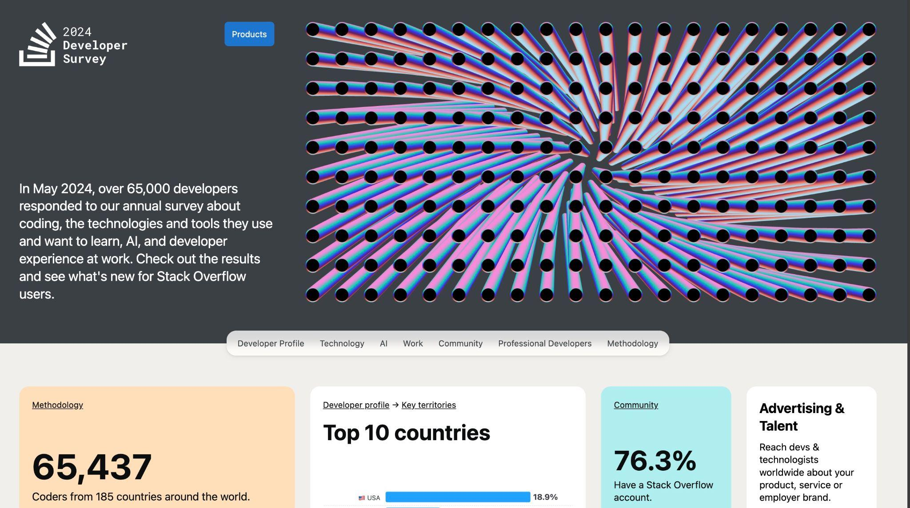
Meet our Dataset: 2024 Stack Overflow Developer Survey

Slide 5


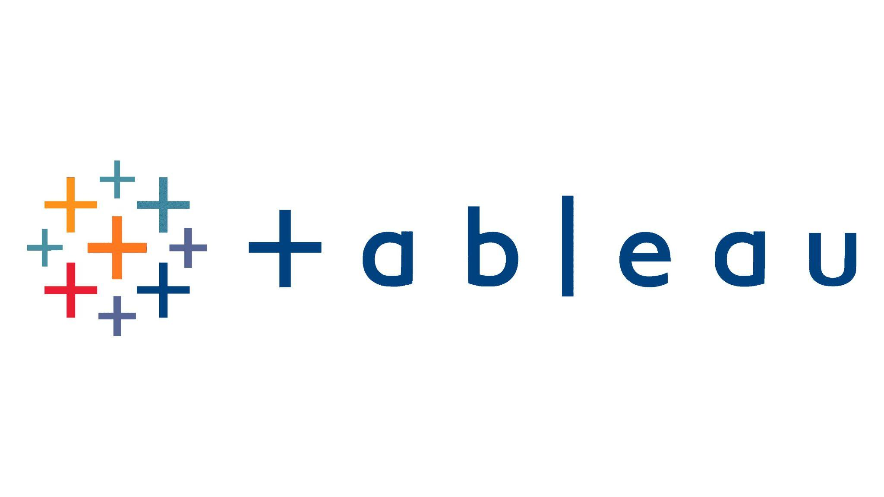

End-to-End Data Pipeline Overview (See V3)
Raw Data (Excel/csv)
Python
Extract,
Transform,
Load into MySQL
MySQL
Clean,
Normalize,
Connect to Tableau
Tableau Visualize and Dashboards

Slide 6
Why We Chose ETL Process as Our Methodology
Extract data from the 2024 Stack Overflow Developer Survey.
Transform the data by cleaning, normalizing, and preparing it using MySQL and Python.
Load the transformed data into MySQL for storage and analysis.
Why ETL? The ETL process ensures that raw data is systematically cleaned, transformed, and stored in a structured way, making it ready for efficient analysis and visualization.

Slide 7
Why We Chose MySQL, Python, and Tableau as our tools:
MySQL: Used for data cleaning, normalization, and creating relational tables. Ensures data integrity with Primary Keys and Foreign Keys. Supports complex queries for analysis.
Python: Automated ETL tasks, one-hot encoding, and database interaction using Pandas and SQLAlchemy. Simplifies data transformations and repetitive tasks.
Tableau: Created interactive dashboards and visualizations for insights. Live connection to MySQL allows for real-time data analysis and dynamic filtering.
These tools were chosen for their ability to handle structured data efficiently, automate tasks, and provide dynamic visualizations, ensuring a seamless end-to-end workflow.
Notes:
Apache Airflow
What It Is:
Apache Airflow is an open-source tool for automating, scheduling, and monitoring workflows (like ETL pipelines).
It allows you to create and manage complex data workflows with a clear visual representation.
How It Works:
You write Python scripts that define your ETL tasks (e.g., extracting data, cleaning, loading into a database).
Airflow executes these tasks on a schedule (e.g., daily, weekly) and tracks their status.
Benefits:
Scalability: Handles large and complex workflows.
Monitoring: Provides logs and dashboards to monitor job status.
Error Handling: Automatically retries tasks if they fail.
Example:
Schedule your ETL pipeline to run every night at midnight to refresh data in the MySQL database and update the dashboards

Slide 8
Automating the ETL Pipeline and Dashboards
Python Scripts: Automated the ETL process, including data extraction, cleaning, normalization, and loading into MySQL. Handled one-hot encoding for multi-choice fields.
Live Connection in Tableau: Direct connection to the MySQL database, allowing dashboards to display real-time data.
Future Recommendations: Use Apache Airflow or cron jobs to schedule the ETL pipeline (f.e. yearly for this survey). Database can be automatically updated with new data.
Reason for Automation: Reduces manual effort and minimizes errors. Ensures the pipeline is scalable, reproducible, and provides real-time insights through Tableau’s live connection.
Notes:
Apache Airflow
What It Is:
Apache Airflow is an open-source tool for automating, scheduling, and monitoring workflows (like ETL pipelines).
It allows you to create and manage complex data workflows with a clear visual representation.
How It Works:
You write Python scripts that define your ETL tasks (e.g., extracting data, cleaning, loading into a database).
Airflow executes these tasks on a schedule (e.g., daily, weekly) and tracks their status.
Benefits:
Scalability: Handles large and complex workflows.
Monitoring: Provides logs and dashboards to monitor job status.
Error Handling: Automatically retries tasks if they fail.
Example:
Schedule your ETL pipeline to run every night at midnight to refresh data in the MySQL database and update the dashboards

Slide 9
Why We Chose a Relational Data Model
Structured Data: The survey data is highly structured with well-defined entities and relationships (e.g., respondents, coding experience, desired skills).
Normalization: Supports 3rd Normal Form (3NF) to reduce redundancy and maintain data integrity.
Complex Queries: Enables efficient execution of joins and analytical queries across multiple tables (e.g., identifying user preferences for languages, platforms, and databases).
Scalability: MySQL can efficiently handle the 30,000 cleaned rows while maintaining performance.
Integration: Seamlessly integrates with Python (SQLAlchemy) for ETL processes and Tableau for visualization.
Data Integrity: Enforces Primary Keys (PKs) and Foreign Keys (FKs) to maintain consistency and accuracy.
Ease of Maintenance: A relational model is straightforward to update, maintain, and expand as the dataset evolves.

Slide 10
Denormalization Considerations: Why We Chose to Stay Normalized
Manageable Dataset: The dataset size of 30,000 rows did not create performance issues.
Read-Heavy Operations: The focus was on analysis and visualization, which works well with normalized data.
Data Integrity: Normalization ensured consistency and reduced redundancy.
Complex Queries Not Needed: The queries were efficient with the normalized structure and did not require optimization through denormalization.

Slide 11
Data Preparation: Profiling, Cleaning, and Standardization
Column Reduction: Removed 96 irrelevant columns, keeping only 18 columns crucial for analysis
Missing Data Handling: Dropped rows with excessive missing data, reducing the dataset to 30,000 high-quality rows to ensure meaningful analysis.
Replacing 'NA' Values: Replaced all 'NA' values with NULLs to prevent ETL errors and ensure consistency.
Multi-Choice Columns: One-hot encoded multi-choice fields for: Languages (LanguageWantToWorkWith), Platforms (PlatformWantToWorkWith), Databases (DatabaseWantToWorkWith). Focused on the top 5 most mentioned items in each category.
Employment Data Simplification: Simplified employment categories to: Employed, Student, Retired, Looking for Work for assessing purchasing power.
Learning Methods Simplification: Converted learning methods to Online or Not Online based on survey responses.
Standardization: Standardized column names by removing spaces, converting to lowercase, and replacing spaces with underscores.
Notes:
Certain columns, such as "LanguageWantToWorkWith," "DatabaseWantToWorkWith," and "PlatformWantToWorkWith," allowed respondents to select multiple options. This resulted in messy, comma-separated values that were challenging to work with. To support our business analysis, we extracted the top 5 most frequently mentioned items from each of these columns and created new columns for each. This approach, known as one-hot encoding, allowed us to reorganize the data into a cleaner format, making it easier to analyze. Each newly created column, such as "language_skill_python," represents whether a respondent mentioned a particular item (1 for yes, 0 for no). The same method was applied to the "DatabaseWantToWorkWith" and "PlatformWantToWorkWith" columns.

Slide 12
Conceptual Data Model: Overview of our Data Model
Respondents
Respondent
Platform Usage
Nore
Respondent
(Basic Info)
Respondent
Coding Experience
Many to Many
Many to Many
Many to Many
Desired
Platform Skills
Desired
Database Skills
Desired
Language Skills

Slide 13
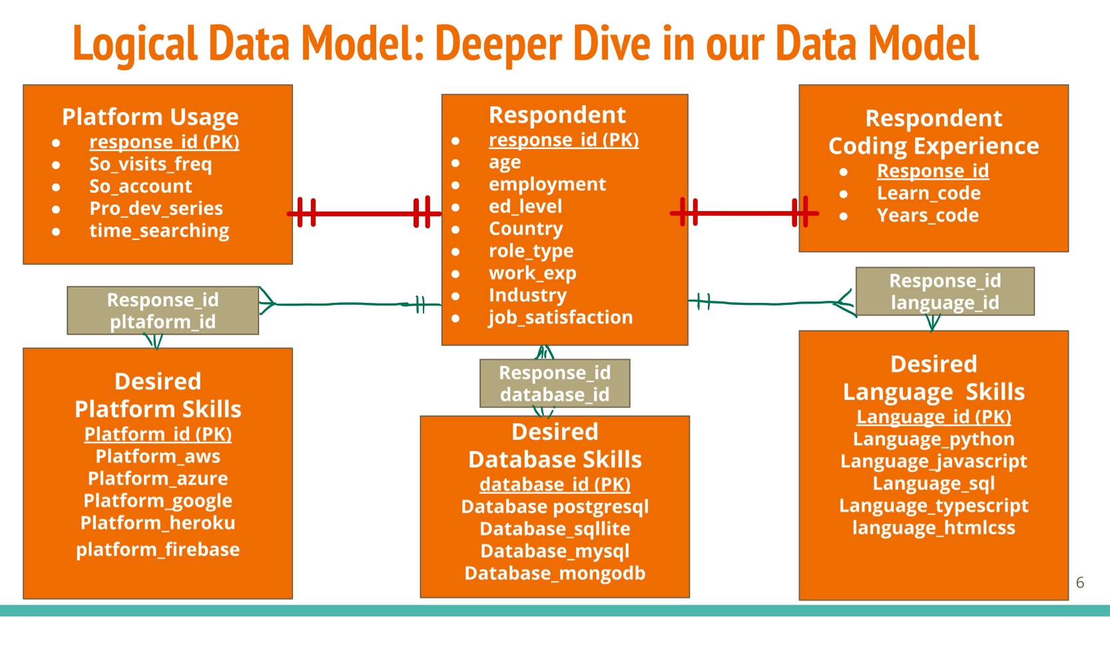

Slide 14
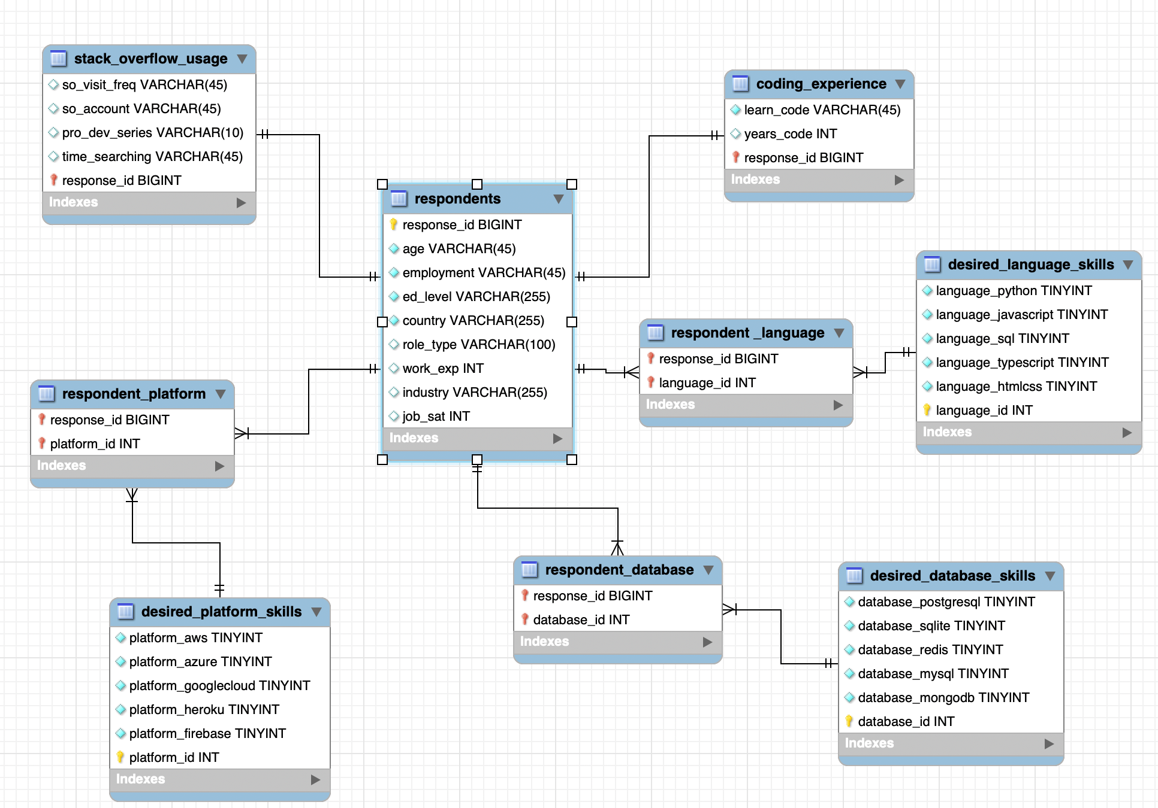
Physical Model: Presenting our Full Data Model

Slide 15
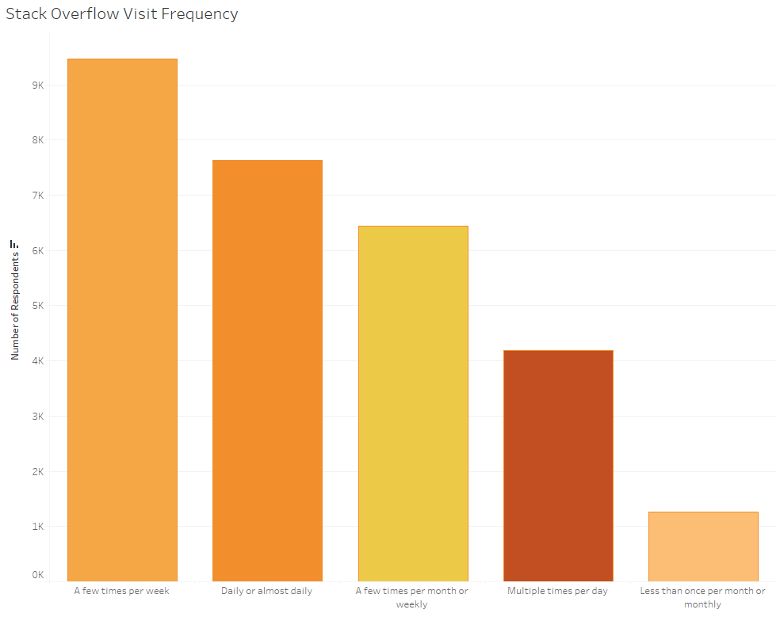
Visitor Frequency and Usage Patterns
Most users visit Stack Overflow daily or weekly.
High engagement indicates a consistent need for learning resources.
Integrating educational content into the platform could enhance user retention.

Slide 16
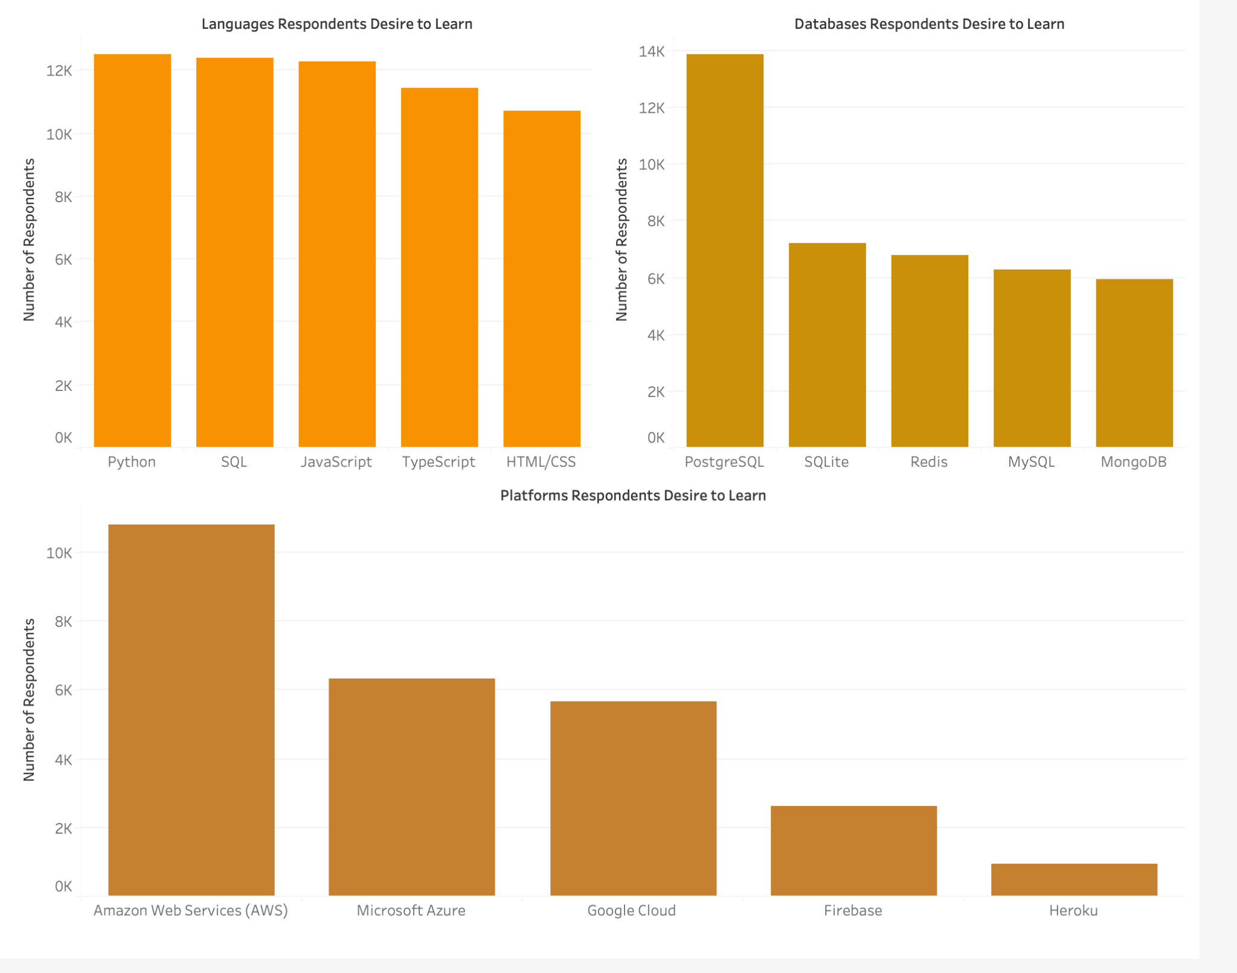
Top Desired Languages, Platforms, and Databases
Potential languages taught should start with Python, SQL, JavaScript.
Potential Database taught should be in PostgreSQL.
Potential platforms should be AWS.

Slide 17
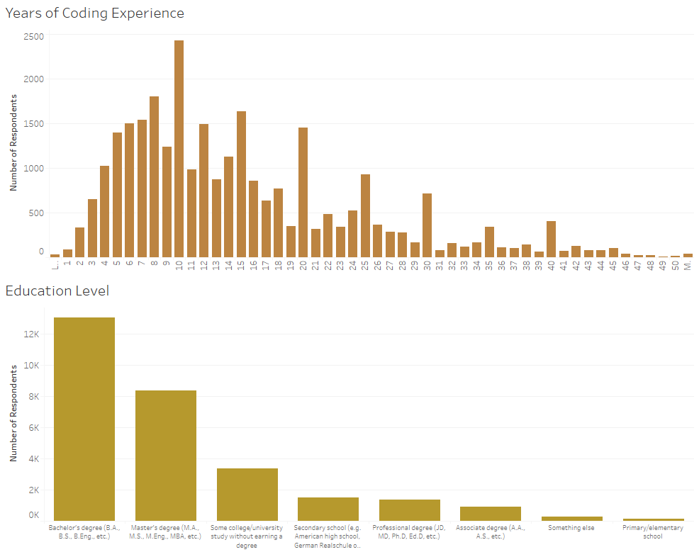
Years of Coding Experience and Education Level
The majority of users have been coding for more than 2 years.
Additionally, a majority of users have a Bachelor’s degree.
This demographic represents a key target audience of experienced coders.
Focus on intermediate-level courses that support career development and skill advancement.

Slide 18
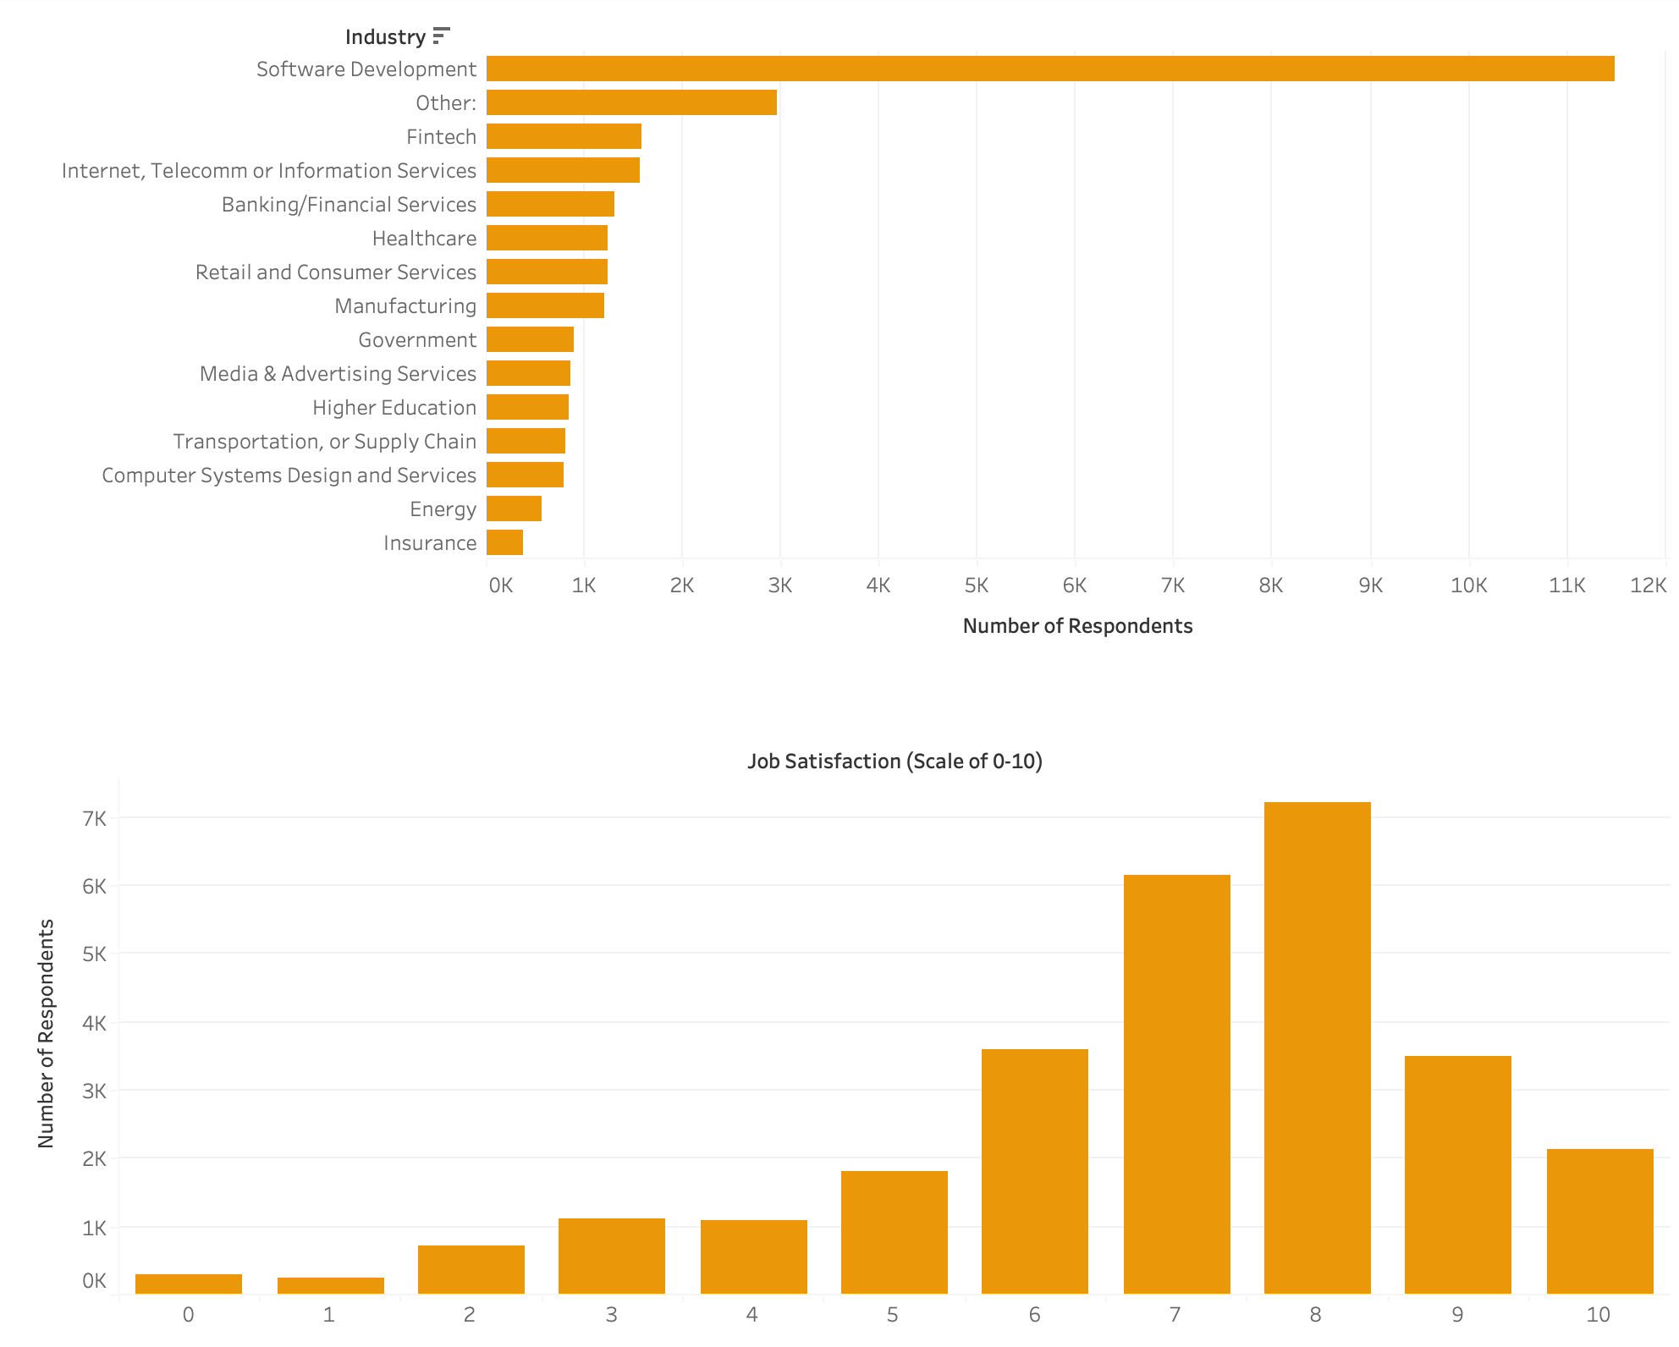
Industry Trends and Job Satisfaction
A large percentage of users work in software development, IT, and tech-related industries.
People also seem satisfied with their jobs, indicating continued learning is important.
Offering advanced technical courses tailored to this industry can meet user demand and drive engagement.

Slide 19
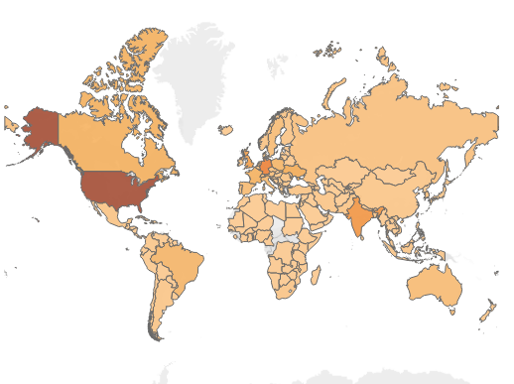

Global Distribution: Heavy focus on North America

Slide 20
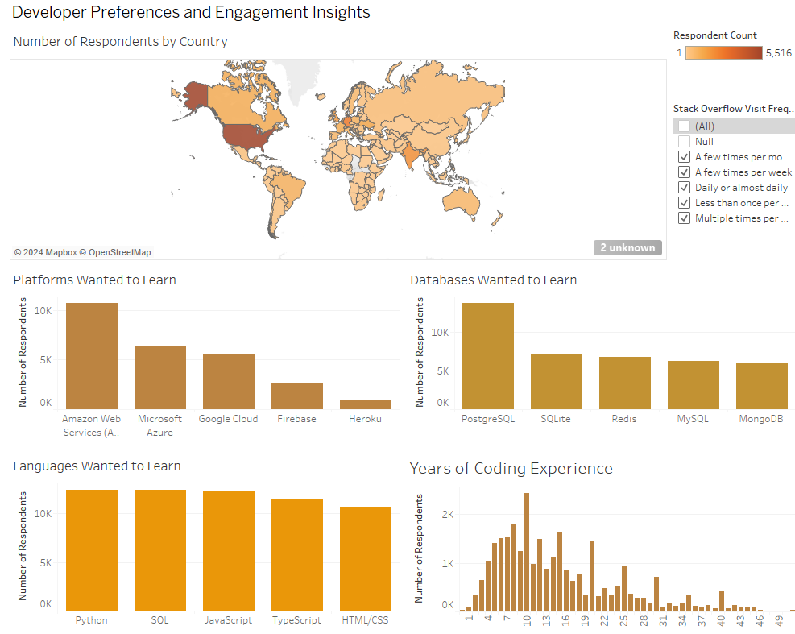
Interactive Dashboard Demo

Slide 21
Lessons Learned
Loading entire original dataset to MySQL will avoid issues and make ETL process much easier than loading separate normalized datasets to MySQL
Including separate .sql scripts in one master Python script will simplify automation and help with file management
When dealing with a complex dataset, doing feature engineering (One-Hot Encoding, Grouped Categories, etc.) will simplify dataset values
Having bridge tables between tables with many-to-many relationships is crucial for designing purpose

Slide 22
Recommendations
Host the database online to ensure consistency across all machines and enable real-time collaboration, eliminating local dependency issues.
Automate the data pipeline further with Apache Airflow or cron jobs to schedule ETL tasks, ensuring the next year’s survey data is automatically processed and loaded into the database.
Maintain a history table or versioned database schema to store previous years' survey data.
Incorporate monitoring tools to track pipeline performance and quickly identify bottlenecks (Track ETL process, log errors, monitor CPU usage, identify bottlenecks etc).

Slide 23
Conclusions
This project analyzed Stack Overflow's 2024 Developer Survey to explore its potential expansion into online education and we found:
High user engagement, strong language preferences for Python & SQL, and high concentration of website visitors being in the US.
We cleaned and transformed survey data, creating a normalized MySQL database with six interrelated tables and a star schema
Stack Overflow’s active, professional user base shows a strong preference for online learning. Offering targeted courses in high-demand skills like Python and cloud platforms presents a clear opportunity to boost engagement and expand revenue.

Slide 24
Appendix

Slide 25
Logical Data Model: Deeper Dive in our Data Model
Platform Usage
response_id (PK)
So_visits_freq
So_account
Pro_dev_series
time_searching
Respondent
response_id (PK)
age
employment
ed_level
Country
role_type
work_exp
Industry
job_satisfaction
Respondent
Coding Experience
Response_id
Learn_code
Years_code
Nore
Response_id
language_id
Response_id
pltaform_id
Desired
Language Skills
Language_id (PK)
Language_python
Language_javascript
Language_sql
Language_typescript
language_htmlcss
Desired
Platform Skills
Platform_id (PK)
Platform_aws
Platform_azure
Platform_google
Platform_heroku
platform_firebase
Response_id
database_id
Desired
Database Skills
database_id (PK)
Database postgresql
Database_sqllite
Database_mysql
Database_mongodb

