Slide 1
Week1
From: Haoxuan Ma

Slide 2
What to do

Slide 3
A Good Feature Extractor
What to do
Background
Mask
Instance
Visual Prompt
…
Notes:
Before the topic, let’s have a view of the background. GPT is a kind of language model, and language model is used in natural language processing to perform a variety of tasks like text classification , machine translation and so on.
According to the training objectives, pre-trained language models can be divided into three categories
Unidirectional Language Model
Bidirectional Language Model
And Hybrid Language Model

Slide 4
Naïve idea
What to do
Crop the image using the Mask, then pass it through the model for embedding
Segmentation
Extractor
Instance
Embedding
Notes:
Before the topic, let’s have a view of the background. GPT is a kind of language model, and language model is used in natural language processing to perform a variety of tasks like text classification , machine translation and so on.
According to the training objectives, pre-trained language models can be divided into three categories
Unidirectional Language Model
Bidirectional Language Model
And Hybrid Language Model

Slide 5
Naïve idea
What to do
Crop the image using the Mask, then pass it through the model for embedding
Question 1
Incomplete Mask areas can result in missed object parts
Segmentation
Extractor
Instance
Embedding
Notes:
Before the topic, let’s have a view of the background. GPT is a kind of language model, and language model is used in natural language processing to perform a variety of tasks like text classification , machine translation and so on.
According to the training objectives, pre-trained language models can be divided into three categories
Unidirectional Language Model
Bidirectional Language Model
And Hybrid Language Model

Slide 6
Naïve idea
What to do
Crop the image using the Mask, then pass it through the model for embedding
Question 1
Incomplete Mask areas can result in missed object parts
Question 2
Missing background context can cause the model to overfocus on local textures
Segmentation
Extractor
Instance
Embedding
Notes:
Before the topic, let’s have a view of the background. GPT is a kind of language model, and language model is used in natural language processing to perform a variety of tasks like text classification , machine translation and so on.
According to the training objectives, pre-trained language models can be divided into three categories
Unidirectional Language Model
Bidirectional Language Model
And Hybrid Language Model

Slide 7
Exsit ideas
What to do
Drawing a red circle around the Masked object and passing the image through CLIP to obtain an embedding
Applying Gaussian blur to the background helps focus the model on the Masked area
Mask pooling, which applies average pooling only to the Masked features, can lead to background features overshadowing the Masked area
Notes:
Before the topic, let’s have a view of the background. GPT is a kind of language model, and language model is used in natural language processing to perform a variety of tasks like text classification , machine translation and so on.
According to the training objectives, pre-trained language models can be divided into three categories
Unidirectional Language Model
Bidirectional Language Model
And Hybrid Language Model

Slide 8
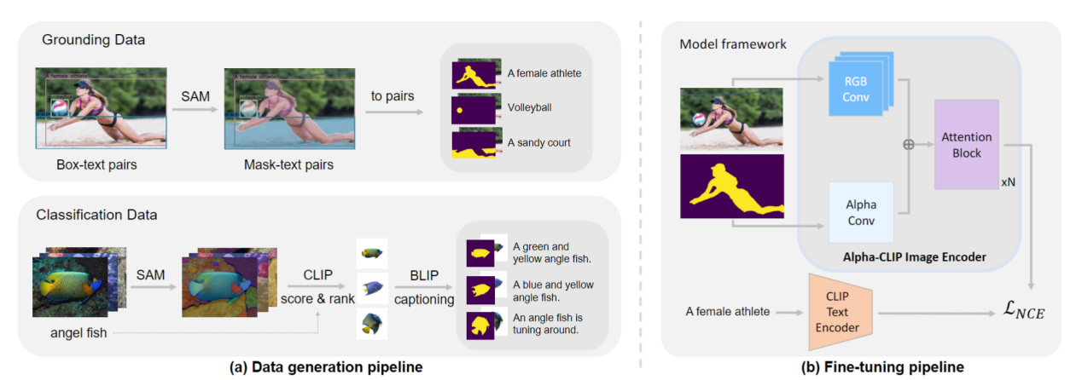
Exsit ideas
What to do
Alpha-CLIP (CVPR2024)
Notes:
Before the topic, let’s have a view of the background. GPT is a kind of language model, and language model is used in natural language processing to perform a variety of tasks like text classification , machine translation and so on.
According to the training objectives, pre-trained language models can be divided into three categories
Unidirectional Language Model
Bidirectional Language Model
And Hybrid Language Model

Slide 9
A Good Feature Extractor
What to do
Data construction
A Good Feature Extractor
Architecture
Application tasks
Notes:
Before the topic, let’s have a view of the background. GPT is a kind of language model, and language model is used in natural language processing to perform a variety of tasks like text classification , machine translation and so on.
According to the training objectives, pre-trained language models can be divided into three categories
Unidirectional Language Model
Bidirectional Language Model
And Hybrid Language Model

Slide 10
Training Architecture

Slide 11
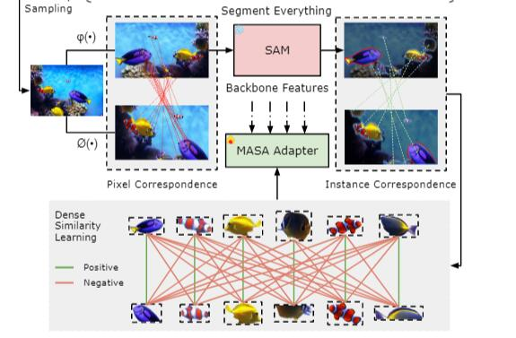
Matching Anything by Segmenting Anything (CVPR2024)
Architecture
Notes:
Before the topic, let’s have a view of the background. GPT is a kind of language model, and language model is used in natural language processing to perform a variety of tasks like text classification , machine translation and so on.
According to the training objectives, pre-trained language models can be divided into three categories
Unidirectional Language Model
Bidirectional Language Model
And Hybrid Language Model

Slide 12
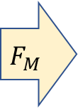
Our architecture
Architecture
Image 1
Image 1
$$F_{M}$$
Pseudo word
Mask
Mask 1
Template [A photo of …]
Pseudo word
Mask 2
Transform
Mask matching
Referring Image Segmentation
/
GradCAM(CLIP as RNN)
(Frozen)
Original Image
Image 2
Notes:
Before the topic, let’s have a view of the background. GPT is a kind of language model, and language model is used in natural language processing to perform a variety of tasks like text classification , machine translation and so on.
According to the training objectives, pre-trained language models can be divided into three categories
Unidirectional Language Model
Bidirectional Language Model
And Hybrid Language Model

Slide 13
Our architecture
Architecture
Image 1
Training part
Image 1
$$F_{M}$$
Pseudo word
Mask
Mask 1
Template [A photo of …]
Pseudo word
Mask 2
Transform
Mask matching
Referring Image Segmentation
/
GradCAM(CLIP as RNN)
(Frozen)
Original Image
Image 2
Notes:
Before the topic, let’s have a view of the background. GPT is a kind of language model, and language model is used in natural language processing to perform a variety of tasks like text classification , machine translation and so on.
According to the training objectives, pre-trained language models can be divided into three categories
Unidirectional Language Model
Bidirectional Language Model
And Hybrid Language Model

Slide 14
Dataset
Architecture
GT from images with mask:
——Difficulty from transform images
5 frames apart By SAM2
Notes:
Before the topic, let’s have a view of the background. GPT is a kind of language model, and language model is used in natural language processing to perform a variety of tasks like text classification , machine translation and so on.
According to the training objectives, pre-trained language models can be divided into three categories
Unidirectional Language Model
Bidirectional Language Model
And Hybrid Language Model

Slide 15
How to train？
Architecture
Image 1
Training part
Image 1
$$F_{M}$$
Pseudo word
Mask
Mask 1
Template [A photo of …]
Pseudo word
Mask 2
Transform
Mask matching
Referring Image Segmentation
/
GradCAM(CLIP as RNN)
(Frozen)
Original Image
Image 2
Notes:
Before the topic, let’s have a view of the background. GPT is a kind of language model, and language model is used in natural language processing to perform a variety of tasks like text classification , machine translation and so on.
According to the training objectives, pre-trained language models can be divided into three categories
Unidirectional Language Model
Bidirectional Language Model
And Hybrid Language Model

Slide 16
How to train？
Architecture
Loss 1 —— Supervision
Image1+Mask1 to a pseudo word token, then compare the Mask' segmented by RIS on Image2 with the real Mask1 for supervision
performance in the latter part
sensitivity to variations in the input text
Notes:
Before the topic, let’s have a view of the background. GPT is a kind of language model, and language model is used in natural language processing to perform a variety of tasks like text classification , machine translation and so on.
According to the training objectives, pre-trained language models can be divided into three categories
Unidirectional Language Model
Bidirectional Language Model
And Hybrid Language Model

Slide 17
How to train？
Architecture
Image 1
Image 1
$$F_{M}$$
Mask 1
Pseudo word
Mask
Mask 1
Template [A photo of …]
Pseudo word
Supervision
Mask 2
Transform
Mask 1
Referring Image Segmentation
/
GradCAM(CLIP as RNN)
(Frozen)
Mask matching
Original Image
Image 2
Notes:
Before the topic, let’s have a view of the background. GPT is a kind of language model, and language model is used in natural language processing to perform a variety of tasks like text classification , machine translation and so on.
According to the training objectives, pre-trained language models can be divided into three categories
Unidirectional Language Model
Bidirectional Language Model
And Hybrid Language Model

Slide 18
How to train？
Architecture
Loss 2 —— Contrastive Learning
Pseudo token of Image1+Mask1 —— Pseudo token of Image2+Mask1
Pseudo token of Image2+Mask2
Pseudo token of Image2+Mask3
Notes:
Before the topic, let’s have a view of the background. GPT is a kind of language model, and language model is used in natural language processing to perform a variety of tasks like text classification , machine translation and so on.
According to the training objectives, pre-trained language models can be divided into three categories
Unidirectional Language Model
Bidirectional Language Model
And Hybrid Language Model

Slide 19
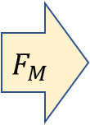
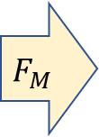

How to train？
Architecture
Image 2
$$F_{M}$$
Mask 1
Pseudo token
Image 1
$$F_{M}$$
Mask 1
Pseudo token
Image 2
$$F_{M}$$
Pseudo token
Mask 2
Notes:
Before the topic, let’s have a view of the background. GPT is a kind of language model, and language model is used in natural language processing to perform a variety of tasks like text classification , machine translation and so on.
According to the training objectives, pre-trained language models can be divided into three categories
Unidirectional Language Model
Bidirectional Language Model
And Hybrid Language Model

Slide 20
Task

Slide 21
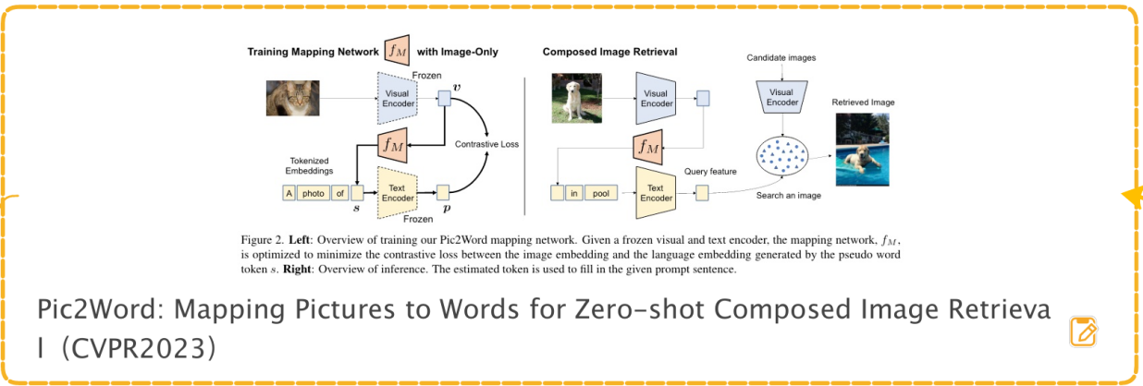
Pic2Word (CVPR2023)
Task
ZS-CIR (Zero-shot Composed Image Retrieval
Notes:
Before the topic, let’s have a view of the background. GPT is a kind of language model, and language model is used in natural language processing to perform a variety of tasks like text classification , machine translation and so on.
According to the training objectives, pre-trained language models can be divided into three categories
Unidirectional Language Model
Bidirectional Language Model
And Hybrid Language Model

Slide 22
Composed Image Retrieval (CIR)
Task
CIR
Image + Text —— Retrieval —— Image
Our Task
Image + Text + Visual Prompt (Mask, Point) —— Retrieval —— Image
Notes:
Before the topic, let’s have a view of the background. GPT is a kind of language model, and language model is used in natural language processing to perform a variety of tasks like text classification , machine translation and so on.
According to the training objectives, pre-trained language models can be divided into three categories
Unidirectional Language Model
Bidirectional Language Model
And Hybrid Language Model

Slide 23
Composed Image Retrieval (CIR)
Task
A Good Feature Extractor —— Good Masks
A New Task — Image + Text —— Mask
Notes:
Before the topic, let’s have a view of the background. GPT is a kind of language model, and language model is used in natural language processing to perform a variety of tasks like text classification , machine translation and so on.
According to the training objectives, pre-trained language models can be divided into three categories
Unidirectional Language Model
Bidirectional Language Model
And Hybrid Language Model

Slide 24
Composed Image Retrieval (CIR)
Task
Two Stage CIR
Stage one: Image + Text —— Mask
Stage two: Mask + Image —— Feature Extractor —— PIC2Word (ZS-CIR)
Notes:
Before the topic, let’s have a view of the background. GPT is a kind of language model, and language model is used in natural language processing to perform a variety of tasks like text classification , machine translation and so on.
According to the training objectives, pre-trained language models can be divided into three categories
Unidirectional Language Model
Bidirectional Language Model
And Hybrid Language Model

Slide 25
visual-prompt-added image
Task
Notes:
Before the topic, let’s have a view of the background. GPT is a kind of language model, and language model is used in natural language processing to perform a variety of tasks like text classification , machine translation and so on.
According to the training objectives, pre-trained language models can be divided into three categories
Unidirectional Language Model
Bidirectional Language Model
And Hybrid Language Model

