Slide 1
Fake Product Identification System Using Blockchain
Presented by:
Isha Kandel [21070514]
Dipen Raut [21070510]
Kshitiz Gupta[21070516]
Utsav Wagle [21070545]

Slide 2
CONTENT
01
INTRODUCTION
06
CASE STUDY
PROBLEM OF STATEMENT
02
07
METHODOLOGY
PROJECT OBJECTIVES
03
EXPECTED OUTCOME
08
TIME AND COST ESTIMATION
04
APPLICATIONS
09
05
LIMITATIONS
10
REFERENCES

Slide 3
INTRODUCTION
The global market faces challenges with counterfeit products, affecting reputations and consumer safety.
A
Blockchain technology offers a secure and transparent framework for product authentication.
B
FPISUB

Slide 4
Problem Statement
Authentication Gaps
Lack of efficient authentication methods in supply chains hinders accurate verification of product authenticity, leading to safety and economic risks.
Counterfeit Problems
Existing methods can't fully stop fake products, hurting trust in brands and legit manufacturers.
Detection Inefficiencies
The current ways of finding fake stuff aren't great; they need special tools and take too much time. It's tricky for people who just want an easy way to know if something is real.
Supply Chain Issues
The way products move lacks strong checks, making it easier for fake goods to spread, risking safety and brand trust.

Slide 5
Project Objectives
Enhanced Authentication
Efficient Supply Chain Operations
Consumer Safety Assurance
Develop anti-counterfeiting robust measures to ensure secure product authentication and protect consumers from counterfeit goods.
Implement technologies that enhance transparency and efficiency in supply chain operations, addressing challenges related to product tracking, verification, and data interoperability.
Prioritize the development of systems that not only protect brand reputation but also assure consumer safety by preventing the circulation of counterfeit products in the market.

Slide 6
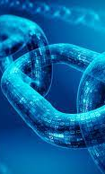
Applications
Luxury Good Sector
Utilize blockchain to enhance trust in the luxury goods industry by providing transparent information on product quality and authenticity, thus preventing counterfeiting.
Food Industry
Deploy blockchain for food safety and traceability, addressing challenges in the food supply chain related to waste reduction, product freshness, and consumer confidence.
General Consumer Goods:
Extend the application of anti-counterfeiting measures to various consumer goods, including electronics, ensuring customers receive original and authentic products.
Pharmaceutical Industry
Implement blockchain solutions to track pharmaceuticals throughout the supply chain, ensuring customers receive authentic products and preventing fraudulent activities.

Slide 7
Limitations
Technology Integration Challenges
The integration of advanced anti-counterfeiting technologies into existing systems may pose challenges, requiring businesses to invest in infrastructure upgrades and employee training.
High Initial Costs
Implementing robust anti-counterfeiting measures, especially those involving blockchain and advanced tracking technologies, may incur high initial costs, impacting the adoption rate among smaller businesses.
Privacy Concerns
The use of technologies like blockchain may raise privacy concerns related to the collection and sharing of sensitive supply chain data, necessitating careful consideration of data protection measures.
Resistance to Change
Resistance from traditional supply chain stakeholders to adopt new technologies and methodologies may slow down the widespread implementation of effective anti-counterfeiting solutions.

Slide 8
CASE
STUDY
VeChainThor Success
VeChainThor used blockchain to stop fake products by making a clear record of where a product comes from. They added extra things like QR codes to prove if a product is real. Buyers can check this and feel certain about the product [1].
01
IBM Food Trust’s Solution
IBM Food Trust uses blockchain to track food and make sure it's safe. It gives clear details about where food comes from, stops waste, keeps it fresh, and gives confidence that the food is good to eat [4].
BlockVerify in Action
02
FPISUB
BlockVerify uses blockchain to follow things like medicine, diamonds, and electronics. It's a system to make sure buyers get what they pay for, especially when it comes to important things like medicine [2].
03
Ambrosus Innovations
Ambrosus deploys tags, tracers, and sensors to track products, ensuring integrity from production to consumer. Customized components like smart gel tags and sealed containers with sensors are tailored based on the product type [5].
Origin Trail’s Transparency
04
Origin Trail uses blockchain for companies to share supply chain details safely. It helps to prove if a product is real and follows the rules. It's used in farming, shipping, and medicine to stop fake products [3].
05

Slide 9
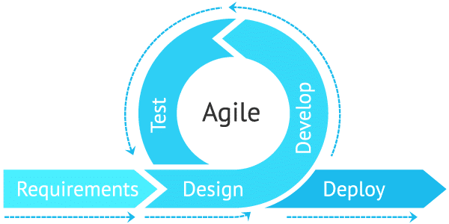
Methodology
Software Development Life Cycle

Slide 10
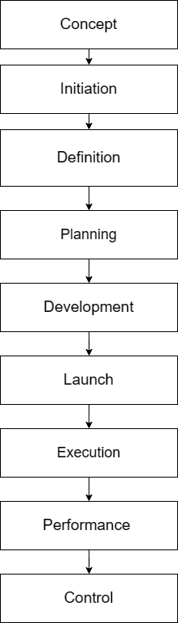
Methodology
Flow of Project

Slide 11
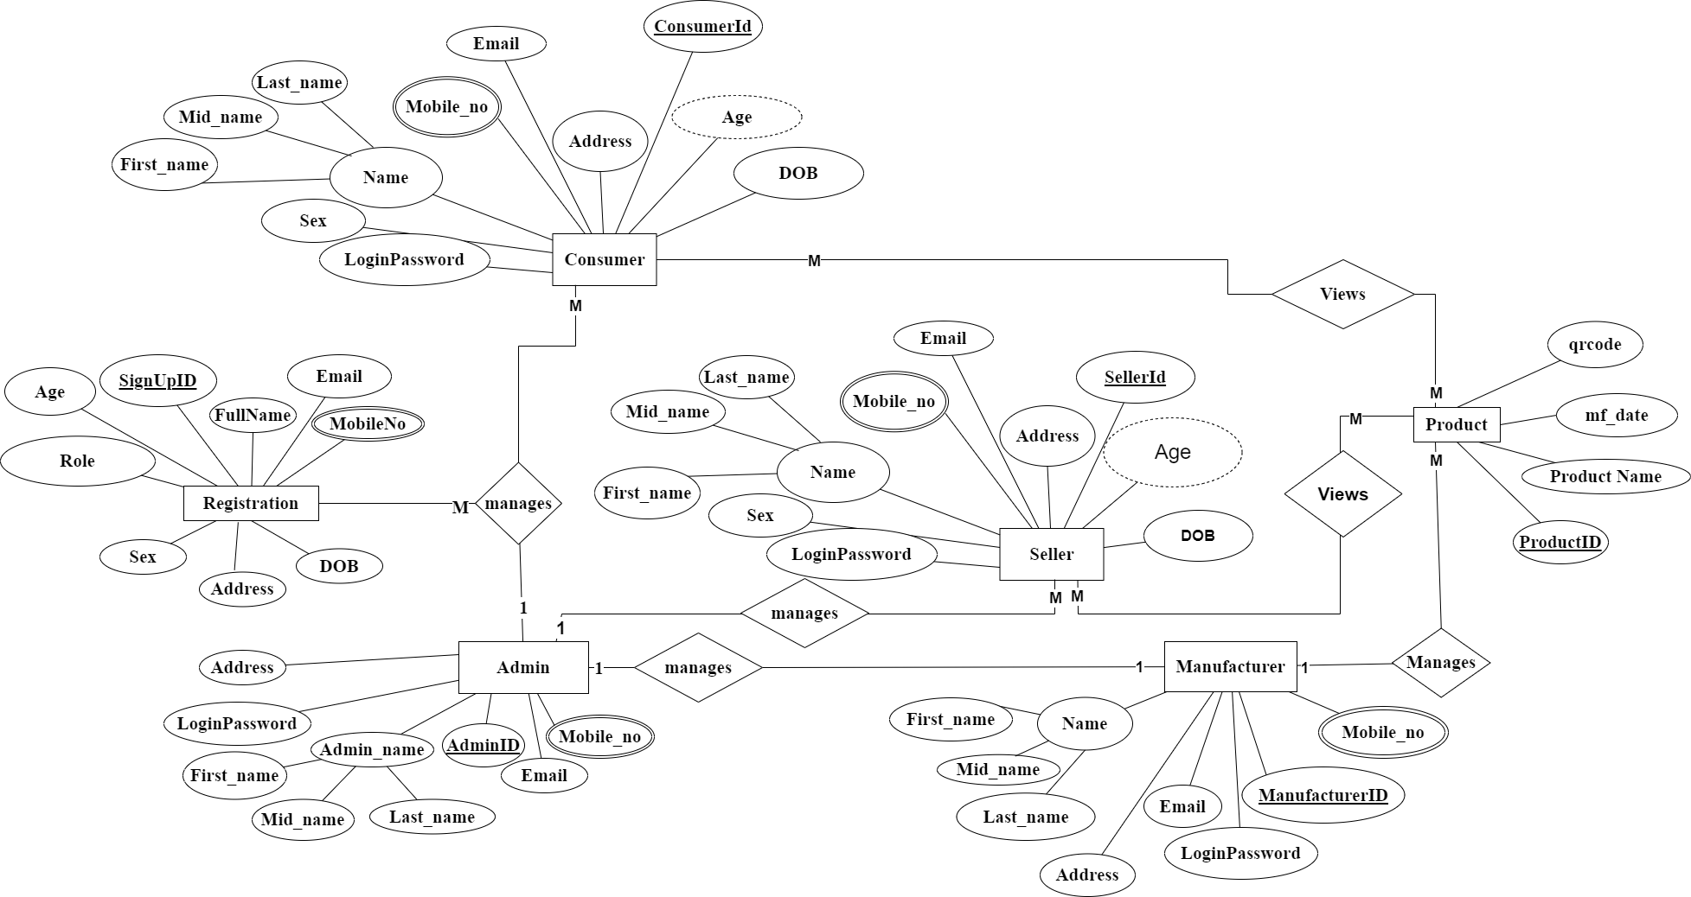
Entity Relationship Diagram
45%
96%
You can simply impress your audience and add a unique zing and appeal to your Presentations.
You can simply impress your audience and add a unique zing and appeal to your Presentations.

Slide 12




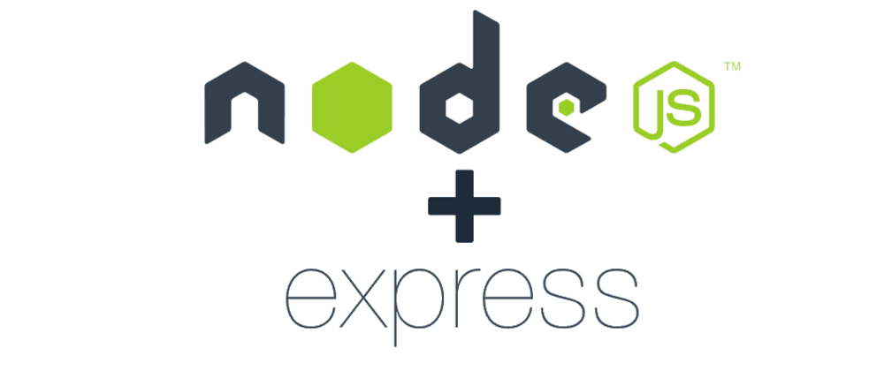



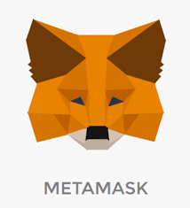

TOOLS AND TECHNOLOGIES USED

Slide 13
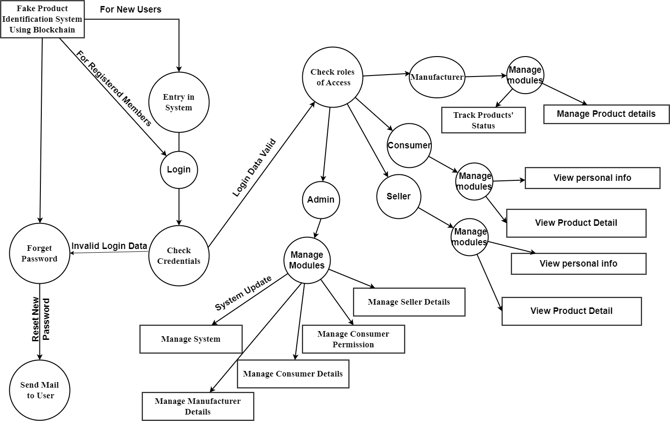
Data Flow Diagram
45%
96%
You can simply impress your audience and add a unique zing and appeal to your Presentations.
You can simply impress your audience and add a unique zing and appeal to your Presentations.

Slide 14
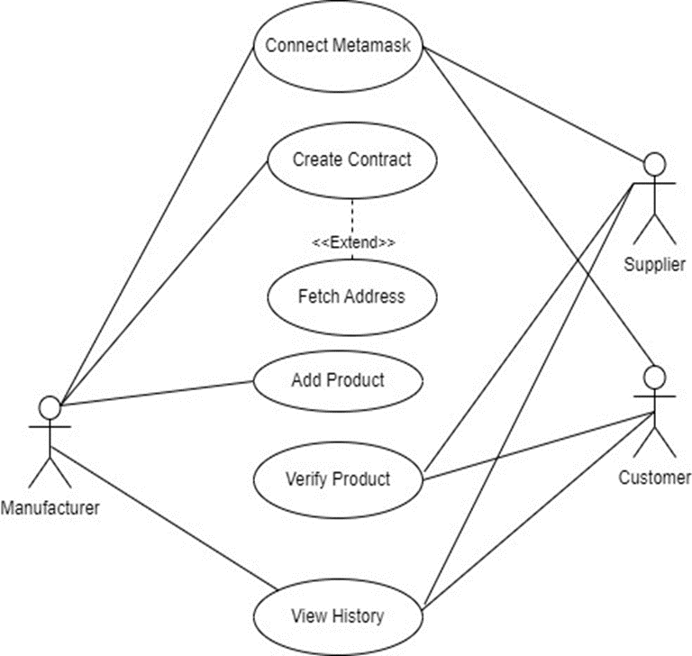
Use Case Diagram
45%
96%
You can simply impress your audience and add a unique zing and appeal to your Presentations.
You can simply impress your audience and add a unique zing and appeal to your Presentations.

Slide 15
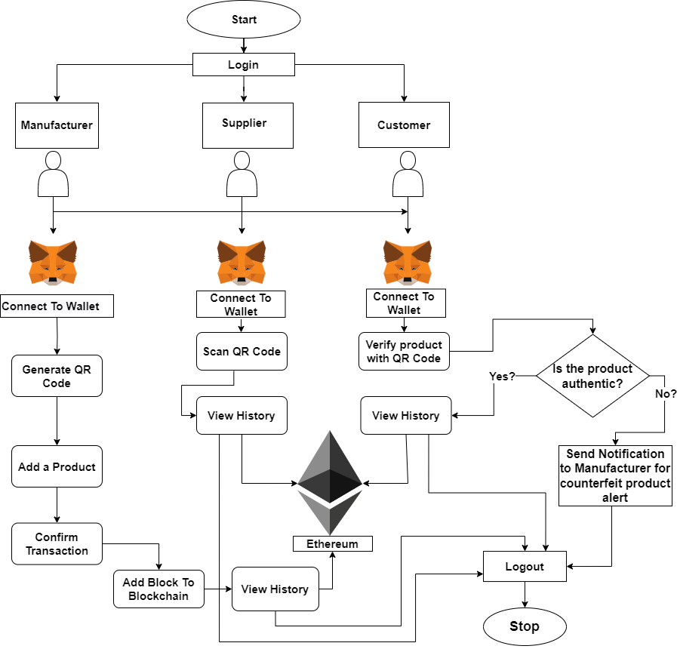
System Flow Diagram

Slide 16
Expected Outcomes
Boosted Confidence
Consumers and businesses gain confidence through improved product authentication.
Less Counterfeiting
Implementation aims to significantly reduce fake product circulation.
Safety and Trust
Empowering Stakeholders
Manufacturers' interests safeguarded, ensuring consumer safety and trust.
High-end brands, consumers, and others empowered with transparent information for a trustworthy marketplace.
Industry-wide Adoption
Success reliant on widespread industry adoption for a substantial reduction in counterfeit risks.

Slide 17
Time Estimation

Slide 18
Cost Estimation
Cost Element | Estimated Cost Range (NPR)
Infrastructure and Hosting | NPR 5,000 – NPR 10,000
Testing and Quality Assurance | NPR 5,000 – NPR 10,000
Training and Documentation | NPR 5,000 – NPR 10,000
Maintenance and Support | NPR 10,000 – NPR 25,000

Slide 19
REFERENCES
[1] “Web3 for Better Whitepaper 3.0,” 2023.
[2] J. Golosova, S. Remese, and A. Romanovs, “Development of the Business Processes Modelling Lab Tools,” in 2019 Open Conference of Electrical, Electronic and Information Sciences, eStream 2019 - Proceedings, Institute of Electrical and Electronics Engineers Inc., Apr. 2019. doi: 10.1109/eStream.2019.8732148.
[3] “OriginTrail Ecosystem White Paper 2.0.”
[4] R. Azzi, R. K. Chamoun, and M. Sokhn, “The power of a blockchain-based supply chain,” Comput Ind Eng, vol. 135, pp. 582–592, Sep. 2019, doi: 10.1016/j.cie.2019.06.042.
[5] I. Malta, H. Nguyen, and L. Do, “THE ADOPTION OF BLOCKCHAIN IN FOOD RETAIL SUPPLY CHAIN Case: IBM Food Trust Blockchain and the Food Retail Supply Chain The adoption of blockchain in food retail supply chain Case: IBM Food Trust Blockchain and the food retail supply chain in Malta Bachelor of Business Administration,” 2018.

Slide 20
THANK YOU
FPISUB

