Slide 1
MATHEMATICS AND NUMERICAL METHODS TOPIC – MATRIX PRESENTED BY – NILADRI KHANRA STUDENT CODE – (BWU/BCA/23/651) PROGRAMMED NAME- BCA-1K COURSE CODE – BCA10001

Slide 2
Matrix Introduction
A matrix is a fundamental mathematical concept used to organized and manipulate data in a structured and manipulate data in a structured way. It is essentially a two dimensional array of number, symbols, or expressions organized into rows and columns.

Slide 3

Types of matrix
Square matrix :
If the number of rows and the number columns are same of a matrix then the matrix is called a square matrix .
$\left[\begin{matrix}1 & 2 & 3 \\ 2 & 3 & 4 \\ 3 & 4 & 5\end{matrix}\right]$
Null matrix :
If all the elements of a matrix are 0 ( zero ) then the matrix is called null matrix or zero matrix . $\left[\begin{matrix}0 & 0 & 0 \\ 0 & 0 & 0 \\ 0 & 0 & 0\end{matrix}\right]$

Slide 4
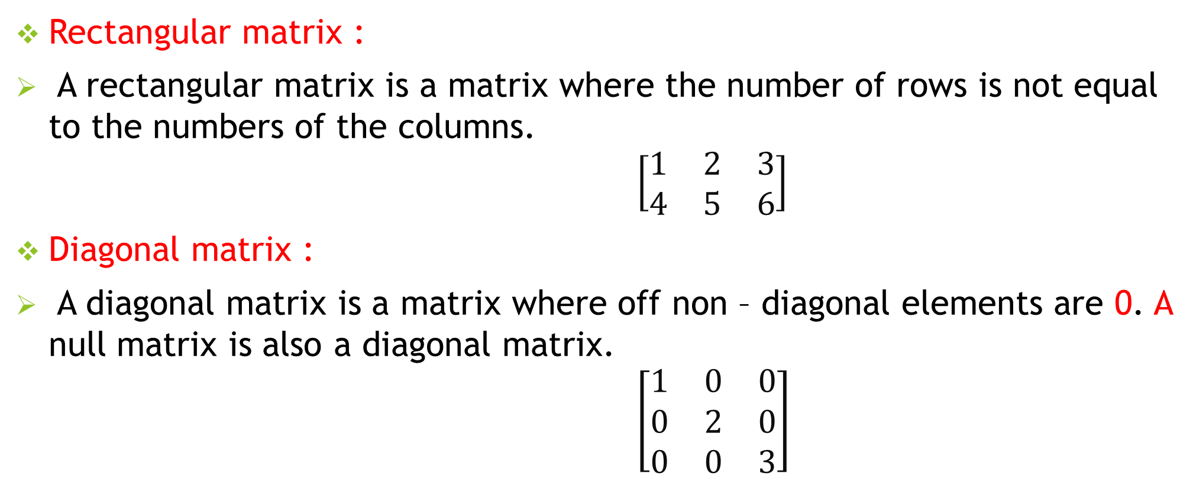
Types of matrix
Rectangular matrix :
A rectangular matrix is a matrix where the number of rows is not equal to the numbers of the columns. $\left[\begin{matrix}1 & 2 & 3 \\ 4 & 5 & 6\end{matrix}\right]$
Diagonal matrix :
A diagonal matrix is a matrix where off non – diagonal elements are 0. A null matrix is also a diagonal matrix. $\left[\begin{matrix}1 & 0 & 0 \\ 0 & 2 & 0 \\ 0 & 0 & 3\end{matrix}\right]$

Slide 5
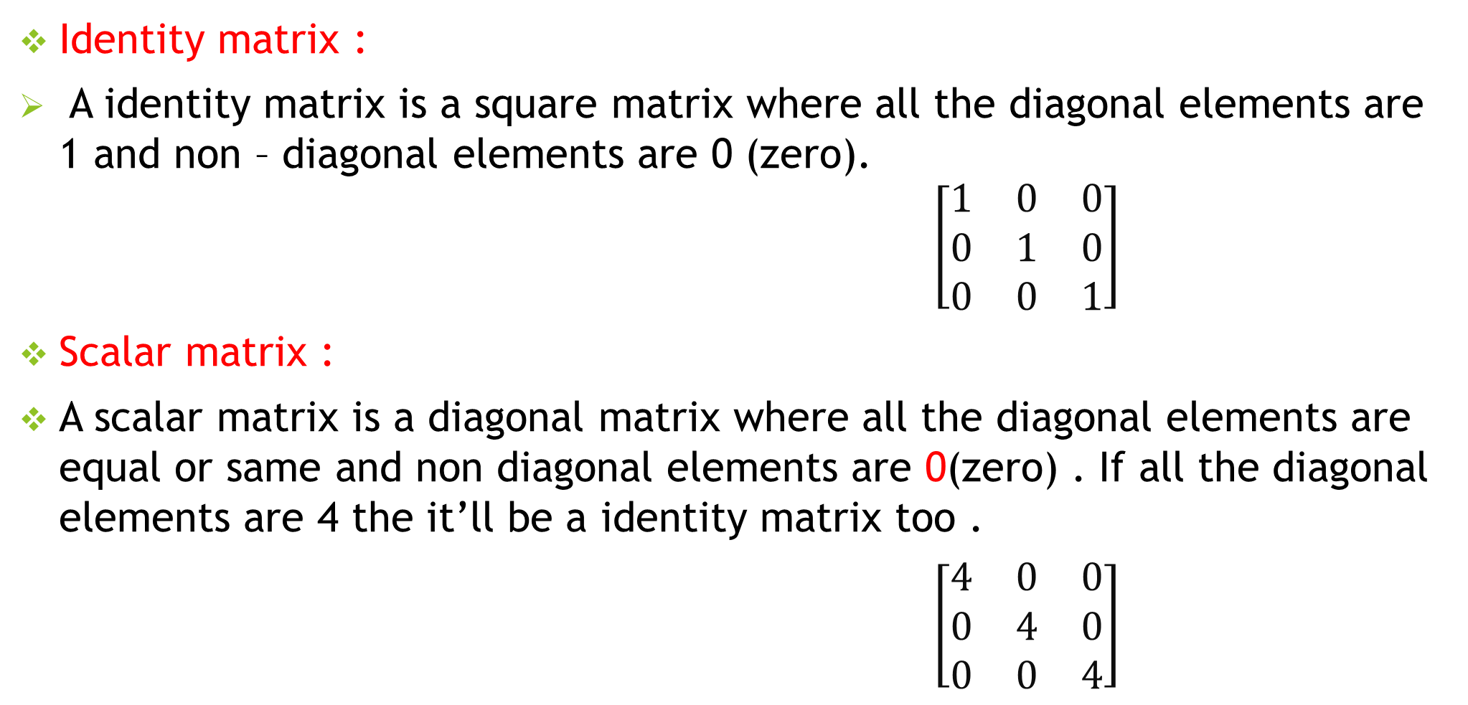
Types of matrix
Identity matrix :
A identity matrix is a square matrix where all the diagonal elements are 1 and non – diagonal elements are 0 (zero). $\left[\begin{matrix}1 & 0 & 0 \\ 0 & 1 & 0 \\ 0 & 0 & 1\end{matrix}\right]$
Scalar matrix :
A scalar matrix is a diagonal matrix where all the diagonal elements are equal or same and non diagonal elements are 0(zero) . If all the diagonal elements are 4 the it’ll be a identity matrix too .
$\left[\begin{matrix}4 & 0 & 0 \\ 0 & 4 & 0 \\ 0 & 0 & 4\end{matrix}\right]$

Slide 6
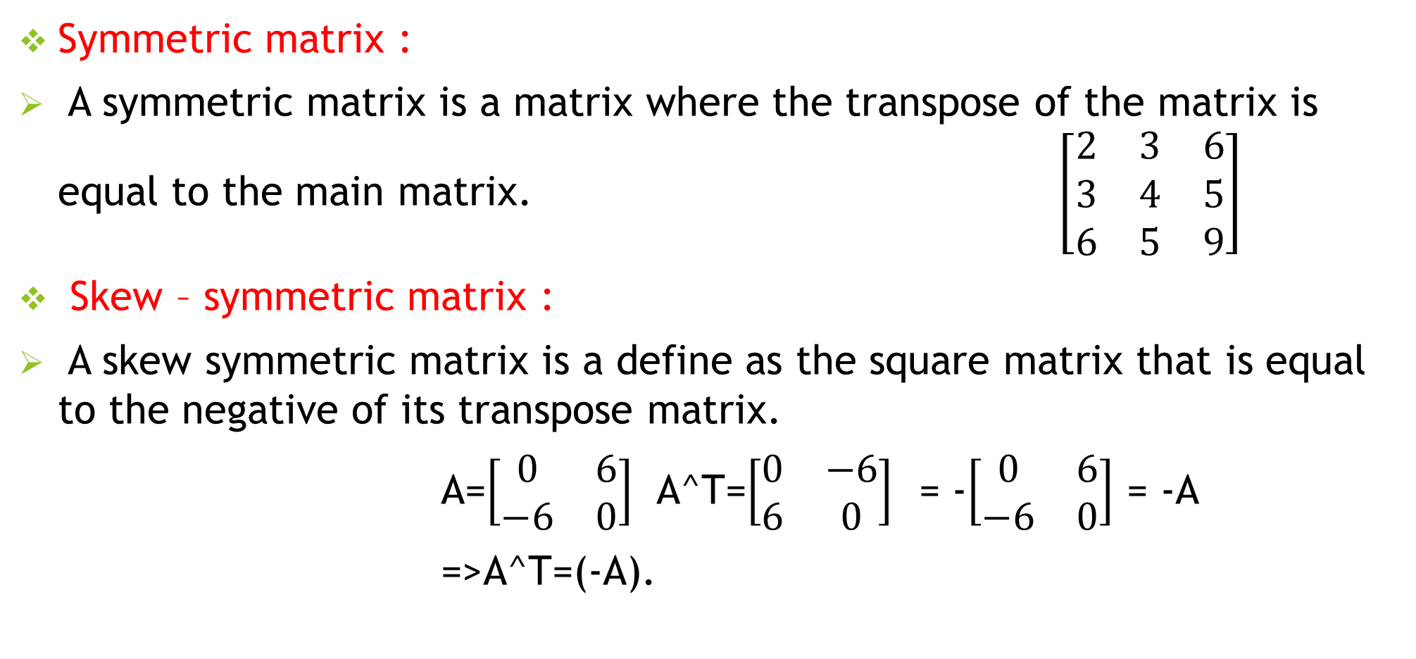
Types of matrix
Symmetric matrix :
A symmetric matrix is a matrix where the transpose of the matrix is equal to the main matrix. $\left[\begin{matrix}2 & 3 & 6 \\ 3 & 4 & 5 \\ 6 & 5 & 9\end{matrix}\right]$
Skew – symmetric matrix :
A skew symmetric matrix is a define as the square matrix that is equal to the negative of its transpose matrix.
A=$\left[\begin{matrix}0 & 6 \\ −6 & 0\end{matrix}\right]$ A^T=$\left[\begin{matrix}0 & −6 \\ 6 & 0\end{matrix}\right]$ = -$\left[\begin{matrix}0 & 6 \\ −6 & 0\end{matrix}\right]$ = -A
=>A^T=(-A).

Slide 7
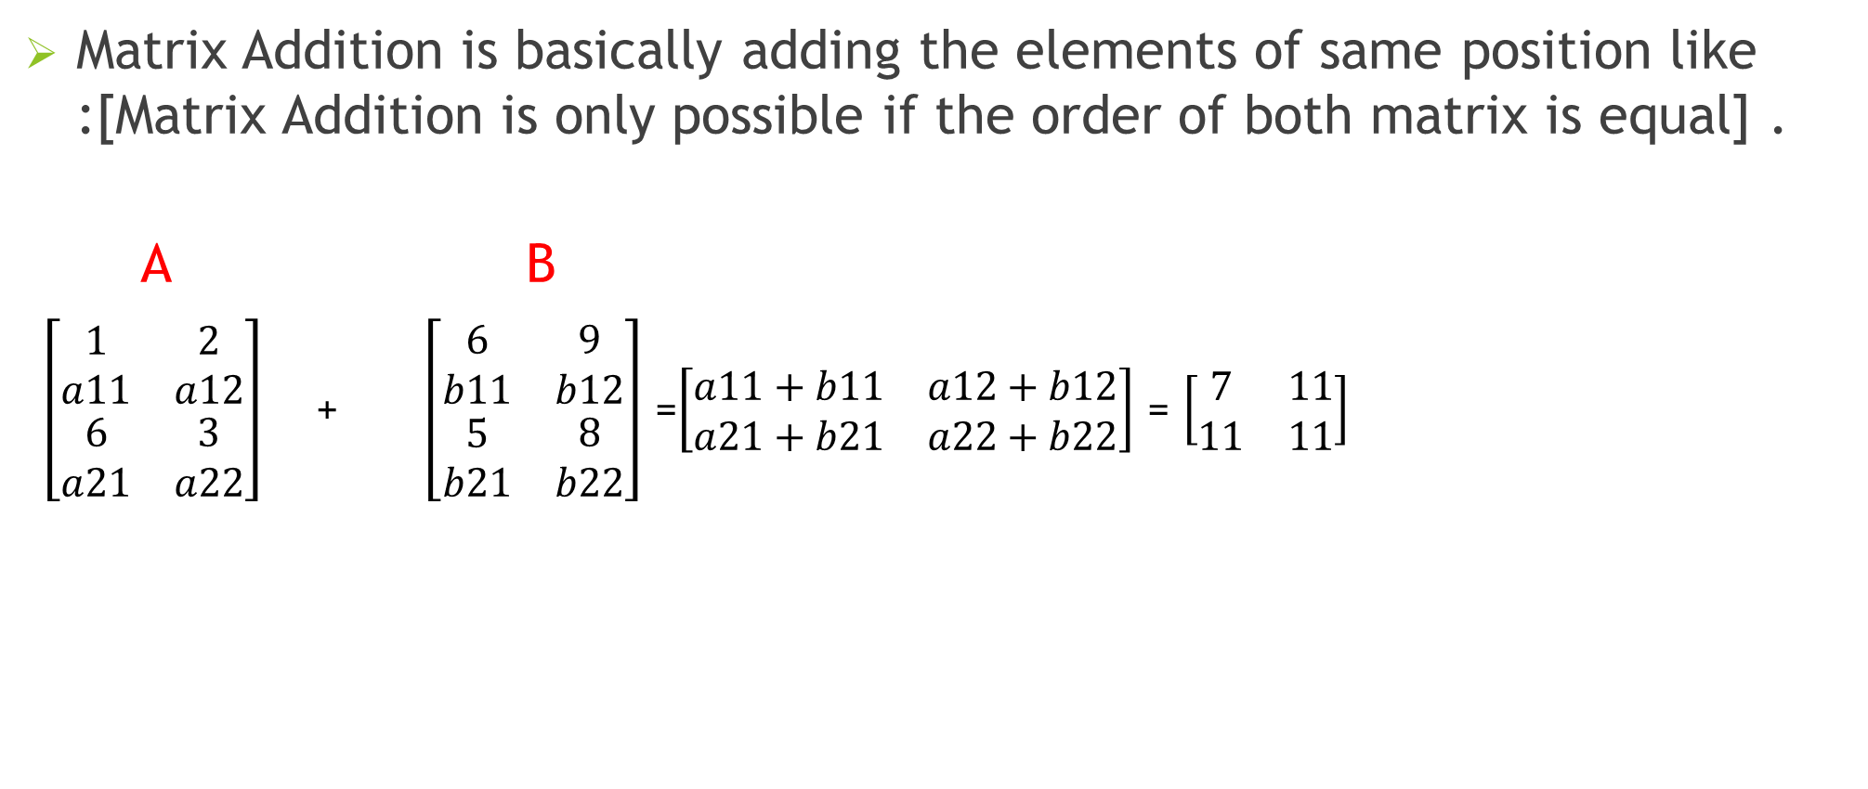
Matrix addition
Matrix Addition is basically adding the elements of same position like :[Matrix Addition is only possible if the order of both matrix is equal] .
A B
$\left[\begin{matrix}\begin{aligned}1 \\ a11\end{aligned} & \begin{aligned}2 \\ a12\end{aligned} \\ \begin{aligned}6 \\ a21\end{aligned} & \begin{aligned}3 \\ a22\end{aligned}\end{matrix}\right]$ + $\left[\begin{matrix}\begin{aligned}6 \\ b11\end{aligned} & \begin{aligned}9 \\ b12\end{aligned} \\ \begin{aligned}5 \\ b21\end{aligned} & \begin{aligned}8 \\ b22\end{aligned}\end{matrix}\right]$ =$\left[\begin{matrix}a11+b11 & a12+b12 \\ a21+b21 & a22+b22\end{matrix}\right]$ = $\left[\begin{matrix}7 & 11 \\ 11 & 11\end{matrix}\right]$

Slide 8
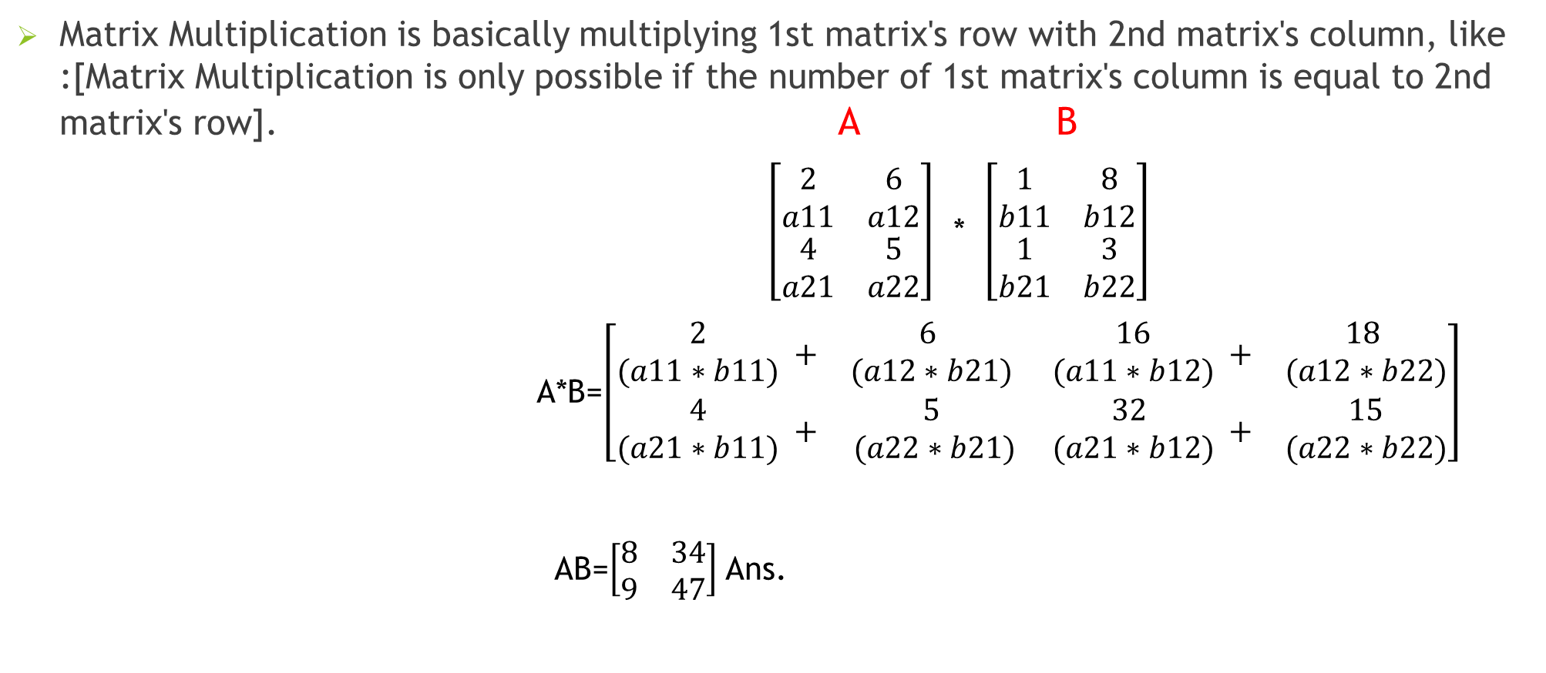
Matrix multiplication
Matrix Multiplication is basically multiplying 1st matrix's row with 2nd matrix's column, like :[Matrix Multiplication is only possible if the number of 1st matrix's column is equal to 2nd matrix's row]. A B
$\left[\begin{matrix}\begin{aligned}2 \\ a11\end{aligned} & \begin{aligned}6 \\ a12\end{aligned} \\ \begin{aligned}4 \\ a21\end{aligned} & \begin{aligned}5 \\ a22\end{aligned}\end{matrix}\right]$ * $\left[\begin{matrix}\begin{aligned}1 \\ b11\end{aligned} & \begin{aligned}8 \\ b12\end{aligned} \\ \begin{aligned}1 \\ b21\end{aligned} & \begin{aligned}3 \\ b22\end{aligned}\end{matrix}\right]$
A*B=$\left[\begin{matrix}\begin{aligned} 2 \\ (a11∗b11)\end{aligned} + & \begin{aligned}6 \\ (a12∗b21)\end{aligned} & \begin{aligned} 16 \\ (a11∗b12)\end{aligned} + & \begin{aligned}18 \\ (a12∗b22)\end{aligned} \\ \begin{aligned} 4 \\ (a21∗b11)\end{aligned} + & \begin{aligned}5 \\ (a22∗b21)\end{aligned} & \begin{aligned}32 \\ (a21∗b12)\end{aligned} + & \begin{aligned} 15 \\ (a22∗b22)\end{aligned}\end{matrix}\right]$
AB=$\left[\begin{matrix}8 & 34 \\ 9 & 47\end{matrix}\right]$ Ans.

Slide 9
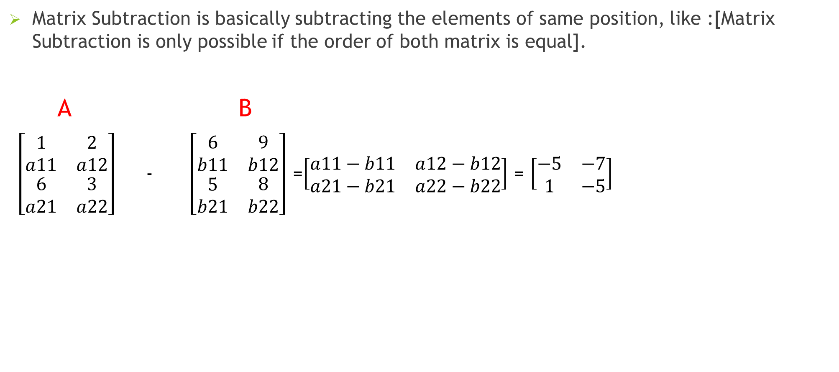
Matrix subtraction
Matrix Subtraction is basically subtracting the elements of same position, like :[Matrix Subtraction is only possible if the order of both matrix is equal].
A B
$\left[\begin{matrix}\begin{aligned}1 \\ a11\end{aligned} & \begin{aligned}2 \\ a12\end{aligned} \\ \begin{aligned}6 \\ a21\end{aligned} & \begin{aligned}3 \\ a22\end{aligned}\end{matrix}\right]$ - $\left[\begin{matrix}\begin{aligned}6 \\ b11\end{aligned} & \begin{aligned}9 \\ b12\end{aligned} \\ \begin{aligned}5 \\ b21\end{aligned} & \begin{aligned}8 \\ b22\end{aligned}\end{matrix}\right]$ =$\left[\begin{matrix}a11−b11 & a12−b12 \\ a21−b21 & a22−b22\end{matrix}\right]$ = $\left[\begin{matrix}−5 & −7 \\ 1 & −5\end{matrix}\right]$

Slide 10
Conclusion
Matrix are fundamental in various mathematical and computational applications.- Operations like addition, subtraction, and multiplication play key roles in linear algebra and data manipulation.
-------------------------------- Thank you ----------------------------------------

