Slide 1
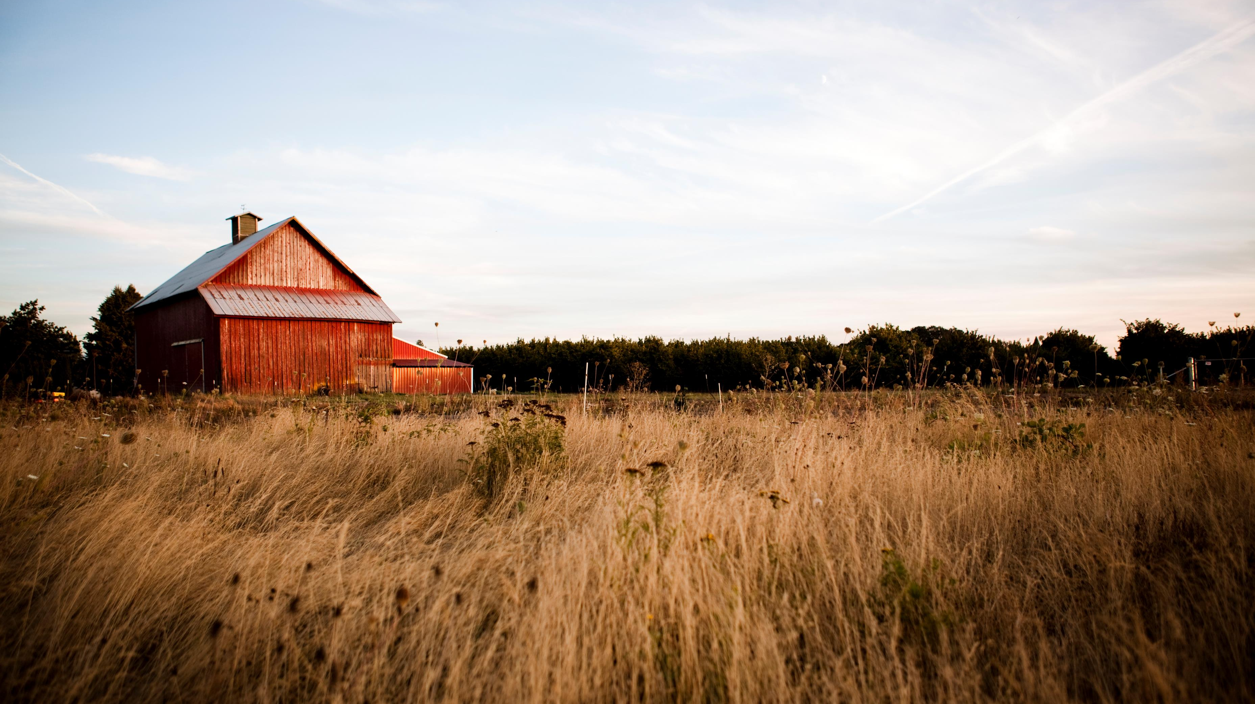
Automated Farming
Hunter Mast

Slide 2
Table of Contents
Purpose
Design
Creation
Results
Possible Additions

Slide 3
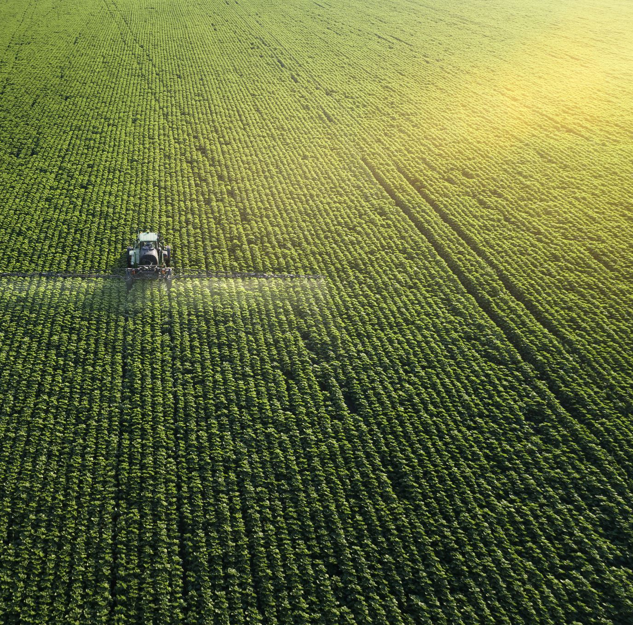
purpose
Automated farming is involving technology to optimize and automate many aspects of agriculture.
Project was to simulate an automated farming vehicle through a randomized field layout.
Goal was to view the complexity a system like this can be.
Focus was on a basic tractor-like vehicle.

Slide 4
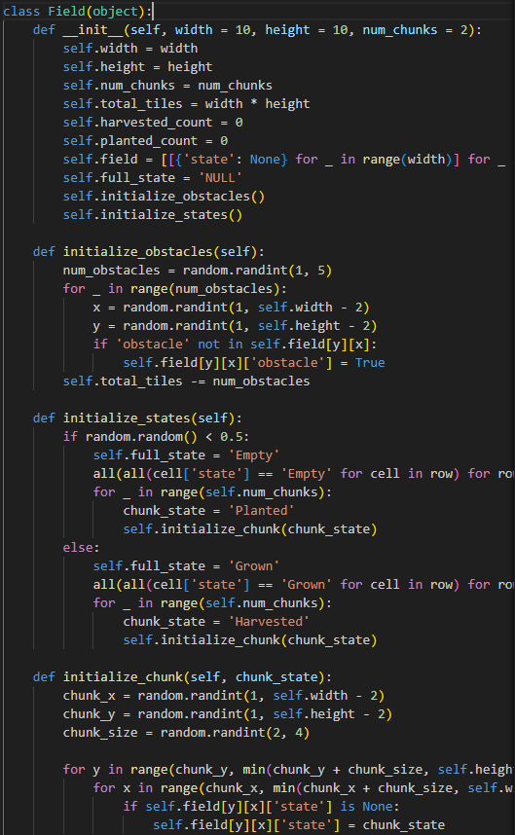
Design
Field is generated with either ‘Empty’ or ‘Grown’ with randomized sections of ‘Planted’ or ‘Harvested’ tiles.
Obstacles are randomly generated inside the field.
Vehicle will turn at edges of the field.
Vehicle will harvest crops on grown tiles and plant seeds on empty tiles.
Crops have a maximum amount they can harvest or plant.

Slide 5
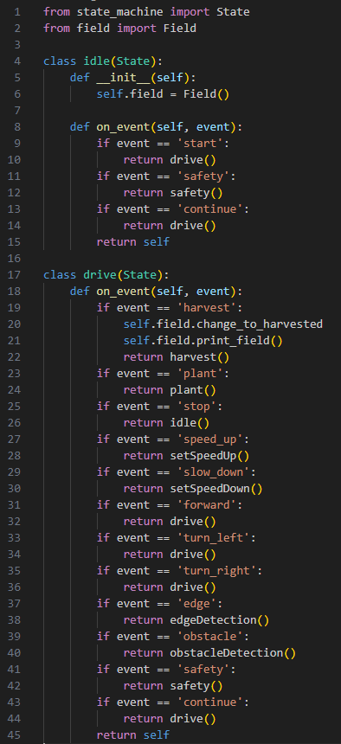
Creation
Created with Python.
State-machine used to create decisions made by the vehicle.
States include:
- idle
- drive
- harvest
- plant
- setSpeed (Up and Down)
- obstacleDetection
- edgeDetection
- safety

Slide 6
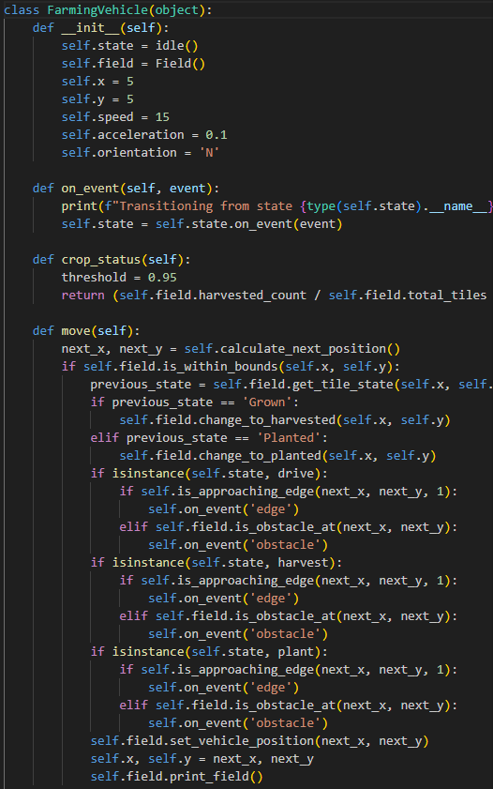
Creation
Created with Python.
State-machine used to create decisions made by the vehicle.
States include:
- idle
- drive
- harvest
- plant
- setSpeed (Up and Down)
- obstacleDetection
- edgeDetection
- safety

Slide 7
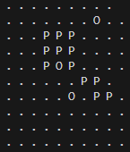
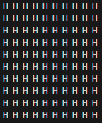

Results
Discovered how complex avoidance systems can be.
Discovered how safety can be managed in such systems.
View of how state machines work from a coding level.

Slide 8
Possible Additions
Markov Decision Process (MDP) for optimality.
Crop management system.
Moving object avoidance.
Additional machinery.
Additional controls for the system like speed or time.

Slide 9
Thank you

