Slide 1

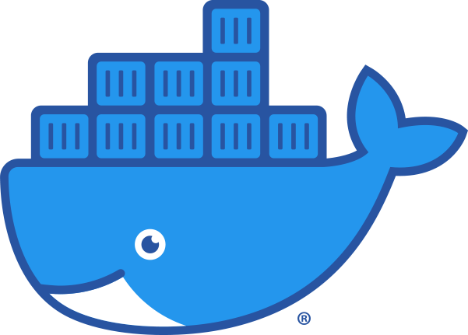
Introducción
a
Docker
Juan Diego Pérez Jiménez

Slide 2
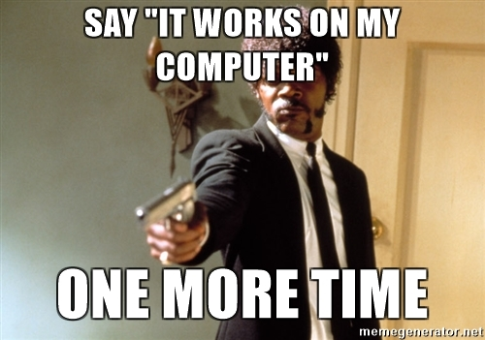

The problem...
Juan Diego Pérez Jiménez

Slide 3
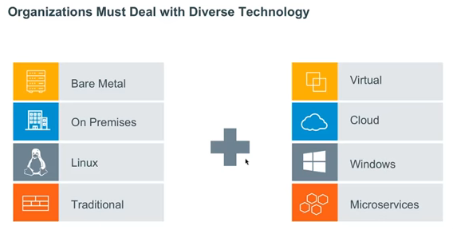
The problem...
Juan Diego Pérez Jiménez

Slide 4
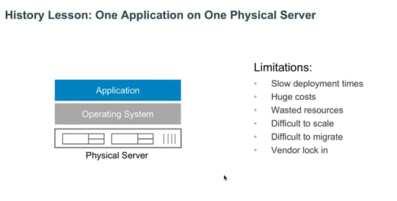
History...
Juan Diego Pérez Jiménez

Slide 5
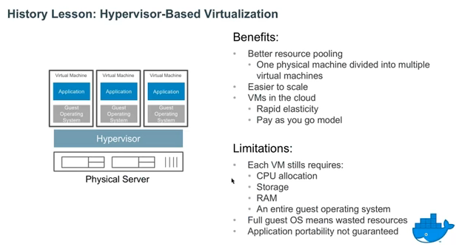
History...
Juan Diego Pérez Jiménez

Slide 6
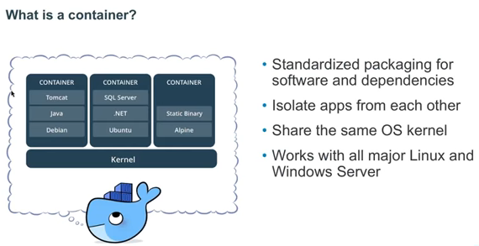
History...
Juan Diego Pérez Jiménez

Slide 7
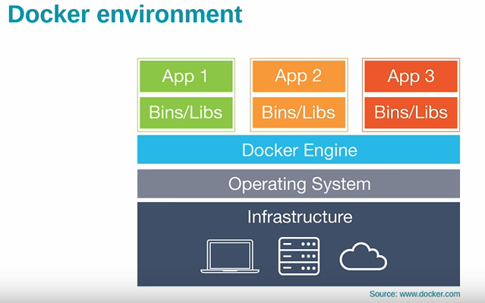
History...
Juan Diego Pérez Jiménez

Slide 8
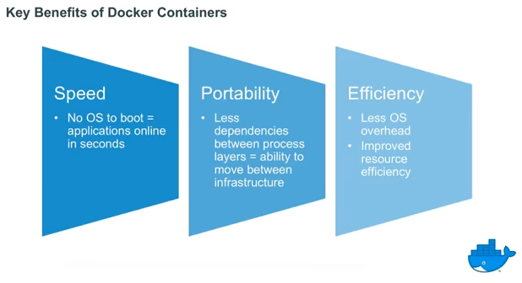
History...
Juan Diego Pérez Jiménez

Slide 9
DockerHub
Docker Hub is a cloud-based repository in which Docker users and partners create, test, store and distribute container images. Through Docker Hub, a user can access public, open source image repositories, as well as use a space to create their own private repositories, automated build functions, webhooks and work groups
https://searchitoperations.techtarget.com/definition/Docker-Hub
Juan Diego Pérez Jiménez

Slide 10

END
Juan Diego Pérez Jiménez

