Slide 1
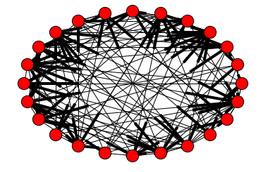
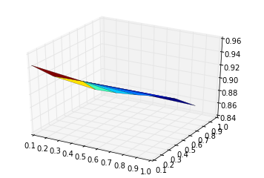
Reducing risk of contagion across financial networks
Hunter Johnson Mentor: Saurav Chakraborty
School of Informatics and Computing, Indiana University
Abstract
In the context of finance, contagion is defined as a spread of market disturbances where insolvencies among individual market participants propagate throughout the larger market in a chain-reaction effect. One notable example of this phenomena is the 2008 financial crisis, wherein the aftermath of the Lehman Brothers bankruptcy other large investment banks were subsequently sold or bailed out resulting in global financial turmoil.
Methods
We used the Python libraries NetworkX and Matplotlib to generate our graphs and plot the results of our simulations. After generating an Erdos-Renyi random graph we conducted our stress test by “shocking” a random subset of the nodes with selection probability K, reducing their weights/capital reserves by φ where 0 < φ < 1. As a result, the net assets of some nodes fell below 0 after factoring in debt obligations, effectively signaling insolvency.
¹ Visualization of a sample network in NetworkX
Objective
We will represent a sample financial network as a directed graph. Each node represents a market participant (bank, trader, etc.) and is assigned a weight corresponding to the total capital held in reserve by that node. Edges are also assigned weights, corresponding to the amount lent/borrowed by the connected nodes. This sample network will undergo a “stress test”, allowing us to assess the risk of contagion and optimize our network’s parameters in order to reduce said risk.
Results
In conclusion, the results of our simulations backed up our initial hypothesis that the risk of contagion resulting in widespread default is generally quite low. However, to ensure continued stability of financial networks several key parameters must be kept in check. Market participants should adhere to the advice of regulatory authorities with regards to minimum standards for leverage and debt/equity ratios, in order to minimize the risk of insolvency and the contagion that can arise as a result.
² 3D plot displaying the decrease in surviving nodes as stress test parameters K and φ (x and y-axes) increase

