Slide 1

Web Scraping for Lead Generation
Hunter Luckow
Department of Computer Science & Innovation
Long Island University
2023

Slide 2
Overview
Company Product: Integrated accounting and expense management software.
Consolidate disparate accounting and financial software’s.
Company Objective: Locate companies hiring accountants or controllers.
Required proficiency in QuickBooks or NetSuite.
Task: Scrape LinkedIn job postings to find target companies.

Slide 3
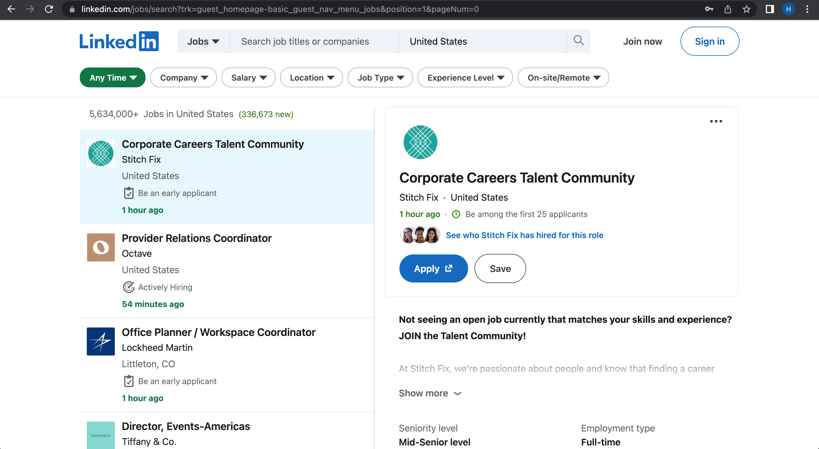
Exploratory Analysis
Visually analyze structure of LinkedIn webpage.
Inspect HTML to find elements of interest (Job Title, Company Name, Link to Job Posting, Software Flagged).

Slide 4
Program Architecture
Utilize selenium to handle the infinite scroll feature.
With each scroll to the bottom of the page, 25 new postings are loaded.
Use selenium to scroll until 1000 postings (max) are visible on the page.
Use BeautifulSoup to parse and extract html elements of interest.
The program will then loop through job postings and if a software of interest is flagged, relevant data is extracted.

Slide 5
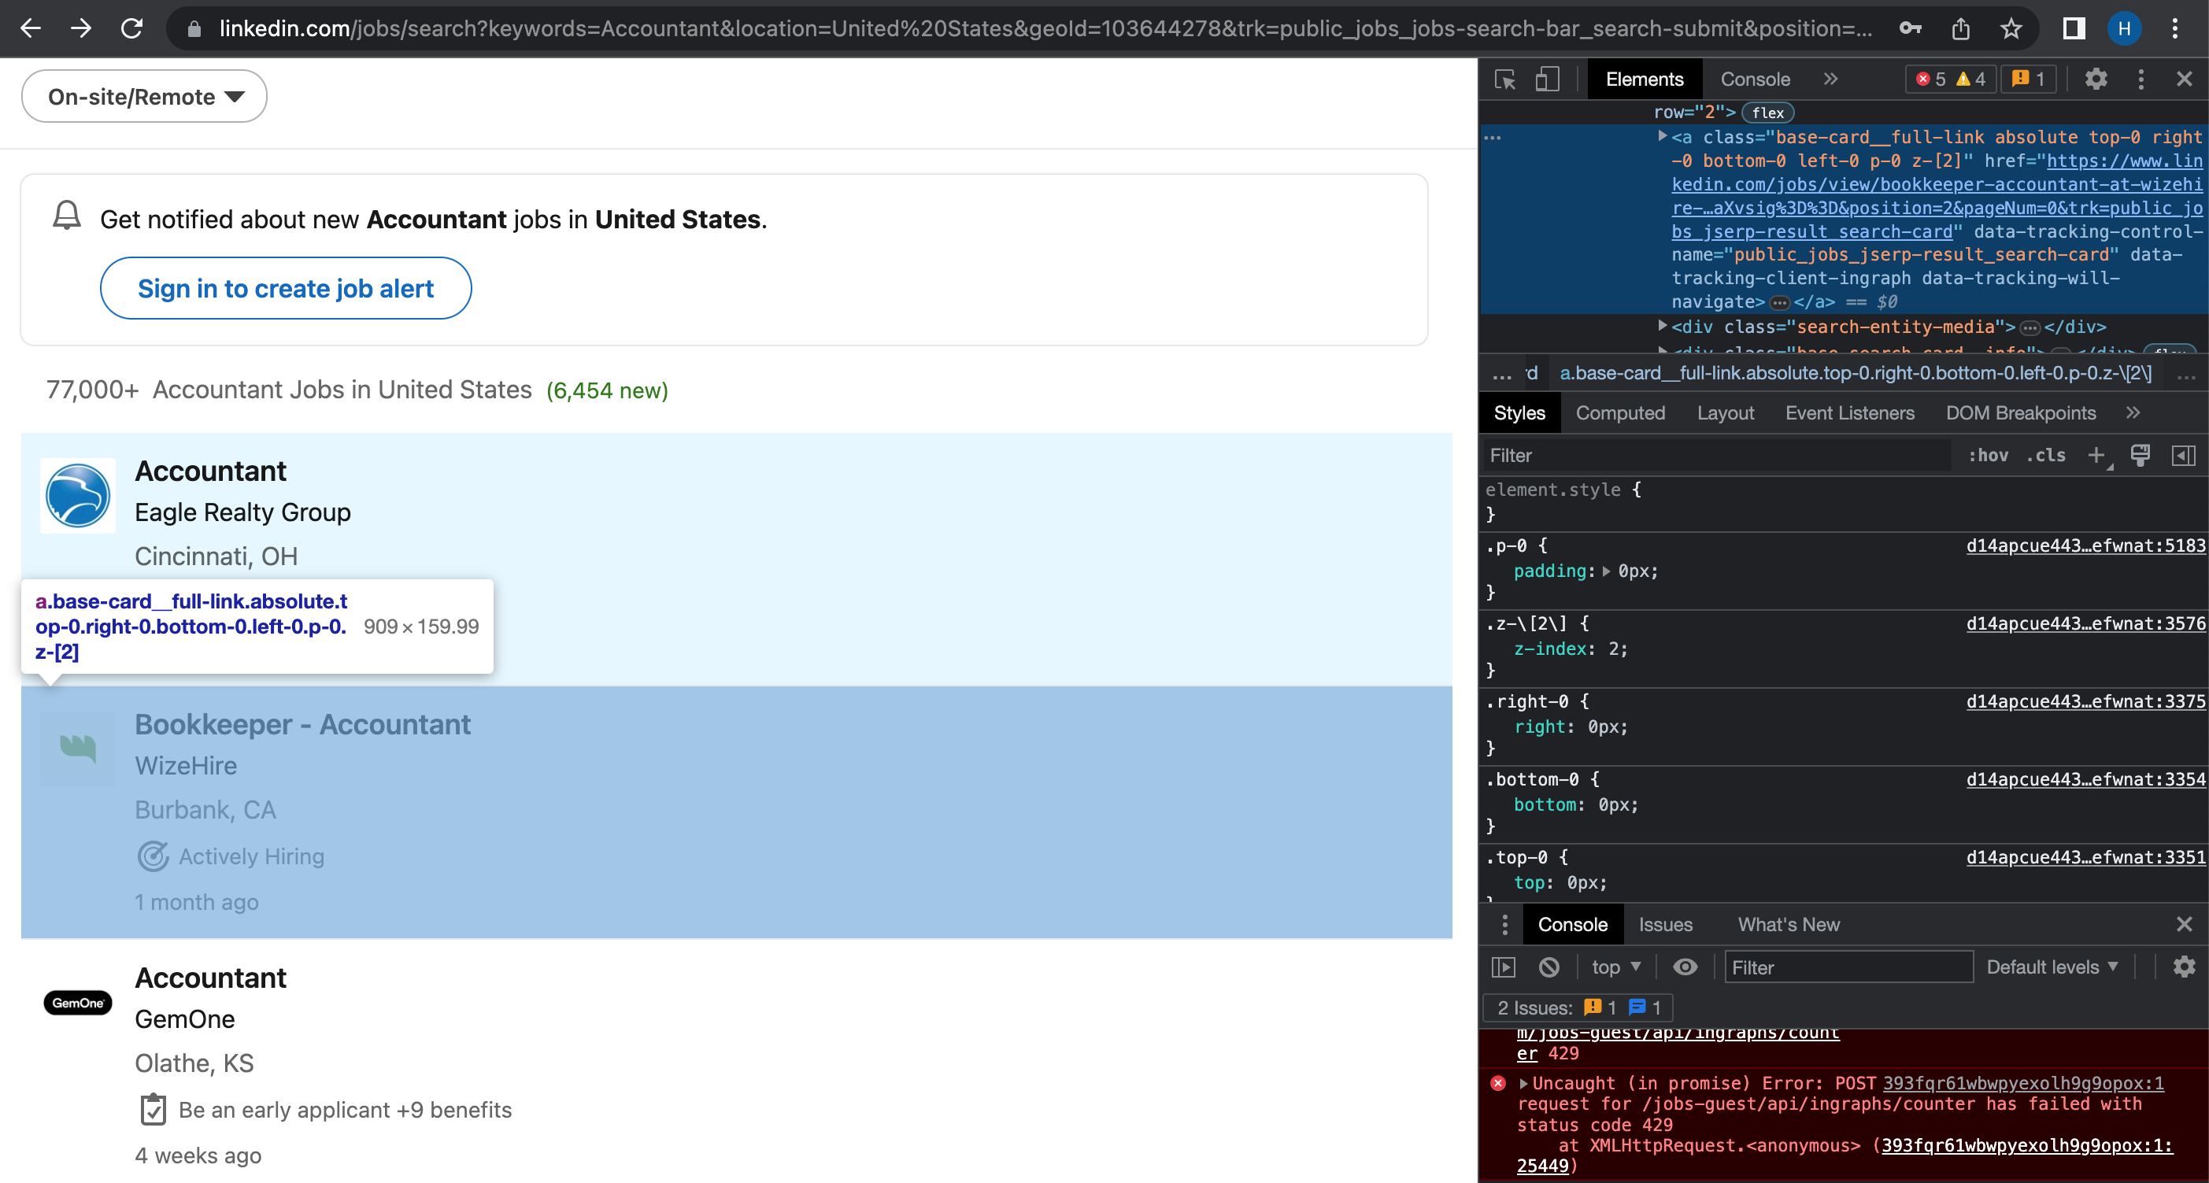
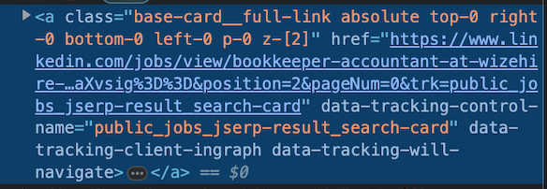
HTML Elements of Interest

Slide 6
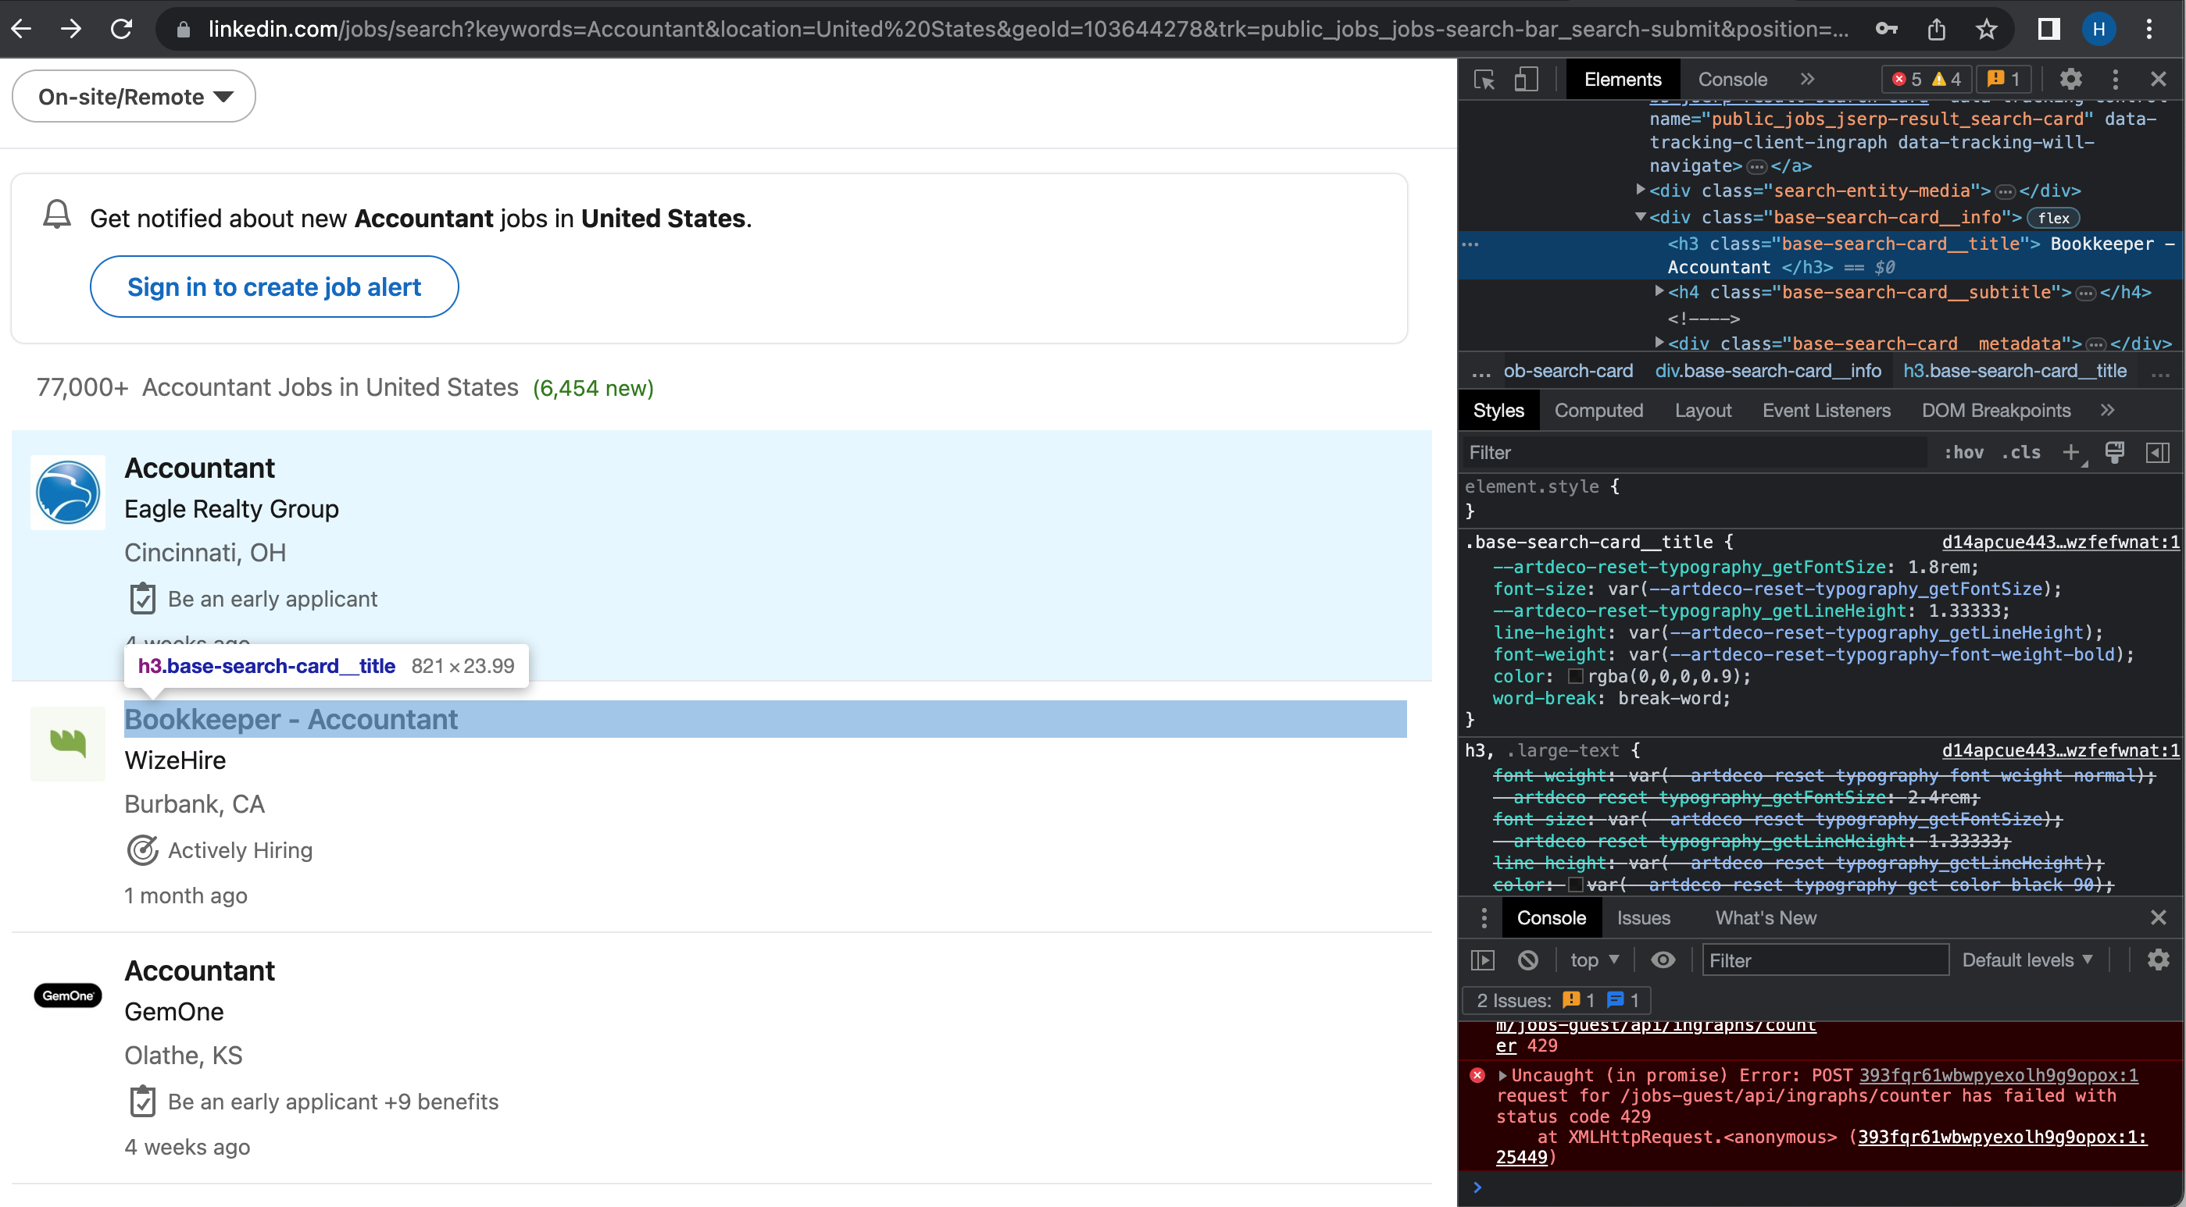
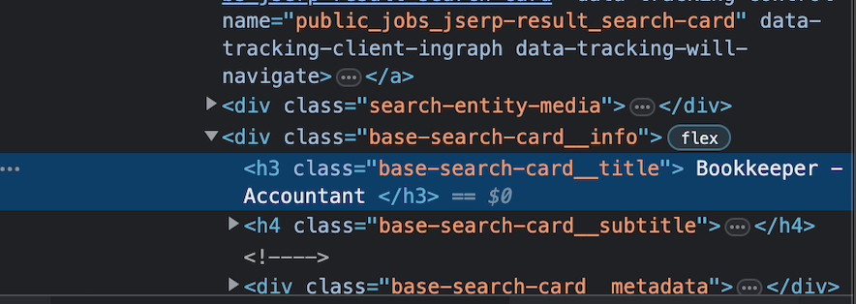
More HTML Elements

Slide 7
Post-Processing
Create data frame of leads with 4 columns: Job Title, Company, Link, Software Flagged.
1
Ensure there are no duplicates in the ‘Company’ column as we are targeting individual companies.
2
Convert data frame into Excel & CSV files.
3

Slide 8
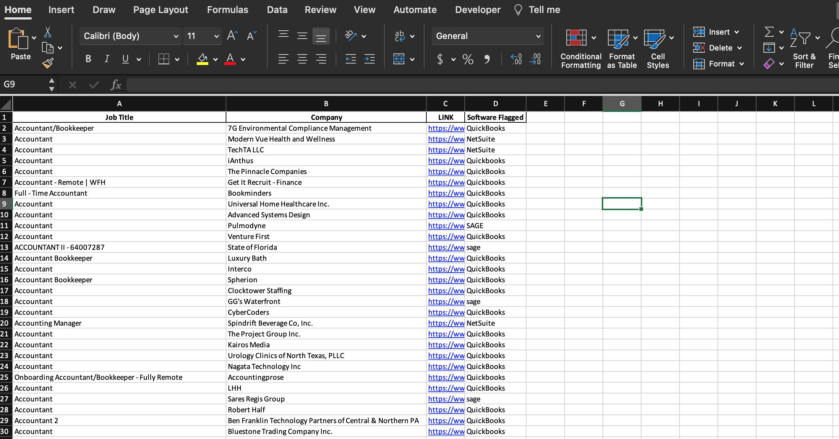

Slide 9
Results & Future Work
Out of 1000 job postings 140 were flagged.
With a success rate of 14%, my program proves to be an effective tool in generating leads.
Next Steps: Explore implementing individually filtered by state to increase the sample pool.

