Slide 1
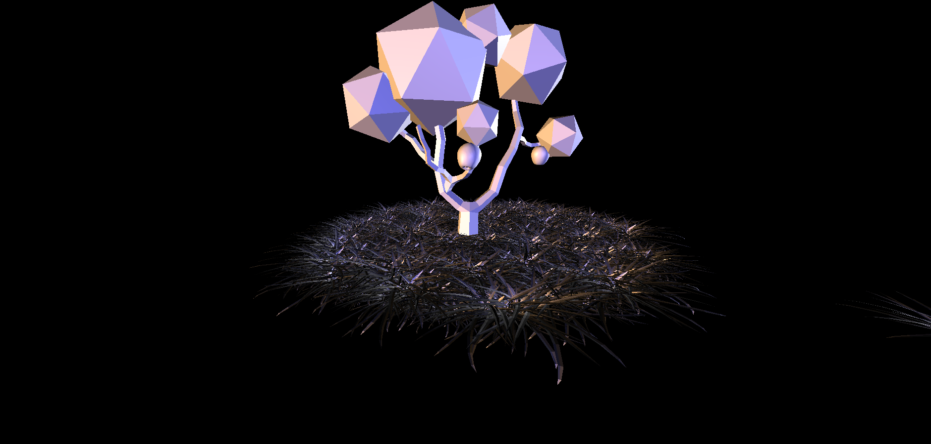
Viewable model of a tree and fruit
Interactable with user click determining when fruit drops
Additional fruit is loaded based on the amount of time after being dropped
Object transformations for the fruit such as rolling upon hitting the ground for more believability

Slide 2
Overview
Would have been nice if my computer didn’t crash and lose basically all of the work
The most challenging task was working with three.js and getting it to do what we needed it to do for the project
The most interesting was setting an object to a variable for later use and transformation
If I would have done things differently I would have saved more frequently (obviously) and tried to loop the object load process if possible since loading several objects manually wastes a lot of time and space in code

