Slide 1
Tree Animation
By Scott Thompson and Hunter McCall

Slide 2
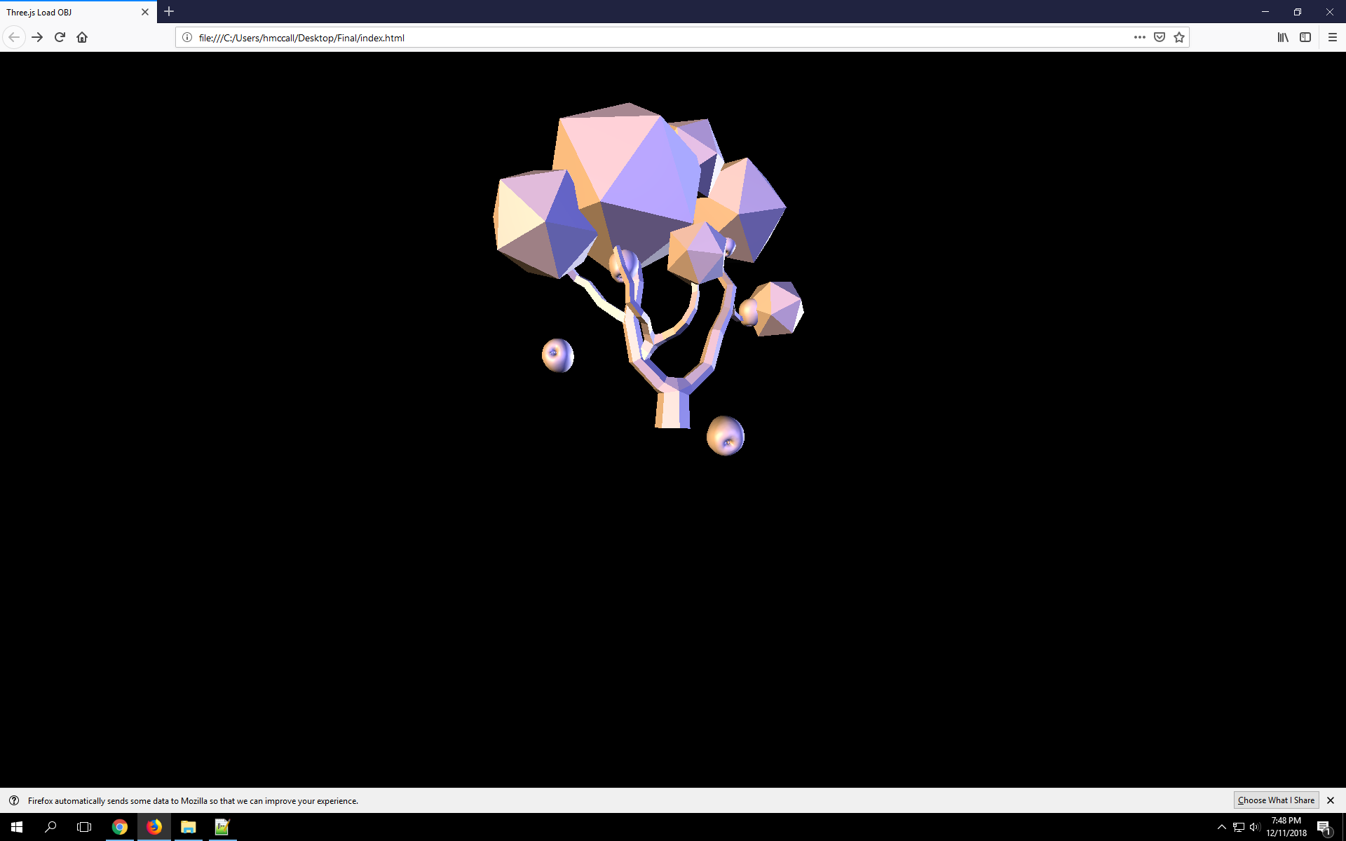
Viewable model of a tree and fruit
Additional fruit is loaded based on the amount of time after being dropped
Object transformations for the fruit such as rolling upon hitting the ground

Slide 3
Overview
The most challenging task was working with three.js and getting it to do what we needed it to do for the project
The most interesting was setting an object to a variable for later use and transformation
Things we would have done differently include trying to loop the object load process if possible since loading several objects manually wastes a lot of time and space in code as well as get the textures to work properly
It would have been nice to have time for more implementation rather than wrestling with three.js to make it even functional

