Slide 1
Avila Bible
Jacklyn Tellez
Hunter Waldridge

Slide 2
Data Description
The Avila Bible: giant Latin copy of the Bible
Classification target: which copyist is author of a certain pattern of data (copyist identified with letters A, B, C, D, E, F, G, H, I, W, X, and Y)
Ten features: intercolumn distance, upper margin, lower margin, exploitation, row number, modular ratio, interlinear spacing, weight, peak number, and modular ratio/interlinear spacing
These features were extracted from 800 images of the Avila Bible

Slide 3
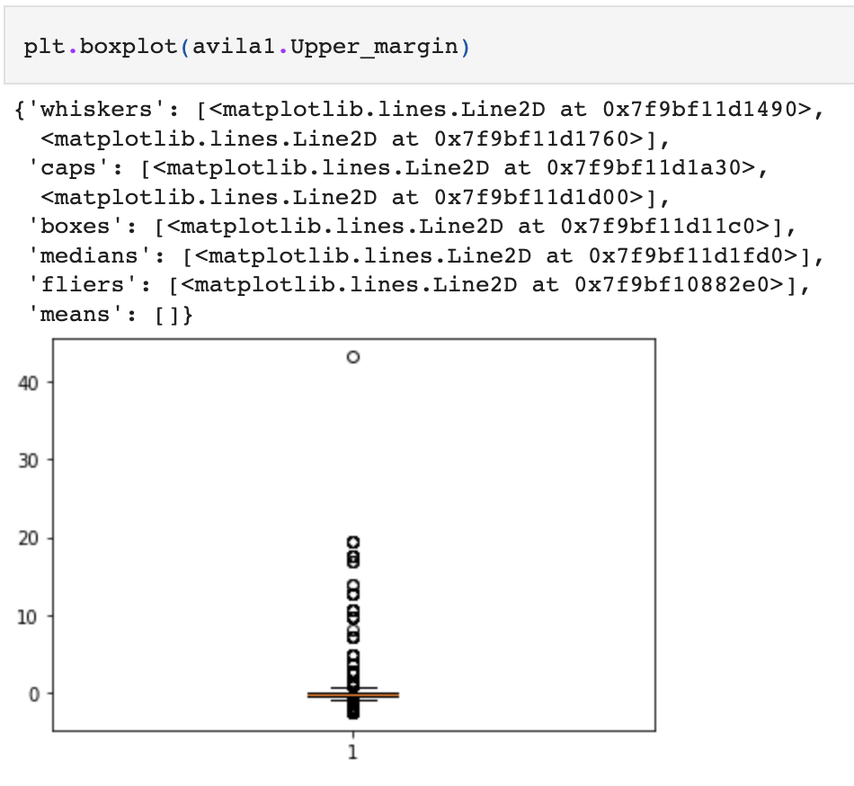
Exploratory Analysis
No missing data
Description said it was normalized but upper margin had standard deviation of 2.85
Checked boxplot for outliers and removed the outlier normalizing that feature
After deletion, histograms show normal distributions

Slide 4
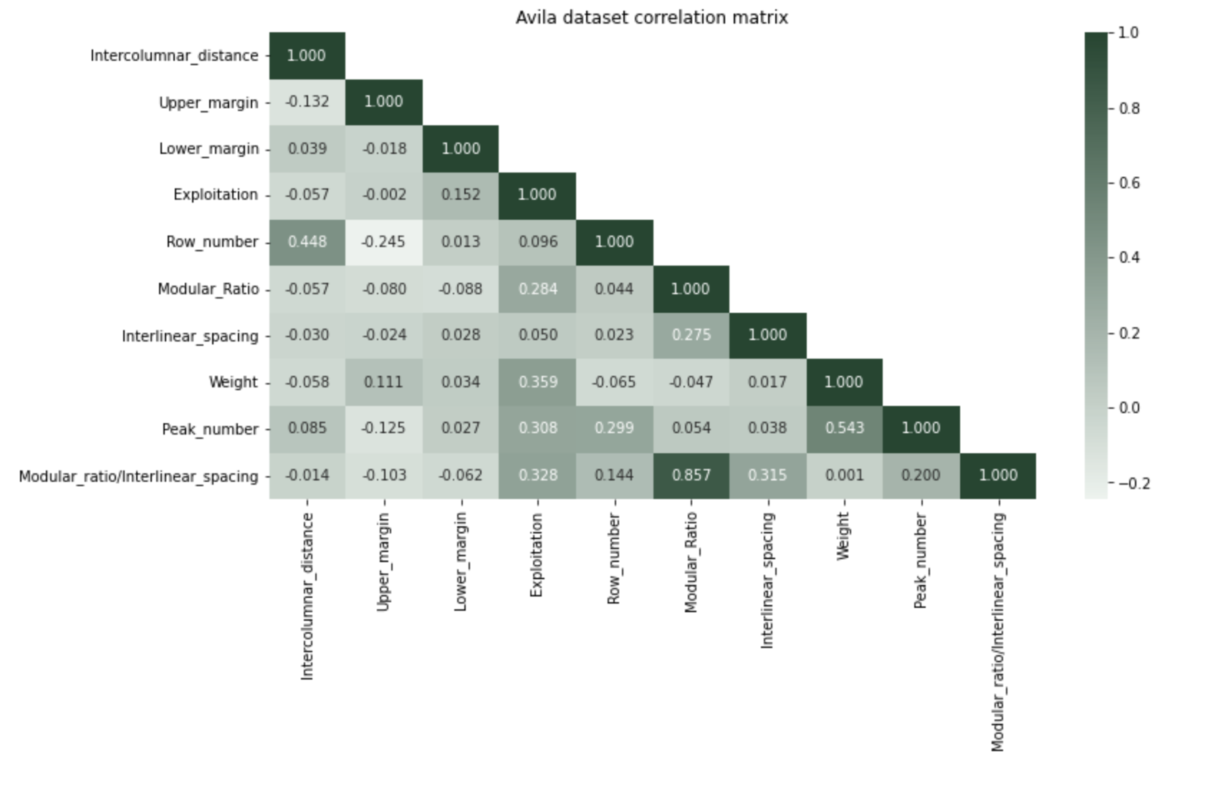
Exploratory Analysis
Found a good way to visualize correlation matrix
There is not much correlation between features except for modular_ratio and modular_ratio/interlinear_spacining

Slide 5
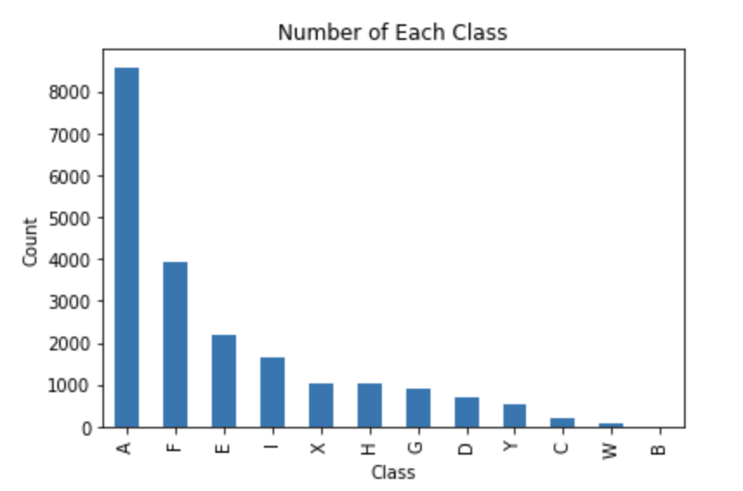
Exploratory Analysis
Counts of each class value: very uneven, very few in class B and the majority of data belonged to class A

Slide 6
Preparing dataset for Machine Learning Models
Combined the train and test datasets to split ourselves into 3: train, validate, and test
Dataset used with first two experiments: avilaml = avila1.query("Class=='A' | Class=='F'")
Dataset with only class A and F data
Two classes with the most data
Train, validate, and test datasets
70/15/15 for first experiment
80/10/10 for second
Full dataset was used for 3rd experiment
Train, validate, and test: 80/10/10
Dataset with only 5 features chosen randomly
Train, validate, and test: 70/15/15

Slide 7
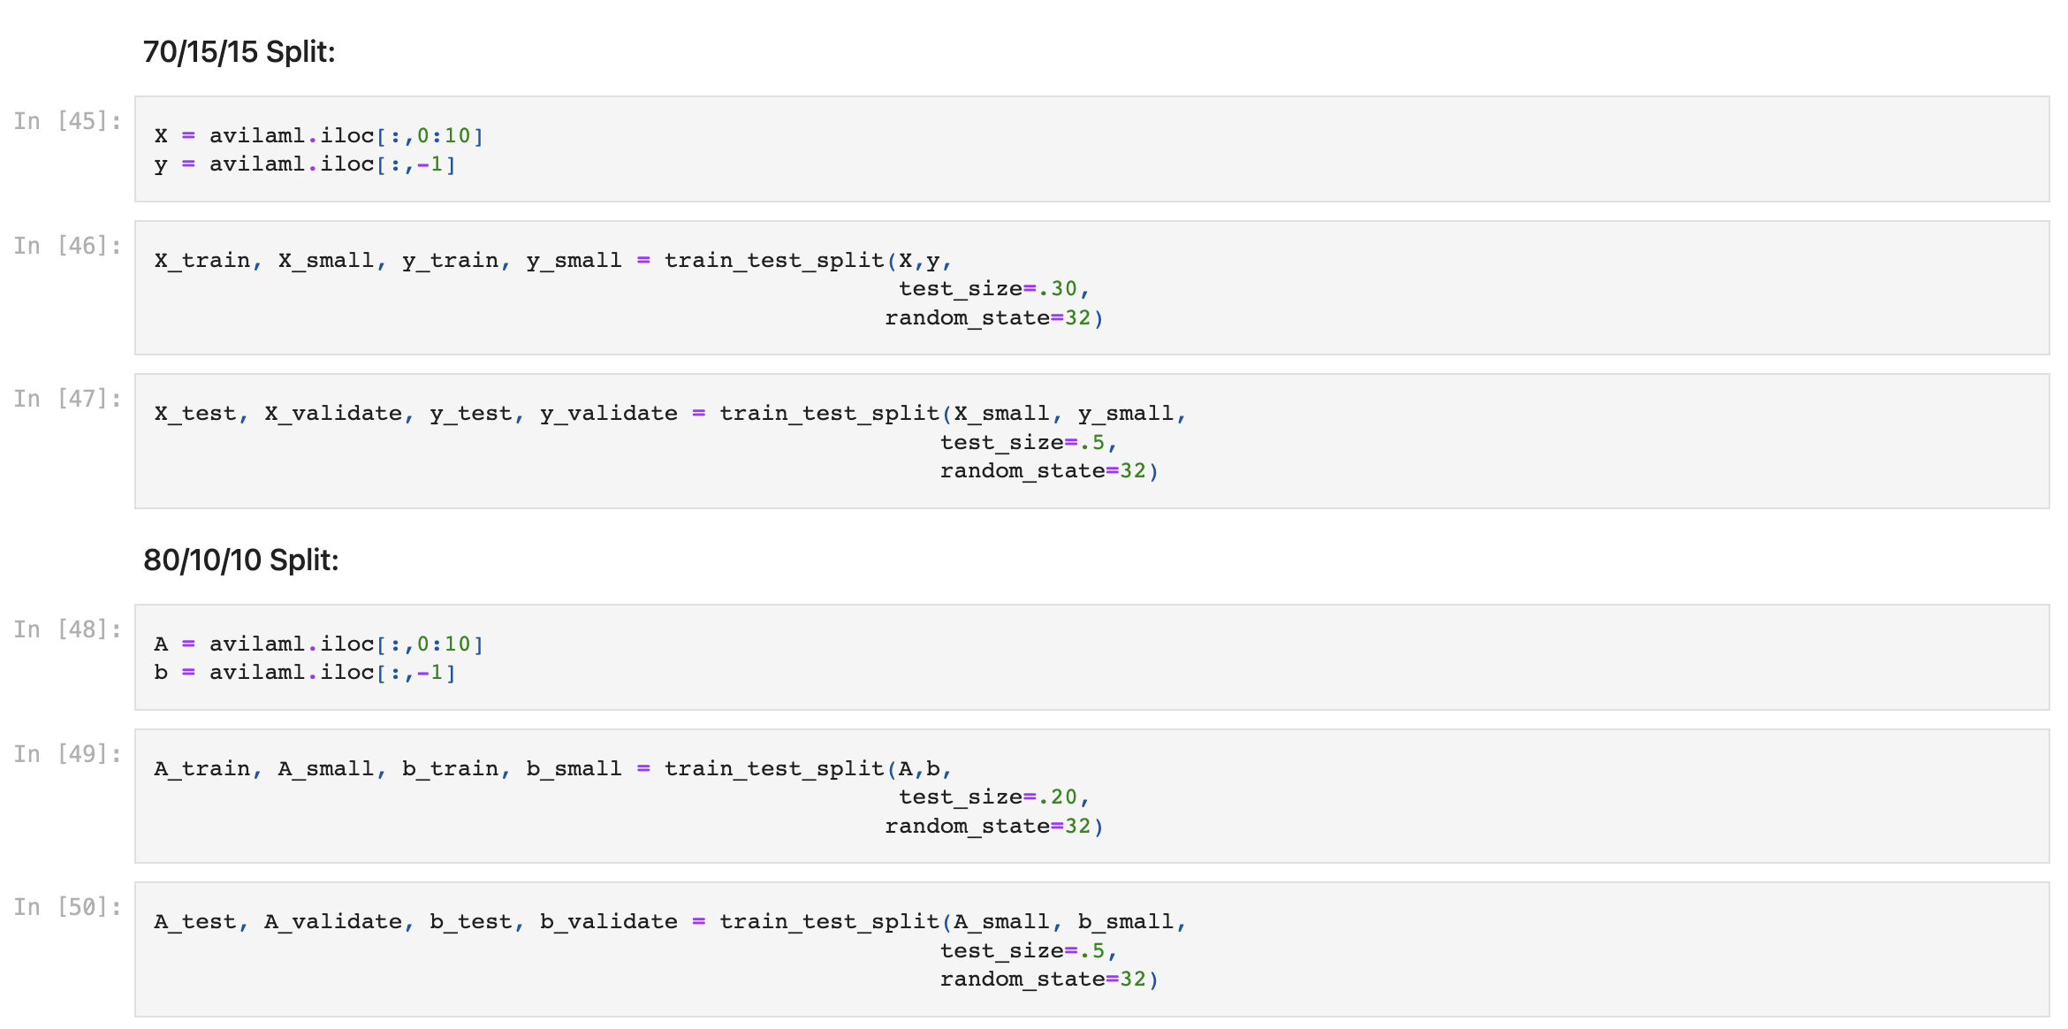

Slide 8
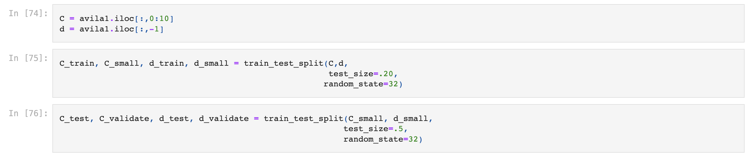
Full Dataset: 80/10/10 split

Slide 9
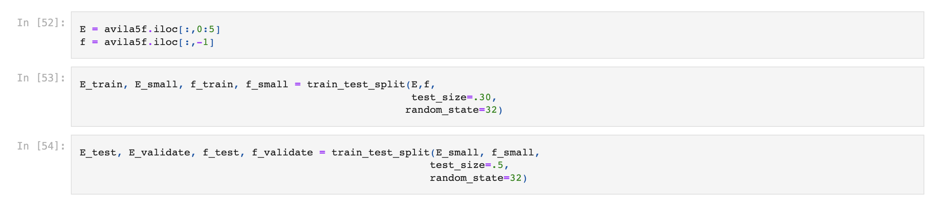
5 Random Features Dataset: 70/15/15 Split

Slide 10
Prediction Scores: All Models
Experiment | KNN | Decision Tree
1. A&F 70/15/15 | .8431 | .9173
2. A&F 80/10/10 | .8478 | .9207
3. Full dataset 80/10/10 | .7949 | .9099
4. 5 Random Features Dataset 70/15/15 | .5476 | .7406

Slide 11
Best Model
Decision Tree – Experiment # 2: A&F dataset – 80/10/10 train, validate, & test split
Scores of train, validation data:
Train: 0.9360
Validation: 0.9304
Prediction score: 0.9207

Slide 12
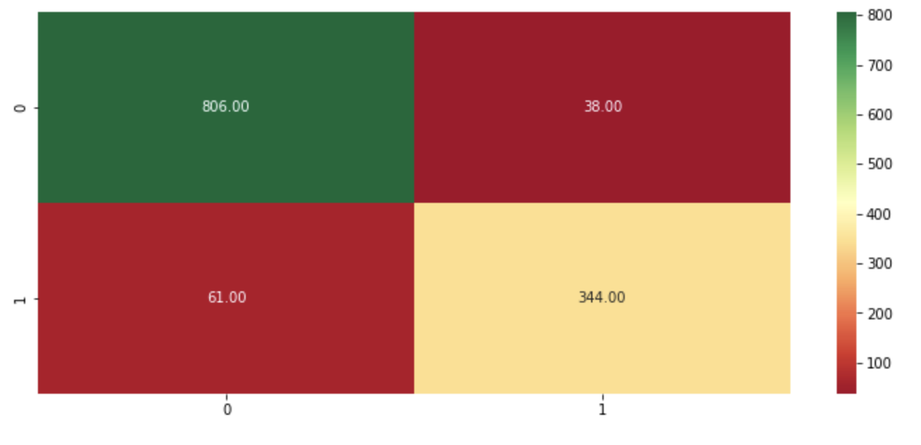
Best Model
Decision Tree – Experiment # 2: A&F dataset – 80/10/10 train, validate, & test split
Confusion matrix:

Slide 13
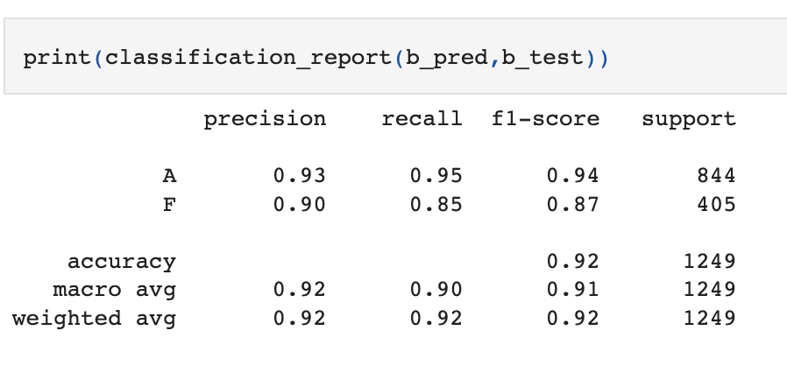
Best Model
Decision Tree – Experiment # 2: A&F dataset – 80/10/10 train, validate, & test split
Classification report:

Slide 14
Worst Model
K-nearest neighbor – Experiment #4: 5 random features dataset with 70/15/15 train, validate, and test split
Scores of train and validation data:
Train: 0.7672
Validation: 0.5374
Prediction score: 0.5476

Slide 15
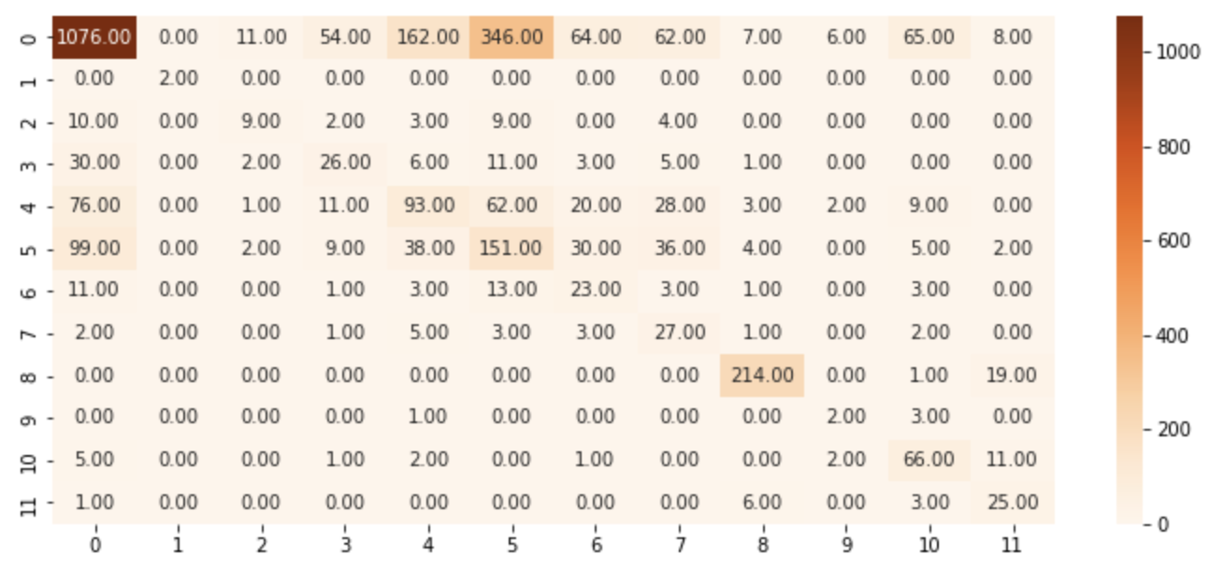
Worst Model
K-nearest neighbor – Experiment #4: 5 random features dataset with 70/15/15 train, validate, and test split
Confusion matrix:

Slide 16
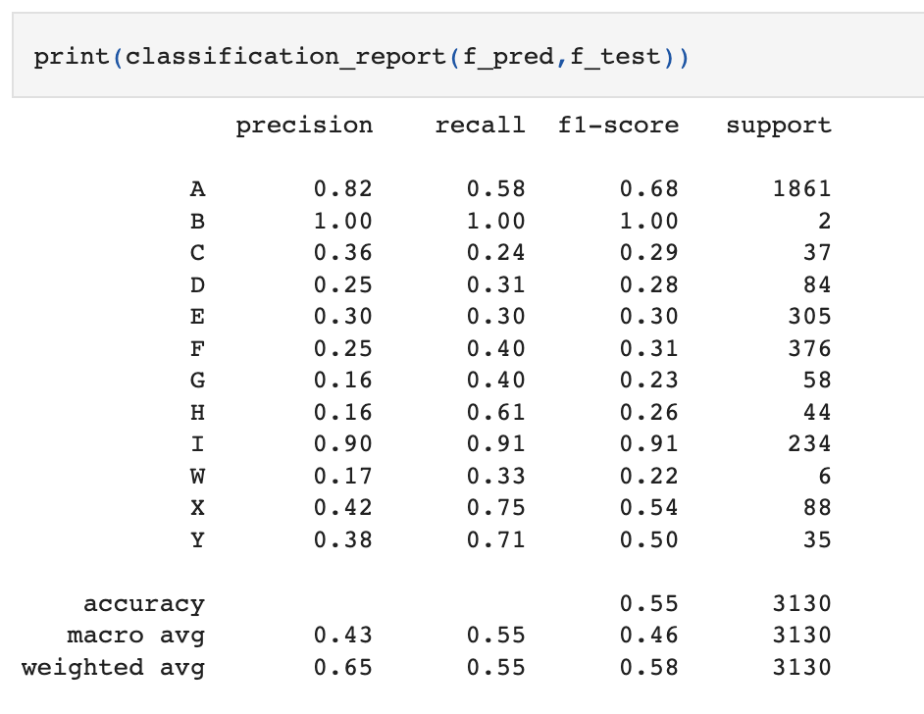
Worst Model
K-nearest neighbor – Experiment #4: 5 random features dataset with 70/15/15 train, validate, and test split
Classification report:

