Slide 1
Retrieval Augmented Generation
Hamza Zafar

Slide 2
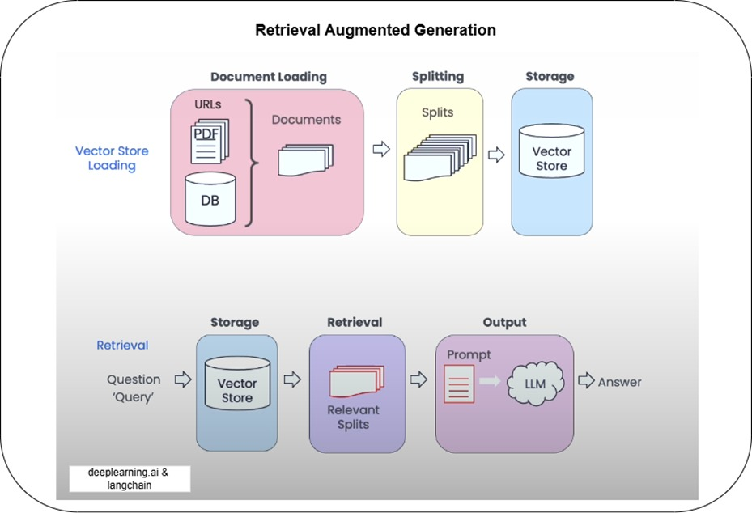
Retrieval Augmented Generation

Slide 3
Entities
RAW DOCUMENTS
SPLITS DOCUMENT
EMBD
STORE DATA
SYS
USR
LLM
QUESTION
ANSWERS

