Slide 1
BAN 502 Course Project
By: Hunter Wilkinson
Date: 3/5/2023

Slide 2
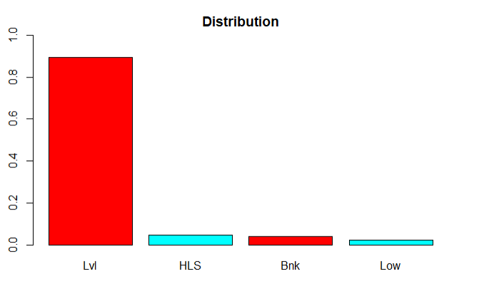
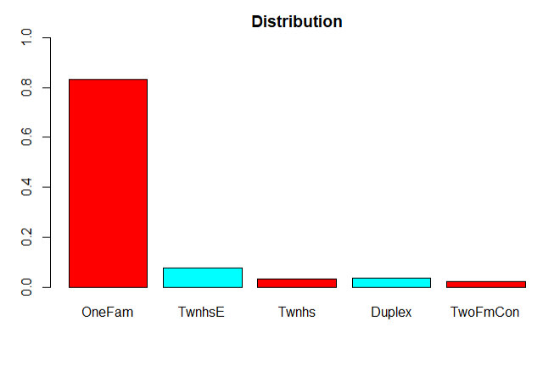
Categorical Imbalances
Imbalanced categorical variables are insignificant in model building:
Plotted all categorical independent variables.
Removed the skewed variables from the data set completely.
This took the total variables from 81 to 47.

Slide 3
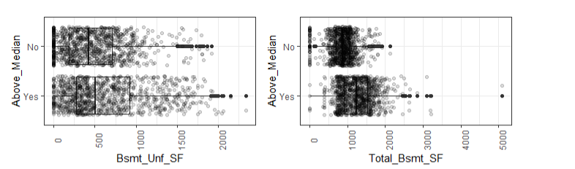
Numerical Significance Box Plots
Generally numeric variable significance can be identified through box plots:
Plotted all numerical independent variables.
Removed the variables with overlapping interquartile ranges.
This took the total variables from 81 to 37.

Slide 4
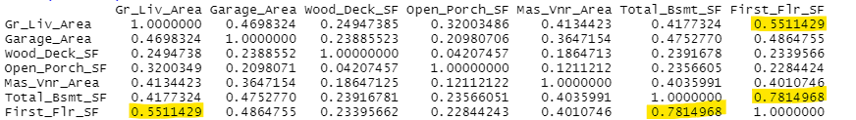
Multicollinearity
Another indicator of significance among numeric variables is a Correlation Matrix:
Compared the correlation of the remaining numerical independent variables.
Removed variables with correlations > .5 (high).
This took the total variables from 81 to 34.

Slide 5
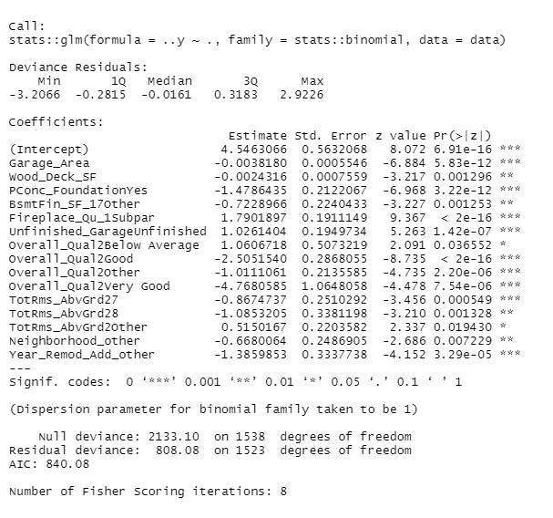
Logistic Regression
Through logistic regression model building each remaining variable could be tested further:
Ran an initial Logistic Regression model which ended up cutting the remaining obvious non-significant variables.
Took the total variables from 34 to 11.
Then implemented grouping techniques to hone the 11 variables.
This resulted in a model of only significant variables
Tested the final Logistic Regression model through a 75% (train) and 25% (test) data split.
Train data Accuracy = 87.78%
Test data Accuracy = 89.88%

Slide 6
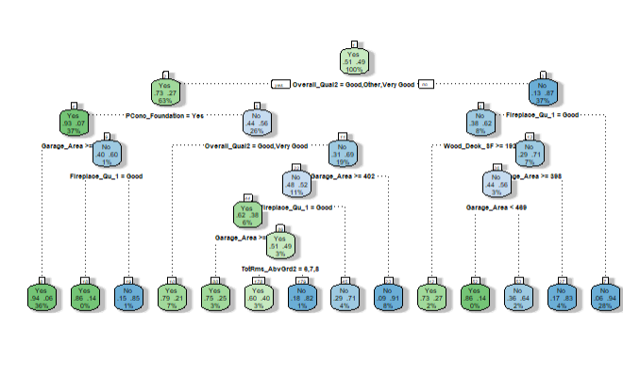
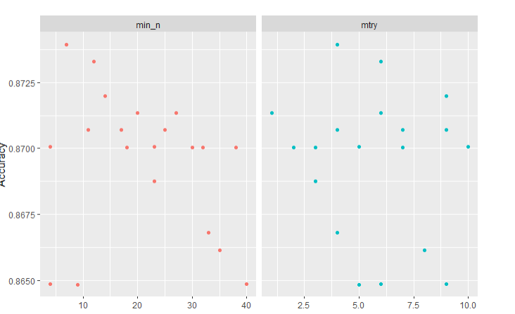
Classification Tree & Random Forest
Through Classification Tree and Random Forest techniques I could test the accuracy of my model further:
Tested the final Classification Tree model.
Train data Accuracy = 88.69%
Test data Accuracy = 89.69%
2) Tested the final Random Forest model.
Train data Accuracy = 91.29%
Test data Accuracy = 90.66%

Slide 7


Thank You

